Slide 1
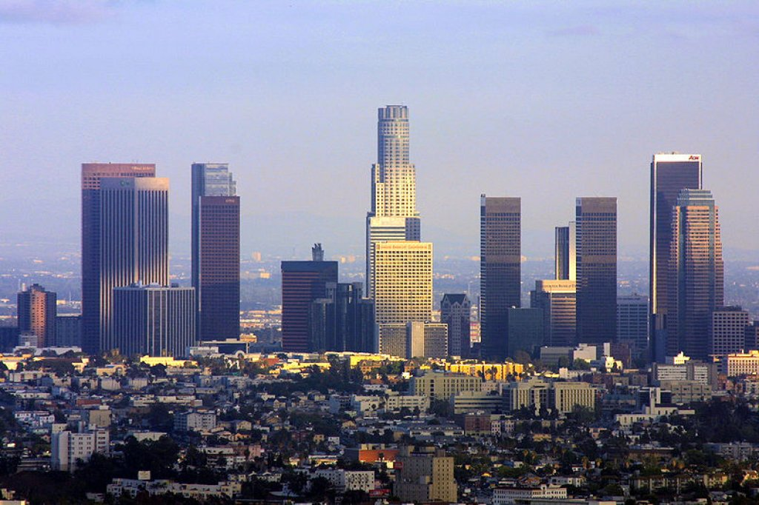
HPG 2015 Award Ceremony Petrik Clarberg and Elmar Eisemann
High Performance Graphics 2015
Los Angeles, CA

Slide 2
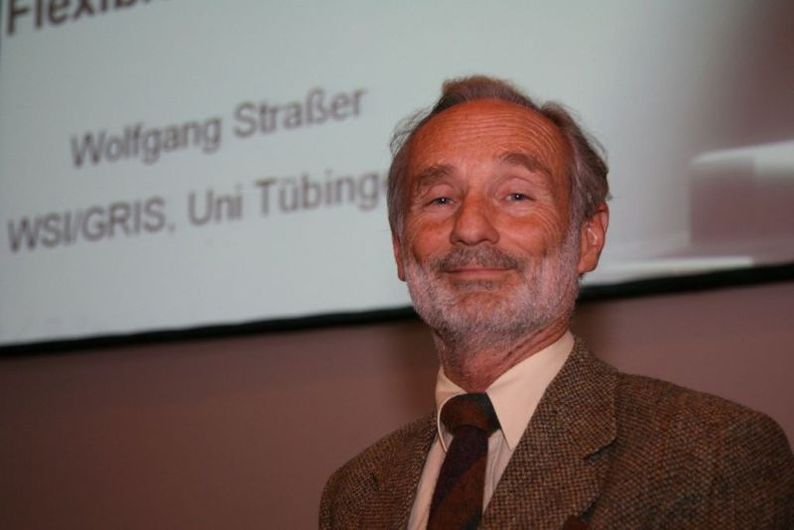
Award Ceremony
Wolfgang Straßer Award (Best Paper Award 2015)
Test-of-Time Award

Slide 3
Wolfgang Straßer Award 2015
Best Paper of the Conference

Slide 4
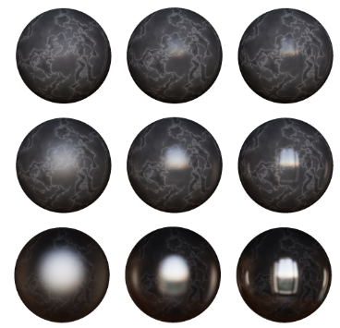
Nominees
Perception of Highlight
Disparity at a Distance
in Consumer
Head-Mounted Displays Robert Toth, Jon Hasselgren,
Tomas Akenine-Möller

Slide 5
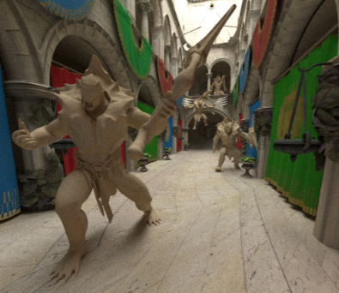
Nominees
Efficient Ray Tracing
of Subdivision Surfaces
using Tessellation Caching Carsten Benthin, Sven Woop,
Matthias Nießner,
Kai Selgard, Ingo Wald

Slide 6
Nominees
Morton Integrals for High Speed Geometry Simplification Hélène Legrand, Tamy Boubekeur

Slide 7
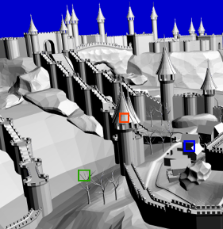
Nominees
Decoupled Coverage Anti-Aliasing Yuxiang Wang, Chris Wyman, Yong He, Pradeep Sen

Slide 8
Second place…

Slide 9
Second Place
Morton Integrals for High Speed Geometry Simplification Hélène Legrand, Tamy Boubekeur

Slide 10
And the winner is…

Slide 11
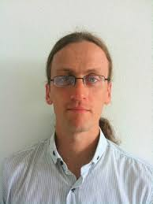
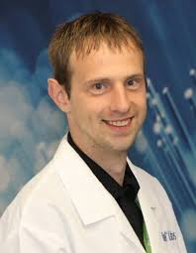
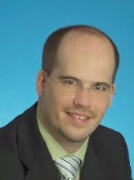
Wolfgang Straßer Award 2015
Efficient Ray Tracing
of Subdivision Surfaces
using Tessellation Caching Carsten Benthin, Sven Woop,
Matthias Nießner,
Kai Selgard, Ingo Wald

Slide 12
Award Ceremony
Wolfgang Straßer Award (Best Paper Award 2015)
Test-of-Time Award

Slide 13
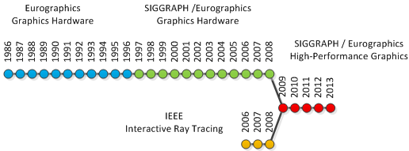
Test of Time Award?
Confluence of two conferences
Graphics Hardware
Interactive Ray Tracing
2014
2015
30 conferences
10 conferences

Slide 14
Graphics Hardware 1986
11 papers accepted

Slide 15
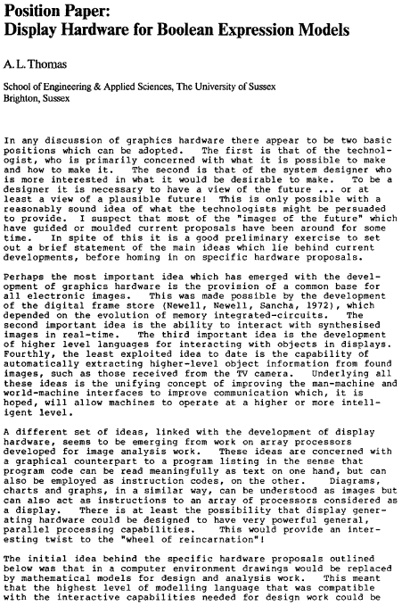
Honorable Mention
28-page paper award:
Position Paper: Display Hardware for Boolean Expression Models
A. L. Thomas

Slide 16
Remarkable Quotes
“Although the cost of processing power has reduced drastically in the past decade, it is still too high to put unlimited resources of processing power in a popular priced workstation.”

Slide 17
Remarkable Quotes
“’Real time' means, the system has to react in less than 150 ms after the trainnee has made an input.”
“VAX 750, 2 000 polygons need about 5 to 10 mn before display. So, 3D animations costs are very expensive from $ 2 000 up to $ 3 000 for ONE second.”

Slide 18
Image of the Conference
AVLSI Chip for Ray Tracing Bicubic Patches R. W. Pulleyblank and J. Kapenga

Slide 19
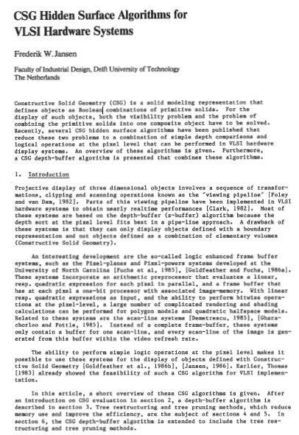
Honorable Mention
Most-cited paper
CSG Hidden Surface Algorithms for VLSI Hardware Systems
Erik Jansen

Slide 20
Test-of-Time Award for 2006
2014
2015
Interactive Ray Tracing and Graphics Hardware

Slide 21
2006 - Nominees
On Building kd-Trees for Ray Tracing, and on doing that in O(N log N) Ingo Wald and Vlastimil Havran

Slide 22
2006 - Nominees
Ray Tracing on the CELL processor Carsten Benthin, Ingo Wald, Michael Scherbaum, Heiko Friedrich

Slide 23
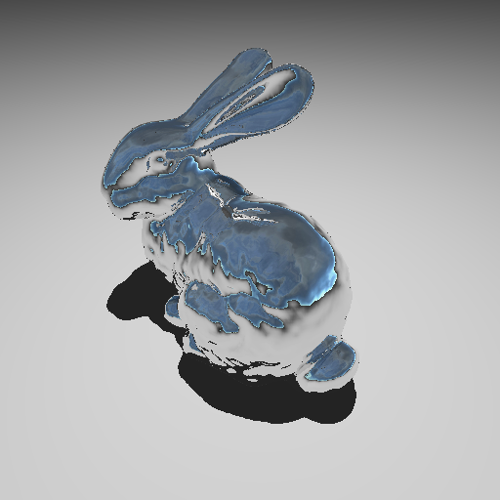
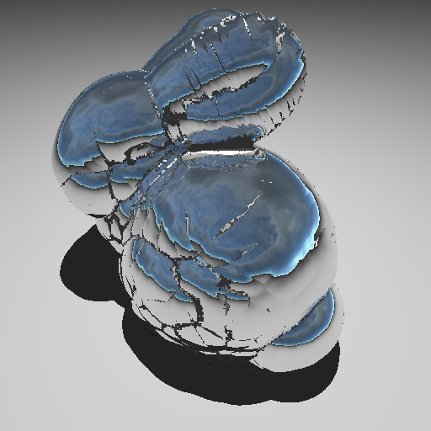
2006 - Nominees
RT-DEFORM: Interactive Ray Tracing of Dynamic Scenes using BVHs Christian Lauterbach, Sung-eui Yoon, David Tuft, Dinesh Manocha

Slide 24
And the winner is…

Slide 25
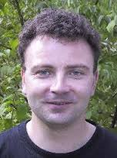
Test-Of-Time 2006 Award
On Building kd-Trees for Ray Tracing, and on doing that in O(N log N) Ingo Wald and Vlastimil Havran
Congratulations!

Slide 26
Thank you very much!
See you next year…
and enjoy SIGGRAPH!

