Slide 1
GVDB: Raytracing Sparse Voxel Database Structures on the GPU Rama Hoetzlein, NVIDIA High Performance Graphics 2016 Trinity College, Dublin

Slide 2
Sparse Volume Rendering
Meshes & Point Clouds Binary Voxels Kampe, 2013 acyclic DAGs Niessner, 2013 voxel hashing (SDF) Reichl, 2014 voxel hashing Villanueva, 2016 graph similarities Meshes Laine, 2010 sparse voxel octrees Chajdas, 2014 sparse voxel octrees Reichl, 2015 fragment buffers Isosurfaces Hadwiger, 2005 complex shaders Knoll, 2009 multi-res surfaces
Volumetric Data Octrees Boada, 2001 texture-based octree Crassin, 2008 gigavoxels Tilemap Grids Hadwiger, 2012 per-sample, out-of-core Fogal, 2013 index table, out-of-core Goals very large domains uncompressed, scalar fields volume ray sampling efficient dynamic topology
all in memory (for simulation)

Slide 3
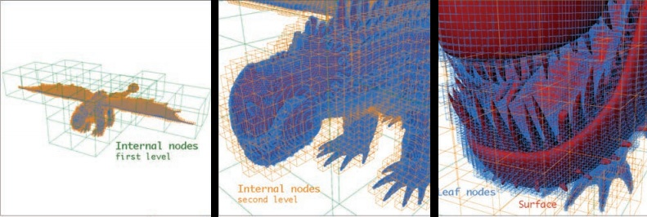
Voxel Data Base (VDB)
OpenVDB: - Focus on simulation and rendering - Multiple channels, scalar data - Uncompressed - Dynamic topology - Very large domains, same grid - Multi-core CPU (iterators, etc.)
VDB: High-Resolution Sparse Volumes with Dynamic Topology Ken Museth, Dreamworks Animation. Transactions on Graphics, 2013

Slide 4
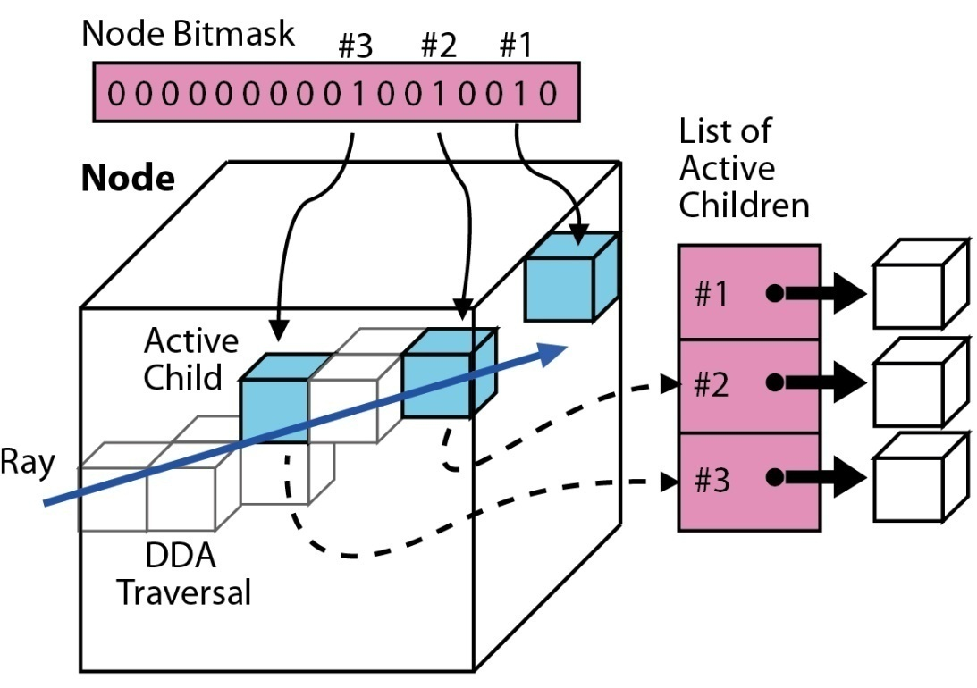
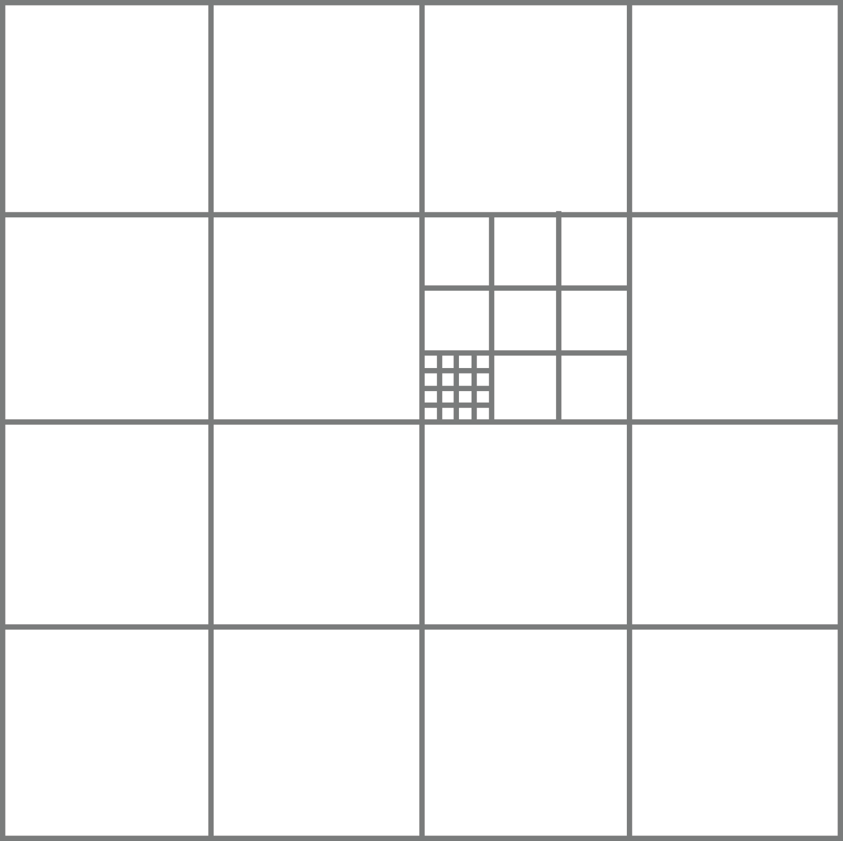
VDB Topology
VDB: Hierarchy of voxel grids, where active children are enabled using a bitmask for pointer indirection.
< L_{N}, .., L₂, L₁, L₀ > L₀ = Leaf dim
Log2 Dims Structure <1, 1, .., 1> Octree <10, 2> Tile map <*, 2> Hash map <5,4,3> OpenVDB <3,3,3,4> GVDB

Slide 5
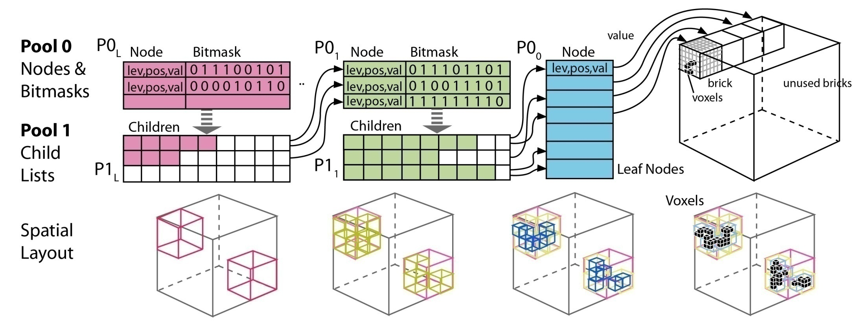
GVDB Memory Layout
Sequence of node pools Pool 0: List of node data and active bitmasks
Pool 1: List of active children Benefits: - Run-time config, Dynamic, Fast construction
Compared to OpenVDB: - No host or device pointers - Identical data on CPU and GPU - Eliminate root, interior, leaf classes
- Eliminate templating - Eliminate per-voxel iterators

Slide 6
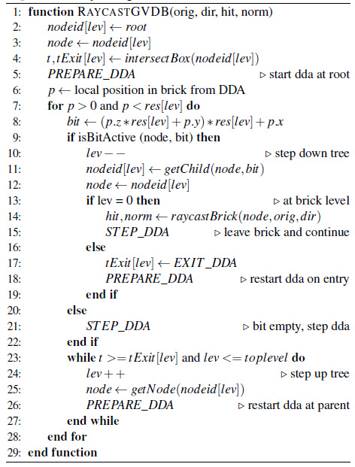
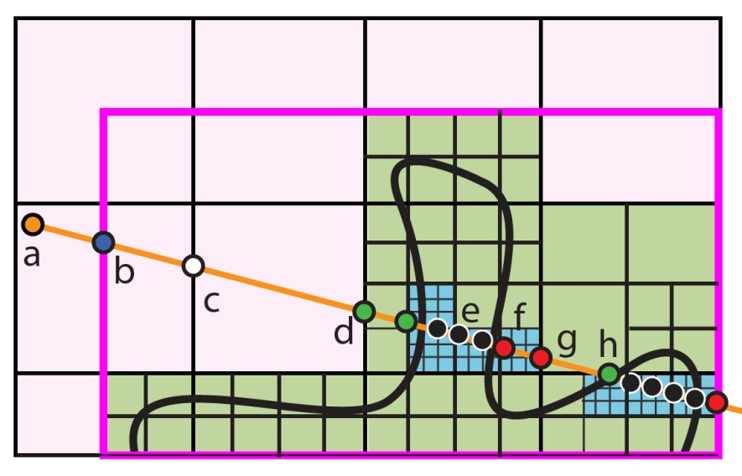
Hierarchical Raytracing
Empty Space Skip
Key features: - Similar to kd-restart with short stack [Foley '05]
- Single set of DDA variables reduces register pressure - Flexible Leaf raytrace: a) Volume sample /w transfer b) Tricubic smoothing func c) Level Set surface /w

Slide 7
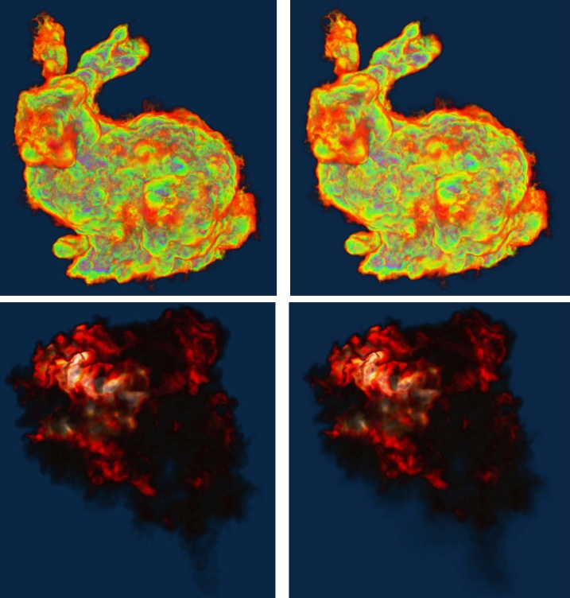
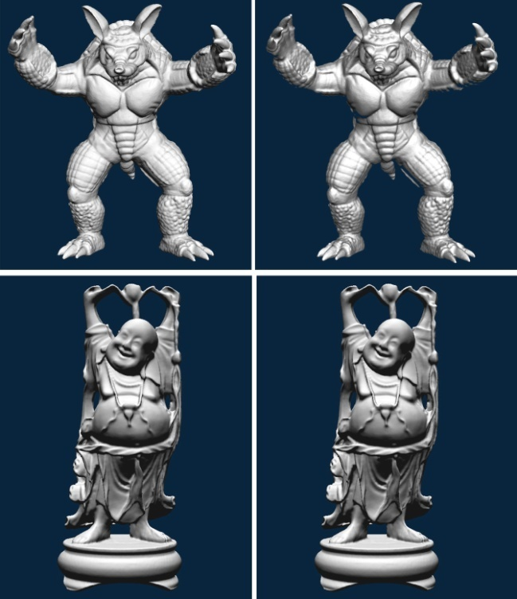
Results GVDB vs OpenVDB
Volume Sampling - Explosion: 280³ 23.4ms / 1764 ms - Bunny: 584³ 34.3ms / 2235 ms - CPU = Intel 4-core i7-3770K - GPU = Quadro M6000
- Identical visual result 25x-30x faster than CPU (4-core)
Level Sets - Armadillo: 1528³ 43.6ms / 281 ms - Buddha: 1312³ 27.9ms / 148 ms - CPU = Intel 4-core i7-3770K - GPU = Quadro M6000
- Identical visual result 5x-6x faster than CPU (4-core)

Slide 8
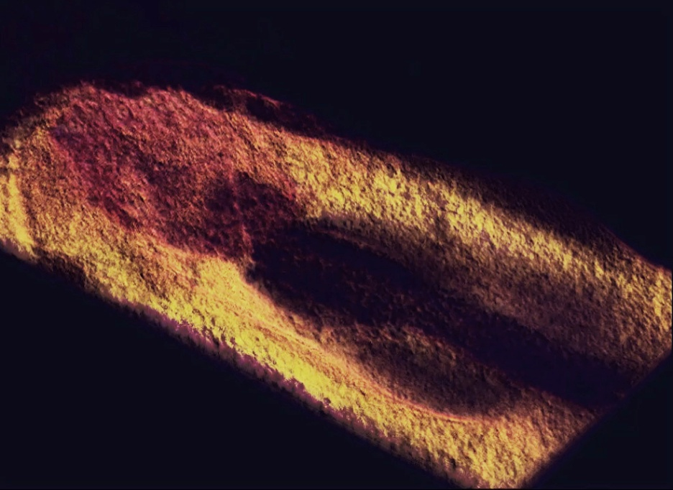
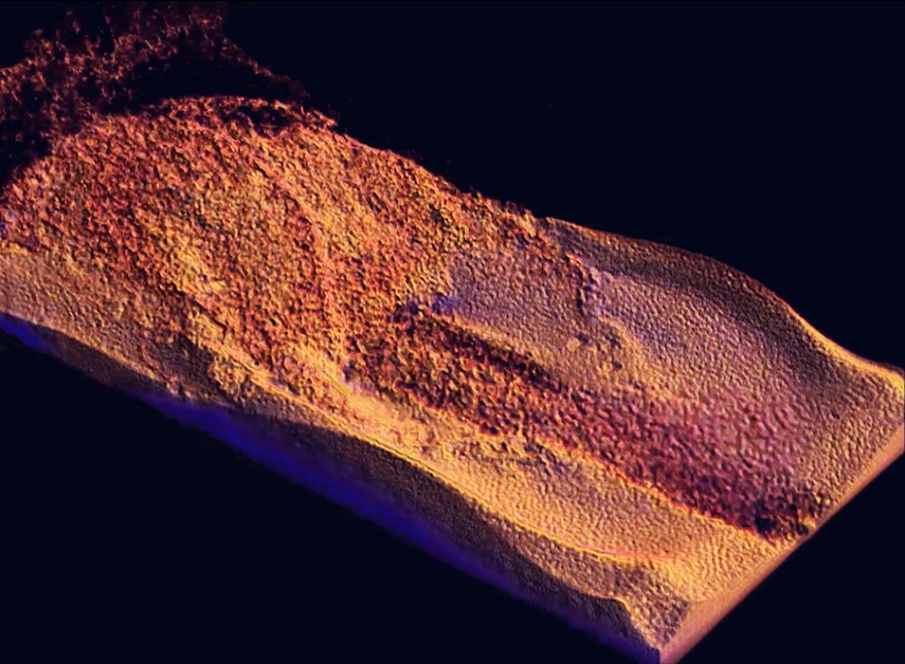
Results Fluid Simulation Data
GVDB
SPH Simulation
Brick Voxel Resampling
Topology Construction
Raytracing
Low Resolution
High Resolution
512 x 180 x 256
2048 x 720 x 1024

Slide 9
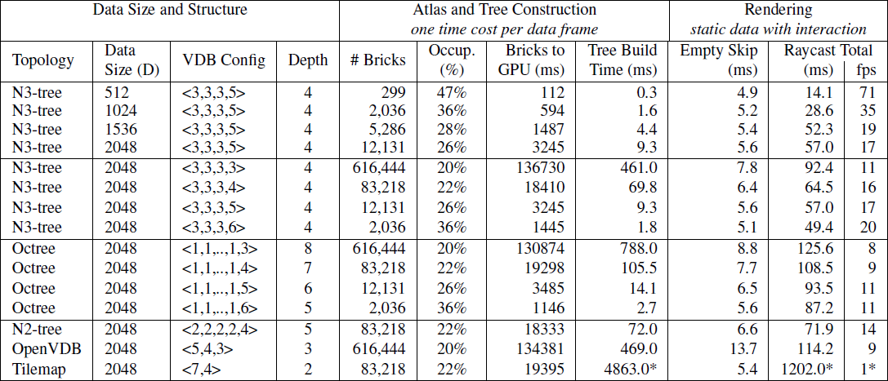
Results Fluid Simulation Data
GVDB
SPH Simulation
Brick Voxel Resampling
Topology Construction
Raytracing
Data Scaling - Very good. Larger data lowers occupancy.

Slide 10
Results Fluid Simulation Data
GVDB
SPH Simulation
Brick Voxel Resampling
Topology Construction
Raytracing
Empty Skipping - Consistently <10% of time. Memory bound (no sm, no tc)

Slide 11
Results Fluid Simulation Data
GVDB
SPH Simulation
Brick Voxel Resampling
Topology Construction
Raytracing
Brick Size - Larger bricks reduce total number of nodes, and atlas creation

Slide 12
Results Fluid Simulation Data
GVDB
SPH Simulation
Brick Voxel Resampling
Topology Construction
Raytracing
Brick Size - Larger bricks also dramatically reduce tree rebuild time

Slide 13
Results Fluid Simulation Data
GVDB
SPH Simulation
Brick Voxel Resampling
Topology Construction
Raytracing
Brick Size - and.. improve render performance
8³ 32³
-6%
+50x
+28%
+37%

Slide 14
Results Fluid Simulation Data
GVDB
SPH Simulation
Brick Voxel Resampling
Topology Construction
Raytracing
Topology - Octree construction has higher cost, due to more intermediate nodes

Slide 15
Results Fluid Simulation Data
GVDB
SPH Simulation
Brick Voxel Resampling
Topology Construction
Raytracing
VDB Topology - For GPU <3,3,3,4> found to be better than default <5,4,3> in OpenVDB

Slide 16
Results Fluid Simulation Data
GVDB
SPH Simulation
Brick Voxel Resampling
Topology Construction
Raytracing
Tilemaps - Rendering unfair, active bitmasks non-optimal . Lookup should be O(1)

Slide 17
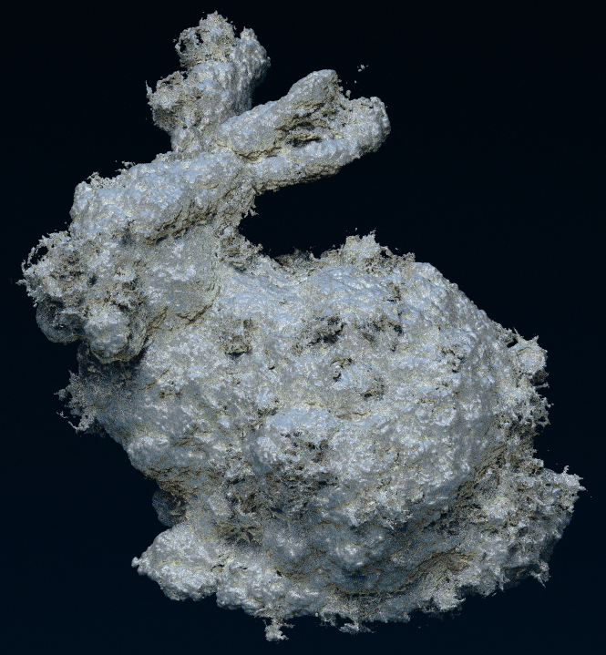
Results NVIDIA OptiX Integration
Rendered in 1.3
seconds at 1280x960 with 16 samples and 3 rays/pixel on a Quadro
M6000. 48 rays/pix

Slide 18
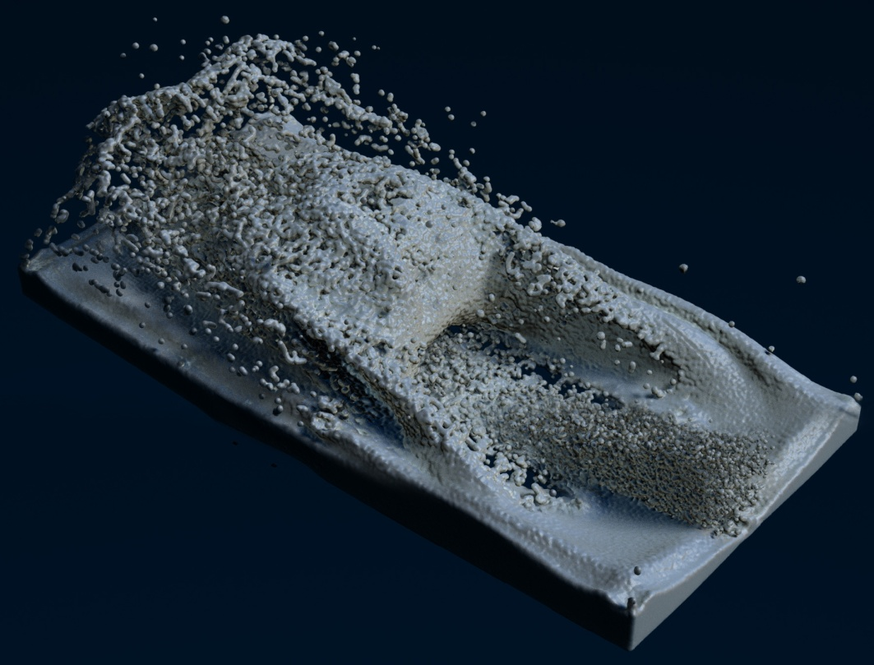
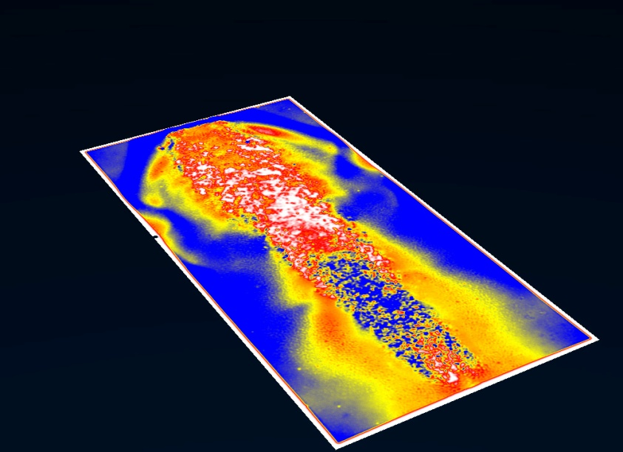
Results

Slide 19
Current Directions 1. Comparison to Gigavoxels recently available 2. Dynamic topology on GPU parallel pool updates Future Goals 1. Full In-situ Simulation multiple channels 2. Out-of-Core rendering residency bit 3. Level of Detail multiple atlases

Slide 20
Thank you!
Rama Hoetzlein rhoetzlein@nvidia.com http://developer.nvidia.com/gvdb
Thanks to: NVIDIA Tristan Lorach Tom Fogal Holger Kunz Christoph Kubisch
Steven Parker Chris Hebert Ken Museth, Dreamworks Animation and SpaceX

Slide 21
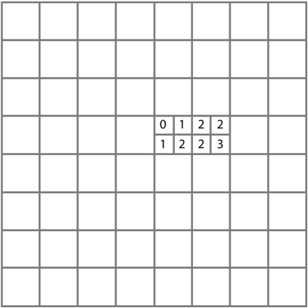
GVDB vs. Virtual Hashing
GVDB
Virtual Hashing
bit lookup
hash lookup
Belief: GVDB may win as volume res scales, since hash lookups must walk virtual brick index space

