Slide 1
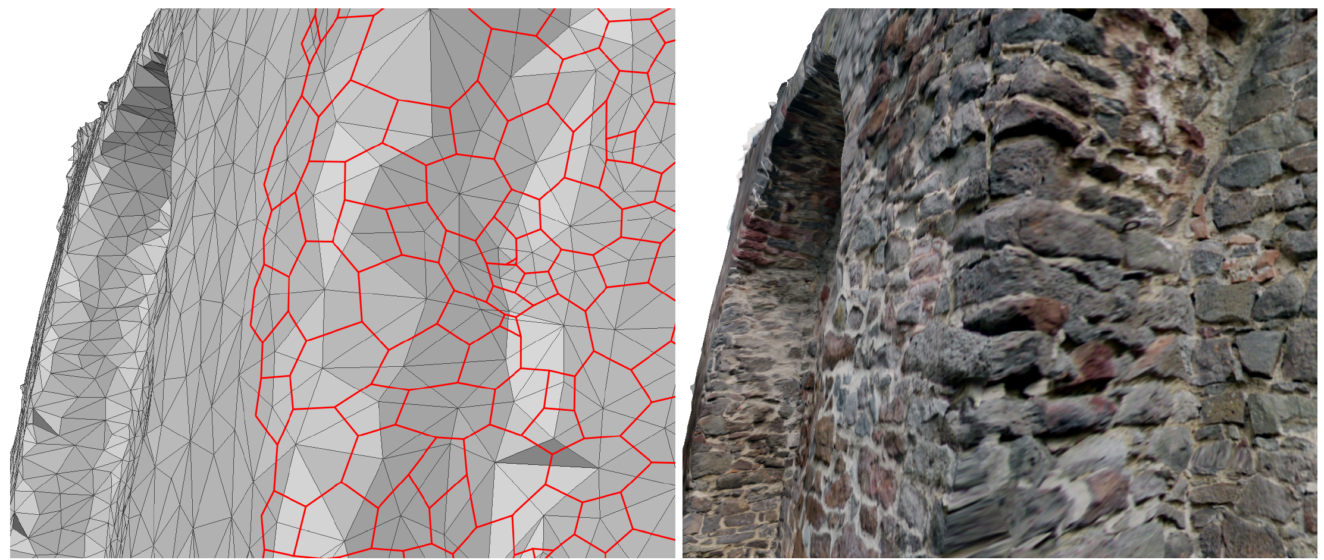
A Fast, Massively Parallel Solver for Large, Irregular, Pairwise Markov Random Fields
Daniel Thuerck, Michael Waechter, Sven Widmer, Max von Buelow, Patrick Seemann, Marc E. Pfetsch and Michael Goesele
Notes:
-> 0:01
Talk is about solving large-scale (very general) MRFs efficiently on massively-parallel systems
MP systems here
GPU or multicore CPU + SIMD vector registers
In interest of brevity, for implementation details, CUDA language (blocks/threads) is used
Now to the term of Markov Random Fields:
Probabilistic model
MRFs broadly used in CV community, not as far spread in CG community…
Since HPG is conference with strong focus on CG, let me first briefly introduce the concept

Slide 2
Pairwise MRF (from an optimization POV)
Input data:
Undirected Graph $G=\left(P, N\right)$
Set of labels per node $L_{i}⊆L, i∈P$
Cost functions
$D_{i}$ for each node $i∈P$(“unary costs”)
$V_{\{i, j\}}$ for each edge $\left\{i,j\right\}∈N$ (“binary costs”)
Possibly $M_{l}$ for each label $l∈L_{i}$ (“label costs”)
Objective: find label assignment $f:P_{i}→L_{i}$ minimizing the objective $E\left(f\right)=\sum_{i∈P}{D_{i}\left(f_{i}\right)}+\sum_{\left\{i,j\right\}∈N}{V_{i}(f_{i},f_{j})}+\sum_{l∈L}{δ\left(l\right)M_{l}}$
Notes:
-> 2:00
Input data:
G, D, V, M
D,V are _always_ paid
M is only paid _once_ if the label was used somewhere in the solution
Idea: enforce sparsity, e.g. allow more labels (clusters) and penalize new labels highly
How label costs fir into out solver: in the interest of time, please see paper
Objective: find energy-minimizing solution/assignment

Slide 3
MRF in a graphics application (I)
[Waechter et al., ECCV 2014]
3D model texturing from registered photos
Notes:
-> 3:00
MRF is a extremely general modelling device
How general: let me show you on 3 examples:
First: texturing 3D models from photos

Slide 4
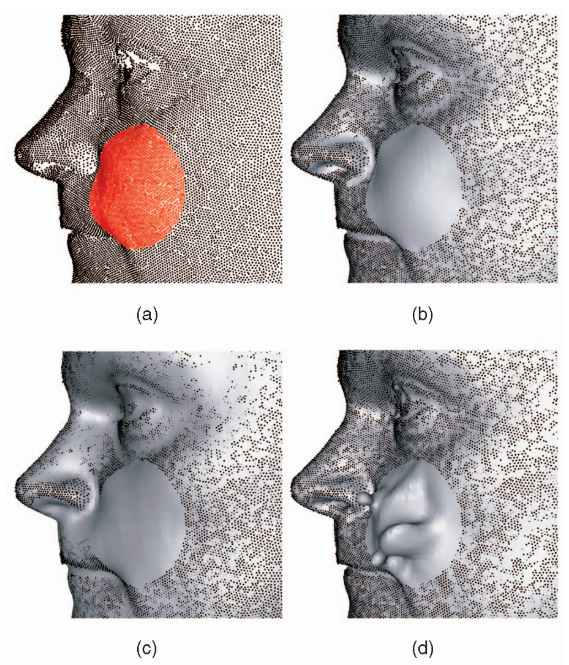
MRF in a graphics application (II)
[Paulsen et al., IJCV 08/2010]
MRF Surface Reconstruction
Notes:
-> 3:30
“Markov Random Field Surface Reconstruction”
Reconstruct surface from point cloud
By estimating a discrete SDF in a voxel grid

Slide 5
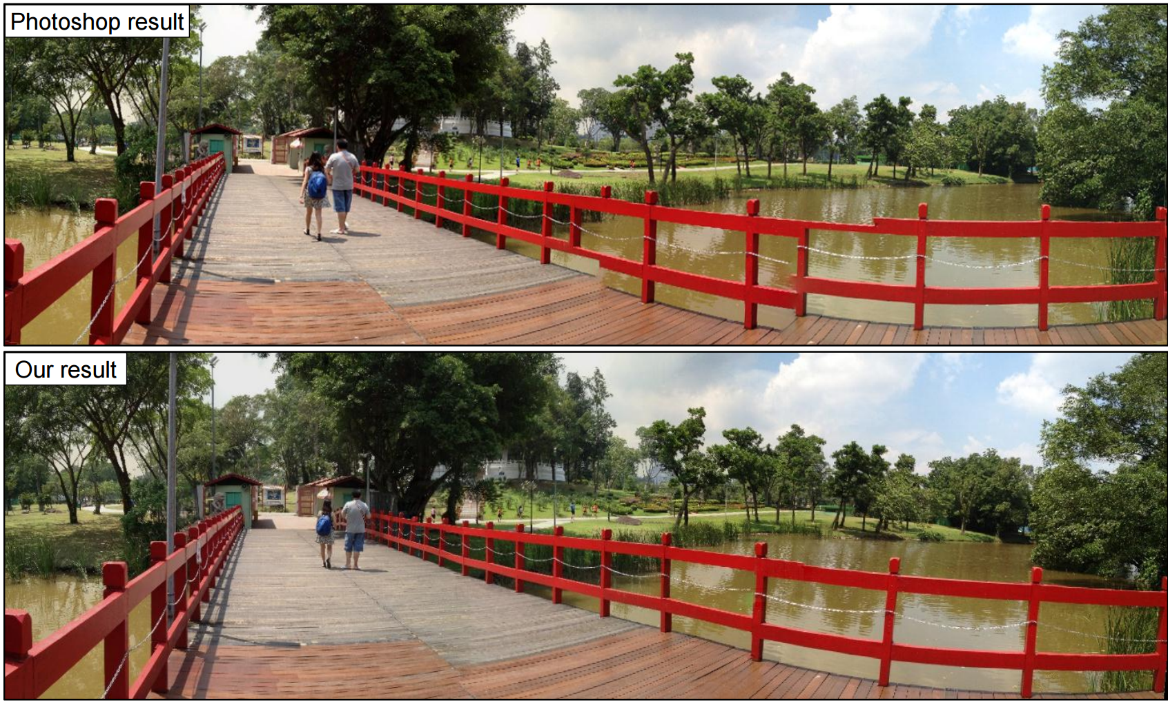
MRF in a graphics application (III)
[Gao et al., EG 2013]
Notes:
-> 4:30
“Seam-driven Image Stitching”
Small conclusion: MRFs are a versatile modelling tool in graphics (might be interesting for you, too)
Generality comes at a cost: MAP in general is NP-hard
Handling NP-hardness: branch & bound / other general methods, but usually too big for general-purpose solver
Here: approximate solution by iteratively working on reduced problems

Slide 6
Related work: problem reductions
Multilabel, arbitrary cost (cyclic) MRFs
Reduce to binary decision
Reduce topology
Notes:
-> 5:30
Two straightforward reductions:
Binary label set: e.g. alpha-Expansion; in each iteration, decide “am I taking alpha” / “am I sticking to my current label”
Reduce topology: go from circles to acyclic graphs
Combine: binary decision between label proposals from two solution

Slide 7
Related work: problem reductions
Multilabel, arbitrary cost (cyclic) MRFs
Max-flow / Min-cut
Dynamic Prog. (DP)
Reduce to binary decision
Reduce topology
Notes:
-> 6:00

Slide 8
Related work: parallelism
Core computation | Approach | Restrictions
Max-flow | push-relabel, cache optimizations | Grid topology
 | hybrid augmenting path / push-relabel | Manual selection of graph partitions
Combine solutions | Exploit cost functions (e.g. parallel $α$-Expansion steps, Fusion steps) | Restricted selection of cost functions
DP / message passing | Find appropriate schemes, linear-time DP | Depends on scheme and/or cost
Notes:
-> 7:00
Since our work focuses on parallelization, let’s look at competing approaches here
Majority of parallelization papers/approaches: parallelize core computational primitives in fine-grained fashion
Max-flow: from global augmenting path to local push-relabel, often limited by global heuristics
Combination: either tailored to cost functions or MRF fusion, which uses flow again
Still rare: combination approaches for individual classes of pairwise costs
In summary: different approaches, different limitations, hence different ‘best’ solver for each problem -> question: can we find ‘middle-ground’ here?

Slide 9
Our goals
Come as close as possible to “one size fits all”
Avoid restrictions on cost functions or topology
Solve large systems efficiently
Design system for massively-parallel hardware
Avoid irregular workloads despite irregular input data
Offer enough fine-grained parallelism to satisfy computational resources
Notes:
-> 8:00
‘middle-ground’ here:
roughly ‘one size fits all’, i.e. a solver with minimal assumptions/minimal restrictions
Should excel at large systems (reason: CV/CG datasets tend to grow in size over time)
In design of system:
Keep massively-parallel hardware in mind (create enough fine-grained tasks)
‘system’ vs. algorithm: means core algorithm + heuristics and implementation here

Slide 10
Massively-parallel DP on acyclic graphs
2 phases
Bottom-up: locally enumerate $E\left(f\right)=\sum_{i∈P}{D_{i}\left(f_{i}\right)}+\sum_{\left\{i,j\right\}∈N}{V_{i}(f_{i},f_{j})}$
Top down: pick optimum at root & propagate to leaves
Well-suited for SIMD:
1 node per block
1 thread per parent’s label, enumerating all child’s labels
Notes:
-> 9:00
DP is a general optimization principle, here we describe its instance used in our solver
Local enumeration:
energy at one node only depends on parent’s label
given a parent’s label, list all node’s labels and computes energy, then find minimum per parent label
does not easily generalize to label costs (-> see paper)
Seems like a good candidate for GPUs, since workload pretty regular

Slide 11
Closely related: CK-BCD
[Chen and Koltun, CVPR 2014]
Operate on horizontal/vertical alternating lines
Implemented with SSE
Does not easily generalize to irregular topologies
Most important: Acyclicity! Let’s generalize it!
Notes:
-> 10:00
Obviously not the first to try DP in parallel
Important question: how to choose the DP subproblems (again: must be ayclic)
Closest in goals (and idea, but tailored for a specific task): Chen, Koltun at CVPR 2015
Close to state of the art results in terms of energy, but in seconds instead of minutes
Use on regular pixel/voxel-grids
Implementation: no heuristics, only basic method
Method is general, but implementation uses lower envelope approach, drawing a lot of performance from that
Drawback: limited to grids
So: can be we generalize it – keeping its good properties but without the restrictions?

Slide 12
Components & control flow
Notes:
-> 10:30
Main topic of our paper: generalize this CK-BCD to irregular input, further add label cost capabilities and still have mostly regular workloads for the GPU
Here: present flow graph of whole system
3 Components:
Blue: DP on acyclic graph
Red / green: heuristics:
Differences to CK-BCD: irregular graphs + heuristics

Slide 13
Components & control flow

Slide 14
Our BCD scheme
R
Notes:
-> 11:30
Not too surprising: trees! (3 kinds of acyclic: single nodes, lines, trees)
Highlight acyclicity
Acylicity here:
Take node subset and implied subgraph (include all edges incident to nodes of the subset between them)
This induced subgraph should be acyclic
BTW: BCD=block coordinate descent -> node subset = coordinates
⬄ if two adjacent nodes are in the tree, they must be in a parent-children relation <- hard to check (irregular workload)

Slide 15
Our BCD scheme
R
3
4
4
4
Notes:
-> 12:30
Now turn around: instead of on nodes of the tree, pay attention to the nodes _not_ in the tree (free nodes)
⬄ every two nodes in the tree that are not in such a relation must be separated by at least one free node <- key insight for implementation
Implementation of this insight:
Markers for each node
marker = number of adjacent coordinates
Inclusion in the tree: marker < 2

Slide 16
Sampling maximal, acyclic coordinate sets
R
1
2
1
1
1
Notes:
-> 13:00
General algorithm: top-down tree growing
Steps
Select a (or many) nodes in the tree
Branch out (a.k.a include a new node)
Update markers
For serial computation, done
Now let’s extend it to parallel computation

Slide 17
Collisions in parallel execution
R
1
2
1
1
Notes:
-> 13:00
Markers are only valid from synchronous last round, now conflicts can be generated between new nodes
Now how do we handle this?

Slide 18
Handling collisions
3 – phase (per round) algorithm:
Grow
Grow as usual, ignore conflicts
Check
Update markers for adjacent nodes around newly selected coordinates
Detect collision pairs and record them (once)
Repair / Rollback
Lock conflict pairs
Select one node at random and remove from tree
Rollback markers, undo degree change, put parent back into queue (higher-order conflicts)
Notes:
-> 14:00

Slide 19
Handling collisions
3 – phase (per round) algorithm:
Grow
Grow as usual, ignore conflicts
Check
Update markers for adjacent nodes around newly selected coordinates
Detect collision pairs and record them (once)
Repair / Rollback
Lock conflict pairs
Select one node at random and remove from tree
Rollback markers, undo degree change, put parent back into queue (higher-order conflicts)
Irregular!
Notes:
-> 14:30
In practice: most time spent in phase I

Slide 20
Regularizing the parallel workload
Perform the following in rounds:
Select a random node in the tree
Select an adjacent node not yet in the tree
Grow branch to node from 2.
Update markers
Efficient selection of nodes in 1.: swap work lists, atomic writes
Efficient selection of nodes in 2.:
Instead of iterating reads, modify adjacency lists after branching
Notes:
-> 15:00

Slide 21
Components & control flow

Slide 22
(Multilevel) Region Graphs
Consider smoothness-preferring binary costs:
1
1
1
3
3
3
3
1
1
1
3
8
8
7
1
3
0
7
2
2
1
0
8
8
7
2
8
4
4
0
0
8
8
7
4
4
4
4
4
8
8
7
May be stacked until no more energy decrease in original occurs
Notes:
-> 16:00
BCD works on single nodes -> may take a few iterations to assemble large, homogeneous regions
Speed up this process: encode structure in graph, based on current labelling
At each step,reproject solution and check for energy decrease
Stack in multi-level fashion
BUT: restriction on cost (our implementation checks costs and decides whether to use that)

Slide 23
Components & control flow
Notes:
Different, more general heuristic: ignore acyclicity and hope for the best

Slide 24
Growing spanning trees
R
Notes:
-> 17:00
Ignore acyclicity = no problems with including nodes into the coordinate set = include all nodes
… but do not use the induced subgraph
Different problem -> hard analysis -> only heuristic, check solution on original problem
Growing spanning trees: just do step 1 of the coordinate set selection (sample node & grow), no markers

Slide 25
Benchmarks
Benchmark machine
CPU: Xeon E5-2650
256 GB RAM
GPU: NVIDIA Titan X (12 GB VRAM, 3072 CUDA cores)
Compiled using GCC 4.8
CUDA 7.5 + Intel TBB 4.4
Competitors:
GCO (with BK-flow, parallel grid-flow/GRIDGCO, parallel hybrid-flow/DGCO)
BP, TRW-S
FastPD
CK-BCD (on horizontal/vertical lines)
Notes:
-> 17:30
So far for theory, now let’s look at results
Paper includes benchmarks on ~30 datasets, will only try to pick representative benchmarks for the talk
Datasets from applications, from community benchmarks, artificial
Benchmarks
Small, medium, large-scale (sense of nodes / sense of label set size) dataset
Evaluation of heuristics
Evaluation of label costs omitted (-> paper)

Slide 26
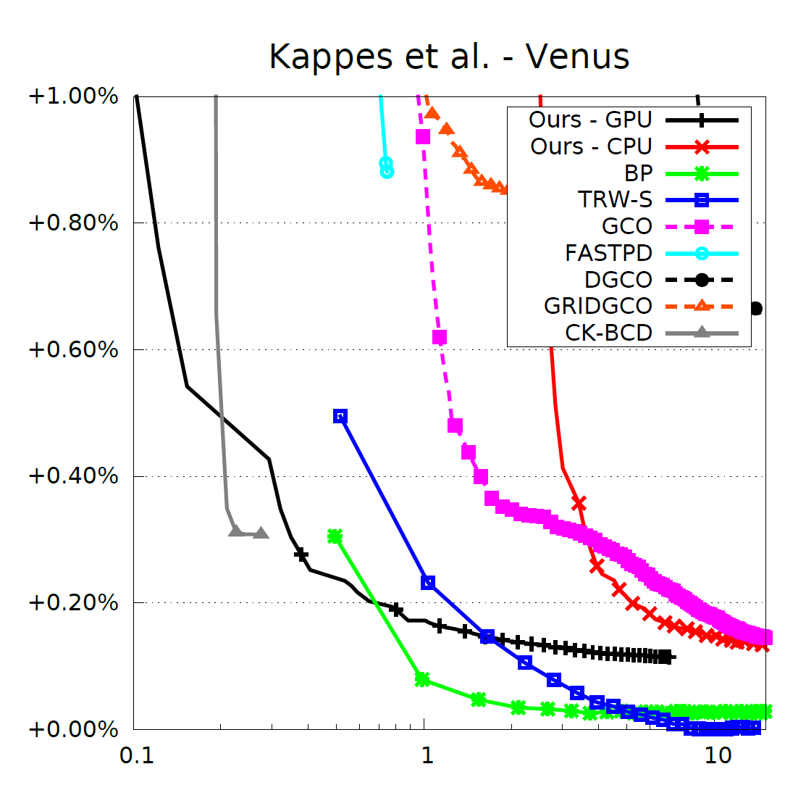
Small dataset
Nodes: 166,222
Edges: 331,627
Labels: 20
Notes:
-> 18:00

Slide 27
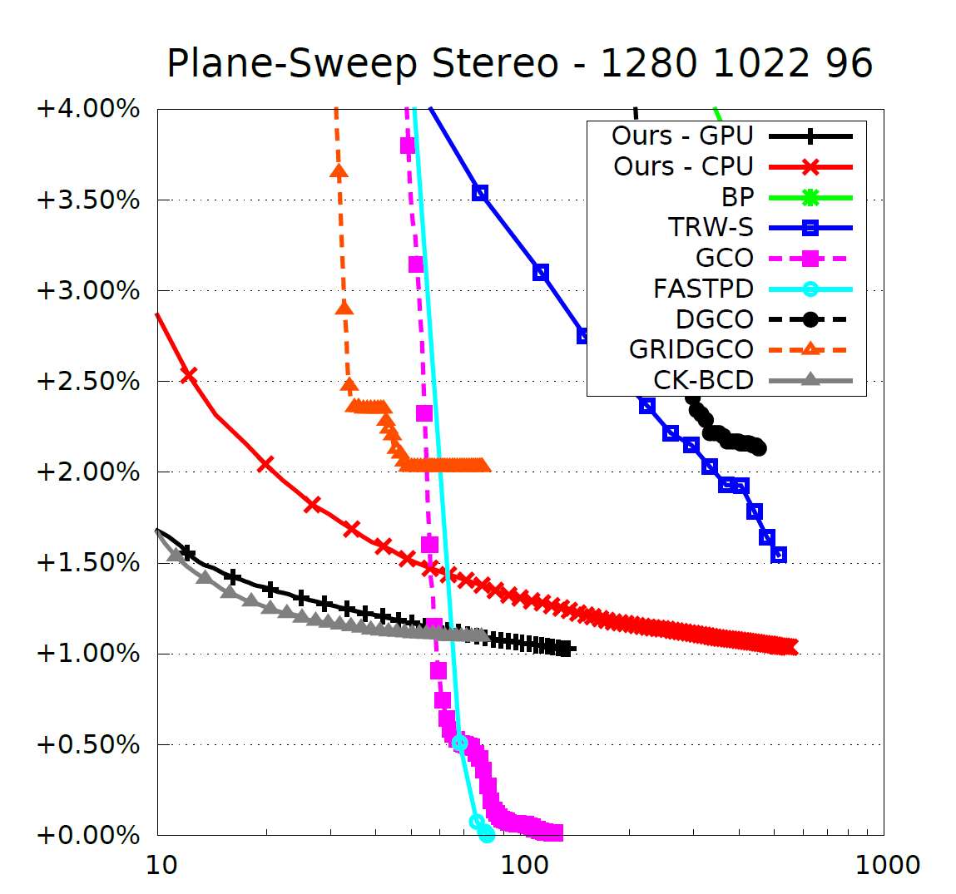
Medium dataset
Nodes: 1,308,160
Edges: 2,614,018
Labels: 96 (avg. 67)
Notes:
-> 18:30

Slide 28
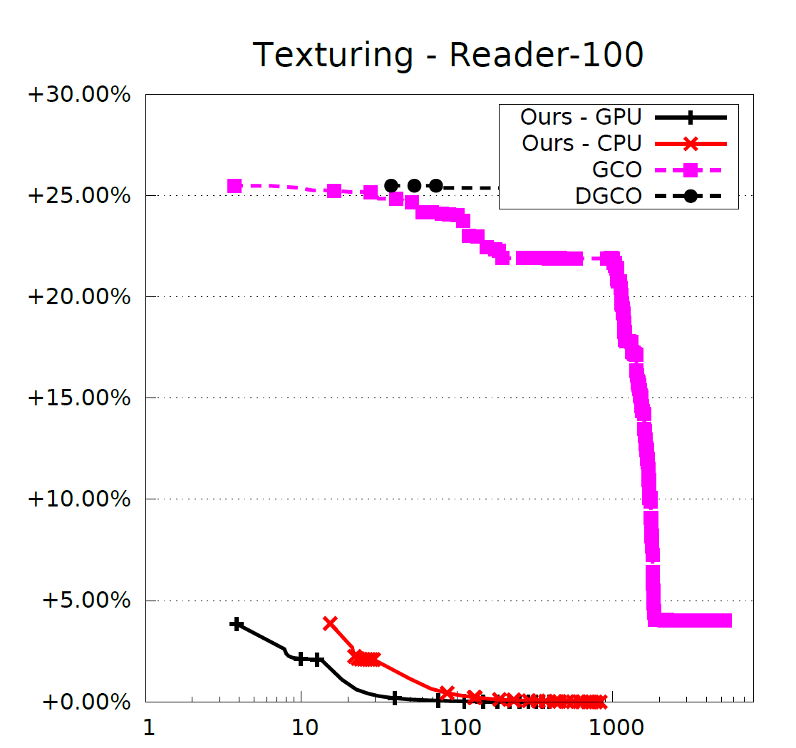
Large dataset
Nodes: 12,463,814,
Edges: 18,697,742
Labels: 539 (avg. 56)
Notes:
-> 19:00

Slide 29
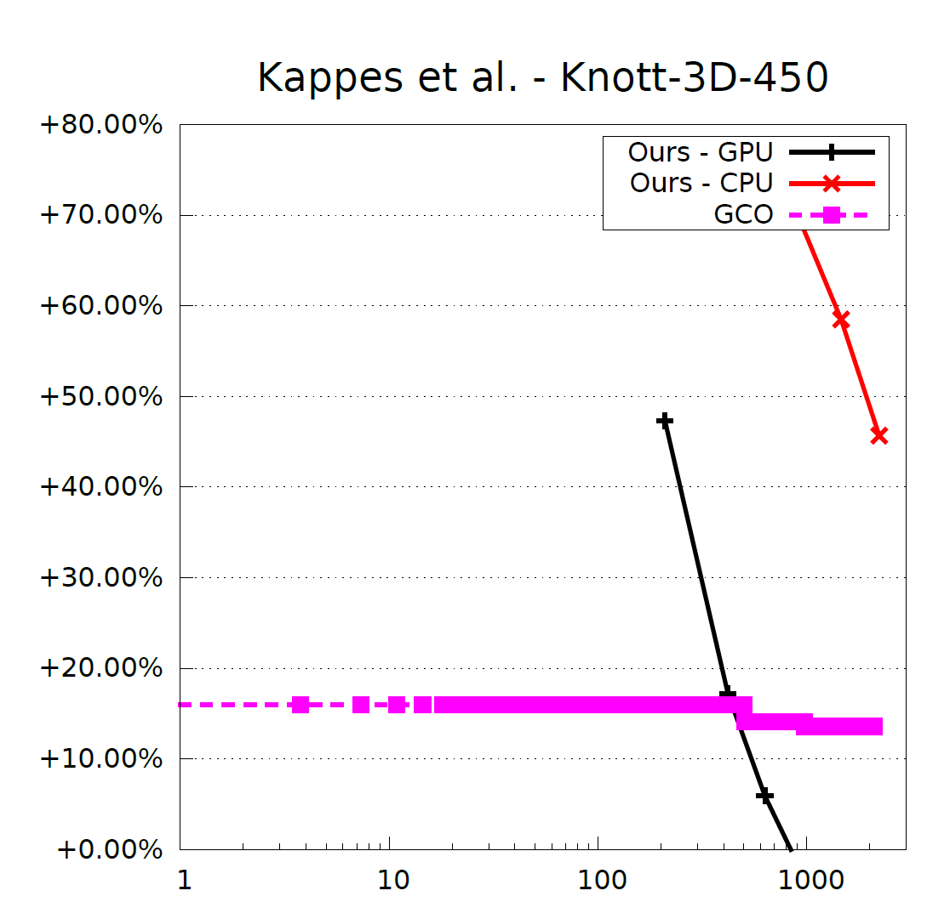
Dataset with a large label set
Nodes: 15,393
Edges: 97,275
Labels: 15,393
Notes:
-> 19:30

Slide 30
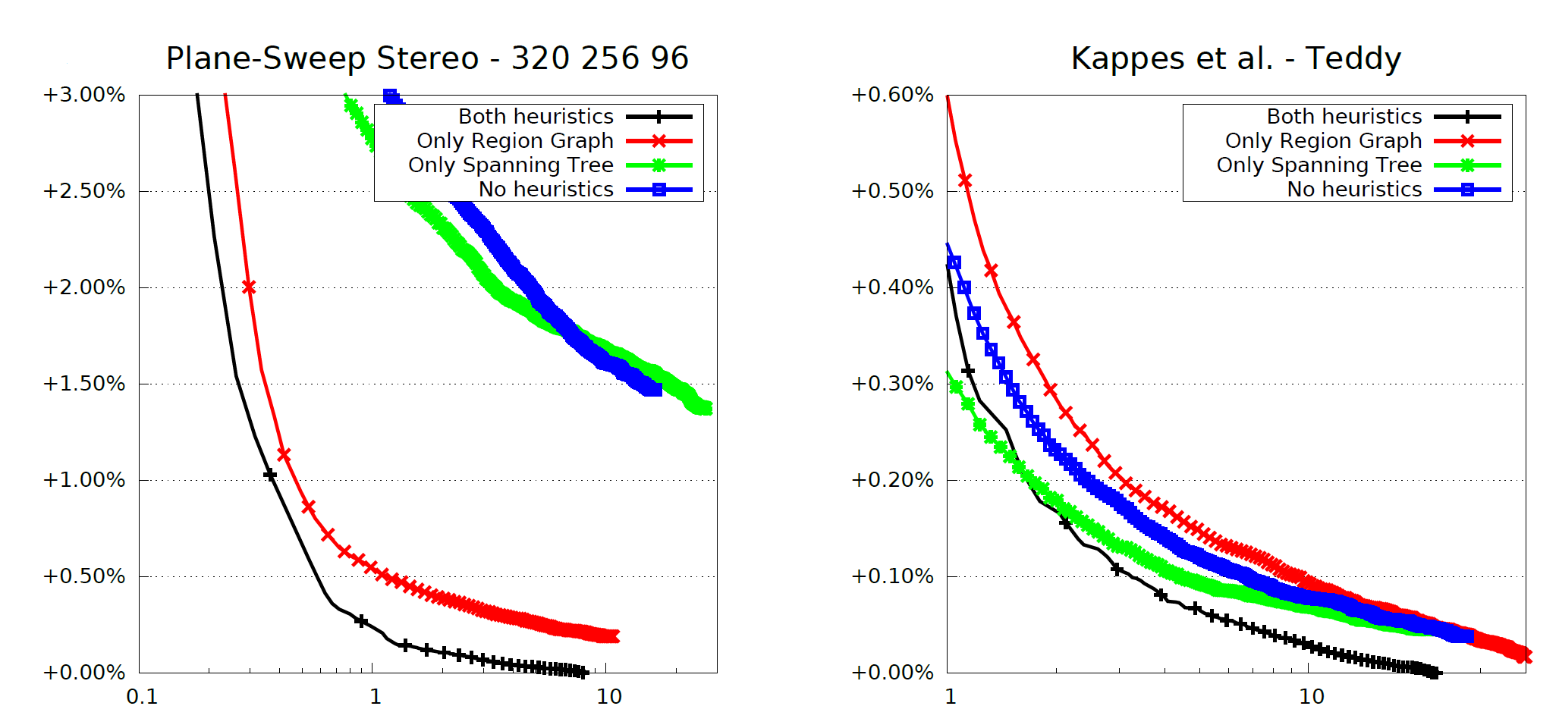
Influence of heuristics
Notes:
-> 20:00

Slide 31
Why you might want to use it
Close to “one size fits all”
No worries about topologies or energy functions…
… just test whatever you need.
You’ll get…
Excellent performance on large data sets
Close to state-of-the-art for smaller data sets
Notes:
-> 20:30
What good is this system if you can’t use it? -> next slide

Slide 32
Code & datasets
CPU/GPU code currently being reworked, available shortly
Need our research code now? Please contact us.
tinyurl.com/gcc-mapmap
Notes:
-> 21:00
… that’s why we release the code for CPU(TBB + SSE/AVX) and GPU (CUDA) implementation
Code currently being reworked to be easily usable for end-users
Will be published shortly
Research code offered on request

Slide 33
Backup slides

Slide 34
Ensuring maximality
Maximal acyclic coordinate set: no free node can become a coordinate without breaking acyclicity
Necessary measures:
Conflict handling with complete rollback
Rescue iteration
Algorithm may get stuck
Solution: add 0-marker node as new root, proceed as usual
2
0
Notes:
OPTIONAL SLIDE
Corner case: add rescue iteration to add problematic nodes as roots

Slide 35
Markov Random Fields
Models distribution of pairwise dependent discrete random variables $x$, given data $y$
“Product of potentials” - form:
$$p\left(x\right)=\frac{1}{Z}\prod_{C}{φ_{C}(x_{C}|y_{C})}$$
$$x_{1}$$
$$x_{2}$$
$$E\left(x\right)=−\text{log}(p\left(x\right))$$
$$=\frac{1}{Z′}\sum_{C}{f_{C}(x_{C})}$$
$$x_{3}$$
$$x_{4}$$

Slide 36
Markov Random Fields (cont.)
Useful representation: (bipartite) Factor graph
$$f_{1}$$
$$x_{1}$$
$$x_{3}$$
$$x_{5}$$
$$f_{3}$$
$$f_{5}$$
$$f_{2}$$
$$x_{2}$$
$$f_{4}$$
$$x_{4}$$
$$x_{6}$$
$$E\left(x\right)= f_{1}\left(x_{1}\right)+f_{2}\left(x_{2}\right)+f_{3}\left(x_{1},x_{2}\right)+f_{4}(x_{2},x_{4})+f_{5}(x_{3},x_{4},x_{5},x_{6})$$

Slide 37
Maximum A Posteriori Problem
Statistical meaning:
Translated into our optimization-centric formulation:
Terminology:
Assignment, labels
Variables / nodes (“unary costs”)
Factors / edges (“binary costs”)
MAX-PROBABILITY
$${\text{MAP}\text{: }x^{∗}=\text{max}}_{x} p(x|y)$$
$${\text{MAP}\text{′: }x^{∗}=\text{min}}_{x} E(x)$$
MIN-COST

Slide 38
Assumptions on MRF in this work
Solely: Only uses unary, pairwise factors or label costs and topology is finite.
This especially enables use of the following:
Irregular, disconnected topologies
Arbitrary cost functions
Edge weights, costs per edge
Sparse label sets
Note: In this generality, MRF MAP is NP-hard.

Slide 39
Classification of MRF solvers in related work
General MRF MAP
Primal
Dual
Graph cut
LP relaxation
$α$-Expansion
FastPD
BCD
Dual decomposition
QPBO
Polytopal

Slide 40
Lessons learnt from first experiments
… in terms of dataset size:
keeps growing (e.g. Texturing, [KAH+15])
… in terms of generality:
No go-to solver that exhibits superior performance for all cases
Most available software has some restrictions
… in terms of parallelizability:
Quality of partitioning is crucial
For our case, BCD seems like a natural fit
Key question: Which BCD scheme to select?

Slide 41
MAP on tree-shaped MRFs
Solve in polynomial time by dynamic programming (DP)
Method: bottom-up local enumeration
$$f_{1}$$
$$x_{1}$$
$$x_{3}$$
$$f_{5}$$
$$x_{5}$$
$$f_{3}$$
$$f_{2}$$
$$x_{2}$$
$$f_{4}$$
$$x_{4}$$
$$f_{6}$$
$$x_{6}$$

Slide 42
DP on tree-shaped MRFs (leaf nodes)
Local energy of $x_{1}$, given a label $l_{2}$ for $x_{2}$:
$$E_{1}\left(x_{1}\right)= f_{1}\left(x_{1}\right)+ f_{3}(x_{1},l_{2})$$
Local optimization:
Enumerate all possible labels for $x_{1}$
Save minimum value and label argument
$$f_{1}$$
$$x_{1}$$
$$f_{3}$$
$$x_{2}$$

Slide 43
DP on tree-shaped MRFs (leaf nodes)
Local energy of $x_{2}$, given a label $l_{4}$ for $x_{4}$:
$E_{2}\left(x_{2}\right)= f_{2}\left(x_{2}\right)+f_{4}\left(x_{2},l_{4}\right)+$ $${ f}_{1}\left(x_{1}\right)+ f_{3}\left(x_{1},l_{2}\right)$$ $$= f_{2}\left(x_{2}\right)+f_{4}\left(x_{2},l_{4}\right)+E_{1}(x_{2})$$
$$f_{1}$$
$$x_{1}$$
$$f_{3}$$
$$f_{2}$$
$$x_{2}$$
$$f_{4}$$
$$x_{4}$$
Algorithm: Optimize bottom-up, until terminated on root. Then propagate optimal labels top-down.

Slide 44
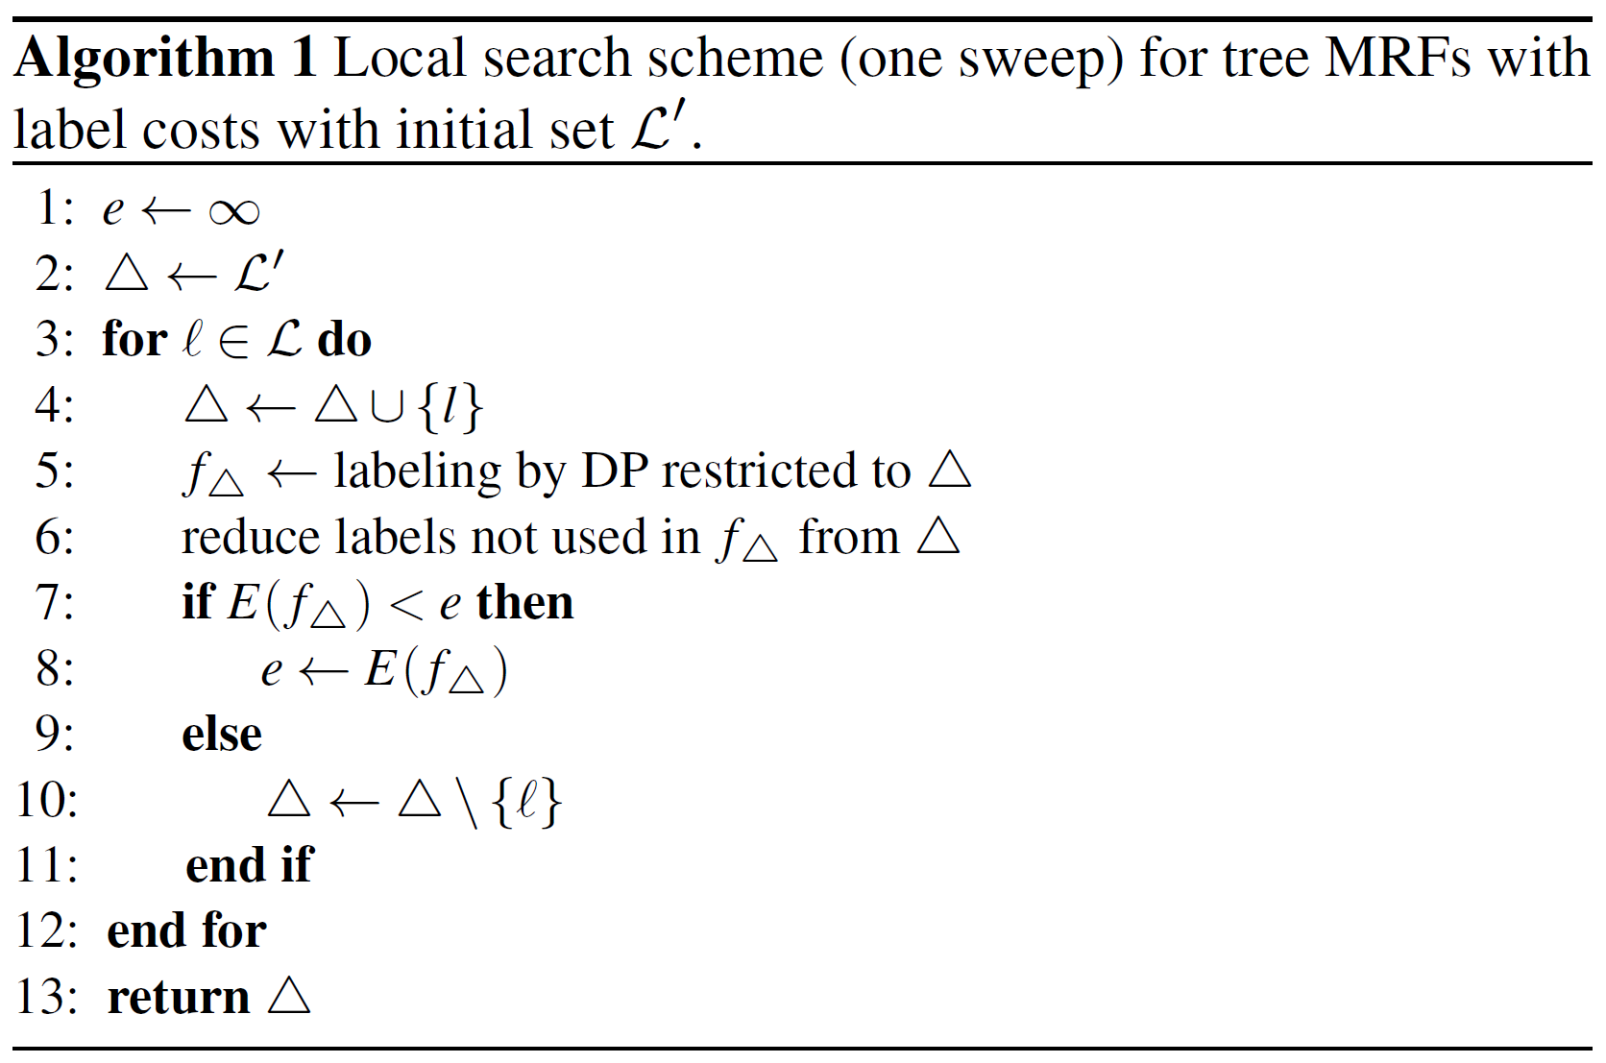
Label costs
No DP-enabling structure embedded (costs are global)
NP-hard, even for trees, use approximation:
$$x_{3}$$
$$x_{5}$$
$$f_{5}$$
$$x_{4}$$
$$x_{6}$$

Slide 45
Considerations on the implementation
Workload type:
regular (except for sparse label sets)
Granularity:
1 block per node, each thread considers one parent label
Memory:
2 * num_nodes * num_labels * num_labels
Can reuse memory from 2 levels below for energy values
Keep label table until the very last iteration
Load balancing:
Let the last block working on a child handle the parent

Slide 46
Growing spanning trees

Slide 47
Growing spanning trees
R

Slide 48
Growing spanning trees
R

Slide 49
Growing spanning trees
R

Slide 50
Growing spanning trees
R

Slide 51
Growing spanning trees
R

Slide 52
Growing spanning trees
R

Slide 53
Growing spanning trees
R

Slide 54
Growing spanning trees
Perform the following in rounds:
Select a random node in the tree
Select an adjacent node not yet in the tree
Grow branch to node from 2.
Parallelization straightforward, but….
… there are two concretizations to be made here:
Selection of node in 1.
Selection of node in 2.

Slide 55
Growing spanning trees
Perform the following in rounds:
Select a random node in the tree
Select an adjacent node not yet in the tree
Grow branch to node from 2.
Efficient selection of nodes in 1.:
We propose switching between two lists: $w_{in},w_{out}$
Update number of free adjacent nodes per node when growing a branch
Put all nodes with at least one such adjacent node into $w_{out}$

Slide 56
Considerations on the implementation
Regularity:
Potentially irregular on irregular graphs
With previous concretizations purely regular (up to list size)
Defer adjacency table modifications of new nodes to later
Granularity:
1 thread handles one node in the list
Synchronization:
Atomic locking of nodes for each complete iteration

Slide 57
Why not simply use spanning trees?
Optimizing on the spanning tree:
Include all variables…
… but not all factors!
We are solving a different problem here.
Decrease in energy on original problem not guaranteed
Thus: Find a monotone alternative!
Key to resulting BCD scheme: acyclicity and dependencies.

Slide 58
Acyclic coordinate sets: definition
Formal: Coordinate set $C$ for graph $(V,E)$ is acyclic iff $(V\left[C\right], E\left[C\right])$ is acyclic.
Informal: “If a node is part of the coordinate set, its adjacent coordinates are its children or parent.” “All coordinates which are not each other’s parents or children are separated by at least one free node.”

Slide 59
Growing acyclic coordinates
Main idea: adopt the spanning tree algorithm, but
Efficiently handle acyclicity violations
Change termination criterion (number of nodes in tree)
Ensuring acyclicity:
From informal definition: “[…] separated by at least one free node […]”
Encode this fact into marker for checks
Marker $m[i]$ = #number of adjacent coordinates

Slide 60
Sampling maximal, acyclic coordinate sets
1
R
1
1

Slide 61
Sampling maximal, acyclic coordinate sets
R
1
1
1

Slide 62
Sampling maximal, acyclic coordinate sets
R
1
2
1
1
1

Slide 63
Sampling maximal, acyclic coordinate sets
R
1
2
1
1
1

Slide 64
Sampling maximal, acyclic coordinate sets
R
3
4
3
3

Slide 65
Collisions in parallel execution
R
1
2
1
1
1

Slide 66
Considerations on the implementation
Regularity:
Grow phase: as spanning trees, regular workload
Other two phases: irregular workload
In our experience: for sparse graphs, not too many collisions
Improvement: multiple roots (tree -> forest)
Synchronization:
Atomic locking of nodes for each complete grow iteration
Atomic locking of nodes in repair phase, handle each node only once

Slide 67
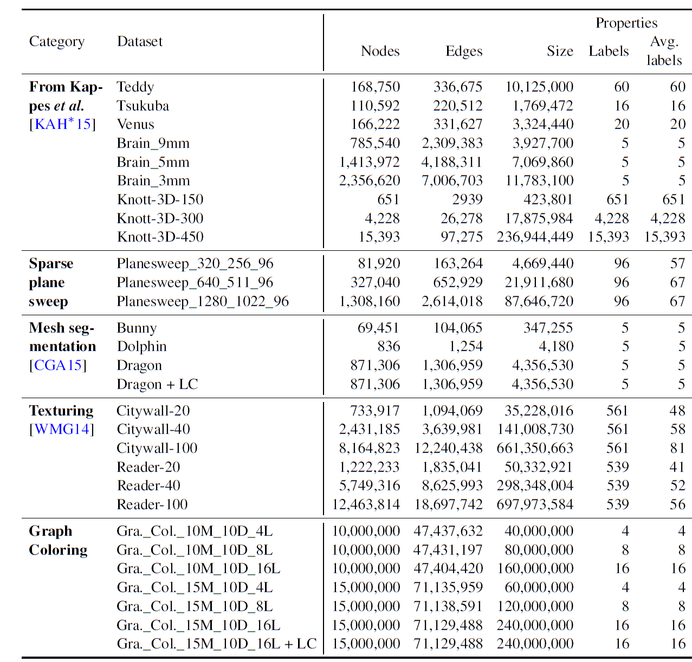
Datasets for evaluation (selection)

Slide 68
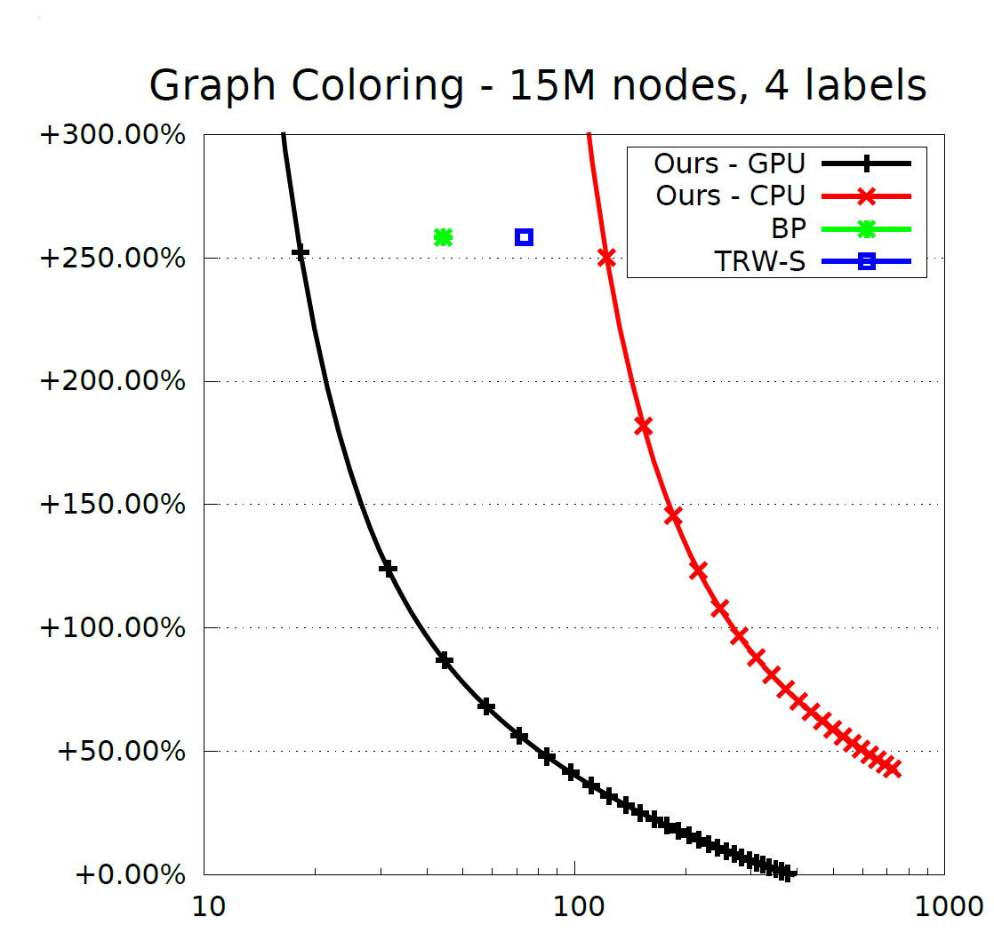
Anti-metric binary costs
Nodes: 15,000,000
Edges: 71,135,959
Labels: 4

Slide 69
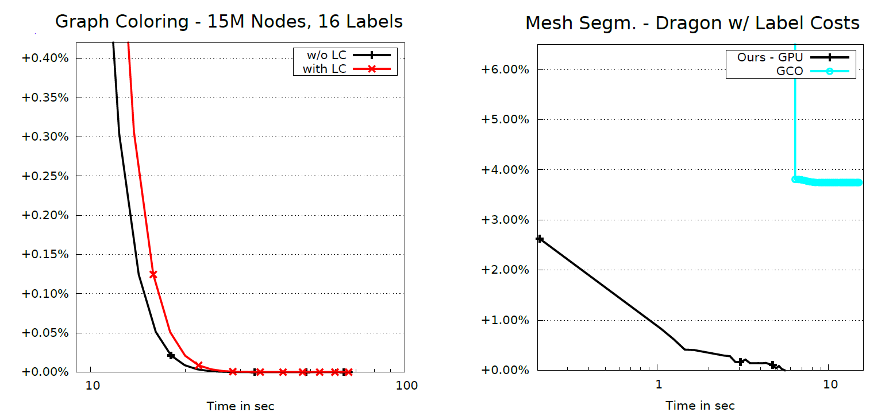
Evaluation of label costs

Slide 70
Conclusion
Our solver
Is highly effective on large data sets, beating the state-of-the-art
Has comparable performance on smaller to medium-sized datasets
Poses minimal assumptions to the problem
Is deployable to a large range of (massively-) parallel systems and hardware (multicore-CPU, Xeon Phi, NVIDIA GPUs)

