Slide 1
Watertight Reduced-Precision Traversal
Karthik Vaidyanathan Tomas Akenine-Möller Marco Salvi

Slide 2
Motivation
Acceleration Structure
HW Optimizations
Vertex Shading
Sorting
Rasterization
Z-Buffer
Z-Compression
Pixel Shading
Fixed Precision
Blend
C-Compression
Notes:
The motivation for our work on ray tracing comes from the GPU rasterization pipeline. This slide shows a simplified representation of such a pipeline.
One of the factors that makes GPUs so efficient is that several core functions have dedicated hardware implementations.
We focus on the rasterization stage, which usually works in conjunction with an acceleration structure, which is queried to determine visibility.
To improve the efficiency of these queries, the Z-Buffer is typically compressed, again using dedicated hardware.
In addition to Z-compression there are several other HW optimizations in a modern GPU.

Slide 3
Motivation
Acceleration Structure
HW Optimizations
Shading
Reduced Precision
Ray Traversal
Bounding Volume Hierarchy (BVH)
Compression
Sorting
Notes:
When it comes to ray tracing, the two key functions are shading and ray traversal. Although this graph looks different there are some interesting similarities.
There is a core algorithm for coverage and visibility computations which works in conjunction with an acceleration structure, which can be compressed.
In addition, these functions can be efficiently implemented in hardware similar to a raster pipe, including optimizations such as reduced precision arithmetic and sorting for shading coherency and locality.
However these optimizations have not been studied as extensively as in the case of rasterization. In this talk we will focus on BVH compression and reduced precision ray traversal starting with compression.

Slide 4
Incremental BVH Encoding [Mahovsky 06, Keely 14]
$$2^{e_{1}}$$
$$2^{e_{0}}$$
Derive low-res grid
Quantize Box
Compute 3-bit offsets w.r.t parent origin
Derive new grid
….
$$\left(s_{x},s_{y}\right)=(5, 6)$$
$$\left(r_{x},r_{y}\right)=(4, 3)$$
$$o$$
2
6
O + ${\frac{2}{8}2}^{e_{0}}$
O + ${\frac{2}{8}2}^{e_{0}}$
O + ${\frac{6}{8}2}^{e_{0}}$
O + ${\frac{6}{8}2}^{e_{0}}$
Bounds
BVH Topology
Notes:
Our technique for BVH compression builds upon two previous approaches: incremental encoding and parent plane sharing. Incremental encoding can be described as follows.
Consider a binary BVH topology and the bounding box for the root node. We can derive a low resolution grid that is aligned with the root box and has a size that is given by the smallest power of 2 that is greater than the size of the box. Lets assume that the grid has 8 divisions along each axis.
Therefore as long as we know the origin and the grid size, we represent any point on the grid with 3-bit coordinates.
We assume that the root box is clamped to the grid.
Descending down the BVH hierarchy we encounter child nodes and their corresponding bounding boxes.
We can quantize these boxes to the parent grid and store 3-bit offsets to represent the box coordinates. R represents the offsets to the lower bounds and S represents the offsets to the upper bounds.
This process is repeated as we traverse the next child.
When the size of a quantized bounding box along an axis is less than half the grid size, we can scale the grid size by a power of 2, to make it finer.
Subsequent nodes are quantized with respect to a finer grid.

Slide 5
Sharing Parent Bounds [Fabianowsky 09]
Reuse Mask:
0
0
1
1
Each parent plane shared with one child
1 bit to indicate the child
Only store new child planes
Reduces planes by half
Stored Plane
Shared Plane
Notes:
Another approach to compress the BVH is sharing bounding planes. Here we have a parent box and two child boxes.
Each bounding plane of the parent box is shared with at least one child.
We can store one bit for each plane to indicate which child shares the plane.
Therefore only the new child planes have to be stored, reducing the number of stored planes by half.

Slide 6
Sharing Parent Bounds [Incremental Encoding + Parent Sharing]
Field | Bits
Reuse Mask | 6
6-bit Planes X 6 | 36
Child Index | 21
Leaf Indicator | 1
Total | 64 (8 Bytes)
Notes:
Assuming 6-bits to represent a quantized plane offset and by sharing parent bounds, we can store a pair of BVH nodes in just 8 bytes. Which is 4 bytes per node.

Slide 7
Ray-Box Intersections [Kay, Kajia 86]
$$λ_{max}$$
Shared Plane
$$μ_{min}$$
$$μ_{y}$$
$$μ^{min}$$
Compute distance to each plane
Find max distance to lower planes
Find min distance to upper planes
Test $λ^{max}≤μ^{min}$
Reuse distances for shared planes
Saves half the computations
$$μ_{x}$$
$$λ_{y}$$
$$λ^{max}$$
$$λ_{x}$$
$$o$$
Notes:
Now moving on to ray traversal which involves traversing the BVH nodes and computing ray-bounding box intersections. A well known method to compute ray box intersections is the slab test which has the following steps.
Compute the distances along the ray to the lower bounding planes (we call this lambda), compute the distances to the upper bounding planes (we call this mu).
Find maximum value of lambda amongst the axes and minimum value of mu. Compare these distances. If lamda < mu, then the ray hits the box.
Otherwise it’s a miss.
Remember that half the planes are shared with the parent so we can reuse the distance values which were computed for the parent, saving the number of distance computations by half.

Slide 8
Reduced Precision Traversal [Keely 14]
Parent
Child
Translate origin closer to child
Reduced precision distances
Parent used previous origin
Precludes parent sharing
$$μ_{x}^{′}$$
$$μ_{x}$$
$$λ_{x}^{′}$$
$$o^{′}$$
$$o$$
Previous
Origin
Notes:
Recently Sean Keely introduced a method that translated the ray origin close to a box before computing the ray box intersections.
As a result of this translation, the distance values become much smaller. This enables reduced precision computations for the distance values.

Slide 9
Reduced Precision & Parent Sharing
Parent
Child
Leverage incremental encoding
Incremental computation
${λ_{x}=λ_{x}^{parent}+w_{x}r}_{x}2^{e_{x}}$
$w_{x}$ is the ray slope
$r_{x}$ is a quantized offset
Reduced precision MUL
Can reuse parent distance
$μ_{x}=μ_{x}^{Parent}$
$$μ_{x}$$
$${w_{x}r_{x}2}^{e_{x}}$$
$$λ_{x}$$
$$λ_{x}^{parent}$$
$$o$$
Notes:
To address this limitation we introduce an incremental traversal method that leverages incremental encoding which was used to compress the BVH.
Similar to the plane offsets, we also compute the plane distances incrementally w.r.t the parent distance. This incremental value can be directly derived from the plane offsets as you can see in the equation. Moreover since the plane offsets are quantized, the corresponding mul is a reduced precision mul.
Moreover we can now reuse the parent distances which cuts the number of computed plane distances by half.

Slide 10
Watertight Intersections
Upper Corner
Numerical errors in $λ,μ$
Errors accumulate
For watertight intersections
No +ve error in $λ$
No -ve error in $μ$
Errors in $λ,μ$ are coupled
Encode $s$ w.r.t upper corner
Independently round $λ,μ$
$$ε≤0$$
$$ε≥0$$
Parent
$$μ_{x}^{parent}$$
Child
$$μ_{x}$$
-${w_{x}s_{x}2}^{e_{x}}$
$$λ_{x}$$
$${w_{x}s_{x}2}^{e_{x}}$$
$$λ_{x}^{parent}$$
Notes:
When computing the plane distances, a numerical error can be introduced.
With incremental compression and traversal this error can accumulate over several steps.
These errors can be acceptable as long as we can guarantee watertight intersections i.e there are no false misses. This can be achieved by ensuring that there are no +ve errors in lambda and no –ve errors in mu.
By carefully rounding the computations we can guarantee that there are no +ve errors in lambda.
However note that both the lower and upper planes were encoded with respect to the origin and therefore mu is incrementally computed with respect to the previous lambda.
Therefore errors in lambda and mu get coupled and a negative error in lambda will introduce a negative error in mu which will violate our constraint.
To address this problem we propose a different encoding scheme where the offset for the upper planes is computed w.r.t the upper corner of the bounding box.
Therefore the value of mu is now computed incrementally with respect to the previous mu instead of lambda. This decouples lambda and mu and now mu can be independently rounded to avoid negative errors.

Slide 11
Topological Traversal Order
Parent always traversed before Child
Required for sharing parent bounds
Revisit nodes using a
Stack or
Restart from root node or
Combination of both [Laine 10]
Notes:
Just a quick node, in order to share distance computations with the parent node, the BVH has to be traversed in topological order.
Normally this is not a problem because typical implementations use a stack to re-visit nodes and this follows a topological order. However some stackless traversal algorithms use backtracking which violates topological order. Instead to reduce the size of the stack, we recommend using a method published by Samuli Laine, that uses a combination of a short stack and a restart trail and guarantees topological ordering.

Slide 12
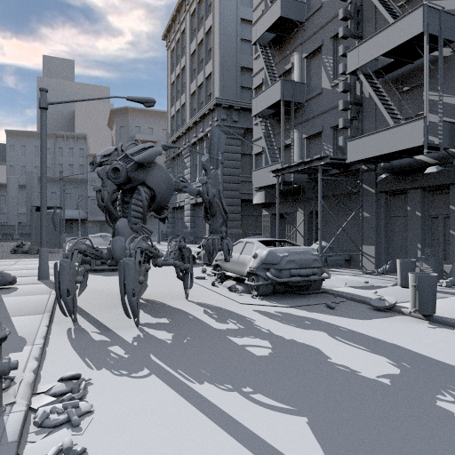
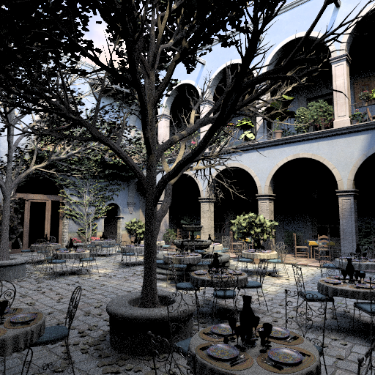
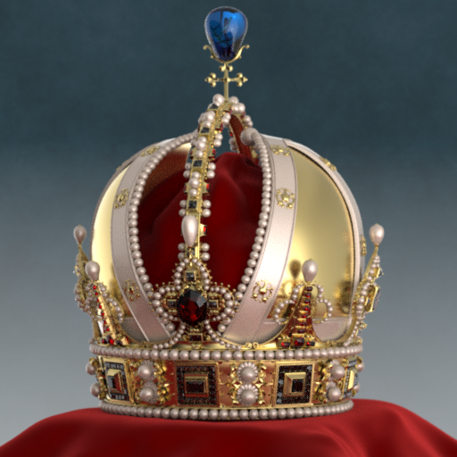
Results

Slide 13
Quantization

Slide 14
Comparison with [Keely 14]

Slide 15
Complexity
 | OUR | Keely 14 | Ratio
NAND Gates | 29,078 | 73,032 | 0.4

Slide 16
Conclusion
Optimizations commonly used in hardware rasterization pipelines can also be used for hardware ray tracing
Incremental BVH encoding can be leveraged for incremental traversal
Enables compression as well as reduced precision arithmetic
Significantly lowers the complexity of intersections
Can produce watertight results
Notes:
Several optimizations commonly used in hardware rasterization pipelines can also be used for hardware ray tracing
Incremental BVH encoding can be leveraged for incremental traversal which enables compression as well as reduced precision arithmetic
This approach significantly lowers the complexity of intersections and can produce watertight results

