Slide 1
Decoupled Coverage Anti-Aliasing
Yuxiang Wang¹ Chris Wyman² Yong He³ Pradeep Sen¹
UC Santa Barbara¹ NVIDIA² Carnegie Mellon University³

Slide 2
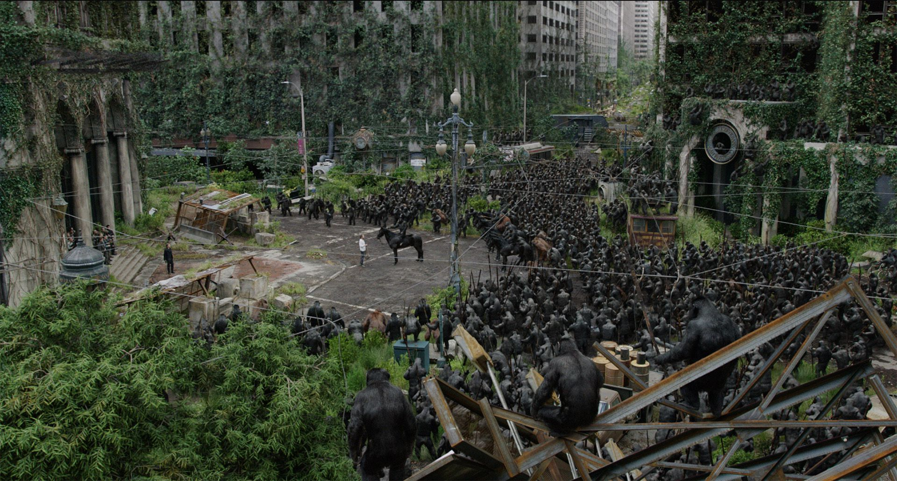
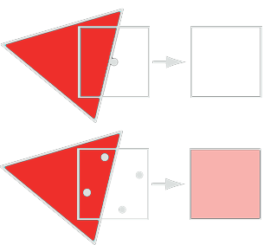
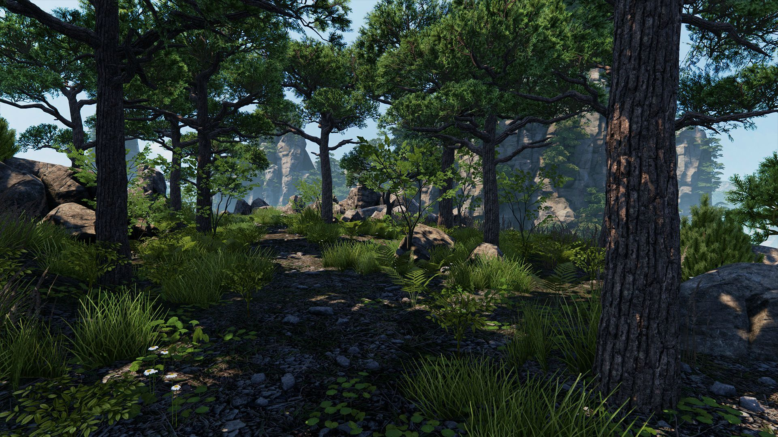
Motivation
Feature Film
Geometric anti-aliasing is a long standing problem
MSAA as gold standard
Idea: decoupled shading and visibility
Reduce shading cost
For high quality rendering, storage is costly
Source: Weta Digital
Game scene
Source: DICE
Notes:
Geometric anti-aliasing...
...With the development of real-time technology…movie-like scenes in games with complex pixels.
…gold standard, it decouples shading and visibility sampling rate by shading once per fragment and test depth at multiple locations, thus reducing shading cost.

Slide 3
Motivation
Estimate:
4 byte/sample color
4 byte/sample depth
No compression
Linear growth with # samples
64x MSAA 1080p:
~1 GB for RGBA8
2+ GB for G-Buffer
Bytes/pixel
Notes:
Let’s see rough esitimation…Note that the growth is linear respect to the number of samples per pixel, and it reaches 1 gigabyte on forward pipeline for 64 samples per pixel, and will get even worse for deferred pipeline.

Slide 4
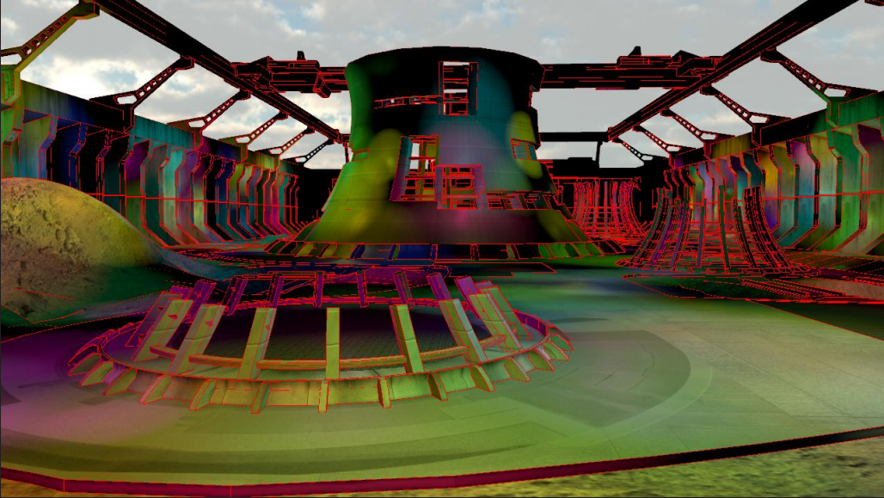
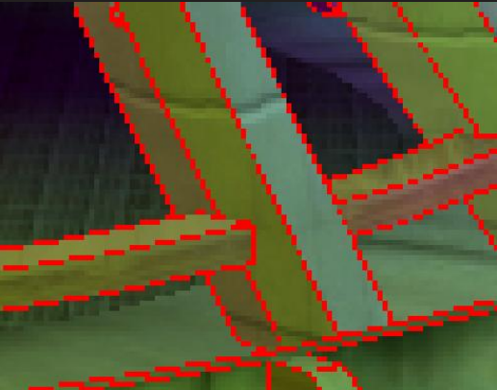
Related Work
Simple/Complex [Lauritzen 2010]
Analyze planar features shared in G-Buffer
Amortize shading cost
Large memory footprint with sizeable depth and color information
Source: [Lauritzen 2010]
Notes:
For related works, Simple/complex method decouples shading and visibility sampling rates for deferred pipeline…

Slide 5
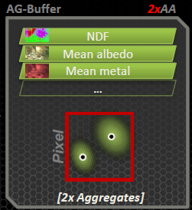
Related Work
Surface Based AA (SBAA)[Salvi & Vidimče 2012], Streaming G-Buffer [Kerzner & Salvi 2014]
Only store N important surfaces
Aggregate Geometry AA (AGAA) [Crassin et al. 2015]
Filter & compression
Rely on MSAA depth sampling -> large memory footprint @ high sample rates
Source: [Salvi & Vidimče 2012]
Source: [Crassin et al. 2015]
Notes:
Another type of work is to compress the G-Buffer into a few shading aggregate, resulting in fixed shading rates and G-Buffer size…
…However, they both rely on MSAA depth sampling, so they also require large memory footprint at high sampling rates.

Slide 6
Motivation
Observations from prior G-Buffer compression work [Salvi & Vidimče 2012]
2-3 shading surfaces are enough for each pixel
Can we use a higher fidelity coverage for compressed surfaces?
High fidelity coverage mask easy to get [Waller et al. 2000][Wyman et al. 2015]
Model contribution of each surface more precisely
Or, in other words…
Can we decouple coverage from visibility?
Higher anti-aliasing quality in less storage by decoupling coverage and visibility rates
Notes:
Observations from the previous G-Buffer compression work is that, …so we don’t need save that much information.
So the question is, for fixed number of shading surfaces, can we use a higher fidelity coverage map for them to improve rendering quality? It is proved that…and because of their high sampling rates, they can…
To rephrase our question, ..of decoupling shading and visibility decoupling, …

Slide 7
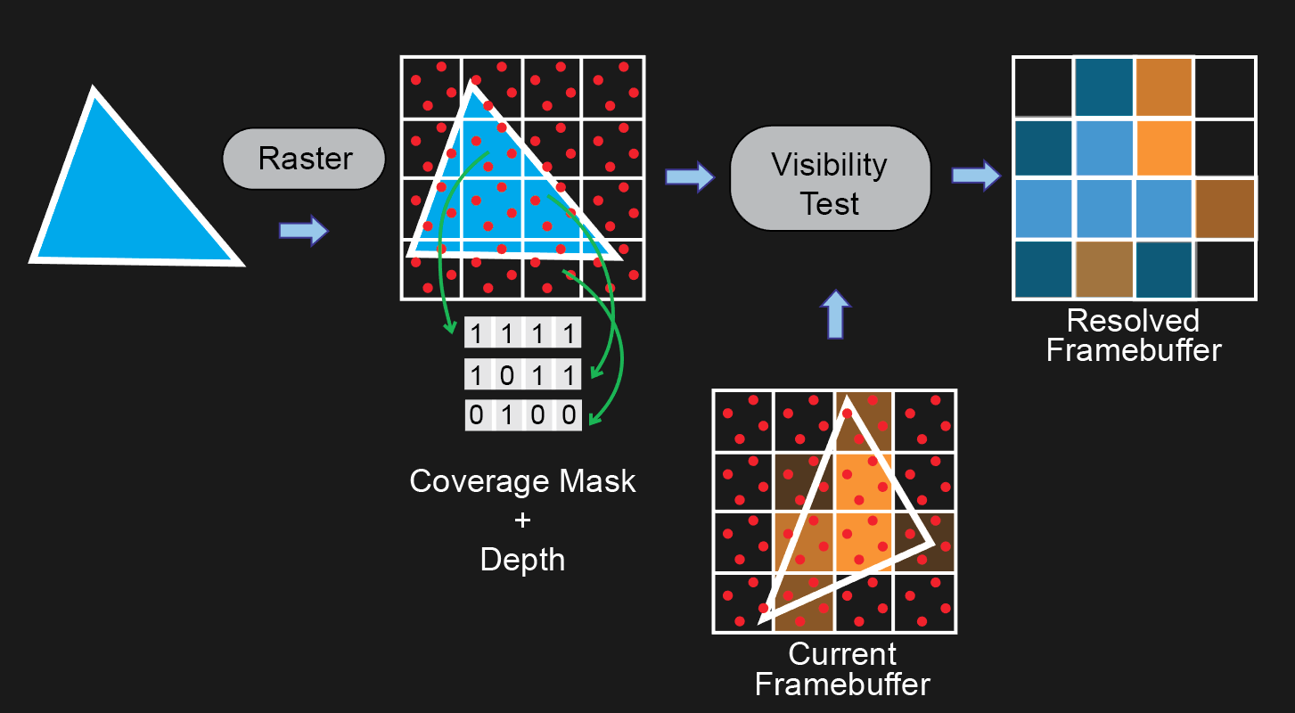
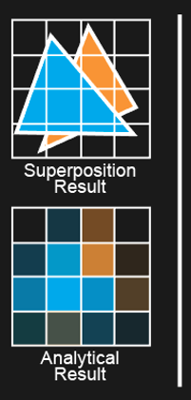
Algorithm Overview
4x MSAA
Notes:
Before introducing our algorithm, let’s look at MSAA first. We are rendering two triangles, orange one comes first, and ideally we can get this framebuffer.

Slide 8
Algorithm Overview
4x MSAA
Notes:
…rasterized into fragments…depth is calculated at several locations…compared with values in the framebuffer…

Slide 9
Algorithm Overview
4x MSAA
Notes:
…rasterized into fragments…depth is calculated at several locations…compared with values in the framebuffer…

Slide 10
Algorithm Overview
4x MSAA
Notes:
the pipeline picks the closer one to the viewer and save it in the depth resolved framebuffer, which is what we see on screen.
Note that we need to store N depth and color values for N times MSAA.

Slide 11
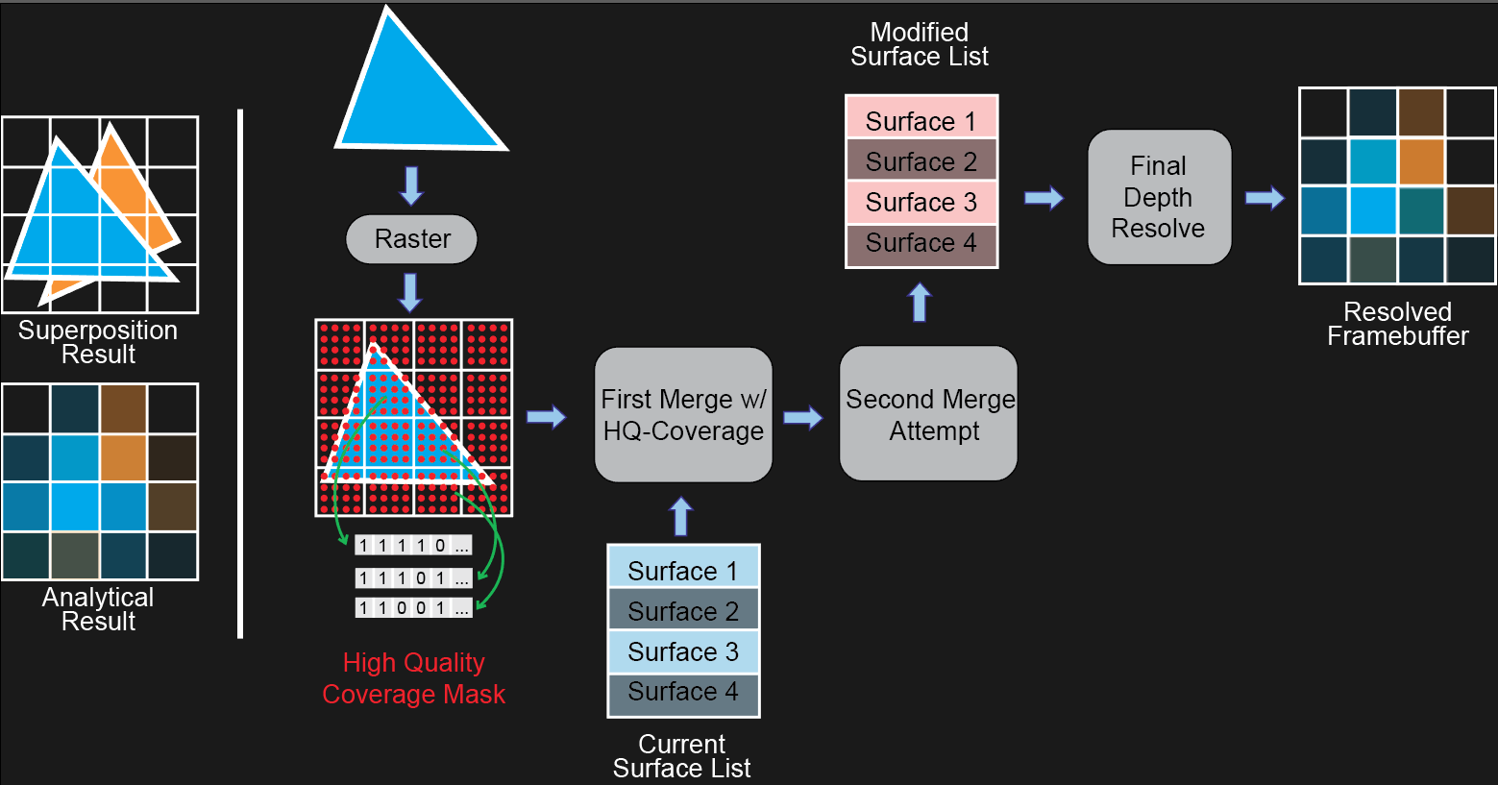
Algorithm Overview
Decoupled Coverage AA
Notes:
Now let’s see our algorithm.

Slide 12
Algorithm Overview
Decoupled Coverage AA
Notes:
The triangle is still rasterized into fragments…

Slide 13
Algorithm Overview
Decoupled Coverage AA
Generate coverage samples
Arbitrary number of samples per pixel
Low cost on storage
Notes:
Instead of generating depth…high fidelity coverage mask which can have arbitrary number of samples per pixel…it has 64 samples per pixel

Slide 14
Algorithm Overview
Decoupled Coverage AA
Merge fragments into few shading surfaces
Shade at fixed rate
HPG 2015
Notes:
Once we get the coverage mask…
If the merge is successful…If the merge failed, we potentially need to discard one of the surfaces to obey the space constraint…which may throw away coverage information and cause leaking, which is high undesired.

Slide 15
Algorithm Overview
Decoupled Coverage AA
Second merge attempt
Merge before discard to save more
information
HPG 2015
Notes:
To solve this problem, we introduce an extra step of…to preserve the information.

Slide 16
Algorithm Overview
Decoupled Coverage AA
Notes:
After all fragments are processed, we use a final depth resolve step to generate the framebuffer to display.

Slide 17
Coverage map generation
MSAA: <= 8 sample/pixel
Depth + colors replicated per sample (e.g., 8 bytes/sample RGBA8 and 16-20 bytes/sample deferred)
Coverage mask is cheaper than MSAA sample (depth+coverage)
1 coverage sample -> 1 bit
High sampling rate supported
Notes:
The first step is coverage map generation…only 1 bit, so we can use high sampling rate.

Slide 18
Coverage map generation
Notes:
To build the coverage map…

Slide 19
Coverage map generation
Notes:
…the first step is to project the triangle onto the screen, just like normal view projection.

Slide 20
Coverage map generation
Look-up table for per-edge coverage
Notes:
From this projection… 2D line function for each edge of the projected triangle, and we define one side…
…we discretize the line into one of the entries of a pre-computed look-up table, where we store the coverage map for each line.

Slide 21
Coverage map generation
Look-up table for per-edge coverage
Notes:
Finally we combine the maps of 3 edges to get the final coverage map.

Slide 22
Fragment Merging
Try to merge fragment into existing shading surfaces
Satisfy merge rules
Combine the coverage mask
Weighted average normal, depth, etc., based on coverage bits
Fail: add fragment into list
Aggregates geometry information
Without losing high fidelity coverage information
Notes:
Once we get the coverage map, …
…if the merge failed, we try to add…
Through this merging, we can…

Slide 23
Merge heuristics
Merge rules
Aligned normal
Overlapping depth intervals
Notes:
We have 2 rules to decide whether to merge or not…Dot product…
…This ensures that the two surfaces are facing the similar direction…
…This ensures that the two surfaces are approximately at the same space position.

Slide 24
Fragment Merging
Keep 4 surfaces at most
2-3 surfaces for Streaming G-Buffer [Kerzner & Salvi 2014]
2 surfaces for AGAA [Crassin et al. 2015]
Sufficient to handle sophisticated scenes
High fidelity coverage mask catches small geometry
Discard rules vs. Clustering approach
Notes:
We keep 4 surface per pixel at most…
…In order to process all geometry in a single pass, we use lossy…instead of clustering…like AGAA

Slide 25
Second merge attempt
When the surface list is full, we need to discard
Discard the one with smallest visible coverage
Discard loses information…
Leaking to background
Blue as background color
Only merge once
Reference
Notes:
If the merge failed, we add the fragment as a surface into the list. When the list is also full, we need to discard one surface to obey the space constraint. A good choice is to…

Slide 26
Second merge attempt
How does the leaking happen with single merge?
Consider this complex pixel:
The eye should see only the blue surfaces
Consider this primitive order
Large derivatives result in big bounding box
No accurate coverage determination…
But only have room for 4 surfaces
2
5
4
3
1
Notes:
So how does the leaking…
…Blue surfaces has large depth derivatives, so their pixelwise bounding boxes…overlap…
At this time we cannot tell that the blue surfaces are covering the red one, so a good choice is…let the coverage be decided at final depth resolve step…
…so we have to discard the 5th surface because it has…this will make the pixel reddish…

Slide 27
Second merge attempt
How does the leaking happen with single merge?
Discarding small, nearby surfaces likely to cause leaks
Prefer to avoid discarding important geometry
Prevent loss of nearby sub-pixel geometry
Potential cost of blurring color on small surfaces
Notes:
We can see that discarding small, nearby surfaces are likely to cause leaks.
We prefer to avoid discarding those geometries, even at the cost of blurring color of ..

Slide 28
Second merge attempt
Give the smallest surface a second chance!
Merge before discard:
Select the smallest coverage surface after first merge
Never try discard the front most one
Try to merge it with others using relaxed rule
Apply only overlapping depth interval rule
If mergeable, average all attributes as usual
(a)
(b)
Notes:
Our solution is, to give the smallest surface a second chance. To do that, …
…Note that we never try to discard the front most one…

Slide 29
Implementation
Conservative rasterizer
Process partially covered fragments
Pixel shader interlock
Ensure primitive ordering
Fragment shader lock
Resolve discard & temporal artifact
Z-prepass
Notes:
For implementation aspect, we use CR to process the pixels that are not covered at the center.
Because we use lossy…rules, our geometry process ordering need to be the same for every frame to avoid discard & temporal artifact. PSI ensures that the ordering to be the same as API call ordering and fragments are processed one at a time in a pixel, so we have no…

Slide 30
Results

Slide 31
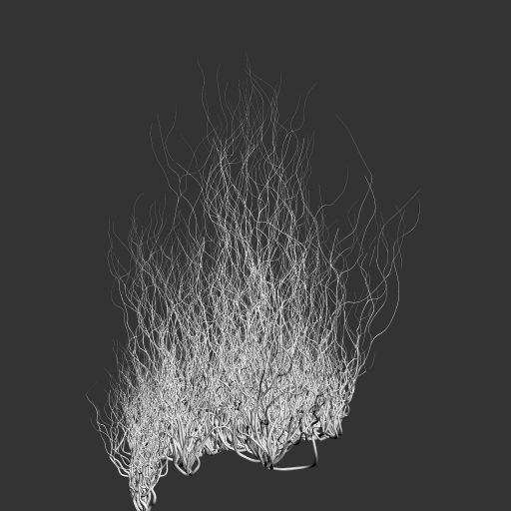
4S DCAA
Notes:
The first scene is…It has a lot of small geometry, which is hard for conventional…

Slide 32
4S SBAA
4S SBAA
Notes:
Suffering from low…SBAA result is not continuous and highly aliased on the tentacles.

Slide 33
8x MSAA
4S SBAA
8x MSAA
Notes:
MSAA shows similar result as they all use the same sampling rates.

Slide 34
4S DCAA
4S SBAA
8x MSAA
4S DCAA
Notes:
Our result is anti-aliased a lot better, with continuous boundries, and our result is very similar with the 512 samples per pixel supersampling result.

Slide 35
512x Supersampling
4S SBAA
8x MSAA
4S DCAA
512x SS

Slide 36
8x MSAA
4S DCAA
Notes:
We can see that we have much less flickering on the tentacle tips than MSAA in the video.

Slide 37
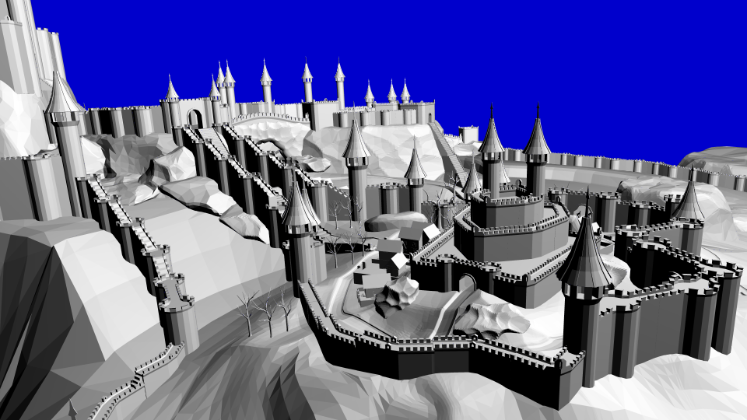
4S DCAA
Notes:
The second scene is Citadel, which is a game like scene that has large geometry as well as fine details.

Slide 38
4S DCAA
8x MSAA
8x MSAA
Notes:
For the tree branches, MSAA result still has alias

Slide 39
4S DCAA
8x MSAA
4S DCAA
Notes:
Our method shows pixels with smoother transition on the branches, which is closer to 512x supersampling result.

Slide 40
512x Supersampling
8x MSAA
4S DCAA
512x SS

Slide 41
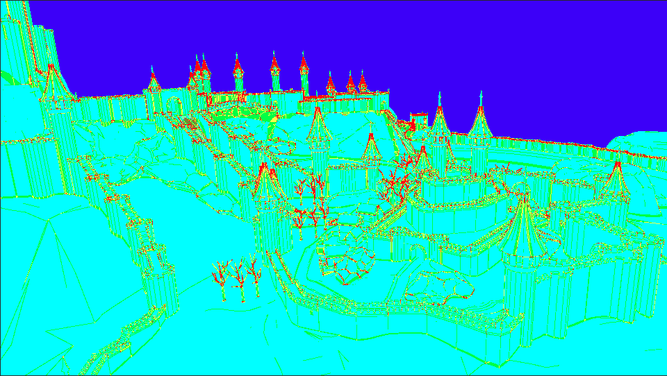
4
3
2
1
0
Notes:
Here is the map of number of surfaces. We can see that for the most part, it only has 1 surfaces, and for the complex regions it reaches 4 surfaces per pixel.

Slide 42
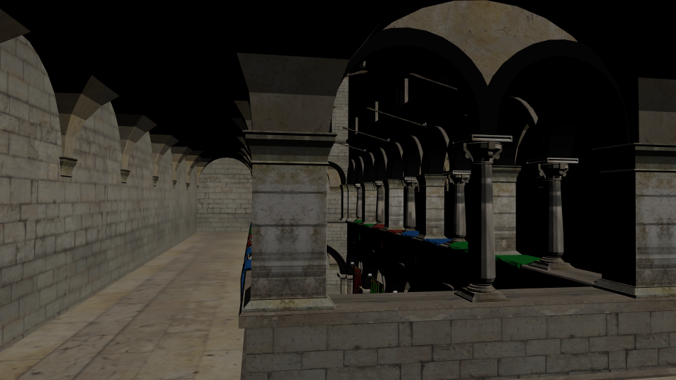
4S DCAA
Notes:
…which has colored texture information.

Slide 43
4S SBAA
4S SBAA
Notes:
At the bottom of the pillar where there are some fine edges, SBAA shows abrupt pixel color changes.

Slide 44
8x MSAA
4S SBAA
8x MSAA
Notes:
MSAA suffers from the same issue at those places too.

Slide 45
4S DCAA
4S SBAA
8x MSAA
4S DCAA
Notes:
Our algorithm shows smoother transition at the edges, which is anti aliased.

Slide 46
512x Supersampling
4S SBAA
8x MSAA
4S DCAA
512x SS
Notes:
And our result is close to 512 time supersampling result.

Slide 47
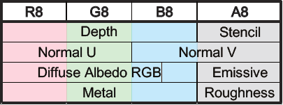
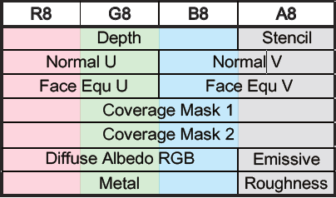
Evaluation
$×$8
$×$4
Memory consumption
28 bytes/surface $×$ 4 surfaces/pixel = 112 bytes/pixel
8x MSAA: 16 bytes/sample $×$ 8 = 128 bytes/pixel (1.14x of DCAA)
64x SuperSampling: 16 bytes/sample $×$ 64 = 1024 bytes/pixel (9.14x of DCAA)
Performance
Bytes/pixel
 | Z-Prepass | Merge | Resolve & Render | Total
Citadel | 1.3 ms | 23.2 ms | 6.4 ms | 30.9 ms
Tentacles | 1.3 ms | 574.5 ms | 6.2 ms | 582.0 ms
MSE
4S SBAA | 8x MSAA | DCAA
2.47*10⁻⁴ | 1.32*10⁻⁴ | 6.40*10⁻⁵
2.28*10⁻³ | 6.05*10⁻⁴ | 5.65*10⁻⁴
Notes:
On memory consumption, our current implementation takes 112 bytes per pixel, and 8x MSAA…For similar quality comparison, 64x SS…
In other word, our method achieves much better quality using only 8x MSAA storage.
On performance side, our algorithm is not very strong, but it will improve with further optimized hardware. For MSE comparison our method beats MSAA and SBAA.

Slide 48
Limitation
Rendering speed
Pixel Shader Interlock with Conservative Rasterizer
Better synchronization would help
Merging artifacts
DCAA
512x Supersampling
Incorrectly merge
Incorrectly discard
Merge blurred texture
Z-prepass leak
Notes:
The major limitation…
We use hardware Z-prepass to speed up…only 8 samples per pixel and may discard some fine geometry. A more clever Z-prepass will resolve this issue without performance punishment.

Slide 49
Conclusion
A streaming compression algorithm for geometric anti-aliasing
Achieves close to 512x SS result with storage of 8x MSAA
Decouple visibility into depth and coverage
Higher sample rates in reasonable memory footprint
Other applications
Performance limitation
Notes:
As a conclusion, …
The key insight is that we can decouple…

Slide 50
Acknowledgments
Anonymous reviewers
NVIDIA hardware donation
Aaron Lefohn and Anjul Patney for helpful discussions
Zi Wang, Chieh-Chi Kao, Ekta Prashnani, and Abhishek Badki for help with the paper
Funding:
National Science Foundation (IIS-1342931 and IIS-1321168)
NVIDIA internship

Slide 51
Thank you!

Slide 52
Final Depth Resolve
After all fragments are processed for current pixel
Brute-force method
Calculate depth at each sample position for each surface
Find the closest surface at each sample position
Contribution of surface: # covered / # total samples
64$×$4=256 depth computation
Could be further optimized
Notes:
After all fragments are processed, we proceed to the final depth resolve step. It is rather simple: we save plane equation for each surface, so we can calculate depth at each sample position and see which surface is visible at this point, and the final contribution is proportional to the visible samples of each surface.

Slide 53
Coarse Depth Resolve
Use to determine the one to discard
Find the one with smallest coverage
“Conservative” depth resolve using bounding boxes
Approximated coverage for occlusion
Not touching those having inter-penetration possibilities
Only modify those are surely occluded

Slide 54
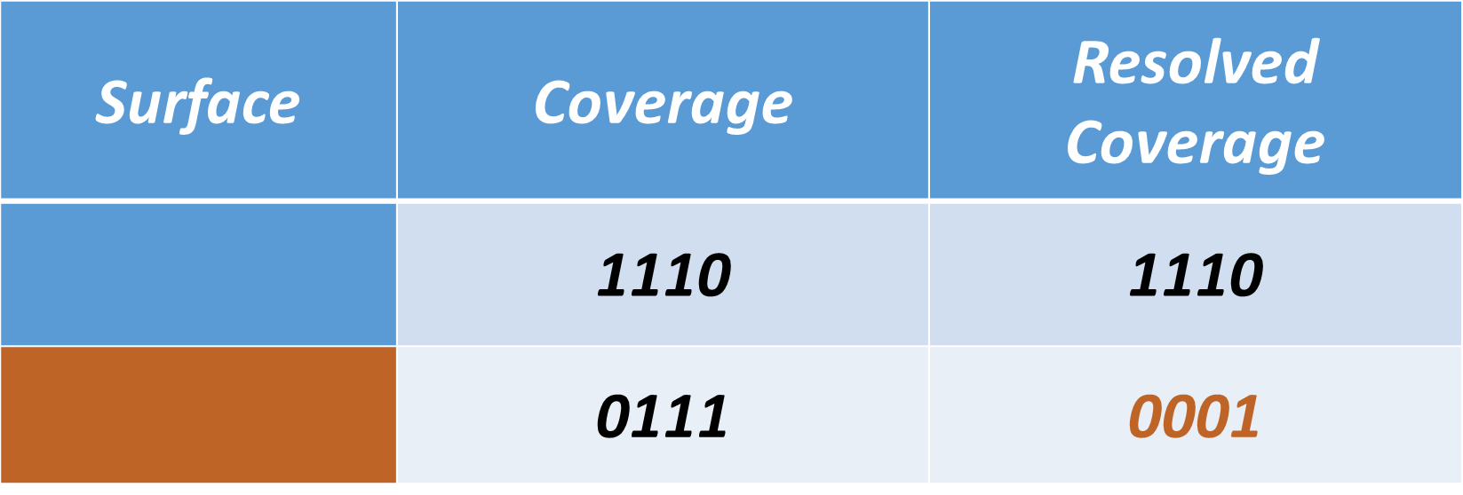
Coarse Depth Resolve
Depth
Samples
Samples

Slide 55
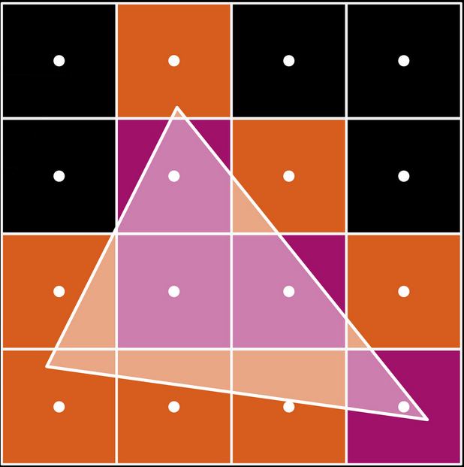
Conservative Rasterizer
Both orange and purple pixels
are considered covered
Source: NVIDIA

