Slide 1

Remembering Wolfgang Strasser

Slide 2
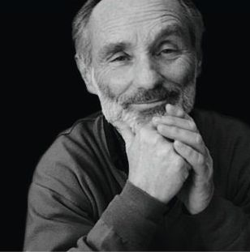
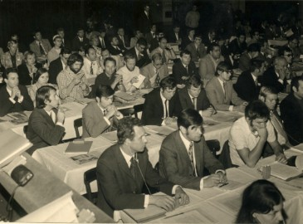
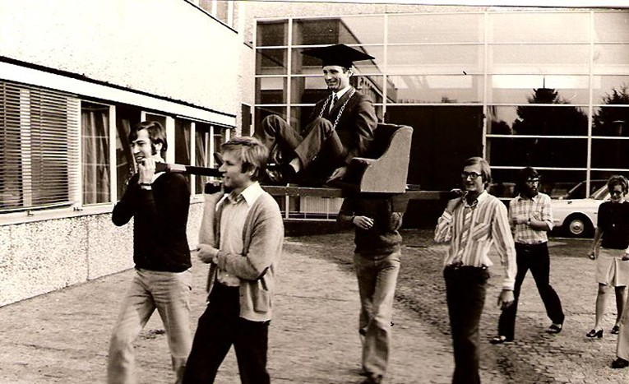
Wolfgang Strasser: Short CV
Born August 10th, 1941 in Metzingen
Died January 24th, 2015 in Tübingen
1962-1969 Student, Communication Eng., TU Berlin
1969-1971 Nixdorf GmbH
1971-1973 Research Assistant, TU Berlin (Prof. Giloi)
1973-1978 Heinrich-Hertz Institute (HHI), Berlin
1978-1986 Professor, TU Darmstadt
1986-2009 Professor, Tübingen University

Slide 3
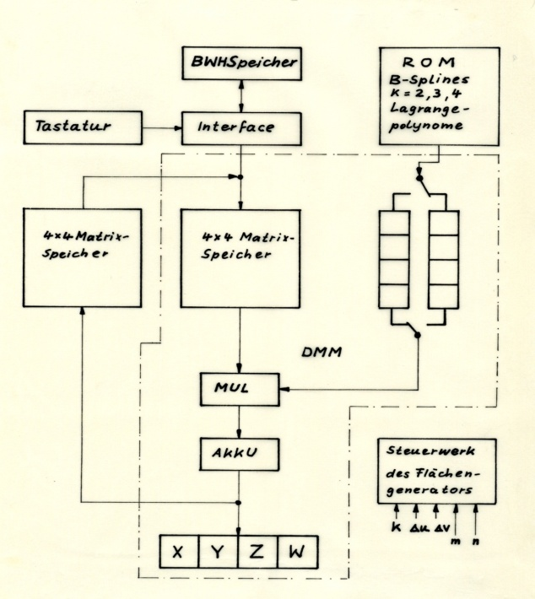
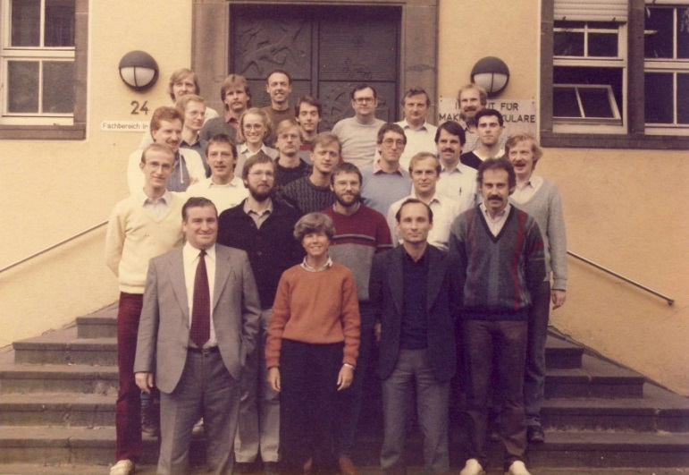
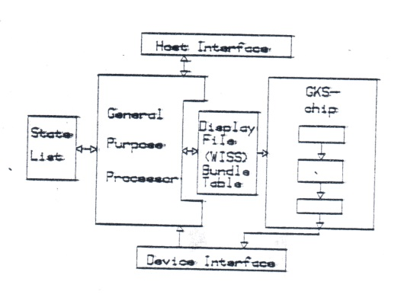
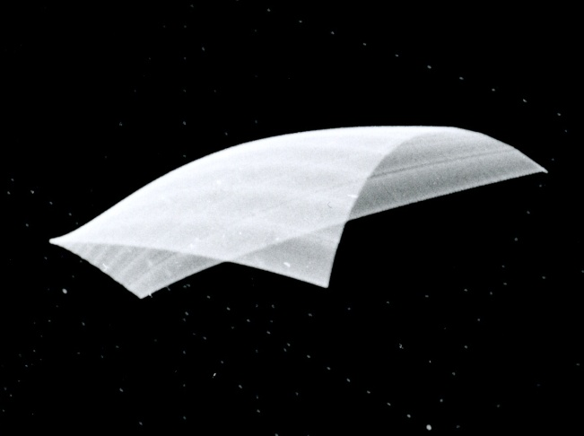
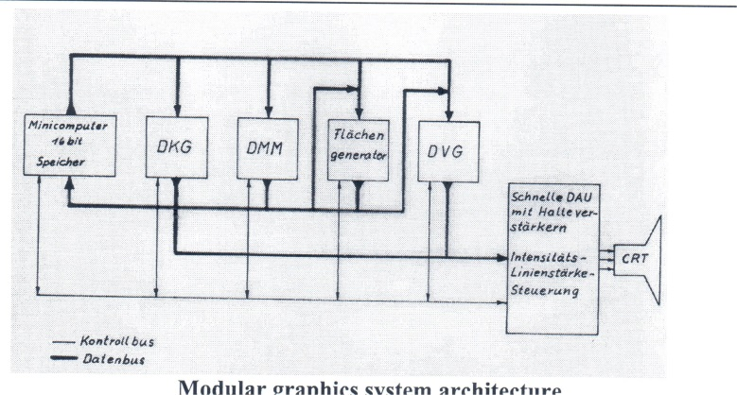
Pioneer of Computer Graphics

Slide 4
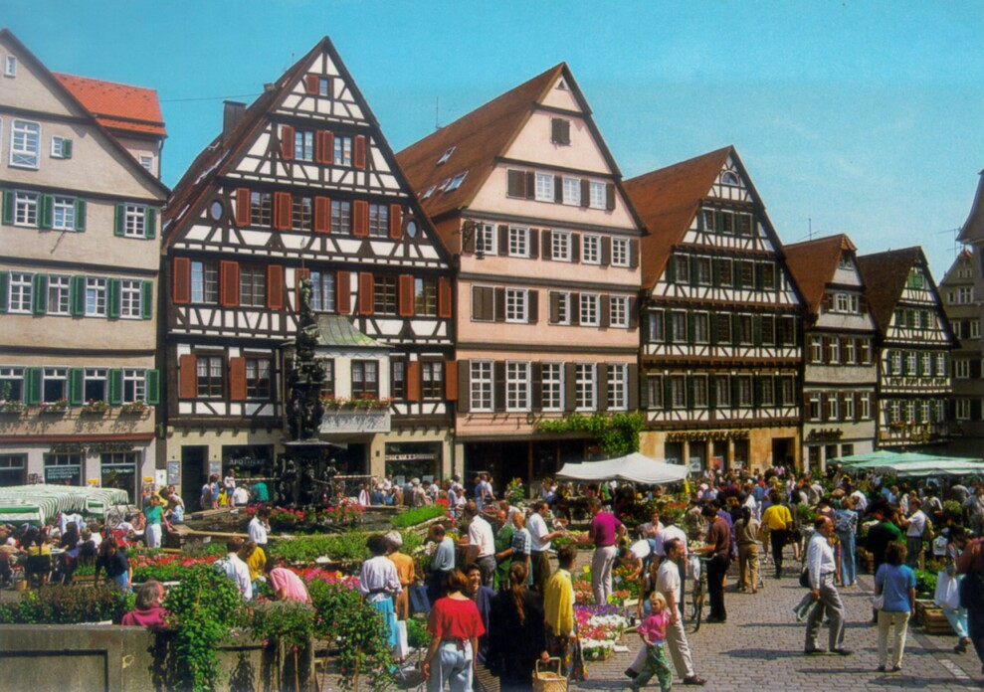
Tübingen: A Postcard City

Slide 5
Wolfgang Strasser in Tübingen

Slide 6
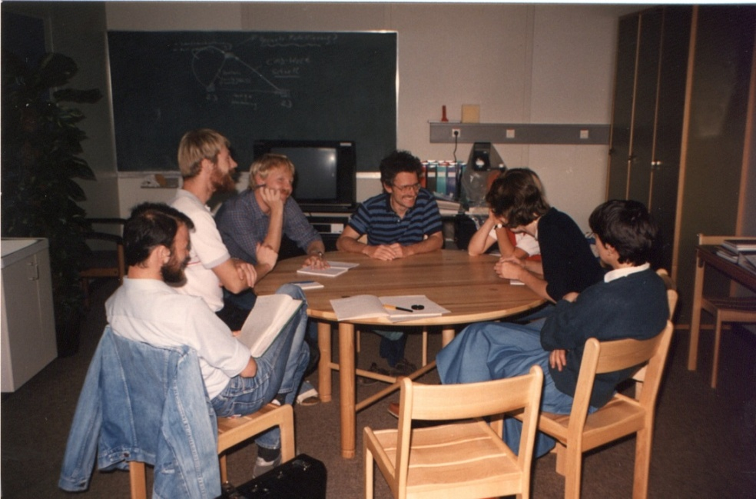
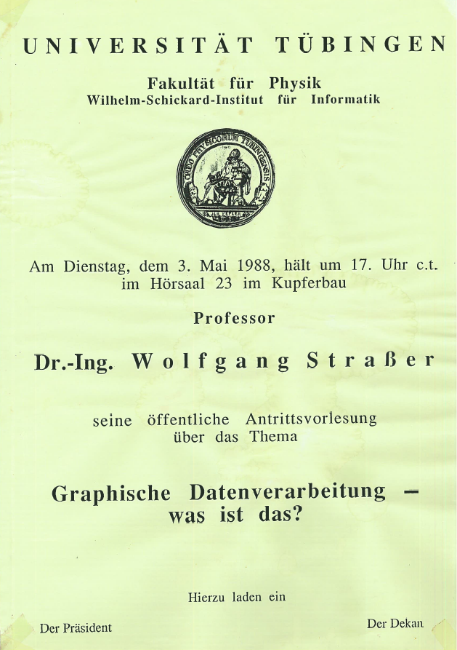
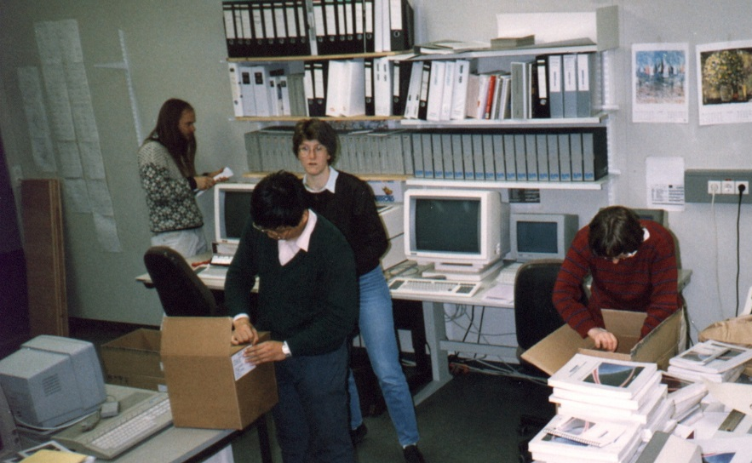
Starting in Tübingen

Slide 7
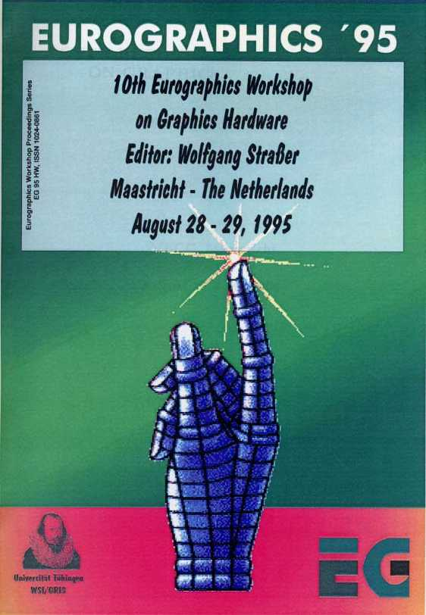
1986: Creating Graphics Hardware

Slide 8
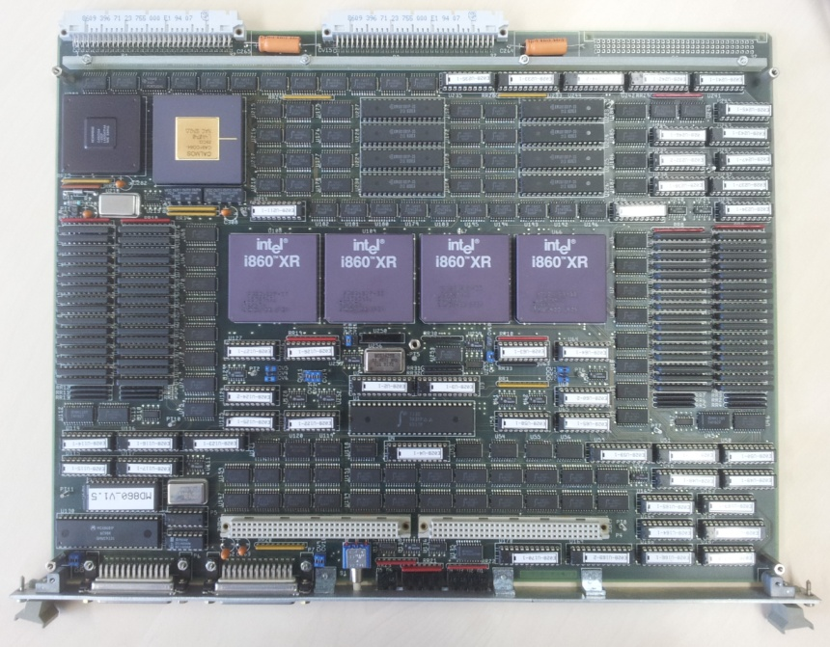
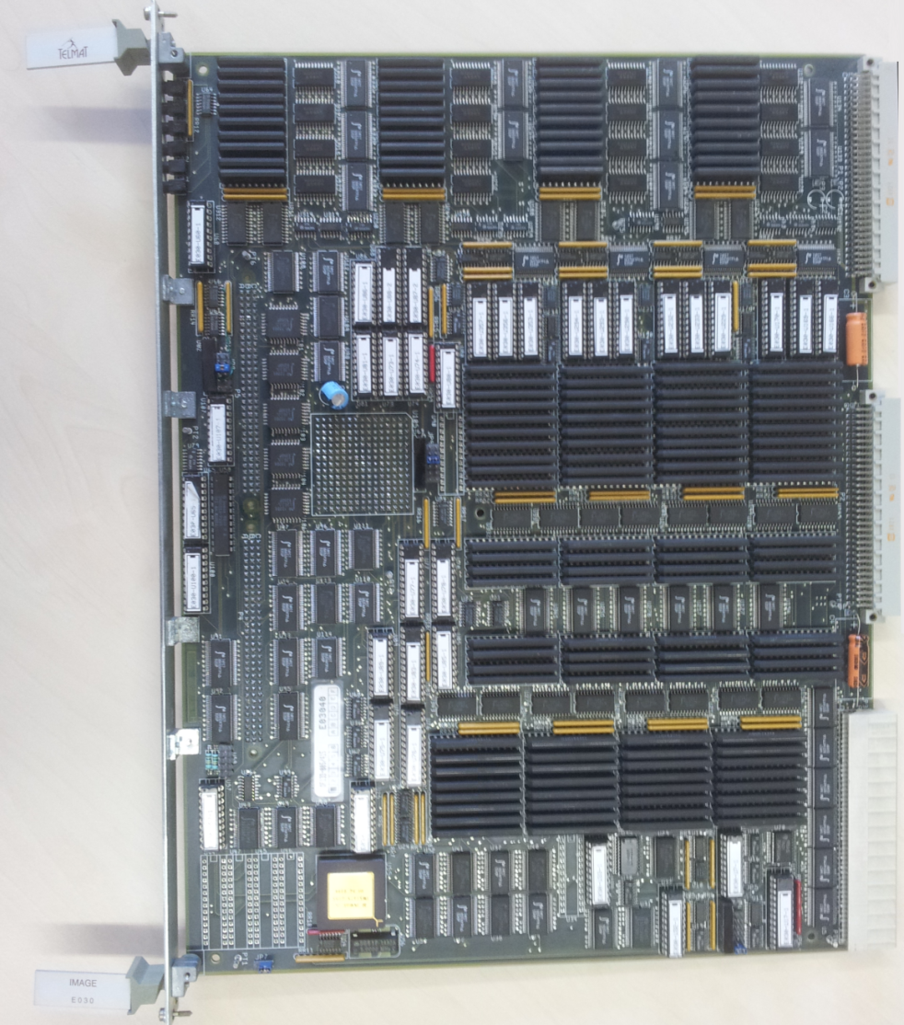
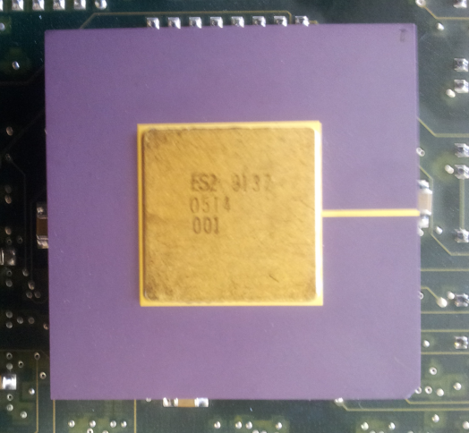
Spirit: HW from Tübingen (1988-92)

Slide 9

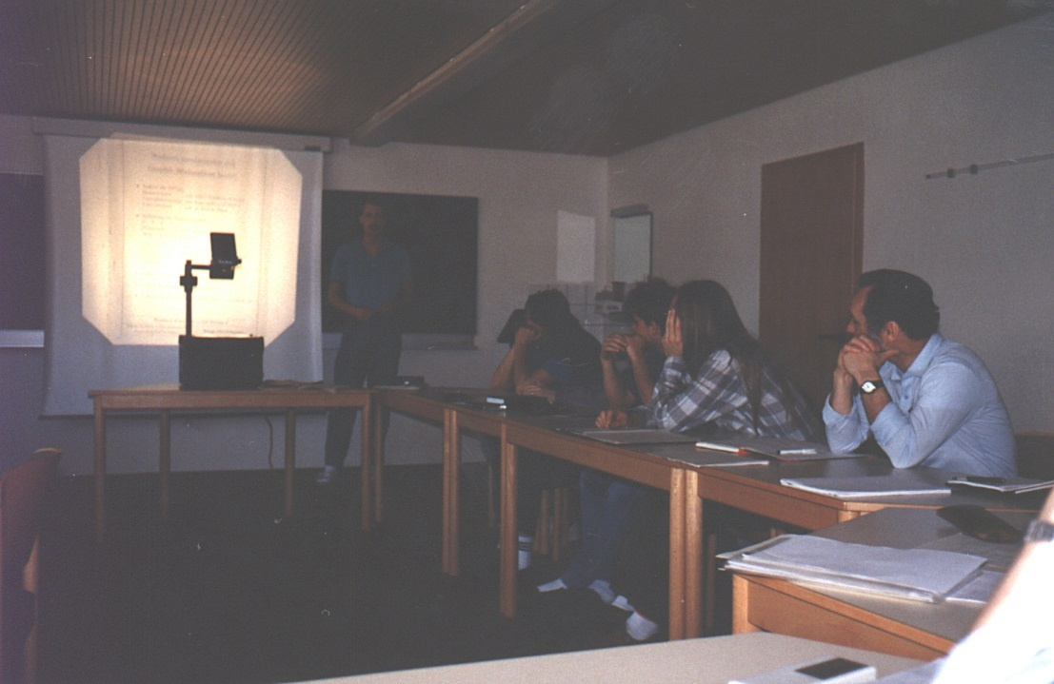
Geometric Modeling
Theory and Practice of Geometric Modeling, Blaubeuren,1988

Slide 10

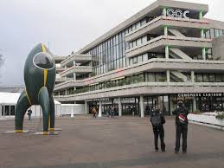
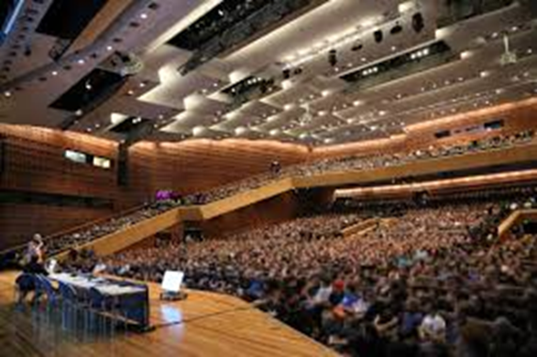
1989
Conference Chair, Eurographics‘89, Hamburg

Slide 11
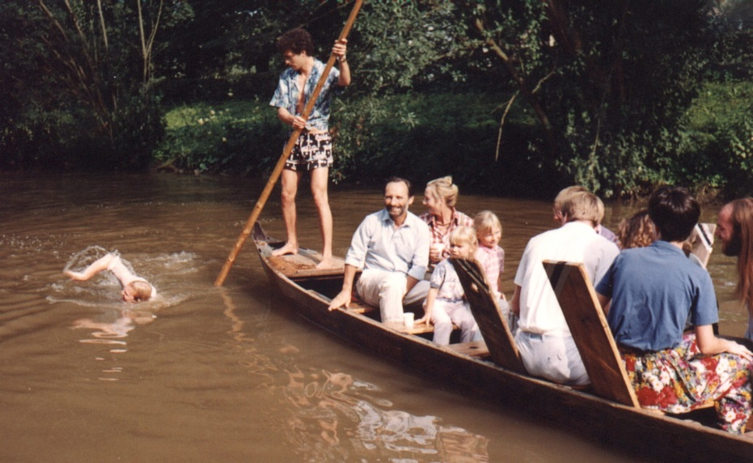
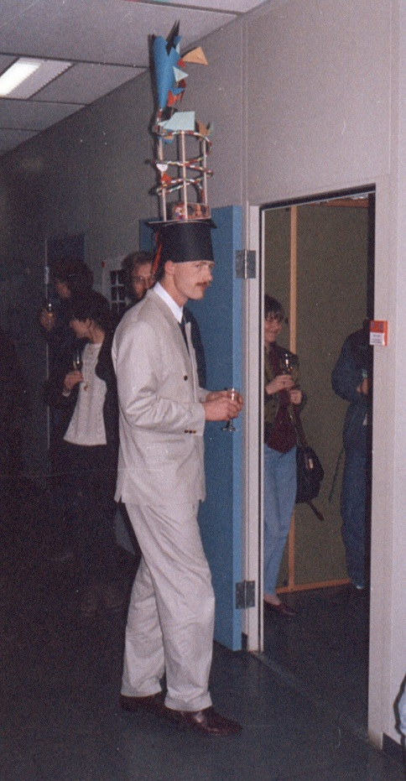
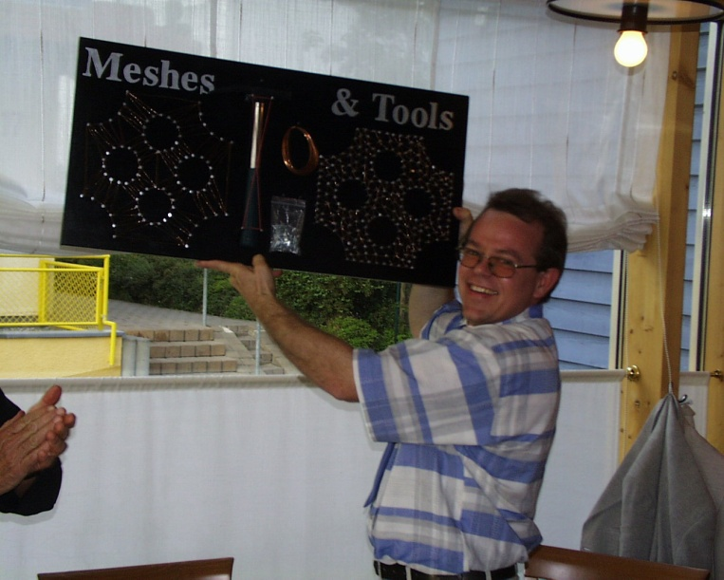
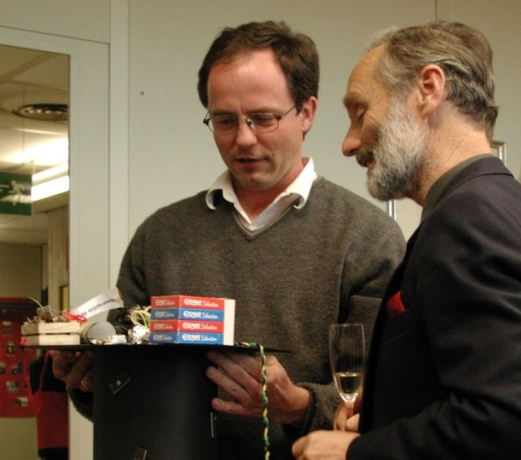
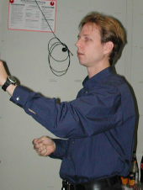
Identifying Young Talent

Slide 12
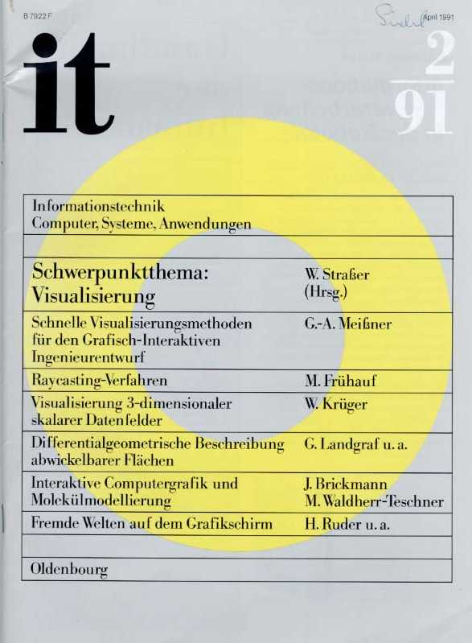

Slide 13
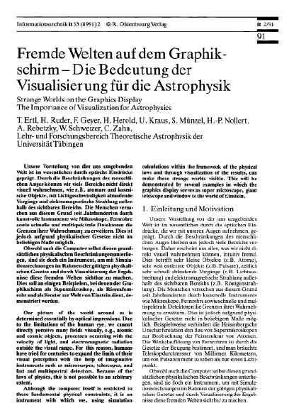

Slide 14
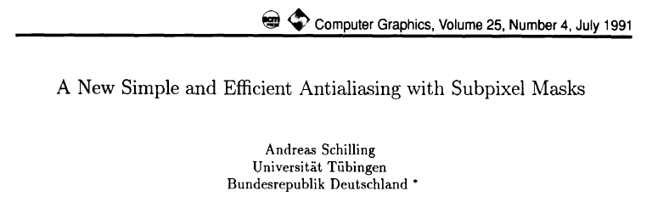
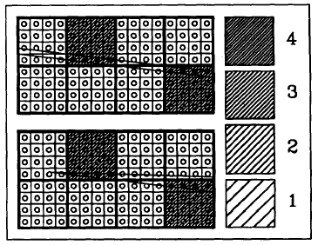
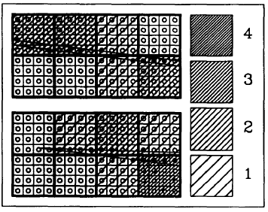
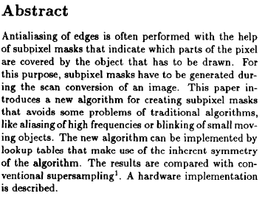
1991
A new simple and efficient antialiasing with subpixel masks,
ACM SIGGRAPH, 1991

Slide 15
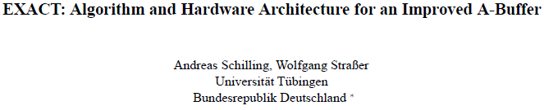
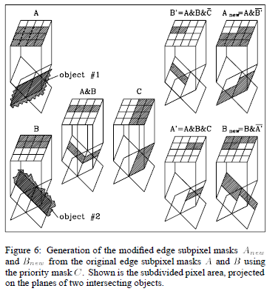
1993

Slide 16
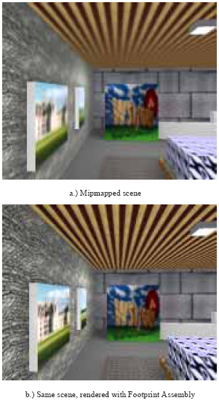
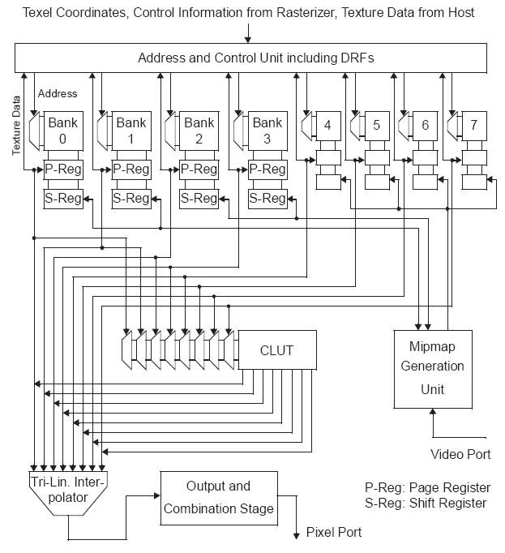
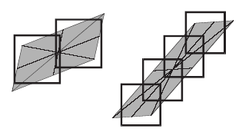
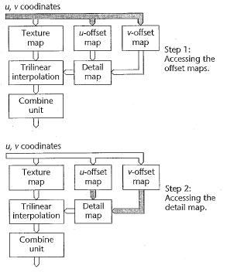
1996
Texram: A smart memory for texturing,
(footprint assembly, dependent texture lookups, etc.)
ACM SIGGRAPH, IEEE CG&A,1991

Slide 17
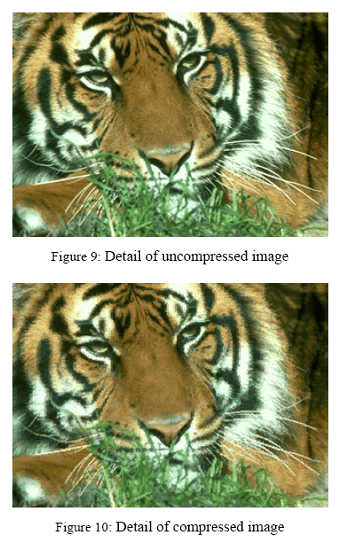
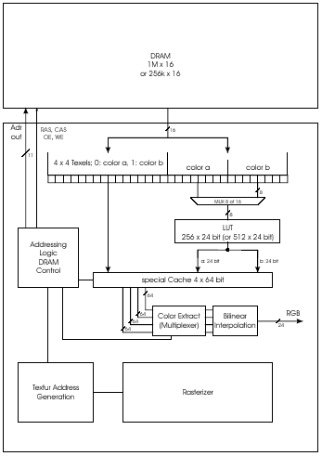
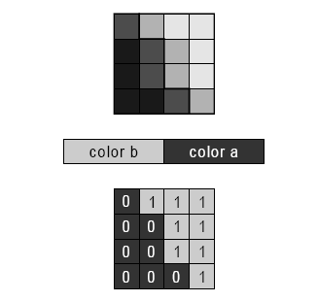
CCC: Texture Compression (→ S3TC)

Slide 18
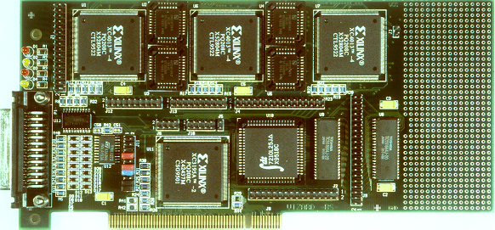
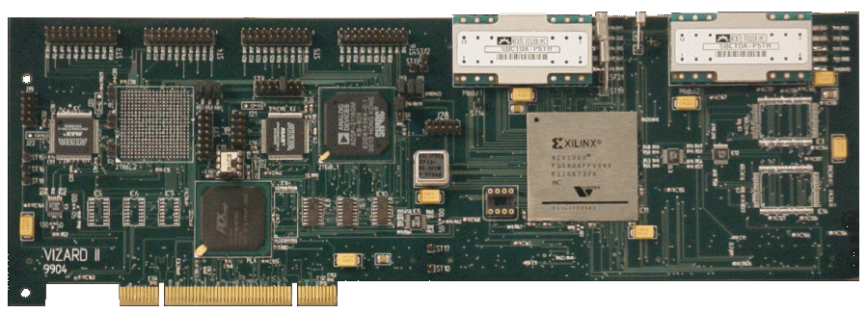
VIZARD
Vizard II board, manufactured by
Philips Medical Research, Hamburg

Slide 19
1996
Mesh Reduction with Error Control, IEEE Visualization, 1996

Slide 20
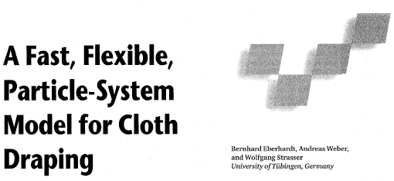
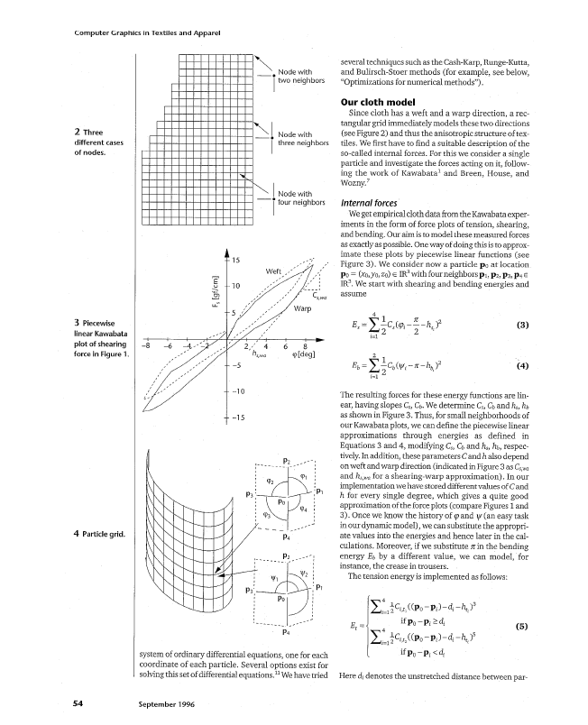
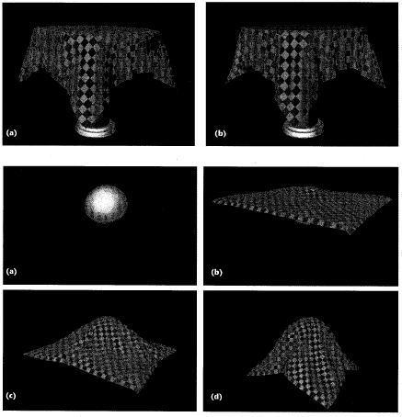
1996
A fast, flexible, particle-system model for cloth draping,
IEEE CG&A, 1996

Slide 21
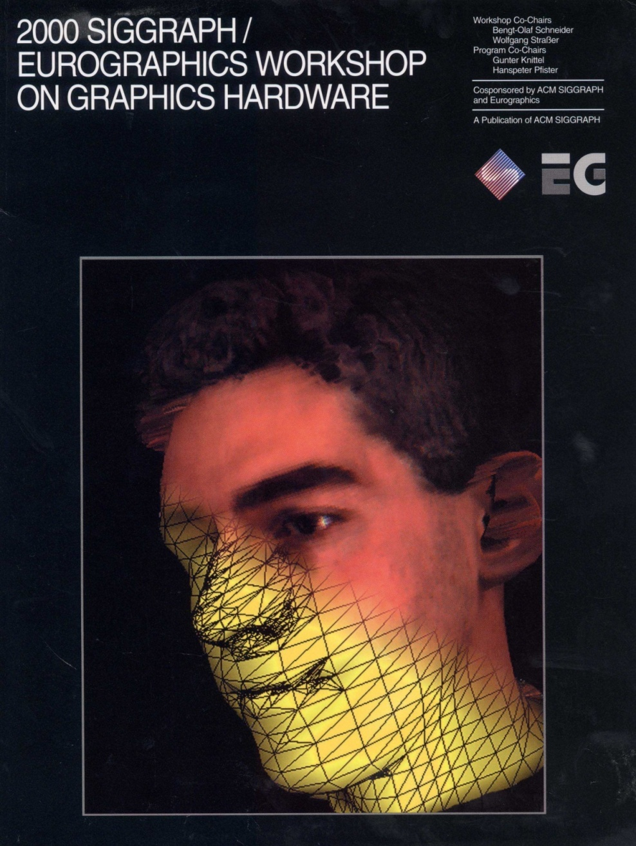
1997: Graphics Hardware moves West

Slide 22
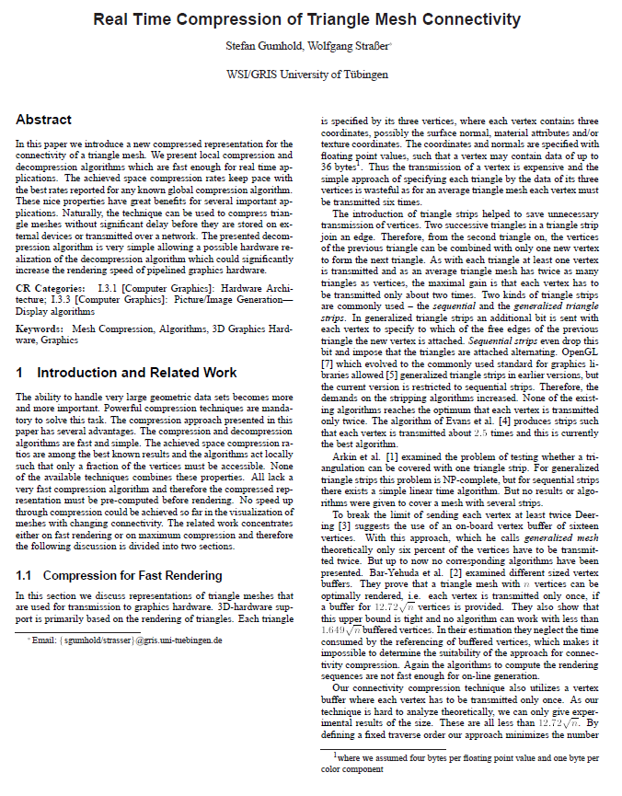
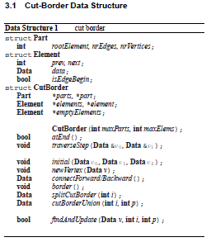
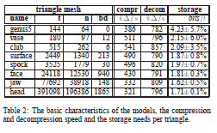

1998
Cut Border Machine, ACM SIGGRAPH 1998

Slide 23
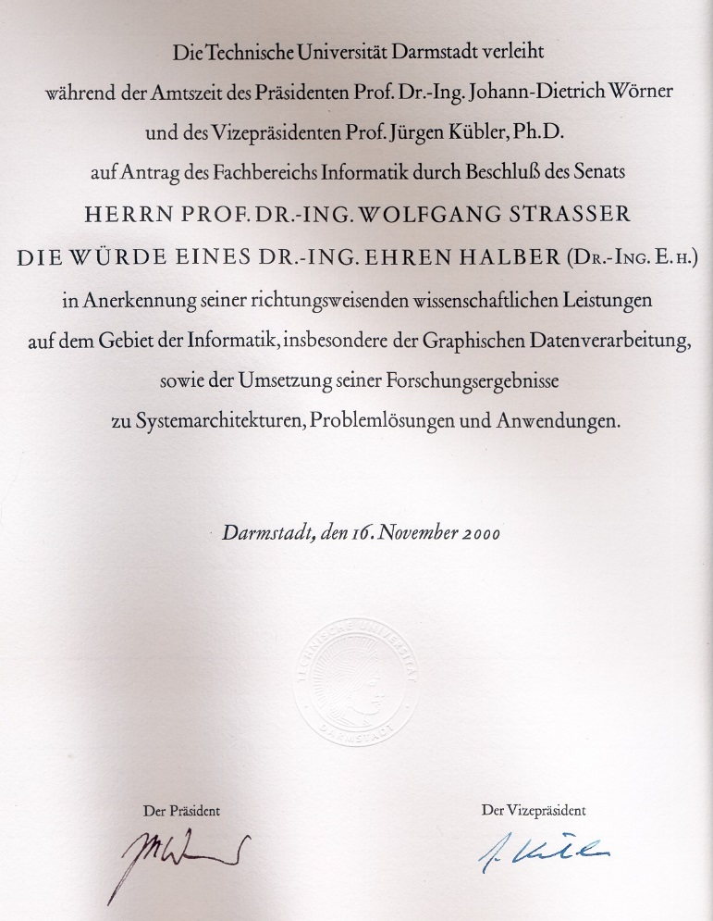
2000
Honorary PhD, TU Darmstadt, 2000

Slide 24
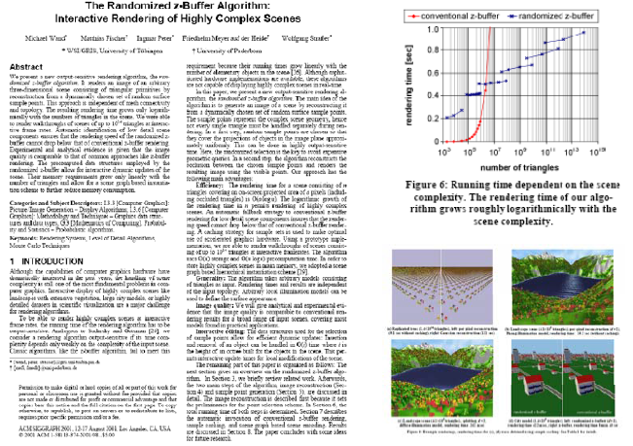
2001
The Randomized z-Buffer Algorithm, ACM SIGGRAPH, 2001

Slide 25



2002
Interactive rendering of large volume data sets,
IEEE Visualization 2002

Slide 26

2009: Graphics Hardware → HPG

Slide 27



HiGraphics

Slide 28


HiGraphics

Slide 29


HiGraphics

Slide 30

HiGraphics

Slide 31


HiGraphics

Slide 32

HiGraphics

Slide 33






Wolfgang Straßer: Beyond Graphics

Slide 34

2009: Retirement?

Slide 35


2009: Not Really !
Eurographics 2009, München

Slide 36


2009
Eurographics Honorary Fellowship

Slide 37

2013
Eurographics Fellows Meeting, EG’13, Girona, Spain

Slide 38

Ciao Wolfgang …

Slide 39
Ciao Wolfgang …
HPG dedicating its Best Paper Award to Wolfgang Strasser

Slide 40







Wolfgang Strasser: Forever Young
Thanks!

