Slide 1
Exploring And Expanding The Continuum of OIT Algorithms
Chris Wyman
High Performance Graphics 2016; June 20, 2016; Dublin, Ireland

Slide 2
What’s This Paper About?
NOT
^

Slide 3
What’s This Paper About?
NOT
^
Not a “survey paper,” at least in the traditional sense
You will not identify “the right” OIT algorithm for you

Slide 4
What’s This Paper About?
NOT
^
Not a “survey paper,” at least in the traditional sense
You will not identify “the right” OIT algorithm for you
Not an “algorithms paper,” at least in the traditional sense
Do present two new algorithms
Do not intend to claim these algorithms are right for you

Slide 5
What’s This Paper About?

Slide 6
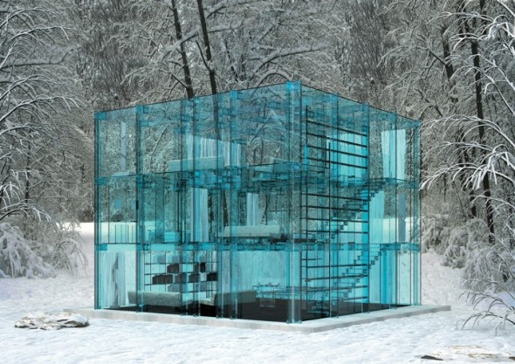
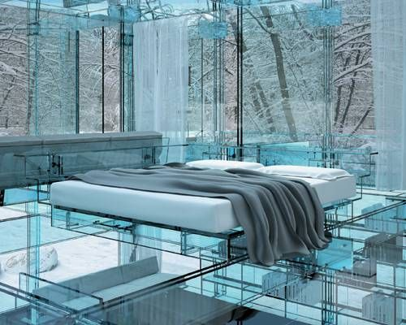
What’s This Paper About?
Story following my thoughts on order-independent transparency
Spurred by discussions w/developers
E.g., Johan Andersson’s SIGGRAPH 2015 talk

Slide 7
What’s This Paper About?
Story following my thoughts on order-independent transparency
Spurred by discussions w/developers
Started with re-exploration of space
Placed on multi-dimensional continuum

Slide 8
What’s This Paper About?
Story following my thoughts on order-independent transparency
Spurred by discussions w/developers
Started with re-exploration of space
Placed on multi-dimensional continuum
Develop algorithms exploring new spaces
Will talk about one today: Stochastic Layered Alpha Blending
Provides continuous transition between stochastic transparency & k-buffering
Stochastic
transparency
Continuous knob transitioning between these techniques
K-buffer variant

Slide 9
Why is OIT hard?

Slide 10
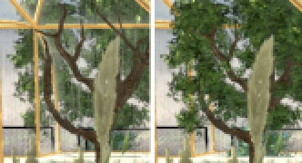
Why Bother at all?
[Porter and Duff 84] outlined numerous common compositing operations
The “over” operator, using multiplicative blending, describes most real interactions:
For streaming compute, you need to sort geometry or keep all α_{i} and c_{i} around
Merge two fragments then later try to insert one in between?
Incorrect Order
Correct Order

Slide 11
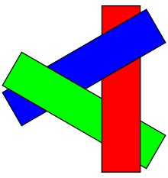
Why Bother at all?
Sorting geometry in advance can fail
May be no “correct” order for triangles
Keep a list of fragments per pixel (i.e., A-Buffers [Carpenter 84])
Virtually unbounded** GPU memory
Still need to sort fragments to apply over operator in correctly
Not just a raster problem; affects ray tracing, too
Unless it guarantees ray hits returned perfectly ordered
** You can define a very conservative upper bound, but it’s quite unhelpful.

Slide 12
Building an OIT continuum

Slide 13
How DO OIT algorithms work?
new triangle
fragment
contributes
to pixel?

Slide 14
How DO OIT algorithms work?
new triangle
fragment
contributes
to pixel?
Different answers, including:
Only if closest fragment [Depth peeling]
Closest & passes α-threshold [Alpha testing]
Randomly decide [Stochastic transparency]
Always use new fragments [Most algorithms]

Slide 15
How DO OIT algorithms work?
new triangle
fragment
contributes
to pixel?
yes
per-pixel
storage
format?
no

Slide 16
How DO OIT algorithms work?
new triangle
fragment
contributes
to pixel?
yes
per-pixel
storage
format?
no
Different answers, including:
Store 1 layer per pass [Depth peeling]
Store k layers [K-buffer, alpha blending (k=1), many other algorithms]
Store k samples [Stochastic transparency]
Store k nodes [Deep shadow maps]
Store k coefficients [Fourier opacity maps]

Slide 17
How DO OIT algorithms work?
new triangle
fragment
contributes
to pixel?
yes
per-pixel
storage
format?
combine k+1
items into storage
for only k?
no

Slide 18
How DO OIT algorithms work?
new triangle
fragment
contributes
to pixel?
yes
per-pixel
storage
format?
combine k+1
items into storage
for only k?
no
Different answers, including:
Discard furthest [Depth peeling, hybrid transparency]
Merge frags w / closest depth [Z³]
Merge 2 most distant frags [Multi-layer alpha blend]
Merge 2 most near frags [Original k-buffer]
Sum coefs in Fourier space [Fourier opacity maps]

Slide 19
How DO OIT algorithms work?
new triangle
fragment
contributes
to pixel?
yes
per-pixel
storage
format?
combine k+1
items into storage
for only k?
merged
done
no
discarded
what to do
with discarded
fragments?
Discarding introduces bias or noise

Slide 20
How DO OIT algorithms work?
new triangle
fragment
contributes
to pixel?
yes
per-pixel
storage
format?
combine k+1
items into storage
for only k?
merged
done
no
discarded
normalization
what to do
with discarded
fragments?
really discard it
Discarding introduces bias or noise
That’s OK; discard [Depth peeling, screen-door transparency]
Sum α-weighted contribs of discarded frags [Stochastic transparency, hybrid transparency, phenomenological models]

Slide 21
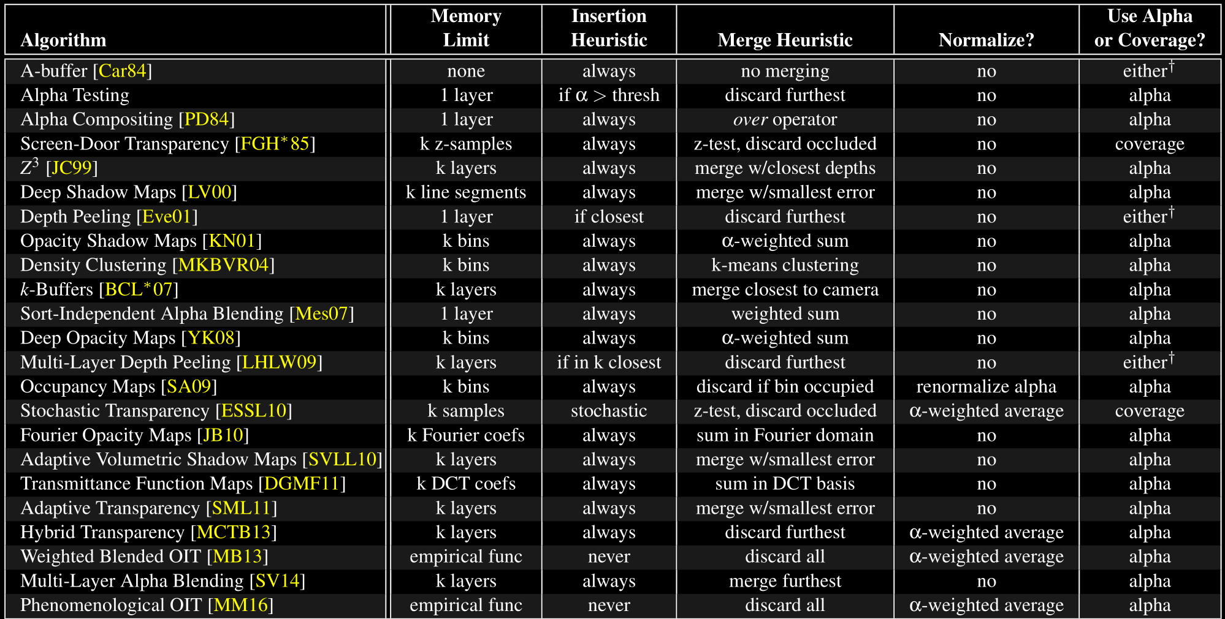
Continuum Summary

Slide 22
Continuum Summary
Notice: Normalization only occurs
when algorithms “discard” fragments

Slide 23
Continuum Summary
Notice: Normalization only occurs
when algorithms “discard” fragments
Normalization can be viewed as
“storing k+1 layers,” using α-weighted
merge on the furthest layer

Slide 24
So what? (Or: Let’s look at an example of how this is useful)

Slide 25
Continuum Summary
Interesting note

Slide 26
What Is Stochastic Transparency?
When rasterizing frag into k-sample buffer:
Stochastically cover α • k samples

Slide 27
What Is Stochastic Transparency?
When rasterizing frag into k-sample buffer:
Stochastically cover α • k samples
Let’s look at an example pixel with 16x MSAA
(MSAA pattern simplified for display)
Values represent current depth sample
1.0
1.0
1.0
1.0
1.0
1.0
1.0
1.0
1.0
1.0
1.0
1.0
1.0
1.0
1.0
1.0

Slide 28
What Is Stochastic Transparency?
When rasterizing frag into k-sample buffer:
Stochastically cover α • k samples
Let’s look at an example pixel with 16x MSAA
(MSAA pattern simplified for display)
First: draw red fragment, z = 0.5, α = 0.5
Values represent current depth sample
0.5
1.0
1.0
0.5
1.0
0.5
0.5
1.0
0.5
1.0
0.5
0.5
1.0
0.5
1.0
1.0
Set 8 samples to red; depth test each

Slide 29
What Is Stochastic Transparency?
When rasterizing frag into k-sample buffer:
Stochastically cover α • k samples
Let’s look at an example pixel with 16x MSAA
(MSAA pattern simplified for display)
First: draw red fragment, z = 0.5, α = 0.5
Second: draw blue fragment, z = 0.7, α = 0.5
Values represent current depth sample
0.5
1.0
0.7
0.5
0.7
0.5
0.5
0.7
0.5
0.7
0.5
0.5
1.0
0.5
0.7
1.0
Set 8 samples to blue; depth test each

Slide 30
What Is Stochastic Transparency?
When rasterizing frag into k-sample buffer:
Stochastically cover α • k samples
Let’s look at an example pixel with 16x MSAA
(MSAA pattern simplified for display)
First: draw red fragment, z = 0.5, α = 0.5
Second: draw blue fragment, z = 0.7, α = 0.5
Third: draw green fragment, z = 0.3, α = 0.5
Values represent current depth sample
0.5
0.3
0.7
0.3
0.7
0.5
0.5
0.3
0.5
0.3
0.3
0.5
0.3
0.3
0.7
0.3
Set 8 samples to green; depth test each

Slide 31
What Is Stochastic Transparency?
When rasterizing frag into k-sample buffer:
Stochastically cover α • k samples
Let’s look at an example pixel with 16x MSAA
(MSAA pattern simplified for display)
First: draw red fragment, z = 0.5, α = 0.5
Second: draw blue fragment, z = 0.7, α = 0.5
Third: draw green fragment, z = 0.3, α = 0.5
Fourth: draw yellow fragment, z = 0.9, α = 1.0
Values represent current depth sample
0.5
0.3
0.7
0.3
0.7
0.5
0.5
0.3
0.5
0.3
0.3
0.5
0.3
0.3
0.7
0.3
Set 16 samples to yellow; depth test each

Slide 32
What Is Stochastic Transparency?
When rasterizing frag into k-sample buffer:
Stochastically cover α • k samples
Let’s look at an example pixel with 16x MSAA
(MSAA pattern simplified for display)
First: draw red fragment, z = 0.5, α = 0.5
Second: draw blue fragment, z = 0.7, α = 0.5
Third: draw green fragment, z = 0.3, α = 0.5
Fourth: draw yellow fragment, z = 0.9, α = 1.0
2nd pass accum. color using this as depth oracle
Values represent current depth sample
0.5
0.3
0.7
0.3
0.7
0.5
0.5
0.3
0.5
0.3
0.3
0.5
0.3
0.3
0.7
0.3

Slide 33
Observations
Can lose surfaces (like yellow one)
But it still converges; surface loss is stochastic
0.5
0.3
0.7
0.3
0.7
0.5
0.5
0.3
0.5
0.3
0.3
0.5
0.3
0.3
0.7
0.3

Slide 34
Observations
Can lose surfaces (like yellow one)
But it still converges; surface loss is stochastic
Loss worse if nearby surfaces almost opaque
Could easily lose blue surface
0.5
0.3
0.7
0.3
0.7
0.5
0.5
0.3
0.5
0.3
0.3
0.5
0.3
0.3
0.7
0.3

Slide 35
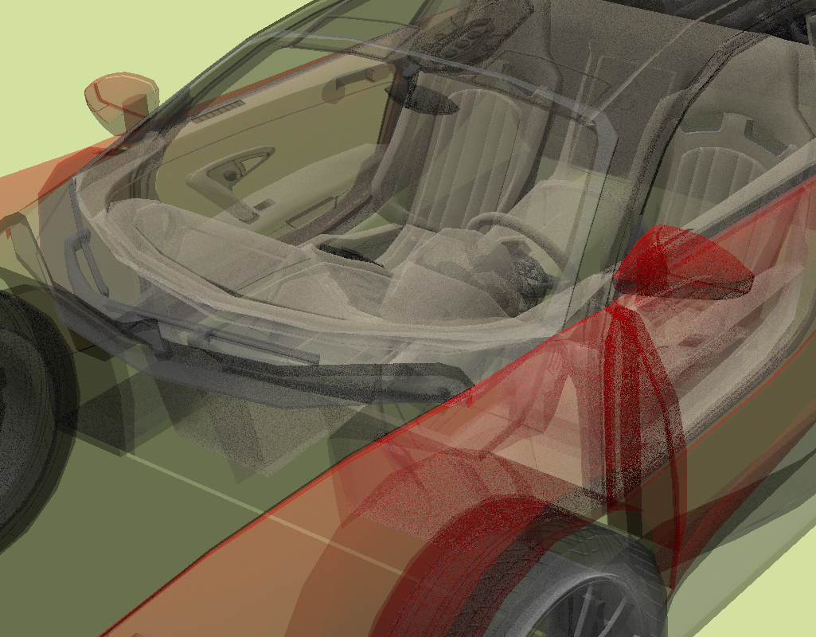
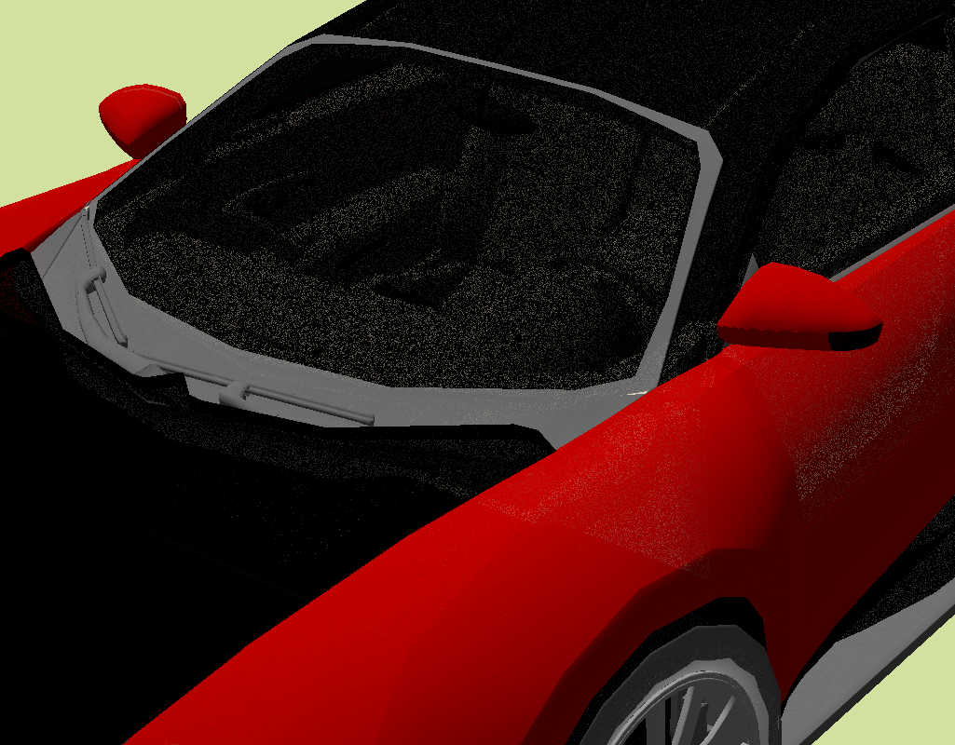
Observations
α = 0.4, 8 spp
Can lose surfaces (like yellow one)
But it still converges; surface loss is stochastic
Loss worse if nearby surfaces almost opaque
Could easily lose blue surface
Also noticed in my experiments
Dashboard and seat noisier with high alpha than low!
α = 0.98, 8 spp
Note: Even uses stratified sampling!

Slide 36
Observations
Can lose surfaces (like yellow one)
But it still converges; surface loss is stochastic
Loss worse if nearby surfaces almost opaque
Could easily lose blue surface
Also noticed in my experiments
Dashboard and seat noisier with high alpha than low!
Seems wasteful to store 8 copies of z = 0.3 **
Why not store one copy of z = 0.3 and a coverage mask?
0.5
0.3
0.7
0.3
0.7
0.5
0.5
0.3
0.5
0.3
0.3
0.5
0.3
0.3
0.7
0.3
** Glossing over some details here; feel free to ask later.

Slide 37
Observations
Can lose surfaces (like yellow one)
But it still converges; surface loss is stochastic
Loss worse if nearby surfaces almost opaque
Could easily lose blue surface
Also noticed in my experiments
Dashboard and seat noisier with high alpha than low!
Seems wasteful to store 8 copies of z = 0.3 **
Why not store one copy of z = 0.3 and a coverage mask?
Implicitly layered − stores (up to) 16 surfaces per pixel (for 16x MSAA)
Also wasteful to store just 3 layers in a structure that can hold 16
0.5
0.3
0.7
0.3
0.7
0.5
0.5
0.3
0.5
0.3
0.3
0.5
0.3
0.3
0.7
0.3

Slide 38
Stochastic Layered Alpha Blending (SLAB)

Slide 39
What Is STOCHASTIC LAYERED ALPHA BLEND?
An explicit k-layered algorithm with stoc. transparency’s characteristics

Slide 40
What Is STOCHASTIC LAYERED ALPHA BLEND?
An explicit k-layered algorithm with stoc. transparency’s characteristics
Memory: store k layers, each with depth and b-bit coverage mask
Insertion: probabilistically insert fragments into per-pixel lists
Merging: if > k layers, simply discard the furthest

Slide 41
What Is STOCHASTIC LAYERED ALPHA BLEND?
An explicit k-layered algorithm with stoc. transparency’s characteristics
Memory: store k layers, each with depth and b-bit coverage mask
Insertion: probabilistically insert fragments into per-pixel lists
Merging: if > k layers, simply discard the furthest
Identical results to k spp stoc. transparency, if k ≥ b
But can independently change values of k and b

Slide 42
What Is STOCHASTIC LAYERED ALPHA BLEND?
An explicit k-layered algorithm with stoc. transparency’s characteristics
Memory: store k layers, each with depth and b-bit coverage mask
Insertion: probabilistically insert fragments into per-pixel lists
Merging: if > k layers, simply discard the furthest
Identical results to k spp stoc. transparency, if k ≥ b
But can independently change values of k and b
Useful since stoc. transp. rarely stores k surfaces in a k-sample buffer
Also can explicitly increase b much further → reduce noise on existing layers

Slide 43
What Is STOCHASTIC LAYERED ALPHA BLEND?
Coverage Mask
Depth
Our same example from before:
First: draw red fragment, z = 0.5, α = 0.5
0.5
Layers

Slide 44
What Is STOCHASTIC LAYERED ALPHA BLEND?
Coverage Mask
Depth
Our same example from before:
First: draw red fragment, z = 0.5, α = 0.5
Second: draw blue fragment, z = 0.7, α = 0.5
0.5
0.7
Layers

Slide 45
What Is STOCHASTIC LAYERED ALPHA BLEND?
Coverage Mask
Depth
Our same example from before:
First: draw red fragment, z = 0.5, α = 0.5
Second: draw blue fragment, z = 0.7, α = 0.5
Third: draw green fragment, z = 0.3, α = 0.5
0.3
0.5
Layers
0.7

Slide 46
What Is STOCHASTIC LAYERED ALPHA BLEND?
Coverage Mask
Depth
Our same example from before:
First: draw red fragment, z = 0.5, α = 0.5
Second: draw blue fragment, z = 0.7, α = 0.5
Third: draw green fragment, z = 0.3, α = 0.5
Fourth: draw yellow fragment, z = 0.9, α = 1.0
0.3
0.5
Layers
0.7
0.9

Slide 47
What Is STOCHASTIC LAYERED ALPHA BLEND?
Coverage Mask
Depth
Our same example from before:
First: draw red fragment, z = 0.5, α = 0.5
Second: draw blue fragment, z = 0.7, α = 0.5
Third: draw green fragment, z = 0.3, α = 0.5
Fourth: draw yellow fragment, z = 0.9, α = 1.0
Layers get inserted only if not occluded
Adds stochasm, if masks randomly chosen
Different random masks might keep this layer
0.3
0.5
Layers
0.7
0.9
occluded by closer surfaces

Slide 48
What Is STOCHASTIC LAYERED ALPHA BLEND?
Coverage Mask
Depth
Our same example from before:
First: draw red fragment, z = 0.5, α = 0.5
Second: draw blue fragment, z = 0.7, α = 0.5
Third: draw green fragment, z = 0.3, α = 0.5
Fourth: draw yellow fragment, z = 0.9, α = 1.0
Layers get inserted only if not occluded
Adds stochasm, if masks randomly chosen
Different random masks might keep this layer
If k = 2, layers beyond 2nd get discarded
0.3
0.5
Layers
0.7
not in 2 closest layers
0.9

Slide 49
Adjusting Parameters
Coverage Mask
Depth
Aim to reduce noise
One way: avoid discarding layers that impact color
0.3
0.5
Layers
0.7
0.9

Slide 50
Adjusting Parameters
Coverage Mask
Depth
Aim to reduce noise
One way: avoid discarding layers that impact color
How to increase chance to store yellow frag?
0.3
0.5
Layers
0.7
0.9

Slide 51
Adjusting Parameters
Coverage Mask
Depth
Aim to reduce noise
One way: avoid discarding layers that impact color
How to increase chance to store yellow frag?
Increase number of bits in coverage mask
0.3
0.5
Layers
0.7
0.9

Slide 52
Adjusting Parameters
Coverage Mask
Depth
Aim to reduce noise
One way: avoid discarding layers that impact color
How to increase chance to store yellow frag?
Increase number of bits in coverage mask
Larger coverage masks → lower noise
What happens as # coverage bits increases?
0.3
0.5
Layers
0.7
0.9

Slide 53
Adjusting Parameters
Coverage Mask
Depth
Aim to reduce noise
One way: avoid discarding layers that impact color
How to increase chance to store yellow frag?
Increase number of bits in coverage mask
Larger coverage masks → lower noise
What happens as # coverage bits increases?
Starts to behave as alpha
Interesting to ask:
Can we stochastically insert fragments using alpha?
0.3
0.5
Layers
0.7
0.9

Slide 54
SLAB using IMPLICIT COVERAGE
Let’s compute an insertion probability
Q: What’s the chance random bitmask B is visible behind random bitmask A?
Bitmask A
Bitmask B₀
Bitmask B₁
Visible
Hidden

Slide 55
SLAB using IMPLICIT COVERAGE
Let’s compute an insertion probability
Q: What’s the chance random bitmask B is visible behind random bitmask A?
Bitmask A
Bitmask B₀
Hidden if none of these get
covered by bits in bitmask B

Slide 56
SLAB using IMPLICIT COVERAGE
Let’s compute an insertion probability
Q: What’s the chance random bitmask B is visible behind random bitmask A?
Bitmask A
Bitmask B₀
Naïve random sampling:
Covered with probability α_{B}
Uncovered with prob (1 – α_{B})

Slide 57
SLAB using IMPLICIT COVERAGE
Let’s compute an insertion probability
Q: What’s the chance random bitmask B is visible behind random bitmask A?
Bitmask A
Bitmask B₀
Naïve random sampling:
Covered with probability α_{B}
Uncovered with prob (1 – α_{B})
All uncovered with prob: (1–α_{B})⁶
Bitmask B visible with prob: 1-(1–α_{B})⁶

Slide 58
SLAB using IMPLICIT COVERAGE
Let’s compute an insertion probability
Q: What’s the chance random bitmask B is visible behind random bitmask A?
$$P_{b}\left(β_{A},β_{B}\right)=1−{ \left(1−\frac{β_{B}}{b}\right)}^{(b−β_{A})}$$
Or
$$P_{b}\left(β_{A},α_{B}\right)=1−{ \left(1−α_{B}\right)}^{(b−β_{A})}$$
Bitmask A
$βA$≡ # bits covered
$βA$= $\left\lfloor αAb\right\rfloor$ or $\left\lceil αAb\right\rceil$
for b bits in bitmask

Slide 59
SLAB using IMPLICIT COVERAGE
Let’s compute an insertion probability
Q: What’s the chance random bitmask B is visible behind random bitmask A?
$$P_{b}\left(β_{A},β_{B}\right)=1−{ \left(1−\frac{β_{B}}{b}\right)}^{(b−β_{A})}$$
Or
$$P_{b}\left(β_{A},α_{B}\right)=1−{ \left(1−α_{B}\right)}^{(b−β_{A})}$$
Bitmask A
$βA$≡ # bits covered
prob of leaving
1 bit uncovered
number of bits that
must be uncovered
$βA$= $\left\lfloor αAb\right\rfloor$ or $\left\lceil αAb\right\rceil$
for b bits in bitmask

Slide 60
SLAB using IMPLICIT COVERAGE
Let’s compute an insertion probability
Q: How about for random masks using stratified samples?
$P_{b}\left(β_{A},β_{B}\right)=\left\{\begin{aligned}1−\frac{β_{A}!\left(b−β_{B}\right)!}{b!\left(β_{A}−β_{B}\right)!} if β_{B}≤β_{A} \\ 1 if β_{B}>β_{A}\end{aligned}\right.$
Bitmask A
$βA$≡ # bits covered
Based on combinatorics
Choosing dependent probabilities so all mask bits in B are covered by A

Slide 61
Wait! Not using INFINITE # Bits?
Both equations require a number of bits b in the coverage mask
$P_{b}\left(β_{A},β_{B}\right)=\left\{\begin{aligned}1−\frac{β_{A}!\left(b−β_{B}\right)!}{b!\left(β_{A}−β_{B}\right)!} if β_{B}≤β_{A} \\ 1 if β_{B}>β_{A}\end{aligned}\right.$ using stratified random samples
$P_{b}\left(β_{A},β_{B}\right)=1−{ \left(1−\frac{β_{B}}{b}\right)}^{(b−β_{A})}$ using naïve random samples

Slide 62
Wait! Not using INFINITE # Bits?
Both equations require a number of bits b in the coverage mask
Can ask what happens to P_{b} as b →$∞$
Turns out as b →$∞$, P_{b} → 1
Instead of stochastic insertion of fragments, they’re always inserted
$P_{b}\left(β_{A},β_{B}\right)=\left\{\begin{aligned}1−\frac{β_{A}!\left(b−β_{B}\right)!}{b!\left(β_{A}−β_{B}\right)!} if β_{B}≤β_{A} \\ 1 if β_{B}>β_{A}\end{aligned}\right.$ using stratified random samples
$P_{b}\left(β_{A},β_{B}\right)=1−{ \left(1−\frac{β_{B}}{b}\right)}^{(b−β_{A})}$ using naïve random samples

Slide 63
Wait! Not using INFINITE # Bits?
Both equations require a number of bits b in the coverage mask
Can ask what happens to P_{b} as b →$∞$
Turns out as b →$∞$, P_{b} → 1
Instead of stochastic insertion of fragments, they’re always inserted
Going back to our continuum
When b = k, SLAB is equivalent to stochastic transparency
When b →$∞$, SLAB is equivalent to hybrid transparency (a variant of k-buffer)

Slide 64
Wait! Not using INFINITE # Bits?
To get something between k-buffers and stoc. transp.
Need to use k ≤ b < $∞$

Slide 65
Wait! Not using INFINITE # Bits?
To get something between k-buffers and stoc. transp.
Need to use k ≤ b < $∞$
Can do this with an explicit coverage mask with b random bits
Using deterministic insertion based on random coverage masks

Slide 66
Wait! Not using INFINITE # Bits?
To get something between k-buffers and stoc. transp.
Need to use k ≤ b < $∞$
Can do this with an explicit coverage mask with b random bits
Using deterministic insertion based on random coverage masks
Can do this with an implicit coverage (i.e., alpha) using b virtual bits
Using stochastic insertion using probability functions
b only controls distance along the k-buffer ↔ stoc transp continuum

Slide 67
Let’s demonstrate

Slide 68
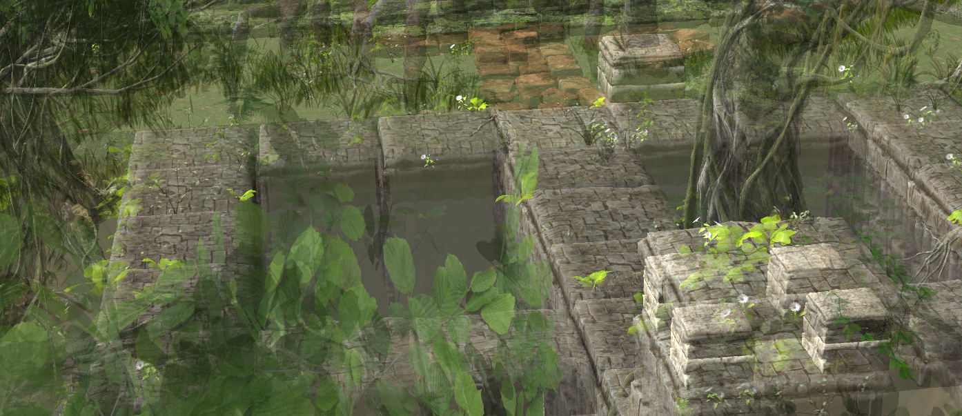
Foliage Map
(From Epic’s Unreal SDK)
All surfaces α = 0.5

Slide 69
Foliage Map
(From Epic’s Unreal SDK)
All surfaces α = 0.5
Stoc transp, 8 spp SLAB, k = b = 8 SLAB, k = 8, b = 32 SLAB, k = 8, b = 128 SLAB, k = 8, b = 32 Hybrid Transparency
using alpha

Slide 70
Foliage Map
(From Epic’s Unreal SDK)
All surfaces α = 0.5
Stoc transp, 8 spp SLAB, k = b = 8 SLAB, k = 8, b = 32 SLAB, k = 8, b = 128 SLAB, k = 8, b = 32 Hybrid Transparency
using alpha

Slide 71
Foliage Map
(From Epic’s Unreal SDK)
All surfaces α = 0.5
Stoc transp, 8 spp SLAB, k = b = 8 SLAB, k = 8, b = 32 SLAB, k = 8, b = 128 SLAB, k = 8, b = 32 Hybrid Transparency
using alpha

Slide 72
Stochastic Transparency to k-Buffers
Stochastic Layered Alpha Blending, k=b=4
Stochastic Transparency, 4 spp

Slide 73
Stochastic Transparency to k-Buffers
Stochastic Layered Alpha Blending, k=4, b=32
Stochastic Transparency, 4 spp

Slide 74
Stochastic Transparency to k-Buffers
Stochastic Layered Alpha Blending, k=4, b=8
(using alpha rather than coverage)
Stochastic Transparency, 4 spp

Slide 75
Stochastic Transparency to k-Buffers
Stochastic Layered Alpha Blending, k=4, b=32
(using alpha rather than coverage)
Hybrid Transparency, 4 layers

Slide 76
Summary

Slide 77
Summary
Introduced an OIT continuum
More detailed discussion in the paper
My key takeaways
All OIT algorithms limit memory by using k “layers” (k=0,1,4,8,32 common)
Biggest difference is merge heuristic
Some algorithm do renormalization; just a fancy merge heuristic
Insertion via stochastic processes is underexplored
Algorithms using coverage masks are underexplored

Slide 78
Summary
Proposed two new algorithms
Stochastic layered alpha blending (SLAB)
Multi-layer coverage blending (MLCB)
Not discussed today, see paper for details
Explored combining OIT + MSAA sampling

Slide 79
Summary
Proposed two new algorithms
Stochastic layered alpha blending (SLAB)
Key takeaways:
K-buffers need not be deterministic
Stochastic transparency and k-buffering are similar; transition via bit count
“Stochastic” need not mean random bitmask generation
Algorithms connecting others useful; here, allow trading noise for bias
SLAB with alpha values can stratify samples in z (between layers)
(Not really discussed in this talk)

Slide 80
Questions?
E-mail: cwyman@nvidia.com, Twitter: _cwyman_
Blacksmith building, from Unity’s “The Blacksmith” demo
Stochastic
transparency
4 spp
SLAB
k = 4, b = 4
SLAB
k = 4, b = 16
using alpha
Hybrid
transparency
4 layers
Multi-layer
alpha blending
4 layers
Ground truth
(A-buffer)
8x MSAA,
alpha-to-coverage

