Slide 1
Comparison of Projection Methods for Rendering Virtual Reality
Robert Toth, Jim Nilsson, Tomas Akenine-Möller
Intel Corporation
Notes:
My name is Robert. I’m going to present the main findings from the paper Comparison of Projection Methods for Rendering Virtual Reality, by Jim Nilsson, Tomas Akenine-Möller and myself, and what it means for you, the audience.

Slide 2
Virtual Reality
Notes:
I assume you all know what virtual reality is, and have used or at least seen some of the new head mounted displays.

Slide 3
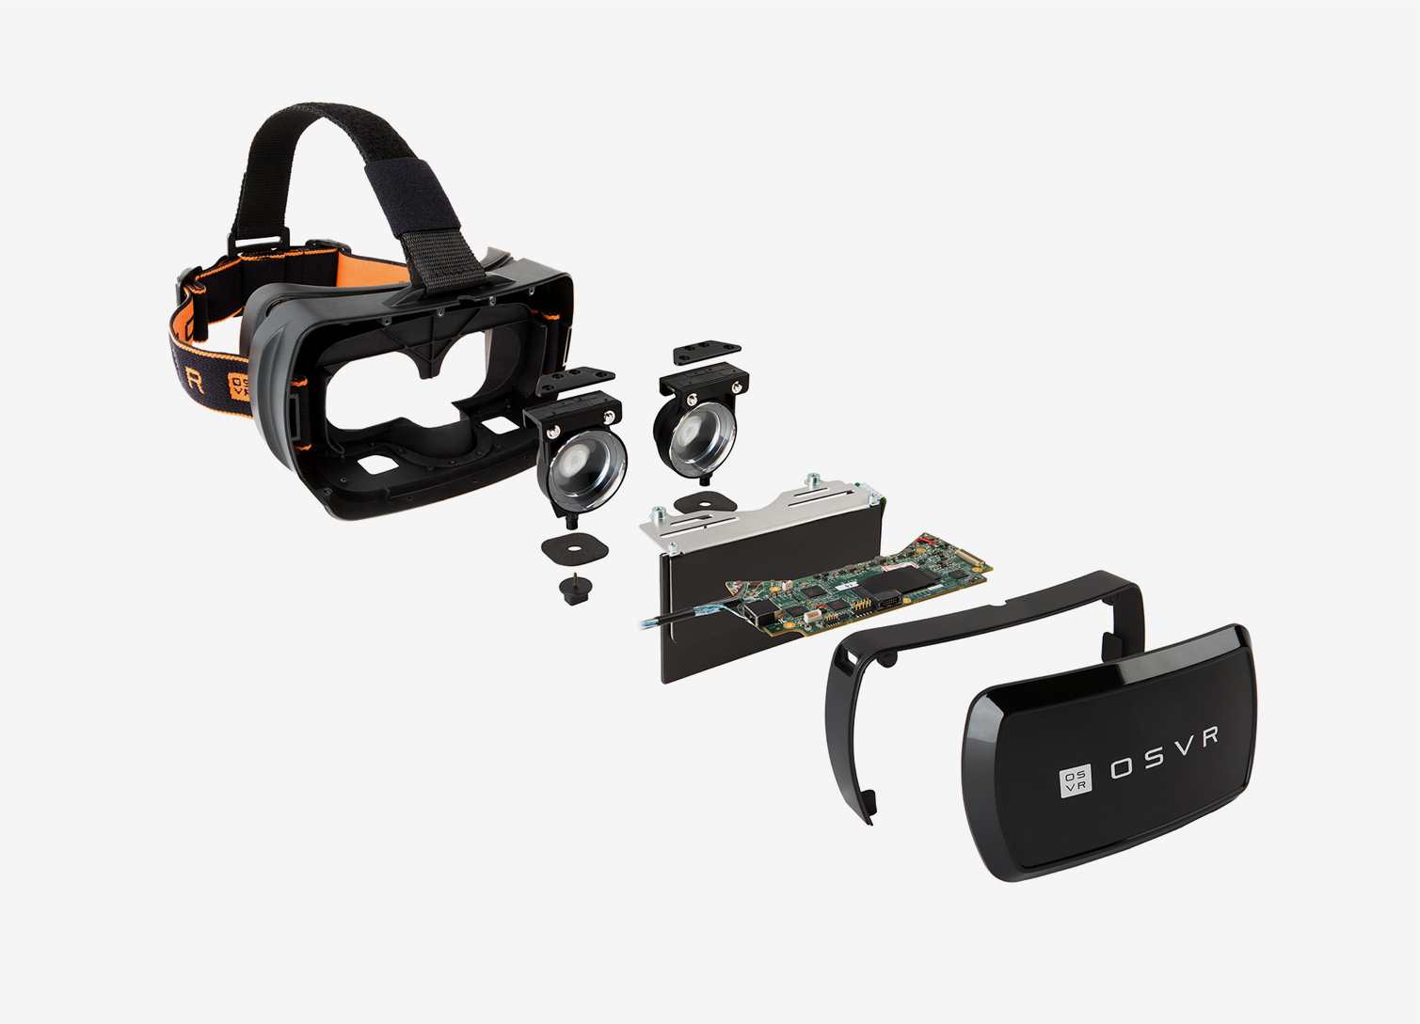
Head mounted display
Lenses
Display
Image from http://www.osvr.org/hardware.html
Notes:
This is an OSVR head mounted display. In a nutshell, an HMD is a ski mask in which you look at a display through a pair of lenses.

Slide 4
Lens distortion
Notes:
This is a lens from an Oculus DK2. Lenses in modern HMDs serve two purposes: First, it allows you to focus on the display that’s only two inches away. Second, it improves the apparent pixel distribution, with a pincushion distortion that evens out PPD to some extent compared to just a flat image.

Slide 5
Lens distortion
Even PPI
Uneven PPI
Even PPI
(pixels per inch)
Lens
Uneven PPD
Even PPD
Even PPD
(pixels per degree)
Notes:
If you look at a display with equally sized pixels, perspective foreshortening and the incident viewing angle make pixels in the periphery appear much more densely. This means you get lower angular resolution straight ahead.
If you want an even angular resolution, the pixels would need to be unevenly sized, which wouldn’t make manufacturers happy.
I’m vastly oversimplifying lens design here, but in effect the lenses in HMDs improve the apparent angular distribution of the uniform display grid.

Slide 6
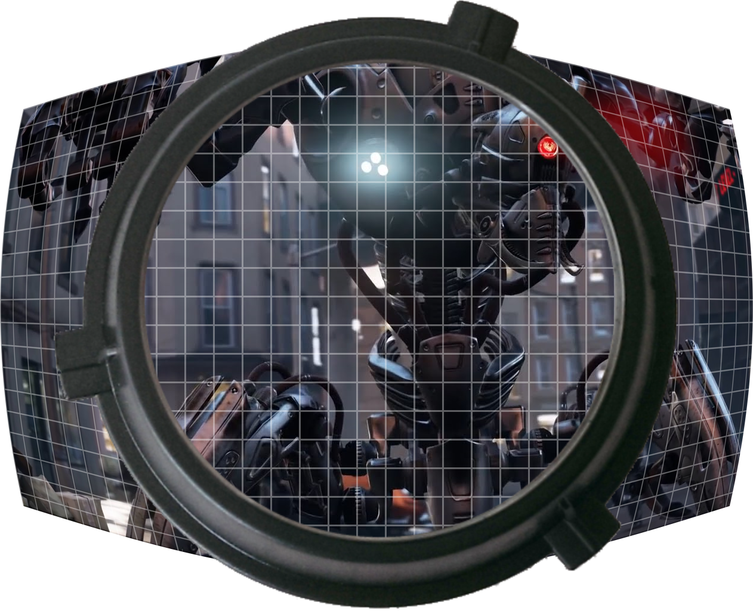
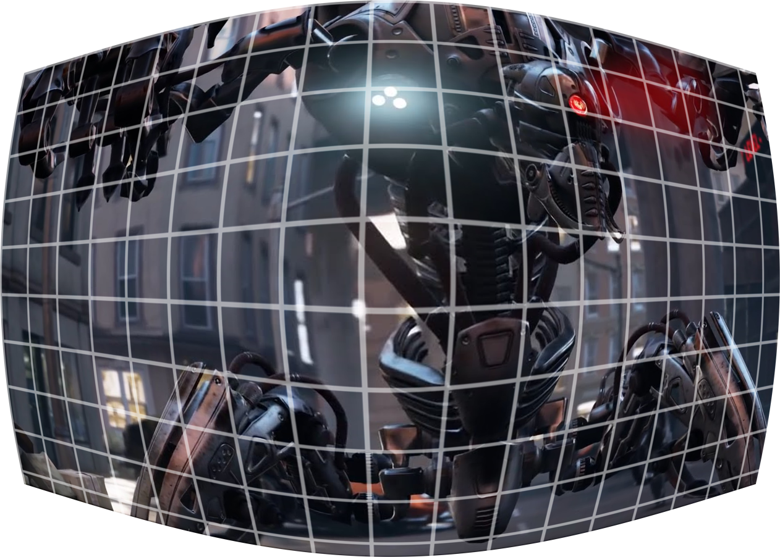
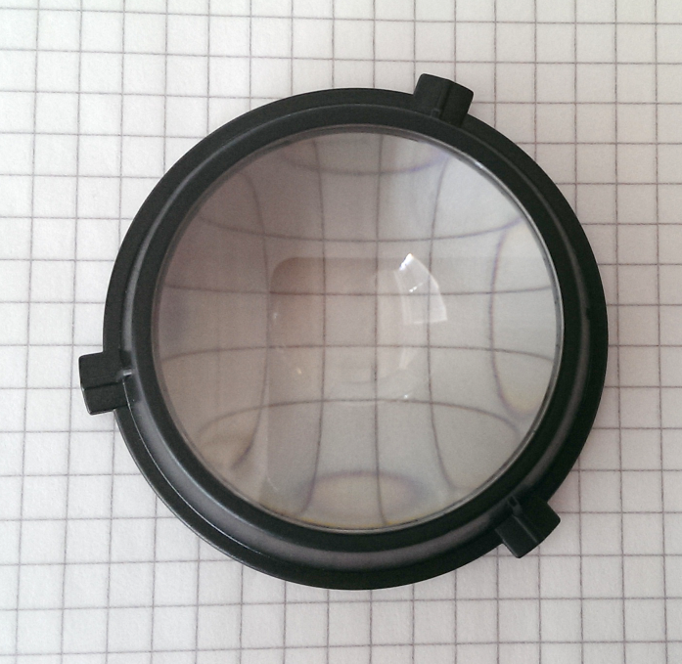
Lens distortion
Notes:
Since the lens has a pincushion distortion, we need to render a barrel distorted image to compensate so that it looks right when viewed through the lens.

Slide 7
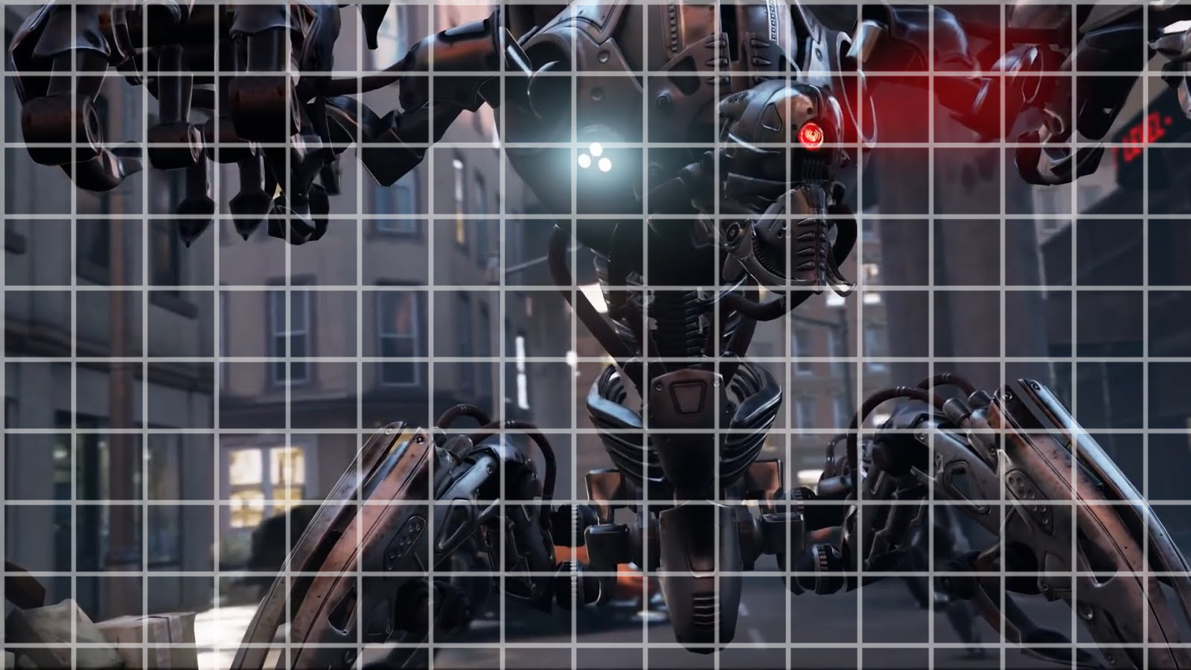
Lens distortion
Notes:
The typical way of doing that is to render a planar projection, and then resampling it in a shader.
There are other ways of doing it but most other methods have one serious flaw or another.

Slide 8
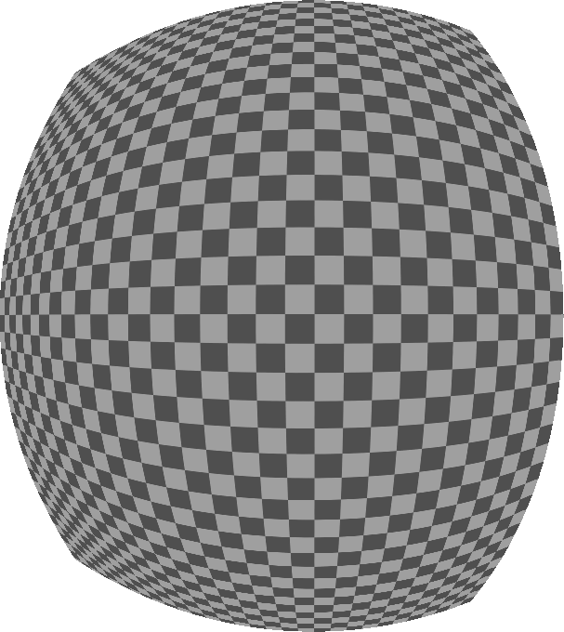
Issue
Density mismatch!
Notes:
The image to the right shows a checkerboard distorted for display on an Oculus DK1. As you can see, the resampling has highly varying density. That is, the squares in the periphery are much smaller than those in the middle. So you need to render the source image at really high density in the periphery to get decent quality at the center. This is what we wanted to address.

Slide 9
Insight
Notes:
We came to the conclusion that one should render to multiple projection planes, which provides superior control over the angular pixel distribution.

Slide 10
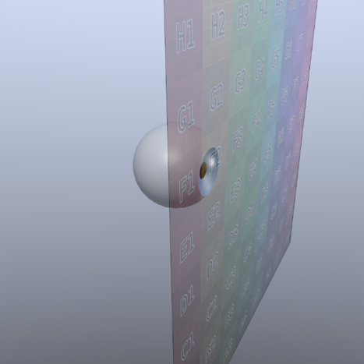
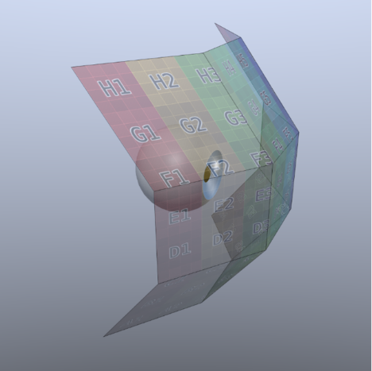
Insight
Notes:
As you can see here, the resampling density is much more even when each of these sub-projections is adjusted with the subsequent distortion in mind. You can see that on the checkerboards to the right, where all the squares are rather similar in size.

Slide 11
Prior methods
Notes:
We’re not the first to render multiple sub-projections. Greene and Heckbert rendered partial cube maps and resampled them for a special cinema projector in 1986. Much more recently, NVIDIA’s Multi Resolution Shading splits the projection plane into nine co-planar pieces with individually determined resolution.

Slide 12
Proposed class of projection sets
Notes:
We propose using a grid of connected projection planes, which gives a lot of control while still rendering relatively few images. We refer to this class as multi-plane projection, or MPP for short.

Slide 13
Projection plane configuration
Notes:
There are a lot of degrees of freedom in a camera setup like this. To find the best possible set of planes, we implemented a stochastic optimizer and let it explore the configuration space to its heart’s content. The optimization goal is to minimize the total number of pixels for all projections put together, while retaining sufficient pixel density for the subsequent barrel distortion resampling. We let our optimizer run on the prior methods in addition to the mpp grids.

Slide 14
Results
9
4
9
5
4
1
Notes:
And here is what our optimizer figured out. Baseline is the typical single projection, Cube4 is based on Greene and Heckbert’s algorithm, and Cube5 is a five-sided version. MRS is NV’s Multi Res Shading, and MPP are the multi-plane projection grids we suggested earlier. The Y axis shows the pixel ratio between the baseline and each rendering algorithm.
The StarVR device has an extremely high field of view, and has the most to gain since it has drastic distortion density variation. The DK2 has a relatively small field of view, with a much more uniform distortion density and has therefore less to gain.
We also see that the optimized MPP configurations are always better than the other optimized configurations.
This looks rather good. Half as many pixels to render for the Vive, and only a third as many for a StarVR. Sounds like a 2-3x performance boost, right? So what’s the catch?
While there is obviously a huge potential here, the number over each bar represents how many different views that algorithm needs to render per eye, and rendering to all of those has a cost.

Slide 15
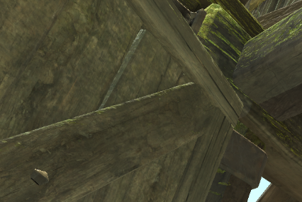
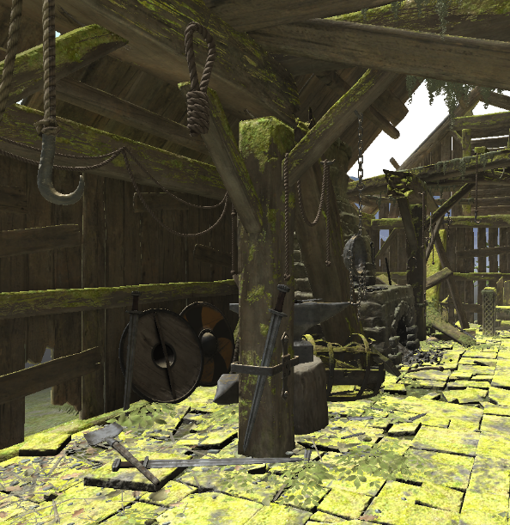
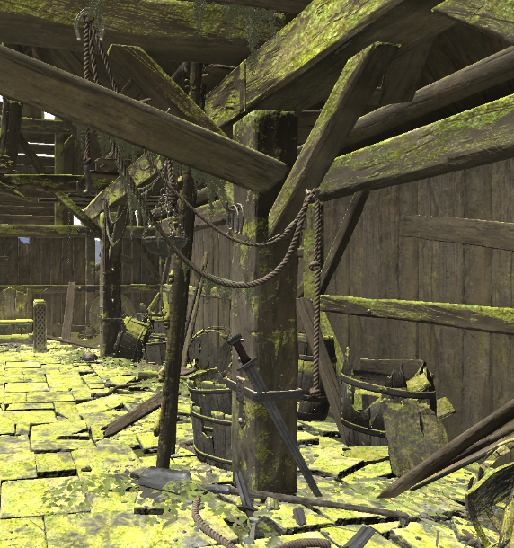
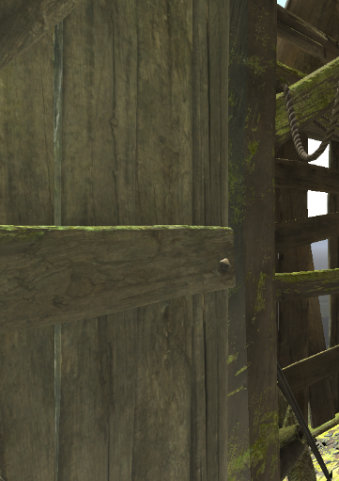
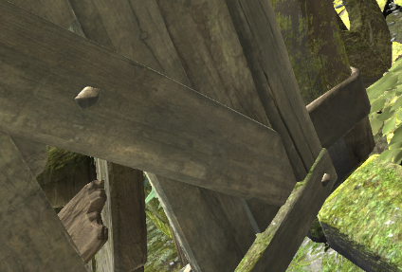
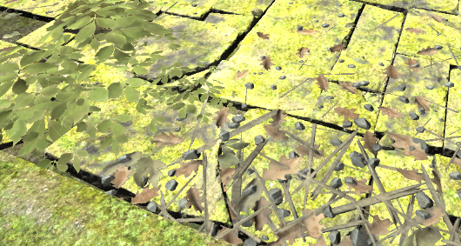
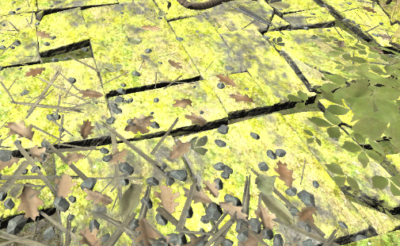
Rendering projections
Notes:
Those different views are just viewports within a render target, or possibly different render targets. This should be familiar from stereo rendering, where you often place the two images side-by-side in a single rendert target.
I’ll spend the rest of this presentation discussing how to efficiently render this.

Slide 16
Implementation #1: Outer loop over views
Application
Shaders
for each view:
set view state
for each object:
set object state
issue draw
trivial
Notes:
The simplest implementation is probably putting a view loop over your existing render loop.
For each view, the viewport is set up, and then you iterate over all the objects as usual, binding resources and updating constants and issuing draws.
The number of per-object state changes and draws are increased by the view count, so it is easy to swamp the CPU and GPU with this implementation.
I’ve highlighted the high-freuqency calls in red here.

Slide 17
Implementation #2: Inner loop over views
Application
Shaders
for each object:
set object state
for each view:
set view state
issue draw
trivial
Notes:
As an alternative, the loops can be swapped, so that we iterate over objects once, and loop over the views for each object. Now only the viewport changes at high frequency instead of resource bindings and other state. It’s still a high-frequency change though, and I’m not sure it would perform any better than the first version.

Slide 18
Implementation #3: Geometry shader
Application
Geometry shader
set view state
for each object:
set object state
issue draw
for each view i:
for each vertex v:
v’ = transform(v, i)
output.Append(v’)
output.RestartStrip()
Notes:
As an alternative, a geometry shader can be used to replicate each primitive to each view, with a loop over views and triangle vertices. The application sets up all views ahead of time and only draws each object once, so the high frequency operation is eliminated from the application. While this seems like a good idea, it has a potentially significant performance downside.

Slide 19
Implementation #3: Geometry shader
Example, 3 views
Before GS: 16 unique vertices
After GS: 162 “unique” vertices
Notes:
The output topology of the GS is always a series of triangle strips stemming from each triangle. So even if your input is indexed with good vertex reuse, the hardware has no way of knowing that the output is also coherent. In addition to using up bandwidth, this can cause a reduction in triangle setup throughput, and ultimately harm performance.

Slide 20
Implementation #4: Instanced views
Application
Vertex shader
set view state
for each object:
set object state
issue instanced draw
v = ComputeVertex()
i = SV_InstanceID
v’ = transform(v, i)
GL_AMD_vertex_shader_viewport_index
Notes:
There is a much better solution, and that is instancing. All major hardware vendors support a GL extension which allows the vertex shader to select the target viewport, and there is also an optional DirectX capability to do the same. So each instance can go to a different view. This still needs to execute the vertex shader multiple times, but state does not change at a high frequency. If your vertex transform is expensive, you should consider first streaming out the transformed vertices to a buffer and drawing from there to avoid paying that cost for each view.

Slide 21
Implementation #5: Multiview
Application
Vertex shader
set view state
for each object:
set object state
issue draw
v = ComputeVertex()
for each view i:
v’[i] = transform(v, i)
GL_OVR_multiview
Notes:
Finally, there are new extensions that may make rendering to multiple views even more efficient than instancing, computing attributes of each vertex only once. It might be a while before these are widely supported though.

Slide 22
Implementation: summary
Outer loop:
Inner loop:
Geometry shader:
Instancing:
Multiview:
Bad
Bad
Bad
Good
Good
Notes:
To sum up, the overhead you’ll see from rendering multiple views depends on your implementation. Go for instancing as a baseline, and if you can afford the development cost, add optional multiview extension fast paths. Don’t bother with geometry shaders, since the added complexity probably won’t buy you the performance you expected.

Slide 23
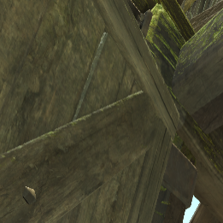
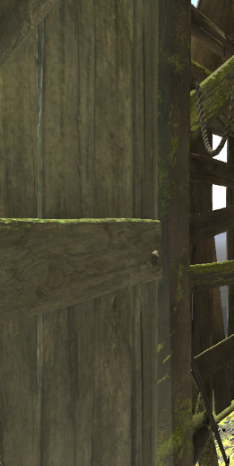
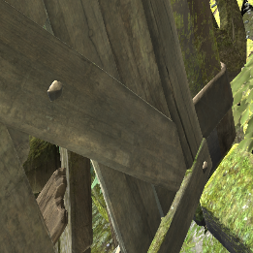
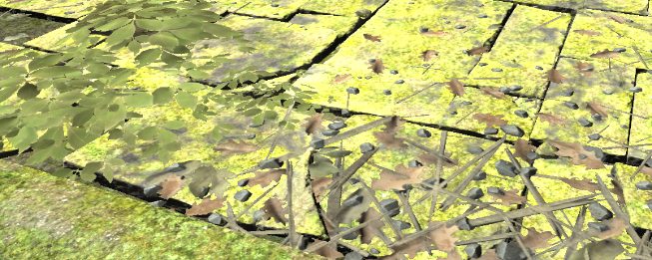
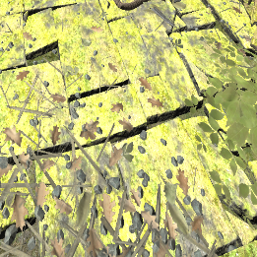
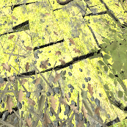
Resolution constraints
Notes:
I want to mention resolution constraints. With the original multi-resolution shading method, the resolution along adjacent projection edges is chosen to match, as shown to the left. We’ve found it preferable to let the resolution along shared edges be independent, and shown to the right, since this further reduces the number of pixels that need to be rasterized and shaded. We tried to find visual artifacts from this, but no matter how hard we tried, we couldn’t see the difference. Likewise, when comparing angled projections to co-planar projections, we couldn’t tell the difference unless we turned the resolution way down, to a quarter, to reveal the pixel orientations. Even then, the pixel orientation discontinuities were not objectionable when compared to the overall aliasing of the scene with such aggressive under-sampling.

Slide 24
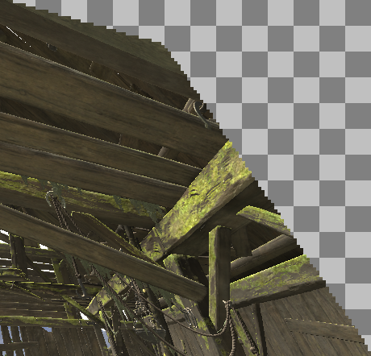
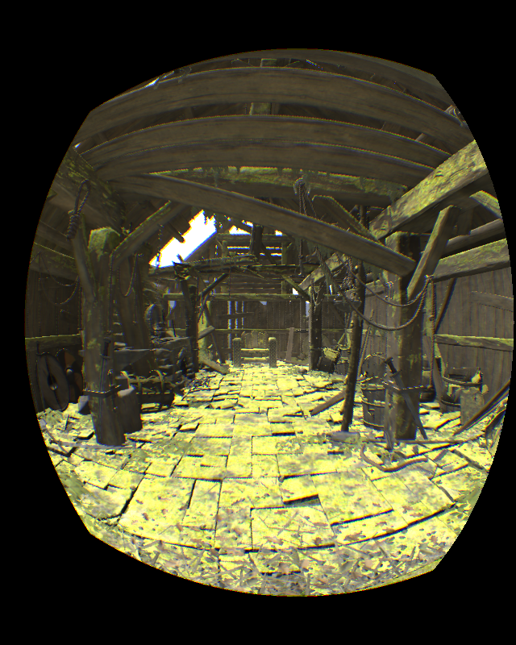
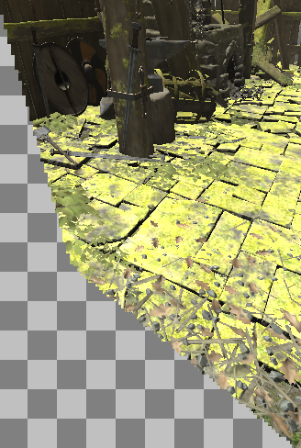
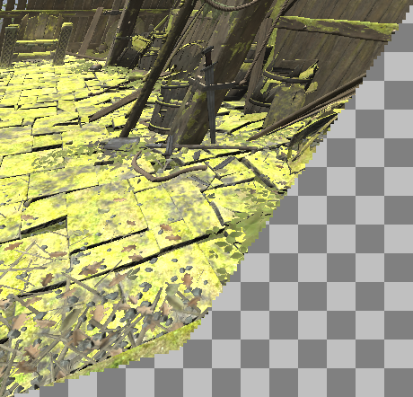
Optimization: masking
Notes:
There are a few other optimizations worth mentioning. Some regions of the views do not contribute to the distorted image. Rendering to these areas is a waste of cycles, so they should be masked away either by using the stencil buffer or depth buffer. Valve’s openVR API provides such masks already, and they apply to multi plane rendering just as well.

Slide 25
Optimization: masking
Not free
Expensive
Vertex fetch
Vertex shader
Triangle setup
Raster
Depth Stencil
Pixel shader
Output merger
Notes:
Rendering objects in the masked region is not free. The expensive pixel shading is eliminated, but the pipeline up until that point still needs to execute before the pixels can be discarded. When looking for optimal projection settings, a rough estimate of the savings of masking pixels should be factored into the optimization cost metric.

Slide 26
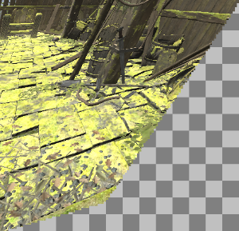
Optimization: culling
Notes:
Going back to this image, I’d like to point out that many objects are visible only in a small number of views. View frustum culling should therefore be performed for each view, to reduce the vertex processing overhead. Our experiments indicate an average replication of 2 for 4 views or 3 for 9 views, as a ballpark for what to expect. Also, the frustum planes used for culling could be further optimized by taking the masked regions into account instead of just the viewport edges.

Slide 27
Post-processing
Notes:
There are some unsolved issues that need to be addressed before multi-projection techniques will be truly useful. Modern applications often rely on post-process filters to achieve a range of effects. Filters that work with a neighborhood of pixels will produce the wrong result if they are applied as-is to a tiled image like this, so there is plenty of future work in getting the effects we know and love to work well with multi-projection techniques. Constrained resolutions may be used as a stop-gap, since the image is then at least continuous, but really such effects need to be re-imagined for VR.

Slide 28
Is it fast?
Notes:
Anyway, what you’re all wondering is of course, “is it fast?” As always, the answer is, ‘it depends’. If your application spends 100% of its time on pixel shading, then it will be twice as fast as rendering a single image as promised in the chart I showed earlier, even if you do a simple implementation. On the other hand, if you’re rendering a bazillion subpixel triangles with a trivial pixel shader, then it will most likely be slower regardless of how well it’s implemented.

Slide 29
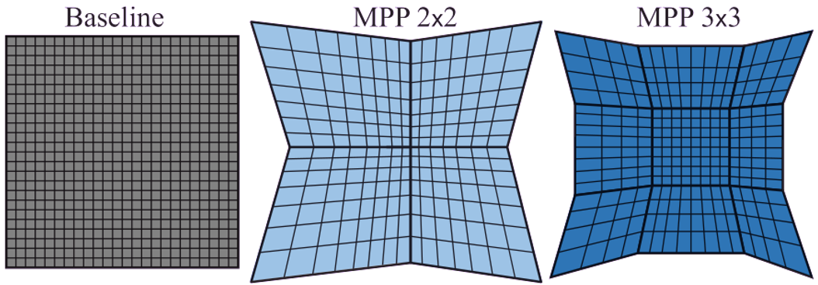
Is it fast?
Outer loop:
Inner loop:
Geometry shader:
Instancing:
Multiview:
Bad
Bad
Bad
Good
Good
Expect better results with:
Instancing or multiview
Masking
Mask-aware culling
Expensive pixel shaders
Notes:
In practice, I’ve seen a 45% performance improvement on the scene you’ve seen throughout this presentation with simple shading. That’s with a naïve implementation in Unity when rendering for a high-res StarVR HMD. For lower resolution devices, the overhead of the naïve implementation was larger than the pixel shading gains. *CLICK* An instancing-based implementation should have drastically better performance. Also, my performance test didn’t include masking nor mask-aware culling, which would both improve performance. Oh, any my scene didn’t perform any lighting, which would certainly benefit from the pixel count reduction. So in a real scenario, this should pay off rather nicely, especially for next-gen devices with higher resolution and field of view, but your mileage may vary.
With that, I’d like to thank you all for listening, and if we have time I’ll gladly answer any questions.

Slide 30
Where do we go from here?
Hardware: deal with multi-projection efficiently
3D APIs: expose multi-projection in a vendor-independent way
VR APIs: not just a per-eye projection matrix – what, then?
Engines/middleware: implement parameter optimization
Applications: re-imagine image-based techniques for VR with multi-projection in mind
Performance/quality control: other optimization criteria?
Eye-tracking: dynamic projection parameters?

