Slide 1
Real-Time ray casting for virtual reality
Warren Hunt
Oculus Research

Slide 2
Ray casting is a viable alternative to rasterization for VR/AR

Slide 3
This talk
Applicability of ray casting for VR/AR
Reference ray casting framework: HVVR
Open problems/Call for participation

Slide 4
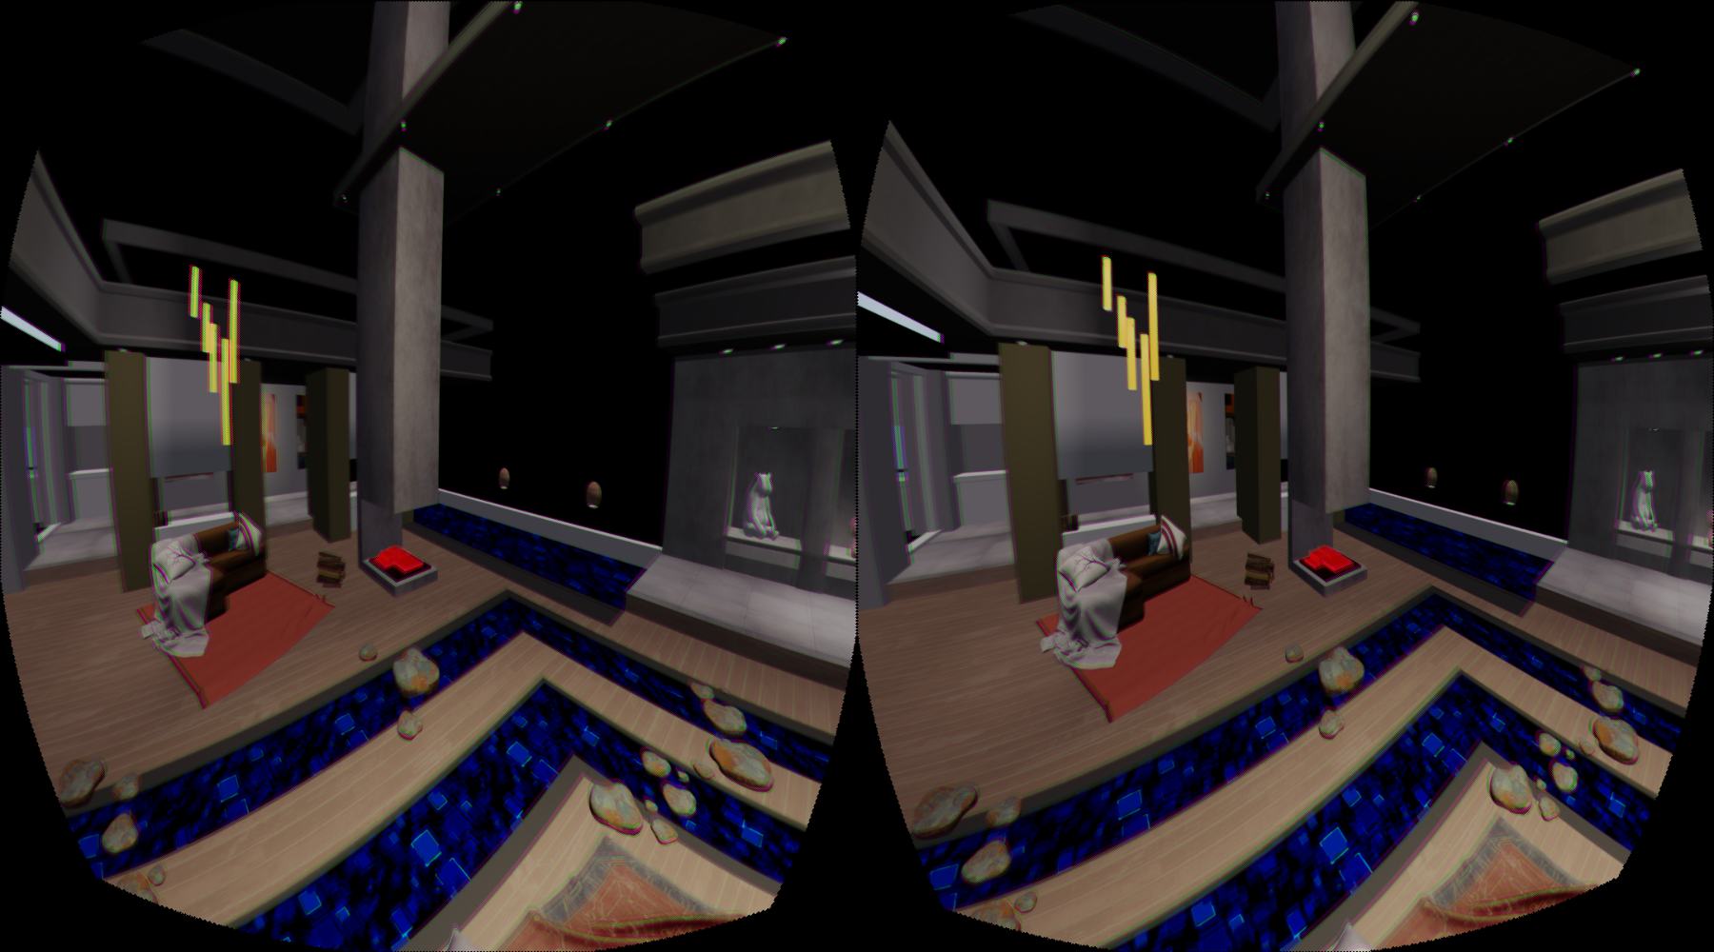
Rendering for VR & AR
Notes:
Host of new problems. I’m going to explain how a change in the way we think about rendering can fix them.

Slide 5
Rasterization
Fast, mature hardware available
Fundamentally based on grids
Well matched to current displays

Slide 6
a new set of requirements!
Wide field of view
Lens distortion
Sub-pixel rendering
Low latency
Rolling display correction
Depth of Field
High resolution & Frame rate
Foveated rendering
Efficient Anti-Aliasing

Slide 7
Feature | Rasterization | Ray Tracing | Ray Casting
Wide Field of View | — | ✓ | ✓
Lens Distortion | — | ✓ | ✓
Sub-Pixel Rendering | ✗ | ✓ | ✓
Low Latency | ✗ | ✓ | ✓
Rolling Shutter Correction | ✗ | ✓ | ✓
Depth of Field | — | ✓ | ✓
Foveated Rendering | — | ✓ | ✓
High Resolution + Frame Rate | ✓ | ✗ | ✓
Efficient Anti-aliasing | ✓ | ✗ | ✓
Notes:
Note composability. Emphasize composability. Emphasize this is why ray-tracing has taken over

Slide 8
Hierarchical Visibility for Virtual Reality
10+Brays/s including shading on commodity hardware
Full dynamic scene support
Arbitrary coherent ray distributions
Including non-point-origin!

Slide 9
Direct distortion & MSAA

Slide 10
Foveated Rendering
Notes:
No nearest neighbor reconstruction

Slide 11
Wide field of view
Notes:
Note that you can do “screen space” effects here w/o dealing with multiple projections.

Slide 12
Depth of field (using MSAA!)

Slide 13
Hierarchical Visibility for Virtual Reality
3-stage Heterogeneous compute entry-point search algorithm
Large packet traversal (CPU)
Small packet traversal (CPU)
Ray/triangle intersection And Shading (GPU)
Notes:
Emphasis: it’s software

Slide 14
Ray Sample Hierarchy
Notes:
An example sample hierarchy. Pixel footprints in orange, with orange pixel center, blue differentials and blue subsample locations. Green tiles contain 4 pixels each and light blue blocks contain 4tiles each. In the actual system these groupings are much larger

Slide 15
Building the Ray Sample Hierarchy
Notes:
We can build the hierarchy from the pixel centers and differentials

Slide 16
Building the Ray Sample Hierarchy
Notes:
Grouping into tiles

Slide 17
Building the Ray Sample Hierarchy
Notes:
And grouping into blocks

Slide 18
Casting the Ray Sample Hierarchy
Notes:
When casting we start by using the blocks to cull the scene

Slide 19
Casting the Ray Sample Hierarchy
Notes:
Then the tiles

Slide 20
Casting the Ray Sample Hierarchy
Notes:
And finally within the pixels, we programmatically generate subsamples… (goto next slide)

Slide 21
Casting the Ray Sample Hierarchy
Notes:
MSAA-style, which give us the final rays we intersect with the triangles left unculled from each tile

Slide 22
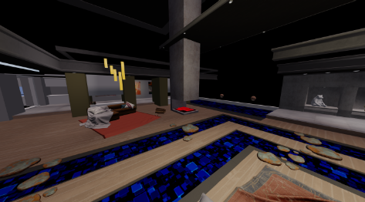
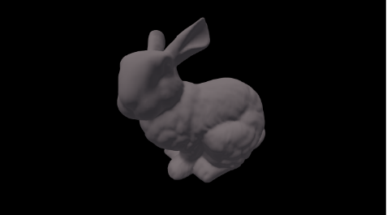
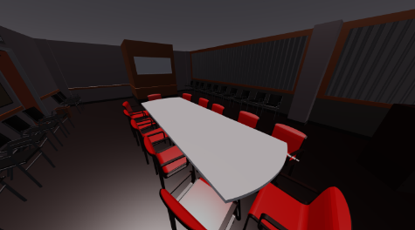
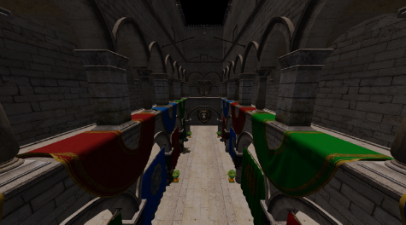
Coherence = performance!
 | Home | Bunny | Conf Room | Sponza
HVVR | 18,432 | 24,674 | 15,840 | 12,375
OptiX Prime | 578 | 529 | 568 | 552
Embree | 322 | 543 | 263 | 223
MRay/s, 2160x1200, 32xAA (per sub-pixel)
Notes:
HVVR time is for the full frame, including driver overhead and GGX shading. OptiX and Embree times only include traversal and intersect.
Quadro P6000 + i7-6850K

Slide 23
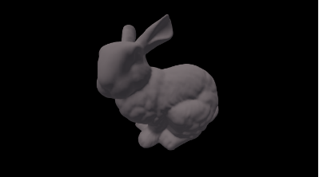
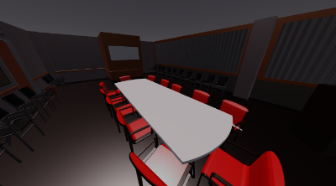
BVH refit is FAST!
Scene | #Triangles | Total Refit Time (μs)
 | 159,588 | 139
 | 69,451 | 69
 | 331,179 | 482
 | 262,137 | 208
Notes:
I’d like to put emphasis on the fact that even *without* hardware support, which means large FP32 bounding boxes, this is a solved problem.

Slide 24
Real-Time Ray casting Open Problems
Call for participation!

Slide 25
It’s Open source!
Special Thanks to Michael Mara and Alex Nankervis!
https://github.com/facebookresearch/HVVR

Slide 26
Ray casting API
Primary Visibility is First Class!
Implicit coherence
Distinct sub-pixel distortions, layouts and differentials
Beam racing/demand driven rendering
Multi-sample anti-aliasing
HVVR API goal: unify and extend established APIs
Come talk to us about it!

Slide 27
Opportunities for collaboration!
Multi-Level BVHs: Static + Dynamic Geometry & Instancing
Multiple Materials, Transparency & Improved Shading Efficiency
Support for Particle Systems
Beam racing, Motion Blur & Rolling Shutter
Notes:
Emphatic note: it’s software!It should also inform hardware
Accurate Shadows
Ray Tracer Integration
Support Geometry Shading & Tessellation
Beam Racing
Support partial Transparency

Slide 28
Oculus Research is hiring!
Software Engineers
Graphics Post-doc
GPU Architect
Visiting professors
Also: Research grants

Slide 29
In short:
Ray casting is well matched to augmented and virtual reality
HVVR is an open source real-time ray casting platform from Oculus Research
Come collaborate: https://github.com/facebookresearch/HVVR

