Slide 1
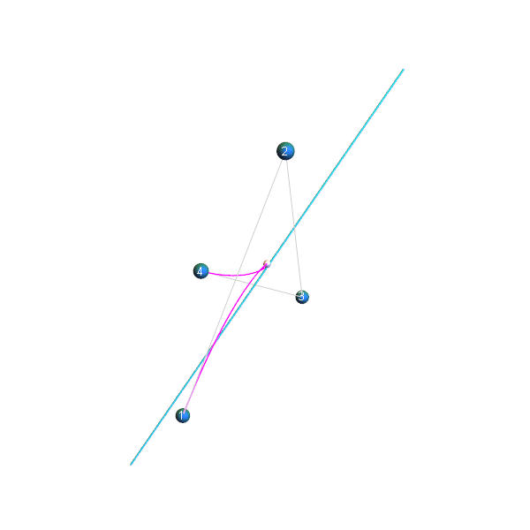

Exploiting
Budan-Fourier and Vincent’s Theorems
for Ray Tracing
3D Bézier Curves
Alex Reshetov
NVIDIA
Notes:
This is 5th paper in a row with Nvidia authors.
It is somewhat unusual: there are 4 names in the title alone but not on authors’ list.
The reason is that, of course, they are all dead.
The practical question though is that if these theorems were known for a long time, why nobody tried to use it before?
There was a lot of confusion among scientists for about 2 centuries and efficient numerical methods based on these theorems were developed only recently.
I will try my best to describe it as simple as possible without distracting details. And no jokes either.

Slide 2
Why now
∃ need
  Hair, grass, vegetation, contours, etc
  Linear approximations or alpha blending are running its course
Significant progress in studies of polynomials
since Galois’ last letter
  Vincent–Akritas–Strzeboński (VAS, 2005) is used by
  Mathematica, Sage, etc
  Math is mostly elementary
  Far-reaching similarities between Bernstein polynomials and
  root-isolation techniques (not fully recognized yet)
Notes:
There is a need for efficient rendering of certain types of assets
and, at the same time, a lot of progress on studying polynomial properties has been made in this century.

Slide 3
What
Ray tracing cubic Bézier curves
  i.e. finding curve’s t for ray/curve intersection(s)
  Rasterization is quite different (t → geometry)
  Degree 3 is sufficient
    It is expressive enough (inflection points & smooth connections)
    Longer curves will be chopped into pieces anyway by acceleration structures
Will not talk about
  Building acceleration structures
  Shading
Notes:
I will describe the new approach to ray/curve intersections.
It is similar to ray/triangle intersection kernel which then can be used in a full ray tracing system.

Slide 4
What intersection?
Notes:
The slide shows a probability of a ray that intersects bounding box of a curve to be closer to the curve than a certain distance.
This probability goes to 0 for very thin curves.

Slide 5
(at least) two approaches
sagitta!
Ray ^ thick curve
more thrilling
√
Minimum distance
more universal (and easier)
Notes:
There are at least 2 ways to handle this.
We could look for a bona fide intersection of a ray and a swept surface around the curve.
Or we could search for a minimum distance between the ray and the curve.
The second approach is more universal and this is what I will present today.

Slide 6

Why t?
It looks simple…
Notes:
This is a Bezier curve which is almost flat.

Slide 7

Why t?
…but it isn’t
t → geometry is easy
geometry → t is not
Yet we have to recover parameters
to keep everything in an analytical form
  normals
  texture maps
  etc
Notes:
And now splitting it into equal parts in a parametric domain. Each color represents 1/10 of the interval.
You see that it is not uniform even though geometry looks almost like a straight line.
Knowing t, we could compute everything else, but reverse is not true.

Slide 8
These approximate 2D methods will not work
Batra et al. 2015;
Ganacim et al. 2014;
Kilgard and Bolz 2012;
Liao et al. 2012;
Loop and Blinn 2005;
Nehab and Hoppe 2008, 2012;
Qin et al. 2008;
Ray et al. 2005;
Reshetov and Luebke 2016;
Sen 2004;
Sun et al. 2012;
Tarini and Cignoni 2005
not because it is 2D,
these methods will not produce
a (good) curve’s parameter t
Notes:
For this reason, these 2D methods will not work, even though, as I will show, a 3D ray/curve intersection could be essentially reduced to a 2D problem.

Slide 9
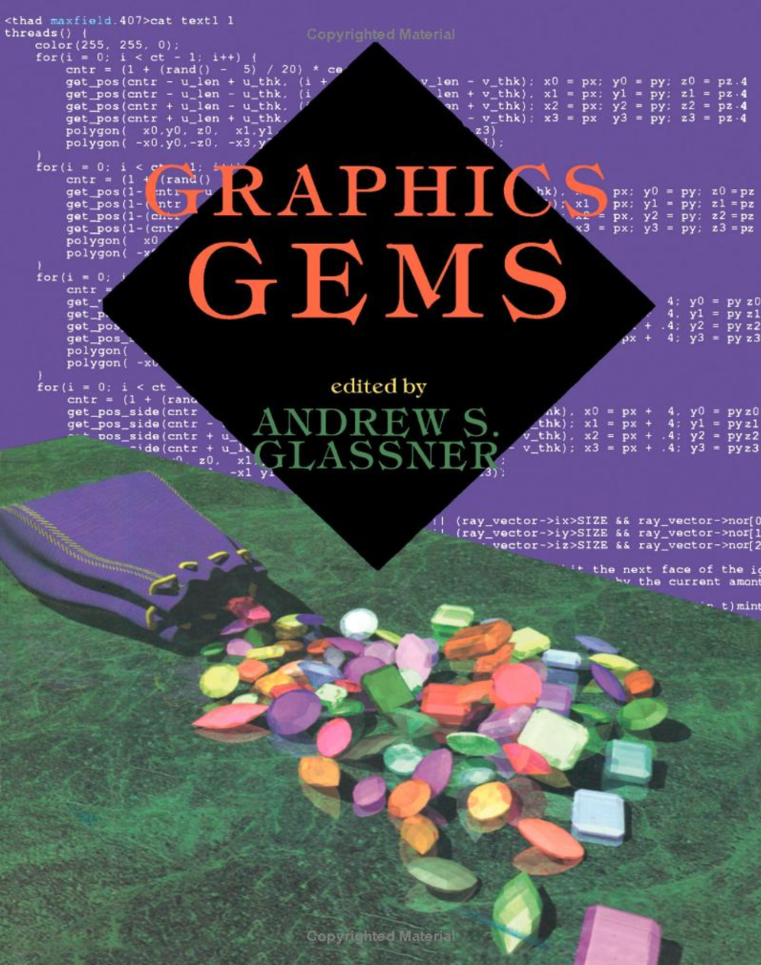
Project’s inspiration
many excellent articles on parametric representation of geometry
Once you use a parametric form, everything is “equation solving” (either explicitly or implicitly)
Hook and McAree [1990] introduced (to graphics community) Sturm sequences for solving equations
Notes:
Original Graphics Gems book had many excellent articles on parametric representation of geometry.
And, once you use a parametric form, everything is “equation solving”.
In this book, Hook and McAree introduced (to graphics community) Sturm sequences for solving polynomial equations.

Slide 10


(my understanding of Sturm sequences)
Notes:
and this is my understanding of Sturm sequences.

Slide 11
State-of-the-art: adaptive linearization
Sederberg and Nishita [1990];
Nakamaru and Ohno [2002];
Barringer et al [2012];
Qin et al [2014];
Woop et al [2014];
Chiang at al [2015]
Just chop the curve into pieces until it can be safely approximated with a line
“Chopping” is done by (recursively) splitting the curve in half during rendering
Works best for almost-linear curves; the curves are pre-split by an acceleration structure anyway
Notes:
All modern approaches to ray tracing Bezier curves stem from Nakamaru and Ohno paper.
Basically, curve is chopped into pieces during rendering until it can be safely approximated with a line.

Slide 12
Why state-of-the-art is smart
It is effectively a bisection search of polynomial roots
(corresponding to the minimum distance)
while simultaneously
isolating roots of the equation.
Splitting in half can be done efficiently by using
curve’s control points
Alternatives (~Hook and McAree) are more challenging:
  Computing Sturm sequences requires a long polynomial division
  Traditional root-finding techniques (Newton-Raphson, secant, etc) have a lot of issues due to the target function non-linearity
Notes:
In essence, such techniques implement bisection search of polynomial roots while simultaneously localizing such roots.
And it can be done fast.
On the other hand, more elaborate approaches might be inefficient and prone to numerical issues.

Slide 13
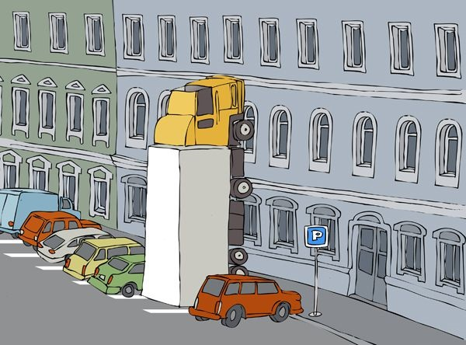
Proposing something drastically different
© A. Zudin
Notes:
That is what I will do today.

Slide 14
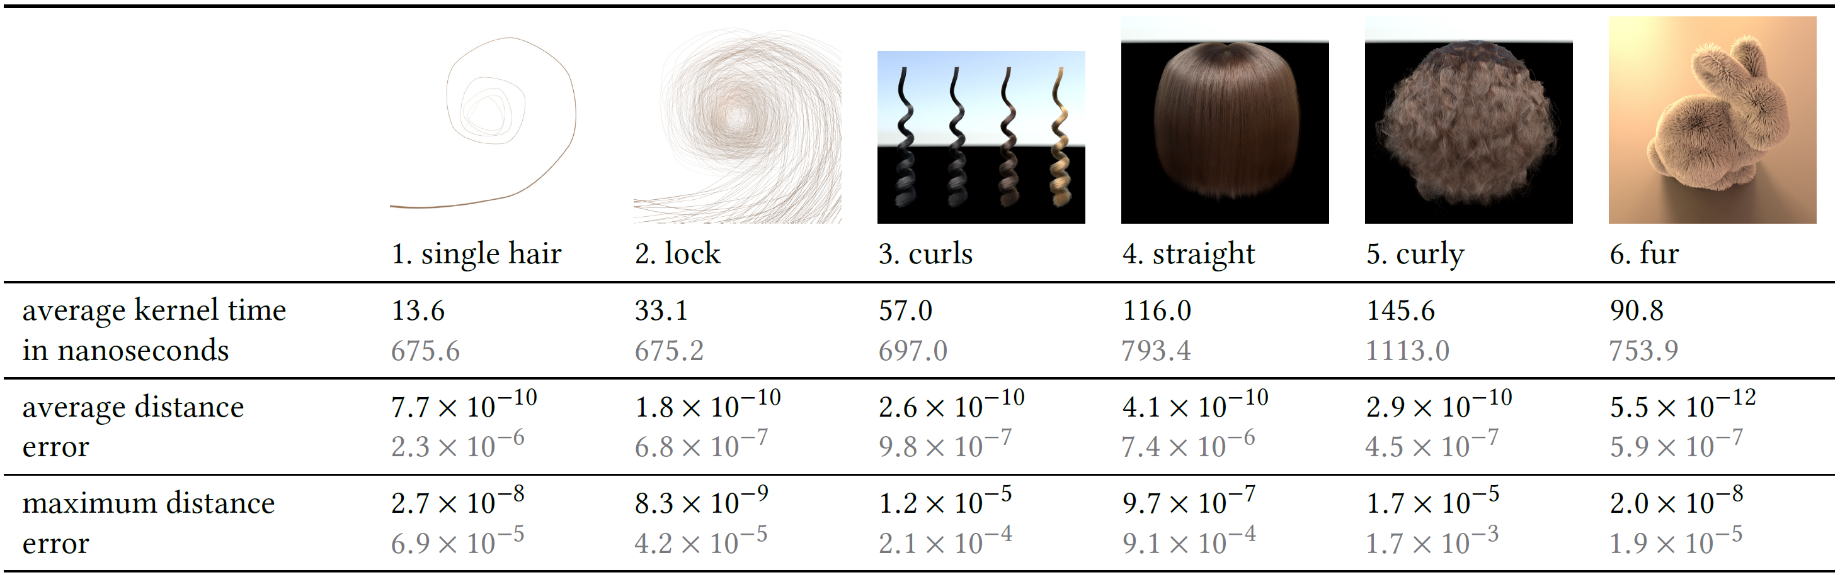
The new approach vs the traditional one
Budan vs adaptive linearization
1000X error
reduction as a
side effect
best
performance
improvement
worst
performance
improvement
Notes:
In this table, the new approach, let’s call it Budan method, is compared with the traditional one, using PBRT for testing.
The best performance improvement is achieved for a spatially varying curve that is not chopped into small pieces. It is about 50 X.
On the other hand, for almost straight dense hair that is mostly axis aligned, the improvement is only 7 X.
It is even smaller for the artificial model that contains only axis-aligned straight lines.
The Budan method improves accuracy by about 1000 X compared with the default settings for the PBRT version.
It is, basically, a side effect of using quasi-analytical approach.
The adaptive linearization accuracy is more or less adequate as such. It can also be improved by prepensely increasing the number of splits – although with the detrimental impact on performance.

Slide 15
Four (trivial) contributions
Raycentric coordinate system
  Using a sole d.o.f. to allow tight clipping
Root localization (the Budan etc thing)
  Optimizing it for Bézier Curves
  and allowing efficient conversions
Splitting only in the parametric domain t ∈ [0,1]
  Not splitting control points at all
Non-linear root finding
  Ridders method [1979]
Notes:
These are 4 rather trivial contributions, and they are all needed.

Slide 16
Raycentric coordinate system
  Using a sole d.o.f. to allow tight clipping
Root localization (the Budan etc thing)
  Optimizing it for Bézier Curves
  And allowing efficient conversions
Splitting only in the parametric domain t ∈ [0,1]
  Not splitting control points at all
Non-linear root finding
  Ridders method [1979]
Notes:
I will present all these topics.

Slide 17
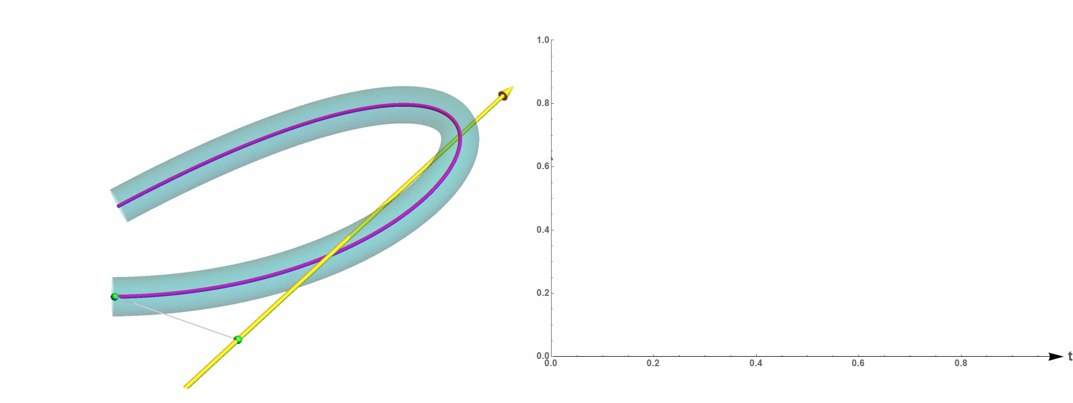
We need minimum of distance(curve(t), ray)
max halfwidth
Notes:
For each point on the curve, we compute a distance to the ray, which is shown on the right plot.
We’re interested in the minimum of such distance but only if it is less than a maximum curve’s radius.

Slide 18
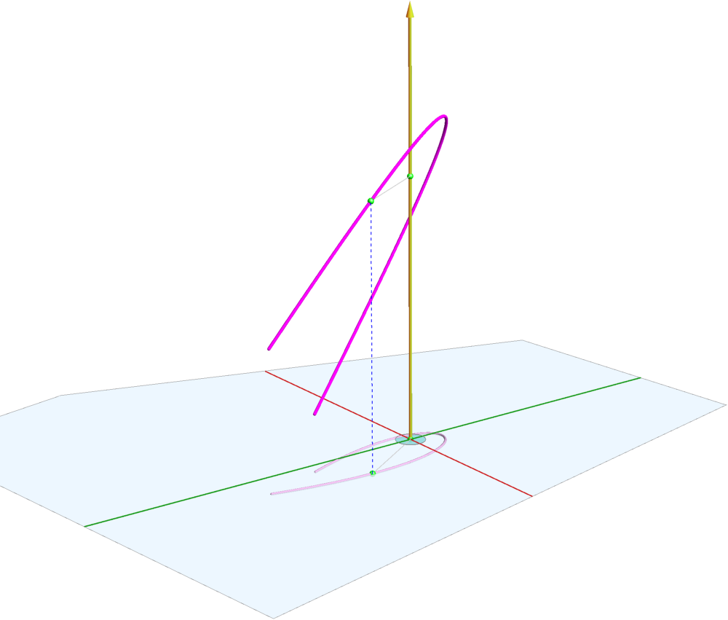
Ray-centric coordinate system
original 3D
Bézier Curve
this distance
is equal to this one
projected 2D
Bézier Curve
Notes:
A distance from the point on the curve to the ray is the length of the vector that is orthogonal to the ray.
So its projection to the plane orthogonal to the ray will have the same length.

Slide 19
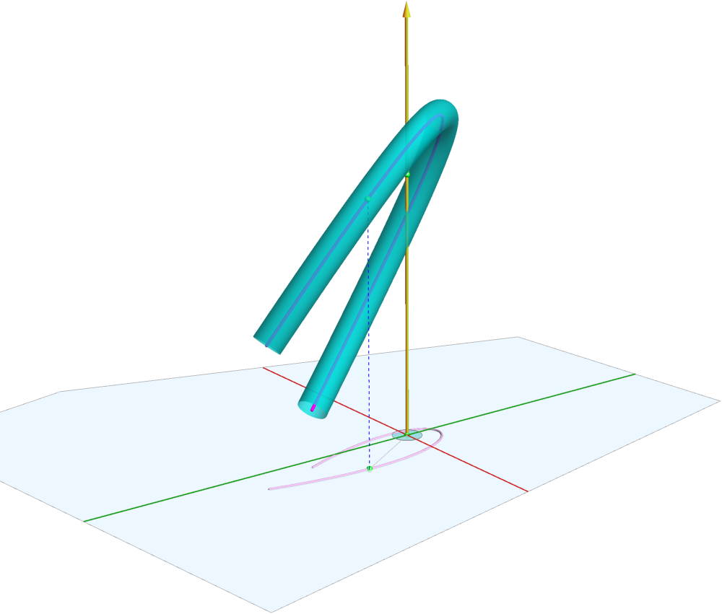
Dimensionality reduction
the ray will not intersect
the swept volume
if the projected curve
does not intersect this circle
then
Notes:
If the projected curve does not intersect this circle with maximum radius then the ray will not intersect the swept volume.

Slide 20
Choosing axes wisely
z axis = ray’s d
1 d.o.f. : x axis
y = x ^{x} d
Notes:
In such layout, one of the axes coincides with the ray, but we still have a one degree of freedom choosing another axis.

Slide 21
How to choose x axis?
Notes:
Let’s do it wisely.

Slide 22

Notes:
We will go left but just for one slide. Please, bear with me.

Slide 23
How to choose x axis
it is orthogonal to
d
x =
some_vector
×
d
b
(t) =
u
+
u
t
+
u
t
+
u
t
cubic
Bézier
curve as
2
3
0
1
2
3
a univariate polynomial
where
u
are 3D vectors and
t ∈
[0, 1]
i
v
, where
(
t
)
v
(
t
) = (
b
(
t) −
o
)
|
|
×
d
distance
from
b
(t)
to the ray
o
+ s
d
using Πυθαγόρας theorem
i.e.
cathetus
= hypotenuse sin α
(
v
t
x coordinate
of
)
x
y
d
in {
,
,
}
v
(
t
) ∙
x
orthonormal coordinate system
if we choose
x
=
u
×
d
3
v
u
∙ u
×
d
= 0
(
t
then the cubic term of
) ∙
x
is
3
3
Notes:
We’re looking for an axis that is orthogonal to ray’s direction, so it can be represented as some vector cross ray’s direction.
This is a univariate representation of a cubic Bézier curve.
Distance from any point on this curve to the ray can be computed by Pythagoras's theorem; we express it here as a length of this vector v.
To find coordinates of any point in a new orthonormal coordinate system, we just need dot products.
If we choose the following expression as x axis then
The cubic term of v-dot-x vanishes as it is just a volume of the corresponding parallelepiped, which is 0.

Slide 24
Ray-centric coordinate system
cubic polynomial z(t)
quadratic polynomial q(t)
cubic polynomial c(t)
only need these two while searching for the minimum of distance² = q(t)² + c(t)²
Notes:
These are 3 components of our Bézier curve in the ray-centric coordinate system; one of the components is a quadratic polynomial and two – cubic.
And we only need these two to compute a distance from a point on the curve to the ray.

Slide 25
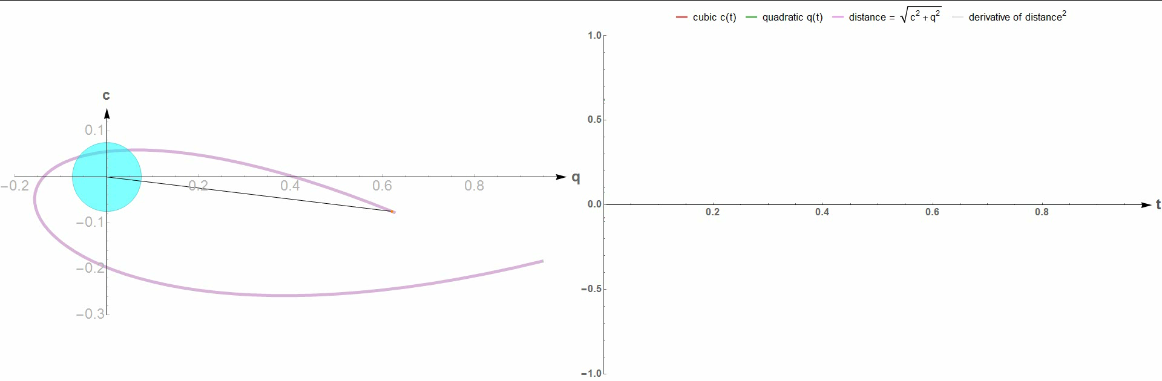
Dual space clipping
Notes:
For each point on the projected curve, the plot on the right shows quadratic and cubic and components as green and red curves and also distance and the derivative of the distance squared.

Slide 26
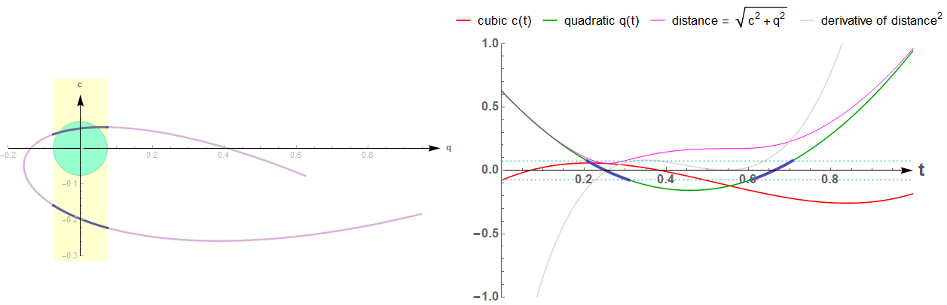
Dual space clipping: interval reduction
and this one can be reduced even further using Budan-Fourier & Vincent’s
this interval can be
excluded by analyzing
the cubic term
only these intervals can
potentially include
min distance < halfwidth
Notes:
We can solve a quadratic equation to find two intervals that can potentially contain the sought minimum.
One of these intervals then can be promptly excluded by analyzing the cubic term.
The remaining interval does contain the minimum and it can be further reduced using machinery in this paper.

Slide 27
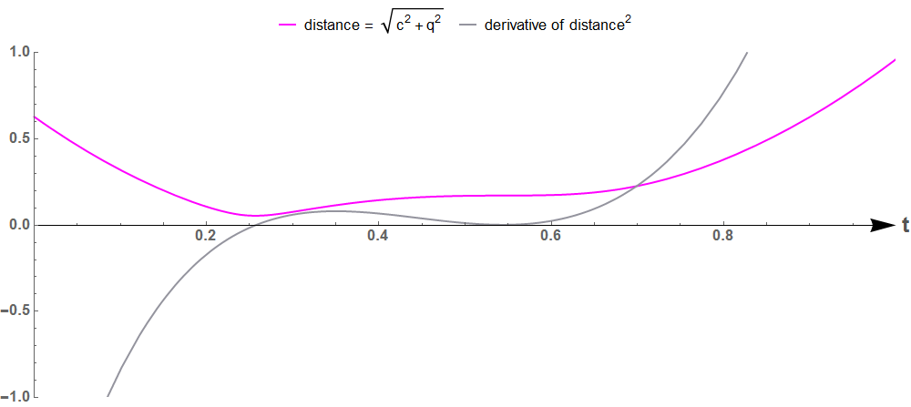
Raycentric coordinate system
  Using a sole d.o.f. to allow tight clipping
Root localization (the Budan etc thing)
  Optimizing it for Bézier Curves
  And allowing efficient conversions
Splitting only in the parametric domain t ∈ [0,1]
  Not splitting control points at all
Non-linear root finding
  Ridders method [1979]
minimum of distance² @ root of its derivative
sextic
polynomial
quintic
polynomial
Notes:
Let’s talk about it a little bit. We’re looking for a minimum of a sextic polynomial.
It corresponds to one of the roots of its derivative.

Slide 28
Details are in the paper…
plus Mathematica code
(I just will provide some insights now)
We want to know # of roots of
p(t) for t ∈ [t₁, t₂]
Notes:
All minute details are in the paper, but now I would like to provide some insights.
We want to know number of roots of the given polynomial on some finite interval.
Knowing this number we can solve a lot of problems.

Slide 29
Details are in the paper…
plus Mathematica code
(I just will provide some insights now)
Only interested in three cases:
0, 1, or many
  More than 1 root → split (≈1% cases)
Notes:
If the answer is more than one, it is unwise to use any local minimization technique and we split the interval.

Slide 30
Details are in the paper…
plus Mathematica code
(I just will provide some insights now)
Only interested in three cases:
0, 1, or many
  More than 1 root → split (≈1% cases)
  One root →
  reduce the interval and find the minimum
Notes:
For a single root, we execute a single iteration of Ridders’ method to find the minimum.

Slide 31
Details are in the paper…
plus Mathematica code
(I just will provide some insights now)
Only interested in three cases:
0, 1, or many
  More than 1 root → split (≈1% cases)
  One root →
  reduce the interval and find the minimum
z(t)
  No roots → drop the interval. Examples:
  c(t) > |halfwidth|
  z(t) < 0
  q(t)² + c(t)² > halfwidth²
  q(t)*q’(t) + c(t)*c’(t) ≠ 0
q(t)
c(t)
Notes:
If there are no roots, we just drop the interval.
There are 4 situations when this is applicable.
If we can prove that the cubic component of the curve is greater than radius or less than minus radius, we eliminate the interval.
The same logic goes for the projection on ray’s direction to eliminate intervals that are behind the ray’s origin.
The case number 3 allows excluding intervals on which the distance is guaranteed to be bigger than radius
And we can also stop processing intervals with no distance extremums as a minimum will be elsewhere.

Slide 32
Insights: Descartes' rule of signs
p(x)
0
x
p(x) = A + B * x has a root for x ∈ [0, ∞] iff
A > 0 and B < 0 or
A < 0 and B > 0 i.e.
the sequence of the polynomial coefficients {A, B} changes sign once
(it can be generalized for higher degrees by induction)
Notes:
Now the promised insights: a linear polynomial will have a single positive root if and only if its coefficients have different signs.
And it can be generalized to higher degrees.

Slide 33
15-16th centuries
1637: Descartes’ rule of sign
  # of polynomial roots ≤ ∑ sign differences between its coefficients
  no proof, just a few confirming examples
Wallis’ claim: it was proposed by Harriot before
  1627–1629: Anglo-French War
1707: the rule restated by Newton
  No proof either
  Encyclopædia Britannica:
  “he considered its proof too trivial to bother recording”
1728 : first (flawed) proof by Segner (written in Latin)
1742: first real proof by De Gua
Notes:
This was first proposed by Descartes who didn’t give any proof except a few validating examples. He would do well in computer graphics research.
A lot of confusion ensued after he published his La Géométrie book. 70 years after that, this rule was restated by Sir Newton.
Since he didn’t bother recording his reasoning, it took another 35 years to definitely prove this rule.

Slide 34
The problem: we need [a, b] and not [0, ∞]
1807: Budan's theorem
  p(x) has no real roots in [a, a+1]
  if p(a) and p(a+1) have the same number of sign variations
1820: Fourier's theorem
  compute # of sign variations lost from a to b in
  p(x), p’(x), p’’(x),… p^{(n)}(x)
1834: Vincent’s theorem
  based on continued fractions
  (these 3 formulations yield upper bound on # of roots)
1829: Sturm sequence: exact #, though it requires
long polynomial division
equivalent
formulations
Notes:
Descartes’ rule is defined for a semi-infinite interval, so the next century researchers were trying to find a formula for a compact interval.
These efforts produce Budan’s and Fourier theorems that are equivalent, and also Vincent’s theorem that uses continued fractions.
These 3 theorems provide an inexact upper bound for the number of roots on the interval, so when Sturm described an exact method, everybody was happy and forgot about anything else.

Slide 35

Fast-forward to 20th century
Notes:
Problem with Sturm sequences is that they require long polynomial division.

Slide 36
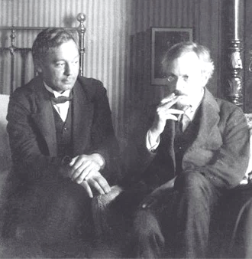
20th century
1948: Uspensky's implementation of Vincent's theorem “faster than Sturm’s algorithm”
  Historical trivia:
  Unfortunately, Uspensky did not have access to Vincent's original paper of 1836, in which Budan’s theorem is cited, and his implementation is actually slower than Sturm’s
Delaunay
Uspensky
Notes:
In middle of 20th century, Uspensky tried to solve this problem by refining Vincent’s approach but, since, he didn’t have access to the original Vincent’s paper, his method is actually slower. It didn’t prevent him from publishing his book on Theory of Equations though.

Slide 37

20th century
1948: Uspensky's implementation of Vincent's theorem
1978: Akritas read about Vincent's theorem in Uspensky's book and made it the topic of his Ph.D. Thesis "Vincent's Theorem in Algebraic Manipulation"
Notes:
Which was read 30 years later by Alkiviadis Akritas.

Slide 38

20th century
1948: Uspensky's implementation of Vincent's theorem
1978: Akritas found Vincent's theorem in Uspensky's book and made it the topic of his Ph.D. Thesis "Vincent's Theorem in Algebraic Manipulation“
Fortunately for Akritas, the heroic librarian at the University of Wisconsin was able to get ahold of the original Vincent's paper
Notes:
Fortunately for Akritas, the heroic librarian at the University of Wisconsin was able to find the original Vincent's paper.
Remember: there were no Internet at that time.

Slide 39
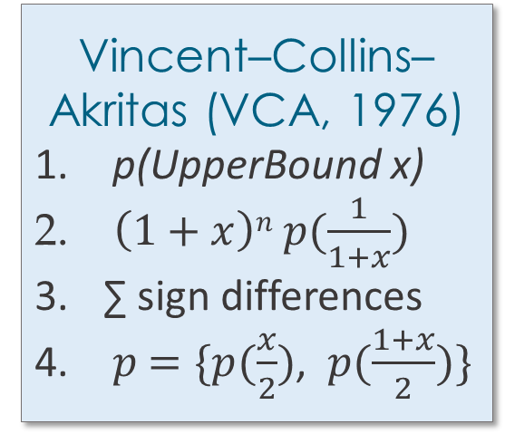
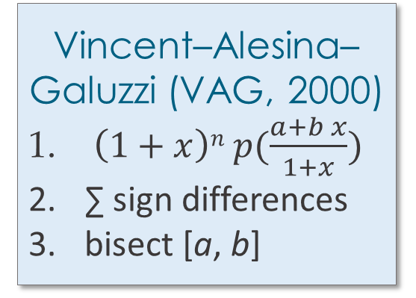
1600s 1800s 1950s 1990s 2000s
Preferred numerical method till 1980’s
Sturm
Vincent–Alesina–Galuzzi (VAG, 2000)
$\left(1+x\right)n p(\frac{a+b x}{1+x})$
∑ sign differences
bisect [a, b]
Descartes
Fourier
Budan
Vincent–Collins–Akritas (VCA, 1976)
p(UpperBound x)
$\left(1+x\right)n p(\frac{1}{1+x})$
∑ sign differences
$p$ $=\{p(\frac{x}{2})$, $p(\frac{1+x}{2})\}$
Vincent–Akritas–Strzeboński
(VAS, 2005)
fine-tune splits
Notes:
And this is taxonomy of all these methods, just as an illustration.

Slide 40


What is important for us
Vincent–Collins–Akritas form $\left(1+x\right)n p(\frac{1}{1+x})$ for x ∈ [0,1] is easy
to compute for Bézier curves in Bernstein form
yet we already have a reduced interval [a,b] and Vincent–Alesina–Galuzzi $\left(1+x\right)n p(\frac{a+b x}{1+x})$ is somewhat more challenging
What we can do though (see the paper)
  Compute Fourier sequences a_{i} and b_{i} for x = 0 and x = 1
  And then on interval [a,b] using the chain differentiation rule
  Convert to VAG representation for the derivative of distance² as
  (VAG sequence for distance² is computed as partial sums)
$$\left(\begin{matrix}b_{1} \\ 5⁢b_{1}−b_{2} \\ 10⁢b_{1}−4⁢b_{2}+\frac{b_{3}}{2} \\ 10⁢a_{1}+4⁢a_{2}+\frac{a_{3}}{2} \\ 5⁢a_{1}+a_{2} \\ a_{1}\end{matrix}\right)$$
Notes:
All modern techniques perform a rational variable substitution.
VCA formulation works great for [0,1] interval.
VAG substitution for an arbitrary interval is more challenging.
One possibility is to always use the simpler VCA formulation and reparametrize the Bezier curve from the arbitrary interval to 0-1.
Even simpler way is to derive everything from Fourier sequences use the chain differentiation rule.

Slide 41
Raycentric coordinate system
  Using a sole d.o.f. to allow tight clipping
Root localization (the Budan etc thing)
  Optimizing it for Bézier Curves
  And allowing efficient conversions
Splitting only in the parametric domain t ∈ [0,1]
  Not splitting control points at all
Non-linear root finding
  Ridders method [1979]
Notes:
This is what done in the paper and it addresses this third contribution.

Slide 42
Raycentric coordinate system
  Using a sole d.o.f. to allow tight clipping
Root localization (the Budan etc thing)
  Optimizing it for Bézier Curves
  And allowing efficient conversions
Splitting only in the parametric domain t ∈ [0,1]
  Not splitting control points at all
Non-linear root finding
  Ridders method [1979]
Go over 37 entries at https://en.wikipedia.org/wiki/Category:Root-finding_algorithms
and choose the best one (see the paper for the discussion)
Notes:
The last one is just a diligent comparison of the available methods and choosing the best one, which is Ridders’ and is based on assuming non-linear exponential nature of the minimized target function.

Slide 43
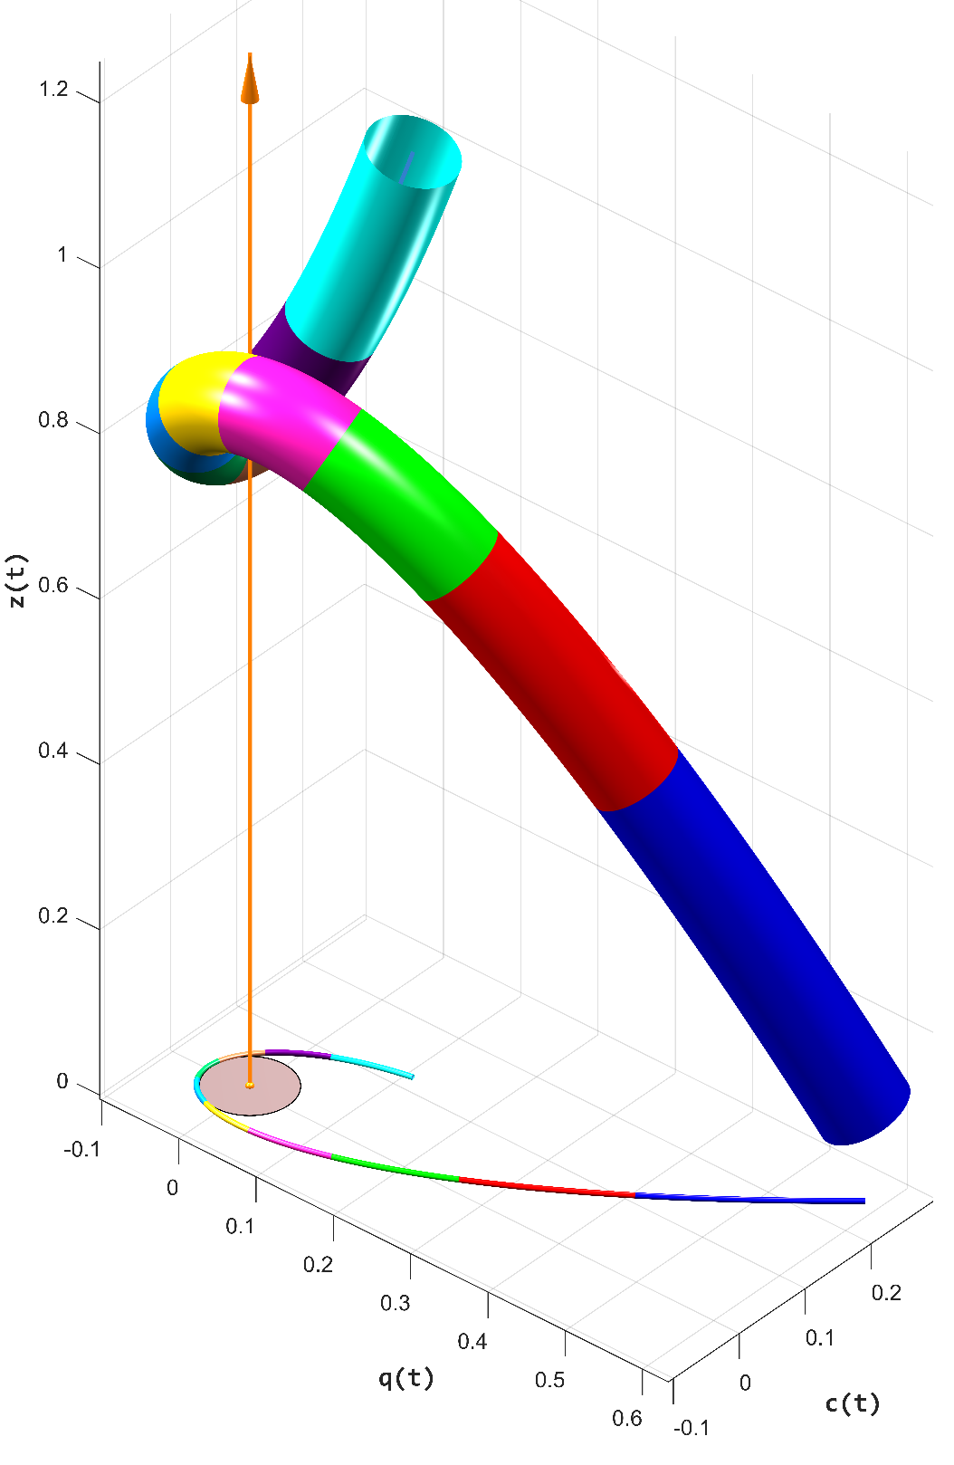
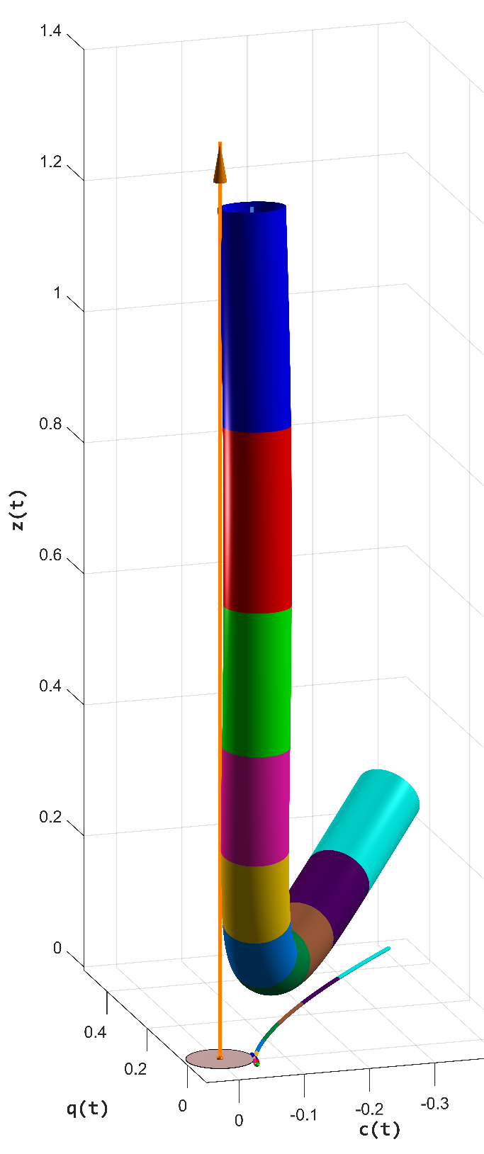
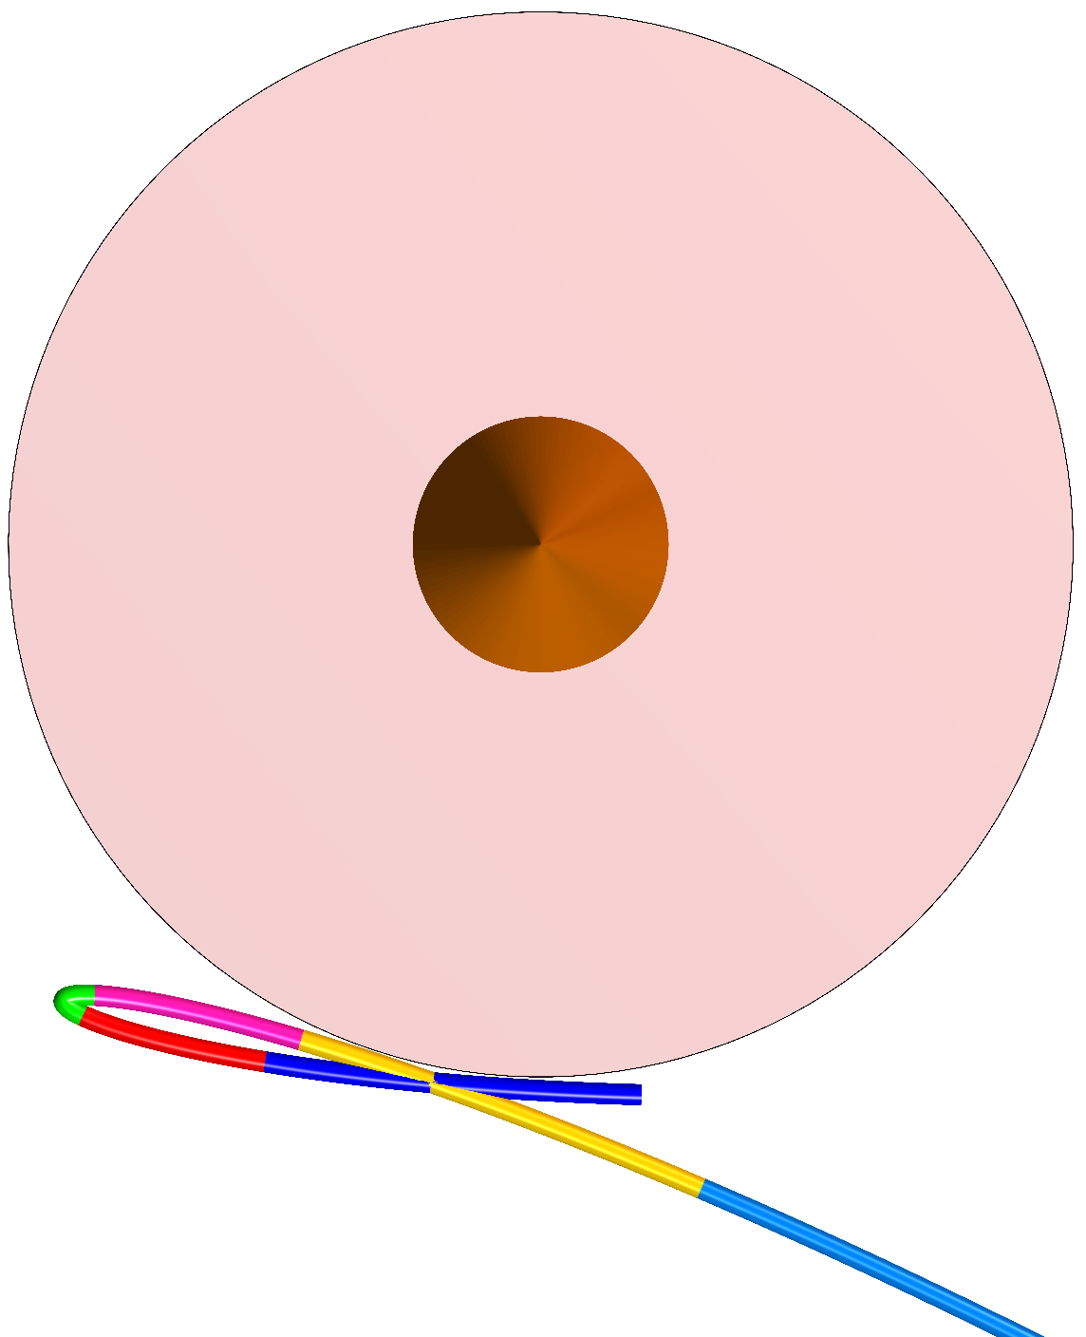
Difficult cases for linear methods
“The hardest thing of all is to find a black cat in a dark room, especially if there is no cat.” ― Confucius
Notes:
This is why linear root-finding methods are not very efficient.
Ray does not intersect the fat curve in both these cases, but come close on a sizable interval.
Generally, it is a typical ray-tracing situation, when the most demanding are close cases without the actual intersections.
Confucius knew about it.

Slide 44
Summary
Notes:
Summary already!

Slide 45
No roots?
Compute only q(t) and solve q(t) == ± r
true
Empty?
Compute c(t), z(t) and validate the interval(s)
true
Find # of roots using Fourier sequences
# = 0?
reject the interval
true
# = 0 or
d > r?
Convert Fourier sequences to VCA; check for distance > r;
recompute # of roots if Fourier says it > 1
true
# > 1?
Split the interval and continue with each part
true
d > r?
Apply Ridders’ to the reduced interval and find min(distance)
true
Notes:
This is the last slide, which contains an overview of the whole algorithm.
First, we compute only the quadratic coordinate of the curve in the ray-centric system. It could allow rejecting some cases by itself.
If not, we compute other components, again with the possibility to stop processing.
For the surviving intervals, we find the number of roots first using Fourier and then Vincent sequences.
Intervals with more than 1 root are split in the parametric domain and
we apply Ridders to the intervals with a single root.

Slide 46
Scripts & backup

Slide 47
How to choose x axis
it is orthogonal to d | x = some_vector × d
cubic Bézier curve as a univariate polynomial | b(t) = u₀ + u₁ t + u₂ t² + u₃ t³ where u_{i} are 3D vectors and t ∈ [0, 1]
distance from b(t) to the ray o + s d | |v(t)|, where v(t) = (b(t) − o)×d i.e. cathetus = hypotenuse sin α
x coordinate of v(t) in {x, y, d} coordinate system | v(t) ∙ x
if we choose | x = u₃ × d
then cubic term of v(t) ∙ x is | u₃ ∙ u₃ × d = 0
using Πυθαγόρας theorem
Notes:
https://support.office.com/en-us/article/I-want-to-animate-individual-cells-rows-or-columns-in-my-table-a161e49c-3801-4385-95b4-de84253593d1

Slide 48
(at least) two approaches
% std::istringstream("1685204011 2815682195 385126455 355161270 2741490130 2213418773 3437980441 3135777609 3486594975 1234267285 1099369070 1004897494 1602088570 2058086804 2766595287 3177268504 2702257490 3124146337 1418718049 1365130483 1265208718 1884250240 3648855035 639353071 4256957795 1605271289 982700018 1959955605 207137408 4223255709 3268747380 62291474 720723770 1432001539 1179295468 4277700772 3384822023 789312185 2745877539 1044122156 2253754244 1044010503 322875373 4015799724 1345322295 99273851 2020442037 2323035699 3484228229 3559337231 4125372910 2067433396 44722077 1341711910 2137959577 1496281135 201449566 2288112463 1808241307 1298612477 3798433704 1473569204 465168807 1173655074 545378063 1215215660 3648634627 759126851 2225790131 2086325018 2554369261 2276960658 941880856 1066069953 1717952623 1984850353 3343835836 2695933096 1656822112 3932875924 3773638371 931018417 2598849831 2643279084 3503712314 132947922 3097522224 3702851089 3056142194 1195040649 412219650 1994870821 337765008 93156141 95192607 1336967578 3577484679 2396266869 4258980693 3395204945 582432190 1581048411 3952965608 2780435230 1281853044 2499783058 4253808186 3062605288 38318014 3270247523 3558152782 729912784 1543269248 3164959574 2404021398 13578967 1272258119 1412589587 2719134096 1701130513 1067314120 1861488225 1184566362 2403701602 1240565084 1311990574 3835906313 3452447601 2539071098 104883673 1121472543 4211714649 3614466054 3738931070 349471191 842287450 3277331210 3245964310 2565353939 519799040 1480779148 1645741614 2383583257 2373547574 4237915924 3202894756 3148590864 1290450093 1945982064 1345964586 1059767949 3120352056 2954115194 1970962417 2807818826 4288411395 280458140 3196262697 643690901 3765177704 3753676503 2241842757 3579928997 3628321 781543337 1997166418 3876904805 2056501733 2952747932 1092137983 4211339744 2251680314 3575996612 2985995824 981302376 2179841463 155498009 4097718670 3090426451 3950054312 3632602667 1556106877 4148384674 3401066556 904566931 20569528 595849810 3623517461 4133363818 3243899690 2584217835 2622436780 4005317734 2817470874 3188779450 231190107 1955823019 337022679 2604165785 3163292398 4114707428 1764383212 2572177483 1973796504 3750958121 804745055 1993459785 4276784439 3834022484 2776507428 3508967888 1699847186 3997024083 82725733 606063791 2984143074 2432647480 254985915 2122283937 47474427 2110125283 2572455943 3415375831 2785076099 2627783621 1592714596 784764603 2178245546 85801516 3487400001 3855936752 2658437062 1191015740 2523391738 3797997762 2105265680 2442552993 2142812732 322379775 2295863178 2794525080 3437059251 314557026 2908496797 3250791855 2027612625 4197355526 2878636016 3249339762 2532865934 3704952630 670074340 1388828656 788474898 3854566936 4140031142 3504167705 1389091907 2702915852 2561147273 3521707995 2696907069 1086119393 778070631 1103895211 2725347355 3775130599 2198148607 3216052957 4228827656 2252511845 1236863666 3953132719 1230365933 3101269550 1186264175 3543486074 206944210 1542383856 713154860 4277298036 958197260 2518833110 1935219647 473080082 933900087 2280263889 1545506654 2992728219 3918997118 3584431475 34563667 3726297827 54782853 796465567 1356215266 3044799671 4241451410 3427418207 3896549751 2450704368 1040672167 2850192145 2612837038 470790924 1851199725 651950670 3453976569 3430959318 795458110 2299767212 2790396125 327221299 1080385624 3606947159 2228760415 2720953837 3875172232 3612108309 3865054701 349953574 4289395775 2501222638 1528482399 2020615770 4181906988 3410405585 955711009 2253974861 1765664884 1577473139 3805172805 3161110250 1381257941 1331962610 1641731630 1732159707 3658172755 3521101282 2802471960 2999654806 1574784185 795196910 3209317949 4092172083 2673956681 2856177 578665840 1410117260 876958718 759108244 2363460035 1697686405 474884213 1974441099 2894689749 2402061879 2485221710 3157428322 2240491335 2467861665 78831800 1507664386 4253484954 176546249 3307579066 2300758379 2254547164 2381868806 2944987653 482229557 776111196 1201108416 4044144538 3049224659 2909989356 3137907294 3860493253 2731451544 1238588477 308511016 3916979781 2732239132 2358757461 3766065875 2676188561 188202881 3942750312 3776931515 241434653 1850642935 1456881045 143032556 1854089893 638425150 2609397761 1259855291 3995665903 2748228522 2410904279 4133385369 3890244691 1269927202 2173266786 357416564 667171161 3498721971 1460437255 405085942 82894503 1690318973 2037687943 1842178682 224646948 3363972818 4258671380 2754564275 4189098102 1328192715 2336094037 2419140087 2523338830 1019298722 2531222161 3353841831 4013938269 309977792 3081713515 212274969 1521244042 161803909 3009038632 3421264194 3435790678 3418096955 3296790731 840138908 2244557633 1542471205 3120941547 1320508325 3440635245 2028899360 536998848 1450634364 4108661774 799244255 3725118394 3968688829 3637617847 751194310 2296501729 2042945363 426573599 1784758273 3281928647 1526585372 3818441274 588204871 121811918 1647063058 3048088652 3309572756 2012161634 496640479 721991116 2890786638 244838095 3966173311 3075051201 3636506565 4169158901 3031275750 2374719437 614493573 1753900116 3902674021 4128416795 2882770774 2579671555 3905854789 1083737215 3800413592 1210948362 3276017723 2282774525 2781763713 2270955670 1408407628 2555530570 2697725778 2476258427 4012045993 2238860543 2822162111 3642920832 1510259615 3583481159 680217030 366547729 2068816041 2281458749 1427164625 4000679175 1269342348 4149071514 1735484759 2354184937 2019027891 296763703 1240542129 2924965487 2475812865 3922667056 2844811041 2262058450 1942740244 2958129230 2207851522 3685692935 2586080668 849737567 2759160197 3402107726 3658722413 2953570163 3550792355 3134427951 4051118033 3071285739 3633769471 4223203455 1750624000 3070701178 4076572526 1694231832 2968907253 589370252 676766806 242933257 1435200681 901761125 3987414775 549440611 3938557999 776978301 3948639091 871071059 4080983779 892588165 2276160415 2899223576 940485226 1474426875 3652297164 3008733142 1646036176 3322626466 3757510579 1101947551 2531620998 1369649733 2602908422 1868656327 2770512978 722783685 3719732719 352558163 2203720183 472079586 3906378084 1519625950 1688678199 1085507723 2393684656 3974950009 861706338 1405260523 3905499796 2576664278 367388648 3827804365 3265124748 2292014770 4103245240 2949120016 4201622372 3029975278 1599826792 3345716154 1435388747 779374721 847236661 1362737722 3960278681 2083335957 3851503928 924809628 3133372642 418288311 3114587019 133875814 3724126360 787970690 700508582 565184219 303753669 203139608 1536751064 1138303486 2043994877 2203741135 2767732549 2663315560 1462681144 2831978468 151051814 524549479 440408845 3810501516 1458311383 1577004251 3601030768 891605198 ") >> mt;

Slide 49
Why t?
par.halfwidth = 0.005; bc(:,1) = [0,0,0]; bc(:,2) = [1,0.01,0.01]; bc(:,3) = [0.5,0,0]; bc(:,4) = [1,0,0]; clf; hsShowBC(bc, par, [0.2,0.4,0.8], 0); axis vis3d; axis off; material metal; lighting phong; axis tight; printcam(cam); light('Position',[0.5,-3,2], 'Style','local', 'Color','c'); camlight headlight; figure(4);
print('-dpng', '-r768', 'w:\ortvet\hair\rayBC\paper\HPG 2017 presentation\\straight curve 1 color.png');

Slide 50
Difficult cases for linear methods
“The hardest thing of all is to find a black cat in a dark room, especially if there is no cat.” ― Confucius
Notes:
% std::istringstream("2564535015 1638736218 2107956201 2937186955 3730037009 498943519 84689217 3246950316 4114820883 3240173913 3462484620 394074486 2973053338 3702450437 2464163180 1417192053 1135881172 811419674 4044971092 3956079974 1161692653 1008181809 1987458667 883438057 1919967749 2833698733 2851968805 1560379774 2656964151 2418604038 1157627314 2879972030 2652639308 3220057319 88163195 3157881514 60695660 2648058561 1370896917 3364199947 1350672720 3081764382 1781546294 2521535966 2819152888 2232259535 1225721103 3892542645 2551683582 681286813 3498037027 3525629907 1186428228 1694904686 1508829185 2909374519 4193917473 2258010531 472337855 3629507478 1707116293 2387765457 576800381 1216656528 3170096757 456805428 4130596038 1162456828 1235382037 1947436841 3508583182 2673787240 2546600218 1631284929 838300170 2028820541 1937763320 2257541770 2813951990 3780448147 2563978272 388481979 2827766809 215054842 4139903478 3798493950 3713964839 1700100491 1133104586 2836190320 1994314580 3361005028 4186778495 2170258505 1156863221 948443299 2471883695 3322656930 1624572135 1070493985 2867088233 3428517020 2310728225 2298485558 3389362156 1908519092 3119420627 1182502880 3387305265 710776615 1658946001 4263544703 2948255836 2831713159 2585858283 1131896160 4172791993 867734487 3989922633 3502556841 3533265802 1966894726 2444155581 2621801686 3981368352 2631963980 295937604 3311861075 2892087568 845270683 1113880233 331004107 1729923995 3190718023 2043526847 2289168253 4002903203 3750405033 2498661532 3954182369 3345118134 3753280502 3880987959 4084050451 548841696 3331358961 1252155916 2196022452 1230266978 2342964388 4242379796 407682218 2279827882 333158369 1829852511 1276640433 75555340 4263877465 2624550176 3918948617 3184774034 2372886641 2394134785 3704814034 128215321 1808455810 1148880725 3121567947 3624966389 388104119 2219037405 1387563430 1987423887 1689902259 1431131368 2823958940 1749885446 1339370612 655894491 3570986266 405204113 4293652202 256832419 3086834438 1506151756 1096578330 3689064289 4155341925 4258179834 1960293882 1734025157 424635667 2100966463 597543735 1099078773 4117614215 3983744728 2246795308 3583480044 736433682 481253346 3865288435 3454805370 2961672840 811828030 389084739 1508901949 1536804987 1665884914 3176601008 4258648588 2771314622 3953723904 4196503300 2180591001 1140060670 2377707891 692304750 252236096 1597361947 4257587230 2121445710 1900821513 2204891143 2239137753 829738312 32015946 346068501 171930669 695200678 3083718500 1543137829 1670718748 1518283354 1314089425 792268795 2129502707 3305727847 3368439650 1851734836 2092218841 531229481 654424351 1939382574 2244132735 4139414086 1519977263 525590557 2614227305 2448655152 2493941172 859514825 3240117321 2353826863 577921983 482054746 2949179522 976239489 3513156583 1162022391 1604790546 1433624708 885998207 634663970 1099744370 349179240 3407475474 3586654144 2719761403 4250276682 1447472603 2514633233 170212751 4052472188 1841274669 3271317871 4217246896 2585196212 2618342628 3120274901 211703275 870296016 2379108394 1818429667 1493267526 113106976 3870985662 2040467888 1141945589 2920937829 3699934661 1105051201 3675017316 2847135944 1484694232 2936758724 1530563142 235507244 437167238 628924425 2819552697 3951363828 2163666849 1495254910 868592971 2546434760 1916450020 171633804 430588016 1068981605 1846929167 1621927869 1879427684 1885071378 3757685689 2635307933 3428679159 183912065 2020334371 2428544937 4016679607 2616634949 1132970565 1264716311 3282944498 703495770 2569798856 1450442489 3355332896 4239834904 505141745 1781921376 1892359825 3379437597 4034181924 3896948402 646041125 3884655338 267548735 3938199854 1786795285 1974814265 4271943022 741261912 3839608336 1446662616 62811383 2435984846 1944207064 265547258 2731388672 4007403305 2611726066 147582481 1230178071 3592852241 3211438462 2351709009 2625098789 484479946 3593955866 2656255558 1728443966 635100998 3015740938 959599253 2636075831 1666593368 1046642573 1274661138 699171057 4104575368 1728854091 4093104295 3286832682 4008751268 1544557147 1688168699 1491613212 257810412 4233274776 2994227876 3690089212 296947482 812638402 4172906507 1189858474 3896263674 3354792897 4143357711 3552456002 4177962284 642667539 1483364360 4283469335 693945199 574128983 167141856 4122312430 2248337936 1827142826 711668744 3881554106 721116048 3122344292 1542722771 271489648 3424182215 2750164460 3125051007 1445055979 1810790637 306184888 666733621 1329835911 3545036669 2051150934 3679819508 2874130453 954472886 4290415730 1020846906 3250696584 2554032254 1107934868 1458106226 36701449 2128793400 653280297 442750682 2941546416 2180273385 2101626215 3806132463 551060174 1326308089 929963404 2870318577 2858956181 720106826 576872938 2627525899 2473330503 1214631156 25951077 25574806 1745196012 232272704 2423880192 809907851 3232819609 235246981 3084594237 2648649120 1340519600 2576286876 3879166494 3341171770 3118417223 3523953412 2927702671 3672205422 3536554447 3953101643 2255715640 3190453171 2491441063 2203585260 2753015738 3630812525 112192572 2390249859 1067266749 1482107754 3566036497 3924224245 25137386 2319935535 2586259615 1522873552 4140347733 3849256655 4072256606 1330966420 701252781 2870128422 2014666522 3457219214 3097710729 374746048 531170474 3386102525 3916312098 1041161714 2588021864 2145700289 1769691824 3356132038 998508203 1968514666 219442475 933762796 436820242 1306052625 4060577864 2796208784 226289556 4014052191 1413439816 2635101386 1467292902 1811744802 19133135 2814940332 41273512 1567757387 2967706934 3579435913 2075556216 3561926596 2710428299 1823050518 468988189 1231742844 1031420765 2257138366 862691898 3403549937 1361485706 2959824616 608339556 3303443335 2419765544 3760021927 5524426 2287403721 308264751 2338297508 1256146840 2291606136 778692158 1873872531 2472131512 3253968001 57430890 1380361459 3737294748 1061350110 3643374010 1066404130 3232026256 3717672230 735092417 2978671950 4058074406 3090104004 849722442 187491679 3373225897 2795344449 1397068191 3098674055 1455461035 52222277 3079317357 89618432 851073590 4249255813 2881030166 1843324445 3168388934 812319759 3486360359 2926289777 1729431965 11880651 3976682839 1915078757 3957429686 1024520108 1168481568 1398057290 1947004893 343629843 3214677191 3440681218 3327398063 1087021607 2009223498 439891940 626201410 2380459353 1292524087 785809311 3594875661 3243959513 659224150 2730571843 2468150523 2225082772 3215603846 4060279405 401114560 2257618715 2902503481 1429347492 3533479031 514838563 2796870447 2296418338 2660892418 4114128227 3643701572 3542997608 4159140253 1836016573 3547723668 137068540 1351310550 2576069182 2250469400 3954124463 1451249738 2711933702 ") >> mt;
par = hsBezierFunctions(); par.alpha = 1; par.test_samples = 5000;
par.halfwidth = 0.05;
rayorg = {0.2577285767 ,0.3824996948 ,0.4773826599};
raydir = {0.8983313441 ,0.2968166173 ,-0.3238836825};
ray.org = cell2mat(rayorg);
ray.dir = cell2mat(raydir);
pc = {{0.0000000000 ,0.0000000000 ,0.0000000000}, {4.4091811180 ,3.3305375576 ,0.1305321008}, {-8.3622989655 ,-5.7433090210 ,1.9863194227}, {4.9531173706 ,2.9115173817 ,-2.0041530132}};
bc = [pc3(:,1), pc3(:,1) + pc3(:,2)/3, pc3(:,1) + 2*pc3(:,2)/3 + pc3(:,3)/3, sum(pc3,2)];
pc2 = [[0.5865566134 ,-1.9271987677 ,1.4531522989 ,0.0000001192]; [0.2455760837 ,-1.6600641012 ,2.7431128025 ,-1.2130432129]; [-0.1904414743 ,4.9071869850 ,-9.8601617813 ,5.9628400803]];
bc2 = [pc2(:,1), pc2(:,1) + pc2(:,2)/3, pc2(:,1) + 2*pc2(:,2)/3 + pc2(:,3)/3, sum(pc2,2)];
for j = 1:4
bc2(:,j) = bc2(:,j) + [0;0;0.3];
end
figure(2); clf; hold on; grid on; axis tight; set(gca,'LooseInset',get(gca,'TightInset'));
hsShowBC(bc2, par, [0.2,0.5,0.8], 0);
axis vis3d; shading interp; lighting phong;
zray.org = [0,0,0]; zray.dir = [0,0,1];
arrow3(zray.org, 1.25*zray.dir, '2q',1,[],0.5);
% scrayvp(zray);
xlabel('q(t)', 'FontName', 'Consolas', 'FontWeight', 'Bold', 'FontSize', 12);
ylabel('c(t)', 'FontName', 'Consolas', 'FontWeight', 'Bold', 'FontSize', 12);
zlabel('z(t)', 'FontName', 'Consolas', 'FontWeight', 'Bold', 'FontSize', 12);
camlight headlight;
camlight left;
light('Position',ray.org, 'Style','local', 'Color',[1,0.8,0.8]);
bcf = bc2; bcf(3,:) = 0;
par2 = par; par2.halfwidth = 0.003; par2.alpha = 1;
hsShowBC(bcf, par2, [0.2,0.5,0.8], 0);
plotCircle3D([0,0,0],[0,0,1],par.halfwidth,1,[0.8,0.7,0.7]/2);
c_p = [4.159128 -4.466036 4.685415];
c_t = [0.265502 0.092815 0.393274];
c_u = [0.000000 0.000000 1.000000];
c_v = 10.988211;
campos(c_p); camtarget(c_t); camup(c_u); camva(c_v);
camlight;
% imwrite(print('-r1536', '-RGBImage'), 'W:\\ortvet\\hair\\rayBC\paper\\HPG 2017 presentation\\difficult case 1.png');
%%%%%%%%%%%%%%%%%%%%%%%%%%%%%%%%%%%%%%%%%%%%%%%%%%%%%%%%%%%%%%%%%%%%%%%%%%%%%%%%%%%%
% std::istringstream("288303533 614729282 1071499788 2046108351 1753244410 2289852428 4040909708 2076102258 401079911 4269637036 3549314325 2305351609 1480087507 4093118439 1682972930 2690425150 2407053500 1789956359 342846832 4019658051 839240276 3453732665 3219760120 3015998393 1490609119 43365551 3884642341 1298076953 477440660 2282684545 4240854733 3926611301 3304474462 2967858386 270646834 3078015965 2618410527 3167989398 4261221514 9792308 264118188 1655278341 627375294 3712705825 3284932758 12611574 529584700 71896539 2386143895 2132609530 3668525881 676827157 2470057341 1441034832 1887793963 2909661641 1191698511 1195851007 296812144 3893252715 1486367556 2920546166 1304747266 1476840814 3500700683 80088937 2554480047 1831473796 858094525 1529673430 2092397081 2669075391 3183990489 365950896 3966363834 1549980232 3783591961 1535646863 2749186644 656749117 1966765921 1301510449 391741506 1975577693 4196301984 724527012 1839638538 2935697326 1397807924 2124994882 2310509257 982027634 565170262 1530214475 958713744 2877944879 710175521 3129601382 372321494 2487170769 3574369443 496311173 1412499679 1529433597 2213257428 3538090711 4153698830 2091502732 558901517 2784176014 3186394794 284756151 1760255907 1350069595 662589172 1170324151 357830722 2964044927 2131444423 2174176917 4091662603 674021537 4247070975 830212071 2440740255 2150683758 333814554 4014808001 1200932362 3925542360 858292969 3177797488 2524545662 1177081713 2910318518 495249035 3063699551 1568907834 2858259665 1633002186 1383390627 2049254263 3504022556 3181565898 1026632312 1030224361 2247295 81681326 3565963834 44091922 873552816 2528795911 3664863377 392641587 2757168057 2713433186 2973076092 2192511571 3960902547 47204463 1643707243 2108484467 2807490204 2097515257 3075902588 2781273179 1708101827 212463409 644061181 1435262074 1228623921 329274267 943452115 3586296300 186274553 3365469676 3385464571 63817865 3896537023 2069606879 1114569546 491866188 450245298 2994815729 4067980695 3346962461 1160516240 2387209456 1167457846 3770268528 2998698013 4190643194 2936369917 2963920476 457957848 2914300667 752934401 2307727402 2348488846 1443339267 529244050 528029539 2684302809 2424271666 2638029500 3689440195 3662748558 3331937392 1003805999 1705143132 806625667 3967112322 3490341049 3203511351 4164908735 1991800067 2557623458 1877183481 1584787890 2194024314 1469369140 417761734 2132365820 2882059952 2199813914 2796813657 1763027145 173449163 1916645115 1439683463 1675307716 4139666848 336977207 3766728348 587932837 1719976708 4024540901 3260467115 1923984950 675425186 3571640794 1570399374 2711827549 2667807086 3063471248 2018977935 586743548 1435858531 1426073506 2008735560 624372167 1284504446 3068014871 1098947398 3720823553 3481764553 821736626 2256178491 2356951423 909218900 1748793896 542843954 2679245504 1817055633 3173187288 1227306763 2452820476 2830698561 339811963 2422069908 1897628732 3008025120 3722910330 4272370638 3645580787 998467779 4013797635 1041225237 2892215391 2305224392 183259338 872282827 3992426033 2506949845 561707247 2806324840 2289154800 3867690137 3098508258 2846277761 3009744849 1327245922 897627443 1965345092 2216449631 3790657752 1510982287 825737519 1571446709 2941982511 2358393581 667166840 1700016262 1340106098 3824652943 2146287213 2024271310 1294834398 720925231 3697882304 4162006309 1724131125 2261404860 2987652655 2816030203 4234382712 2623186371 650030946 2026153192 2956247596 2013084518 4018376676 1245406821 267840183 252152439 4099166520 2707005581 1462886578 3235017447 113203517 1022024539 461979442 576041478 3460199339 3558902422 3239275288 3803690487 2894487189 1136861669 1180394567 4037150450 2184886122 2972255582 3465632419 1127768696 1866505238 1889985901 2559791351 2602897157 1742384672 2942131555 2692071844 2795584990 2294031661 2053755885 1235085695 397643290 1268317095 2609979364 4053642533 2028513126 1026632716 3108818470 144349599 1754117159 173697643 2240561317 4152353362 1908974693 4074660069 2179027504 708849965 1507818805 1805204217 2966093134 1589091443 4701298 3208928371 1049096975 1713302886 3373320735 2794240649 3274112341 290388589 3978830721 3697579467 1078927722 3322377146 1408084609 4135765509 800806884 2922295931 2738760773 3609884812 1043273973 3349346100 4028168511 937390649 3403125515 3388230583 1808872340 3275167834 3073588655 1593043924 1313081757 1564493857 2849347126 1511135259 3636424154 2185132342 300853022 73989745 2393759025 3864891836 2250422521 1938706342 1633078659 1372039147 1812429556 1483972940 2886457861 579585384 3013708718 3022989443 3671000461 747122863 2626805173 422865374 2338821186 2079571693 550150346 4253256545 2452320602 607375721 157405471 3629783534 1155993909 1070243641 11883571 587105494 3982159910 2087161170 1623273081 1935511315 385357270 3026855211 1273142251 826130193 3725818997 981811791 2335732205 331799566 630870346 3697847799 2886743818 1896939503 472733870 924523631 3673333909 3854803705 1161631854 2184645784 632054928 2663693983 1609317057 3739479953 270575724 33046639 947246239 966720400 1900630438 2653984698 811947376 3905136393 1390101196 1457263036 1115432557 1216280185 3913643830 3550897864 20329207 342445140 3987739398 2714251228 3970609786 2787781794 3638902022 121356768 2725535560 837694491 4254729105 715820165 236953445 1988751814 658564209 569482116 2703753476 2357108559 139464787 2526535090 4284328036 3991114136 49375005 1731671400 104613221 950890450 3556934100 1029327566 2051654466 1399711340 61292543 1177860250 1507117607 3760986367 162052462 2496596073 3759970107 2059182877 2776258578 3939848279 1886496556 3179875274 3503796210 1305961760 2868941073 3227609484 1054158457 826874060 1303377548 188267698 188462668 1865521679 2288338842 409835789 4118829367 3956017051 2360826128 2860435507 1115567727 2884524417 428174795 502462004 2181626018 1727510847 1787839894 3679077812 1604153941 2342064455 2458173277 677534112 2216951366 153204475 2316731951 803997418 540538492 3059784983 3485546613 2980867771 1935127083 118998721 1627764053 3130425429 1584411525 1718745415 3259486418 4140580266 2805122787 2141053436 3240464393 1982672939 3619716300 3747940070 4291774357 389056107 4009839989 3828463565 2442970246 1738550869 1330199910 2610060006 1604182584 1927922626 240294197 1728500016 2952446877 234374916 34679518 3569924577 3420015222 449183606 1242427868 2264576896 730293914 1753868051 4102999660 1641667358 1125125263 1273951323 2088801240 2227730420 3137600614 23075277 693364027 1549993378 1552578219 2462567791 1874748255 1490846837 2702071844 2833194847 526067475 1013225442 673570958 671062123 3746916253 1316450749 1294040468 2776517426 794844250 3236338669 804250962 681336263 944865521 146791044 ") >> mt;
par = hsBezierFunctions(); par.alpha = 1; par.test_samples = 5000;
par.halfwidth = 0.05;
rayorg = {0.7822990417 ,0.6723060608 ,0.6017684937};
raydir = {-0.6214764714 ,-0.5874332190 ,-0.5183524489};
ray.org = cell2mat(rayorg);
ray.dir = cell2mat(raydir);
pc = {{0.0000000000 ,0.0000000000 ,0.0000000000}, {2.3056058884 ,2.2831101418 ,1.4535746574}, {-1.8454210758 ,-2.3226132393 ,-0.7914432287}, {-0.1751176715 ,0.6584773064 ,0.3378685713}};
bc = [pc3(:,1), pc3(:,1) + pc3(:,2)/3, pc3(:,1) + 2*pc3(:,2)/3 + pc3(:,3)/3, sum(pc3,2)];
pc2 = [[0.0094651580 ,-0.4446877241 ,0.9116346240 ,0.0000000000]; [-0.0516736358 ,0.0124917328 ,0.2453181595 ,-0.6108196974]; [1.1930435896 ,-3.5275185108 ,2.9215123653 ,-0.4531149268]];
bc2 = [pc2(:,1), pc2(:,1) + pc2(:,2)/3, pc2(:,1) + 2*pc2(:,2)/3 + pc2(:,3)/3, sum(pc2,2)];
for j = 1:4
bc2(:,j) = bc2(:,j) + [0;0;0.1];
end
figure(2); clf; hold on; grid on; axis tight; set(gca,'LooseInset',get(gca,'TightInset'));
hsShowBC(bc2, par, [0.2,0.5,0.8], 0);
axis vis3d; shading interp; lighting phong;
zray.org = [0,0,0]; zray.dir = [0,0,1];
arrow3(zray.org, 1.4*zray.dir, '2q',1,[],0.5);
% scrayvp(zray);
xlabel('q(t)', 'FontName', 'Consolas', 'FontWeight', 'Bold', 'FontSize', 12);
ylabel('c(t)', 'FontName', 'Consolas', 'FontWeight', 'Bold', 'FontSize', 12);
zlabel('z(t)', 'FontName', 'Consolas', 'FontWeight', 'Bold', 'FontSize', 12);
light('Position',ray.org, 'Style','local', 'Color',[1,0.8,0.8]);
bcf = bc2; bcf(3,:) = 0;
par2 = par; par2.halfwidth = 0.003; par2.alpha = 1;
hsShowBC(bcf, par2, [0.2,0.5,0.8], 0);
plotCircle3D([0,0,0],[0,0,1],par.halfwidth,1,[0.8,0.7,0.7]);
camlight headlight;
c_p = [-7.167512 2.072611 2.969243];
c_t = [0.209946 -0.196936 0.697460];
c_u = [0.000000 0.000000 1.000000];
c_v = 11.305120;
campos(c_p); camtarget(c_t); camup(c_u); camva(c_v);
% imwrite(print('-r1536', '-RGBImage'), 'W:\\ortvet\\hair\\rayBC\paper\\HPG 2017 presentation\\difficult case 2.png');

