Slide 1
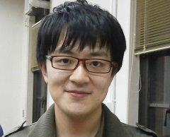
Fast Maximal Poisson-Disk Sampling by Randomized Tiling
TONG WANG, REIJI SUDA,
IST, University of Tokyo

Slide 2
Maximal
Poisson Disk Sampling

Slide 3
Poisson-disk sampling
Definition: Poisson-disk sampling pattern is a group of samples with no two of them within a specified distance r.
  Considered a good property in many applications.
Essentials in many computer graphics applications.
  Texture generation, Object placement, Rendering and anti-aliasing, Image stippling, etc.
r
d
Sample
Random
Poisson-disk

Slide 4
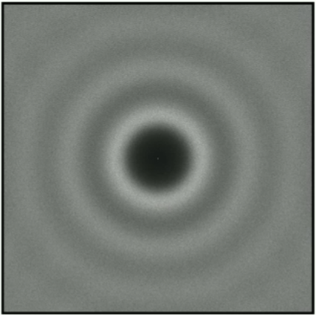
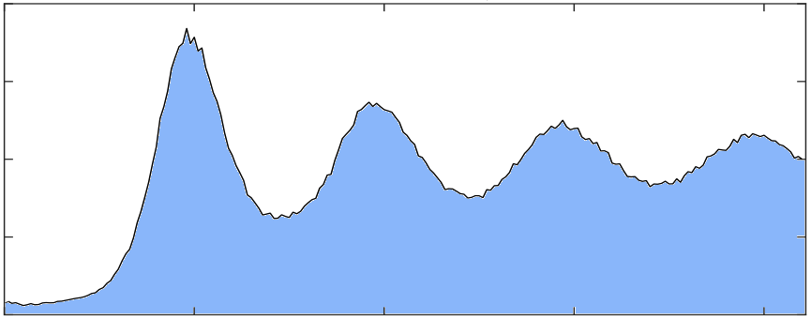
Blue noise property
One reason that Poisson-disk sampling is good for many applications is because of its blue noise spectral properties [1].
Frequency
Power
Samples
Power Spectrum
Radial Mean
[1] Gamito M N, Maddock S C. Accurate multidimensional Poisson-disk sampling[J]. ACM Transactions on Graphics (TOG), 2009, 29(1): 8.

Slide 5

Maximal Poisson-disk samples (MPS)
A Poisson-disk sample set is maximal coverage iff.
  For sample set as X in domain D.
Guaranteed the quality of samples.
  No big gaps and clusters.
  Evenly distributed sampling density.
r
Notes:
Maximal Poisson-disk samples ensured that there are no such points in the sample plane that are not covered by a sample disk with radius r.

Slide 6
Generate Poisson-disk samples
Dart throw
Relaxation
r
Often need many iterations to reach maximal coverage.

Slide 7
Tile based method
Sample Plane
Tile Set
…
Preprocessing.
  Generate tile set, etc.
Choose a tile from tile set.
Tile on the plane.

Slide 8
Tile based method
Extremely fast to fill the sample plane.
But
Preprocessing takes a long time.
Regular artifacts are not desirable in many applications.
Notes:
Tiling methods more or less have regular artifacts.

Slide 9
Add more randomness in tiling
Design the tile sets and tiling techniques: [1][2].
  Affect preprocessing and tiling performance.
Transform and rotate tiles to make tiles non-periodic: [3].
  But [3] didn’t deal with sample conflicts, which is not acceptable in many applications.
Randomly subdivide the space and fetch tiles on-the-fly.
  Our method.
[1]. Kopf J, Cohen-Or D, Deussen O, et al. Recursive Wang tiles for real-time blue noise[M]. ACM, 2006.
[2]. Wachtel F, Pilleboue A, Coeurjolly D, et al. Fast tile-based adaptive sampling with user-specified Fourier spectra[J]. ACM Transactions on Graphics (TOG), 2014, 33(4): 56.
[3]. Kalantari N K, Sen P. Fast generation of approximate blue noise point sets[C]//Computer Graphics Forum. Blackwell Publishing Ltd, 2012, 31(4): 1529-1535.Transactions on Graphics (TOG), 2012, 31(6): 171.
Notes:
To solve the regular artifacts, people are trying to add more randomness in tiling.

Slide 10
Performance and Regularity
For Poisson-disk sample generation:
Performance
Regular Sampling
Regular Tiling
Approximate Tiling^{[3]}
[1]. [Kopf J, Cohen-Or D, Deussen O, et al. Recursive Wang tiles for real-time blue noise[M]. ACM, 2006.
[2]. Ip C Y, Yalçin M A, Luebke D, et al. Pixelpie: Maximal poisson-disk sampling with rasterization[C]//Proceedings of the 5th High-Performance Graphics Conference. ACM, 2013: 17-26.
[3]. Kalantari N K, Sen P. Fast generation of approximate blue noise point sets[C]//Computer Graphics Forum. Blackwell Publishing Ltd, 2012, 31(4): 1529-1535.Transactions on Graphics (TOG), 2012, 31(6): 171.
[4]. Balzer M, Schlömer T, Deussen O. Capacity-constrained point distributions: a variant of Lloyd's method[M]. ACM, 2009.
[5]. Ebeida M S, Mitchell S A, Patney A, et al. A Simple Algorithm for Maximal Poisson‐Disk Sampling in High Dimensions[C]//Computer Graphics Forum. Blackwell Publishing Ltd, 2012, 31(2pt4): 785-794.
Ours
PixelPie^{[2]}
Wang Tiles^{[1]}
Flat Quad-tree Dart Throw^{[5]}
Regularity Artifact
Capacity Constrained
Relaxation^{[4]}
Lloyd’s Relaxation
Dart Throw

Slide 11
Our algorithm

Slide 12
Algorithm Outline
Prepare a pre-generated MPS pattern.
KD-tree based randomized tiling (KDRT) is divide-and-conquer based.
  Divide: Subdivide the sampling plane using KD-tree.
    Each leaf node square (2d case) is called a building block of the entire sampling plane.
  Tile: Fill each building block with points clipped from a pre-generated MPS pattern.
  Conquer: Eliminate conflicts on the edge, and insert new samples in the gap to ensure maximal coverage property.
Divide and clipping from MPS pattern are randomized, no regular artifacts.
Conquering process is determined and easy to convergence.

Slide 13
Prepare pre-generated pattern
Use any unbiased Poisson-disk sampling method to generate a pattern.
  Here we use algorithm described in [1] to generate a pattern.
Define a scale factor ratio as how many times samples that the final sampling plane contains compared with the pattern.
  The final sample set size is controlled by manipulate this parameter.
Pattern
Result
Ratio=2
Result
Ratio=4
[1]. Ebeida M S, Mitchell S A, Patney A, et al. A Simple Algorithm for Maximal Poisson‐Disk Sampling in High Dimensions[C]//Computer Graphics Forum. Blackwell Publishing Ltd, 2012, 31(2pt4): 785-794.

Slide 14
Divide: Subdivide the sampling plane
Building blocks of the sampling plane.
Conflict area that will be processed in conquering.

Slide 15
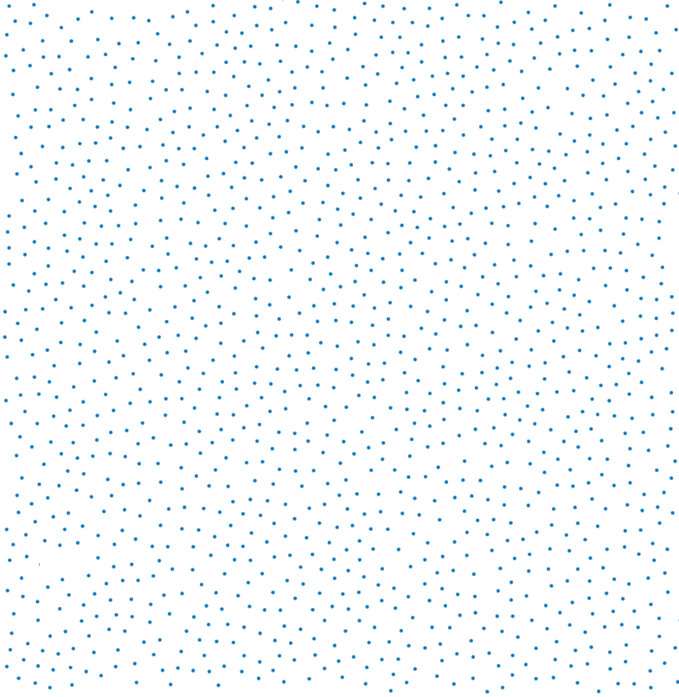
Tiling: Filling building block with samples
Notes:
Size of the leaf node will be controlled such that all dimensions of the leaf node will be smaller than 1/ratio.

Slide 16
Tiling: Filling building block with samples
MPS Pattern
Tilled Sampling Domain
Tile
Tile
Clipping
Tile
Tile
Tile
Clipping
Clipping
Tile
Clipping
Tile
Tile
(a)
(b)

Slide 17
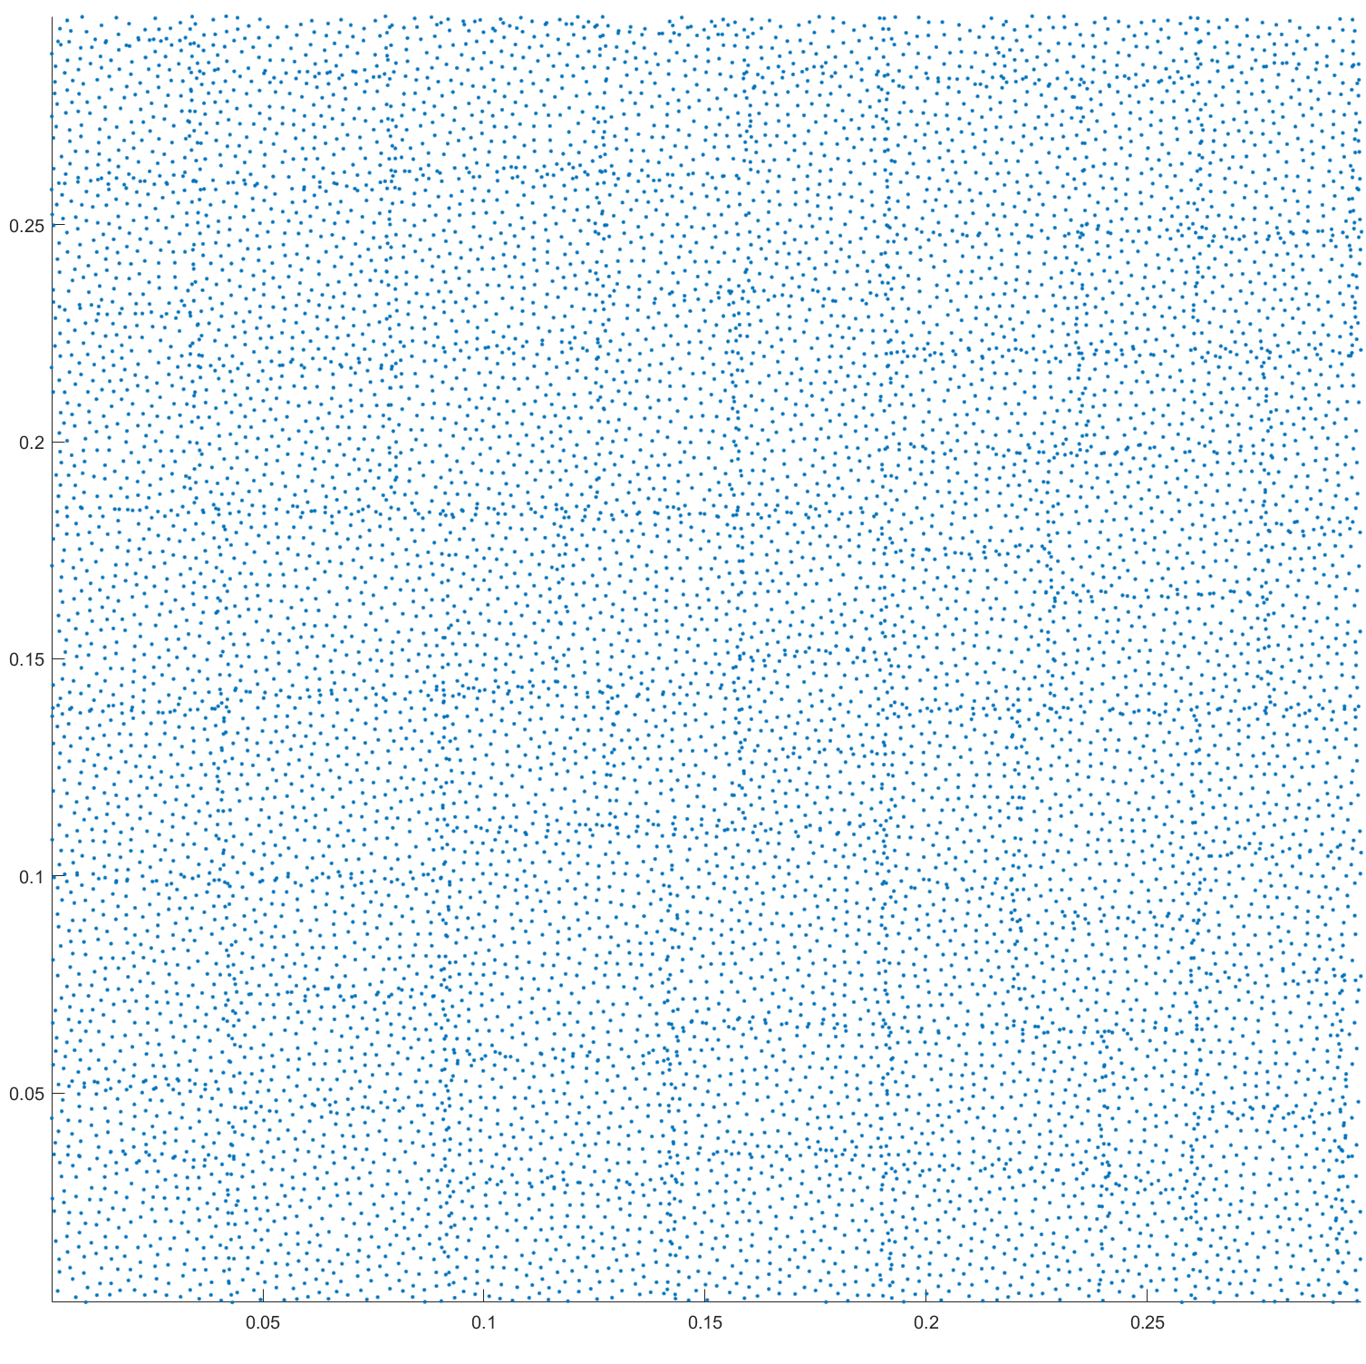
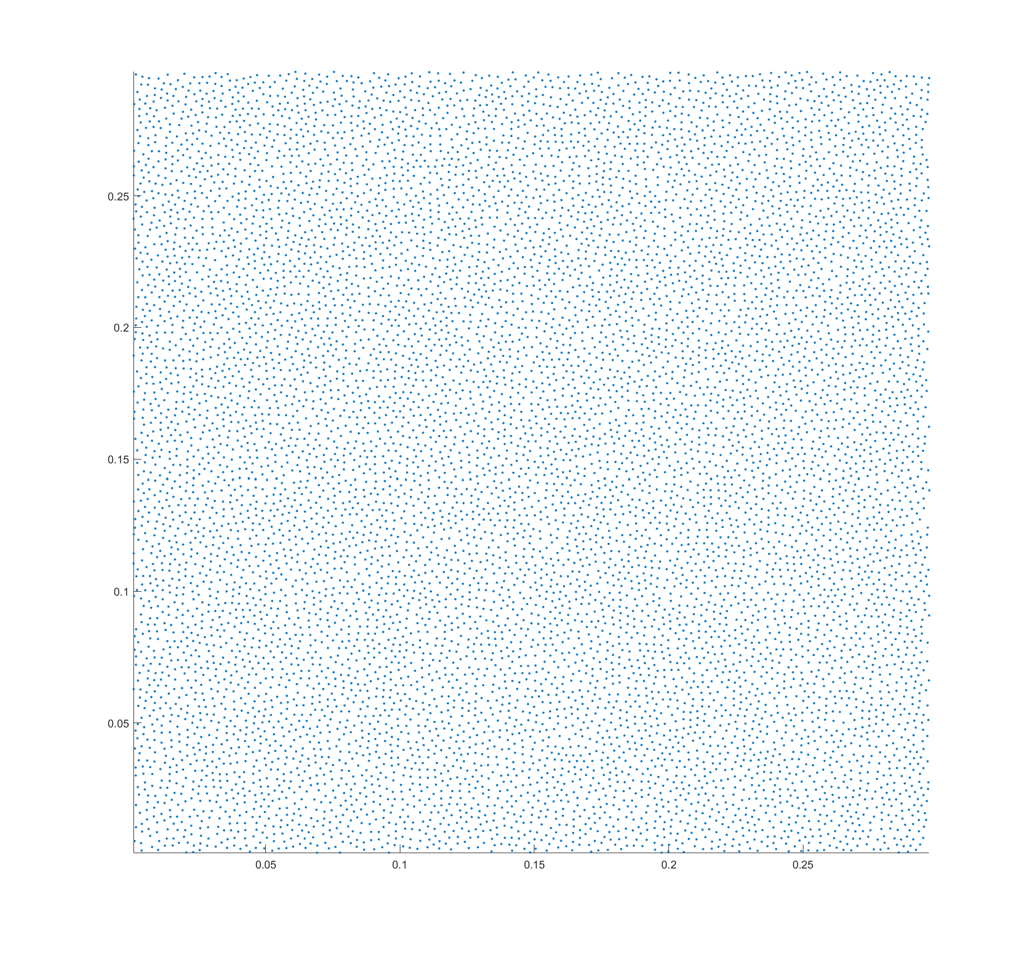
Tiling: Filling building block with samples
(a)
(b)
Notes:
It is maximal coverage, easy to prove. But it is not conflict-free, which is not acceptable.
Next step is to conquer all building blocks into one single sample set by elimination and insertion.

Slide 18
Conquering: Outline
Conquer
Conflict Area
Tile A
Tile B
Tile A
Tile B
: Eliminated
: Inserted
Conquering
Conquered Result

Slide 19
Conquering: Necessary Redundant
height
height+2r
width
width+2r
(a)
(b)
Notes:
Notice that we have some necessary redundant to keep the final result maximal.

Slide 20
Conquering: Gap detection
Gap detection^{[1]}: A gap exist among three disks centered at i,j,k ( i,j,k ∈ C ), if the circumcenter c of the triangle i,j,k is not covered by any disks.
i
i
j
k
k
j
[1]. Yan D M, Wonka P. Gap processing for adaptive maximal Poisson-disk sampling[J]. ACM Transactions on Graphics (TOG), 2013, 32(5): 148.

Slide 21
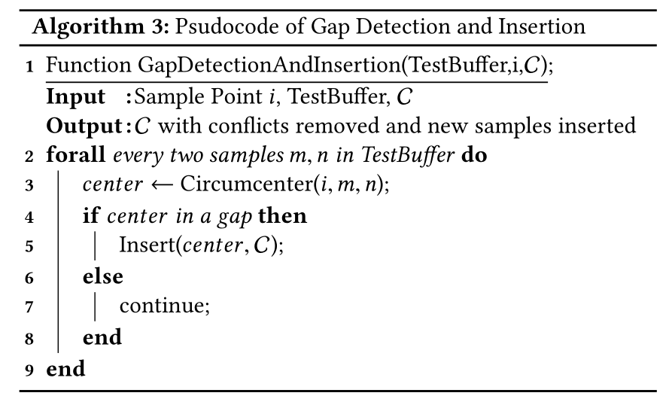
Conquering: Elimination
Processing yellow point.
Eliminate red point to avoid conflicts.
Insert blue point to ensure maximal coverage.

Slide 22
Conquering: Insertion
Notice that there are circumstances that if GapDetectionAndInsertion being applied on all sample points p ∈ C , it is not guaranteed that all gaps could be covered.
(1). Processing yellow disk
(2). Red disk eliminated
gap generated
(3). Green disk
inserted in gap
(a) Gaps that cannot be covered by single insertion

Slide 23
Conquering: Insertion
Notice that there are circumstances that if GapDetectionAndInsertion being applied on all sample points p ∈ C , it is not guaranteed that all gaps could be covered.
(1). Processing yellow disk
(2). Red disk eliminated
gap generated
(3). No gaps detected,
No insertion
(b) Gaps that cannot be detected by current processing sample

Slide 24
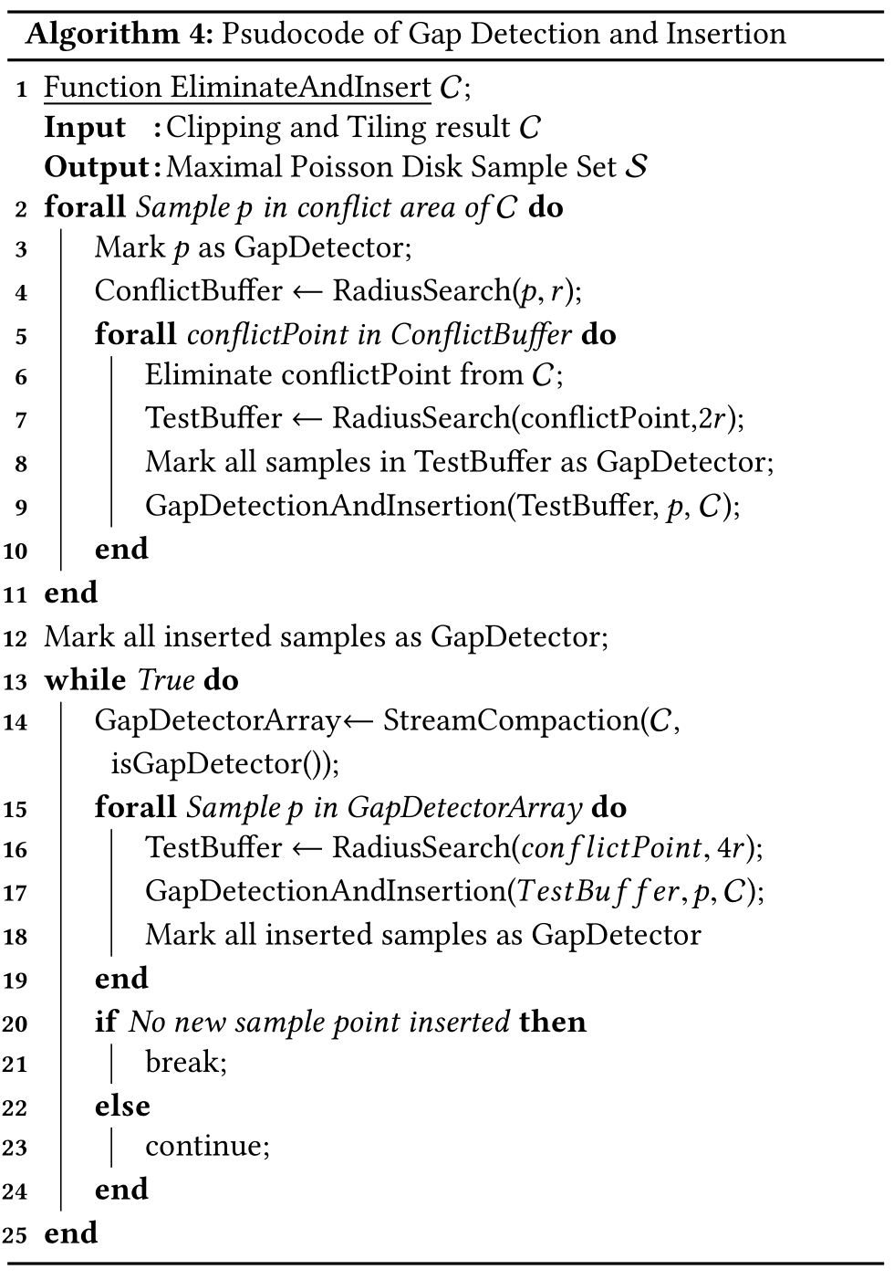
Conquering: Insertion
All samples are
marked as gap detector
New gaps detected
by the green disk
k
i
j
All samples are
marked as gap detector
Gap detected by triangle i,j,k
while dealing one of the vertex
Notes:
To solve these problems, introduce gap detector.
When a sample point is eliminated from the original set due to conficts with pivot point, we mark all disks intersecting the eliminated sample point as GapDetectors.
All gaps are formed by arcs of gap detectors.

Slide 25
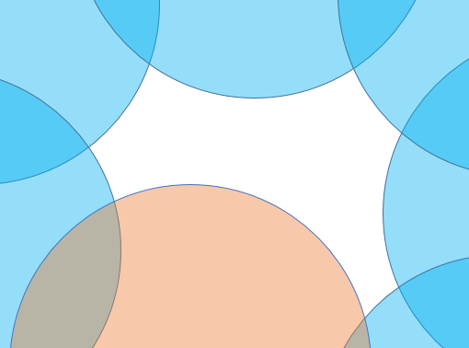
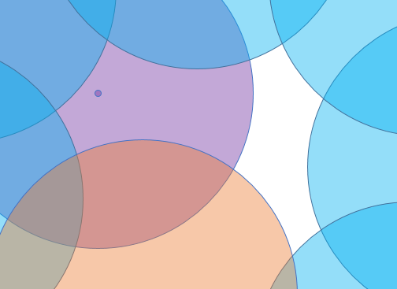
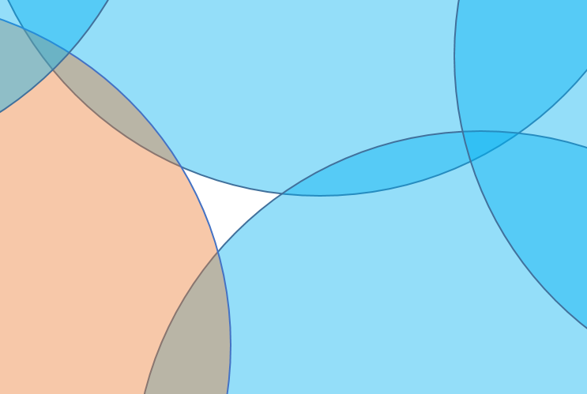
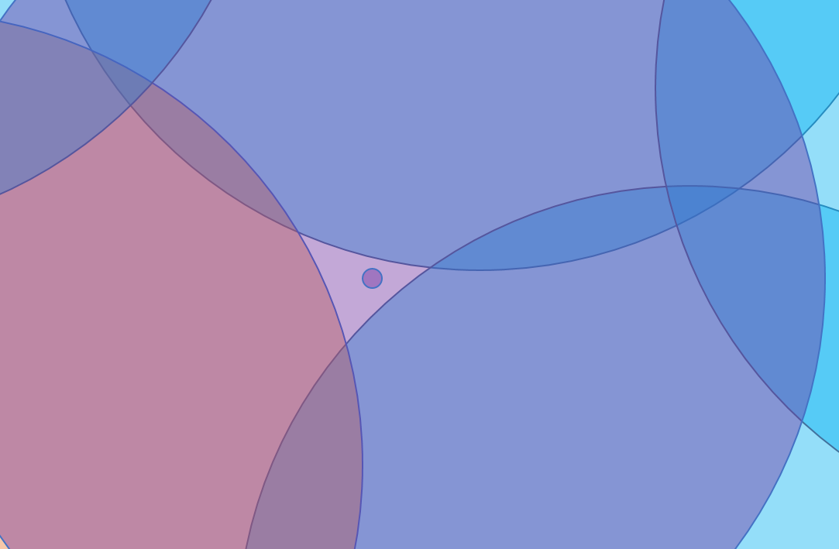
Conquering: Insertion
All gaps can be detected this way.
Type N Gap
Type N-1 Gap
Type 1 Gap
No Gap
Notes:
If we defne a gap that need at most N inserted points
to cover as type N gap, then each iteration solves the type 1 gap,
and reduce the type of other gaps by 1. As each gap must have a
fnite number of type, in this case, the algorithm is able to meet a
termination condition, which is all gap type decreased to 1, and
then solved by a single insertion loop.

Slide 26
Results

Slide 27
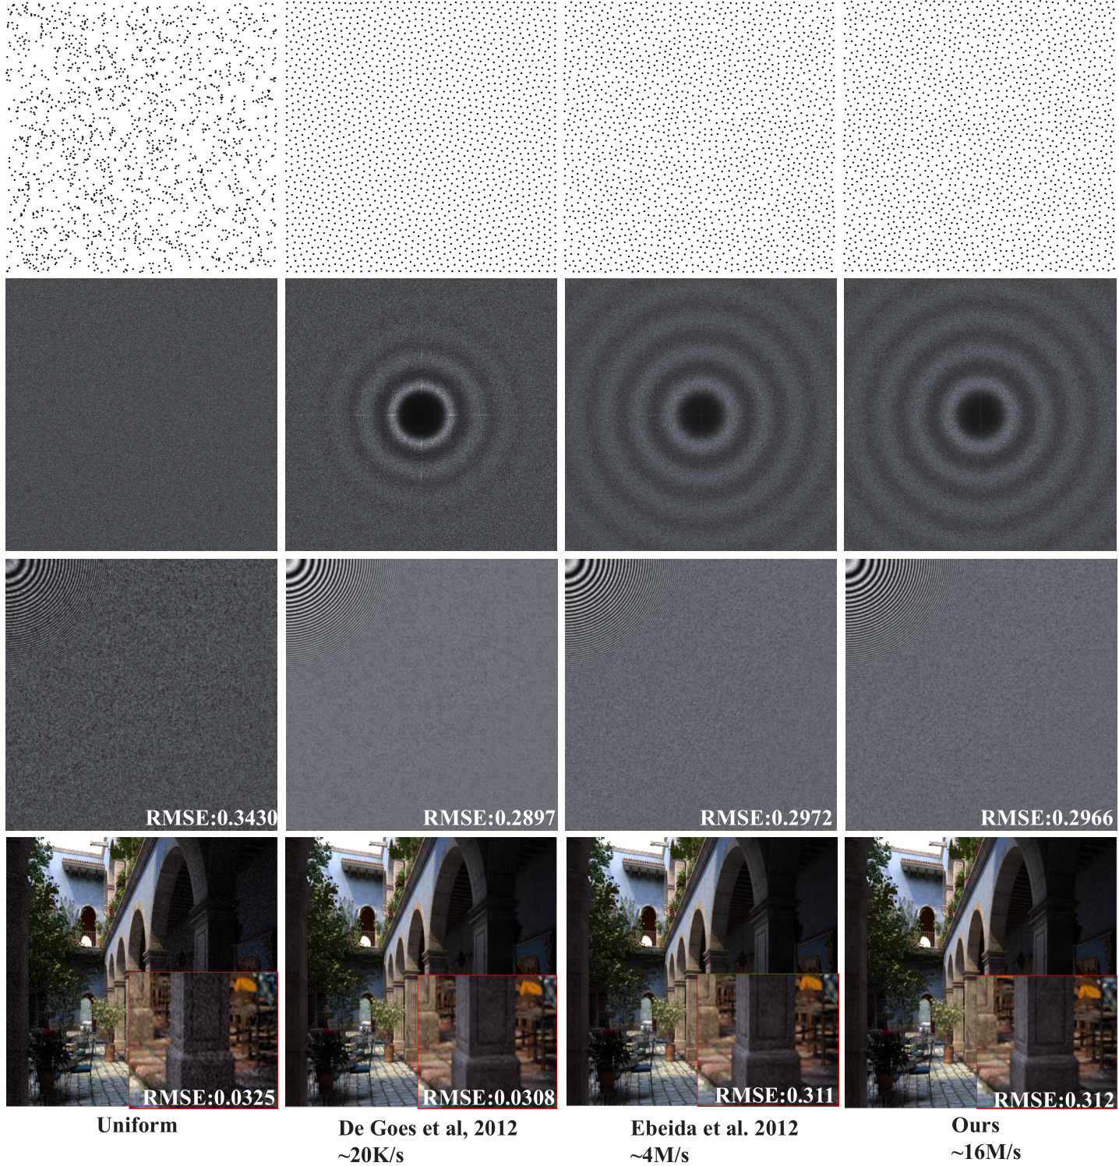
Results
Notes:
Rendering and anti-aliasing may not be the best application for MPS, but it shows that the samples generated with our method performs quite similar to the unbiased MPS samples.

Slide 28
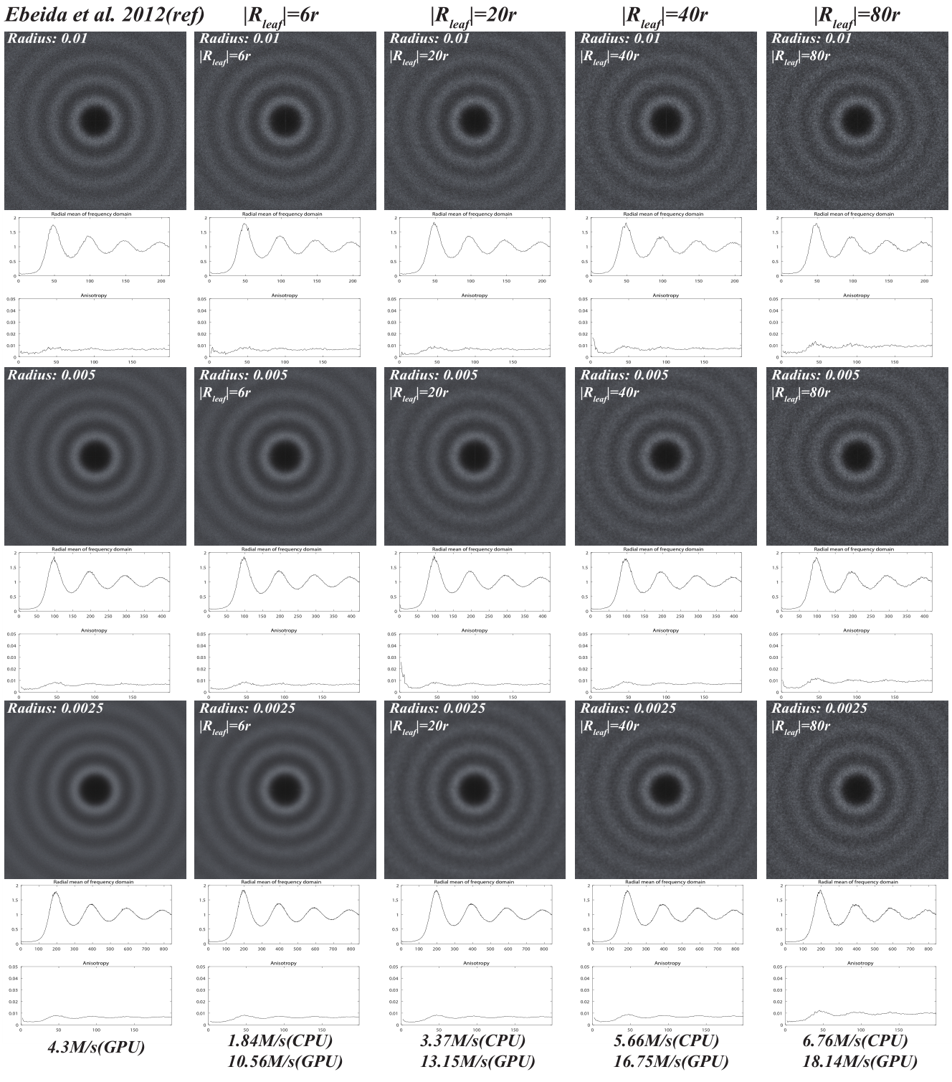
Results

Slide 29
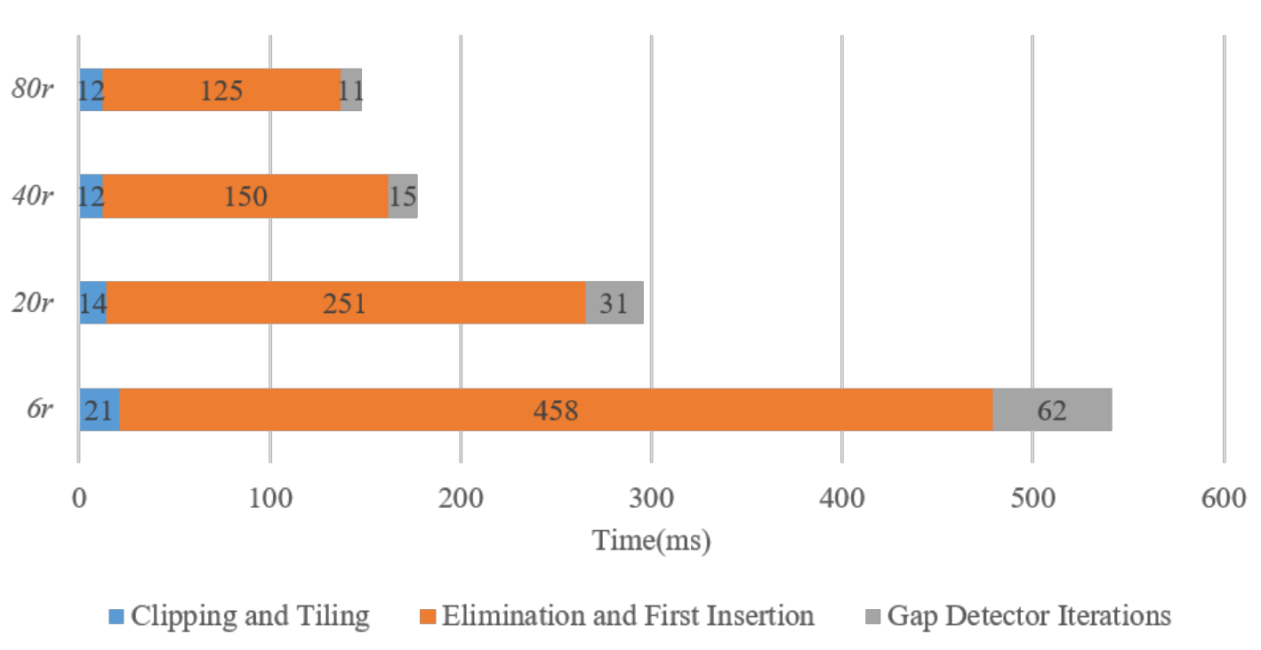
Results
Time taken by each procedure to generate 1 million samples.

Slide 30
Combining MPS sample sets
Vertical Zipping Result
9 MPS set each 1017625 samples
Vertical Zipping
3 MPS set each 2991817 samples
Horizontal Zipping
Result with 8795941 samples
Combining Size | CPU Time (ms)
3751372 | 85
4689216 | 102
5861520 | 144
7326900 | 158
9158625 | 202

Slide 31
Conclusion
KDST is a tile based method that can generate maximal Poisson-disk samples.
KDST is a divide and conquer method, including:
  Divide: Randomly divide the sample plane into building blocks.
  Tiling: Fill the building blocks with samples clipped from a pre-generated pattern.
  Conquer: Eliminate conflict points and insert new points in the gap.
Conquering step can be used to combine MPS sample sets together to form a larger one.
KDST performs fast on CPU and GPU, and is very easy to implement.

Slide 32
Thank you!
Thanks for all reviewers for your constructive comments.
Special thanks to Anjul Patney for his efforts to help the author to get the U.S. visa.

