Slide 1
A Fast Method to Calculate the Volumetric Divergence Metric for Evaluating the Accuracy of the Extracted Isosurface
Cuilan Wang
Georgia Gwinnett College
High-Performance Graphics 2018
August 10-12, Vancouver, BC

Slide 2
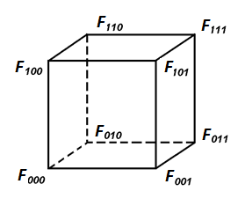
Isosurface Extraction
Usually: 3D scalar rectilinear volumes
Trilinear interpolation
Commonly used to model the interior of each dataset cell especially when the underlying data function is unknown
where F_{ijk} denotes the value at cube corner, i,j,k = 0,1, and (x, y, z) are local coordinates in a cube,
0 ≤ x ≤1, 0 ≤ y ≤1, 0≤ z ≤1.

Slide 3
Isosurface Extraction Algorithms
Example: Marching Cubes
Produce a triangular mesh to approximate the isosurface given by trilinear interpolation
Accuracy
Closeness of the mesh and the trilinear interpolation isosurface

Slide 4
Estimating Accuracy of the Produced Mesh
Benefits
Researchers: design new isosurfacing algorithms
The extracted mesh with high accuracy are useful:
Users need to substantially zoom into the data.
Medical applications where thin specimens or internal small cavities need to be viewed.

Slide 5
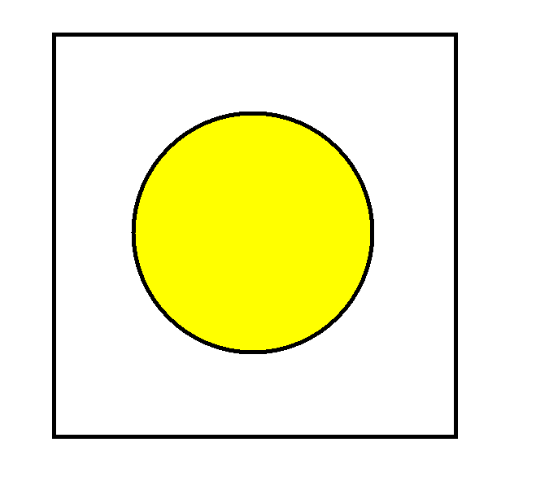
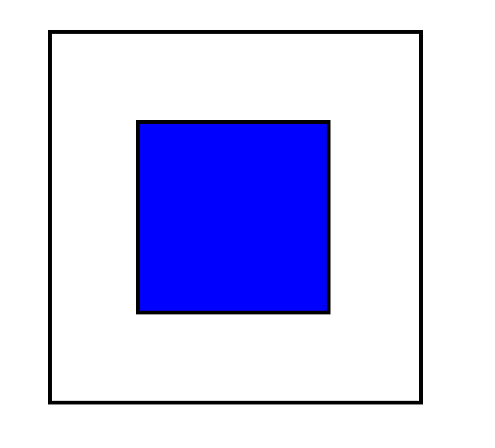
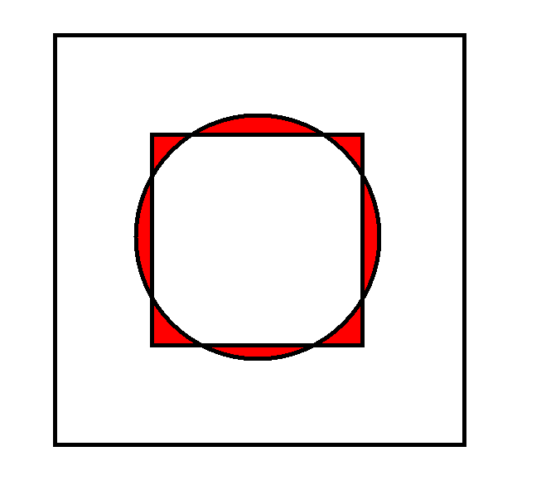
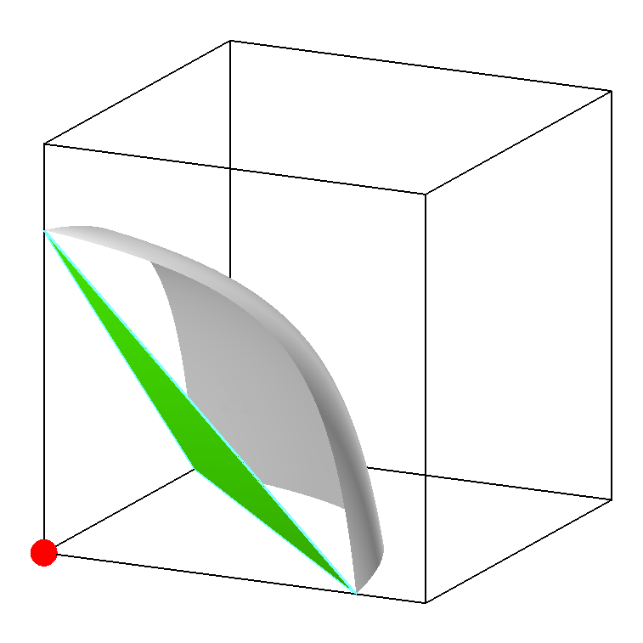
Volumetric Divergence (VD) Metric
Volumetric divergence of two closed surfaces A and B:
, where
A
B
R
It is a natural and accurate metric to measure the closeness between two surfaces.
To measure the accuracy of the extracted isosurface
A: extracted triangular mesh
B: trilinear interpolation isosurface

Slide 6
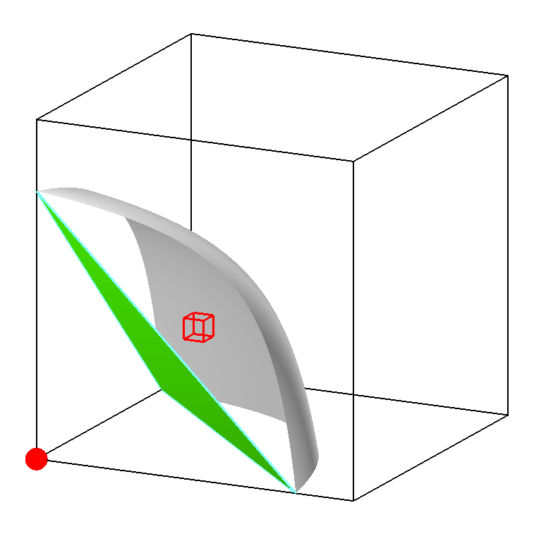
Volumetric Divergence Calculation
The previous method (i.e., VDC method) [1] is a numerical approach
Recursively subdivide a cube into 8 subcubes until a certain subdivision depth is reached or other termination criteria are satisfied.
Determine each subcube’s contribution to the volumetric divergence and sum the contributions.
When the subdivision depth is high, the produced VD metric is very accurate, but the execution time is very long

Slide 7
Goal
Develop a new VD calculation method faster than the previous method when both methods achieve the same level of accuracy
Make the VD metric used in real time to benefit isosurface extraction algorithms, such as Multi-Resolution MC [2]
Solution
Combine an analytical approach and a numerical approach

Slide 8
Related Work

Slide 9
Measure Representational Accuracy
Global geometric metrics
Surface area, volume inside the meshes [3]
Do not measure local deviation well
Distance based metrics
Quadric error metric [4], Hausdorff distance [5]
Consider only some points (e.g., mesh vertices) of the mesh
Metro Scheme [6]
At densely sampled locations
Shortcomings
Not exhaustive
One-sided (i.e., not symmetric)
Approximate measures of mesh distance
Notes:
Due to the complex shape of the trilinear interpolation isosurface, the most common way to check the accuracy of the extracted isosurface mesh in representing the trilinear interpolation isosurface has been to use visual comparison.
Visual examination can allow evaluation of smoothness and maintaining of the notable shape features.
Often a high resolution triangular mesh serves as the reference of the trilinear interpolation isosurface.
In this situation, this problem becomes comparing two meshes.
Thus, measures related to the closeness of the meshes including global geometric metrics and distance-based metrics.
Examples of global geometric metrics are isosurface surface area and volume inside the isosurface.
However, such metrics don’t well-measure local deviation of meshes.
For example, these two figures show cut away views of surface A and surface B.
Surfaces A and B have the same boundary size and they enclose
the same amount of space in both figures. However, the measures here fail to differentiate that the
two surfaces has more similar boundaries in the left figure than in the right one.

Slide 10
The Slicing Method

Slide 11
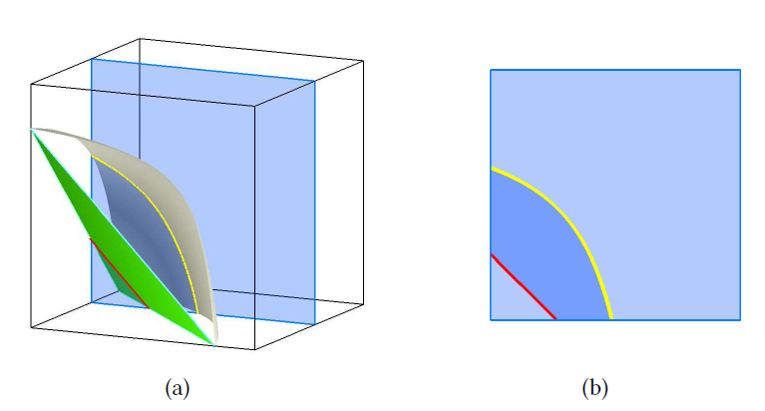
The Overall Method
Analytical approach
On each slice, the cross section of the VD region is enclosed by the isocontour hyperbola and the iso-polyline. Its area can be calculated analytically.
Numerical approach
Similar to integrating areas to find volume

Slide 12
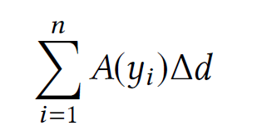
The Overall Method
Suppose the cube is evenly sliced along the y-axis. The volume of the VD region is approximated by
, where n is the number of slices, $∆d=1/n$ , and $A\left(y_{i}\right)$is the cross-sectional area of the VD region on the slice $y=y_{i}$.
The more that the cube is sliced, the more accurate the result is.

Slide 13
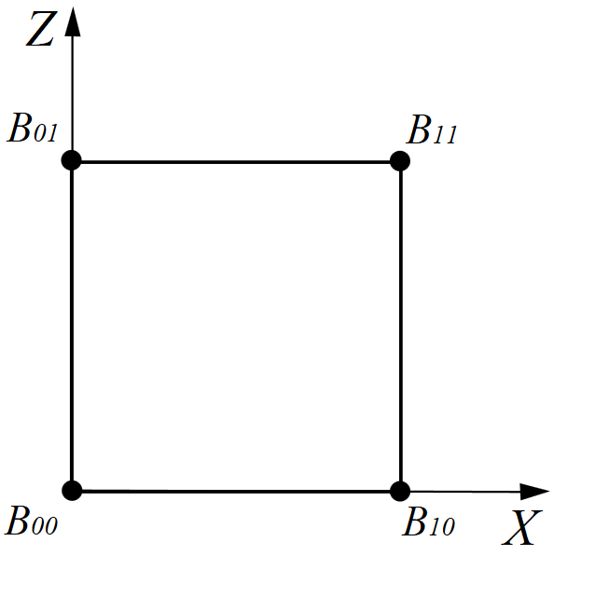
Area Under Hyperbola
The bilinear interpolation function over a slice is
It can be rewritten as
where

Slide 14
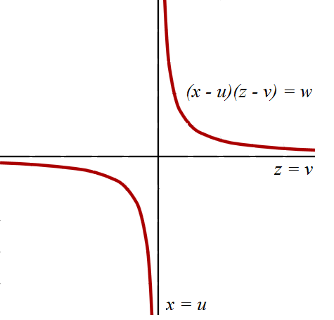
Area Under Hyperbola
Let $β$ be the isovalue.
The bilinear interpolation isocontour is defined as
It can be rewritten as
It can be expressed as $z$being
a function of $x$:

Slide 15
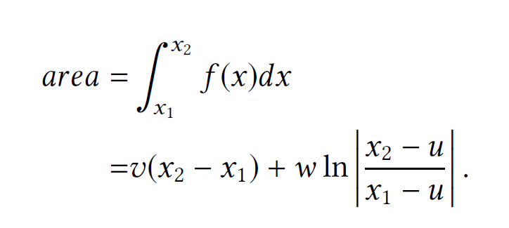
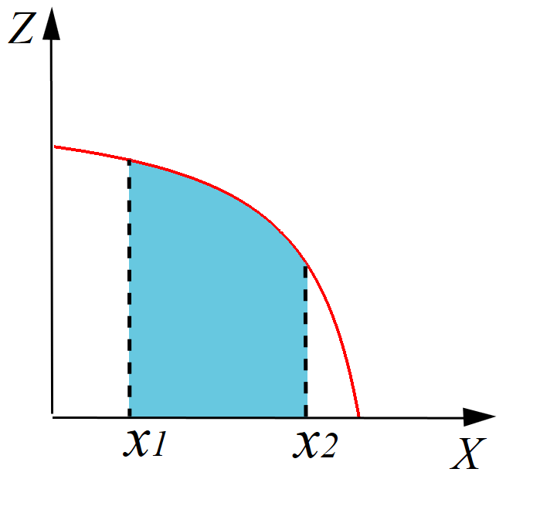
Area Under Hyperbola
Integrating $z=f(x)$between the limits of $x_{1}$and $x_{2}$ to get the area under hyperbola:

Slide 16
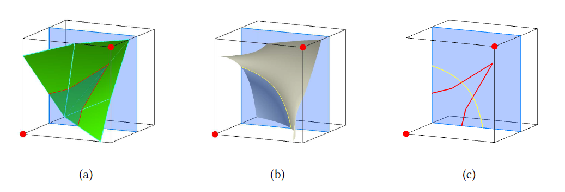
Slice Partition
The iso-polyline may intersect with the isocontour hyperbola

Slide 17
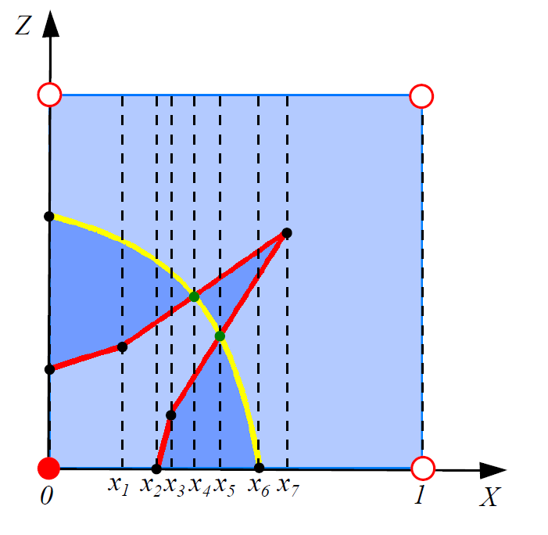
Slice Partition
To partition, use the x values of the following points:
Iso-polyline vertices
intersection points of isocontour hyperbola and slice edges
Intersection points of iso-polylines and isocontour hyperbola

Slide 18
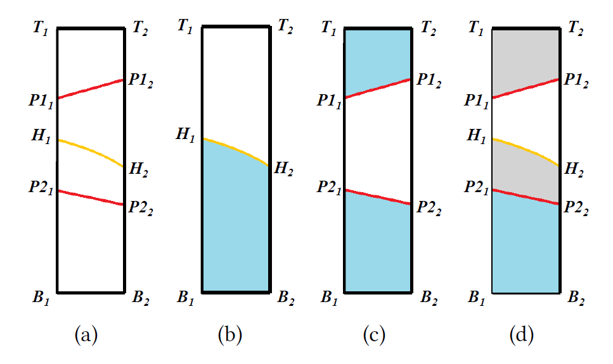
Subregion Division
The iso-polylines and the isocontour hyperbola divide a subregion into several segments.
The segments that are inside one type of the surface but outside the other belong to the VD region.

Slide 19
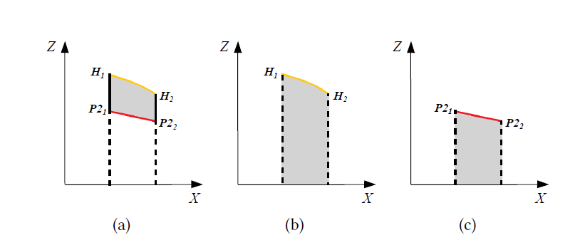
Calculating the Area of a Subregion Segment
Area under the upper boundary (b) subtracting the area under the lower boundary (c) yields the subregion segment area (a).

Slide 20
Results

Slide 21
Experimental Settings
The unit of the VD metric is the volume of a unit cube, which is set to 1.
Two depths
VDC method – subdivision depth $s$
Slicing method – partition depth $p$
Number of slices = $2^{p}$

Slide 22
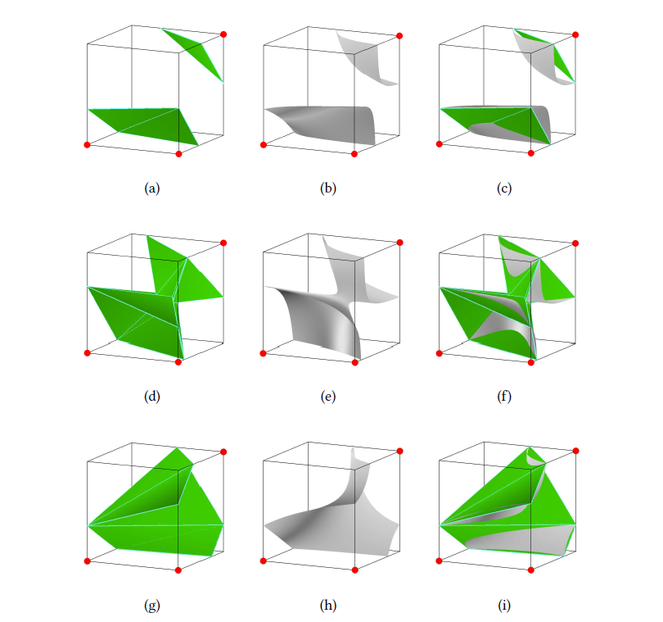
Individual Cube Instances
Three instances of base case 6. 1. 1, 6. 1. 2, and 6. 2
6.1.1
6.1.2
6.2
Extracted
Isosurface
Tri. Inter.
Isosurface
overlay

Slide 23
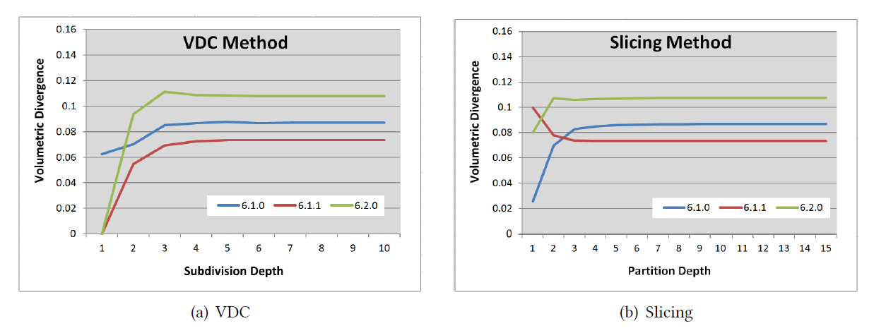
Individual Cube Instances
Both methods converge and they converge to the same set of values

Slide 24
Randomly Generated Instances
Test 1000 randomly generated instances for each of three isovalues: 63, 127, and 191
Use the VDC method with subdivision depth 10 as the baseline

Slide 25
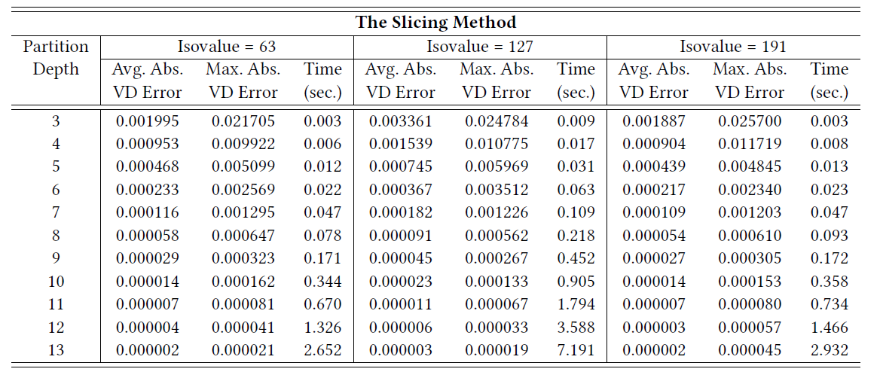
Randomly Generated Instances

Slide 26
Randomly Generated Instances

Slide 27
Randomly Generated Instances
Map the VDC method and the Slicing method with the same level of accuracy.

Slide 28
Randomly Generated Instances
Performance comparison

Slide 29
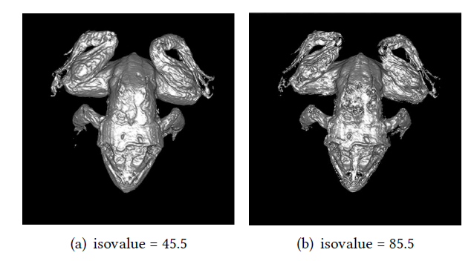
Real Datasets
Performance comparison

Slide 30
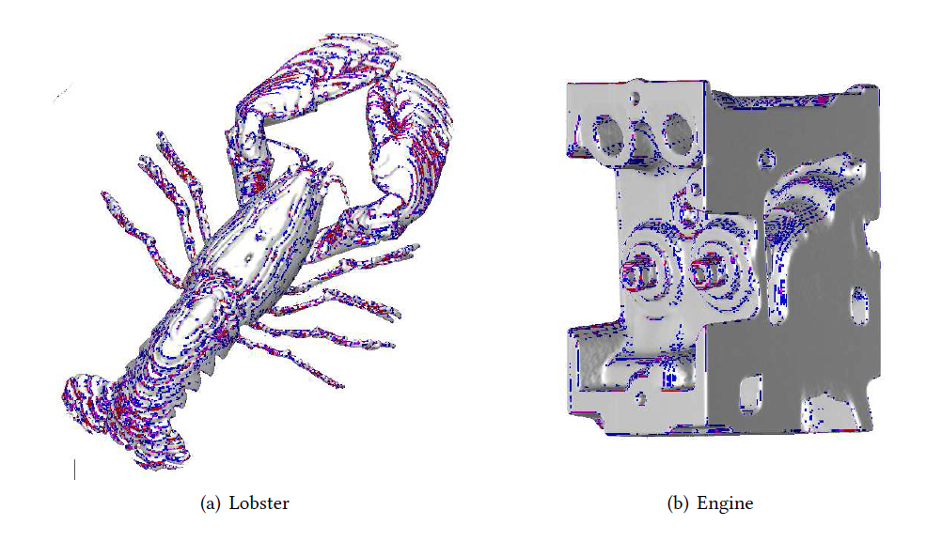
Real Datasets
Rendering of two real datasets where the mesh has large error is rendered in color

Slide 31
Application of the Slicing Method in Adaptive Isosurface Extraction
Three methods are compared
Marching Cubes (MC)
Multi-Resolution Marching Cubes (MRMC) in [2]
Use the Slicing method to calculate the VD metric values
Mesh at the cubes where the VD metric values are larger than a threshold is refined.
Dividing Cubes with subdivision depth 1 (DC1)

Slide 32
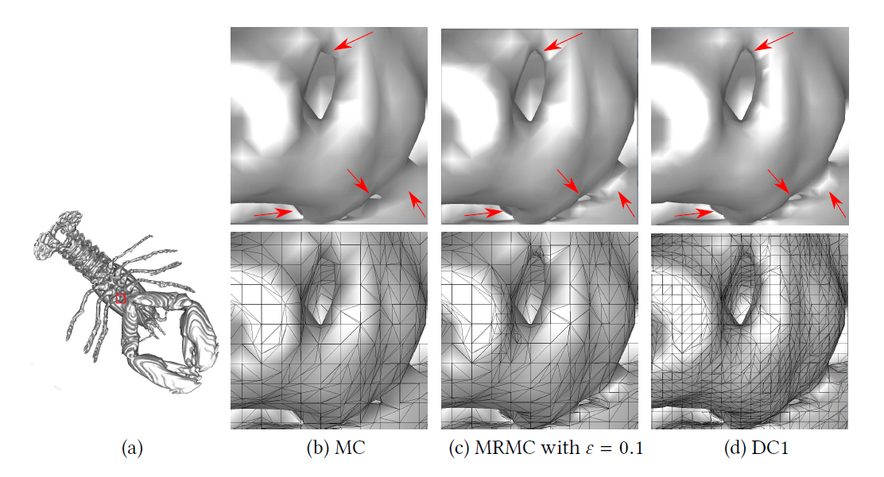
Application of the Slicing Method in Adaptive Isosurface Extraction

Slide 33
Conclusion and Future Work

Slide 34
Conclusion
Both methods are correct and are capable of producing highly accurate VD metric values.
The new method is about 15-70 times faster than the previous method.

Slide 35
Potential Future Work
Modify the method to compute
Volume between two meshes
Check the closeness of the two meshes
Volume between two isosurfaces
Reveal the change rate of the isosurfaces
May be used to guide the selection of the representative isovalues of a dataset
Volume between a mesh and an isosurface where the underlying data function is known, but not trilinear interpolation isosurface

Slide 36
Questions?

Slide 37
Thank you!

Slide 38
References
[1] C. Wang, T. Newman, J. Lee: On accuracy of marching isosurfacing methods, In Proceedings of the Eurographics/IEEE VGTC Workshop on Volume Graphics '08, Los Angeles, CA, USA, pp. 49-56, 2008
[2] C. Wang and S. Lai, Adaptive Isosurface Reconstruction Using a Volumetric-Divergence-Based Metric, In Proceedings of 12th International Symposium on Visual Computing (ISVC ’16), Las Vegas, NV, USA, pp. 367–378, 2016.
[3] G. Treece, R. Prager, A. Gee, Regularised Marching Tetrahedra: Improved Iso-surface Extraction, Computers & Graphics, Vol. 23, pp. 583-598, 1999.
[4] M. Garland and P. Heckbert, Surface Simplification Using Quadric Error Metrics. Computer Graphics (SIGGRAPH '97 Proceedings), vol. 31, pp. 209-216, 1997.
[5] R. Klein, G. Liebich, and W. Straber, Mesh Reduction with Error Control, Proceedings of Visualization '96, San Francisco, pp. 311-318, 1996.
[6] P. Cignoni, C. Rocchini, R. Scopigno, Metro: Measuring error on simplified surfaces. Comp. Graphics Forum 17, Vol. 2, pp. 167–174, 1998

