Slide 1
Revisiting The Vertex Cache
Understanding and Optimizing
Vertex Processing on the modern GPU
Bernhard Kerbl
Michael Kenzel
Elena Ivanchenko
Dieter Schmalstieg
Markus Steinberger

Slide 2
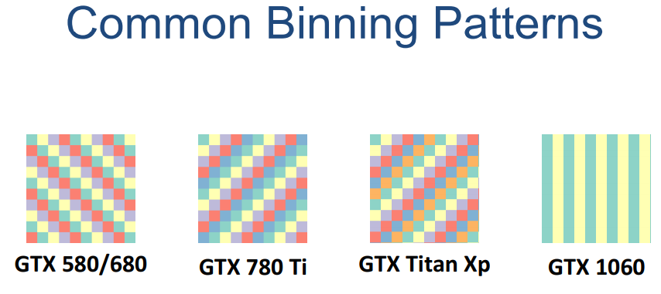

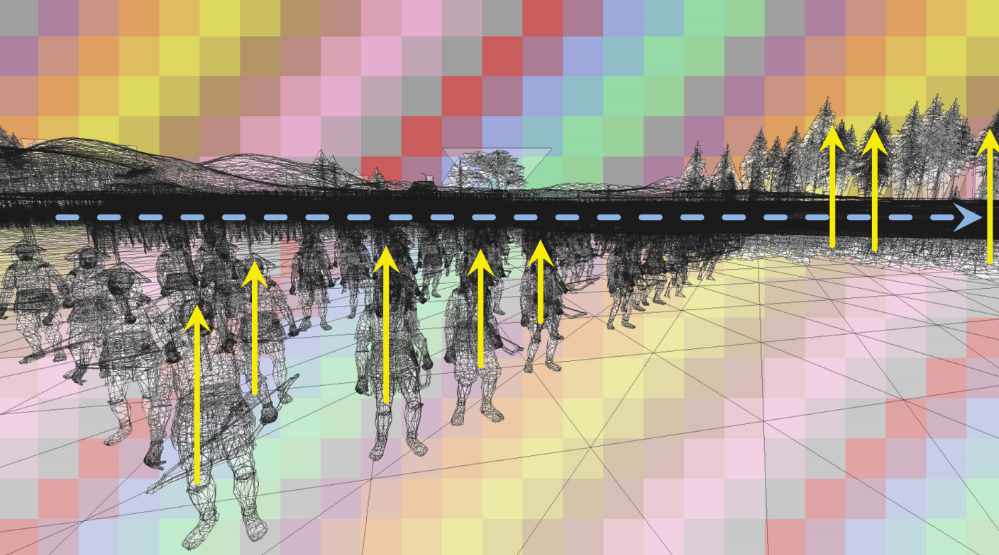
Last year‘s talk at HPG‘17

Slide 3

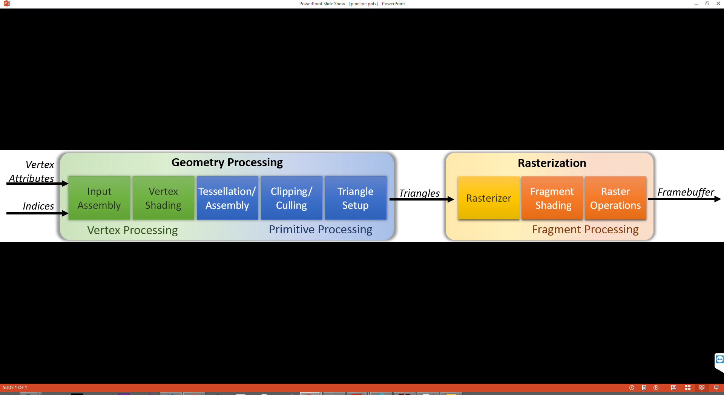
This year‘s talk

Slide 4

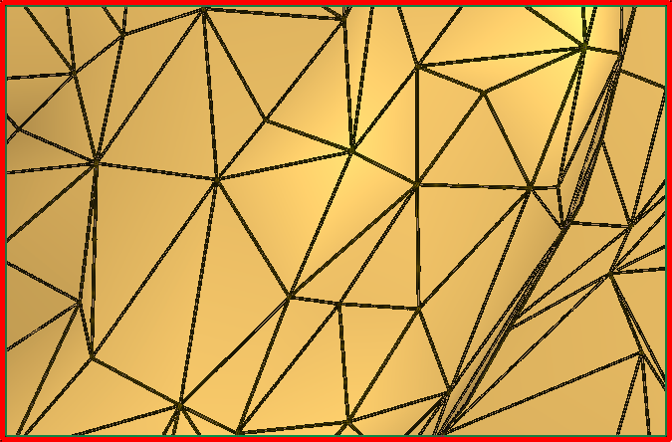
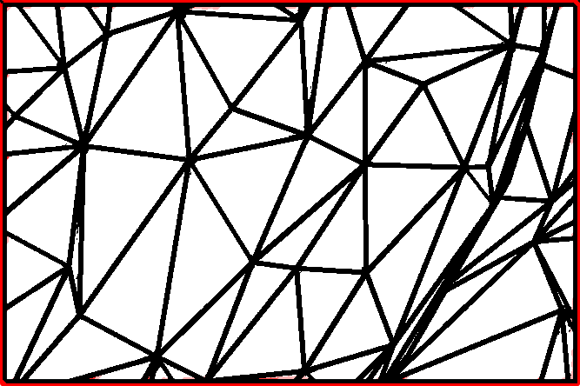

Reuse in Triangle Meshes
Exploit high vertex valence
Ex.: Triangle strips, fans…
Index list can cause $≪1.0$shaded vertex per triangle
2
3
4
1
5
7
6

Slide 5
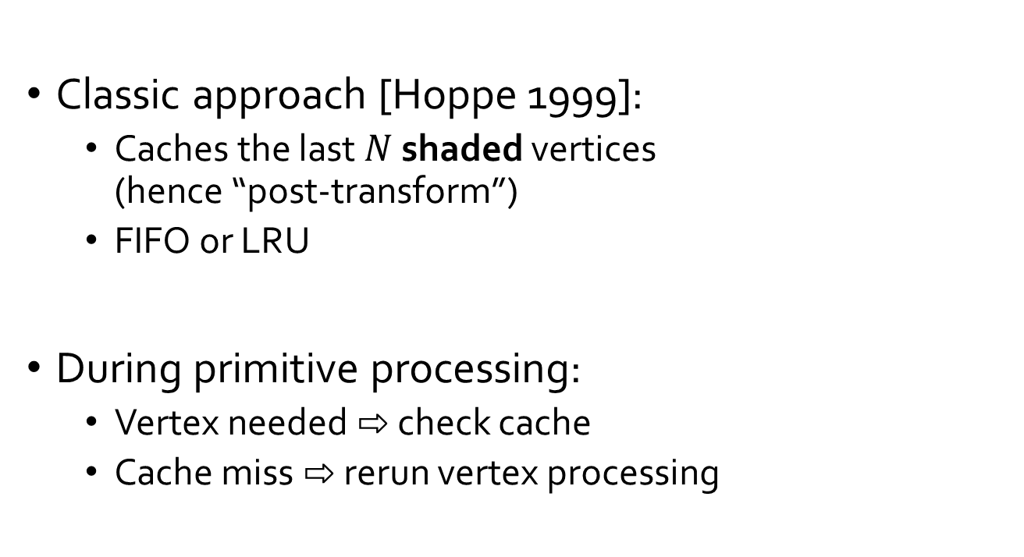
Post-transform Vertex Cache
Vertex Processing
Classic approach [Hoppe 1999]:
  Caches the last $N$ shaded vertices
  (hence “post-transform”)
  FIFO or LRU
During primitive processing:
  Vertex needed ⇨ check cache
  Cache miss ⇨ rerun vertex processing
Vertex Cache
Primitive Processing

Slide 6
Mission Statements
Assess caching for massively parallel devices
Identify actual GPU workload distribution scheme
Optimize vertex input order for the modern GPU

Slide 7
Aspects of Vertex Reuse
Vertex Reuse
Mesh Optimization
Scheduling of vertex processing to
Exploit locality of vertex references
This work
Reordering of the index stream to
Maximize locality of vertex references
Most previous work

Slide 8
Mesh Optimization Algorithms
Exploit existence of cache and reorder vertices to minimize Average Cache Miss Rate (ACMR)
Greedy algorithms: add new triangles to reordered list based on a score function
Usually build triangle strips to reduce run time

Slide 9



Cache-based Mesh Optimizers
D3DXMesh
(Hoppe, 1999)
K-Cache Reorder
(Lin & Yu, 2006)
AMD Tootle Tipsify
(Sander et al., 2006)
Images used from Pedro V. Sander, Diego Nehab, and Joshua Barczak. Fast Triangle Reordering for Vertex Locality and Reduced Overdraw. ACM Transactions on Graphics (Proc. SIGGRAPH) 26(3), August 2007.

Slide 10
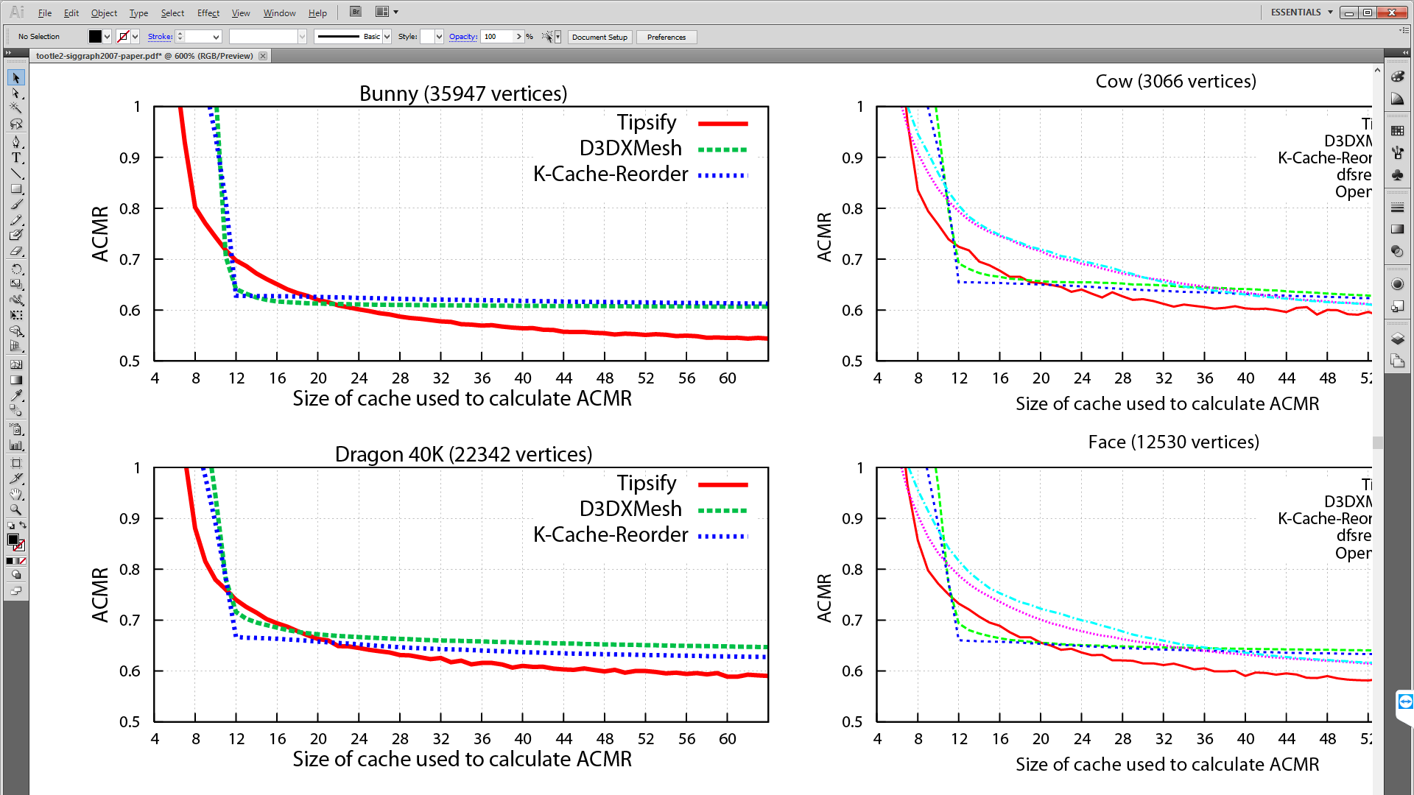
Cache Optimizer Performance
Ability to reduce
overall ACMR
Parameterized
with cache size
Usually better as
cache gets bigger
Images used from Pedro V. Sander, Diego Nehab, and Joshua Barczak. Fast Triangle Reordering for Vertex Locality and Reduced Overdraw. ACM Transactions on Graphics (Proc. SIGGRAPH) 26(3), August 2007.

Slide 11
Mission Statements
Assess caching for massively parallel devices
Identify actual GPU workload distribution scheme
Optimize vertex input order for the modern GPU

Slide 12
Cache with Massive Parallelism
Streaming Multiprocessor
Streaming Multiprocessor
Warp
Warp
Warp
Warp
Warp
Warp
Warp
Warp
Warp
Warp
Warp
Warp
Warp
Warp
Warp
Warp
Cache (?)
Streaming Multiprocessor
Streaming Multiprocessor
Warp
Warp
Warp
Warp
Warp
Warp
Warp
Warp
Warp
Warp
Warp
Warp
Warp
Warp
Warp
Warp

Slide 13
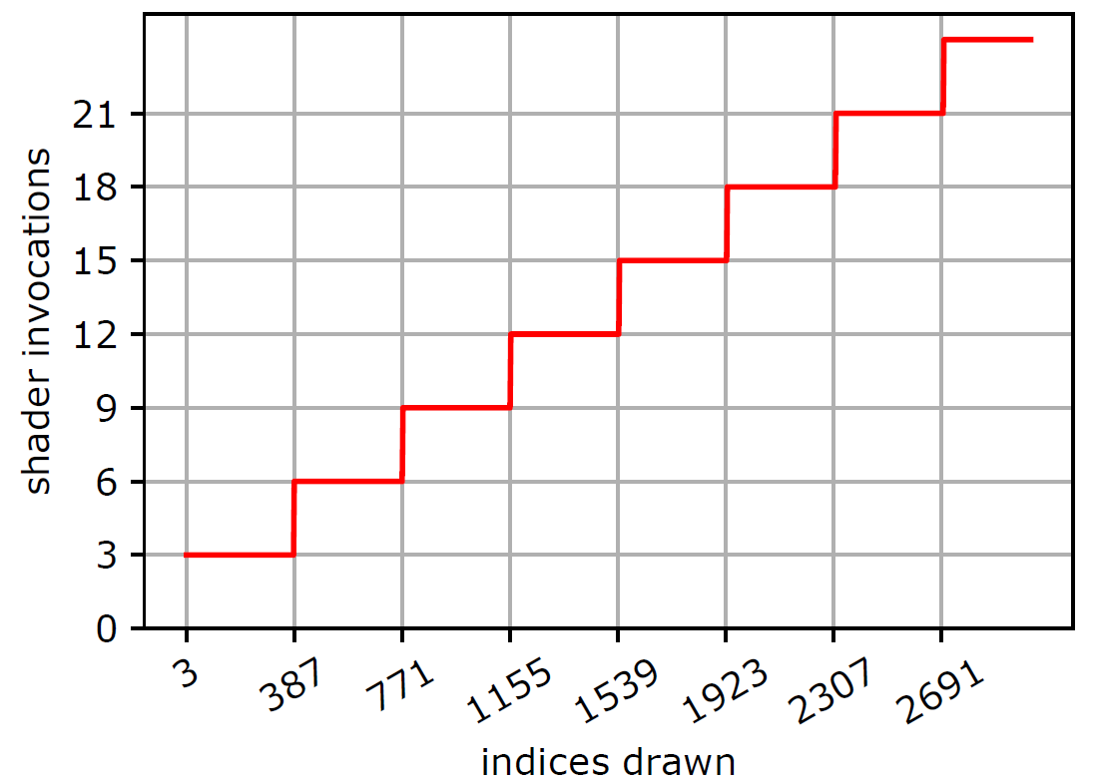
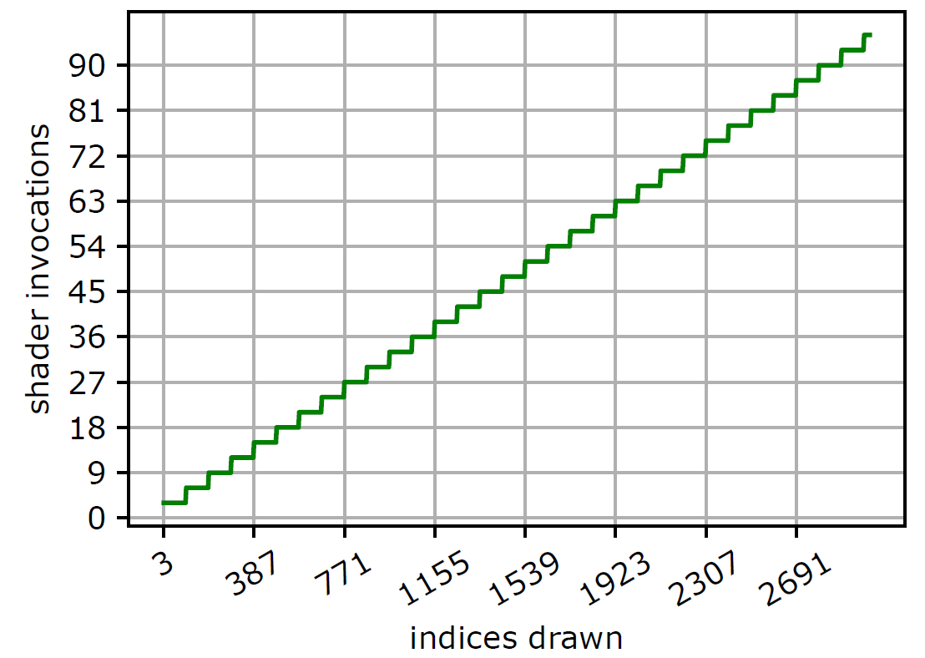
Counting Vertex Shader Calls
Use atomic counter for vertex indices (0,1,2|0,1,2|...)
Atomically increment counter in each shader call
384
96
AMD
Nvidia

Slide 14
In-depth analysis
Shader Model 6.0 supports wave communication
Enables us to see the mapping of vertex indices to individual wavefronts for processing
  On AMD we see large portions of reused range
  On Nvidia corresponds to full set of reusable vertices
0, 1, 4, 6, 3, 7, 5
0, 1, 2, 3, 4, 5
6, 7, 8, 2, 5, 3
4, 6, 7, 5, 9, 1, 2

Slide 15
Findings and Interpretation
Limited reuse indicates independent batches
Contradicts idea of a central vertex cache
If there are multiple reuse modules (e.g. per SM), they appear to be cleared with every new batch
No reuse in post-transform manner – submitted load produces optimal parallelism under reuse!

Slide 16
GPU Batching
Hardware tries to consolidate idea of vertex reuse and massively parallel independent processing
Solution: reuse should not be detected after vertex transformation, but before
Analyze input stream and make explicit choices on how to split to enable reuse and load balancing

Slide 17
Mission Statements
Assess caching for massively parallel devices
Identify actual GPU workload distribution scheme
Optimize vertex input order for the modern GPU

Slide 18
The Batch Predictor
Analyzes input stream and splits list to produce batches of primitives to balance workload
Can be implemented in hardware or software
Considers at least 3 limiting factors
  Number of indices in batch
  Number of shader calls
  Retention model for reusing vertices in batch

Slide 19
Outlining the Batch Predictor
Input: {0, 1, 2|3, 2, 4|2, 5, 1|6, 7, 8|…}
0
1
2
3
Start at triangle: 0
End at triangle: 3
Retention Model
0, 1, 2, 3, 2, 4, 2, 5, 1, 6, 7, 8
Batch Indices
0, 1, 2, 3, 4, 5, 6
Shader Calls

Slide 20
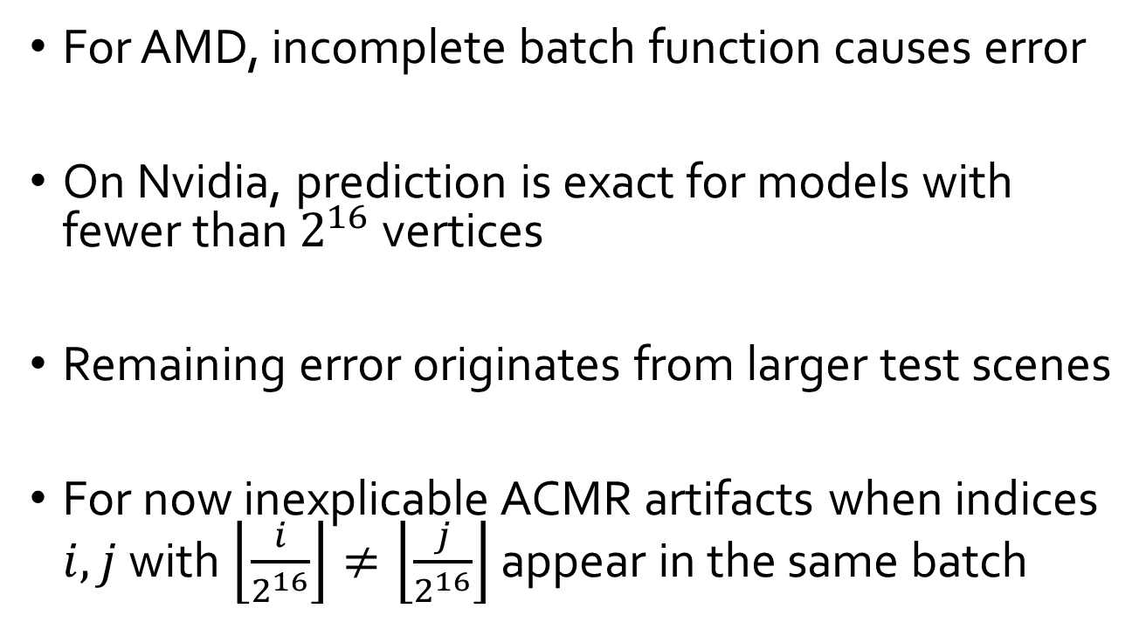
Nvidia Batches and Reuse
Max. indices in batch: 96 (or 1 triangle per thread)
Max. shader calls: 32 (or 1 shader per thread)
No caching required for retention model: simple look back at last $N$ indices, those are remembered
  Q: How long can Nvidia remember vertex indices?
  A: 42 (approximately, depending on order in triangle)

Slide 21
AMD Batches and Reuse
Batches have a consistent length of 384 indices
But: Batches don’t necessarily correlate with achieved ACMR
AMD employs second-tier assignment of indices into batches to individual wave fronts
15 vertices can be reused in LRU cache

Slide 22
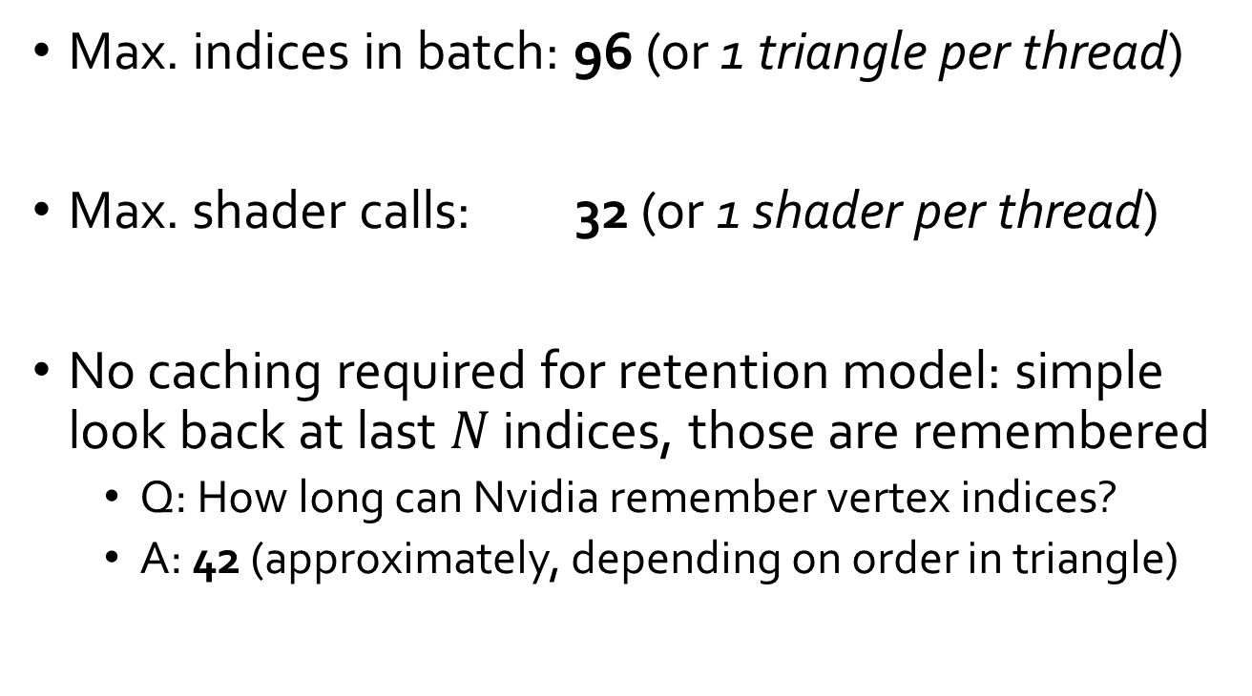
Prediction Quality and Remarks
For AMD, incomplete batch function causes error
On Nvidia, prediction is exact for models with fewer than $2^{16}$ vertices
Remaining error originates from larger test scenes
For now inexplicable ACMR artifacts when indices $i, j$ with $\left\lfloor \frac{i}{2^{16}}\right\rfloor ≠\left\lfloor \frac{j}{2^{16}}\right\rfloor$ appear in the same batch

Slide 23
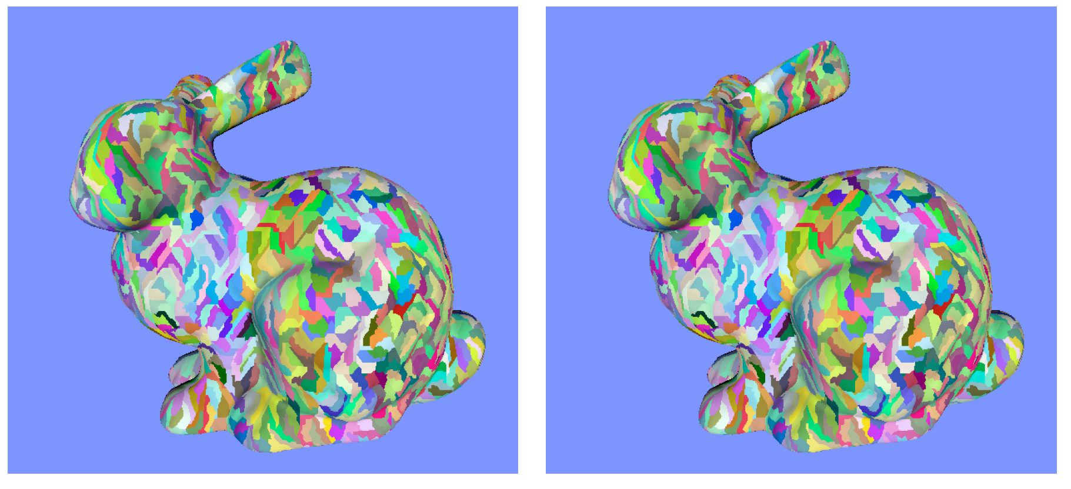
Predicting Batch Composition
Nvidia predicted
Nvidia measured

Slide 24
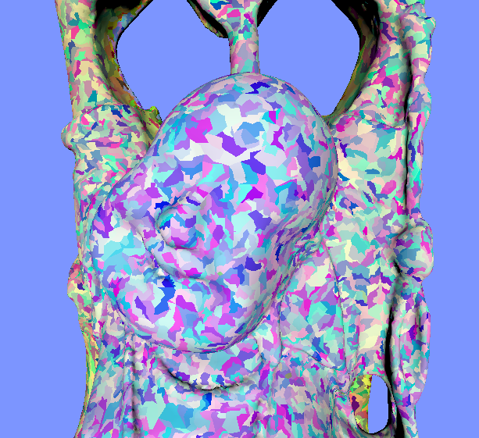
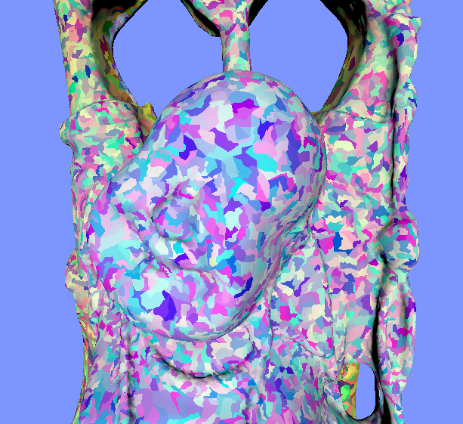
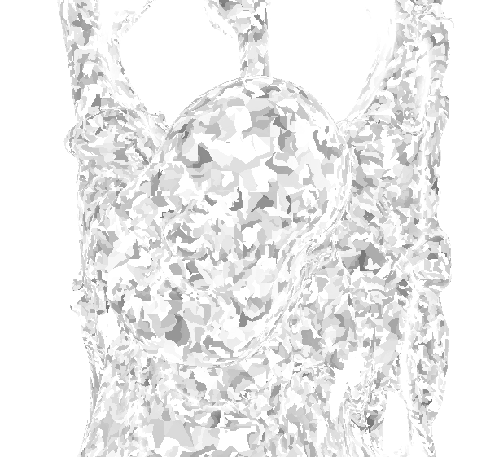
Prediction Mismatch
Nvidia predicted/measured
Difference

Slide 25
Mission Statements
Assess caching for massively parallel devices
Identify acutal GPU workload distribution scheme
Optimize vertex input order for the modern GPU

Slide 26
Mesh Optimization Algorithm
Greedy algorithm inserts new triangles into batch based on a score function
Score for each triangle is defined by four factors:
  Vertex Reuse : #vertices already loaded and available
  Vertex Valence : #unused triangles that share its vertices
  Face Distance : average distance to other batch faces
  Neighborhood : prefer neighbors of existing batches

Slide 27
Algorithm Overview
Are there any triangles left?
Done*
No
Yes
Choose triangle with best score
Add triangle to current batch
Yes
Batch Predictor: Can we add triangle without exceeding limits?
End current batch,
reset predictor
No

Slide 28
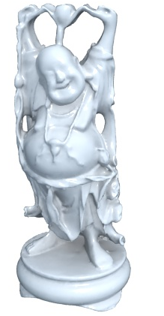

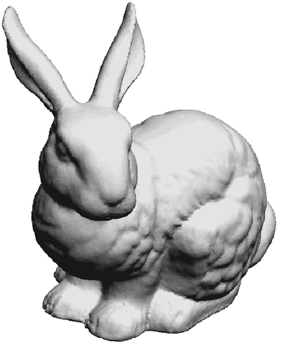
Evaluating our Approach
Used on established models as well as
triangle sets from recent video games
Compared achieved ACMR to alternatives
Bunny
The Witcher 3 (tw)
Happy Buddha

Slide 29
Optimizers Performance Nvidia

Slide 30
 | DirectXMesh | AMD Tootle | K-Cache | Ours | Ideal
Sphere | 0.83 | 0.83 | 0.82 | 0.81 | 0.50
Bunny | 0.84 | 0.86 | 0.84 | 0.82 | 0.50
Happy Buddha | 0.98 | 0.98 | 0.95 | 0.81 | 0.50
XYZRGB Dragon | 1.07 | 1.08 | 1.10 | 0.82 | 0.50
Tree | 2.07 | 2.09 | 2.09 | 2.06 | 2.06
AoM 1 | 0.97 | 0.88 | 0.86 | 0.84 | 0.60
AoM 2 | 0.95 | 0.81 | 0.81 | 0.78 | 0.48
Black Flag 1 | 0.87 | 0.88 | 0.85 | 0.83 | 0.59
Black Flag 2 | 1.27 | 1.28 | 1.26 | 1.24 | 1.11
Deus Ex 1 | 0.88 | 0.90 | 0.85 | 0.89 | 0.61
Deus Ex 2 | 0.87 | 0.88 | 0.84 | 0.84 | 0.62
Stone Giant 1 | 0.87 | 0.88 | 0.83 | 0.83 | 0.53
Stone Giant 2 | 0.89 | 0.89 | 0.85 | 0.84 | 0.56
Shogun 1 | 1.01 | 1.00 | 0.97 | 0.92 | 0.74
Shogun 2 | 0.98 | 0.98 | 0.95 | 0.94 | 0.74
Tomb Raider 1 | 0.95 | 0.93 | 0.89 | 0.87 | 0.68
Tomb Raider 2 | 0.93 | 0.92 | 0.89 | 0.88 | 0.66
The Witcher 1 | 0.87 | 0.89 | 0.87 | 0.84 | 0.55
The Witcher 2 | 1.43 | 1.41 | 1.39 | 1.37 | 1.23

Slide 31
Optimizers Performance AMD

Slide 32
Test Scene | DirectXMesh | AMD Tootle | K-Cache | Ours | Ideal
Sphere | 0.66 | 0.68 | 0.67 | 0.72 | 0.50
Bunny | 0.68 | 0.72 | 0.70 | 0.72 | 0.50
Happy Buddha | 0.73 | 0.75 | 0.71 | 0.75 | 0.50
XYZRGB Dragon | 0.67 | 0.71 | 0.69 | 0.72 | 0.50
Tree | 2.06 | 2.07 | 2.07 | 2.06 | 2.06
AoM 1 | 0.85 | 0.77 | 0.74 | 0.77 | 0.60
AoM 2 | 0.81 | 0.69 | 0.68 | 0.68 | 0.48
Black Flag 1 | 0.74 | 0.74 | 0.73 | 0.75 | 0.59
Black Flag 2 | 1.19 | 1.20 | 1.19 | 1.20 | 1.11
Deus Ex 1 | 0.77 | 0.79 | 0.75 | 0.82 | 0.61
Deus Ex 2 | 0.75 | 0.76 | 0.73 | 0.74 | 0.62
Stone Giant 1 | 0.73 | 0.75 | 0.71 | 0.74 | 0.53
Stone Giant 2 | 0.77 | 0.77 | 0.73 | 0.76 | 0.56
Shogun 1 | 0.88 | 0.86 | 0.84 | 0.84 | 0.74
Shogun 2 | 0.87 | 0.88 | 0.85 | 0.86 | 0.74
Tomb Raider 1 | 0.83 | 0.81 | 0.78 | 0.80 | 0.68
Tomb Raider 2 | 0.81 | 0.81 | 0.78 | 0.79 | 0.66
The Witcher 1 | 0.72 | 0.75 | 0.73 | 0.75 | 0.55
The Witcher 2 | 1.35 | 1.33 | 1.31 | 1.32 | 1.23

Slide 33
AMD Results Interpretation
More modest results for batching on AMD cards
Multiple reasons
  Overall simpler algorithm
  ASR is much lower in general
  Larger batch → closer to central retention, less benefit
  Batching function incomplete
  Second-tier assignment not yet fully understood

Slide 34
Future Directions
Fully decipher AMD, Intel batching function
Tie entire solution into an easy framework
Next stop: Tessellation?

Slide 35
Thank you!
Questions?

Slide 36
One decade later...

Slide 37
Vertex reuse is limited
Can be used for at most 96 (Nvidia) / 384 (AMD) indices in sequence
No plateau – staircase shape continues indefinitely
On AMD: reuse length can vary, but caps at 384
On Nvidia: consistent for last 4 GPU generations

Slide 38
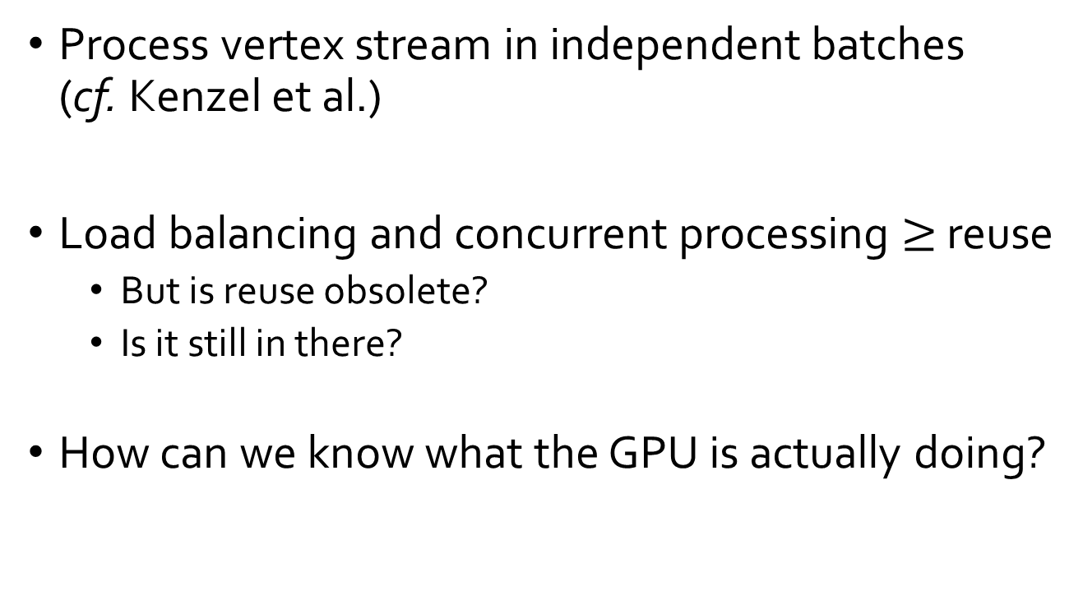
Massively Parallel Vertex Reuse
Process vertex stream in independent batches
(cf. Kenzel et al.)
Load balancing and concurrent processing $≥$ reuse
  But is reuse obsolete?
  Is it still in there?
How can we know what the GPU is actually doing?

Slide 39
Triangle Meshes as Input
First idea: triangle strips and fans
  Two indices are known
  For every new triangle, only one vertex needs shading
More general: the indexed triangle list
  Replace full info per vertex with index into buffer
  As vertices are reused → usually easier on memory
  Potentially more frequent reuse of vertices
  Shaded vertices per triangle can be much lower than 1

Slide 40
Optimizer Algorihm Overview
Continue forming batches until no indices remain
Choose triangle with best score and add to batch
If predictor detects overflow, start new batch
On Nvidia, post-process to remove boundaries

Slide 41
Our Batch-based Optimization
Score for each triangle is defined by four factors:
  Vertex Reuse : #vertices already loaded and available
  Vertex Valence : #unused triangles that share its vertices
  Face Distance : average distance to other batch faces
  Neighborhood : prefer neighbors
We weight each factor with appropriate coefficients

Slide 42
Optimizing Vertex Order
Based on our findings, we define an optimization algorithm that takes batching into account
Uses an abstract batch predictor class (implementation differs depending on vendor)
Suggests new order for indices to achieve high reuse within actual batches

Slide 43
Nvidia Batching Process
Input:
0
1
2
2
3
4
1
5
2
6
7
5
...
Shader calls:
0
1
2
3
4
5
6
7
Batch limitation on input (96) and shader calls (32)
If one of these constraints is violated → new batch
Shaded vertices can be remembered

Slide 44
The GPU Hardware Pipeline (simplified)

Slide 45
Indexed Triangle Lists
Index Buffer (Triangles)
0, 1, 2
2, 1, 3
0, 2, 3
...
Vertex Buffer
Vertex 0: Color, Normal, TextureXY...
Vertex 1
Vertex 2
Vertex 3
...
Idea: Introduce specific hardware module for GPU to remember recently used indices
Solution: The post-transform cache

Slide 46
The Post-Transform Cache
Built-in hardware module is fast and easy to use
Commonly referred to as vertex cache
Stores some recent shader outputs for quick reuse
Can use FIFO, LRU or similar method

Slide 47
Exploiting the Vertex Cache
Algorithms of varying complexity take indices as input and reorder according to target architecture
Wide adoption in libraries, rendering pipelines
Idea: If we know that this module exists, we can optimize input to make reuse as high as possible
Minimize average shading rate (ASR/ACMR)

