Slide 1
Non-Periodic Tiling of Procedural Noise Functions
Aleksandr Kirillov
Graphics Engineer, Unity Technologies
High-Performance Graphics 2018

Slide 2
Content creation is becoming a bottleneck.

Slide 3
Book of the Dead (2018)
Notes:
This is a screenshot from the Book of the Dead demo that was released this year by Unity. It is not unreasonable to expect an equal level of world detalization in near-future games.

Slide 4
Procedural content creation is becoming increasingly attractive.
Notes:
Procedural content creation allows us to reduce content production time.
Memory bandwidth is growing much slower than GPU computational power, which makes procedural methods even more attractive.

Slide 5
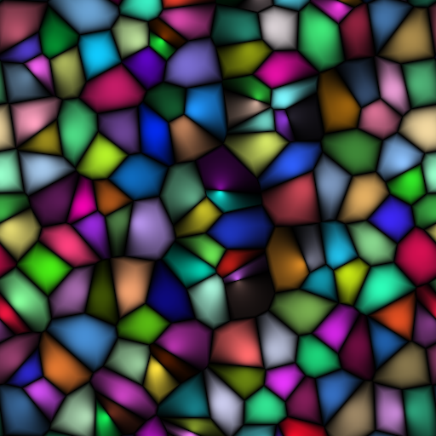
Procedural Noise Functions Overview
Notes:
Procedural noise functions are widely used in computer graphics.
Left to right: Perlin, Better gradient, Gabor and Worley noises.

Slide 6
Procedural Noise Functions Overview
Integer lattice noises
[Perlin 1985, Perlin 2002, Olano 2005, Kensler et al. 2008]
Fast evaluation
Periodic
Sparse convolution noises
[Lewis 1989, Lagae et al. 2009]
Both periodic and non-periodic variants
Nice properties
Too heavy for most real-time applications
Explicit noises
[Cook and DeRose 2005, Goldberg et al. 2008]
Precomputation required
Notes:
The State of the Art Report in Procedural Noise Functions by Lagae et al. [2010] subdivides procedural noise functions into three broad categories.

Slide 7
There is no noise function that is non-periodic and at the same time fast enough to evaluate in runtime.
Notes:
Applications usually can’t afford noise valuation at runtime.
Those functions that are designed with efficiency in mind are periodic.
Since most applications use only basic texture tiling algorithms, this leads to repetition or loss of detail.

Slide 8
What if we use advanced tilings?
Notes:
Advanced tiling can help address both repetiton and loss of detail problems.
An additional benefit of using them is the potential to reduce the amount of memory required by the textures.

Slide 9
Wang Tiles

Slide 10
Wang Tiles
Rectangular tiles of the same size with color-coded edges
Two constraints for valid tiling
Tiles cannot be rotated or reflected
Adjacent edges must share an edge of the same color
Non-periodic tiling possible with a finite tile set
[Berger 1966, Culik 1996, Kari 1996, Jeandel and Rao 2015]
Notes:
[Jeandel and Rao 2015] 11 tiles with 4 colors are a minimal set required for non-periodic tiling.

Slide 11
Related Work
Direct tile set construction during preprocessing
Limited set of patterns [Stam 1997]
Triangular patches instead of rectangles [Neyret and Cani 1999]
Example-based tile synthesis
[Wei and Levoy 2000, Efros and Freeman 2001, Cohen et al. 2003]
No guarantee that there are no internal seams
Tiles are generated during preprocessing
Other applications of Wang tiles
Object distribution [Lagae and Dutré 2005]
Poisson set generation [Lagae and Dutré 2005, Kopf et al. 2006]

Slide 12
Our approach is to combine Wang tiles and procedural noise functions.
Notes:
We lift the periodicity limitations of the noise functions by combining Wang tiles and procedural noise functions.

Slide 13
Non-Periodic Tiling of Procedural Noise Functions
We modify the noise functions to output a Wang tile set directly
The appearance of the noise stays the same
The key characteristics of the noise stay the same (*)
Both preprocessing and full runtime evaluation supported
Hardware-friendly tile layout for sampling precomputed textures [Wei 2004]
Guaranteed seamless tiling
* Mostly, a detailed discussion is available in the paper

Slide 14
Perlin Noise Tiling

Slide 15
Perlin Noise Tiling
Subdivide the lattice into inner points and boundary points
Further subdivide boundary points
Corners (C)
Vertical borders (V₀ and V₁)
Horizontal borders (H₀ and H₁)
To get a correct tile set, we ensure that all points within the same group at corresponding locations within a tile have the same coordinates
A function modifies the lattice point coordinates
Inner points are not affected
Notes:
Similar to toroidal boundary handling.

Slide 16
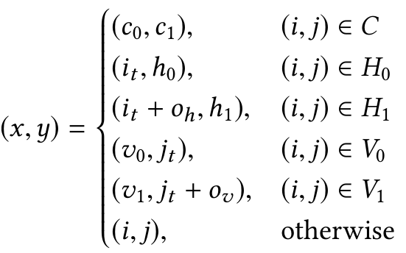
Perlin Noise Tiling
is the original lattice point coordinate
is the coordinate of the lattice point local to the tile
Other parameters control the locations of border points
T
Notes:
The group that the lattice point belongs to determines the way the coordinate is modified.
The resulting coordinates for the boundary points are always local to the tile.

Slide 17
Perlin Noise Tiling
Subdivide the lattice

Slide 18
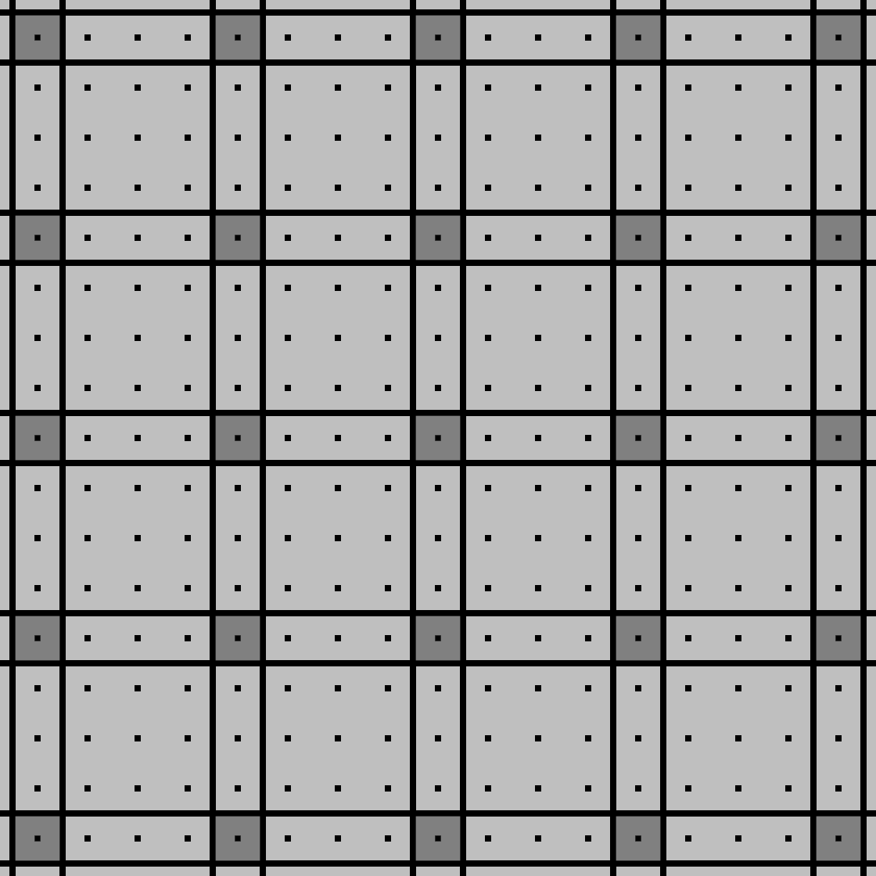
Perlin Noise Tiling
Subdivide the lattice
Corners ( , C)

Slide 19
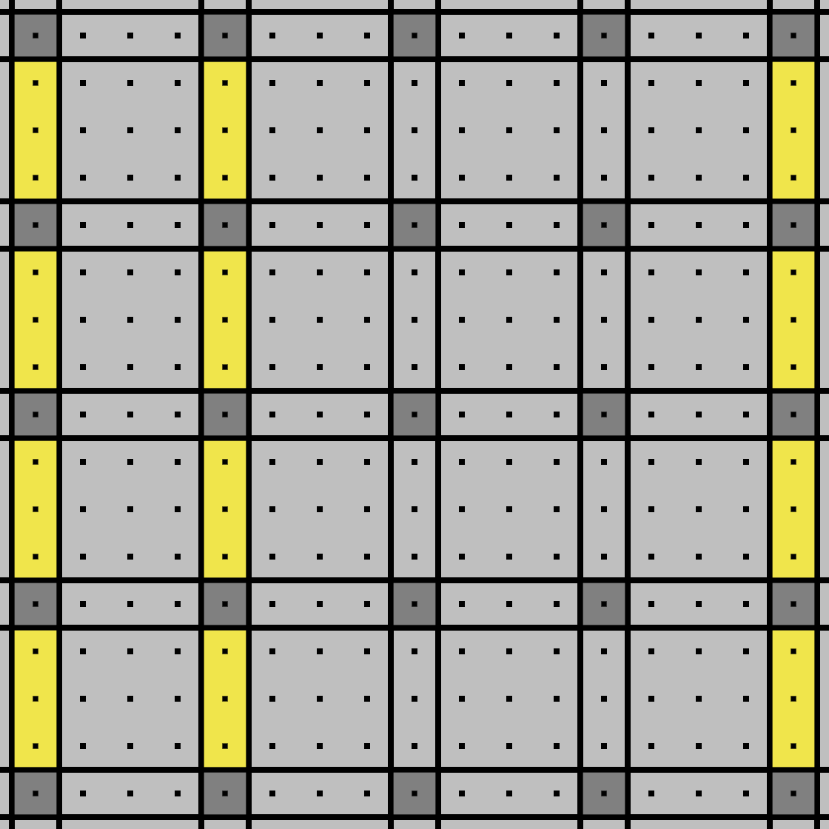
Perlin Noise Tiling
Subdivide the lattice
Corners ( , C)
Vertical borders ( , V₀)

Slide 20
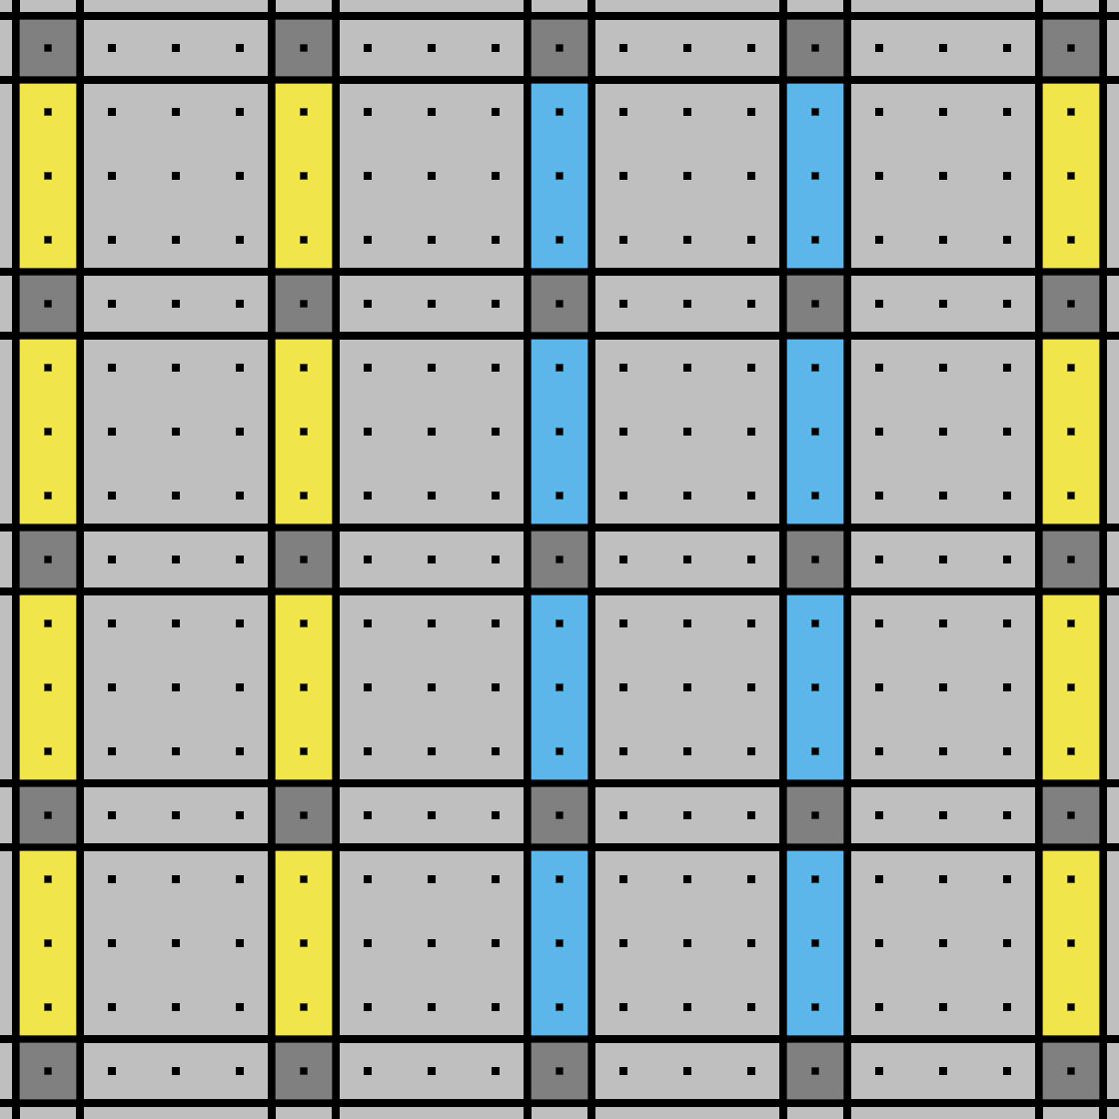
Perlin Noise Tiling
Subdivide the lattice
Corners ( , C)
Vertical borders ( , V₀ and , V₁)

Slide 21
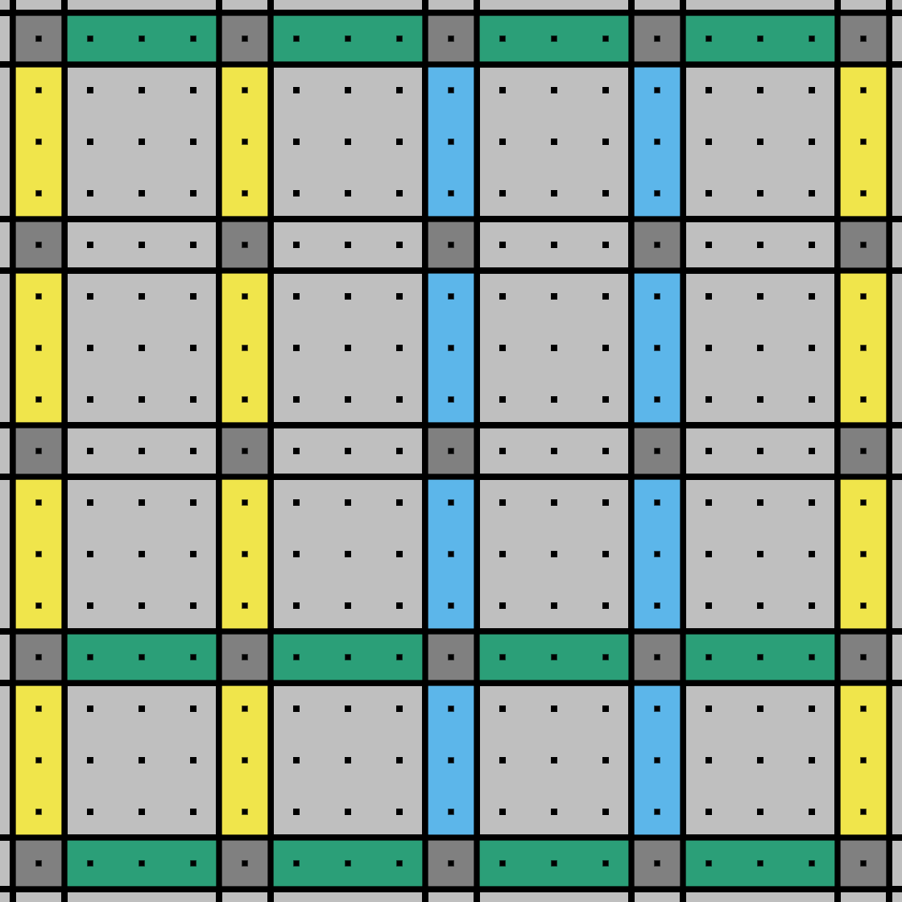
Perlin Noise Tiling
Subdivide the lattice
Corners ( , C)
Vertical borders ( , V₀ and , V₁)
Horizontal borders ( , H₀)

Slide 22
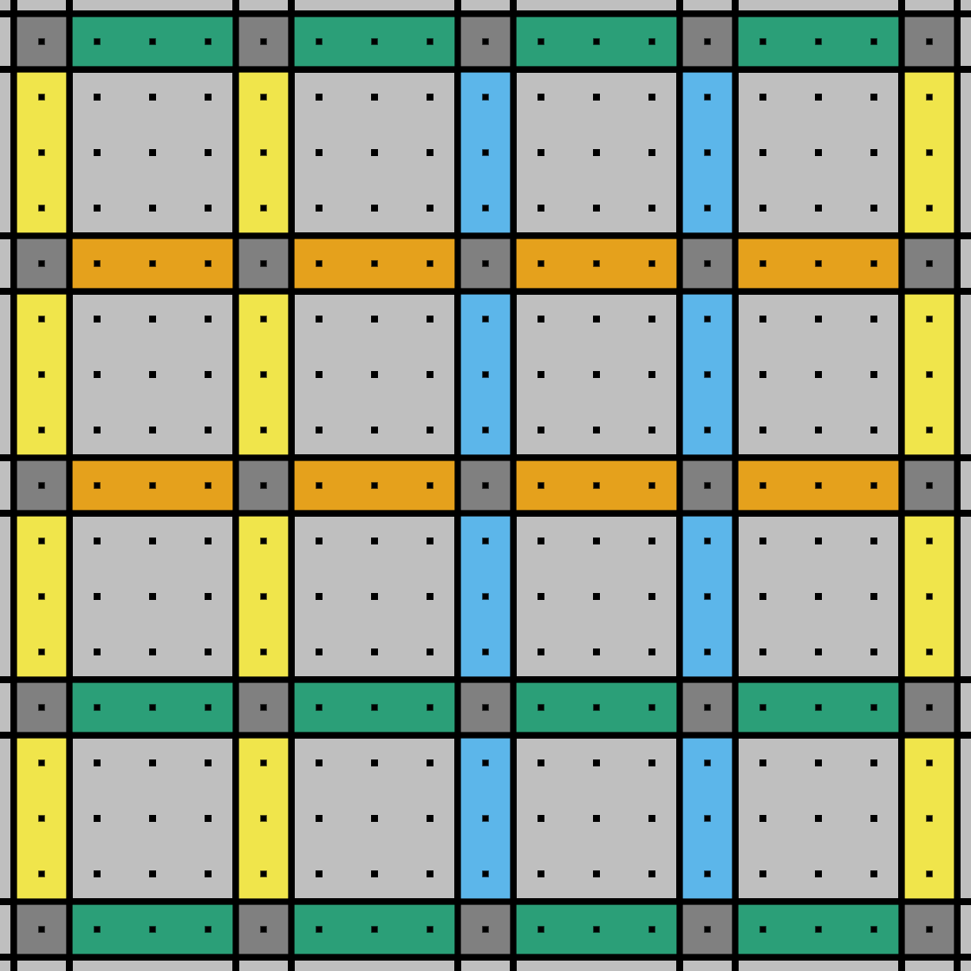
Perlin Noise Tiling
Subdivide the lattice
Corners ( , C)
Vertical borders ( , V₀ and , V₁)
Horizontal borders ( , H₀ and , H₁)

Slide 23
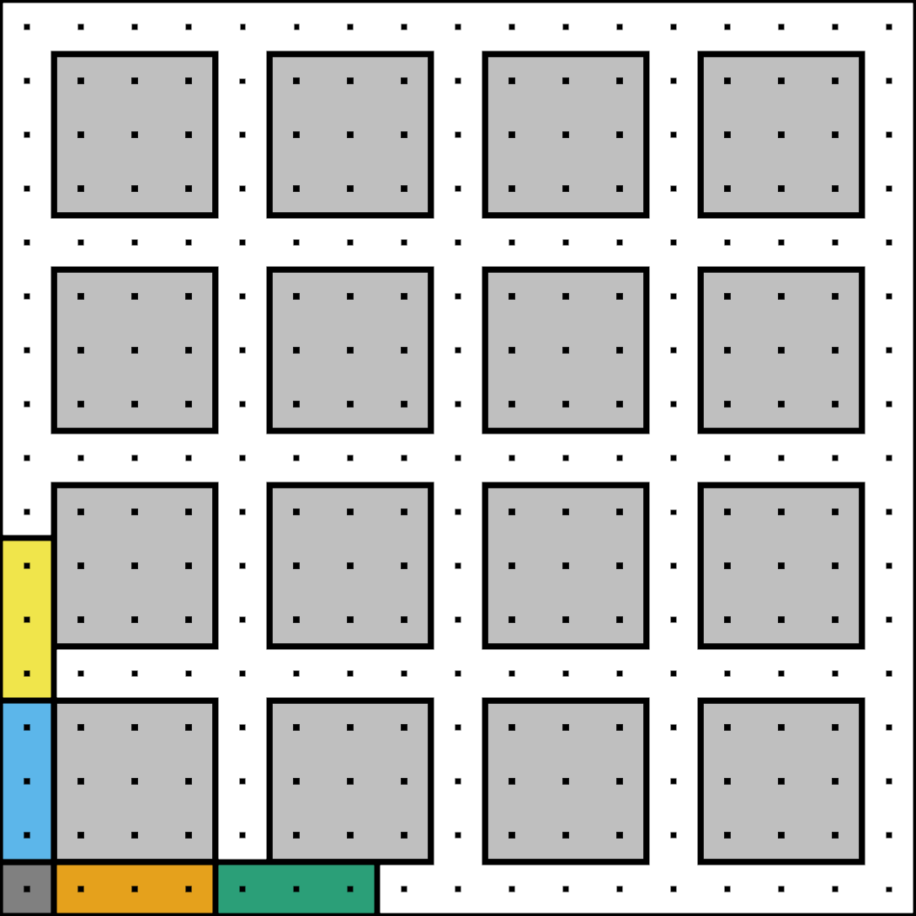
Perlin Noise Tiling
Subdivide the lattice
Corners ( , C)
Vertical borders ( , V₀ and , V₁)
Horizontal borders ( , H₀ and , H₁)
Transform the coordinates of the points within these regions
Inner points ( ) are not affected
Notes:
Example: the bottom point in the blue group will always have the coordinate (0, 1).
We used 0 for all parameters except o_{h} and o_{v}.
The choice of parameters does not affect the noise characteristics as long as the resulting regions do not intersect each other.

Slide 24
Perlin Noise Tiling
Checking which region a lattice point belongs to is very simple
i_{t} = 0 => left border
j_{t} = 0 => top border
Both are 0 => corner
Right and bottom borders are handled by the next tile
Coordinate adjustment is a condition-driven offset
Conditional moves are cheap
We use the modified lattice coordinates as inputs to the hash function to produce Wang tiles
This is the only change to the noise function

Slide 25
Perlin Noise Tiling
Notes:
The original function is on the left, out result is on the right. We keep this layout for the rest of the presentation.

Slide 26
Tiling Gabor, Worley and Better Gradient Noises

Slide 27
Gabor Noise Tiling
Cell coordinate is the only input affecting the PRNG
All other parameters control the appearance of the noise
Cell coordinates instead of lattice point coordinates
Value can be affected by the cell and its immediate neighbours
Coordinate transformation needs slight adjustment
Thickness of the border region is now one cell instead of one lattice point
Need to check the bottom and the right tile borders as well
Notes:
Gabor noise is evaluated on a grid to improve performance.

Slide 28
Isotropic Gabor Noise Tiling

Slide 29
Anisotropic Gabor Noise Tiling

Slide 30
Tiling Worley and Better Gradient Noises
Worley noise is very similar to Gabor noise
Cell coordinates drive the PRNG that generates the feature points
The coordinate transformation function we used for Gabor noise works for Worley noise
Better gradient noise uses a wider filter than Perlin noise
Need to increase the thickness of the border again, to three lattice points
Notes:
Better gradient noise uses a 4x4 filter instead of 2x2 used by Perlin noise.

Slide 31
Better Gradient Noise Tiling

Slide 32
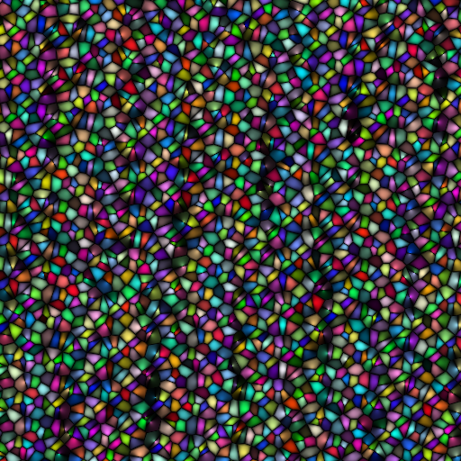
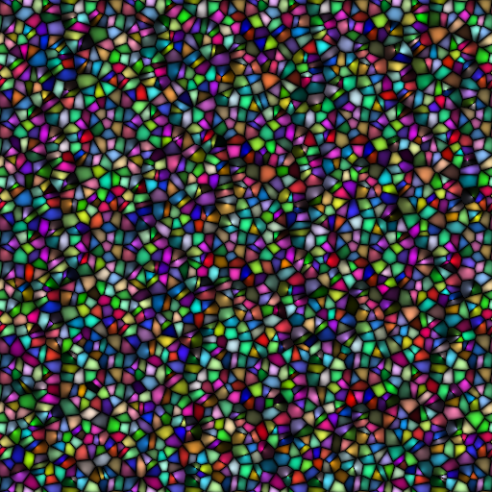
Worley Noise Tiling

Slide 33
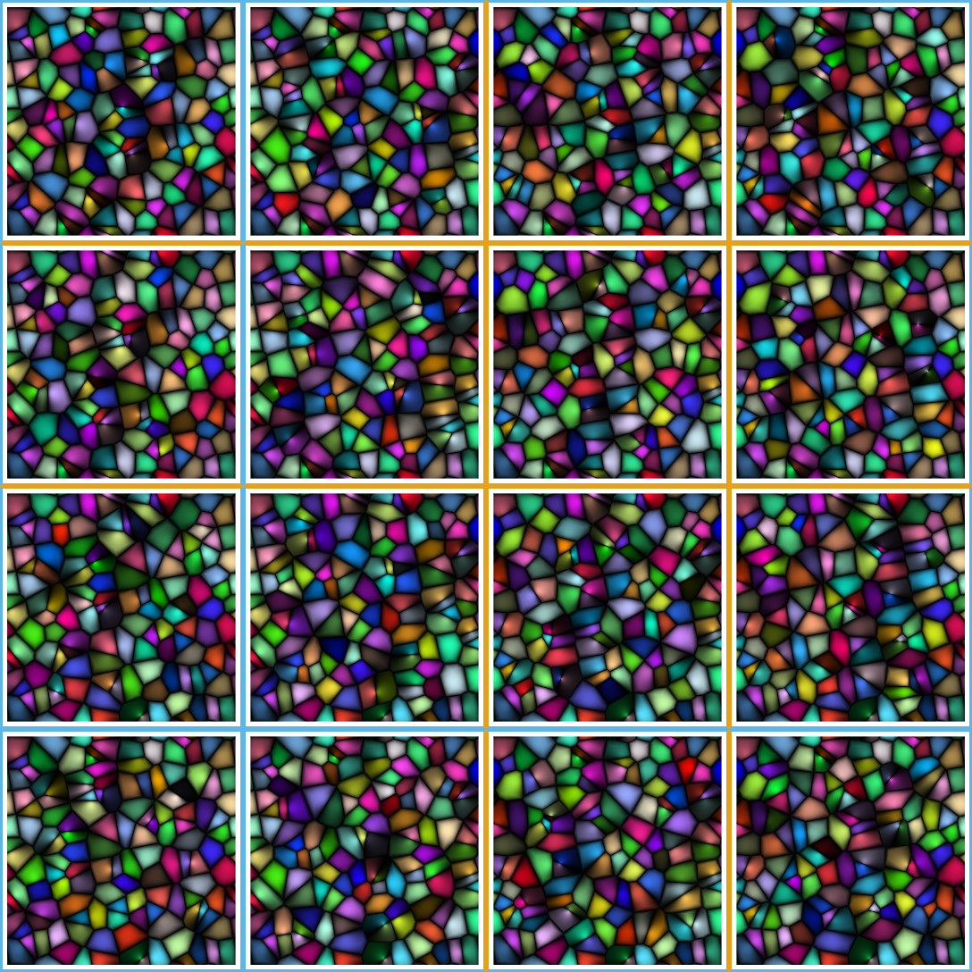
Worley Noise Tiling
Notes:
Note that the corresponding borders of the tiles marked with the same color are identical.

Slide 34
Results
Notes:
Ken Perlin showed that his noise function can be used as a building block for creation of realistic-looking textures. Similar results can be achieved with our modifications.

Slide 35
Observation
Once a function F is applied to a Wang tile texture, the result can remain a Wang tile texture with the same layout
If F depends only on the pixel color
If F depends on the pixel position and forms a Wang tile texture with the same layout
Examples of function F
Linear combination of Wang tile textures
Periodic function with the period being a multiple of the Wang tile size

Slide 36
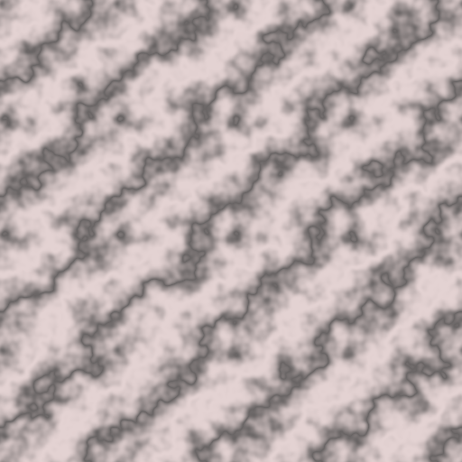
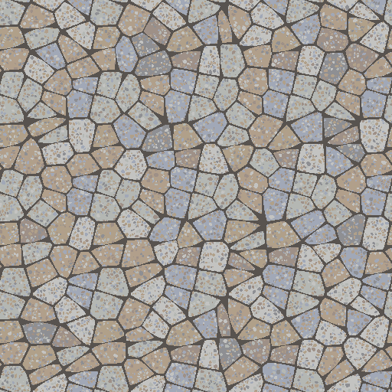
Results
Notes:
All three images are Wang tile texture maps.

Slide 37
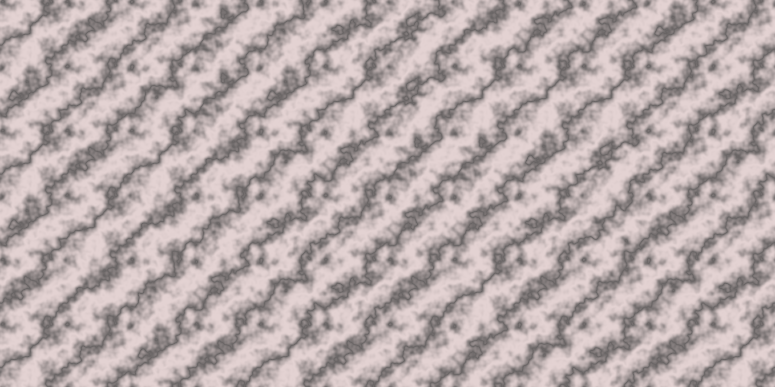
Results

Slide 38
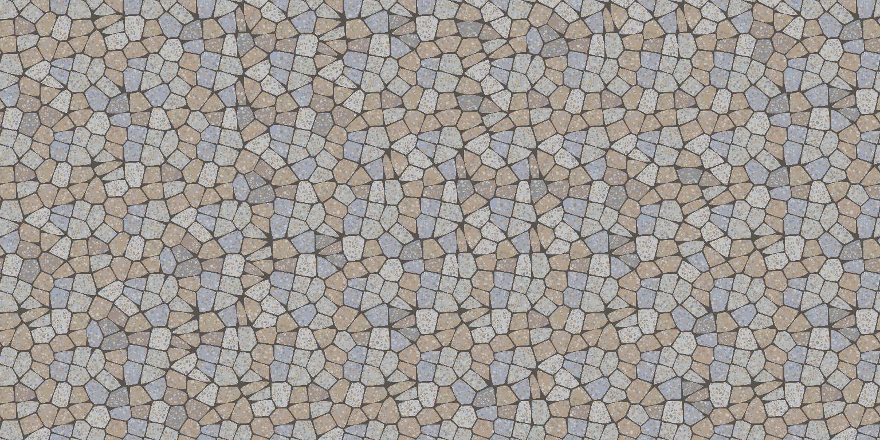
Results

Slide 39
Results
Notes:
The top image is a simple tiling of a 1024x1024 brick wall texture.
The bottom image uses a Wang tile texture map with 512x512 pixels.
Image on the bottom is non-periodic and requires 4 times less memory.

Slide 40
Limitations
Downscaling and compression can introduce artifacts
Anisotropic filtering hides the discontinuities
Texture atlases with Wang tile textures are tricky
As are texture wrapping modes other than clamping
Wang tiles have their own limitations
Avoid large-scale features in tiles
Hash-based evaluation of tile edge colors requires a complete set of tiles
Discontinuities around tile corners are possible

Slide 41
Results
A high-performance solution for non-periodic tiling of procedural noise functions
Supports both runtime evaluation and precomputation
Enables non-periodic tiling for a large range of noise-based procedurally generated textures and effects
Has a potential to decrease memory consumption
Straightforward to implement

Slide 42
More in the Paper
Impact on the key noise characteristics
Power spectrum
Amplitude distribution
Mapping to surfaces and filtering
Performance analysis
Improvement of the tiling algorithm
Source code examples

Slide 43
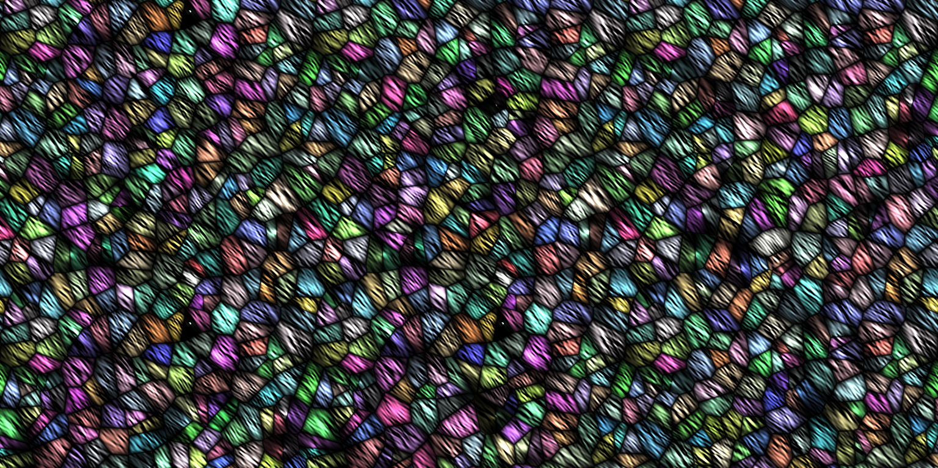
Thank you!

