Slide 1
Patch Textures: Hardware Implementation of Mesh Colors
Ian Mallett Larry Seiler Cem Yuksel
2019
Utah Graphics

Slide 2
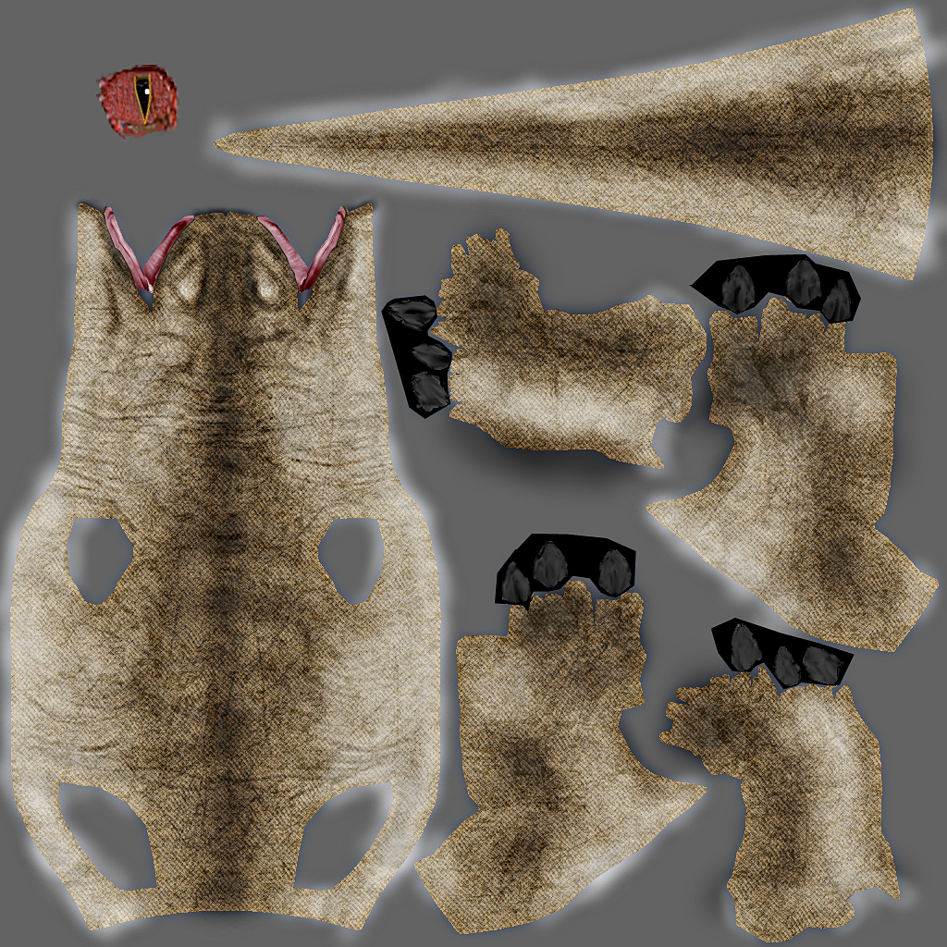
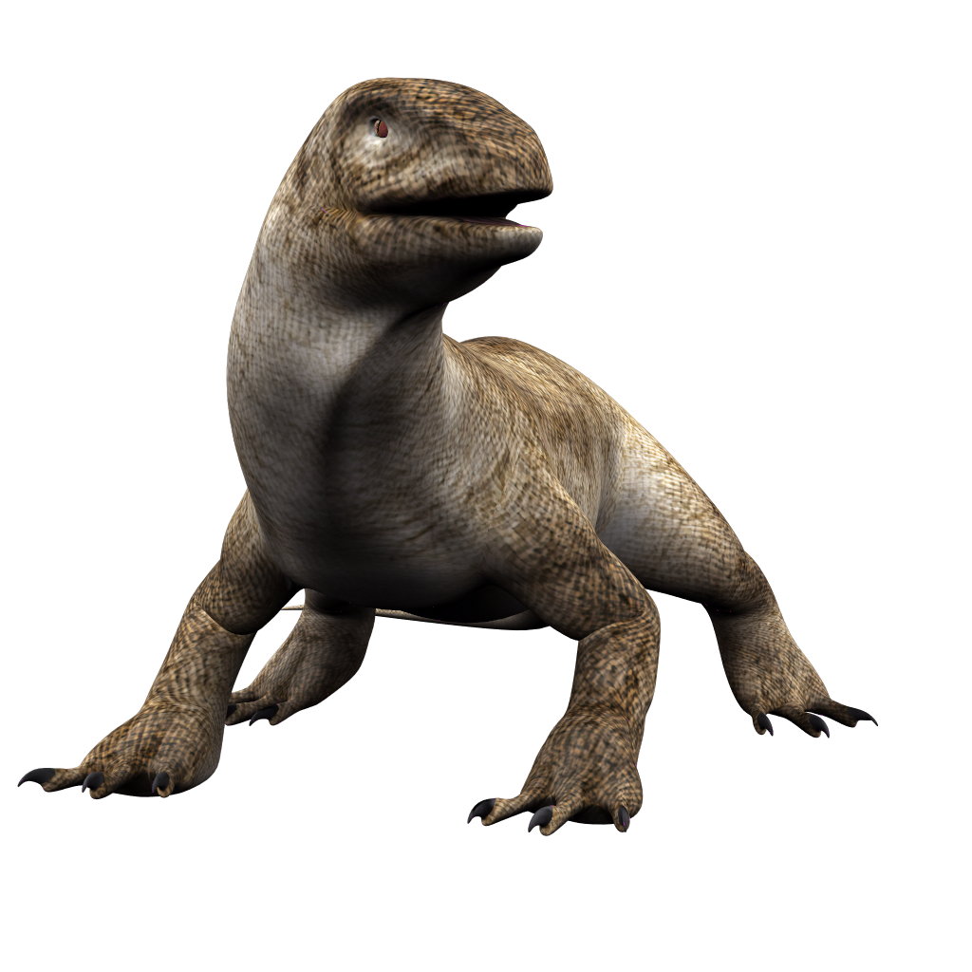
Textures
Textures . . . Have Problems

Slide 3
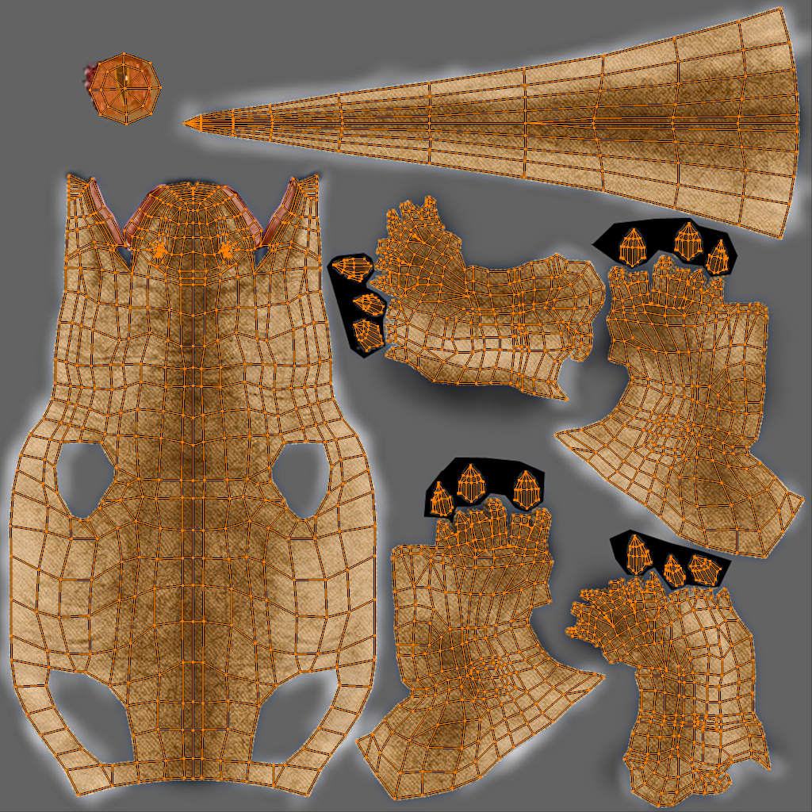
Textures . . . Have Problems
Artist must make mapping
Notes:
Harp on this slide a lot

Slide 4
Textures . . . Have Problems
Distortion
Seams

Slide 5
Textures . . . Have Problems
Wasted space

Slide 6
Textures . . . Have Problems
Incorrect mipmap reduction

Slide 7
Textures . . . Have Problems
Incorrect anisotropic filters

Slide 8
Textures . . . Have Problems
Local resolution adjustment means remaking texture and mapping

Slide 9
Textures . . . Have Problems
Artist must make mapping
Notes:
Harp on this slide a lot

Slide 10
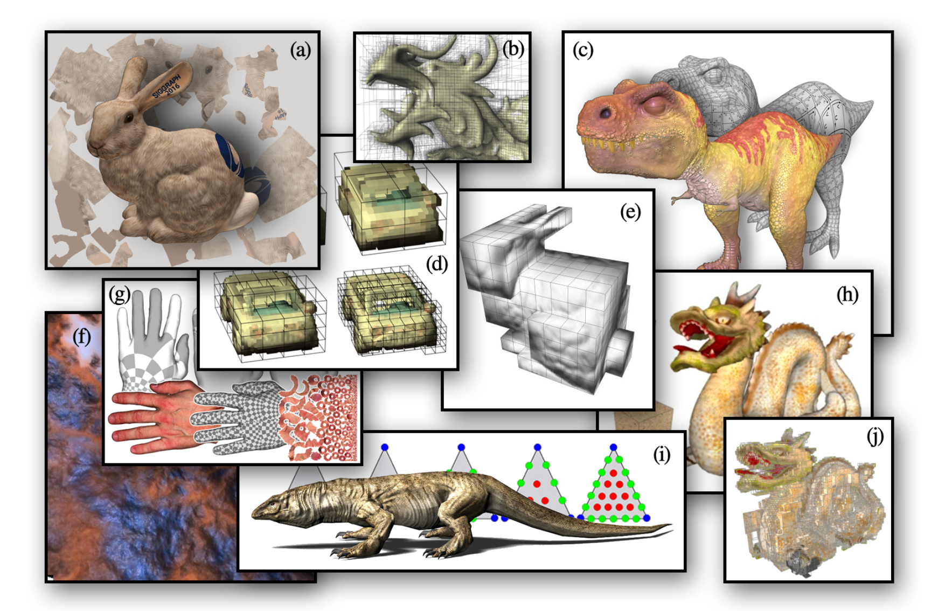
Lots of Different Approaches . . .
What does industry actually use?
(Figure [Yuksel et al. 2019])

Slide 11
Texture Data Living on Surfaces!
Ptex and Mesh Colors

Slide 12
Texture Data Living on Surfaces!
Film uses texture data directly on surfaces
Much easier to model!
Get all the rendering benefits too
Ptex widely (sometimes exclusively) used
Mesh Colors has also been used in production

Slide 13
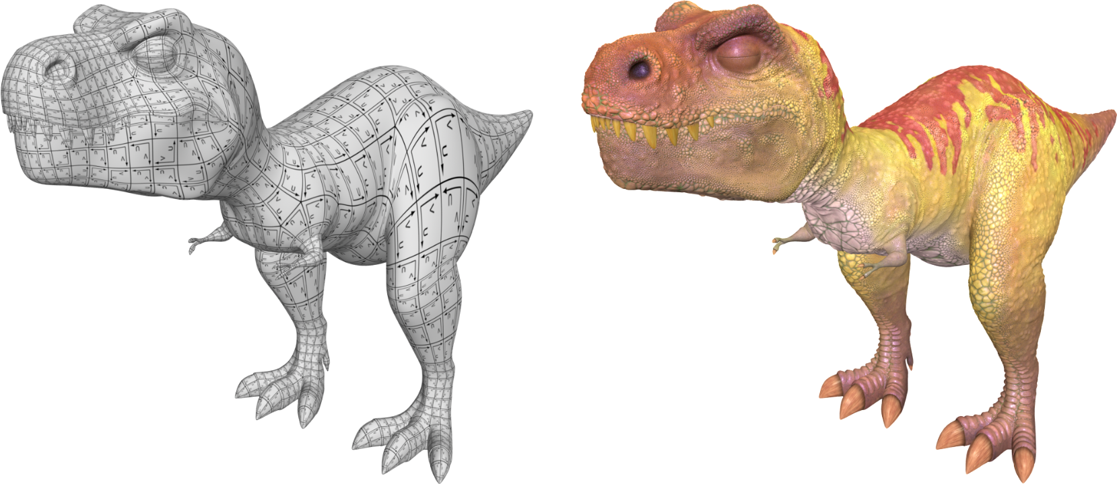
Mesh Colors and Ptex
Every model has a list of patches, each with its own separate texture.
(Figure modified from [Burley and Lacewell 2008] and [Yuksel et al. 2019])

Slide 14
Mesh Colors and Ptex
(Figure modified from [Burley and Lacewell 2008] and [Yuksel et al. 2019])
Notes:
Mention generated with Ptex.
Without getting into detail right now, this minor detail makes implementing Mesh Colors in hardware easier, so in this work, we concentrate on Mesh Colors.

Slide 15
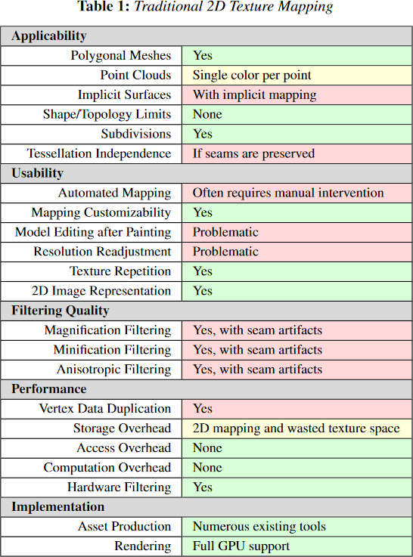
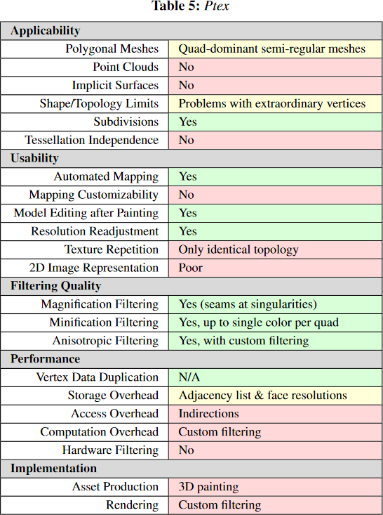
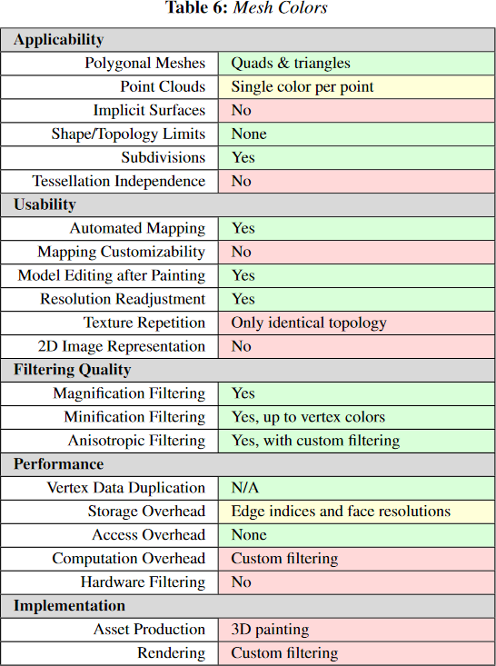
Mesh Colors and Ptex
(Figures Yuksel et al. 2019)

Slide 16
Mesh Colors or Ptex . . . In Realtime?
Possible [McDonald 2013], [Yuksel et al. 2010], …
Still less-practical than 2D textures due to SW (or SW+HW) implementation:
Software is much-slower than hardware!
Complicated to emulate filtering functionality
Implementation limitations

Slide 17
Mesh Color Textures [Yuksel 2017]
Implements Mesh Colors using standard 2D textures
Almost as fast as 2D textures for simple filtering
Added shader complexity
Complicated implementation
Anisotropic filtering problematic
What if the required HW changes to implement directly were small?

Slide 18
Our Contribution
We show that implementing Mesh Colors on existing GPUs would require minimal HW changes
Introduce “patch texture” representation—this is what makes the required HW changes minor!
Can leverage existing storage!
Can leverage existing filtering HW!
Edge-crossing unnecessary
Similar performance expected

Slide 19
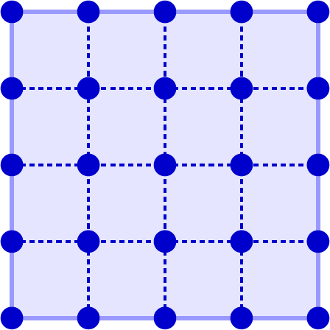
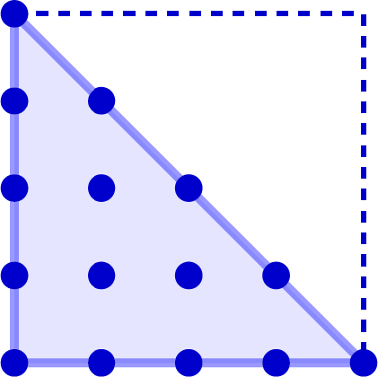
Patch Textures
Unlike in Mesh Colors, in a Patch Texture, edge and corner data is duplicated, not shared with neighbors.
Standard 2D Texture
Set of Patch Textures
Notes:
Mention quads bilinearly filtered, and

Slide 20
Patch Textures
Standard 2D Texture
Set of Patch Textures
Individual Patch Texture

Slide 21
Patch Textures
No restriction on resolution is imposed, but if 2^{n}+1 on a side, Smooth filtering between neighbors is possible.
Individual Patch Texture

Slide 22
Patch Textures
0
¼
½
¾
1
4
1
3
¾
2
½
1
¼
0
0
0
1
2
3
4
(u,v) and (s,t) coordinates in a patch texture

Slide 23
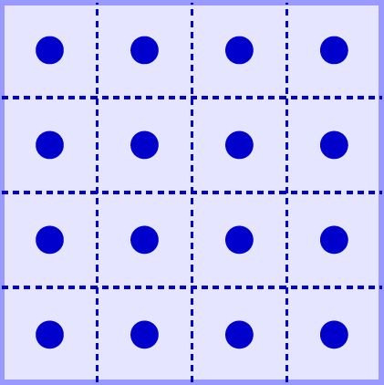
Patch Textures
0
¼
½
¾
0
1
¼
½
¾
1
4
4
1
1
3
3
¾
¾
2
2
½
½
1
1
¼
¼
0
0
0
0
0
1
2
3
0
4
1
2
3
4
2D Texture (u,v) and (s,t)
(u,v) and (s,t) coordinates in a patch texture
Patch Texture (u,v) and (s,t)
Notes:
Explain that uv/st is unnormalized/normalized

Slide 24
Patch Texture Storage
Very similar to standard 2D textures

Slide 25
Patch Texture Storage (Mipmaps)
Very similar to standard 2D textures
Most GPUs store in e.g. 4⨯4 tiles
If mesh textures are 2^{n}+1 on a side, requires padding

Slide 26
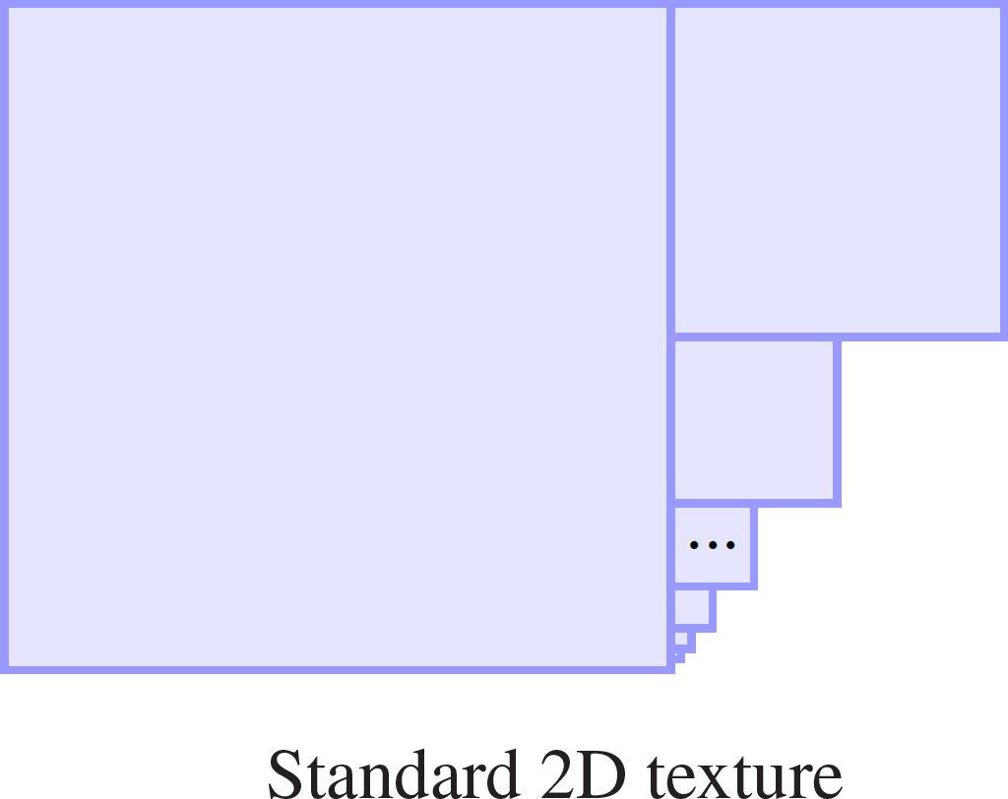
Patch Texture Storage (Mipmaps)
Power-of-two 2D textures fit nicely in memory

Slide 27
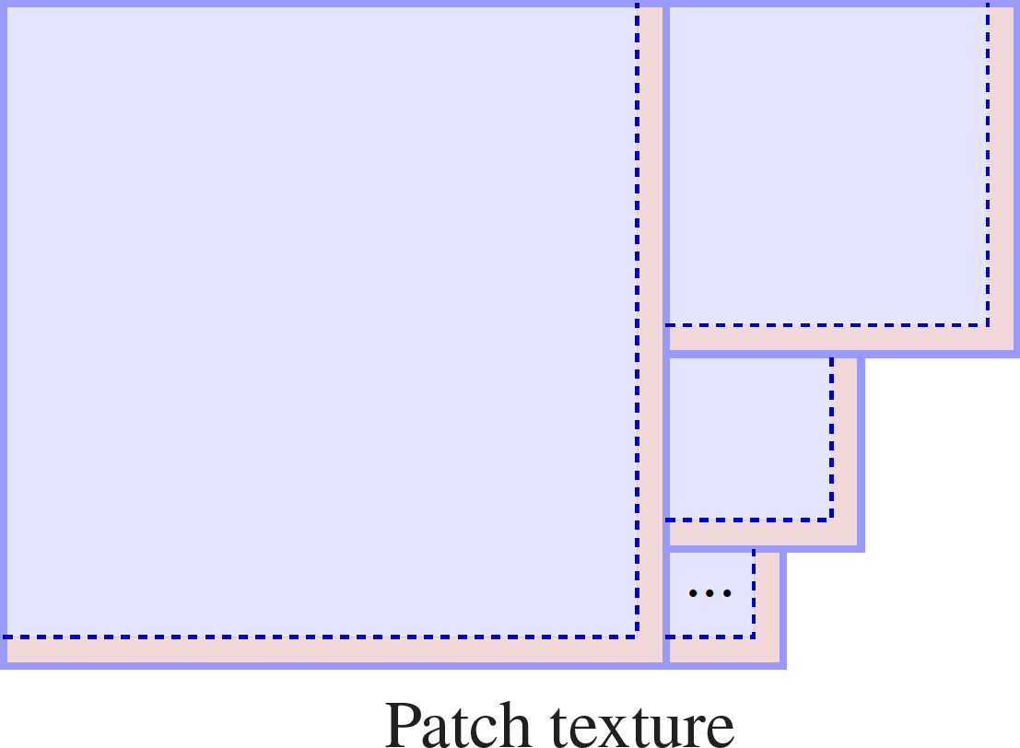
Patch Texture Storage (Mipmaps)
2^{n}+1 patch textures require padding (a few %)

Slide 28
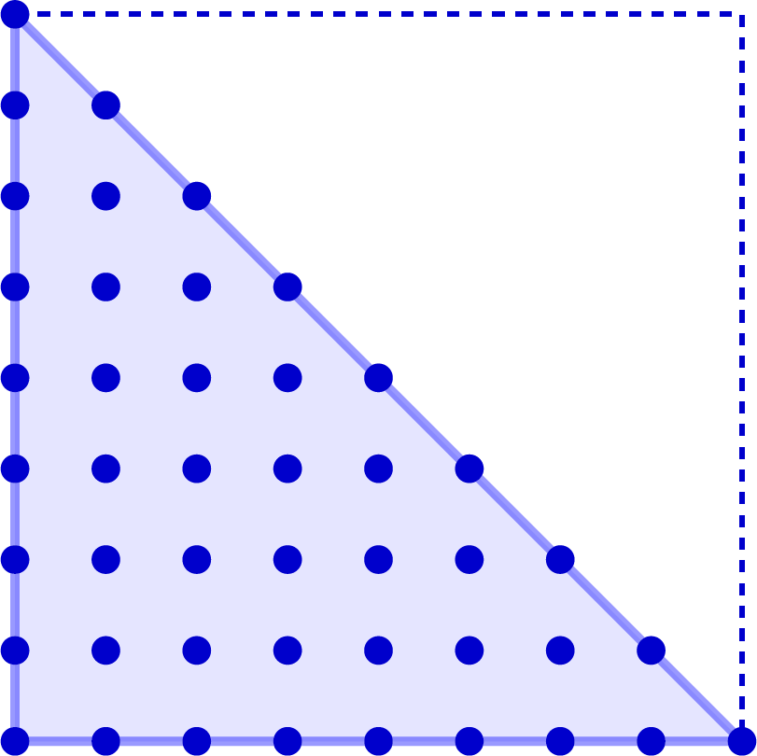
Patch Texture Storage (Triangular Patches)
Triangular patch textures do not map nicely to 2D storage
Not necessarily a problem
Quad-dominant meshes standard
Patch textures typically small
Clever workarounds exist (though require more HW changes)
Wasted space?

Slide 29
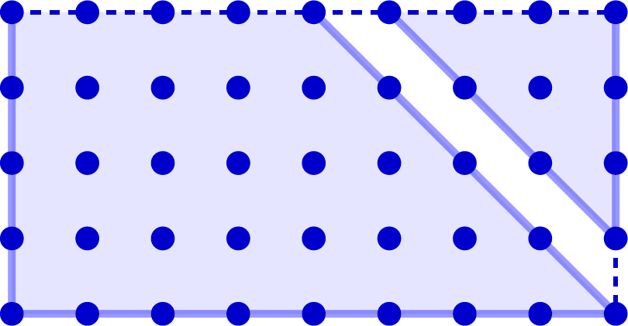
Patch Texture Storage (Triangular Patches)
Slice

Slide 30
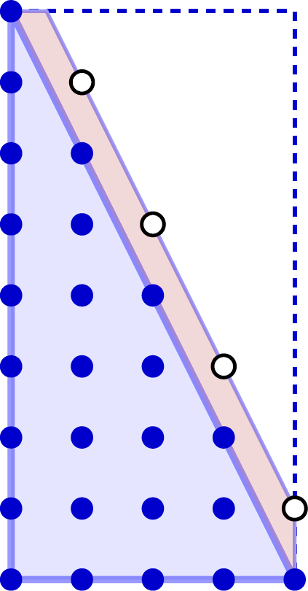
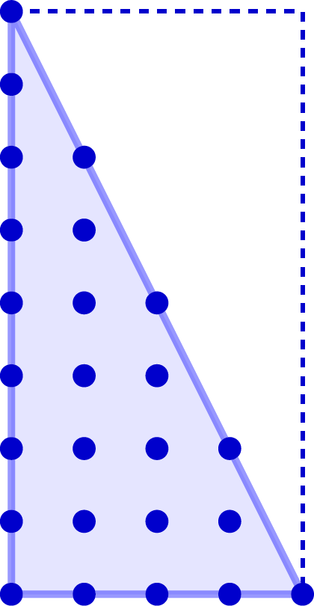
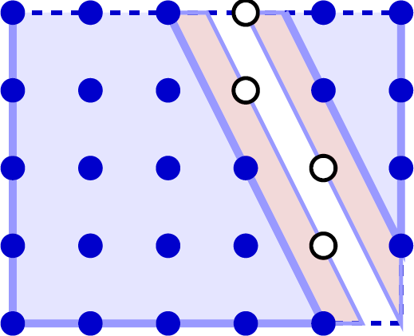
Patch Texture Storage (Triangular Patches)
Filtering can require values outside triangle to be defined.
Extra defined texels Ref. [Yuksel 2017]
Slice

Slide 31
Filtering (Quadrilateral Patches)
Exactly the same as for 2D textures!
(Except we don’t need the half-texel shift of 2D textures for (s,t)↦(u,v) conversion.)
2D Texture
Quad Patch Texture

Slide 32
Filtering (Triangular Patches)
Triangular patches use barycentric filtering
Many possible ways to tweak existing logic so that it can implement this
Mostly, just pass 0 in some places (see paper)

Slide 33
Anisotropic Filtering
Same process as for 2D textures
However, we now have the chance to detect patch boundaries!

Slide 34
Anisotropic Filtering (Patch Boundaries)
What to do about out-of-patch samples?

Slide 35
Anisotropic Filtering (Patch Boundaries)
“Right” thing is to tra- verse to neighbor patch
This is expensive (an indirection)

Slide 36
Anisotropic Filtering (Patch Boundaries)
Clamping the points to the edge changes the filter shape.

Slide 37
Anisotropic Filtering (Patch Boundaries)
Clipping the filter is a simple alternative.

Slide 38
Anisotropic Filtering (Patch Boundaries)
If multisampling is used, the on-screen result can be similar to the correct filter (see [Yuksel et al. 2010], [Toth 2013])

Slide 39
Anisotropic Filtering Comparison
Any approach is acceptable
None of the methods reveal the edges
Ground truth not expected without edge-crossing
This is because not filtering across edges, like in 2D textures

Slide 40
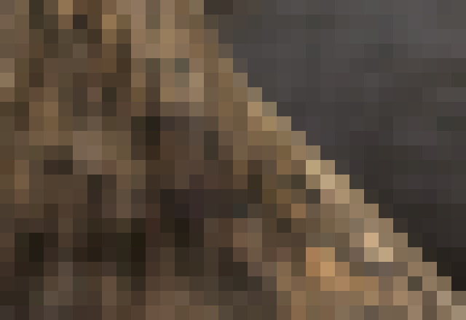
Anisotropic Filtering Comparison
Patch Edges
Ground Truth

Slide 41
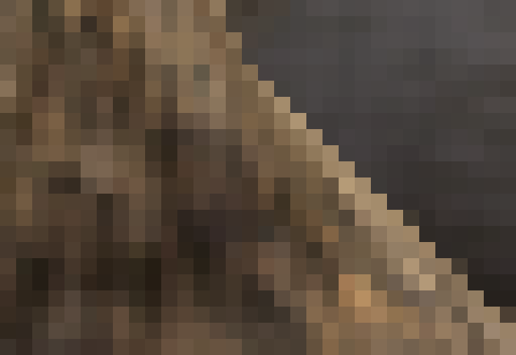
Anisotropic Filtering Comparison
Patch Edges
Clamped

Slide 42
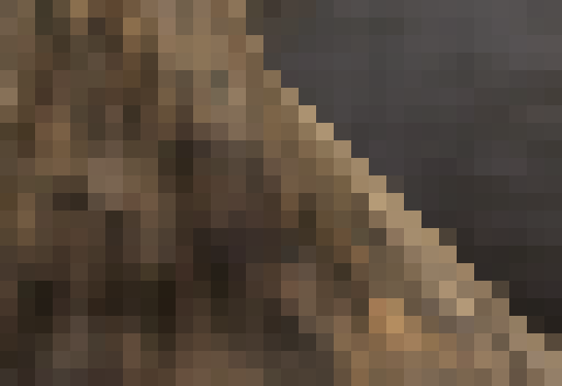
Anisotropic Filtering Comparison
Patch Edges
Clipped

Slide 43
Anisotropic Filtering Comparison
Patch Edges
Ground Truth

Slide 44
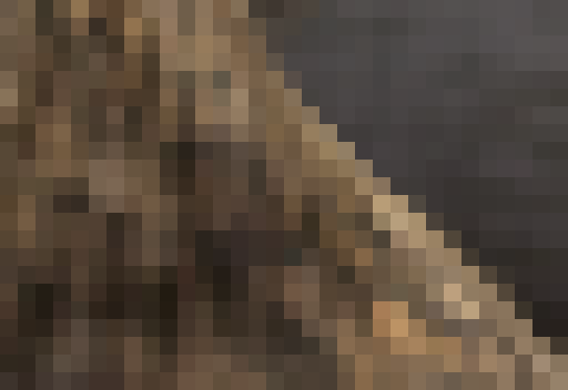
Anisotropic Filtering Comparison
Patch Edges
Clamped+MSAA

Slide 45
Anisotropic Filtering Comparison
Patch Edges
Clipped+MSAA

Slide 46
Proof of Concept
Implemented all algorithms in GPU renderer

Slide 47
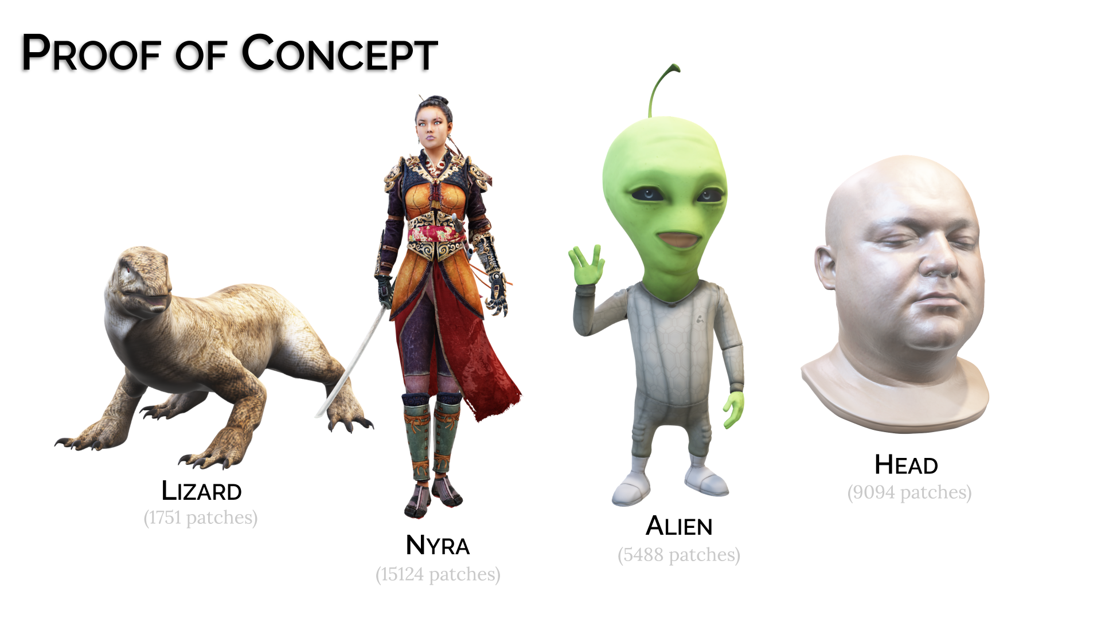

Slide 48
Conclusion
Implementing Mesh Colors requires only minimal changes to existing GPU hardware
Takeaway for vendors: go implement it already! ☺

Slide 49
Questions
2019
preprint
Utah Graphics

Slide 50
Why is it Harder with Ptex?
Ptex and Mesh Colors have minor theoretical differences (they are duals of each-other), but this leads to significant difficulty in-practice.
Main problem is that edge-crossing is required for correct filtering in Ptex.

Slide 51
Why is it Harder with Ptex?
Data from neighbor required for correct bilinear filter near edge.

Slide 52
Why is it Harder with Ptex?
???
Unclear how to correctly filter here. Different solutions, all involving edge-crossing. This means substantial HW changes!

Slide 53
Why is it Harder with Ptex?
Duplicating edge data avoids crossing, but is inconsistent.

Slide 54
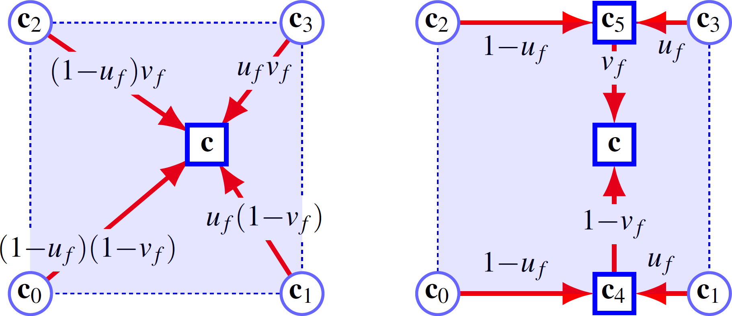
Filtering (Quadrilateral Patches)

Slide 55
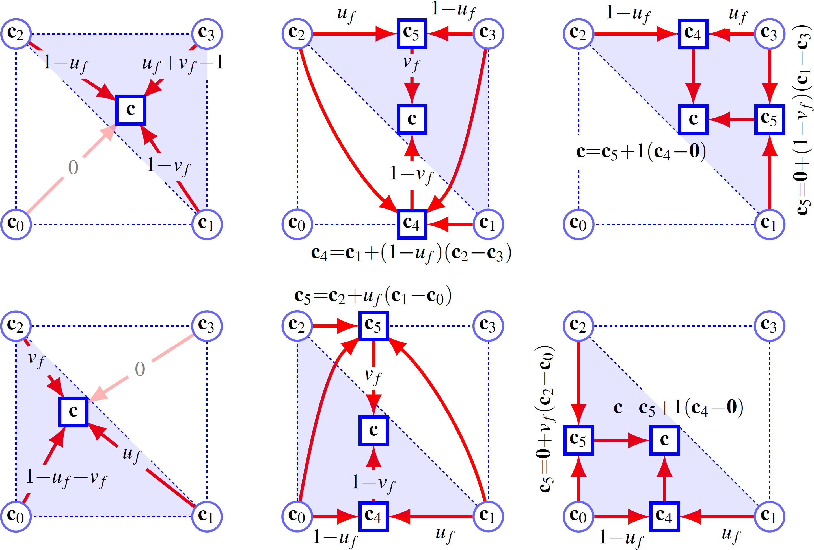
Filtering (Triangular Patches)

