Slide 1

Spherical Parametric Measurement for Continuous and Balanced Mesh Segmentation
Huadong Zhang, Lizhou Cao, and Chao Peng
Rochester Institute of Technology, New York, USA
Notes:
It’s my pleasure to present this work at HPG and to the EGSR audience.
We present parallel algorithms for segmenting the mesh into a balanced mesh structure. By “balanced”, we mean the sub-meshes that contain an equal number of triangles. This structure has the potential to improve the utilization of parallel computing architecture for geometry processing applications.

Slide 2
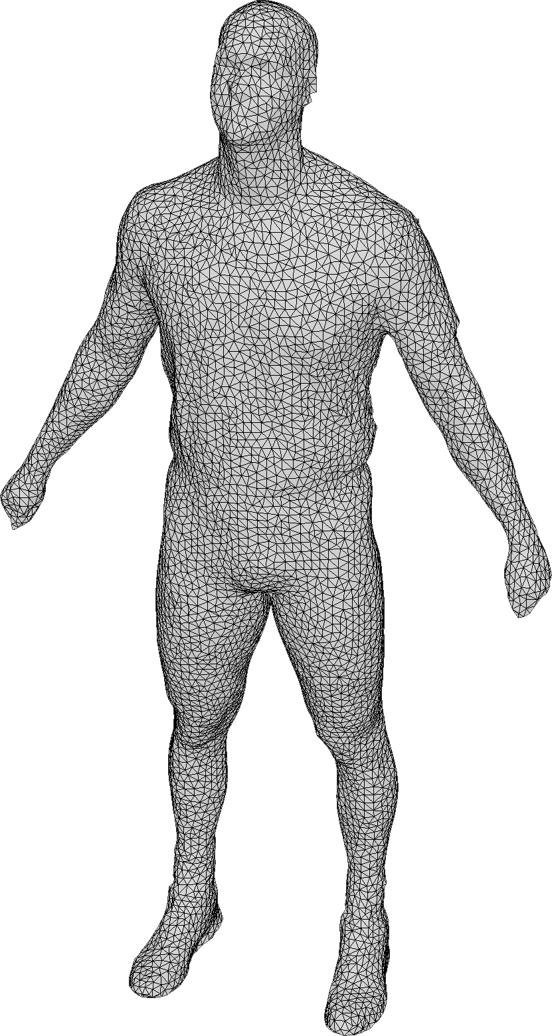
Motivation
Aligning the mesh structure with hardware requirements
Shared Memory
Shared Memory
Shared Memory
Shared Memory
Shared Memory
Global Memory
Buffer objects
Notes:
We use a GPU application to illustrate our motivation. GPU is designed with an array of streaming multiprocessors that manage blocks of threads with accessing to the same shared memory.
The vertices and triangles, as arrays, are sent to the global memory of the GPU.
However, they are maintained in the global memory, and not use much of the shared memory.

Slide 3
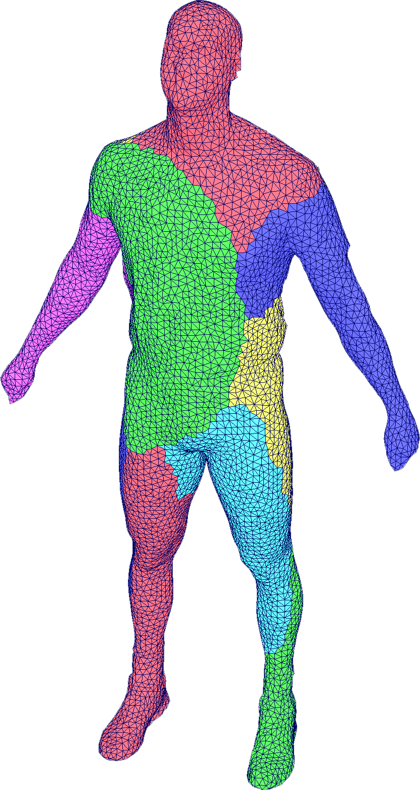
Motivation (cont.)
Aligning the mesh structure with hardware requirements
Shared Memory
Shared Memory
Shared Memory
Shared Memory
Shared Memory
Global Memory
Notes:
In this work, we want to partition the mesh into sub-meshes of equal size.
This will give us precise control over the sub-meshes.
So, when maintaining them on the GPU, we can optimize their fit into the shared memory.

Slide 4
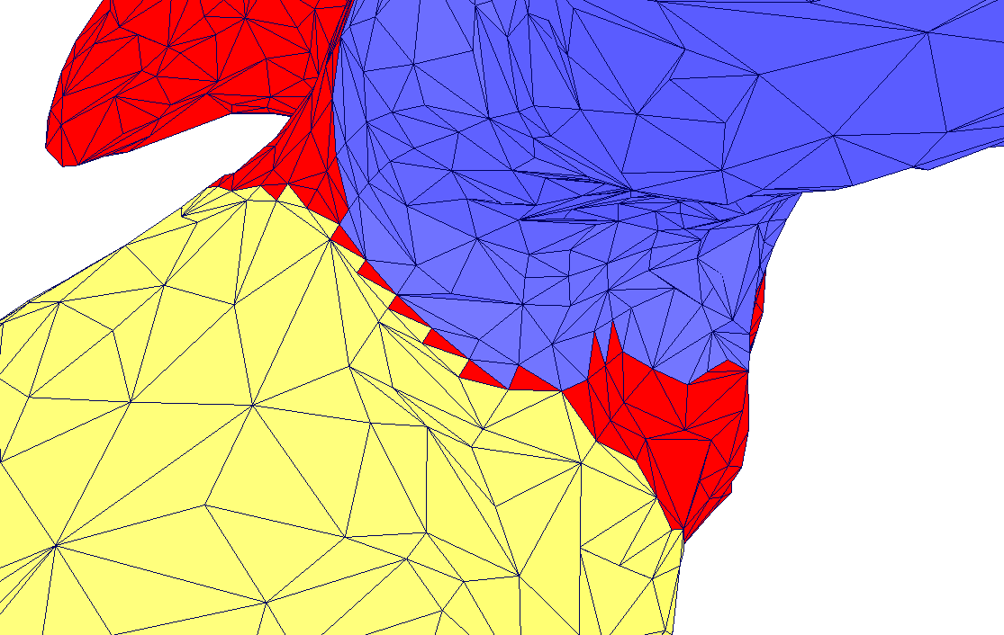
The goals of this work
Challenge:
  Exact balancing of sub-meshes is an NP problem.
Goals:
  Controlling the triangle counts among sub-meshes
  Maintaining 2-manifold topology in each sub-mesh
  Supporting fast segmentation of meshes
The “bowtie” non-manifold shapes
Notes:
When it comes to achieving exact balancing of the sub-meshes, it is an NP problem, which is difficult to deal with. We propose a strategy to address this issue by focusing on three primary goals.
We aim to develop a strategy that allows us to precisely control the size of sub-meshes. This control is important to ensure that the resulting sub-meshes align with hardware requirements.
We need to maintain 2-manifold topology for the sub-meshes. It is possible that the resulting sub-meshes have the non-manifold topological issue (e.g., “bowtie” shape). We develop an algorithm to resolve this.
The segmentation needs to be performed in high performance so that it can be reconfigured according to different hardware and application needs.

Slide 5
Related Work
Iterative approaches with region growing [Shlafman et al., 2002, Mahmound et al., 2021]
  Specifying K seeds to customize the number of sub-meshes
  Maintaining continuity
  Lack of support for balancing of primitive counts
METIS [Karypis and Kumar, 1997]
  Maintaining continuity but with bowties
  Supporting balancing but not exact
JA-BE-JA [Rahimian et al., 2013]
  Supporting exact balancing
  Resulting in severe discontinuity
Notes:
Existing work has been conducted for balanced segmentation research.
A common approach is to employ the region growing method. K seed triangles can be randomly selected on the mesh surface, and grow the regions from the seeds to the neighboring triangles.
METIS uses multilevel bisection method and Kernighan-Lin algorithm to refine the segmentation results.
JA-BE-JA is based on the operation of randomly swapping neighbor nodes.

Slide 6
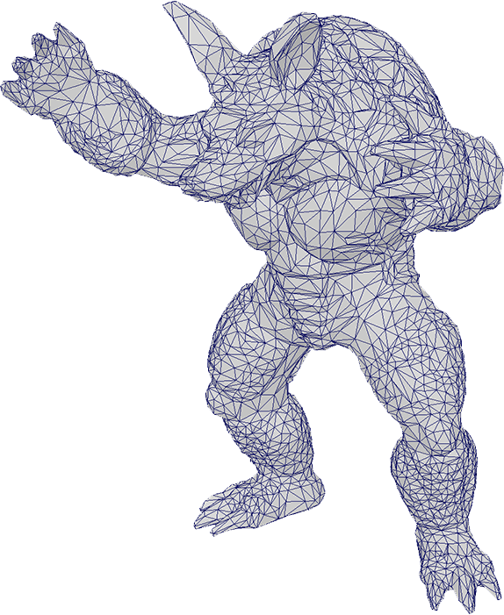
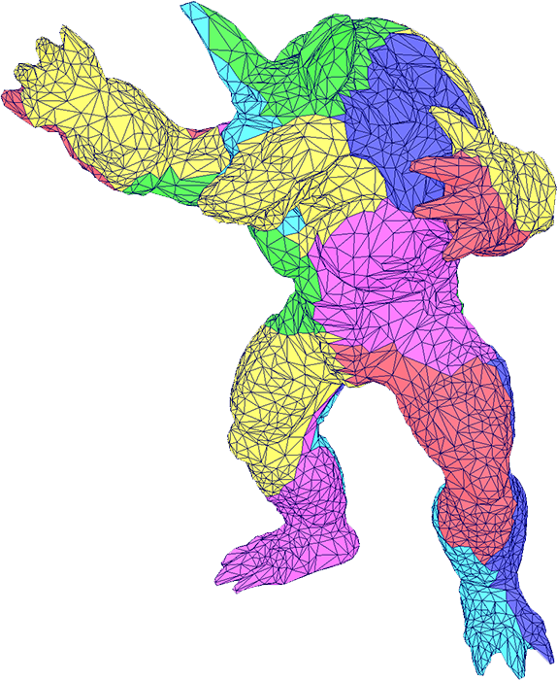
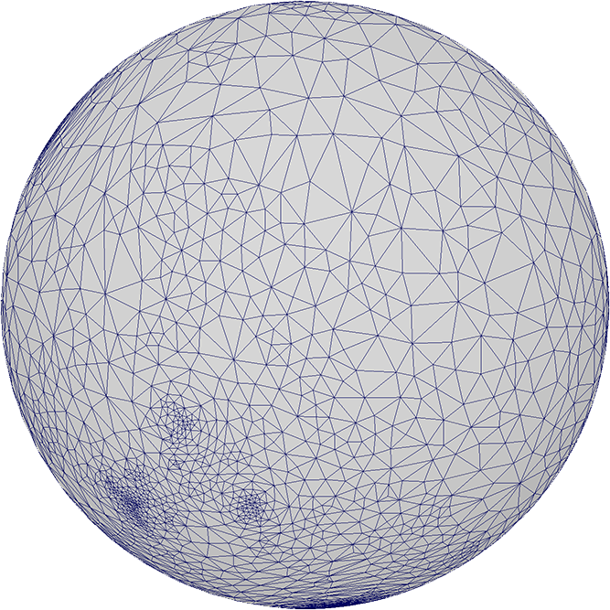
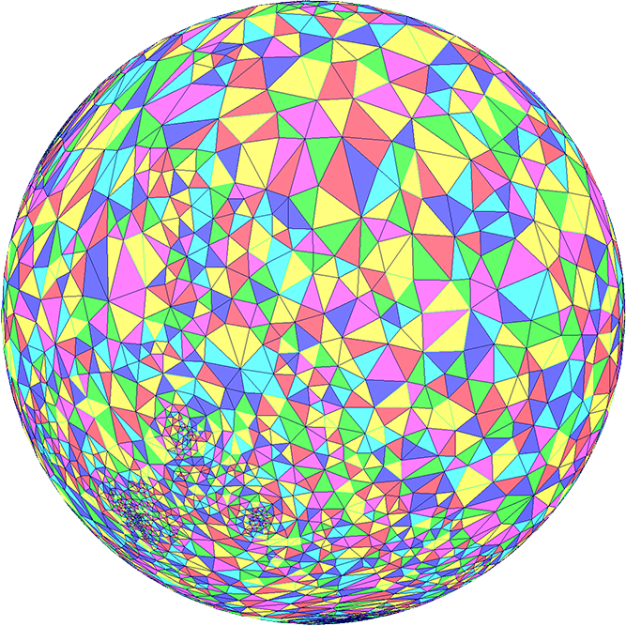
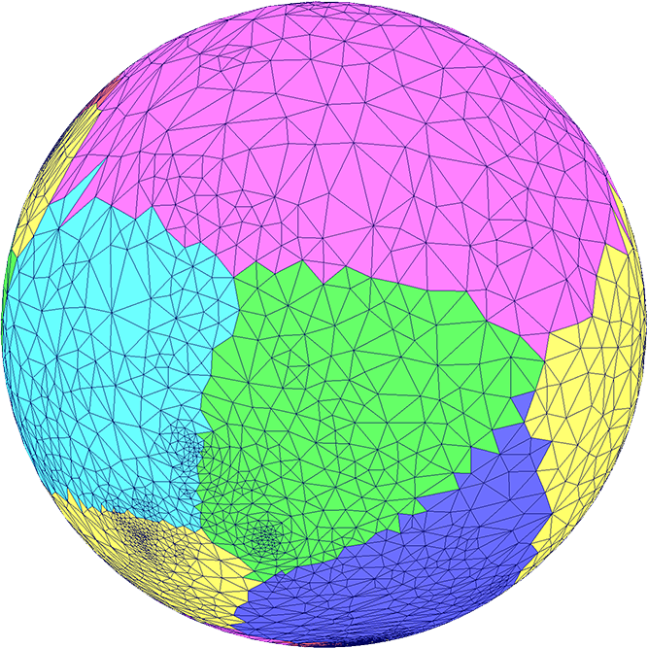
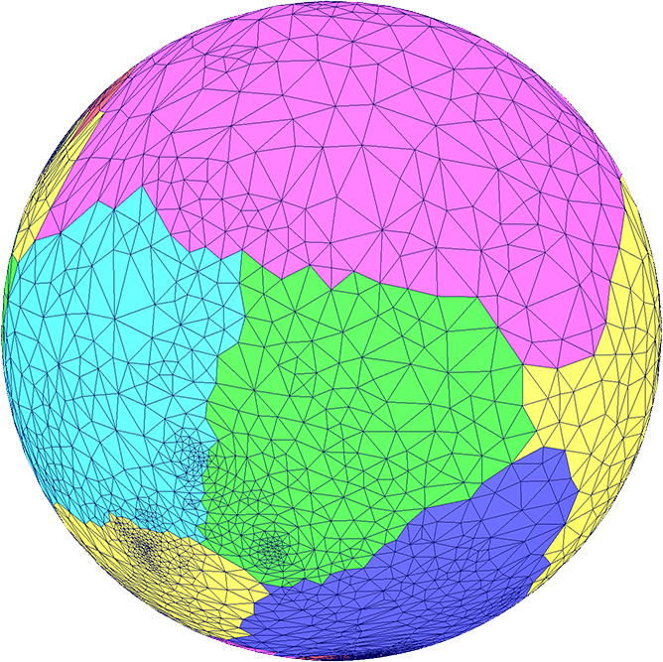
Overview of the Approach
Using spherical domain
Cohesion algorithm – starting with a “chaos” and grouping triangles into sub-meshes
  Executing label swapping operations in parallel
Refinement algorithm – improving segmentation results
  Resolving the “bowtie” issue
  Improving smoothness of sub-mesh boundaries
Spherical
Parameterization
Initial
labelling
Cohesion
Refinement
Notes:
Our algorithms are performed in spherical domain. The input-mesh is parameterized into a sphere.
The sub-mesh labels are assigned to each triangle in a random manner.
We developed a cohesion algorithm to establish the continuity from randomly initialized labels. At the core of the execution, this continuity is achieved by swapping labels between triangles.
We also developed a refinement algorithm to resolve the bowtie issue and improve the smoothness of the boundaries.

Slide 7
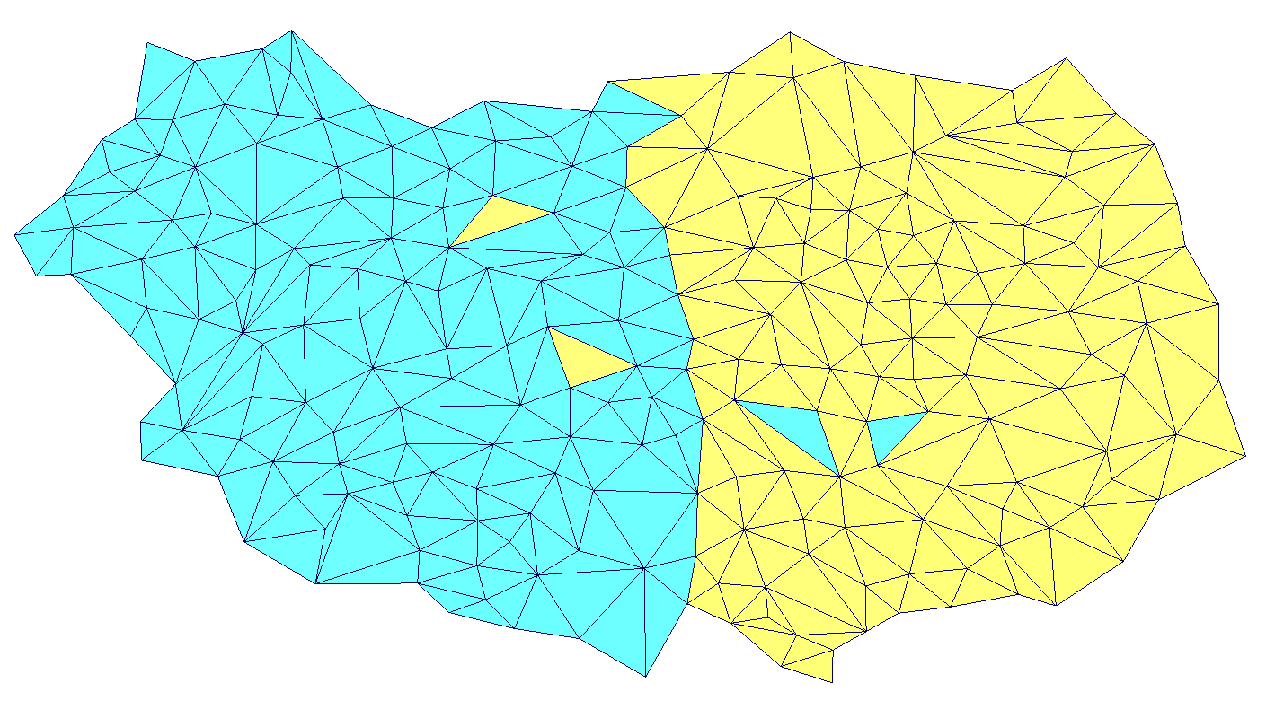
Cohesion
The cohesion algorithm gathers nearby triangles by swapping their labels.
A pair of triangles
Notes:
Let’s consider an example for the cohesion process. We have two sub-meshes.
Here is a pair of triangles need to be evaluated for swapping their labels.

Slide 8
Cohesion
The cohesion algorithm gathers nearby triangles by swapping their labels.
The centroid of the blue sub-mesh
The centroid of the yellow sub-mesh
The centroid of the blue triangle
The centroid of the yellow triangle
Notes:
First, we compute the centroid positions of the sub-meshes and the centroids of the pair of triangles.

Slide 9
Cohesion
The cohesion algorithm gathers nearby triangles by swapping their labels.
The centroid of the blue sub-mesh
The centroid of the yellow sub-mesh
The centroid of the blue triangle
The centroid of the yellow triangle
d₂
d₁
Notes:
We measure the distance between the centroid of the sub-mesh and the centroid of the triangle that belongs to this sub-mesh.

Slide 10
Cohesion
The cohesion algorithm gathers nearby triangles by swapping their labels.
The centroid of the blue sub-mesh
The centroid of the yellow sub-mesh
The centroid of the blue triangle
The centroid of the yellow triangle
d₂
d₂
d₁
d₁
Notes:
We measure the distance between the centroid of the sub-mesh and the centroid of the triangle that belongs to this sub-mesh.

Slide 11
Cohesion
The cohesion algorithm gathers nearby triangles by swapping their labels.
The centroid of the blue sub-mesh
The centroid of the yellow sub-mesh
The centroid of the blue triangle
The centroid of the yellow triangle
d₂
d₂
d₁
+
d₂
d₁
d₁
Notes:
d1 + d2.

Slide 12
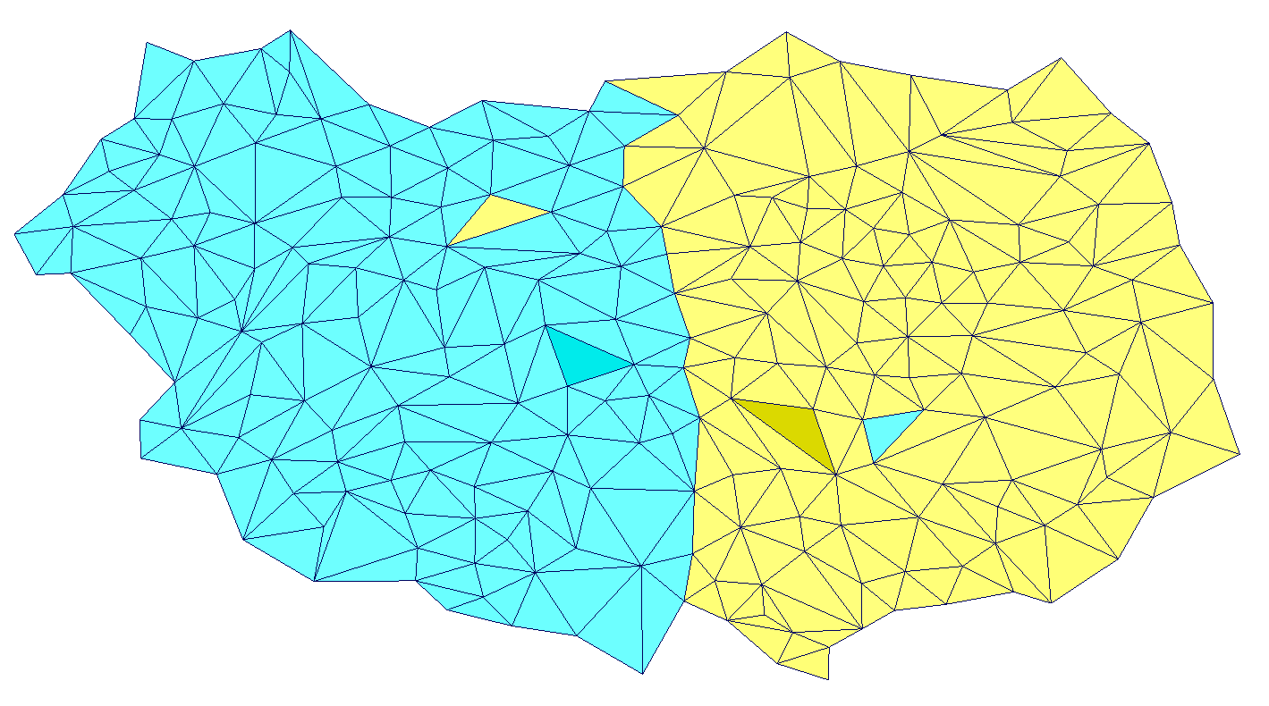
Cohesion
The cohesion algorithm gathers nearby triangles by swapping their labels.
The centroid of the blue sub-mesh
The centroid of the yellow sub-mesh
The centroid of the blue triangle
The centroid of the yellow triangle
d₄
d₃
d₁
+
d₂
Next, we assume the swapping would have happened.
Notes:
Next, we assume that the labels are swapped, and we measure the distances again to obtain d3 + d4.

Slide 13
Cohesion
The cohesion algorithm gathers nearby triangles by swapping their labels.
The centroid of the blue sub-mesh
The centroid of the yellow sub-mesh
The centroid of the blue triangle
The centroid of the yellow triangle
d₄
d₄
d₃
d₁
+
d₂
d₃
Notes:
Next, we assume that the labels are swapped, and we measure the distances again to obtain d3 + d4.

Slide 14
Cohesion
The cohesion algorithm gathers nearby triangles by swapping their labels.
The centroid of the blue sub-mesh
The centroid of the yellow sub-mesh
The centroid of the blue triangle
The centroid of the yellow triangle
d₄
d₄
d₁
+
d₂
+
d₃
d₃
+
d₄
d₃
Notes:
Next, we assume that the labels are swapped, and we measure the distances again to obtain d3 + d4.

Slide 15
Cohesion
The cohesion algorithm gathers nearby triangles by swapping their labels.
The centroid of the blue sub-mesh
The centroid of the yellow sub-mesh
The centroid of the blue triangle
The centroid of the yellow triangle
d₂
d₃
d₁
+
d₂
>
+
d₄
d₃
+
d₄
d₁
Before swapping
After swapping
Notes:
In this example, d1 + d2 is larger than d3 + d4. This indicates that swapping their labels would result in a more closely cohered group.

Slide 16
Cohesion
The cohesion algorithm gathers nearby triangles by swapping their labels.
The centroid of the blue sub-mesh
The centroid of the yellow sub-mesh
The centroid of the blue triangle
The centroid of the yellow triangle
d₁
+
d₂
>
+
d₃
+
d₄
Labels swapped
Before swapping
After swapping
Notes:
So, we proceed with the swap.

Slide 17
Cohesion – Distance Measurement
Geodesic distance
  Defining the minimum path connecting two triangles
  Precise, computed in surface domain, and expensive
  In our case, it represents the minimum number of edges on the dual graph of triangle
d₁
Notes:
In the cohesion process, the choice of distance measurement plays an important role. One common method is to use geodesic distance.

Slide 18
Cohesion – Distance Measurement
Geodesic distance
  Defining the minimum path connecting two triangles
  Precise, computed in surface domain, and expensive
  In our case, it represents the minimum number of edges on the dual graph of triangle
    Computational time is high (e.g., Dijkstra; Sharp and Crane, 2020).
d₁
Notes:
In our case, this distance can be defined as the minimum number of edges on the dual graph of triangles. However, the time to compute is high.

Slide 19
Cohesion – Distance Measurement
Chord distance in the spherical domain
  Measuring distance at constant time
  Not precise, but preserves the correctness of comparison
Chord distance
Notes:
Alternatively, we employed the chord distance in the spherical domain. The calculation of chord distance is at constant time. It may not be as accurate as geodesic distance, but it effectively preserves the correctness for that before-and-after distance comparison for the triangle pair.

Slide 20
Cohesion – Parallelization
0
1
2
3
4
5
6
7
8
9
10
11
12
13
Unique pairs of triangles
0
1
2
3
4
5
6
Parallel evaluation for the unique pairs
13
12
11
10
9
8
7
Notes:
In terms of implementation, we evaluate the unique pairs of triangles in parallel.
By defining “unique pairs”, we ensure that each triangle is paired with only one other triangle. This is to avoid racing conditions if multiple triangles attempt to swap labels simultaneously.
Specifically, we assign the first triangle index to be paired with the last triangle index, the second triangle with the second last triangle, and so on, until the middle two triangles are paired.

Slide 21
Cohesion – Parallelization
0
1
2
3
4
5
6
7
8
9
10
11
12
13
Unique pairs of triangles
u_{i} = u_{i} >1 : u_{i} – 1 ? n-1
Applying Round Robin scheduling method to update triangle indices in the pairs
0
1
2
3
4
5
6
13
12
11
10
9
8
7
Notes:
To ensure we evaluate all triangle pairs, we used the round-robin scheduling method, which cycles through all indices.
Starting from the second element (u_i = 1), the index values are shifted forward by one (u_i = u_i - 1), except for the starting one, which is replaced with the last index.

Slide 22
Cohesion – Parallelization
0
1
2
3
4
5
6
7
8
9
10
11
12
13
Unique pairs of triangles
u_{i} = u_{i} >1 : u_{i} – 1 ? n-1
Repeating n-1 times of shifting to ensure all triangle pairs are evaluated
0
13
1
2
3
4
5
12
11
10
9
8
7
6
We iterate this cycle of n-1 times of shifting until no triangle pair needs to swap.
Notes:
We repeat this cycle of shifting n-1 times to ensure the evaluation of all triangle pairs. This n-1 times of shifting is one iteration, and we iterate the process until no triangles need to be swapped.

Slide 23
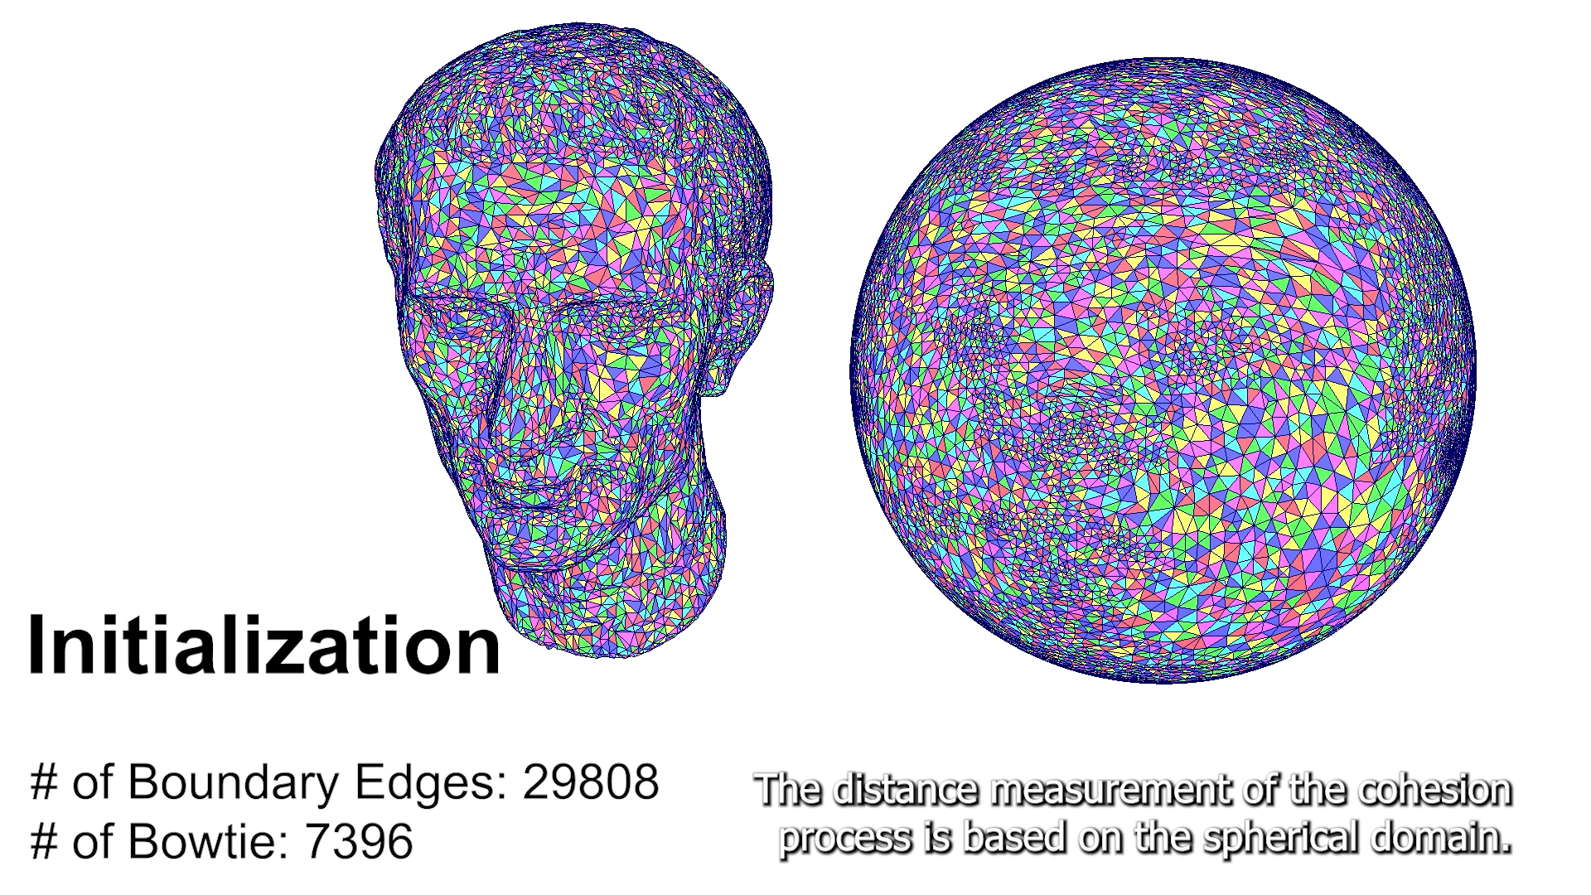
Cohesion – Iteration Example
Notes:
Here is a video clip showing the iterations of cohesion applied to the head model. Throughout the video, we track the number of boundary edges and the number of bowties at each iteration.

Slide 24
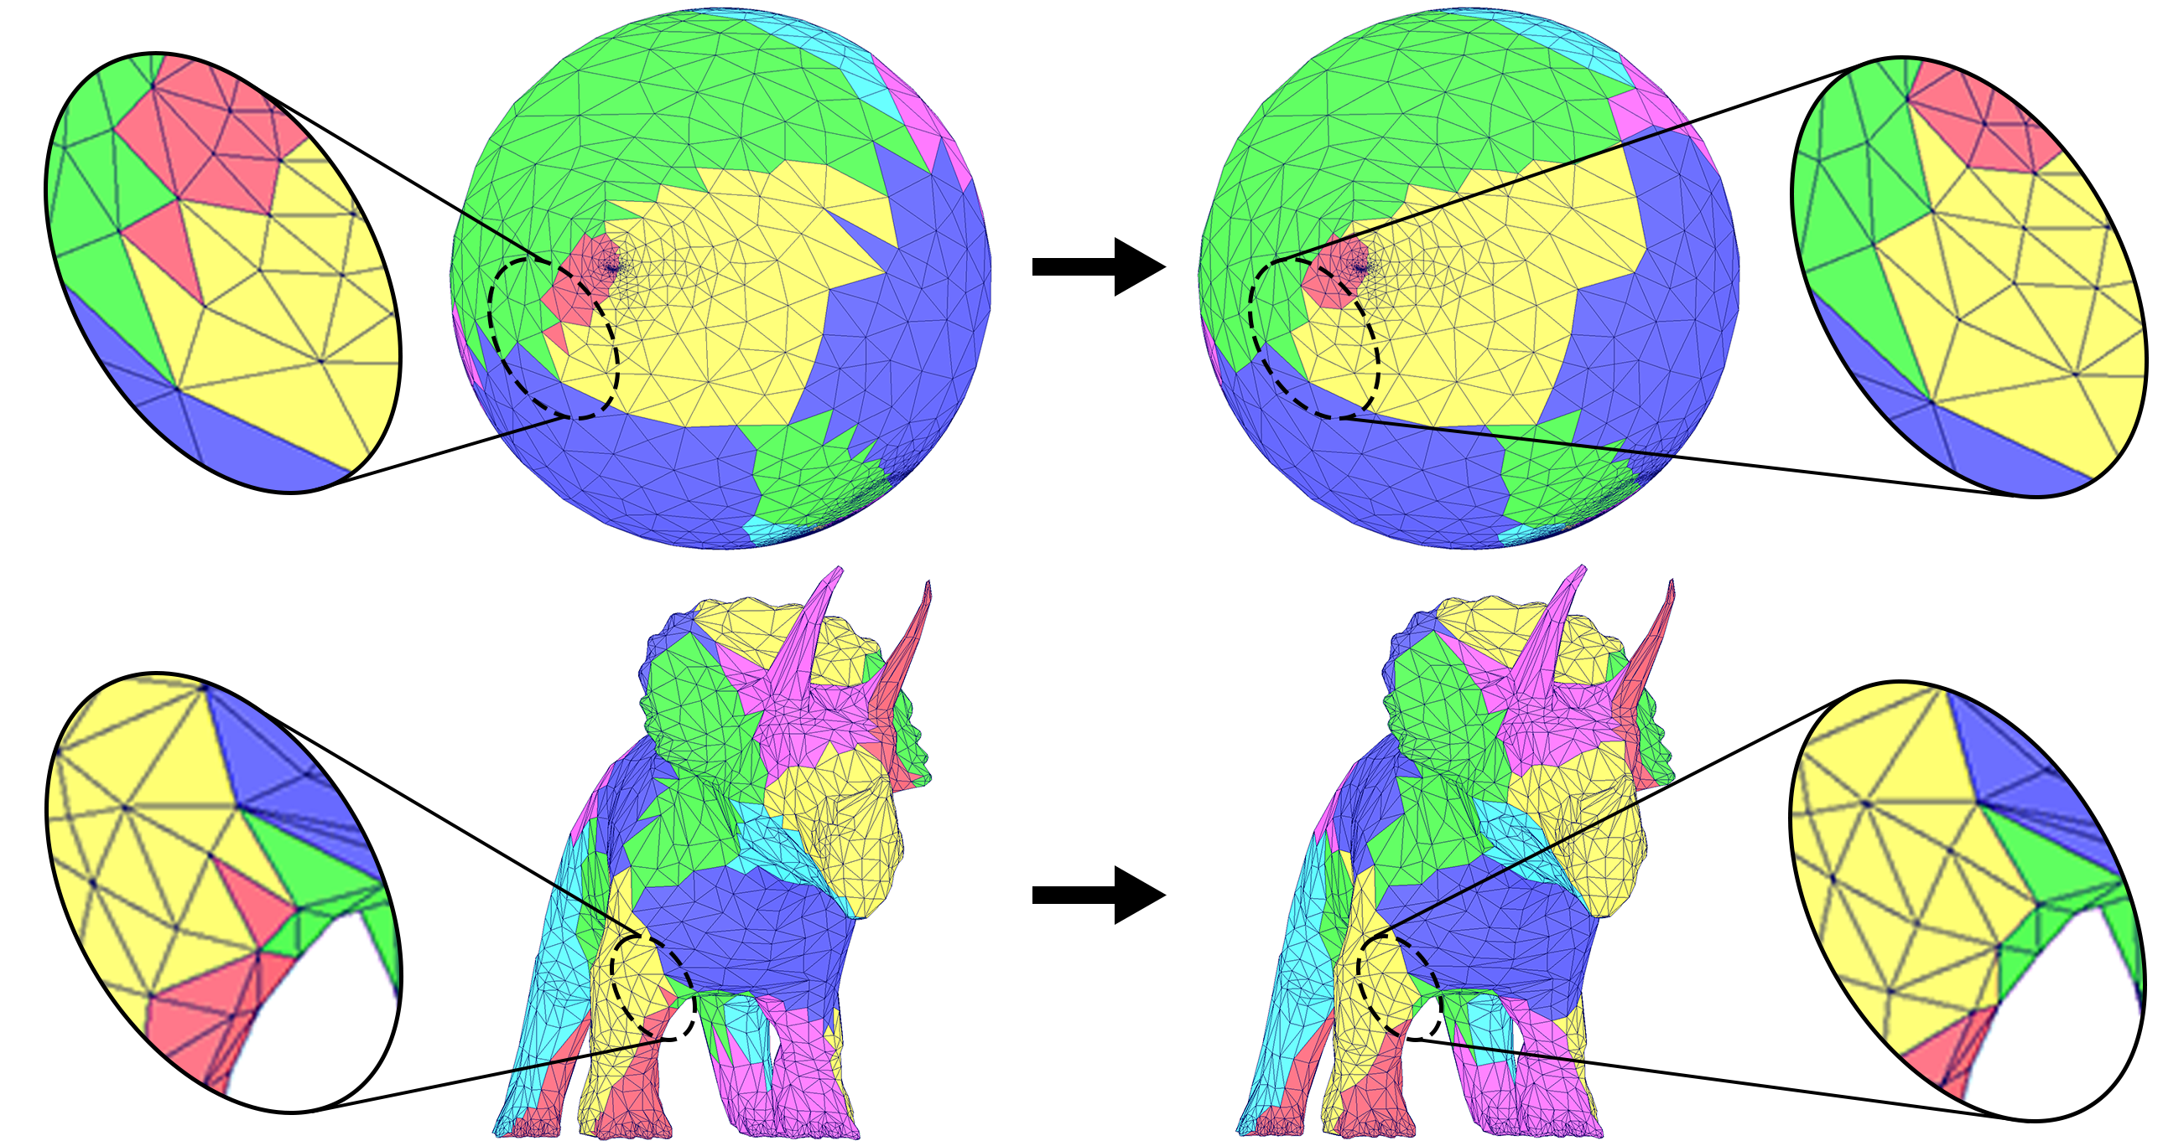
Refinement
Goal: resolving bowties and smoothening the boundaries
Notes:
The result obtained from the cohesion algorithm may contain the non-manifold issue. The refinement algorithm is developed to resolve this issue.

Slide 25

Refinement
Evaluating pairs of triangles for swapping their labels
Based on topological connection in neighbor triangles
Counting the number of boundary edges in the pair of triangles
2
2
Notes:
Similar to the cohesion process, we evaluate pairs of triangles for label swapping. However, the evaluation criteria in this case are based on topological connection.
For a triangle pair, we count the number of boundary edges. The yellow triangle has two boundary edges adjacent to the blue sub-mesh, the bule triangle has two boundary edges adjacent to the yellow sub-mesh.

Slide 26
Refinement
Evaluating pairs of triangles for swapping their labels
Based on topological connection in neighbor triangles
Counting the number of boundary edges in the pair of triangles
2
2
2
2
Notes:
These boundary edge numbers are recorded.

Slide 27
Refinement
Evaluating pairs of triangles for swapping their labels
Based on topological connection in neighbor triangles
Then, finding the neighbor triangles belonging to the same sub-meshes, and counting their boundary edges
2
2
2
2
1
2
Notes:
Then, we find the neighbor triangles that belong to the same sub-mesh, and count their boundary edges.

Slide 28
Refinement
Evaluating pairs of triangles for swapping their labels
Based on topological connection in neighbor triangles
Then, finding the neighbor triangles belonging to the same sub-meshes, and counting their boundary edges
2
2
2
2
2
1
1
2
Notes:
Then, we find the neighbor triangles that belong to the same sub-mesh, and count their boundary edges.

Slide 29
Refinement
Evaluating pairs of triangles for swapping their labels
Based on topological connection in neighbor triangles
Then, finding the neighbor triangles belonging to the same sub-meshes, and counting their boundary edges
2
2
2
1
2
2
1
2
Notes:
Then, we find the neighbor triangles that belong to the same sub-mesh, and count their boundary edges.

Slide 30
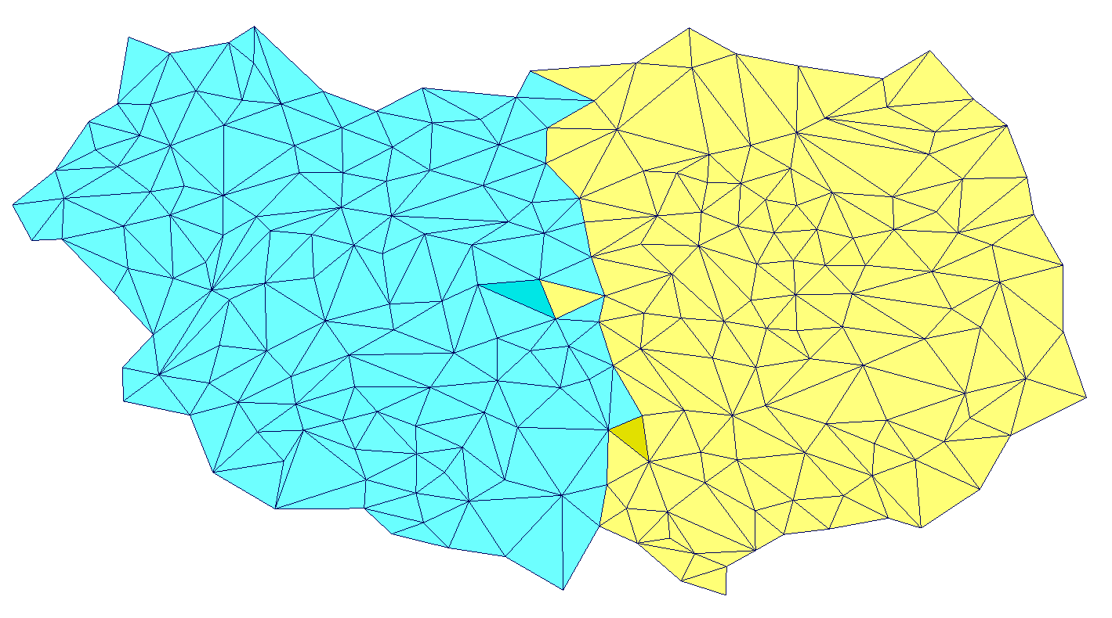
Refinement
Evaluating pairs of triangles for swapping their labels
Based on topological connection in neighbor triangles
Now, assuming the swap would have happened, and counting the boundary edges
2
2
2
1
0
1
1
1
Notes:
Next, we assume the swap would have happened, and we count the number of boundary edges.

Slide 31
Refinement
Evaluating pairs of triangles for swapping their labels
Based on topological connection in neighbor triangles
Now, assuming the swap would have happened, and counting the boundary edges
2
2
2
1
0
0
1
1
1
1
1
1
Notes:
And we record them.

Slide 32
Refinement
Evaluating pairs of triangles for swapping their labels
Based on topological connection in neighbor triangles
Now, assuming the swap would have happened, and counting the boundary edges
2
2
2
1
1
1
0
1
0
1
1
1
Notes:
And we record them.

Slide 33
Refinement
Evaluating pairs of triangles for swapping their labels
Based on topological connection in neighbor triangles
We use the summed squares of these numbers as the cost value for evaluation
2
2
2
2
2
2
2
2
2
2
2
1
1
1
0
1
+
+
+
+
+
+
0
1
Before swapping
After swapping
1
If the cost value becomes smaller after swapping, we proceed with this swap.
1
Notes:
we use the summed squares as the cost value to determine whether the labels should be swapped.
If the cost value becomes smaller after swapping, we proceed with this swap.

Slide 34
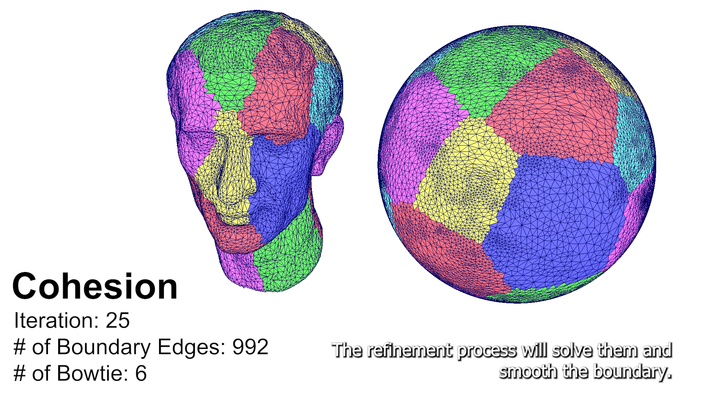
Refinement – Example
Notes:
Here is a short video clip demonstrating the sub-mesh refinement using the result obtained from the cohesion process.

Slide 35
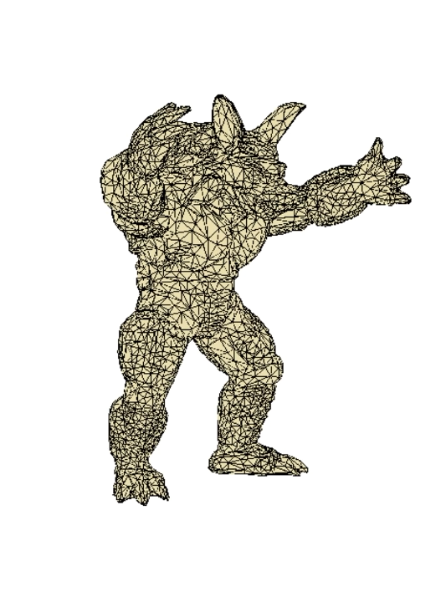
Spherical Parameterization
We have adopted the progressive parameterization method.
  Vertices are collapsed progressively to embed feature-intensive regions into flattener regions, until the shape reaches a tetrahedron.
Notes:
As you can see, our algorithms rely on the input mesh in spherical representations. We have employed an existing spherical parameterization method.
The mesh is simplified into a tetrahedron by embedding the high curvature regions into a flattener region.

Slide 36
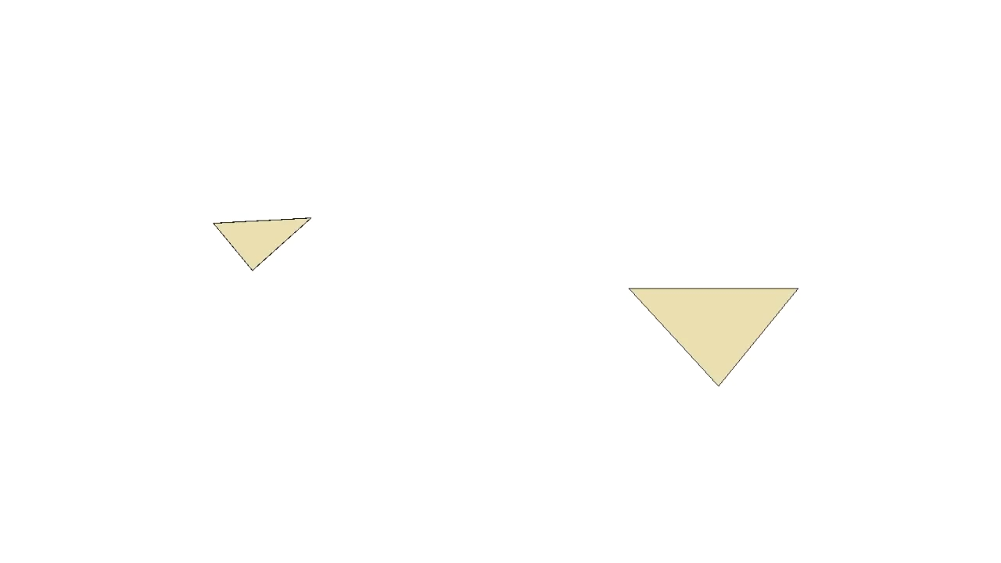
Spherical Parameterization
  The vertices are inserted in the reverse order of collapsing and projected onto the sphere.
Notes:
Then, the vertices are inserted back in the reverse order of collapsing and projected onto the sphere. Each vertex is inserted into its one-ring space within the neighborhood of triangles it had been collapsed into.

Slide 37
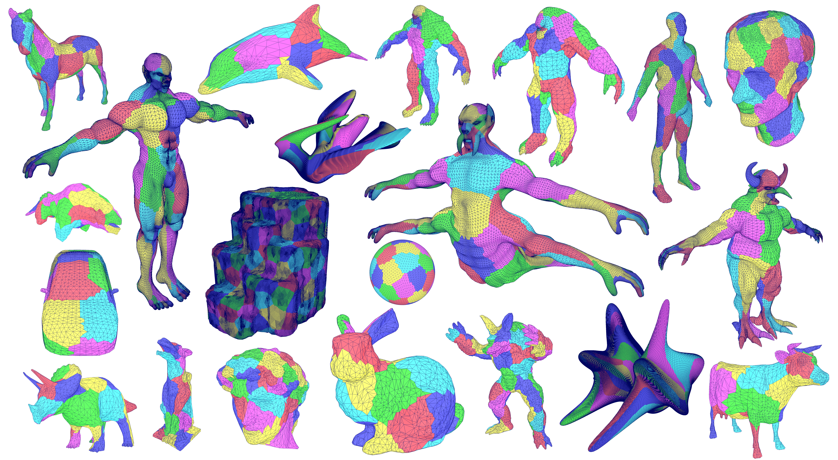
Results
Implemented with C++ and CUDA 11.6 on RTX 3090 GPU.
We tested the algorithms with 21 models.
Notes:
Here we show the segmentation results from our algorithms. Largest – 0.5 million, smallest – a few thousand, limited by the capability of spherical parameterization

Slide 38
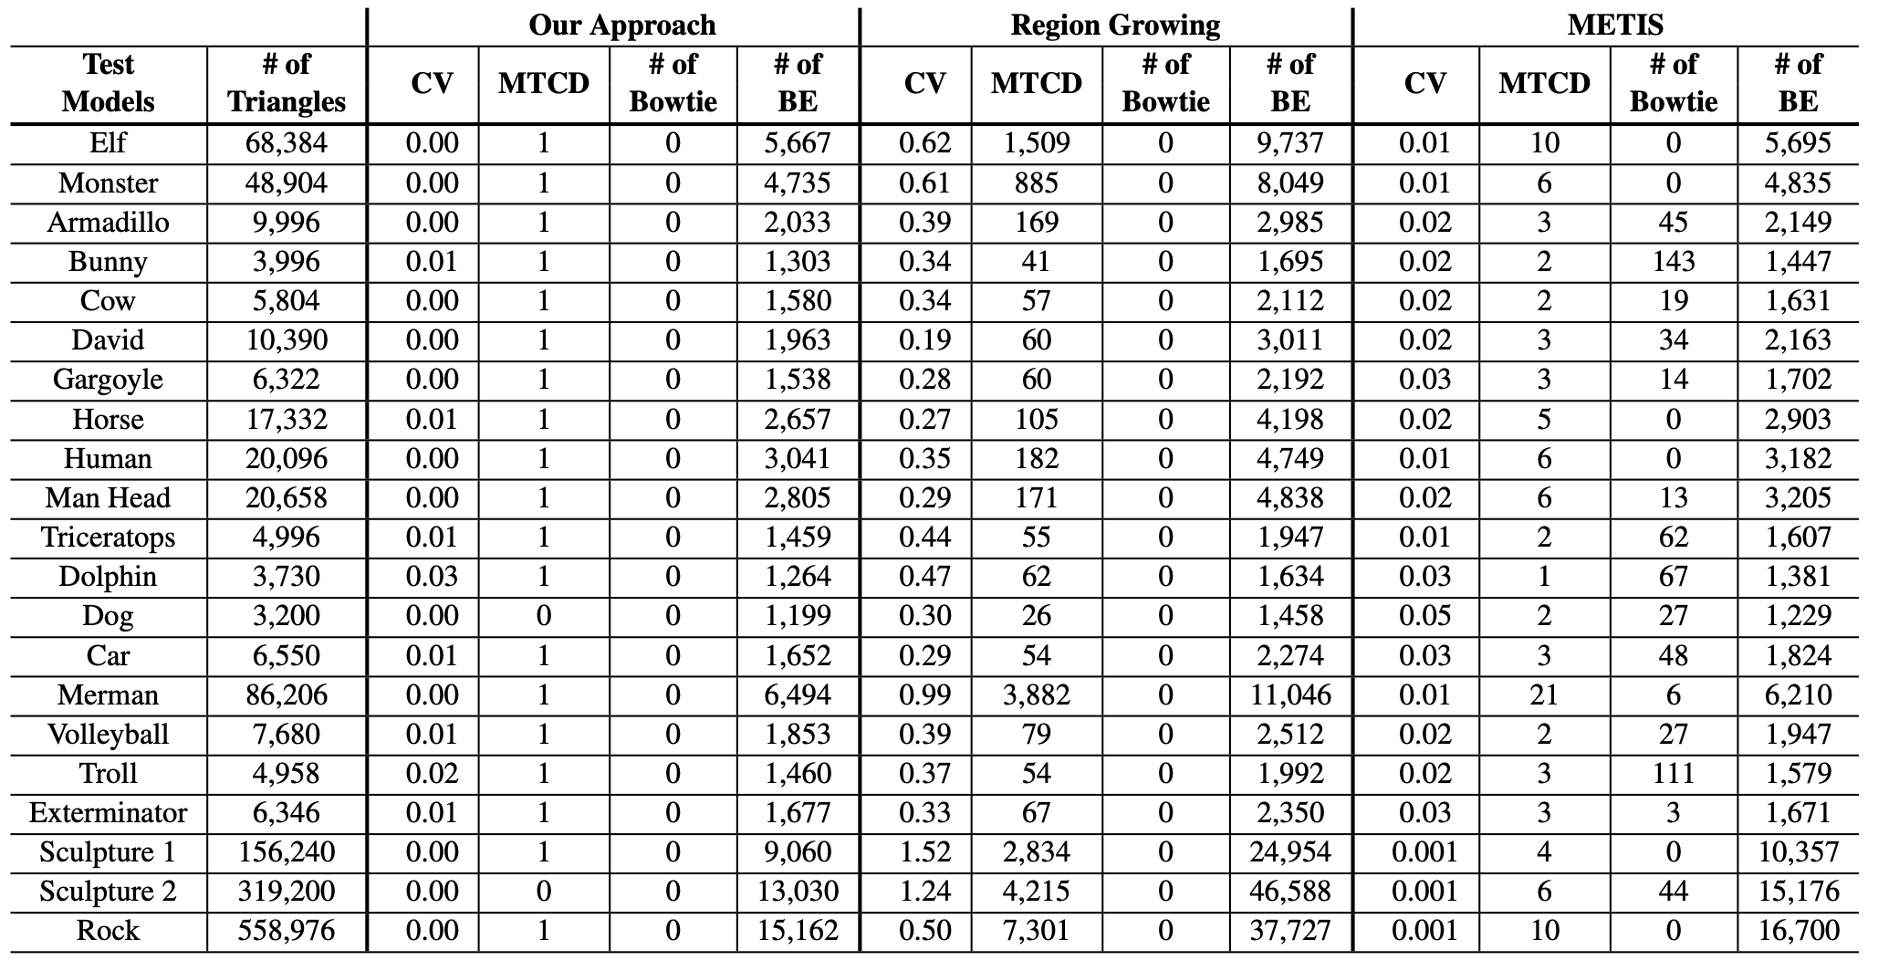
Results
The max triangle count difference between any two sub-meshes
Non-manifold issue
Number of boundary edges
Notes:
We conducted a comparison between our approach, region growing, and METIS. In terms of balancing, we measured the maximum triangle differences between any two sub-meshes. Our approach has achieved exact balance of triangle counts among the sub-meshes. The region growing method has exhibited the most significant unbalancing issue.
Both our approach and region growing method have avoided the presence of bowtie shapes, while METIS is not able to avoid this.
Our approach and METIS demonstrated significantly fewer boundary edges compared to the region growing method.

Slide 39
Results
Notes:
This figure highlights the non-manifold issue observed in the result from METIS.

Slide 40
Results
Cohesion iterations
Refinement iterations
Cohesion iterations
Refinement iterations
Using Human model at 200 sub-meshes
Notes:
We present the timing results of our algorithms.
The initial iterations of the cohesion algorithm take longer, because they involve a greater number of swapping operations than later iterations.
The refinement algorithm requires fewer iterations but can be more computationally intensive due to the evaluation of neighbor triangles.
The initial iterations of the cohesion algorithm significantly reduce the number of boundary edges, leading to a rapid convergence and stabilization of the process.

Slide 41
Testing with Two Applications
Level of detail on GPU: Fitting sub-meshes into shared memory and simplifying them independently
Notes:
We have applied the segmentation results obtained from our algorithms to two mesh processing applications.
The first application is Level of Detail (LOD), which was tested on the GPU. In this application, each sub-mesh runs an independent LOD selection process and reforms a simplified version without collapsing the boundary edges.
Our approach demonstrates a better collapsibility of the edges due to resolving the bowtie issue and improving the smoothness of the boundaries.
Additionally, our approach has shown improved shared memory usage.

Slide 42
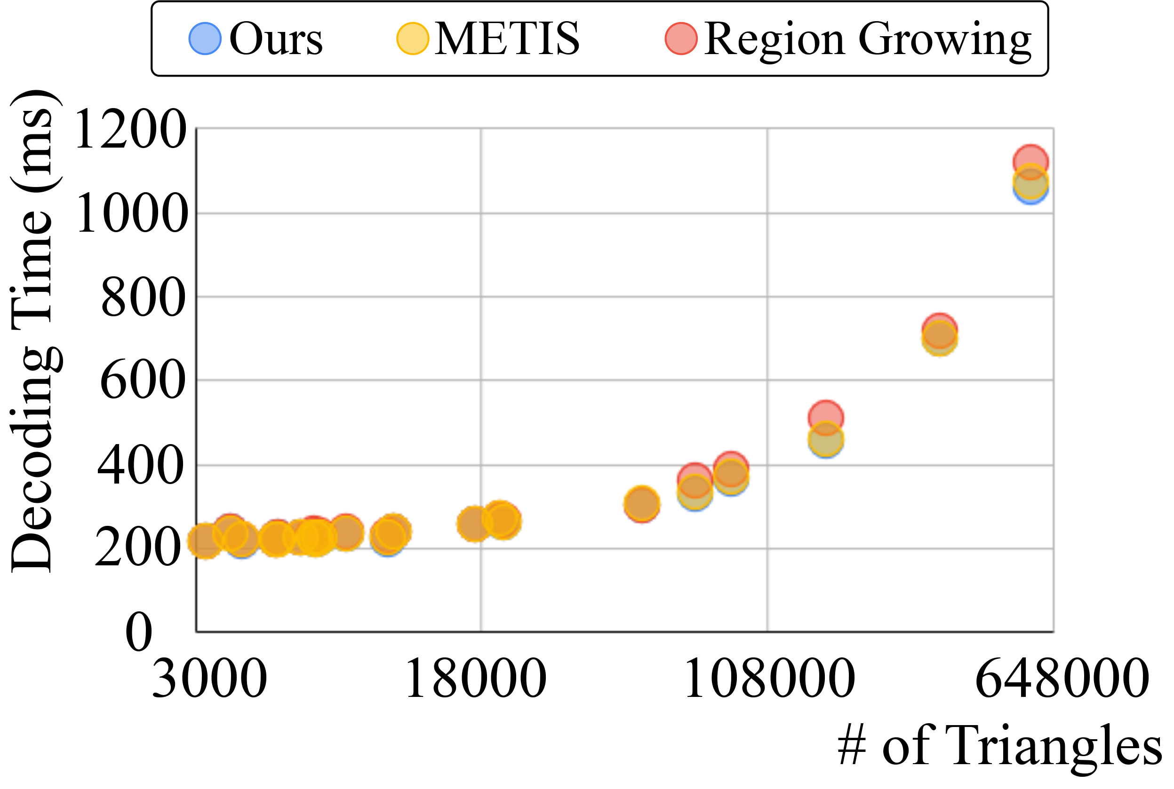
Testing with Two Applications
Multi-threaded Mesh compression: we used Google’s Draco mesh
compression library to encode meshes, and test the decoding time.
Notes:
The second application is mesh compression, where we used Google's Draco mesh compression library for encoding the meshes.
We conducted tests on the decoding time using a multithreaded implementation on the CPU. Our approach and METIS have demonstrated similar decoding times, particularly for larger data sizes.
This is because the balanced workload has the advantage in multithreaded implementations.

Slide 43
Conclusion, Limitations, and Future Work
Conclusion:
  Cohesion and refinement algorithms in spherical domain with parallel executions
Limitations:
  restricted to genus-zero meshes
  Possibly falling into a local optimum during refinement
Future work:
  Introducing and handling seams and open boundaries to reduce the genus level
  Further investigation on the refinement algorithm
  Improving robustness of spherical parameterization
  Building the hierarchical mesh structure

Slide 44
Thanks for Your Attention ☺
Golisano College of Computing and Information Sciences
School of
Interactive Games and Media
Media, Arts, Games, Interaction and Creativity
MAGIC Spell Studios

