Slide 1
GPU-Accelerated LOD Generation for Point Clouds
Markus Schütz¹, Bernhard Kerbl², Philip Klaus³, Michael Wimmer¹
¹ TU Wien, ² Inria, Université Côte d’Azur, ³ Austrian Institute of Technology,
Notes:
18-20 minutes presentation, 25 minutes in total with Q&A

Slide 2
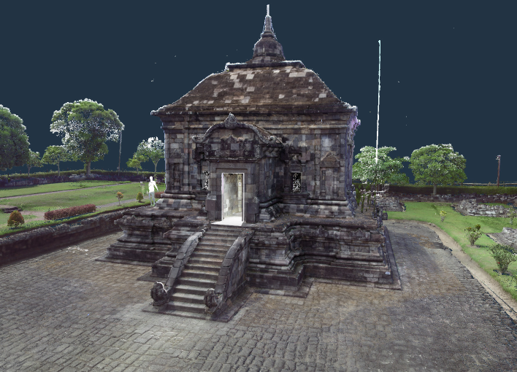
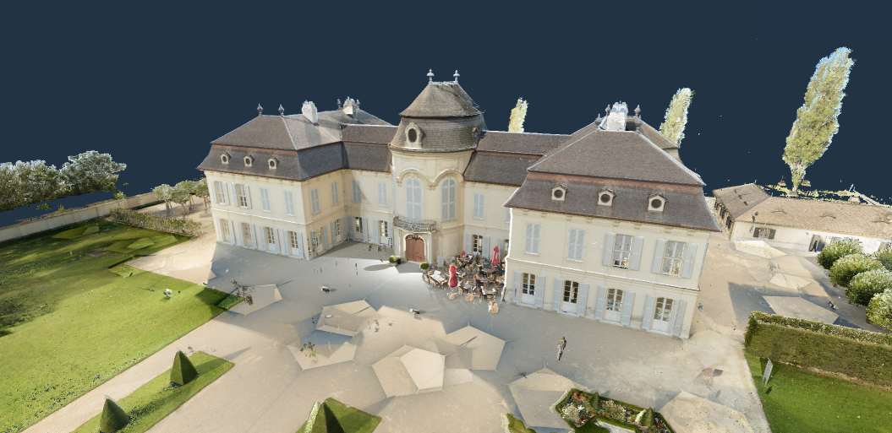
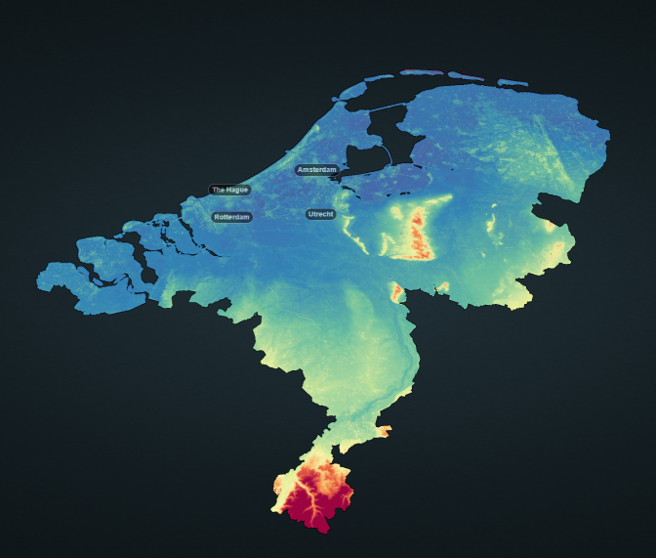
Problem Statement
Point clouds comprise millions to billions of points
How fast can we construct LOD structures?
4M (64MB)
529M (8.5GB)
1B (16GB)
640B (10TB)

Slide 3
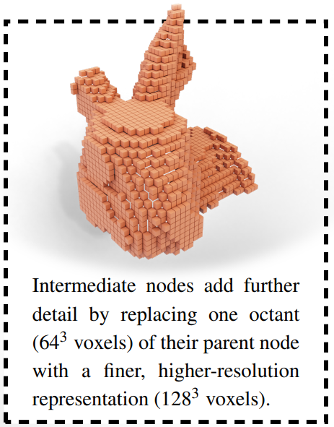
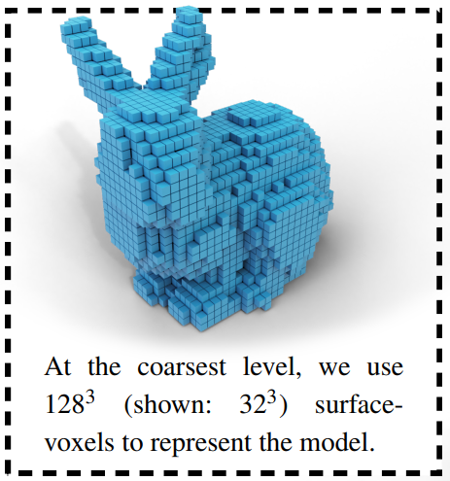
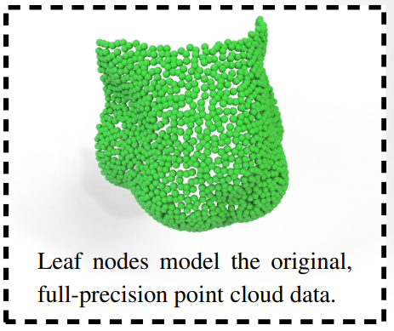
LOD Structure

Slide 4
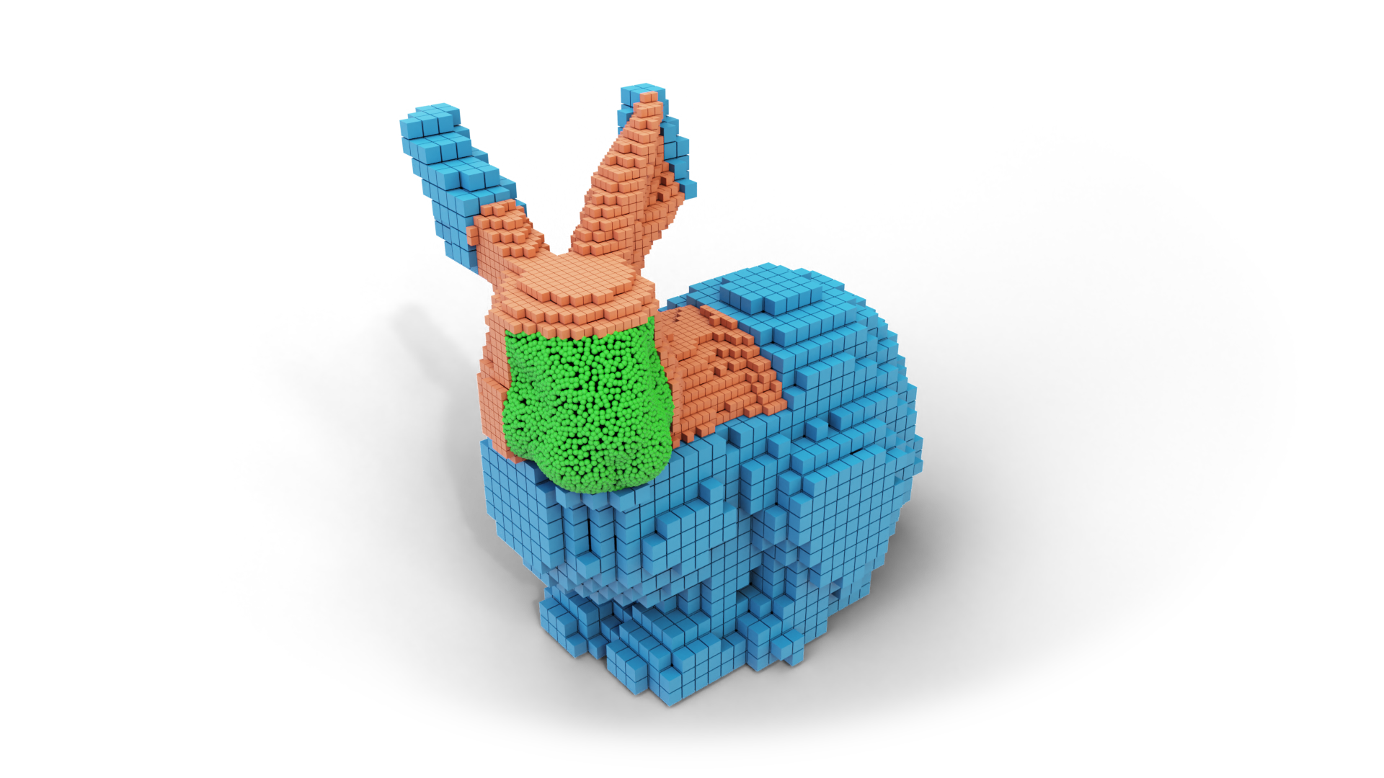
LOD Structure
We target surface models
Sparse surface voxels
128³ sampling grid (~2M)
But only about 128² occupied (~16k)
Temporary grid for voxel sampling
But vertex-buffer for rendering & storage
Rendering pixel-sized voxels

Slide 5
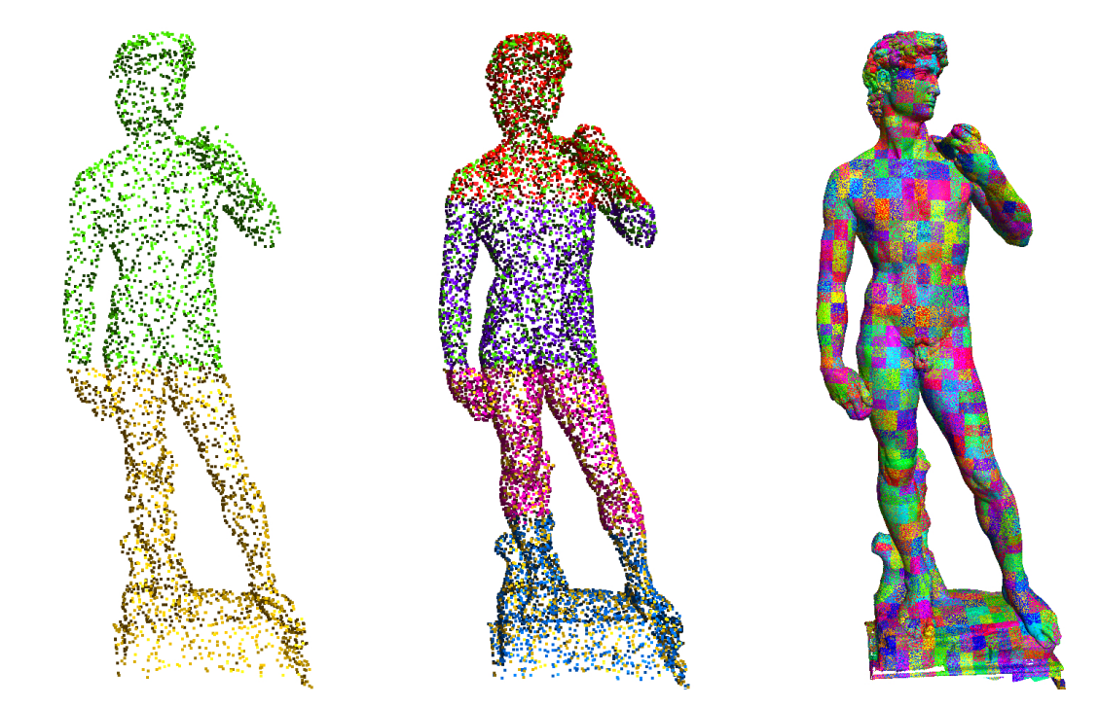
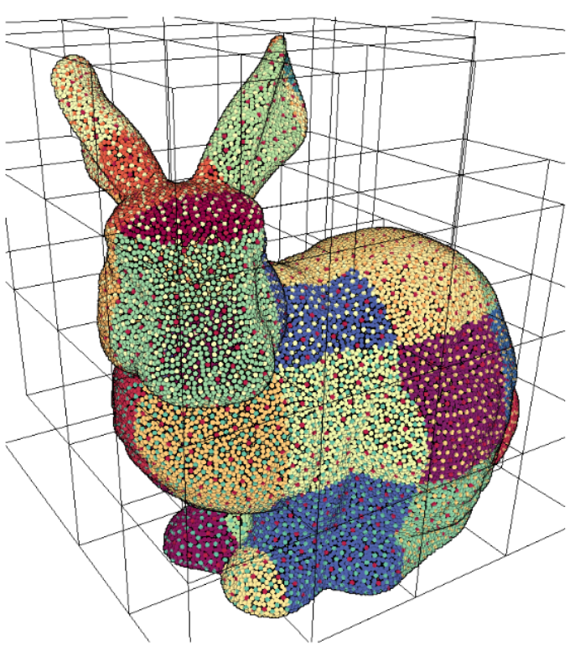
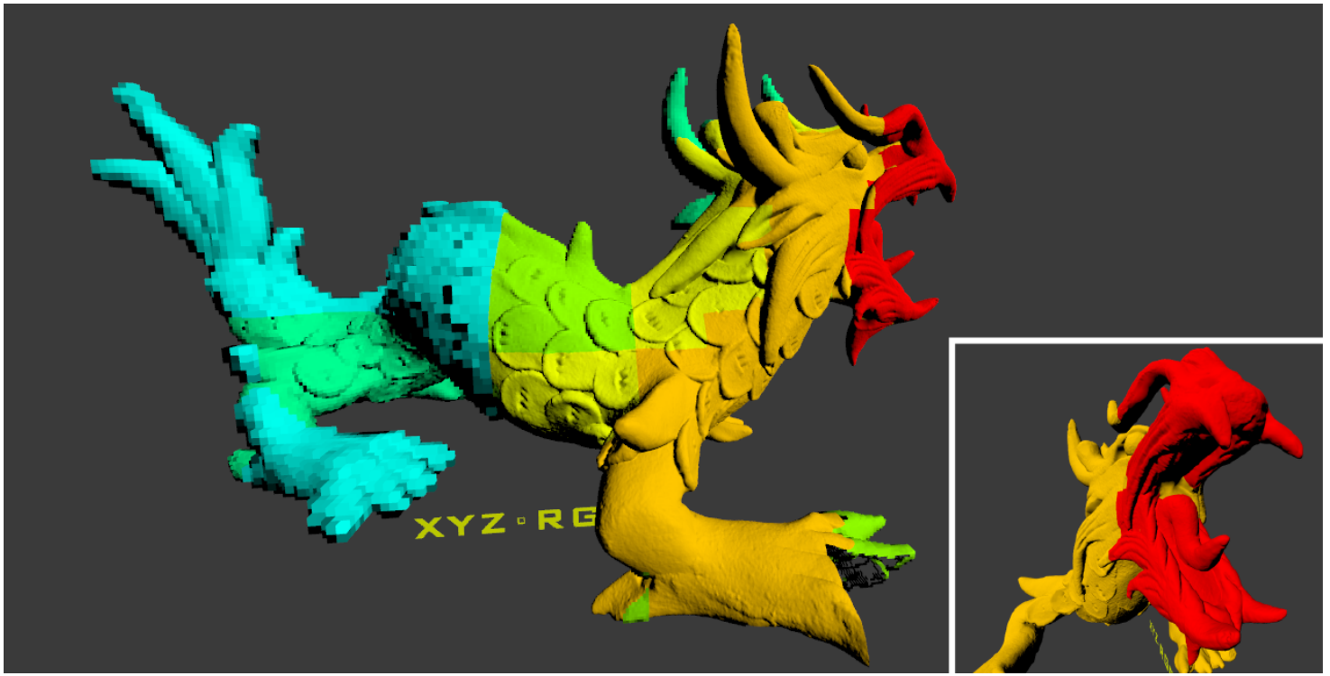
Related Work – LOD Structures
Layered Point Clouds (LPC)
M random points per node
M around 512 to 8192
No duplicates
Wand et al.
Original points in leaf nodes
Quantized points/surfels/voxels in inner nodes
Using 128³ sample grid
Essentially what we generate
Modifieable Nested Octree
Like LPC
But with Octree
And with 128³ sampling grid instead of random
Chajdas et al.
256³ voxels in all nodes
Triangles in leaf-nodes
“Layered point clouds: a simple and efficient multiresolution structure for distributing and rendering gigantic point-sampled models”, Gobbetti and Marton
“Processing and interactive editing of huge point clouds from 3D scanners”, Wand et al.
“Out-of-Core Selection and Editing of Huge Point Clouds”, Scheiblauer and Wimmer
“Scalable rendering for very large meshes”, Chajdas et al.

Slide 6
Related Work – LOD Generation
“Efficient Randomized Hierarchy Construction for Interactive Visualization of Large Scale Point Clouds”,
Lai Kang, Jie Jiang, Yingmei Wei, Yuxiang Xie
~2.5 million points / sec
“A System for Fast and Scalable Point Cloud Indexing Using Task Parallelism”,
Pascal Bormann, Michel Krämer
~2.6 million points / sec
“Point cloud indexing using Big Data technologies”
Kevin Kocon, Pascal Bormann
~5 million points / sec
“Fast Out-of-Core Octree Generation for Massive Point Clouds”
Markus Schütz, Stefan Ohrhallinger, Michael Wimmer
~11 million points / sec

Slide 7
GPU-Accelerated LOD Generation
Split until leaf nodes have <50k points
Compute lower-res voxel representations from bottom-up

Slide 8
GPU-Accelerated LOD Generation
Hierarchical counting sort
8 Octree levels with 2 iterations over all points
Counting-grid: Each cell = leaf node
256³ grid for 8 octree levels (2⁸ = 256)
Count points in cells
Merge if too few (aim for close to but less than 50k)

Slide 9
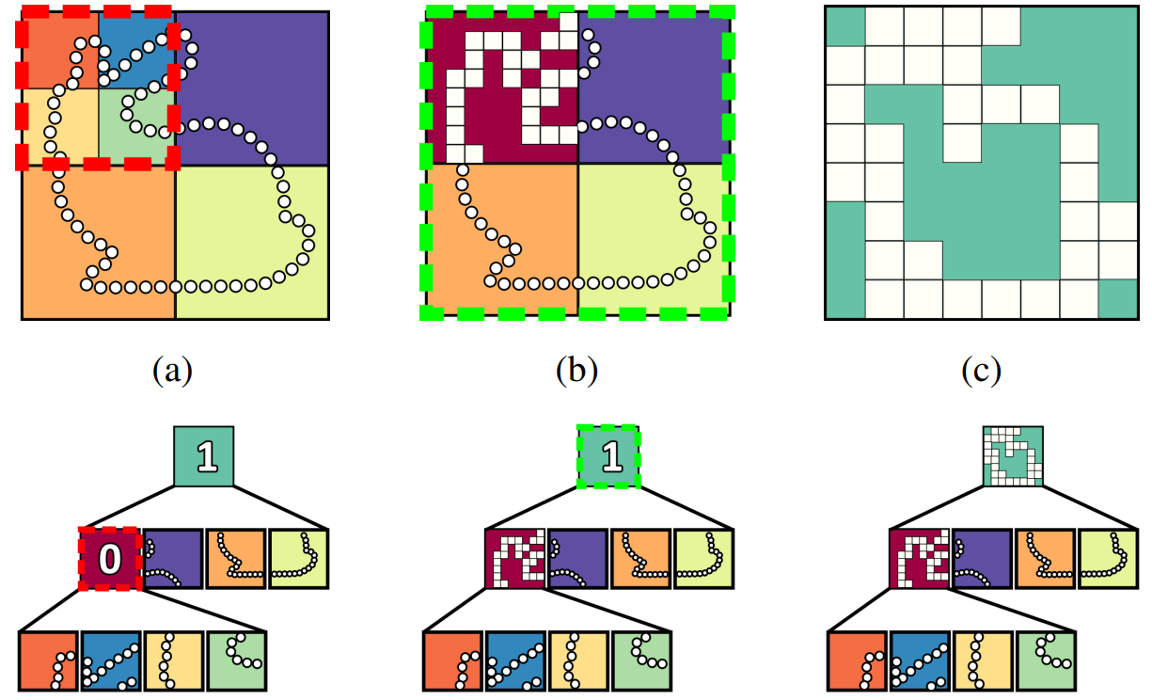
GPU-Accelerated LOD Generation
Create lower-res voxel representations from bottom-up
Pick an empty node
Create 128³ sampling grid
Add points&voxels from children into sampling grid
Extract voxels from grid
Store them in a vertex buffer

Slide 10
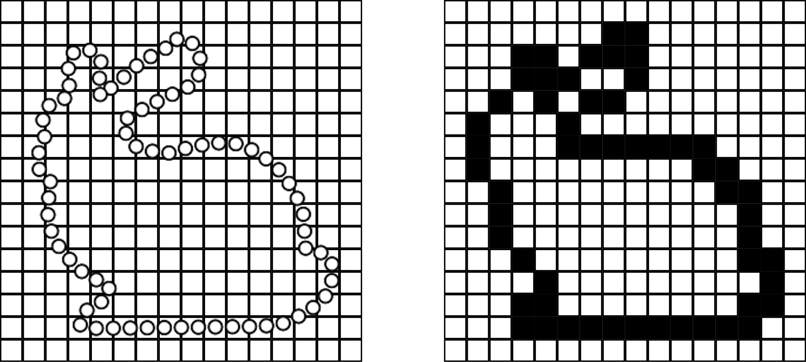
Voxelization
Several strategies: First, Random, Average, Weighted
All use 128³ sampling grid

Slide 11
Voxelization
First:
1 bit per cell
Each child separate, so 64³ grid, reused 8 times
Sample-grid: 32kb -> fits in shared mem / l1 cache
Random:
32 bit per cell (12 bit random value, 20 bit sample index)
Sample-grid: 8MB

Slide 12
Voxelization
Average:
4 * 32 bit per cell (RGB and counter)
Sum up all samples
Sample-Grid: 32MB
Weighted-Average:
Same as average, but also add to adjacent cells
First/Random
Average
Weighted

Slide 13
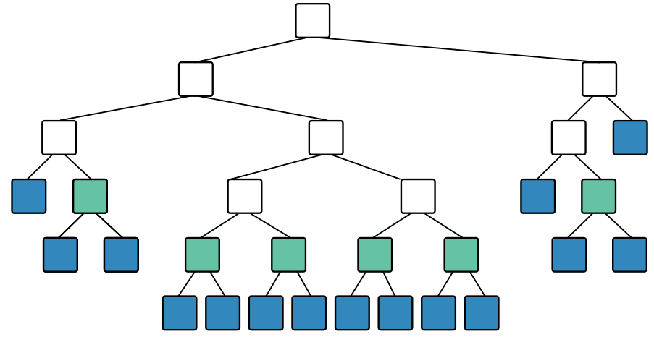
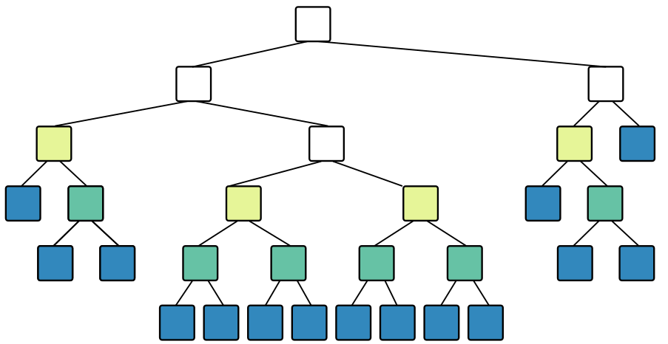
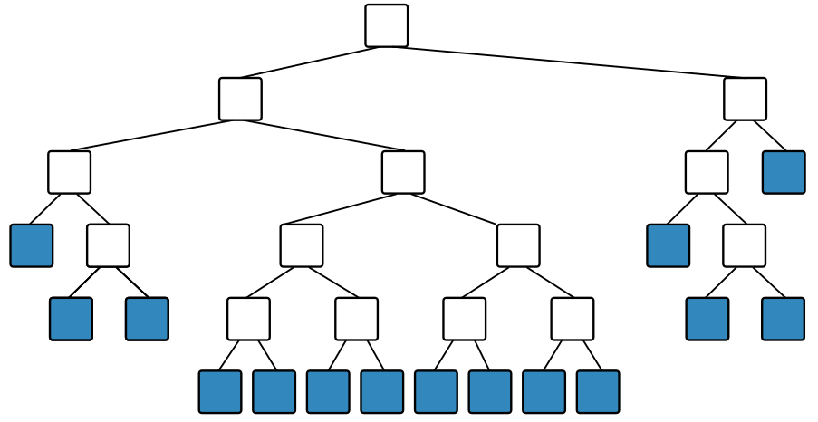
Voxelization
Make list of bottom-most empty inner nodes
Voxelize each in parallel
Repeat until root
One workgroup per node
But spawn at most <Streaming Multiprocessors> workgroups
RTX 3090: 82 SMs * 32MB = 2.7GB
Workgroups loop until all nodes voxelized
...

Slide 14
Results - Performance
Ours (CUDA)
2-5 billion points / sec with first or random
2 billion points / sec with averages
1 billion points / sec with weighted averages
Potree (CPU; Out-of-Core; From Ram-Disk)
~13 million points / sec
“Efficient Randomized Hierarchy Construction for Interactive Visualization of Large Scale Point Clouds”,
Lai Kang, Jie Jiang, Yingmei Wei, Yuxiang Xie
~2.5 million points / sec
“A System for Fast and Scalable Point Cloud Indexing Using Task Parallelism”,
Pascal Bormann, Michel Krämer
~2.6 million points / sec
“Point cloud indexing using Big Data technologies”
Kevin Kocon, Pascal Bormann
~5 million points / sec

Slide 15
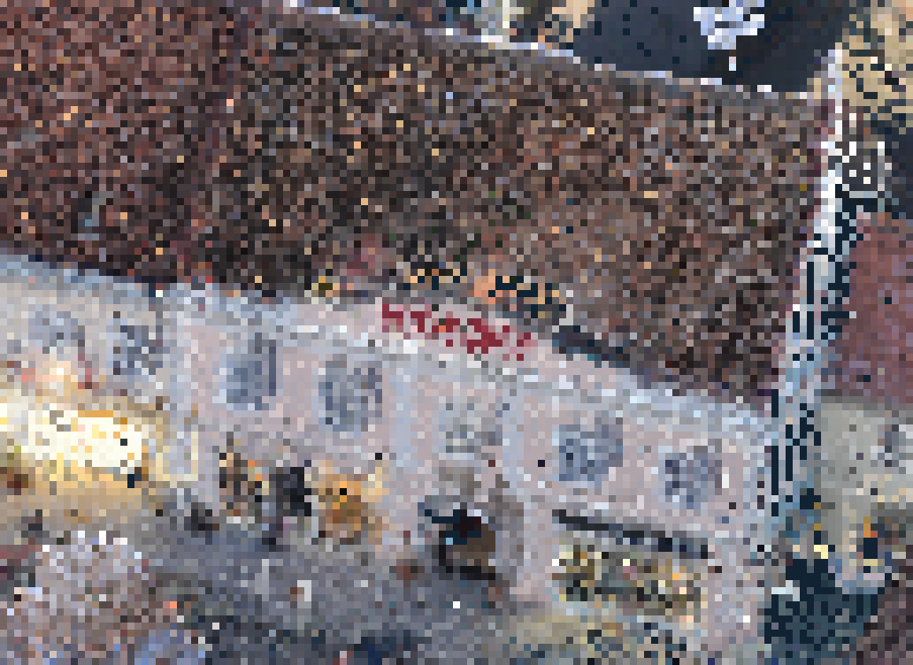
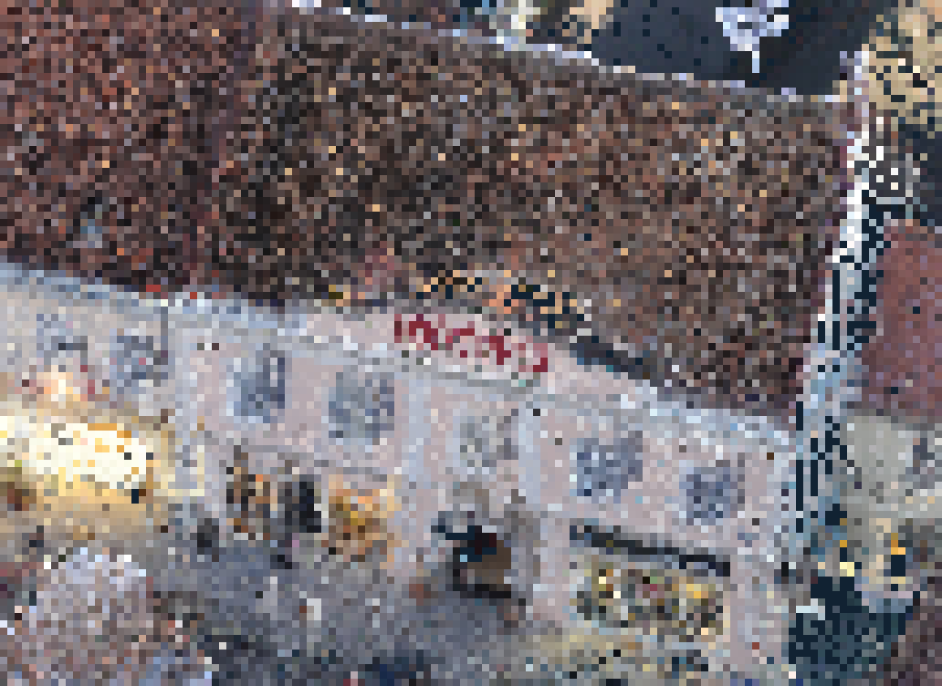
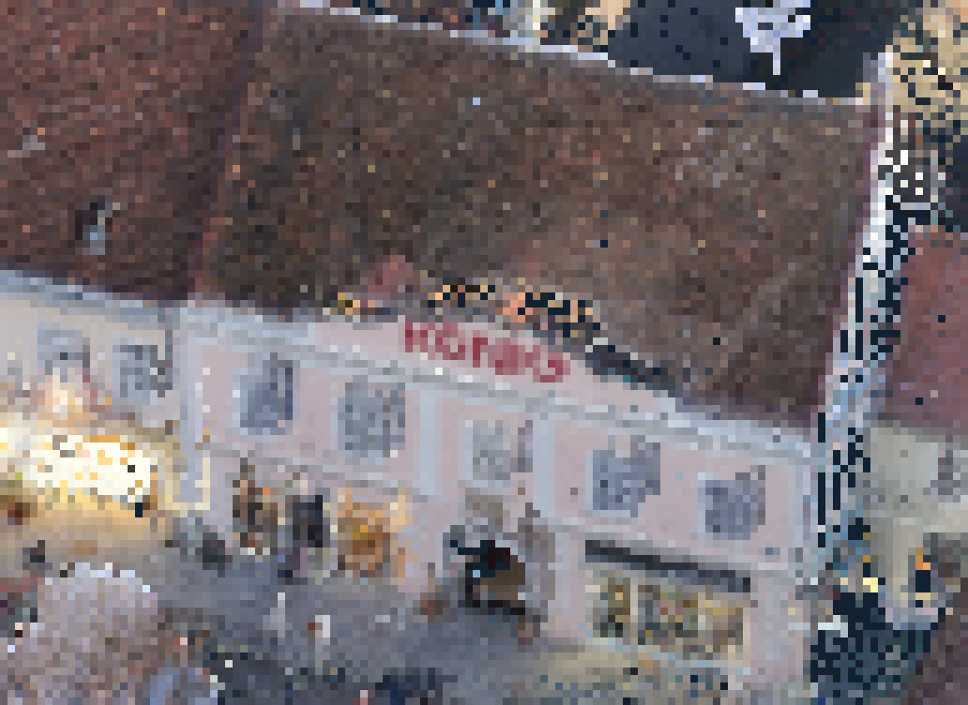
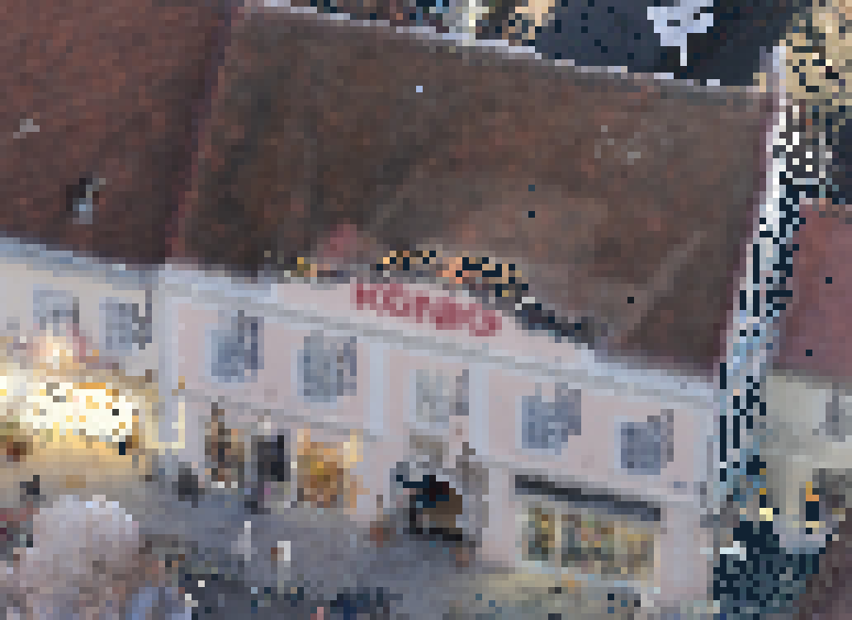
First
Random
Average
Weighted

Slide 16
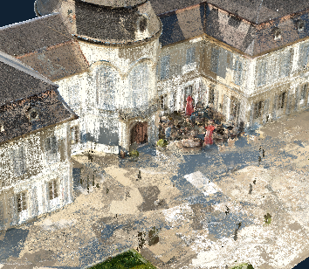
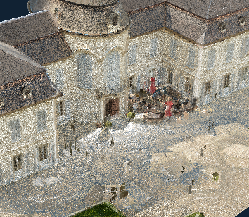
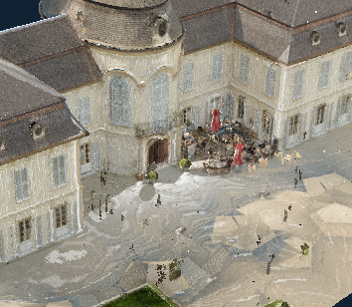
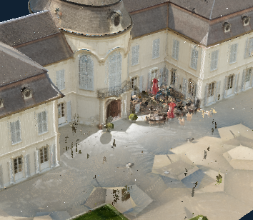
First
Random
Average
Weighted

Slide 19
Limitations
Average colors are better, but not great
Aids, but does not replace high-quality-shading (blending)
Color should depend on view-direction
Better: Radiance Fields, Spherical Harmonics
Not yet Out-of-Core
Structure & Construction process focuses on quickly handling massive LIDAR data
Widely used for LIDAR (Entwine, Potree, QGIS, Arena4D, Cesium, ...)
But for rendering perf & quality, textured meshes are better (e.g., Nanite)

Slide 20
Potential Implementation Improvements
More economical sampling grids
First-Come uses 64³ and reuses for children, all others 128³
Could use 64³ for all
Could also try 18-18-18-10 bit instead of 32 bit per channel
2.7GB -> 160MB
Quantize point and voxel coordinates to node extent
Currently all 16 bytes (12 coordinate, 4 color)

Slide 21
Future Work
Current: 1 second to construct LOD!
but a minute to load data from disk (1B points = 26 to 34GB file)
Future Work: Incremental construction (& rendering) on the GPU

Slide 22
Thank you for your Attention!
Source: https://github.com/m-schuetz/CudaLOD

