Slide 1
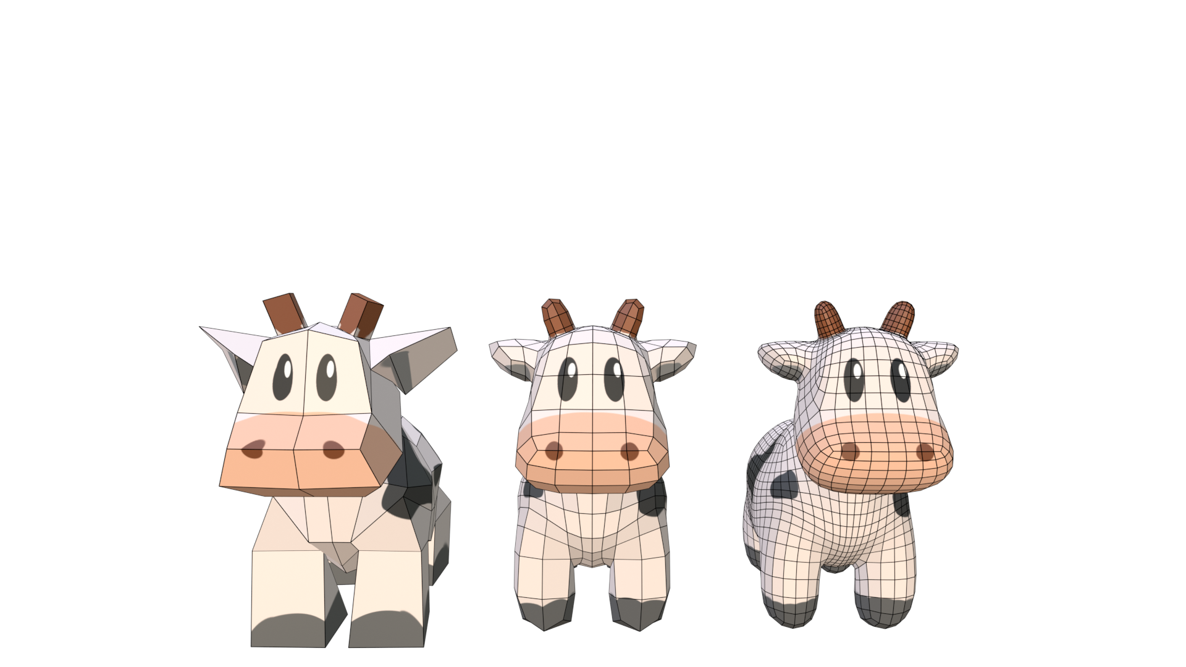
Edge-Friend: Fast and Deterministic Catmull-Clark Subdivision Surfaces
Bastian Kuth, Max Oberberger, Matthäus Chajdas, Quirin Meyer

Slide 3
Catmull-Clark Subdivision

Slide 4
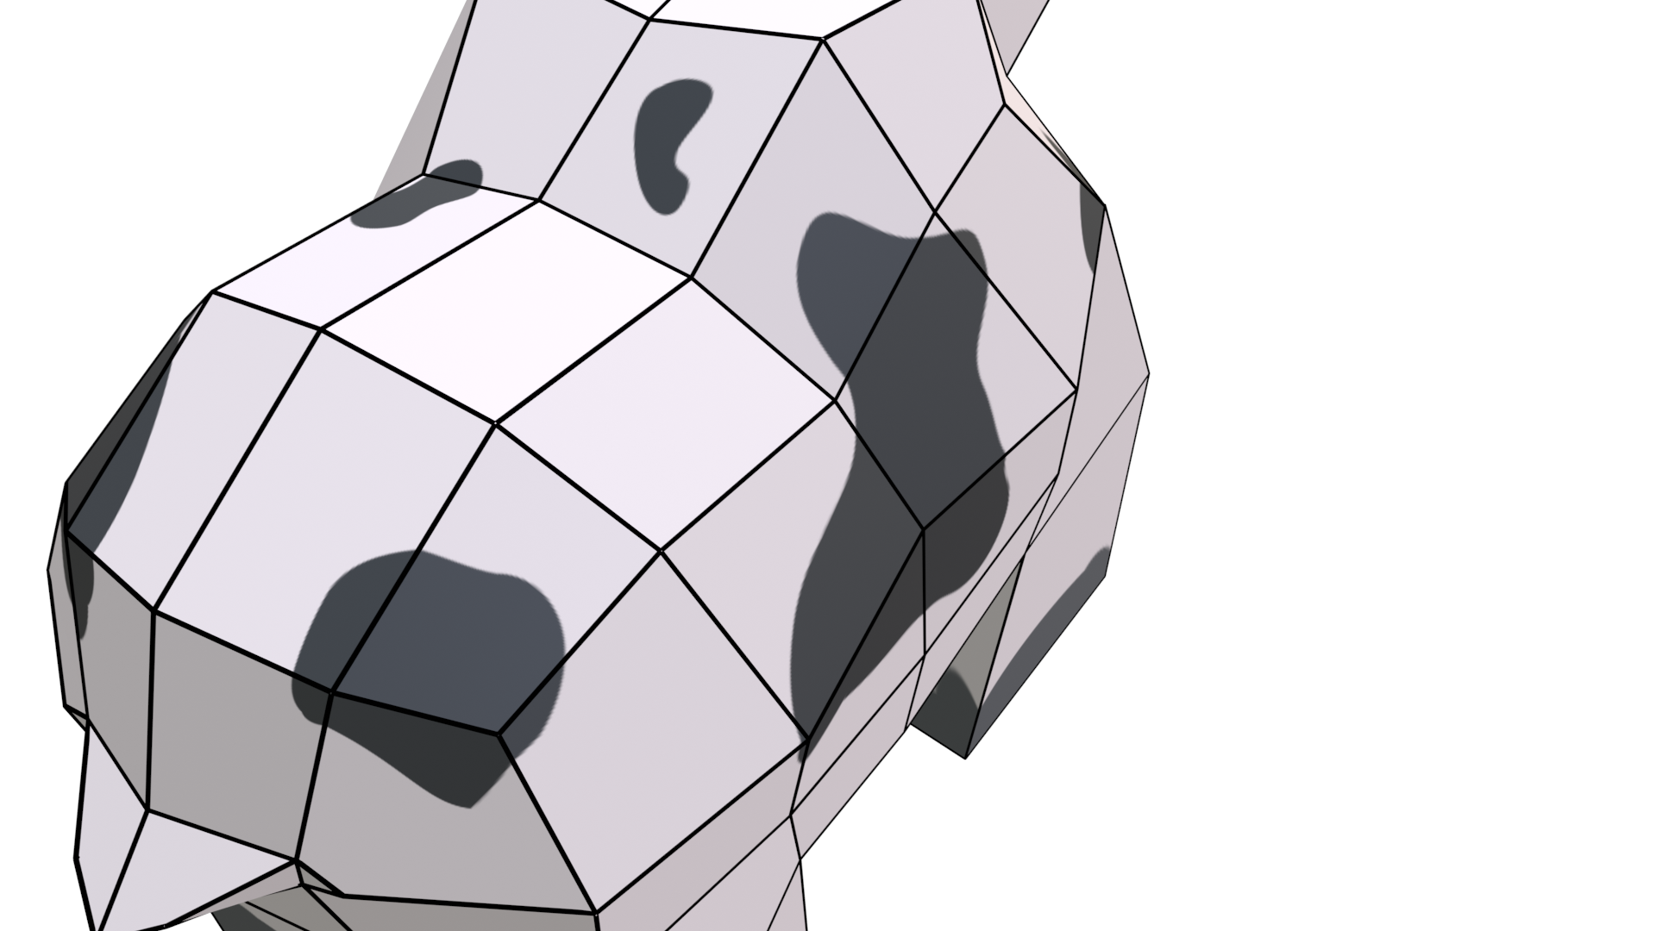
$f\left(u,v\right)=\sum_{i}^{3}{\sum_{j}^{3}{P\left(i,j\right)}}⋅B\left(u,i\right)⋅B\left(v,j\right)$
$$v$$
$$u$$

Slide 6
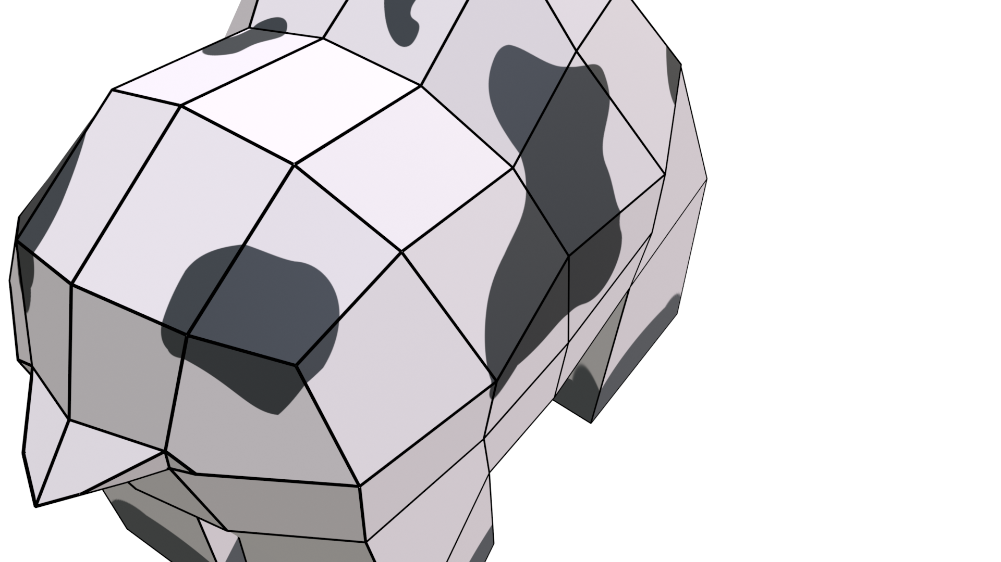
$$?$$

Slide 7
$$?$$
valence 3

Slide 8
$$?$$

Slide 9
$$?$$
pentagon

Slide 10
$$?$$

Slide 12
$$v_{1}$$
$$v_{0}$$
$$v_{2}$$
$$v_{3}$$

Slide 13
$$f=\frac{1}{4}(v_{0}+v_{1}+v_{2}+v_{3})$$
$$v_{3}$$
$$v_{2}$$
$$v_{0}$$
$$v_{1}$$
$$f_{0}$$

Slide 14
$$f=\frac{1}{4}(v_{0}+v_{1}+v_{2}+v_{3})$$
$$v_{1}$$
$$v_{0}$$
$$v_{2}$$
$$v_{3}$$
$$v_{4}$$
$$v_{5}$$
$$v_{6}$$

Slide 15
$$f=\frac{1}{4}(v_{0}+v_{1}+v_{2}+v_{3})$$
$$e=\frac{1}{4}(v_{0}+v_{1}+f_{0}+f_{1})$$
$$v_{4}$$
$$v_{3}$$
$$v_{1}$$
$$e_{0}$$
$$v_{2}$$
$$v_{0}$$
$$v_{6}$$
$$v_{5}$$

Slide 16
$$f=\frac{1}{4}(v_{0}+v_{1}+v_{2}+v_{3})$$
$$v_{1}$$
$$v_{0}$$
$$e=\frac{1}{4}(v_{0}+v_{1}+f_{0}+f_{1})$$
$$v_{2}$$
$$v_{3}$$
$$v_{7}$$
$$v_{4}$$
$$v_{5}$$
$$v_{6}$$

Slide 17
$$f=\frac{1}{4}(v_{0}+v_{1}+v_{2}+v_{3})$$
$$e=\frac{1}{4}(v_{0}+v_{1}+f_{0}+f_{1})$$
$$v_{4}$$
$$v_{3}$$
$$v_{1}$$
$$v_{2}$$
$$v_{0}$$
$$v_{6}$$
$$v_{7}$$
$${v′}_{3}$$
$$v_{5}$$
$$v′=\frac{1}{n}(Q+2R+(n−3)v)$$

Slide 18
$${v′}_{1}$$
$$e_{0}$$
$$e_{4}$$
$${v′}_{0}$$
$$f_{0}$$
$${v′}_{2}$$
$$e_{8}$$
$$e_{1}$$
$${v′}_{3}$$

Slide 19
$${v′}_{1}$$
$$e_{0}$$
$$e_{4}$$
$${v′}_{0}$$
$$f_{0}$$
$${v′}_{2}$$
$$e_{8}$$
$$e_{1}$$
$${v′}_{3}$$

Slide 20
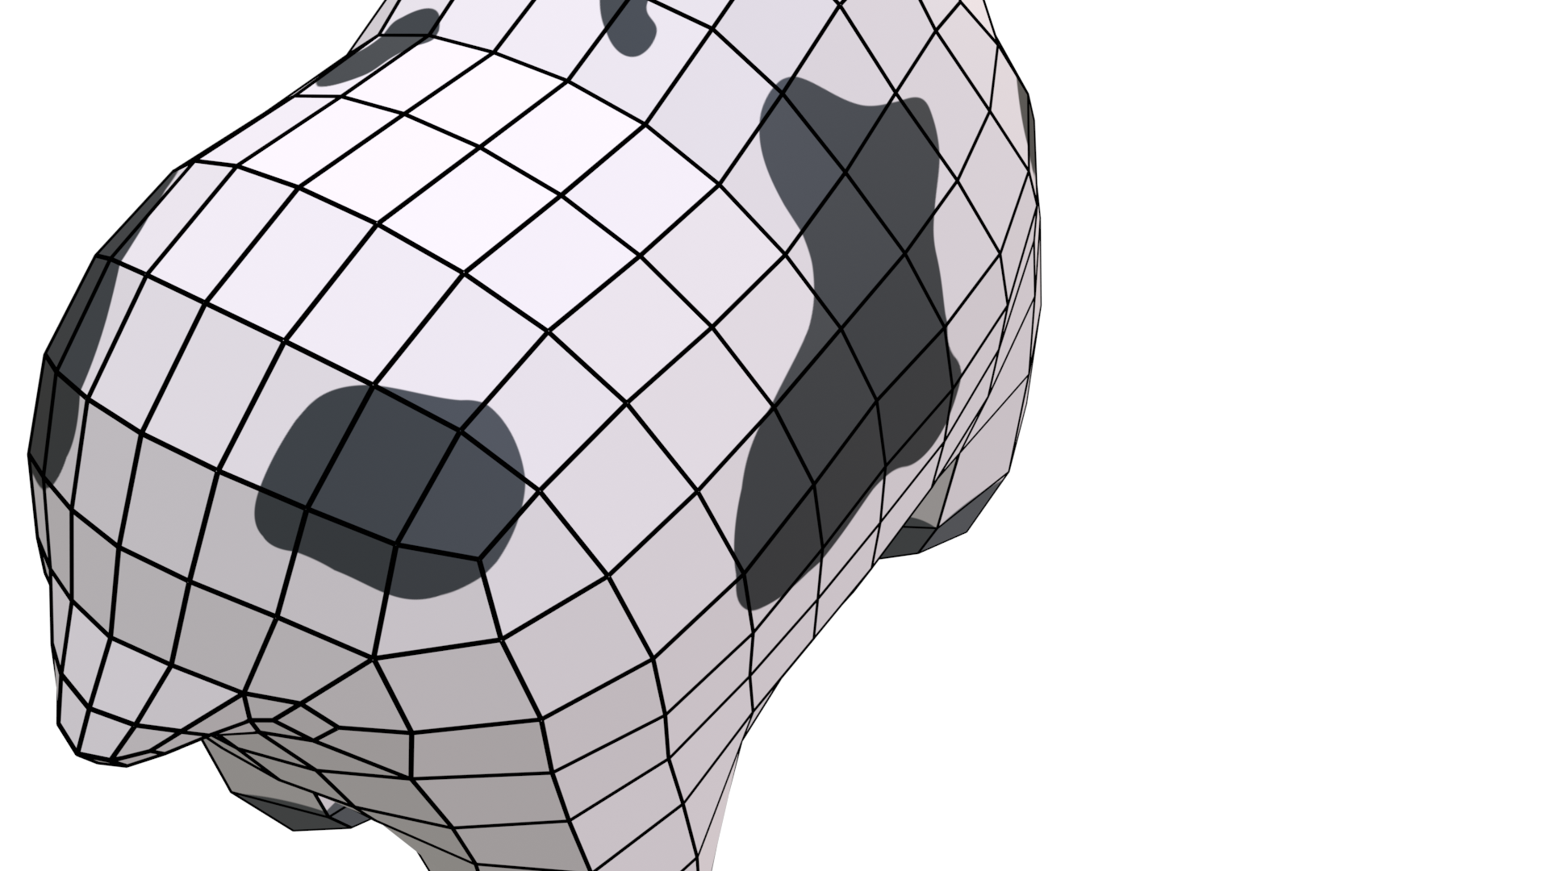
$${v′}_{1}$$
$$e_{0}$$
$$e_{4}$$
$${v′}_{0}$$
$$f_{0}$$
$${v′}_{2}$$
$$e_{8}$$
$$e_{1}$$
$${v′}_{3}$$

Slide 21
more bicubic patches
[NLMD12, BFK∗16]

Slide 22
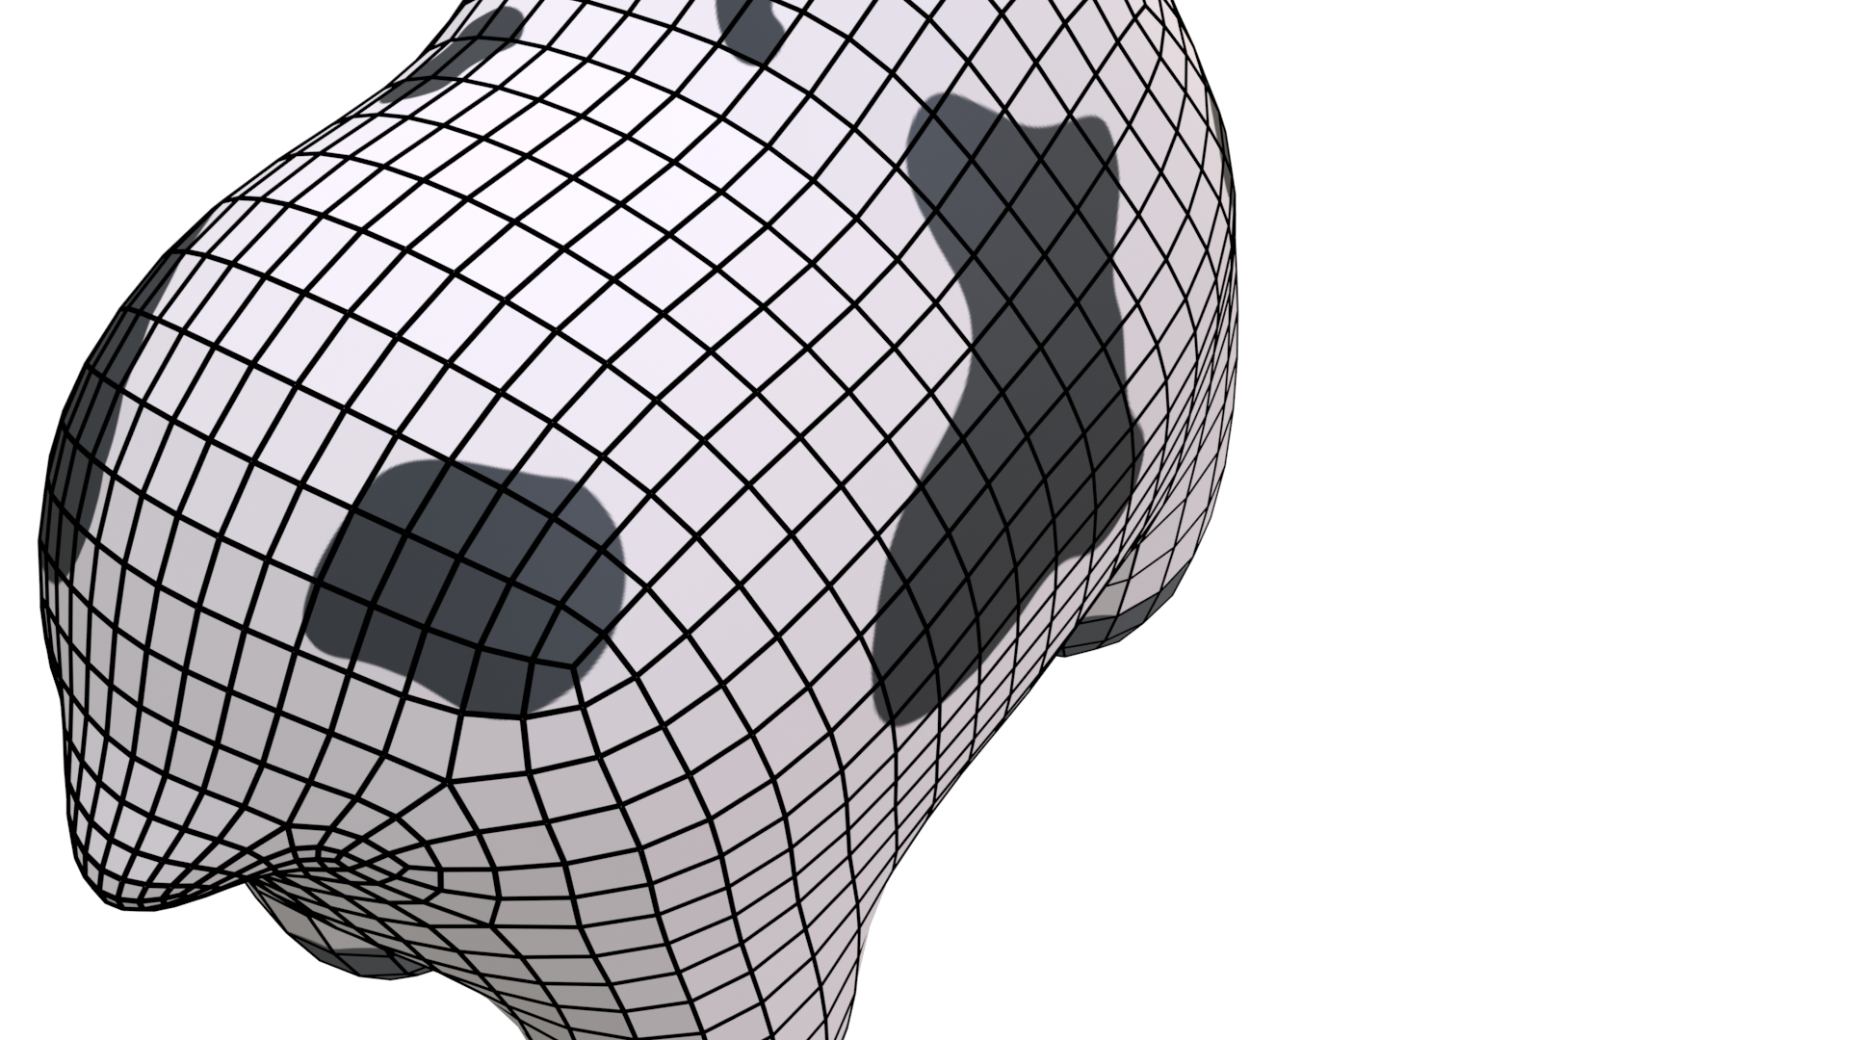
[Sta98, LB07]
extra-ordinary vertices get isolated

Slide 23
breadth-first halfedge refinement
$${v′}_{1}$$
$$e_{0}$$
$$e_{4}$$
$${v′}_{0}$$
$$f_{0}$$
[DV21]
$${v′}_{2}$$
$$e_{8}$$
$$e_{1}$$
$${v′}_{3}$$

Slide 24
ToDo
breadth-first halfedge refinement
$${v′}_{1}$$
$$e_{0}$$
$$e_{4}$$
$${v′}_{0}$$
$$f_{0}$$
$${v′}_{2}$$
$$e_{8}$$
$$e_{1}$$
$${v′}_{3}$$

Slide 25
ToDo
☐ run fast
breadth-first halfedge refinement
$${v′}_{1}$$
$$e_{0}$$
$$e_{4}$$
$${v′}_{0}$$
$$f_{0}$$
$${v′}_{2}$$
$$e_{8}$$
$$e_{1}$$
$${v′}_{3}$$

Slide 26
ToDo
☐ run fast ☐ real-time topology changes
breadth-first halfedge refinement
$${v′}_{1}$$
$$e_{0}$$
$$e_{4}$$
$${v′}_{0}$$
$$f_{0}$$
$${v′}_{2}$$
$$e_{8}$$
$$e_{1}$$
$${v′}_{3}$$

Slide 27
ToDo
☐ run fast ☐ real-time topology changes
☐ easy to implement and extensible
breadth-first halfedge refinement
$${v′}_{1}$$
$$e_{0}$$
$$e_{4}$$
$${v′}_{0}$$
$$f_{0}$$
$${v′}_{2}$$
$$e_{8}$$
$$e_{1}$$
$${v′}_{3}$$

Slide 30
$$v$$

Slide 31
$$v$$

Slide 32
$$v$$
$$e$$
$$f$$

Slide 33
$$v$$
$$e$$
$$f$$

Slide 35
ToDo
☐ run fast ☐ real-time topology changes
☐ easy to implement and extensible

Slide 36
ToDo
☐ run fast ☐ real-time topology changes
☐ easy to implement and extensible
☐ reduce neighbor information

Slide 37
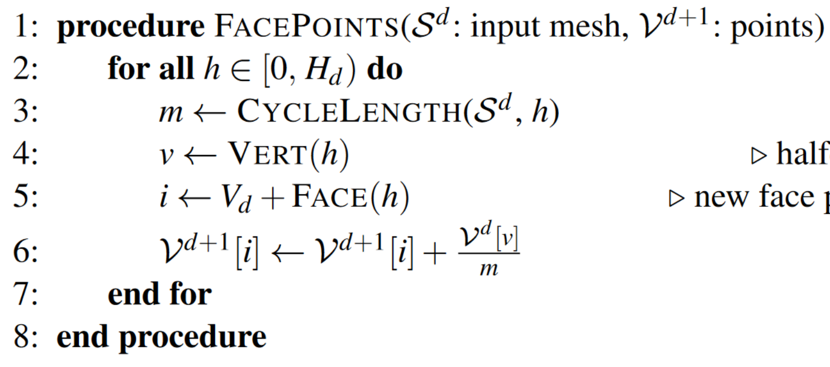
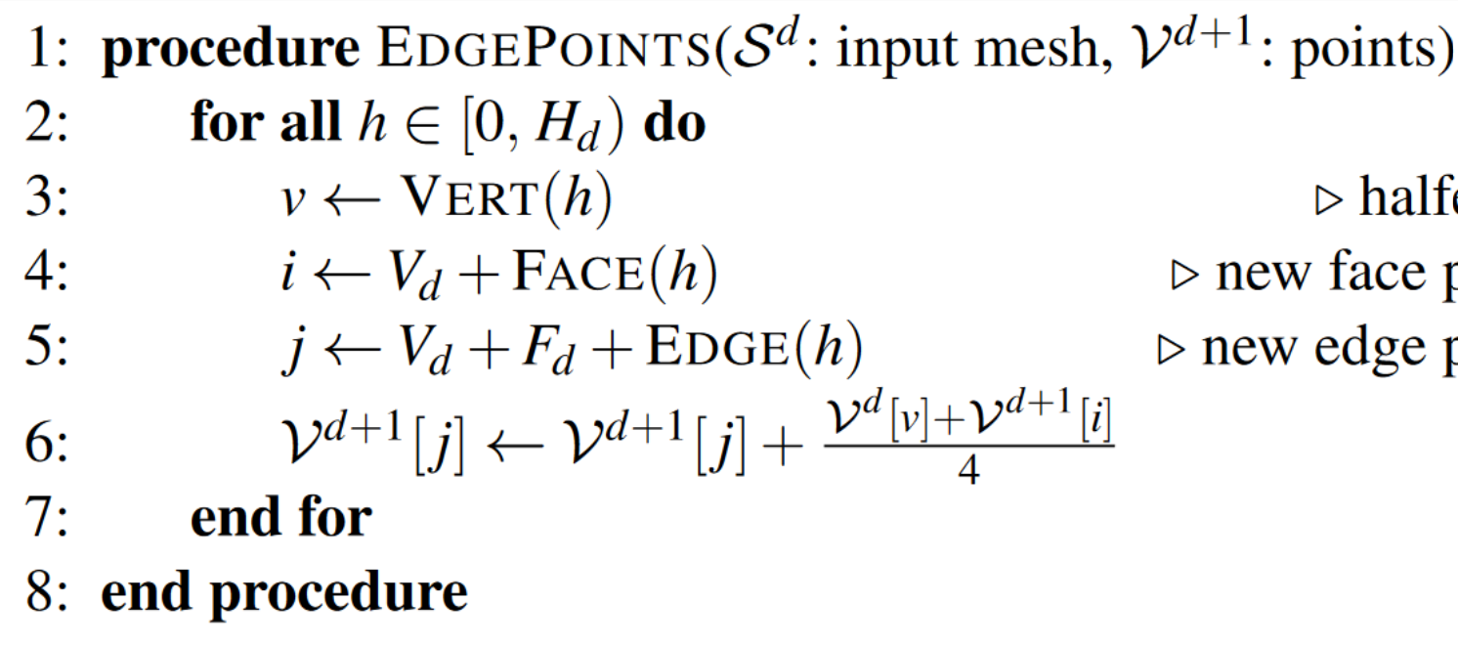
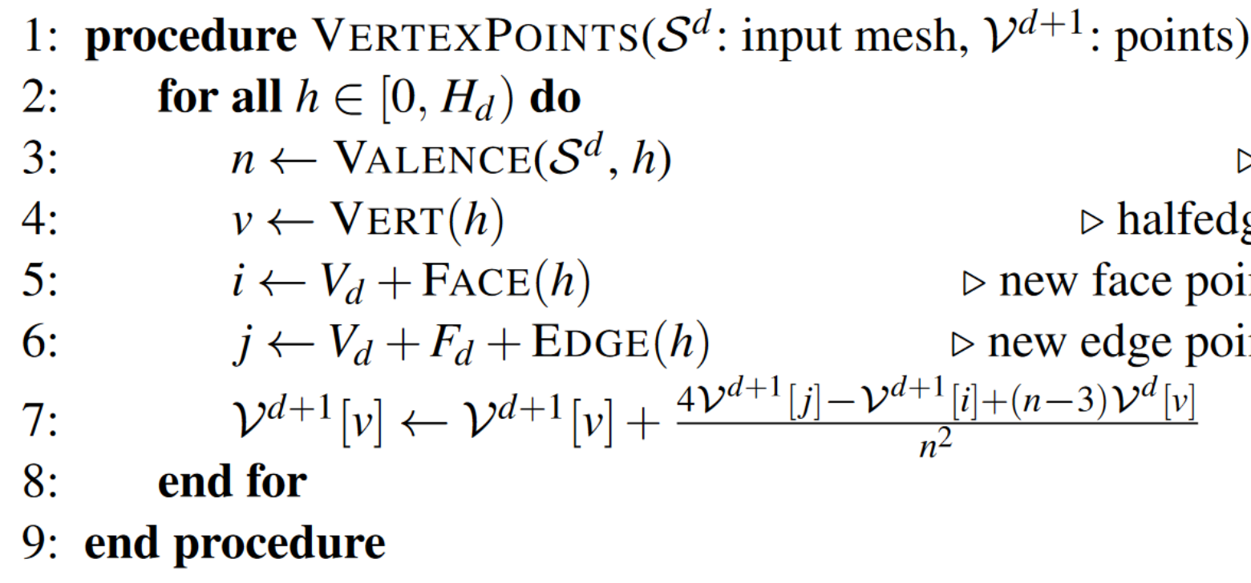
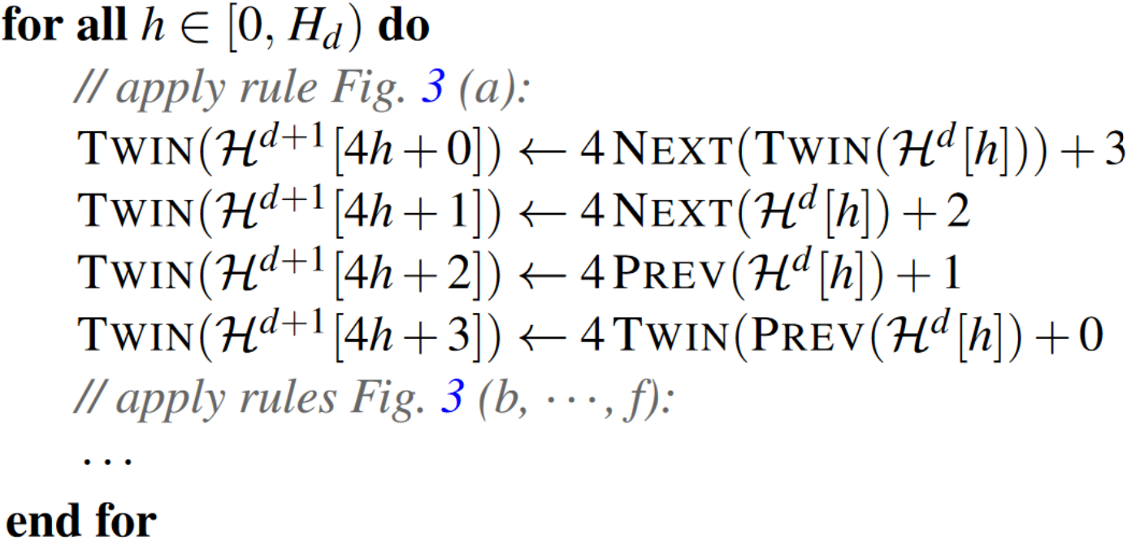
[DV21]

Slide 38
[DV21]

Slide 39
Barrier!
Barrier!
[DV21]

Slide 40
ToDo
☐ run fast ☐ real-time topology changes
☐ easy to implement and extensible
☐ reduce neighbor information
Barrier!
Barrier!
[DV21]

Slide 41
ToDo
☐ run fast ☐ real-time topology changes
☐ easy to implement and extensible
☐ reduce neighbor information
☐ merge to single dispatch
Barrier!
Barrier!
[DV21]

Slide 42
[DV21]

Slide 43
atomicAddFloat
[DV21]

Slide 44
Atomic Floating-Point Arithmetic

Slide 45
Atomic Floating-Point Arithmetic

Slide 46
Atomic Floating-Point Arithmetic

Slide 47
Atomic Floating-Point Arithmetic

Slide 48
Atomic Floating-Point Arithmetic

Slide 49
Atomic Floating-Point Arithmetic

Slide 50
Atomic Floating-Point Arithmetic
ToDo
☐ run fast ☐ real-time topology changes
☐ easy to implement and extensible
☐ reduce neighbor information
☐ merge to single dispatch

Slide 51
Atomic Floating-Point Arithmetic
ToDo
☐ run fast ☐ real-time topology changes
☐ easy to implement and extensible
☐ reduce neighbor information
☐ merge to single dispatch
☐ remove all atomic float arithmetic

Slide 52
[DV21]

Slide 53
[DV21]

Slide 54
ToDo
☐ run fast ☐ real-time topology changes
☐ easy to implement and extensible
☐ reduce neighbor information
☐ merge to single dispatch
☐ remove all atomic float arithmetic
[DV21]

Slide 55
ToDo
☐ run fast ☐ real-time topology changes
☐ easy to implement and extensible
☐ reduce neighbor information
☐ merge to single dispatch
☐ remove all atomic float arithmetic
☐ improve memory layout
[DV21]

Slide 56
ToDo
☐ run fast ☐ real-time topology changes
☐ easy to implement and extensible
☐ reduce neighbor information
☐ merge to single dispatch
☐ remove all atomic float arithmetic
☐ improve memory layout

Slide 57
ToDo
☐ run fast ☐ real-time topology changes
☐ easy to implement and extensible
☐ reduce neighbor information
☐ merge to single dispatch
☐ remove all atomic float arithmetic
☐ improve memory layout

Slide 63
Edge-Friends

Slide 75
ToDo
☐ run fast ☐ real-time topology changes
☐ easy to implement and extensible
☐ reduce neighbor information
☐ merge to single dispatch
☐ remove all atomic float arithmetic
☐ improve memory layout

Slide 76
ToDo
☐ run fast ☐ real-time topology changes
☐ easy to implement and extensible
☑ reduce neighbor information
☐ merge to single dispatch
☐ remove all atomic float arithmetic
☐ improve memory layout

Slide 77
ToDo
☐ run fast ☐ real-time topology changes
☐ easy to implement and extensible
☑ reduce neighbor information
☐ merge to single dispatch
☐ remove all atomic float arithmetic
☐ improve memory layout

Slide 80
Quad-Task

Slide 81
Quad-Task

Slide 82
Quad-Task

Slide 83
Quad-Task

Slide 84
Quad-Task

Slide 85
Quad-Task

Slide 87
Vertex-Task

Slide 88
Vertex-Task

Slide 89
Vertex-Task

Slide 90
Vertex-Task

Slide 91
ToDo
☐ run fast ☐ real-time topology changes
☐ easy to implement and extensible
☑ reduce neighbor information
☐ merge to single dispatch
☐ remove all atomic float arithmetic
☐ improve memory layout
Vertex-Task

Slide 92
ToDo
☐ run fast ☐ real-time topology changes
☐ easy to implement and extensible
☑ reduce neighbor information
☐ merge to single dispatch
☑ remove all atomic float arithmetic
☐ improve memory layout
Vertex-Task

Slide 93
ToDo
☐ run fast ☐ real-time topology changes
☐ easy to implement and extensible
☑ reduce neighbor information
☐ merge to single dispatch
☑ remove all atomic float arithmetic
☐ improve memory layout
Vertex-Task

Slide 94
Task-Merge
$F$ Quad-Tasks
$V$ Vertex-Tasks

Slide 95
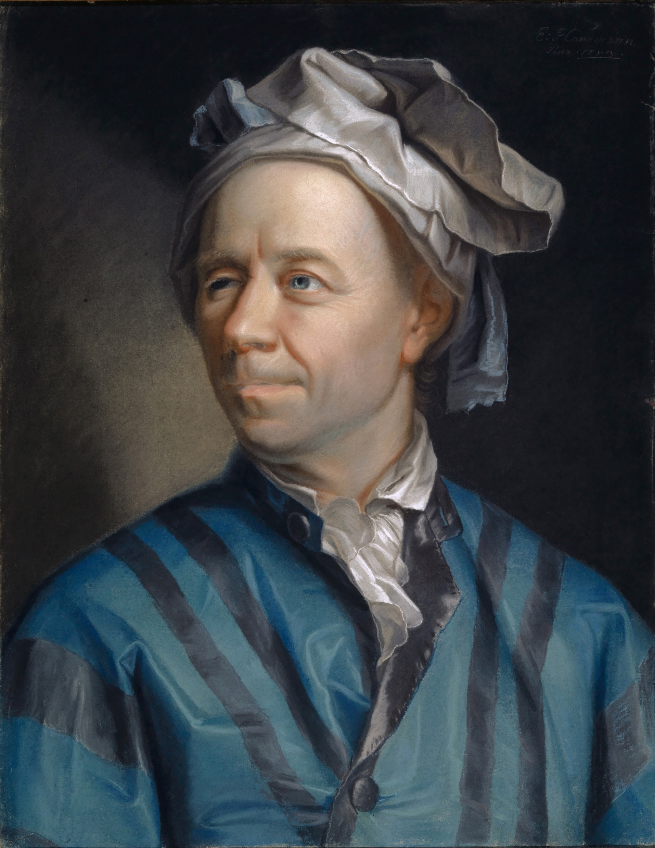
Task-Merge
$F$ Quad-Tasks
$V$ Vertex-Tasks

Slide 96
Task-Merge
$F$ Quad-Tasks
$V$ Vertex-Tasks
$$V−E+F=2$$

Slide 97
Task-Merge
$F$ Quad-Tasks
$V$ Vertex-Tasks
$$V−E+F=2$$
$$E=2F$$

Slide 98
Task-Merge
$F$ Quad-Tasks
$V$ Vertex-Tasks
$$V−E+F=2$$
$$2F$$

Slide 99
Task-Merge
$F$ Quad-Tasks
$V$ Vertex-Tasks
$$2F$$
$$V−E+F=2$$

Slide 100
Task-Merge
$F$ Quad-Tasks
$V$ Vertex-Tasks
$$V−2F+F=2$$

Slide 101
Task-Merge
$F$ Quad-Tasks
$V$ Vertex-Tasks
$$V−2F+F=2$$
$$V−2F+F=2$$

Slide 102
Task-Merge
$F$ Quad-Tasks
$V$ Vertex-Tasks
$$V−2F+F=2$$
$$V−F=2$$

Slide 103
Task-Merge
$F$ Face-Tasks
$V$ Vertex-Tasks
ToDo
☐ run fast ☐ real-time topology changes
☐ easy to implement and extensible
☑ reduce neighbor information
☑ merge to single dispatch
☑ remove all atomic float arithmetic
☐ improve memory layout
$$V−2F+F=2$$
$$V−F=2$$
$$⇒V≈F$$

Slide 104
Task-Merge
$F$ Face-Tasks
$V$ Vertex-Tasks
ToDo
☐ run fast ☐ real-time topology changes
☐ easy to implement and extensible
☑ reduce neighbor information
☑ merge to single dispatch
☑ remove all atomic float arithmetic
☐ improve memory layout
$$V−2F+F=2$$
$$V−F=2$$
$$⇒V≈F$$

Slide 105
Memory Layout
V
F
E

Slide 106
Memory Layout
V
F
E

Slide 107
Memory Layout
V
F
E
V
F
E

Slide 108
Memory Layout
V
V
F
E
F
E
$$v$$
$$e$$
$$e$$
$$f$$

Slide 109
Memory Layout
V
V
F
E
F
E
$$v$$
$$f$$
$$e$$
$$e$$

Slide 110
Memory Layout
V
V
F
E
F
E
$$2V≈2F=E$$

Slide 111
Memory Layout
V
V
F
E
F
E
$$2V≈2F=E$$
V
F
E
V
F
E
V
F
E
V
F
E

Slide 112
Memory Layout
ToDo
☐ run fast ☐ real-time topology changes
☐ easy to implement and extensible
☑ reduce neighbor information
☑ merge to single dispatch
☑ remove all atomic float arithmetic
☐ improve memory layout
V
V
F
E
F
E
$$2V≈2F=E$$
V
F
E
V
F
E
V
F
E
V
F
E

Slide 113
Memory Layout
ToDo
☐ run fast ☐ real-time topology changes
☐ easy to implement and extensible
☑ reduce neighbor information
☑ merge to single dispatch
☑ remove all atomic float arithmetic
☑ improve memory layout
V
V
F
E
F
E
$$2V≈2F=E$$
V
F
E
V
F
E
V
F
E
V
F
E

Slide 114
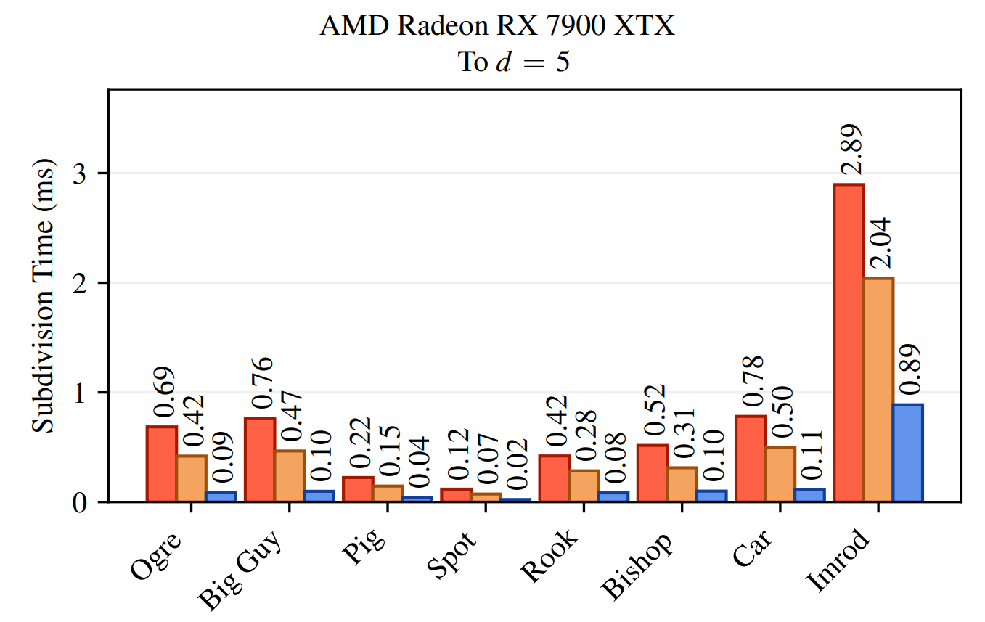

Slide 115
ToDo
☐ run fast ☐ real-time topology changes
☐ easy to implement and extensible
☑ reduce neighbor information
☑ merge to single dispatch
☑ remove all atomic float arithmetic
☑ improve memory layout

Slide 116
ToDo
☑ run fast 3x faster!
☐ real-time topology changes
☐ easy to implement and extensible
☑ reduce neighbor information
☑ merge to single dispatch
☑ remove all atomic float arithmetic
☑ improve memory layout

Slide 117
CPU Pre-Processing
ToDo
☑ run fast 3x faster!
☐ real-time topology changes
☐ easy to implement and extensible
☑ reduce neighbor information
☑ merge to single dispatch
☑ remove all atomic float arithmetic
☑ improve memory layout

Slide 118
CPU Pre-Processing
ToDo
☑ run fast 3x faster!
☑ real-time topology changes
☐ easy to implement and extensible
☑ reduce neighbor information
☑ merge to single dispatch
☑ remove all atomic float arithmetic
☑ improve memory layout

Slide 119
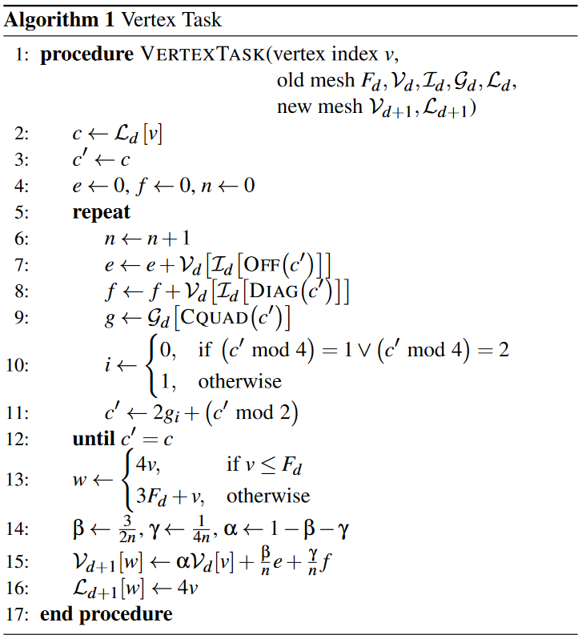
ToDo
☑ run fast 3x faster!
☑ real-time topology changes
☐ easy to implement and extensible
☑ reduce neighbor information
☑ merge to single dispatch
☑ remove all atomic float arithmetic
☑ improve memory layout
pseudocode in paper!

Slide 120
ToDo
☑ run fast 3x faster!
☑ real-time topology changes
☑ easy to implement and extensible
☑ reduce neighbor information
☑ merge to single dispatch
☑ remove all atomic float arithmetic
☑ improve memory layout
pseudocode in paper!

Slide 121
ToDo
☑ run fast 3x faster!
☑ real-time topology changes
☑ easy to implement and extensible
☑ reduce neighbor information
☑ merge to single dispatch
☑ remove all atomic float arithmetic
☑ improve memory layout

Slide 122
Copyright and disclaimer
©2023 Advanced Micro Devices, Inc. All rights reserved.
AMD, the AMD Arrow logo and combinations thereof are trademarks of Advanced Micro Devices, Inc. Other product names used in this publication are for identification purposes only and may be trademarks of their respective companies.
The information presented in this document is for informational purposes only and may contain technical inaccuracies, omissions, and typographical errors. The information contained herein is subject to change and may be rendered inaccurate releases, for many reasons, including but not limited to product and roadmap changes, component and motherboard version changes, new model and/or product differences between differing manufacturers, software changes, BIOS flashes, firmware upgrades, or the like. Any computer system has risks of security vulnerabilities that cannot be completely prevented or mitigated. AMD assumes no obligation to update or otherwise correct or revise this information. However, AMD reserves the right to revise this information and to make changes from time to time to the content hereof without obligation of AMD to notify any person of such revisions or changes.
THIS INFORMATION IS PROVIDED 'AS IS." AMD MAKES NO REPRESENTATIONS OR WARRANTIES WITH RESPECT TO THE CONTENTS HEREOF AND ASSUMES NO RESPONSIBILITY FOR ANY INACCURACIES, ERRORS, OR OMISSIONS THAT MAY APPEAR IN THIS INFORMATION. AMD SPECIFICALLY DISCLAIMS ANY IMPLIED WARRANTIES OF NON-INFRINGEMENT, MERCHANTABILITY, OR FITNESS FOR ANY PARTICULAR PURPOSE. IN NO EVENT WILL AMD BE LIABLE TO ANY PERSON FOR ANY RELIANCE, DIRECT, INDIRECT, SPECIAL, OR OTHER CONSEQUENTIAL DAMAGES ARISING FROM THE USE OF ANY INFORMATION CONTAINED HEREIN, EVEN IF AMD IS EXPRESSLY ADVISED OF THE POSSIBILITY OF SUCH DAMAGES.

