Slide 1
Perception of Highlight Disparity at a Distance in Consumer Head-Mounted Displays
Robert Toth¹, Jon Hasselgren¹, Tomas Akenine-Möller^{1,2}
¹Intel Corporation, ²Lund University

Slide 2
Disparity
One of many depth cues
Not to be confused with accommodation or vergence
Notes:
Disparity is one of many visual cues used by the human visual system to interpret depth. It’s different from the two cues most of you may be familiar with, which are accomodation and vergence.

Slide 3
Disparity
One of many depth cues
Not to be confused with accommodation or vergence
Accommodation:
Contracting the lens such that an object is depicted sharply on the retina
Notes:
If you close one eye, hold up your index finger in front of you, and look at something distant, you’ll see that your finger is out of focus and has a blurry outline. That’s because the lens is in your eye is focused at a larger distance. Determining distance by focusing the lens in the eye is called accommodation, and is mostly useful at short distances.

Slide 4
Disparity
One of many depth cues
Not to be confused with accommodation or vergence
Vergence:
Rotating the eyes such that an object is depicted on the same spot on the retinas (e.g., fovea)
Notes:
If you again hold up your index finger in front of you and look at it, with both eyes this time, your eyes will swivel in their sockets until they’re both directed at your finger. Determining distance by the amount of eye rotation is called vergence.

Slide 5
Disparity
One of many depth cues
Not to be confused with accommodation or vergence
Disparity:
The retina projection difference of an object, when vergence is at a different object
Notes:
Disparity is closely related to vergence. If you again look into the distance, you will see your finger in double due to you verging at a larger distance. Your brain uses that information to judge the distance to your finger, while you’re actually looking at something else.

Slide 6
Highlight disparity
Disparity of specular reflections
Materials appear lustrous, with a deep surface
Notes:
highlight disparity is the disparity between the diffuse and specular reflections of a surface. When you look at a diffuse surface, you focus on the surface. When you look at a highlight, you typically focus somewhat beneath the surface. This difference gives the surface an appearance of depth, or lustre.

Slide 7
Why is this important?
A point on a surface looks different for the two eyes
Surface shading must be computed twice
Can VR users perceive the difference?
If not: surface shading could be computed once
Not to be confused with mono rasterization
Disocclusion issues
Notes:
Important because it means we must shade surfaces twice for stereo display systems, once for each eye.
***
Your VR customers will have mainstream devices, so those conditions are of most interest.
If they can’t tell the difference, we may get away with shading only once.
***
I’m not talking about reprojection, which can cause all sorts of artifacts due to disocclusion, but just using the same surface colors for both eyes.

Slide 8
Shade once, rasterize twice
Not the focus of our work
Shading systems capable of approximate depth-of-field rendering:
REYES [Cook et al 1987]
Decoupled Deferred Shading for Hardware Rasterization [Liktor and Dachsbacher 2012]
Deep Shading Buffers on Commodity GPUs [Clarberg and Munkberg 2014]
Notes:
There are several shading systems that can render depth of field while shading only as seen from the center of the lens. These can be used for stereo shading as well.

Slide 9
Framing the question
Under which circumstances do we perceive highlight disparity, in consumer-grade VR devices?
Best answered by a user study
Notes:
Since human perception plays a central part of this, we realized that we’d need to perform a user study to properly answer the question.

Slide 10
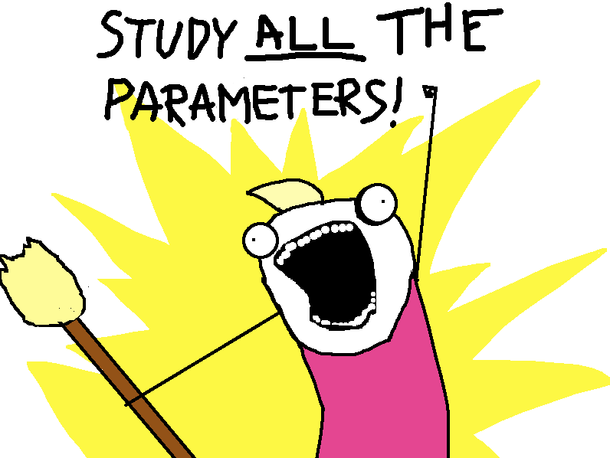
Parameter space
Notes:
we want to look at everything. Distance. Roughness. Shininess. Shape. Size. Illumination. Shading model. Environment. Mood. Texture. Resolution.

Slide 11
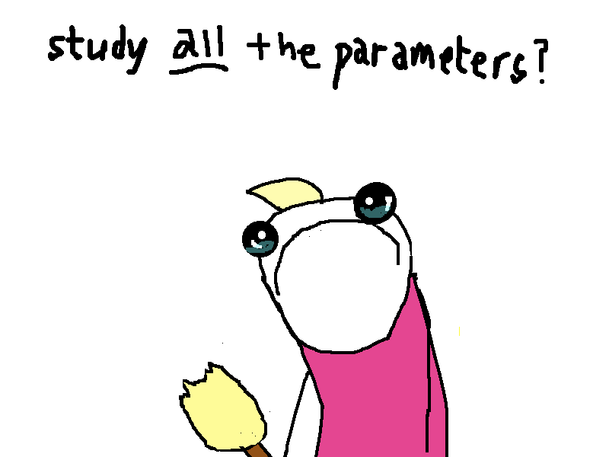
Parameter space
Limited due to practical scope
Notes:
Unfortunately, that would make the study impractically large. So we had to settle for just a few parameters and values.

Slide 12
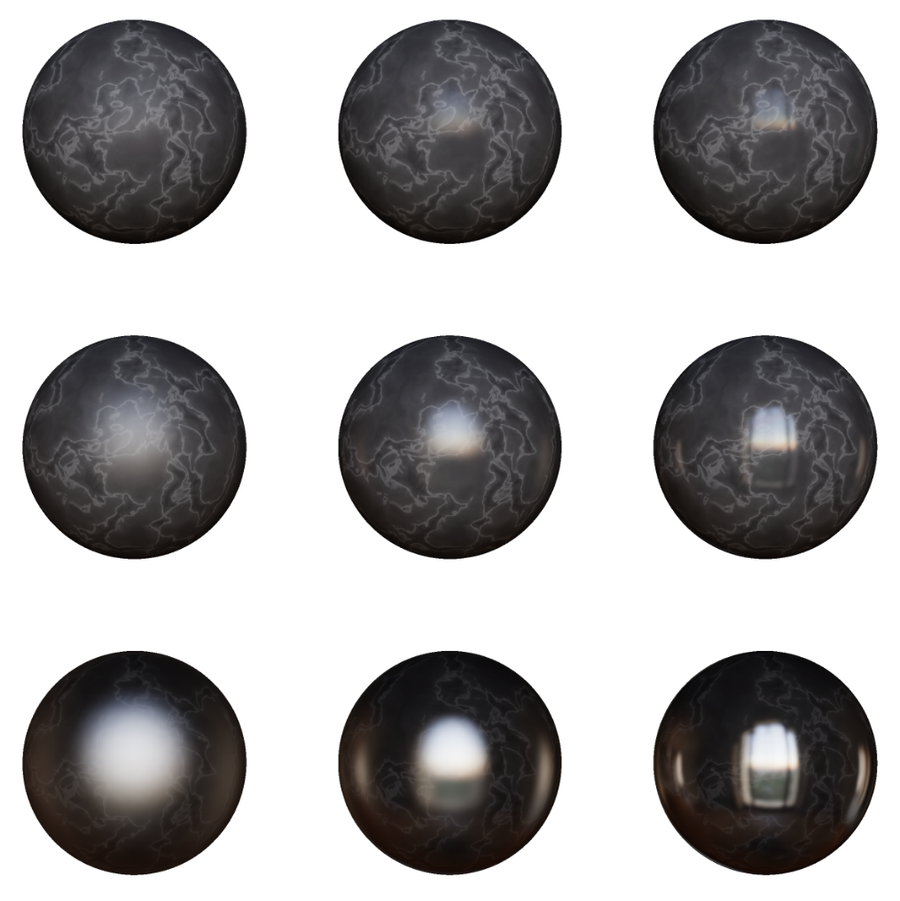
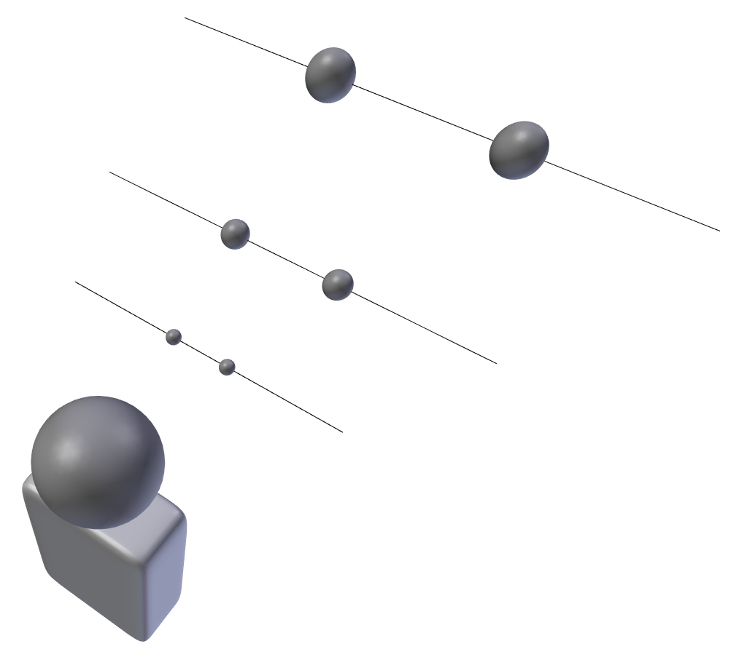
Parameter space
Limited due to practical scope
Mono / stereo shading
Distance
Roughness
Shininess
Notes:
Mono vs stereo shading determines the presense of highlight disparity.
At large distances, disparity tends to zero, so we included that as a parameter.
Roughness (the microscopic normal distribution) limits the angular frequency of specular reflections, so we looked at that as well.
Finally, if there is only specular or only diffuse, no disparity can be visible. We therefore also vary shininess (the relative contrast between these).

Slide 13
Conducting the study
Notes:
This is what participants saw. They were put in an envmap, which they could inspect to get a feeling for the reflected environment. The main light source is a large window behind them. They were presented with two spheres at a time, which were either both shaded in stereo, both in mono, or one stereo and one mono. Their task was to determine if they were shaded the same, or different. The answer is given by clicking the left or right mouse button. Another pair with new parameters is then presented, and this goes on until all parameter combinations have been tested.

Slide 14
Parameter space
Lots of other potential factors:
Resolution
Shape
Texture
Size
Illumination
Notes:
There are lots of parameters we didn’t look at, so there’s plenty of room for future work.

Slide 15
Conducting the study
Side-by-side 2-alternative forced choice: “same” or “different”
36 participants
Phenomenon explained in advance
Example pronounced stimuli discussed
2 participants disqualified (outliers)
1836 data points gathered
Notes:
As for the practicalities, the ”same-vs-different” design choice avoids the subjective notion of ”better” and of arbitrary scales, which simplifies interpreting the results.
Two of the participants were disqualified because they couldn’t see the effect even in a pronounced introductory setting.
All in all, we collected 1836 data points, which are provided in XML form as supplementary material if you want to do your own analysis.

Slide 16
Analysis
Distance
Roughness
Shininess
Every configuration (3×3×3 = 27) has one test and one control
Test: objectively different
Control: objectively same
Answers converted into score
±0.5 score per control
±0.5 score per test
Notes:
A ”test” means that only one of the objects was stereo and the other was mono.
A ”control” means that either both objects were stereo or both were mono.
We converted this into a score, where a correct answer is +.5 points and an incorrect answer is -.5 points. So each participant has has -1, 0, or +1 point per configuration.

Slide 17
Score interpretation
Portion of correct answers unaccounted by chance
0: pure chance
1: pure skill
Several scenarios can give same score
0.5: 50% of subjects could consistently tell the difference
0.5: 100% of subjects could tell the difference with 50% accuracy
Notes:
We’ll be looking at score averages, and it’s important not to read too much into what those mean.

Slide 18
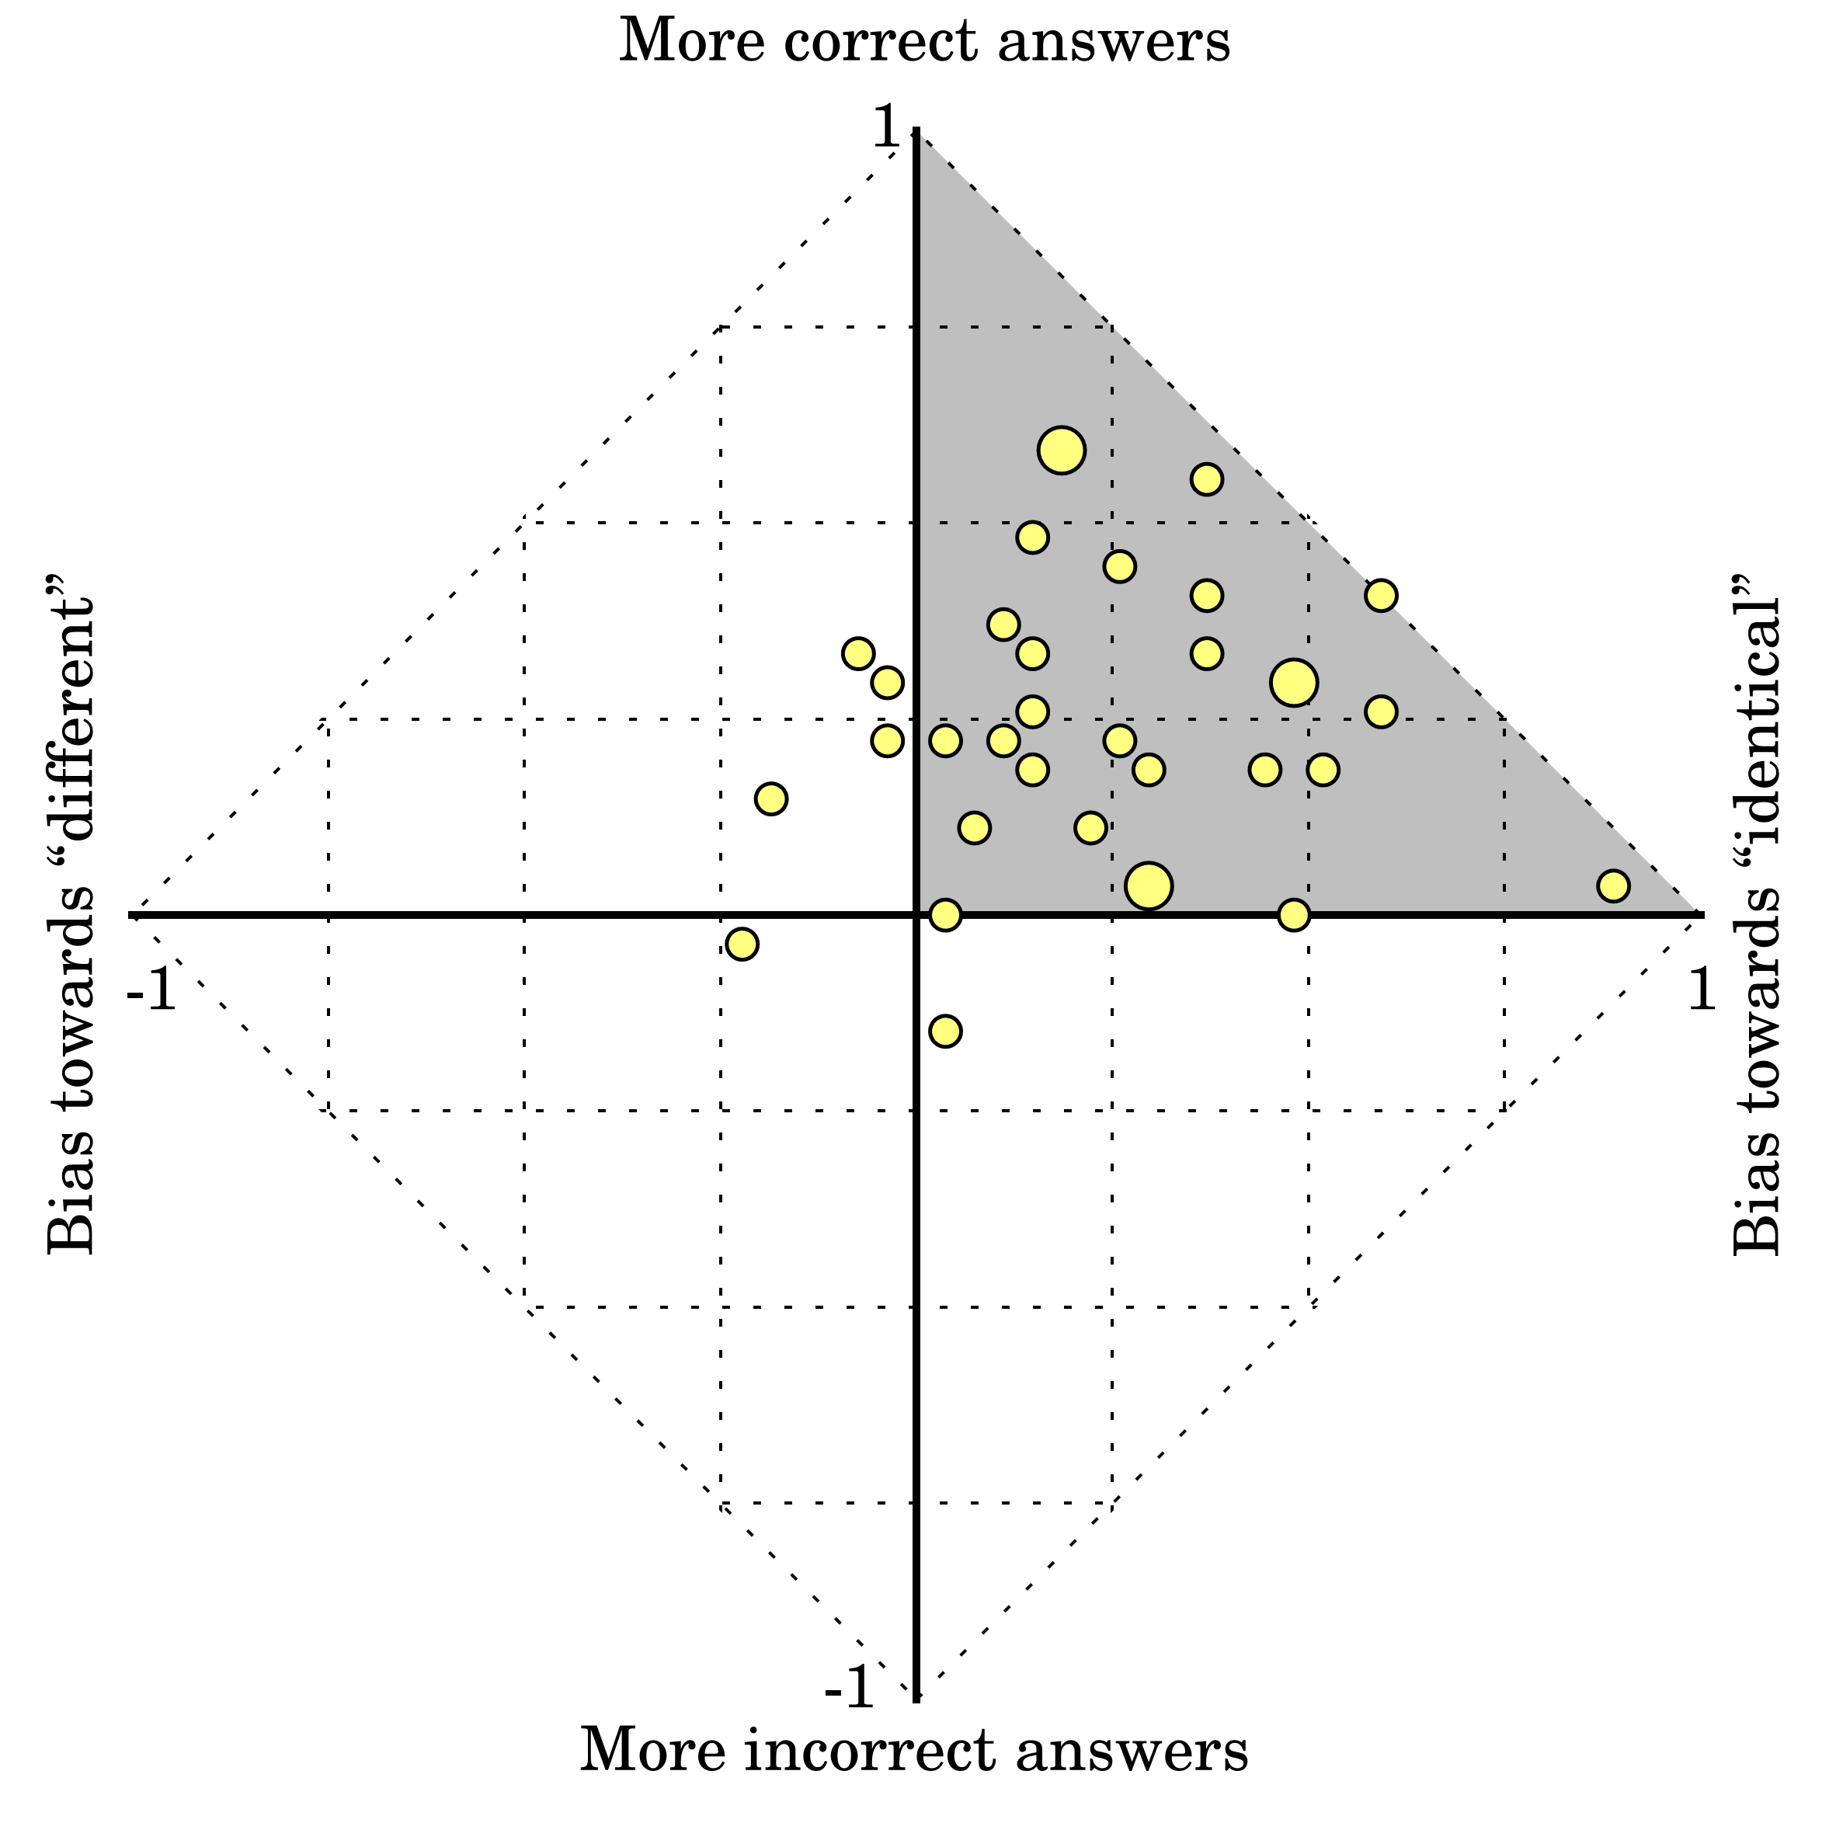
Per-user score
Notes:
The y-axis is score, or how reliably the participants could tell stereo from mono.
The x-axis is the answer frequency of ”same” to the right vs ”different” to the left.
Each dot is the average for one participant. Large dots mean two coincident data points.

Slide 19
Per-user score
“different” on test
“same” on control
“different” on control
“same” on test
Notes:
Answering ”same” on a control is a correct answer, moving the average up. It also moves the average answer towards ”same” to the right. Answering ”same” on a test is an incorrect answer, moving the average down, while still moving the average answer towards ”same” to the right. And similarly for the other directions.
So what we can see is that the controls were more or less correctly answered, while the tests were more of a mixed bag.

Slide 20
Per-user score
Omniscient
Expected region
Always “same” unless real perceivable difference
Coin toss
Always “different”
Always “same”
Weighted coin toss
Omniscient liar
Notes:
Always ”different”: This possibility alone illustrates why score should be interpreted with care: if a user saw differences plain as day, but also imagined small differences where there are none, he’d end up here, and we couldn’t tell the difference from someone who just mashed the right mouse button for fun.
We expected participants to be somewhere between that ideal edge and pure guessing, in the grey region.
There are two takeaways here.
First, some participants performed quite well while others performed really poorly, so there’s probably no one-size-fits-all answer.
Second, humans are complex, so don’t read too much into the scores.

Slide 21
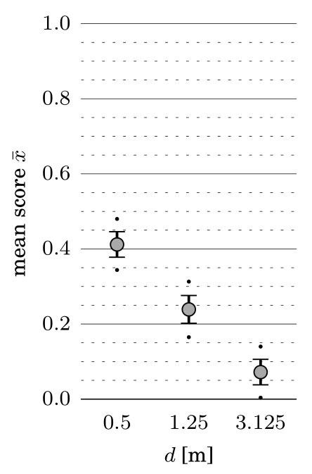
Results
Longer distance: Worse performance
Notes:
With that out of the way, let’s look at the parameter space we chose.
X-axis shows different distances.
Y-axis shows mean score. The whiskers and dots are one and two SEM, so they represent 68 and 95% confidence intervals.
As distance to the object increases, it gets harder to detect shading differences.

Slide 22
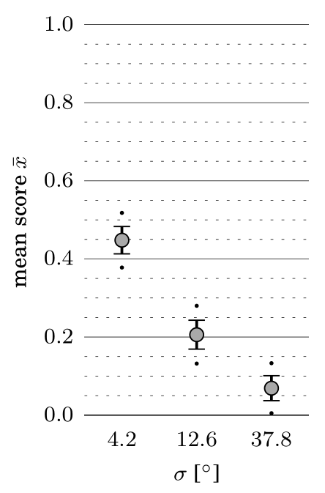
Results
Rougher surface: Worse performance
Notes:
X-axis is now surface roughness. The units aren’t important, you can look at the examples to the left.
As roughness of the object increases, it again gets harder to detect shading differences.

Slide 23
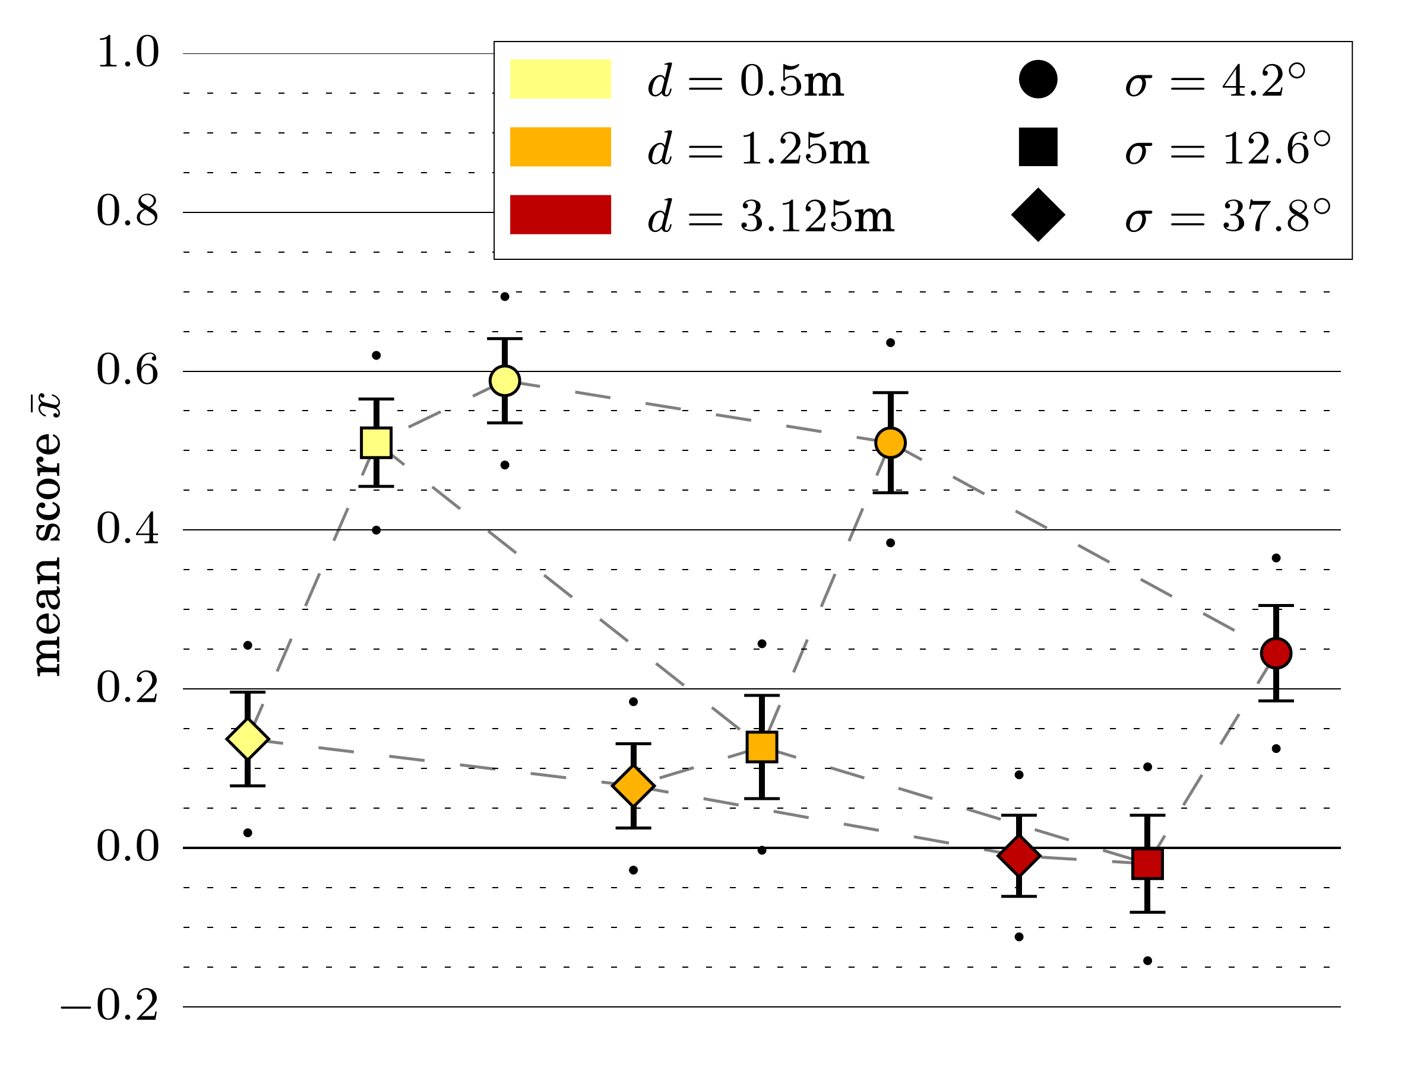
Results
Longer distance: Score decreases
Notes:
The two effects are not independent of eachother. Here, the color denotes distance and the data point shape denotes roughness.
As you can see, the shape of the trends vary depending on the other variable.

Slide 24
Results
Longer distance: Score decreases
Higher roughness:
Score decreases
Notes:
The two effects are not independent of eachother. Here, the color denotes distance and the data point shape denotes roughness.
As you can see, the shape of the trends vary depending on the other variable.

Slide 25
Results
Longer distance: Score decreases
Higher roughness:
Score decreases
Lower shininess:
No significant effect
Notes:
And it turned out that the third parameter we looked at, relative contrast between specular and diffuse, did not have a statistically significant impact.

Slide 26
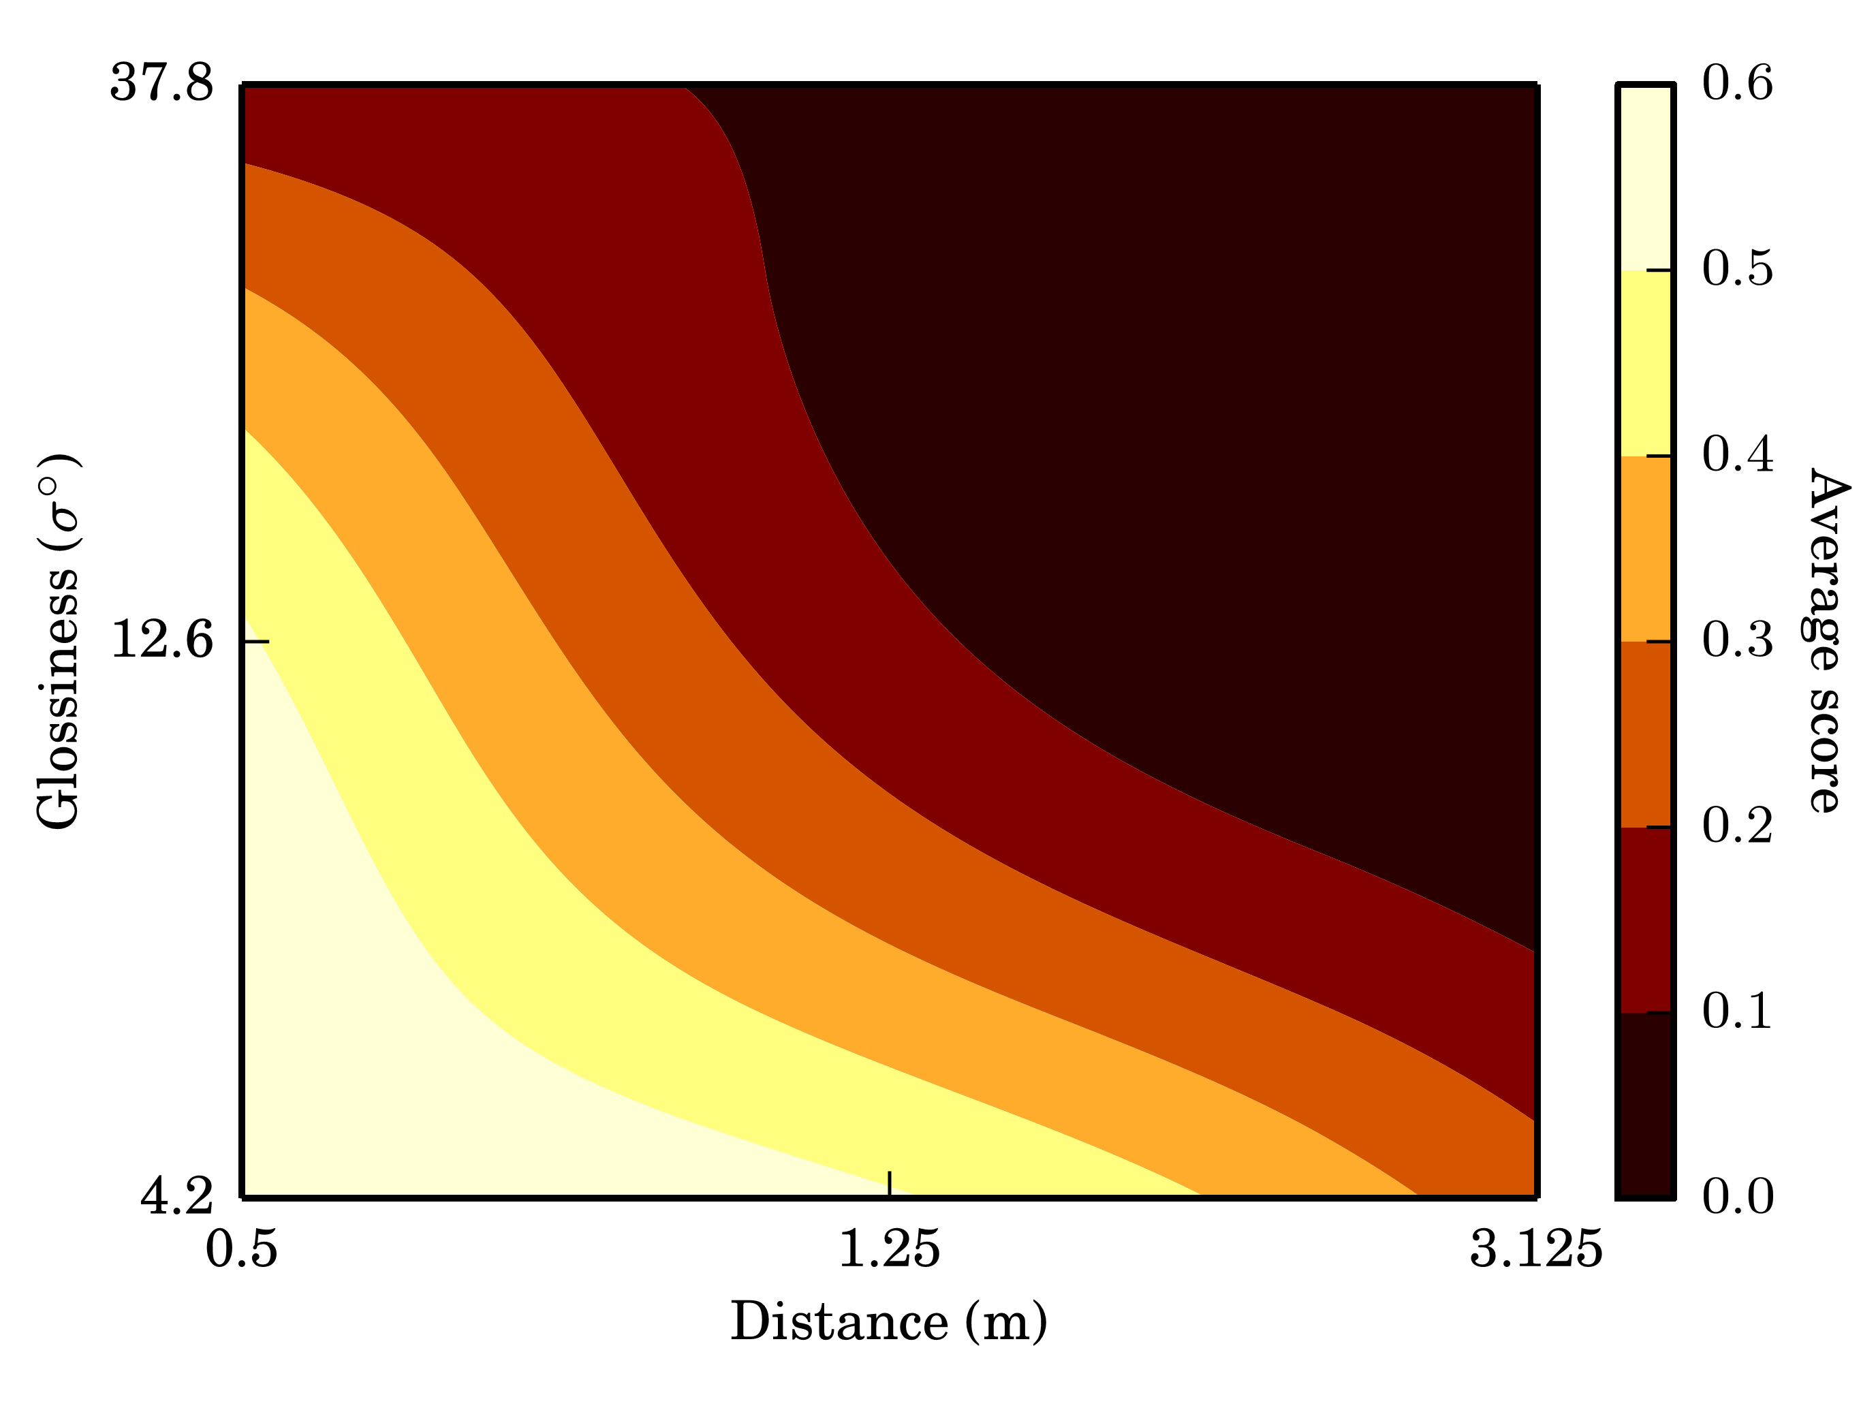
Answering the question
Q: Under which circumstances do we perceive highlight disparity, in consumer-grade VR devices?
A: If objects are nearby and are not rough
Roughness

Slide 27
Conclusions
Monoscopic shading does work for distant or rough objects
Test with your own assets
Be careful when interpreting results
Use quality setting to determine threshold

Slide 28
Q & A
We are hiring!
e-mail me at robert.m.toth@intel.com

