Slide 1
MSAA-Based Coarse Shading for Power-Efficient Rendering on High Pixel-Density Displays
Pavlos Mavridis Georgios Papaioannou
Department of Informatics, Athens University of Economics & Business

Slide 2
Motivation
High-pixel-density displays are widely used on many devices
Mobile phones and tablets
Laptops
4K monitors/TVs are now mainstream
5K displays are introduced in the high-end
High-pixel-density -> high resolution
Real-time rendering on such resolutions is challenging
Especially on power-constrained mobile devices

Slide 3
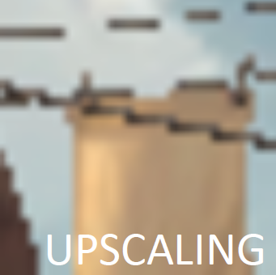
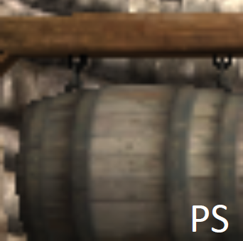
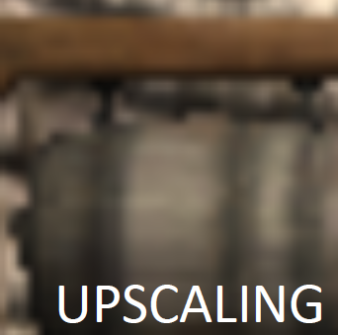
Typical Approaches
Render at a lower resolution and upscale
Introduces blurriness
Thin geometric features are under-sampled
Edge-preserving filters (bilateral) can be used for better results,
but under-sampling is still an issue.
Images from [Vaidyanathan et al. 2014]

Slide 4
A Better Alternative
Use a decoupled sampling approach, where visibility is sampled at a higher rate than shading.
In particular, the desired approach will:
Sample visibility at least once per pixel, in order to preserve the clarity of geometric edges
Perform shading at a lower (more coarse) rate.

Slide 5
Decoupled Sampling: Previous Work
Parametric-space shading
[Cook et al. 1987; Andersson et al. 2014; …]
Caveats: high overhead when implemented on existing GPUs, overshading
Deferred shading
Inherently decouples visibility from shading
Many decoupling opportunities [Lauritzen 2010; Kerzner and Salvi 2014; … ]
Caveats: memory bandwidth (or tiling overhead), transparency
Multi Sample Anti-Aliasing (MSAA) [Akeley 1993]
Supported virtually on all shipping GPUs.
Caveat: Each covered primitive is shaded at least once per pixel -> Not directly applicable for coarse shading.

Slide 6
Decoupled Sampling: Previous Work
Recent extensions of MSAA allow coarse and multi-rate shading [Vaidyanathan et al. 2014; He at al. 2014; Clarberg et al. 2014]
Hardware modifications are required.
Can we perform coarse shading efficiently on existing GPUs in the context of forward rendering?

Slide 7
MSAA-based coarse shading
Main Idea:
Starting from the render buffer with the final desired resolution.
Final high-res buffer

Slide 8
MSAA-based coarse shading
Main Idea:
Starting from the render buffer with the final desired resolution.
Every NxN block of pixels is replaced with one pixel with at least NxN MSAA samples.
Final high-res buffer
Intermediate MSAA buffer

Slide 9
MSAA-based coarse shading
Main Idea:
Starting from the render buffer with the final desired resolution.
Every NxN block of pixels is replaced with one pixel with at least NxN MSAA samples.
A custom resolve shader maps individual MSAA samples to screen pixels
Final high-res buffer
Intermediate MSAA buffer
MSAA sample

Slide 10
MSAA-based coarse shading
Final high-res buffer
Intermediate MSAA buffer
MSAA sample

Slide 11
MSAA-based coarse shading
Per pixel shading: Nine fragment shader invocations
Final high-res buffer
Intermediate MSAA buffer
MSAA sample
Shader Invocation
Per-pixel Shading

Slide 12
MSAA-based coarse shading
Per pixel shading: Nine fragment shader invocations
Coarse shading: Three fragment shader invocations (3x reduction)
Final high-res buffer
Intermediate MSAA buffer
MSAA sample
Shader Invocation
Coarse Shading

Slide 13
MSAA-based coarse shading
Per pixel shading: Nine fragment shader invocations
Coarse shading: Three fragment shader invocations (3x reduction)
Centroid sampling should be used in order to evaluate shaders near the covered sample positions.
Final high-res buffer
Intermediate MSAA buffer
MSAA sample
Shader Invocation
Coarse Shading

Slide 14
Practical Configurations
Configuration #1
¼ resolution + 4xMSAA
Visibility: 1 sample/pixel
Shading: at least 1 sample per 2x2 block
Resolve: 1:1 mapping (nearest filtering)

Slide 15
Practical Configurations
Configuration #1
¼ resolution + 4xMSAA
Visibility: 1 sample/pixel
Shading: at least 1 sample per 2x2 block
Resolve: 1:1 mapping (nearest filtering)
Configuration #2
¼ resolution + 8xMSAA
Visibility: 2 samples/pixel
Shading: at least 1 sample per 2x2 block
Resolve: 2:1 mapping (weighted average of 2 values)

Slide 16
Practical Configurations
Configuration #1 (alternative)
Bind a non-MSAA high-res buffer
“Pretend” it is a low-res MSAA buffer during rendering
It could be done on some consoles, exploiting non-standard APIs and H/W behavior
Configuration #1
Quarter resolution + 4xMSAA
Visibility: 1 sample/pixel
Shading: at least 1 sample per 2x2 block
Resolve: 1:1 mapping (nearest filtering)
Configuration #2
¼ resolution + 8xMSAA
Visibility: 2 samples/pixel
Shading: at least 1 sample per 2x2 block
Resolve: 2:1 mapping (weighted average of 2 values)

Slide 17
Spatial Interleaving
The method Inherently creates interleaved sampling patterns [Keller et al. 2001]
Neighboring pixels are always sampled at different positions.

Slide 18
Spatial Interleaving
Masks inter-pixel aliasing with noise (well-known concept from stochastic sampling)
Regular Sampling
Interleaved Sampling
a)
b)
b)
a)

Slide 19
Spatial Interleaving
High-pixel-density displays: Beneficial even when one visibility sample is used (but the more samples the better)
Low-pixel-density displays: regular sampling + MLAA/FXAA/etc… might be preferable (highly subjective).
Revert to regular sampling using programmable sample positions.
Note: NVIDIA’s Maxwell architecture supports interleaved sampling with MSAA (>1 sample/pixel).

Slide 20
“Side Effects”

Slide 21
“Side effect”: triangle size
The pixel footprint gets bigger-> relative triangle size is decreased.
Can negatively affect the efficiency of rasterization (due to increased “quad over-shading”)
Techniques like Quad-Fragment Merging [Fatahalian et al. 2010], Pixel Merge Unit [Sathe et al. 2015] or similar can be highly beneficial.

Slide 22
“Side effect”: frame buffer compression
Neighboring pixels share the same color
-> good opportunity for better compression.
But, our implementation binds an MSAA render target for reading
this disables compression or triggers a decompression operation on some architectures -> high overhead.
An implementation that avoids this issue might be possible
Mobile architectures: read directly from the on-chip tile local storage.
Expect different behavior on different GPUs (tests show more gains on Intel GPUS than on NVIDIA or AMD)

Slide 23
Results

Slide 24
Methodology
Test Hardware: Apple MacBook Pro 13’’ / Intel Iris 5100 GPU
Intel Power Gadget tool for energy measurements
Measurements include both CPU and GPU consumption.
V-Sync ensures that all methods perform the same amount of work.
ARB_pipeline_statistics_query for shader invocation measurements
Includes “helper” invocations for derivative calculations

Slide 25
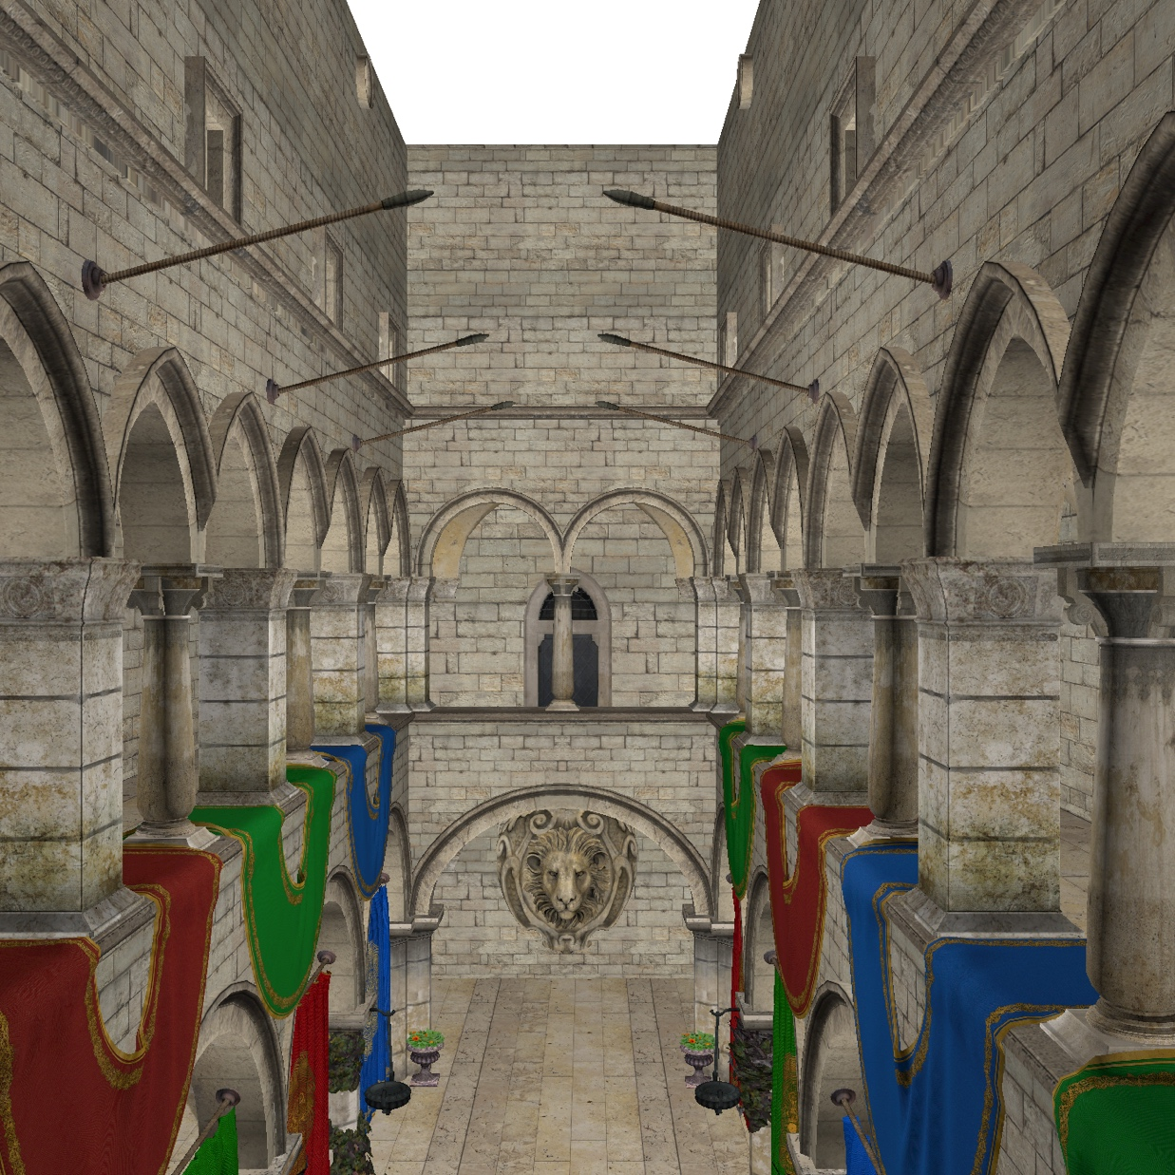
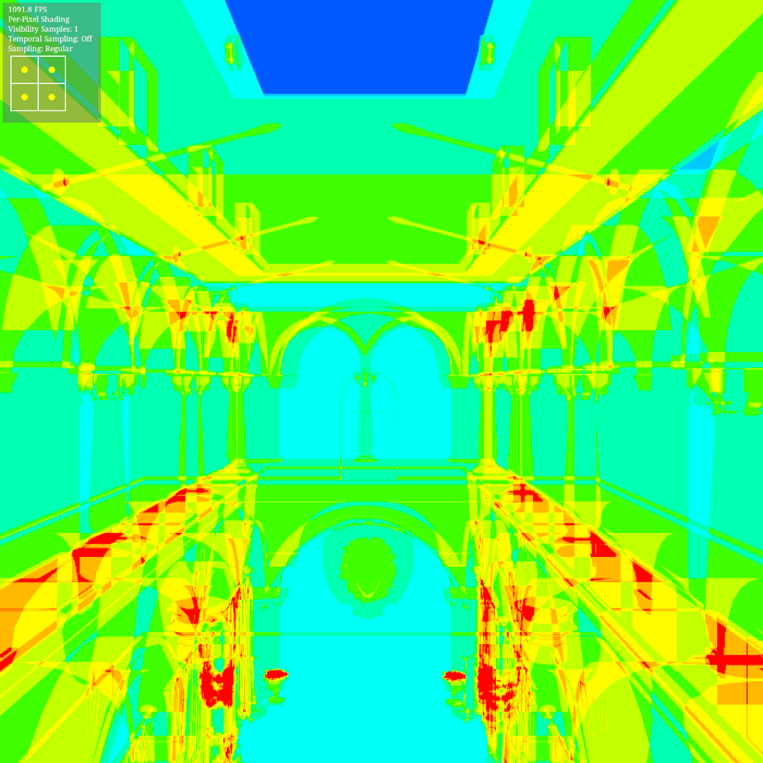
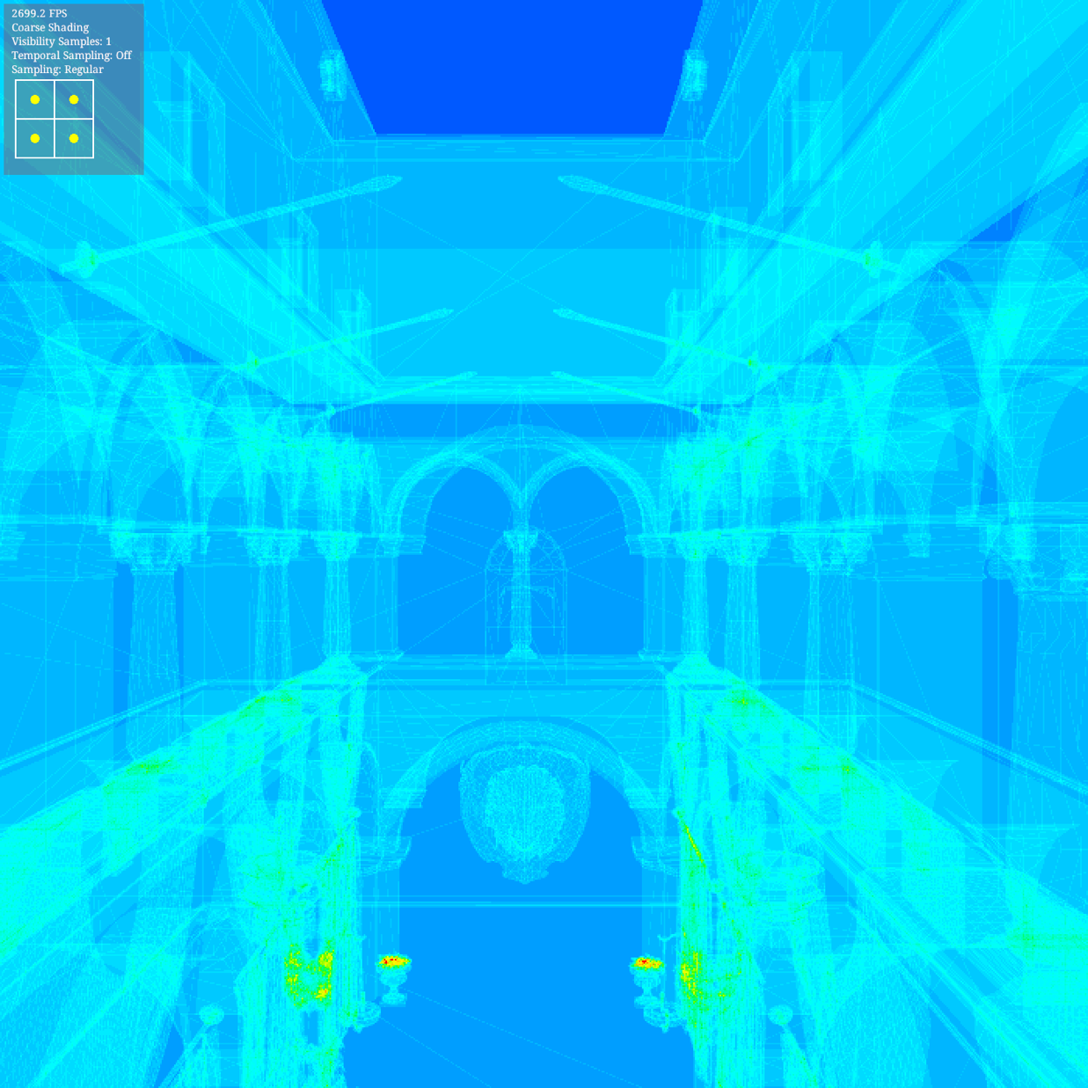
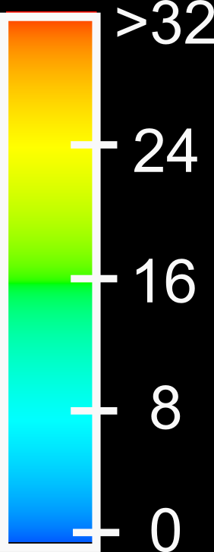
Shader Invocations (per 2x2 pixel block)
Sponza Atrium
262k Triangles
Per Pixel Shading
Coarse Shading
Invocations: 69.3% reduction (3.5M vs 1.1M)
Power usage: 45.7% reduction (32 vs 17 Watts)
OR 1.73x speedup in rendering

Slide 26
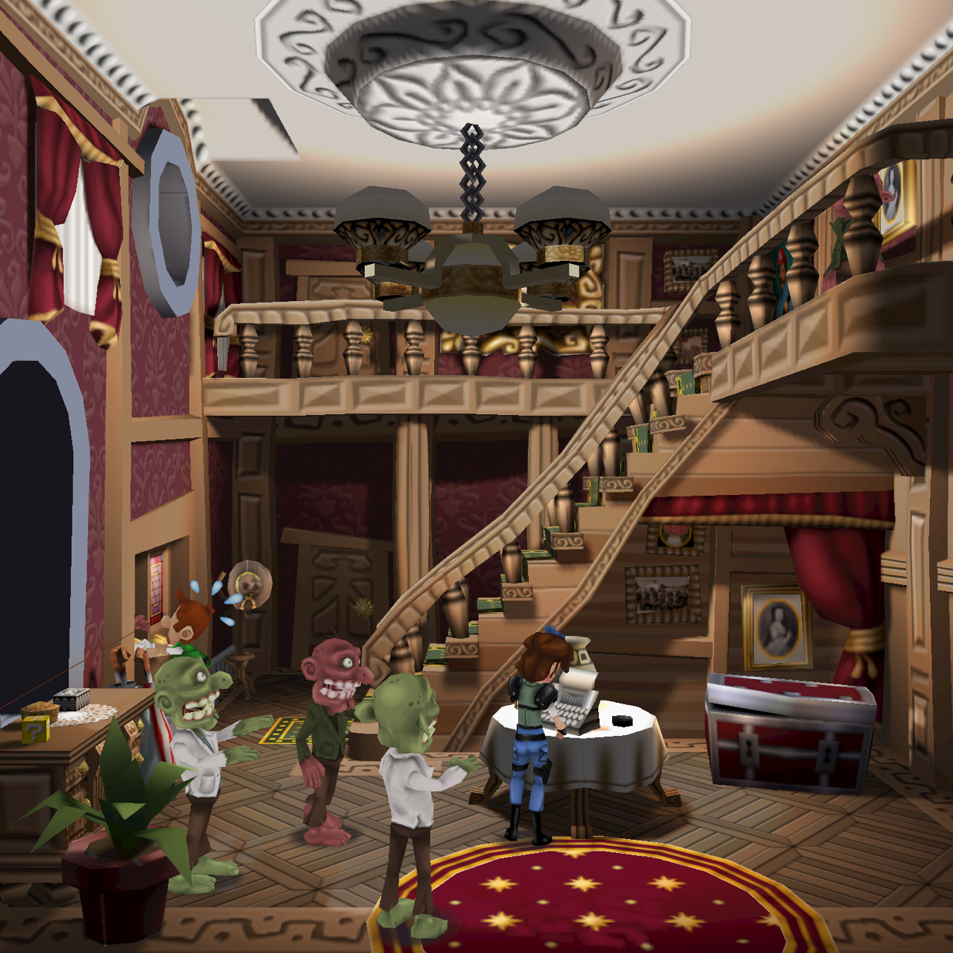
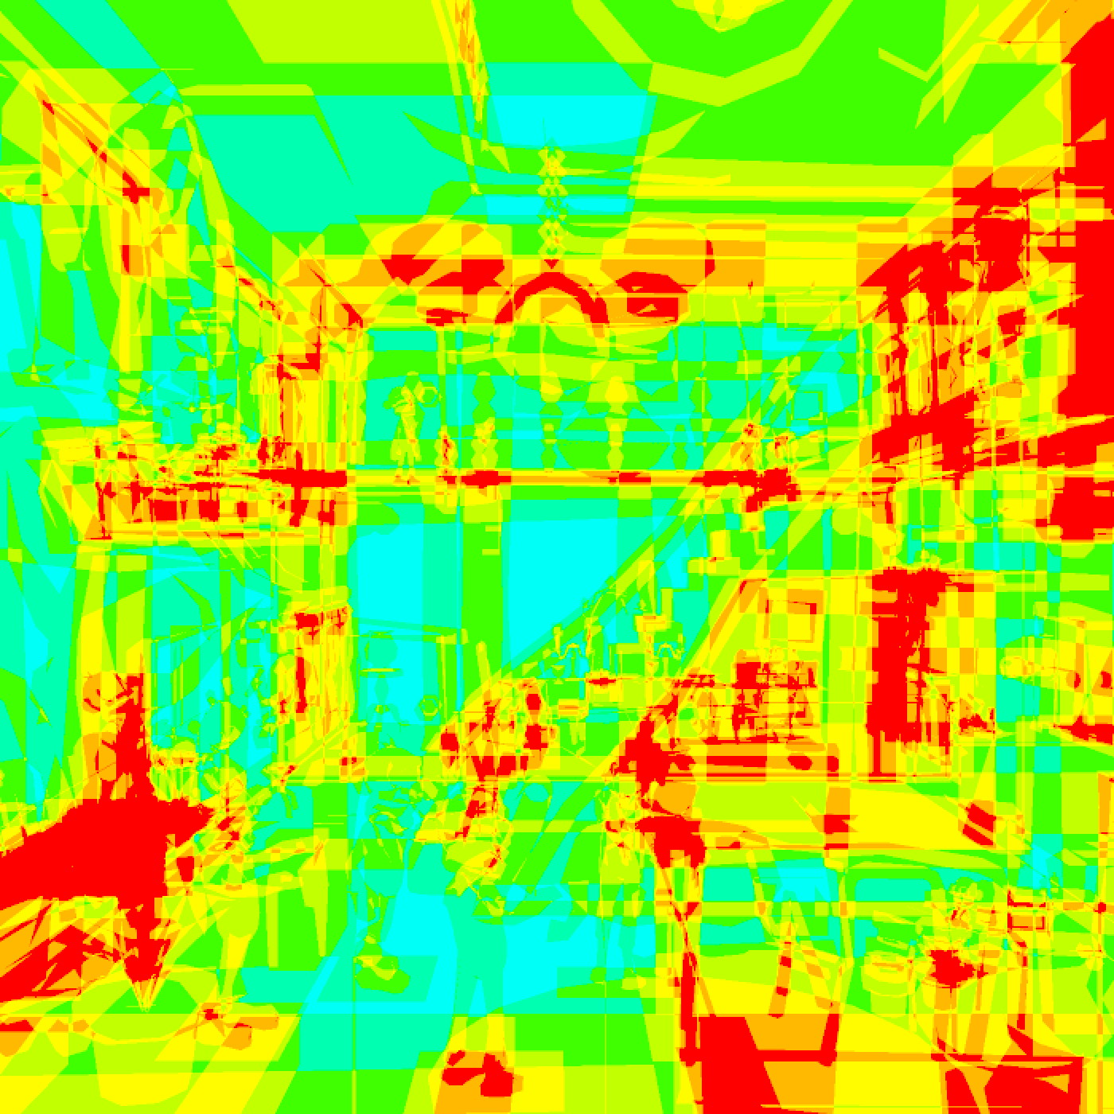
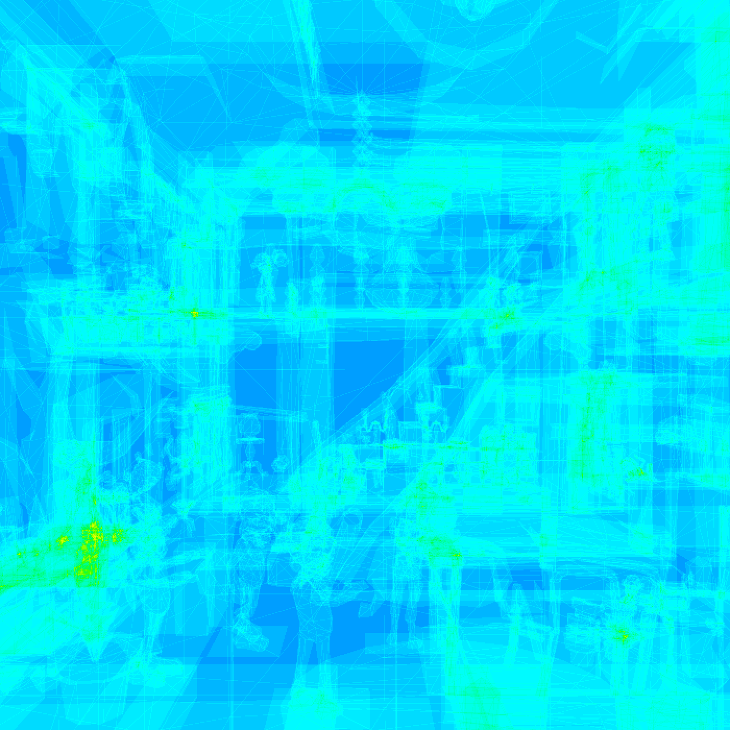
Shader Invocations (per 2x2 pixel block)
Mansion Scene
53k Triangles
Per Pixel Shading
Coarse Shading
Invocations: 72.5% reduction (10M vs 2.7M)
Power usage: 12.6% reduction (8.7 vs 7.6 Watts)
OR 1.23x speedup in rendering

Slide 27
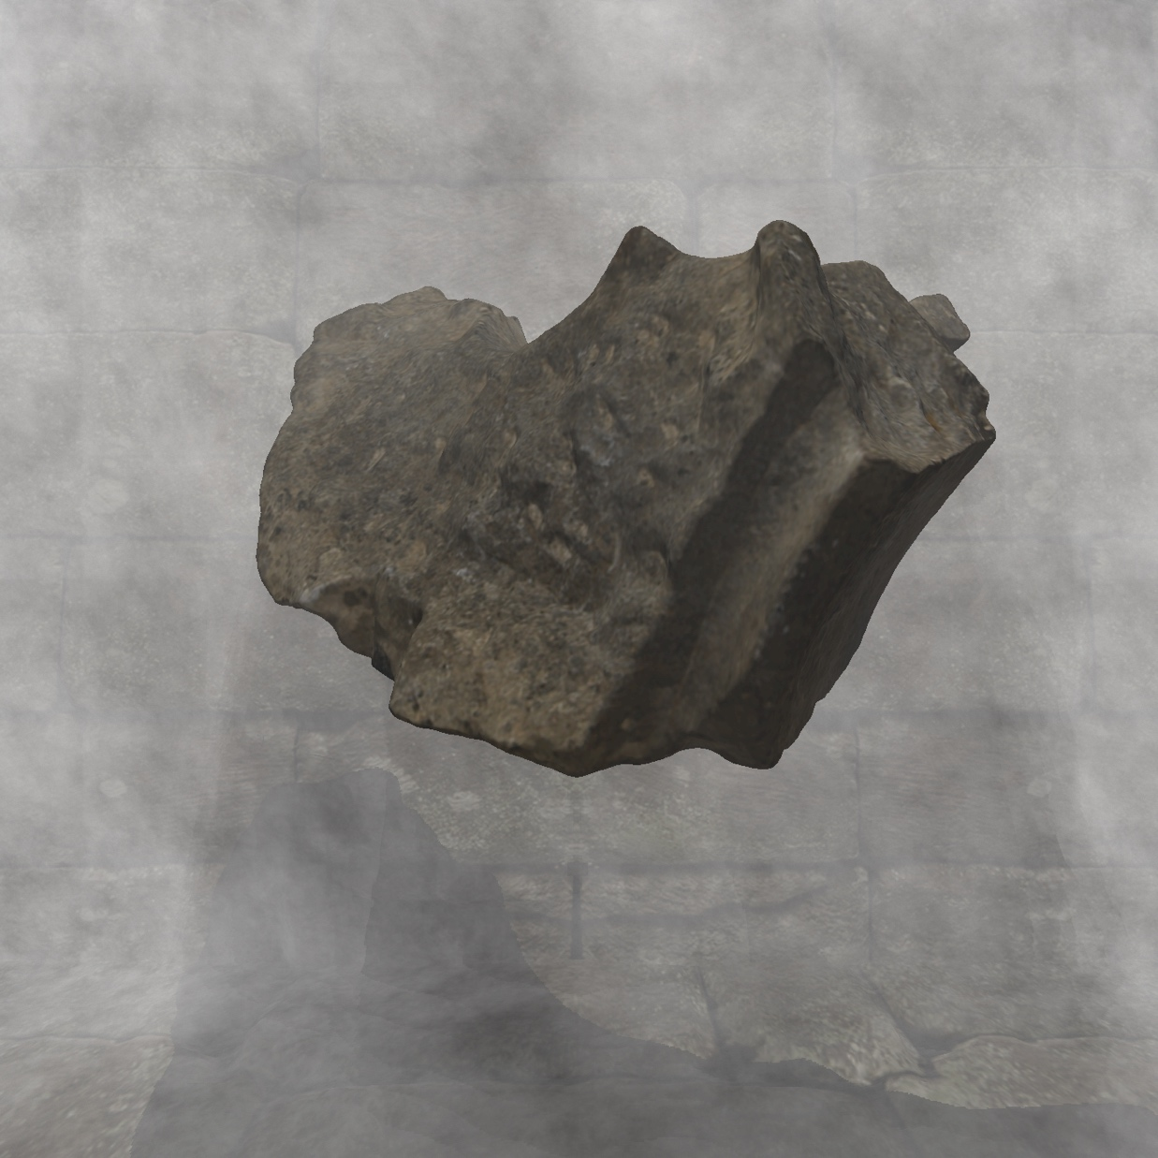
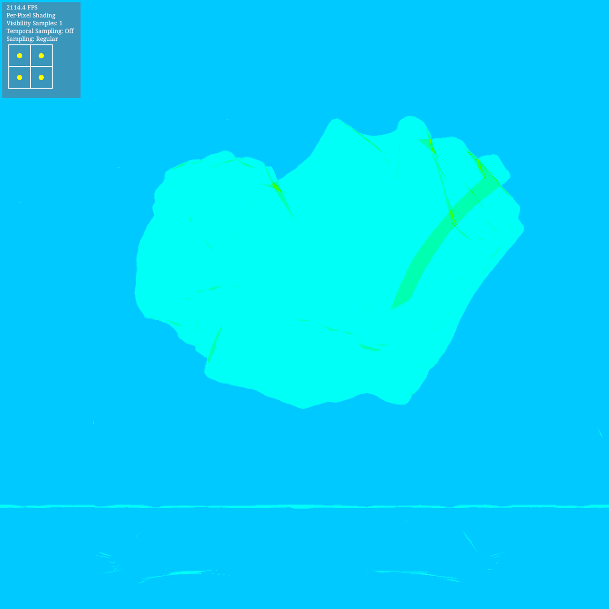
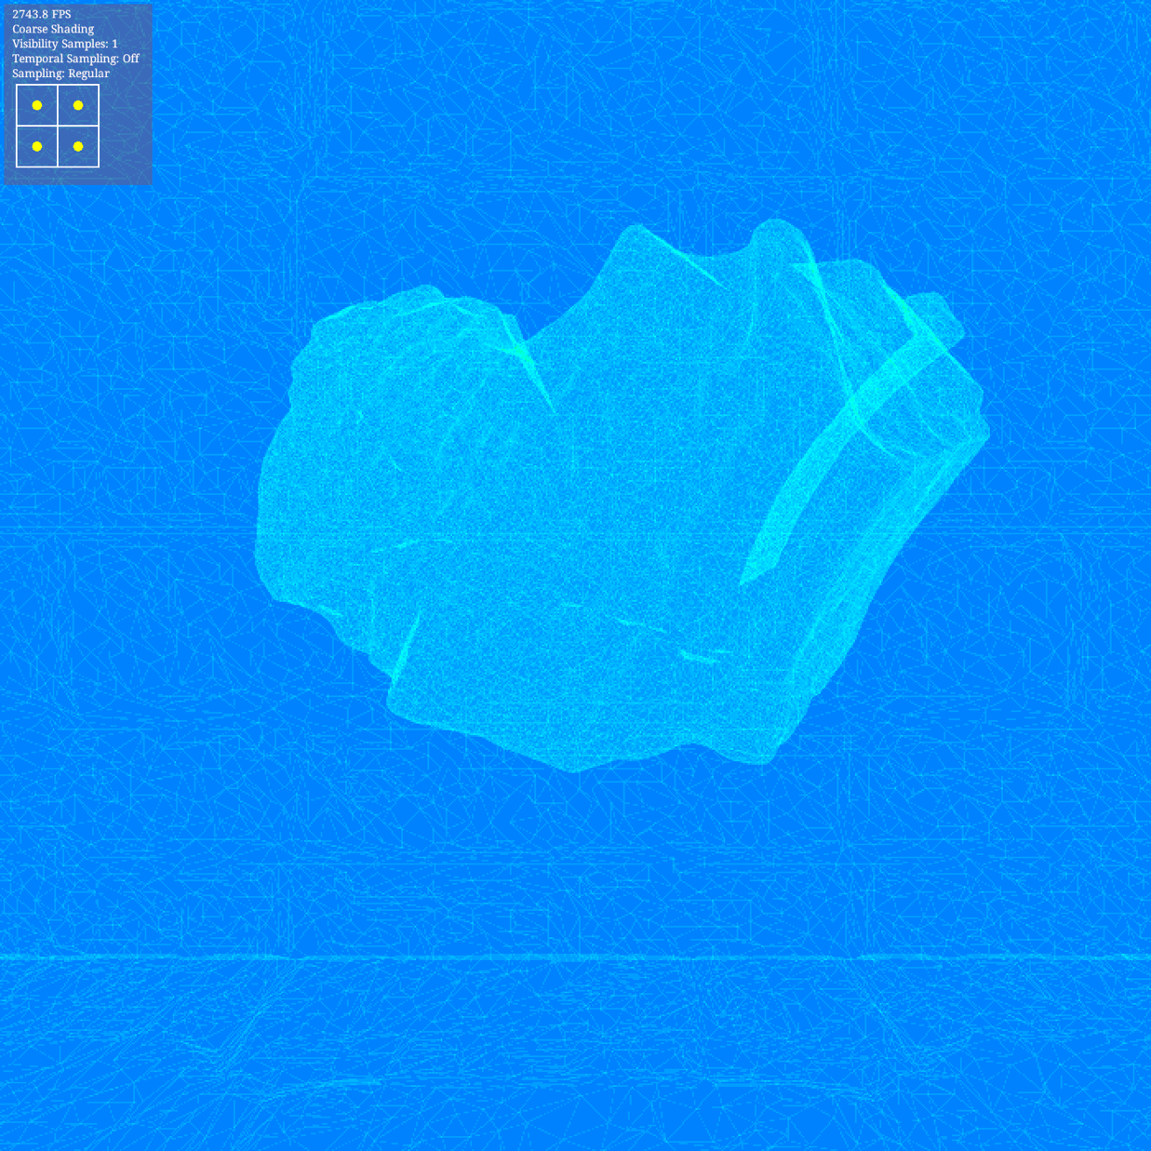
Shader Invocations (per 2x2 pixel block)
Volumetric Shadows
215k Triangles
Per Pixel Shading
Coarse Shading
Invocations: 63.2% reduction (1.9M vs 0.7M)
Power usage: 45.8% reduction (30 vs 16 Watts)
OR 2.14x speedup in rendering

Slide 28
Shader Invocations (per 2x2 pixel block)
P
Volumetric Shadows
215k Triangles
Per Pixel Shading
Coarse Shading
Invocations: 63.2% reduction (1.9M vs 0.7M)
Power usage: 45.8% reduction (30 vs 16 Watts)
OR 2.14x speedup in rendering

Slide 29
Shader Invocations (per 2x2 pixel block)
P
Volumetric Shadows
215k Triangles
Per Pixel Shading
Coarse Shading
Invocations: 63.2% reduction (1.9M vs 0.7M)
Power usage: 45.8% reduction (30 vs 16 Watts)
OR 2.14x speedup in rendering
Shadow-map lookup +
4D Perlin Noise + math

Slide 30
Vector Drawing
Tested using the NanoVG library (vector drawing with OpenGL)
Important for UI / Maps / 2D games
Flat or smooth shaded regions exhibit very small loss of image quality.
Invocations: 74% reduction (439K vs 114K)
Power usage: 14.3% reduction (7 Watts vs 6 Watts) OR 1.27x speedup in rendering
Butterfly Scene (SVG)

Slide 31
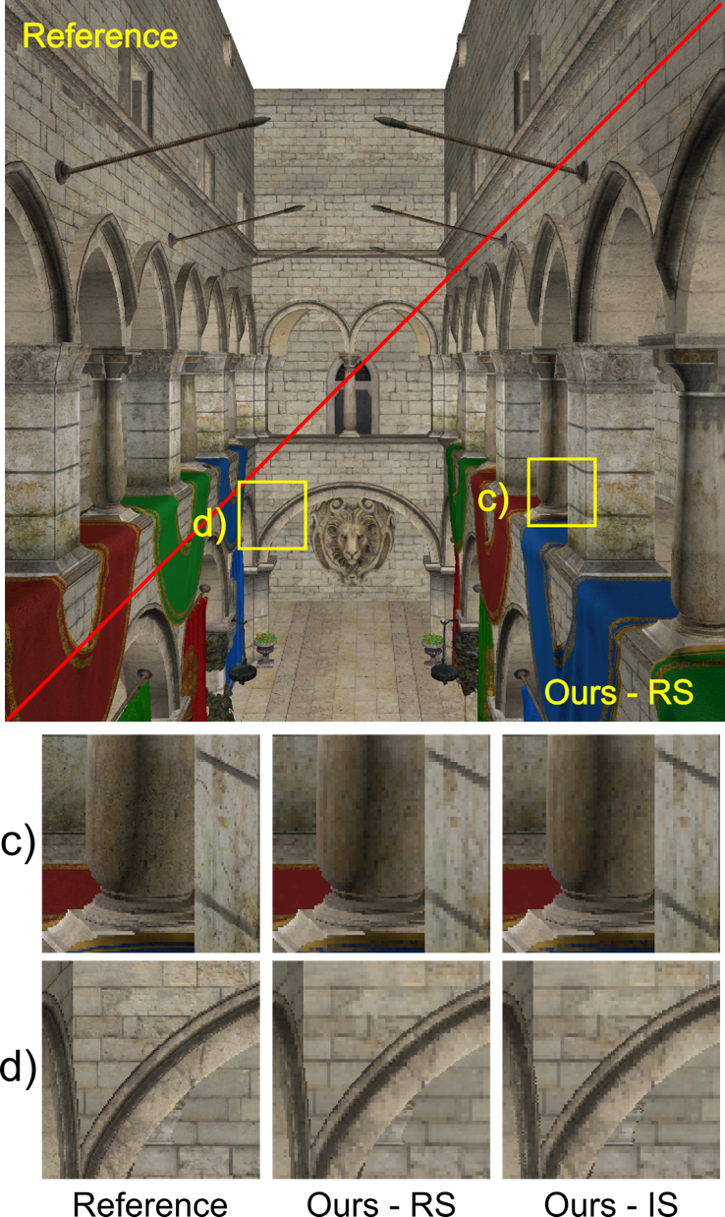
Image Quality
Subjective evaluation: we can switch between per-pixel and coarse shading without noticing any quality degradation on Hi-PPI displays (see the demo!)

Slide 32
Image Quality
Objective evaluation:
Scene Name | SSIM (%)
Butterfly (2D SVG) | 99.9
Mansion | 95.6
Volumetric Shadows | 96.5
Sponza | 81.2
Hairball | 97.6
Coarse shading compared to per-pixel shading

Slide 33
Extension: Selective Coarse Shading
Apply coarse shading only on specific parts of the scene
Out of focus regions (defocus blur)
Fast moving objects (motion blur)
Distant objects (often covered by thin haze)
Peripheral objects in VR applications (foveated rendering)
On existing hardware we can switch between coarse and fine shading between draw-calls
Not as fine-grained control as the proposed hardware implementations

Slide 34
Conclusions
We have presented a method to perform coarse shading efficiently on commodity graphics hardware
Important for practitioners & software developers.
Important for IHVs: before designing new hardware extensions it is important to understand the limits of existing architectures.
Up to 45% reduction in power consumption.
Interleaved sampling for improved antialiasing.

Slide 35
Thank you for your attention!
Acknowledgement
This project has received funding from the European Union’s Seventh Framework Programme for research, technological development and demonstration under grant agreement No 600533

Slide 36
Backup Slides

Slide 37
Temporal Interleaving
Alternate between two sampling patterns at successive frames
Frame N
Frame N+1
(render up-side-down & flip at resolve)

Slide 38
Temporal Interleaving
Alternate between two sampling patterns at successive frames
Static content: Render at a high frame rate (>60Hz v-sync locked) and let the human visual system perform the required averaging.
Dynamic content: Temporal sample re-projection…
Frame N
Frame N+1
Composite
(render up-side-down & flip at resolve)

Slide 39
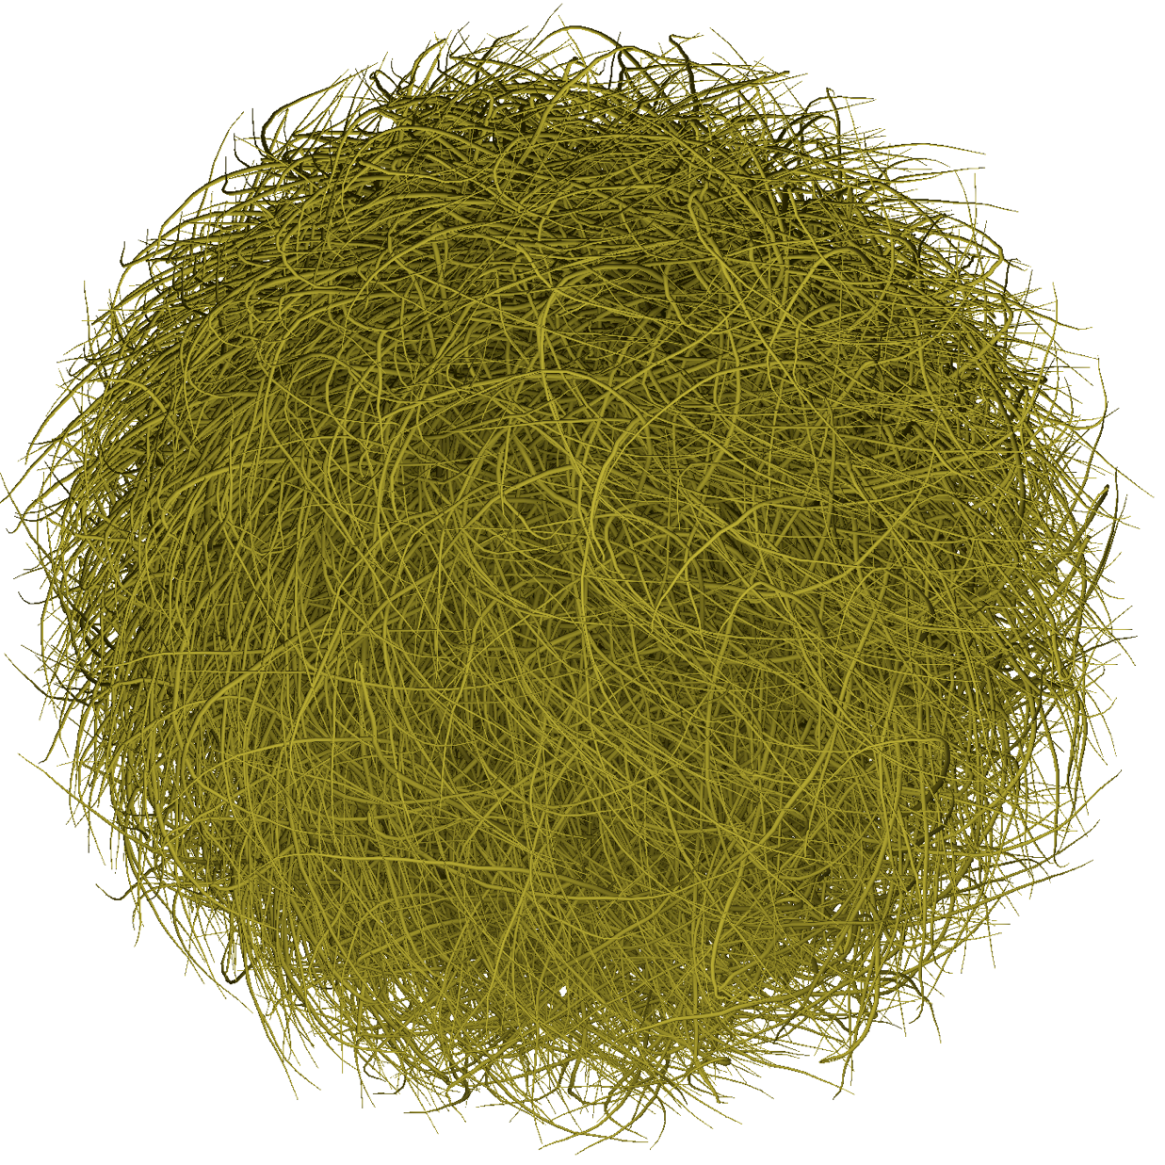
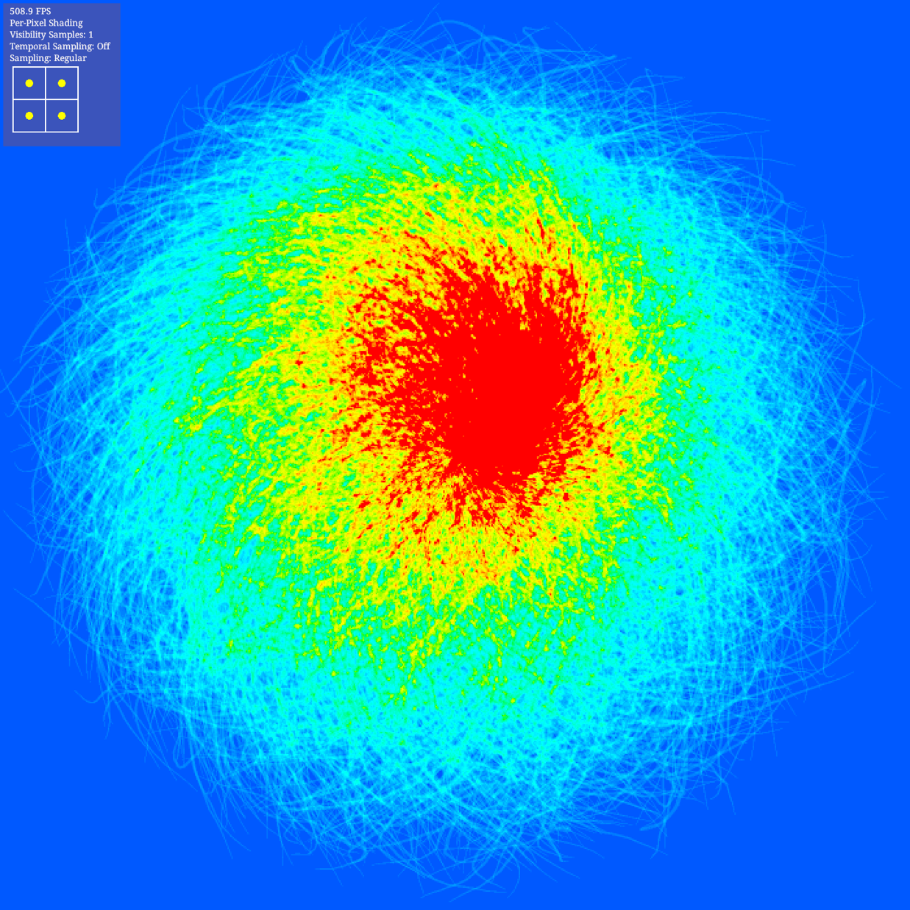
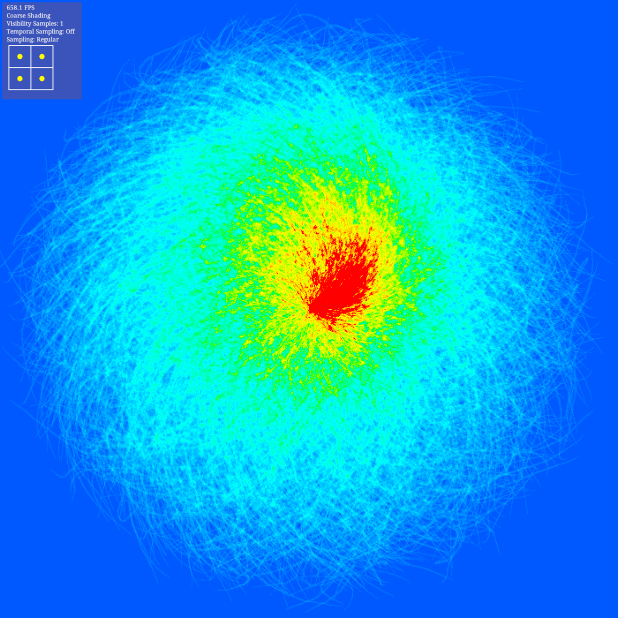
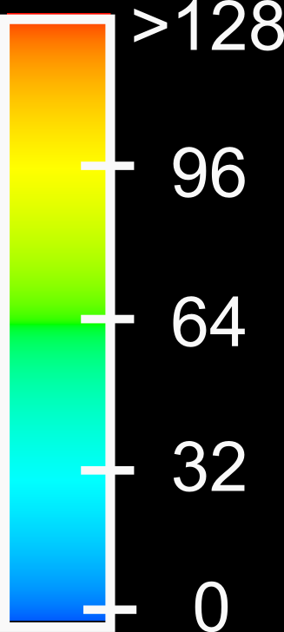
Shader Invocations (per 2x2 pixel block)
Hairball
2850k Triangles
Per Pixel Shading
Coarse Shading
Invocations: 34.9% reduction (3.2M vs 2.0M)
Power usage: 7.4% increase (29 vs 31 Watts)
OR 0.82x speedup in rendering

