Slide 1
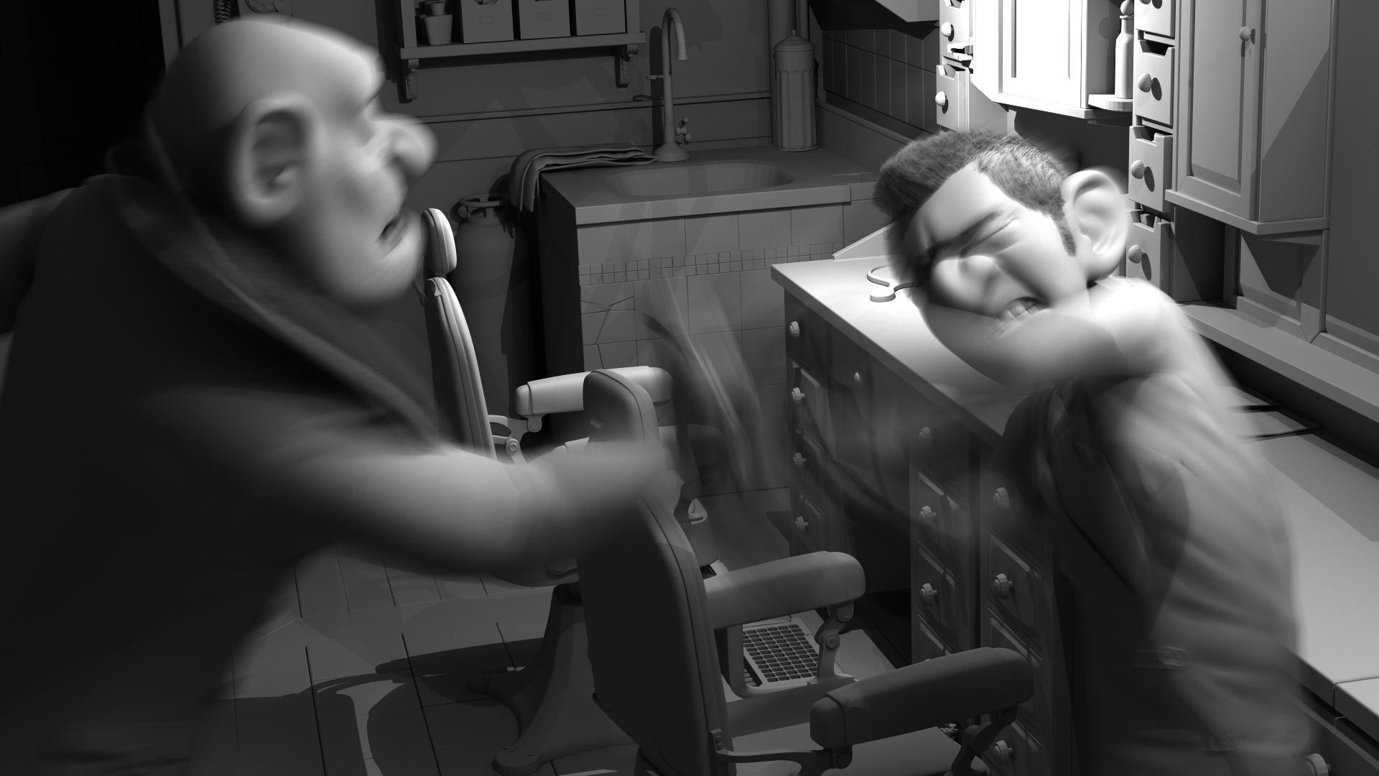
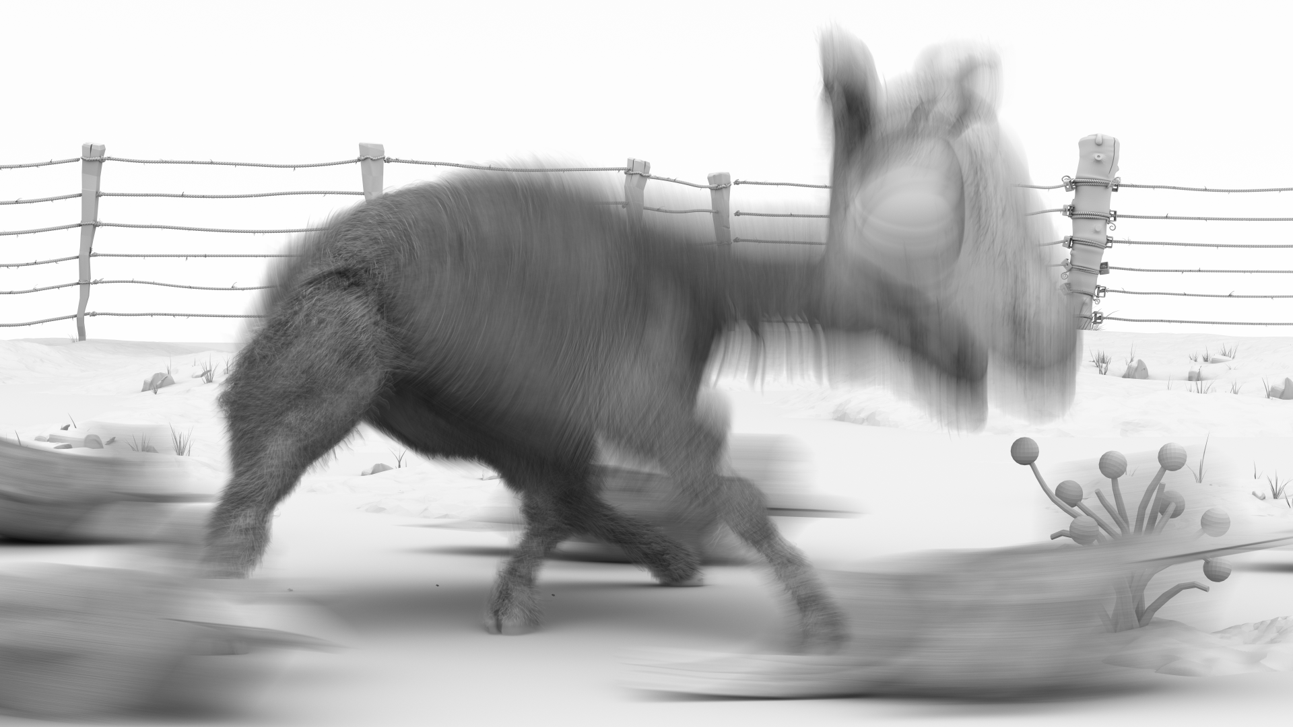
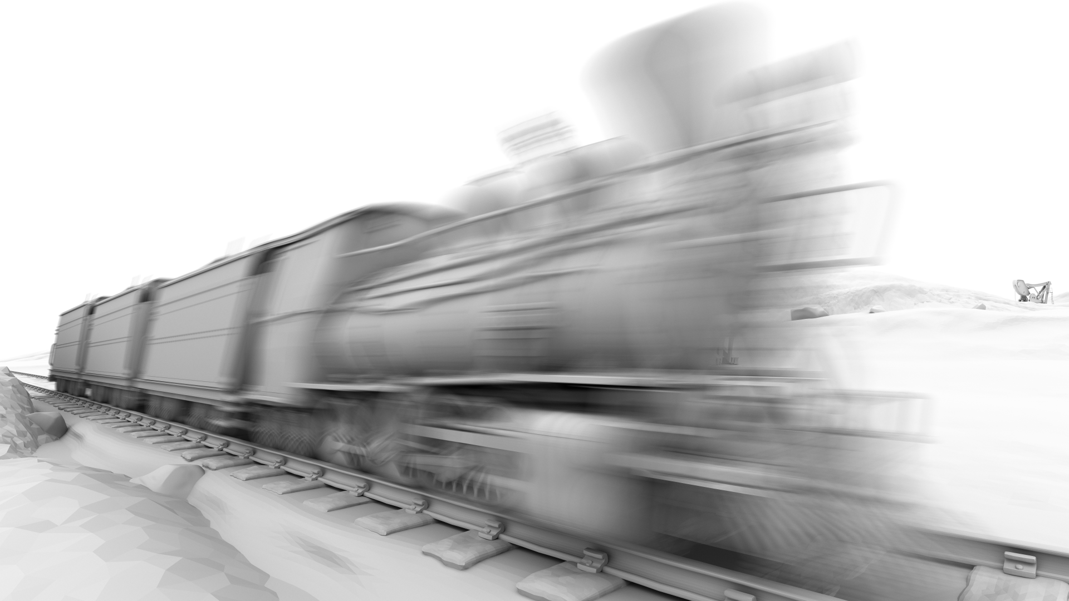
STBVH: A Spatial-Temporal BVH for Efficient Multi-Segment Motion Blur
Sven Woop, Attila Áfra, Carsten Benthin
Intel Corporation

Slide 2
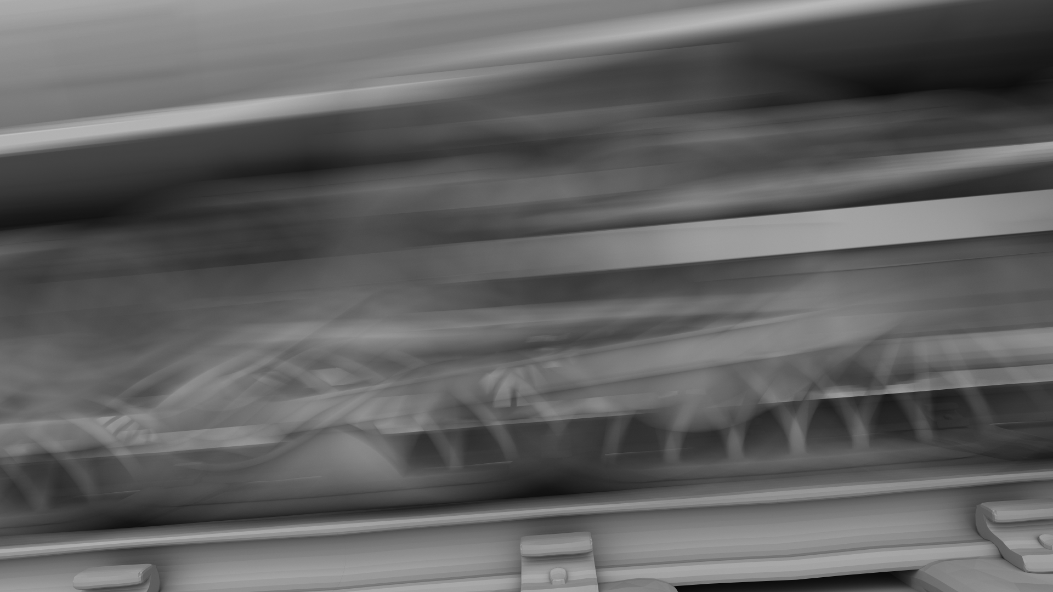
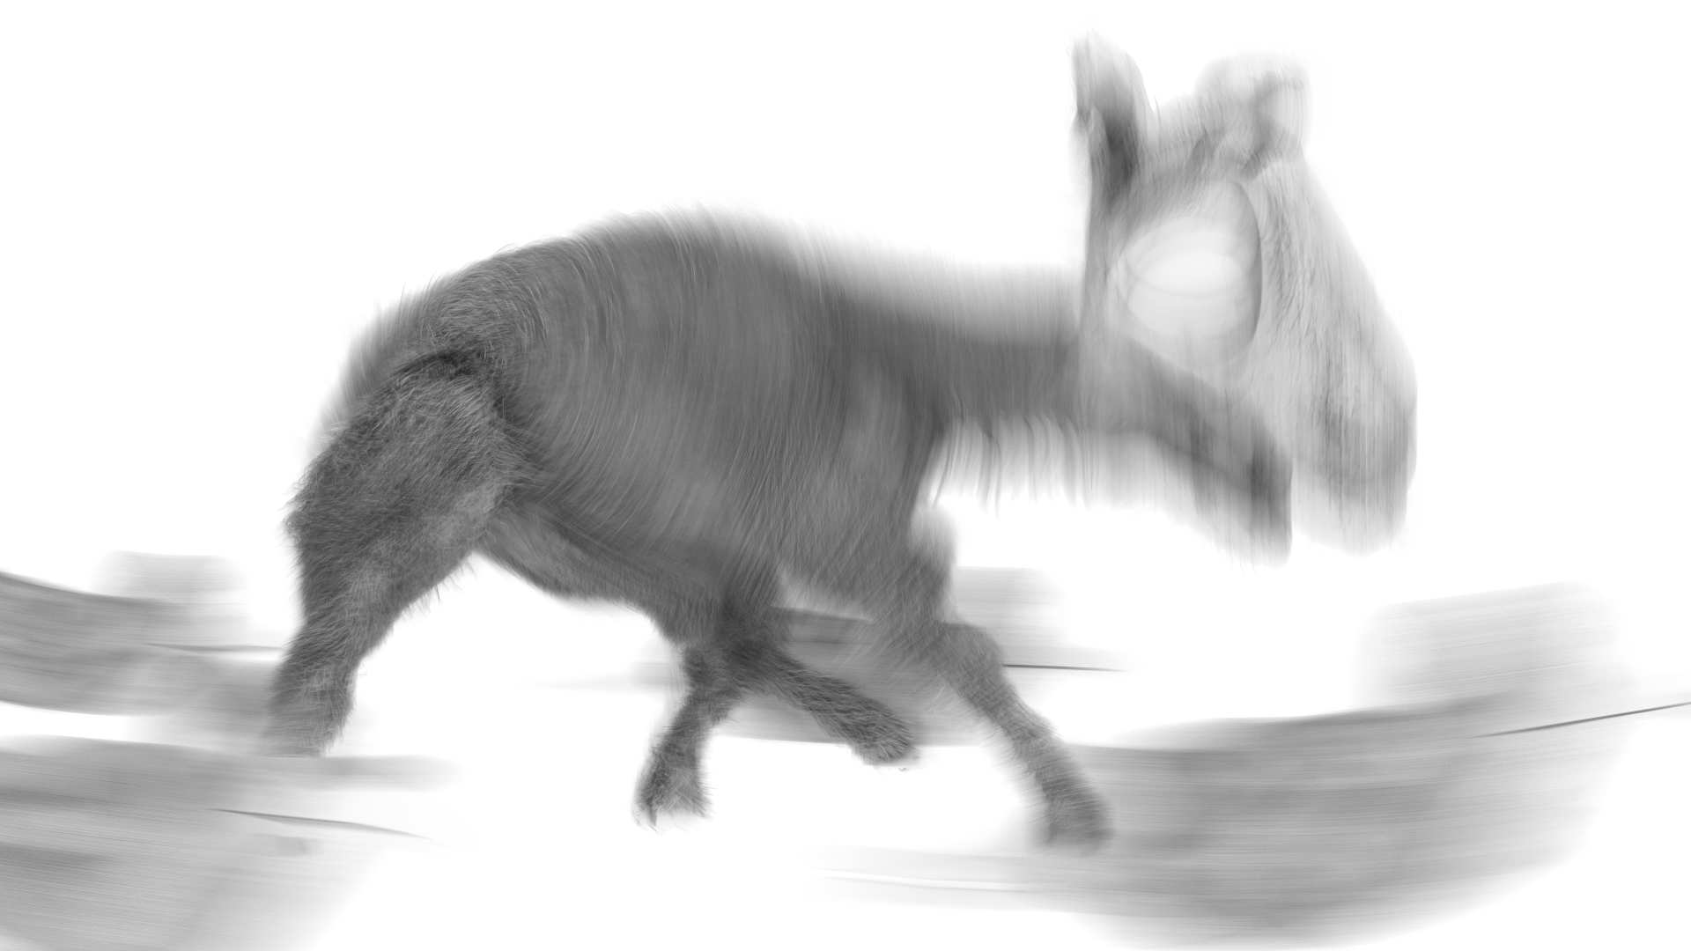
Motion Blur
Fast moving geometry gets blurred for long shutter times
Often fast moving geometry moves on a straight line (linear motion blur)
Sometimes fast curved motion (e.g. rotating wheel, fight scenes, spinning dancer, flying bird, etc.)
➔ Multi Segment Motion Blur required

Slide 3
Multi Segment Motion Blur
Represent curved motion as sequence of time steps to be linearly interpolated
Typically equidistant time steps and often different number of time steps per geometry
x
4 primitive segments
1
t
0
5 time steps

Slide 4
Previous Work
Linear Motion BVH using OBB Hyper-trapezoids [Hou et al. 2010]
Works well for linear motion but inefficient for curved motion.
Multiple Linear Motion BVHs for sufficiently large number of time segments [Embree v2.12.0]
High performance but memory consumption can be arbitrarily bad.
Sequence of AABBs per BVH node [Grünschloß et al. 2011]
One BVH topology for entire motion, calculate segment to interpolate per traversal step, packet techniques have to gather bounds
4D kd-tree [Olsson 2007]
Can shrink time range to simplify motion, kd-tree not good at bounding linear motion, no good build algorithm described
4D BVH using 12 fixed slab directions [Glassner 1988]
Expensive to traverse (24 distance tests to mostly non-axis aligned planes), fixed directions do not align optimally with motion direction
Combining separate renderings for sufficiently many time segments
No adaptive noise reduction possible, interactive preview not possible

Slide 5
4D Spatial-Temporal BVH (STBVH)
N-ary BVH (4 or 8 wide) [Ernst 2008, Dammertz 2008]
SOA layout allows efficient use of SIMD instructions during traversal
Stores spatial linear bounds [Qiming Hou et al. 2010]
Pair of AABBs that bound the geometry for each time when linearly interpolated to the respective time
Efficient support for the common case of linear motion
Stores temporal bounds as time range [Olsson 2007, Glassner 1988]
Efficient support of curved motion through time range reduction
Two node types for improved performance
Spatial-temporal nodes (stores linear bounds and time range)
Spatial nodes (stores linear bounds only)

Slide 6
STBVH Advantages
Efficient handling of different number of time steps per geometry
E.g. high temporal resolution possible for main character
Large memory savings compared to Embree 2.12.0 implementation
Efficient handling of longer animations
Renderers with large setup times can render multiple frames with one STBVH
Reduced memory consumption in case of unnecessarily high number of time steps
For these parts time ranges do not have to get reduced

Slide 7
Temporal Spatial Bounds Example 1
x
0
1
t

Slide 8
Temporal Spatial Bounds Example 2
x
Global linear bounds allow direct interpolation with ray time.
0
1
t

Slide 9
Minimal Traversal Changes
Ray/box intersection with box interpolated to ray time
Additional check for time bounds in case of spatial-temporal node

Slide 10
Motion Blur Surface Area Heuristic (MBSAH)
Motion Blur Surface Area Heuristic
$C_{leaf}(X)={\left|X\right|}_{s}∙C_{I}$
$C_{split}(X,X_{0},X_{1})=C_{T}+P\left(X_{0} | X\right)⋅C_{leaf}\left(X_{0}\right)+P\left(X_{1} | X\right)⋅C_{leaf}\left(X_{1}\right)$
Where
X is the set of pairs of primitives and time ranges
${\left|X\right|}_{s}$ is the sum of the number of primitive segments active in the time range
$P\left(Y | X\right)= \frac{{SA}^{′} (Y)}{{SA}^{′}(X)}⋅\frac{T(Y)}{T(X)}$
$T(X)$ calculates the size of the merged time bounds over X
$SA′(X)$ calculates the surface area of the center time bounds of the linear bounds of X

Slide 11
MBSAH Advantages
Handling primitives plus time range
Makes time splits of primitives possible
Counting primitive segments active in time range
Increases cost for geometries with many time steps
Splitting time at discrete time boundaries produces optimal SAH
Surface area of linear bounds
More accurate than previous approaches
Up to 10% render performance improvement for some scenes

Slide 12
STBVH Build
Top-down construction using MBSAH
Build primitive represents primitive for current time range
Stores linear bounds and number of active primitive segments
Object split
Bin build primitives in 3 dimensions using centroid of center time bounds
Splits build primitives into two disjoint sets with current time range unchanged
Temporal split
Splits current time range at center time (adjusted to hit discrete time boundary)
Generate build primitives for both time ranges (most primitives valid in both time ranges)

Slide 13
MBSAH: Temporal Split
Best
x
x
t
t
Object split
Temporal split

Slide 14
MBSAH: Spatial Split
x
x
Best
t
t
Object split
Temporal split

Slide 15
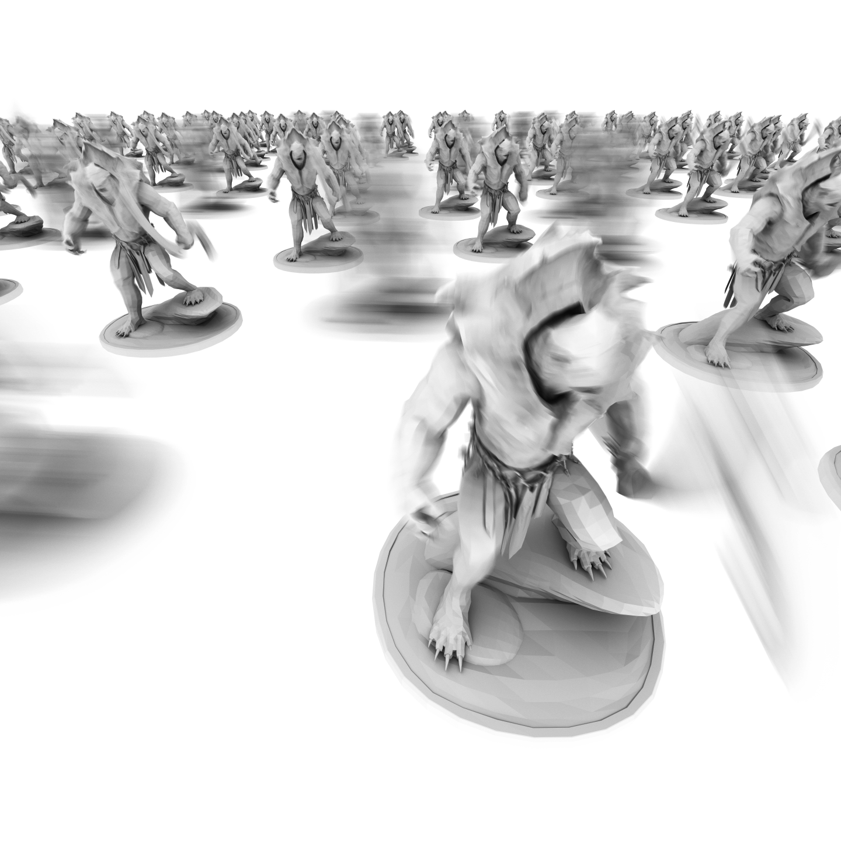
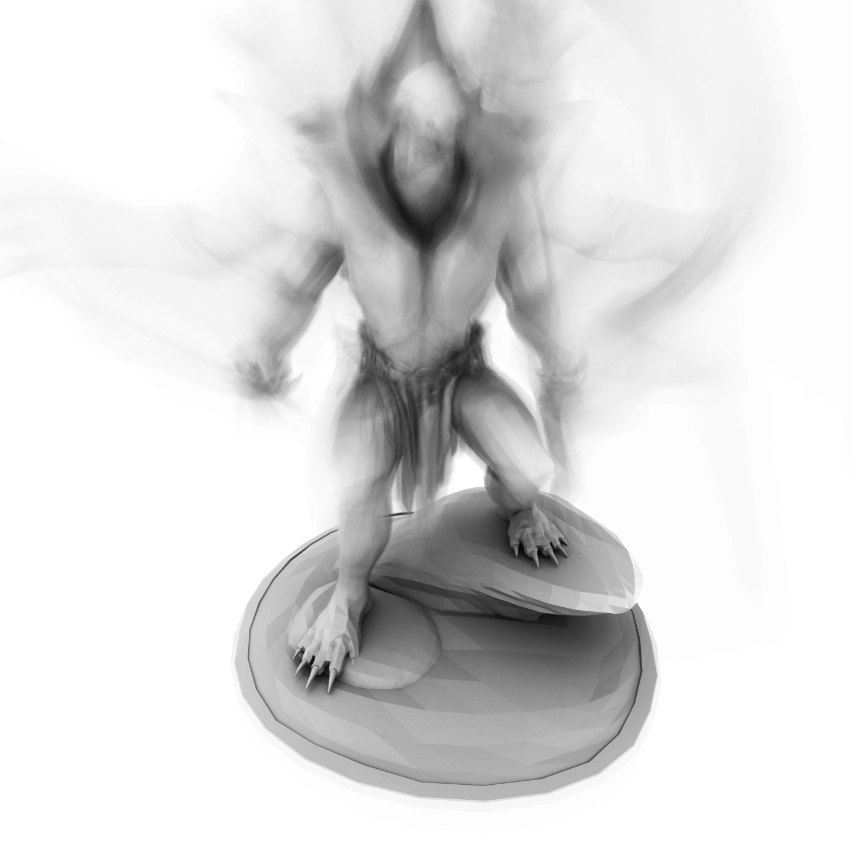
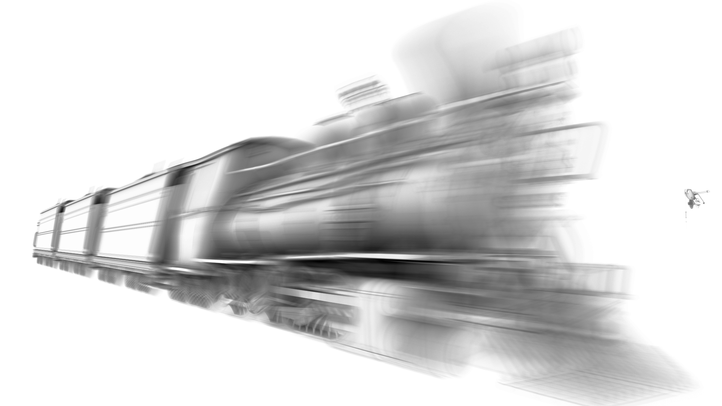
Results
Llama
3 time steps: 7M primitives
9 time steps: 1.7M primitives
Turtle Barbarian Crowd
2 time steps: 7.5M primitives
6 time steps: 2.8M primitives
15 time steps: 0.1M primitives
Barbershop
3 time steps: 1.4M primitives
5 time steps: 2.8M primitives
9 time steps: 3.9M primitives
Turtle Barbarian
15 time steps: 0.1M primitives
Train
3 time steps: 0.3M primitives
17 time steps: 2.0M primitives
Turtle Barbarian Rotate 0.5x
9 time steps: 0.1M primitives

Slide 16
Results
Comparing against LBVH of Embree 2.12.0
Separate Linear Motion BVHs for maximal number of linear time segments
We integrated our STBVH into Embree thus share algorithmic details of traversal and build
Only motion blur geometry for benchmarks
Intel® Xeon® E5-2699 v4 workstation (Broadwell 22 cores, 2.2 GHz)

Slide 17
Memory Consumption
Similar BVH size
Smaller BVH due to varying number of time segments
2.5x
9x

Slide 18
Build Performance
Slower due to linear bounds binning
Faster due to smaller BVH

Slide 19
Render Performance
Faster due to less memory traffic
Competitive but slightly slower

Slide 20
Questions?
“High Performance Rendering Appliance” demo at Intel booth #807 at SIGGRAPH

