Slide 1
MLAA FROM 2009 TO 2017 Research Impact Retrospective
Alexander Reshetov - Jorge Jimenez
High Performance Graphics 2017
Notes:
Hi,
I’m Jorge Jimenez and,
in this part of the talk,
I’ll cover MLAA industry impact
and the fascinating evolution of practical real-time antialiasing on the last 8 years,
which I think have been greatly influenced by MLAA.
I’ve included the works that most influenced my own antialiasing work,
with an emphasis on techniques that shipped in games.
But given the time constraints, there are awesome techniques that we could not include.

Slide 2
Gold Standards: MSAA – CSAA – EQAA
Notes:
So, let’s start.
One decade ago, the gold standard was MSAA.
This technique is based on shading each pixel only once,
but storing multiple depth testing results,
as opposed to true SSAA where you shade each subsample individually.
It was sometimes an expensive solution,
but to a large degree, not much research was done to search for alternatives.

Slide 3
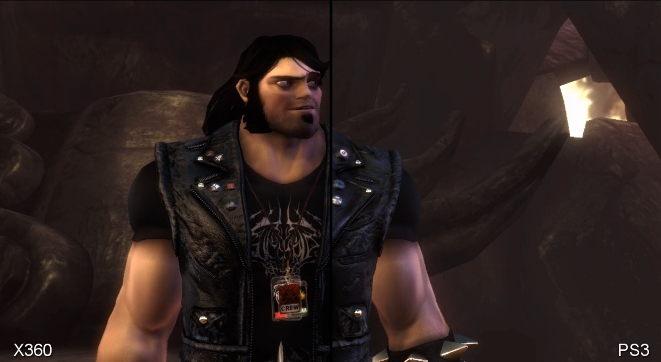
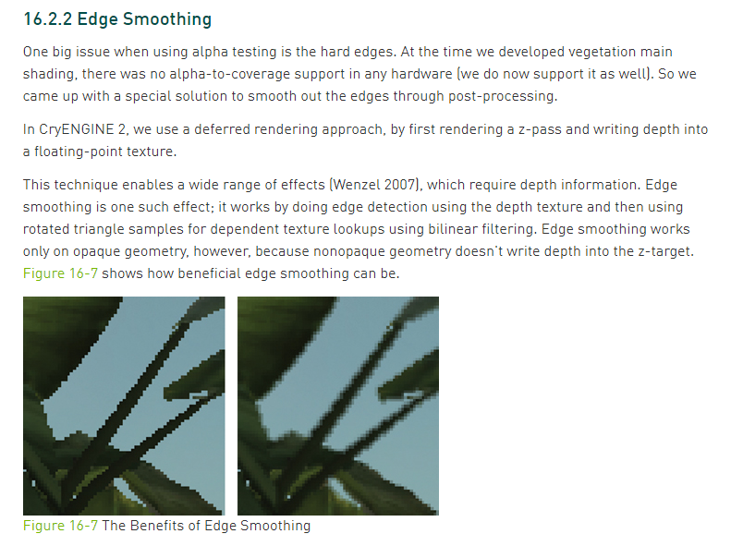
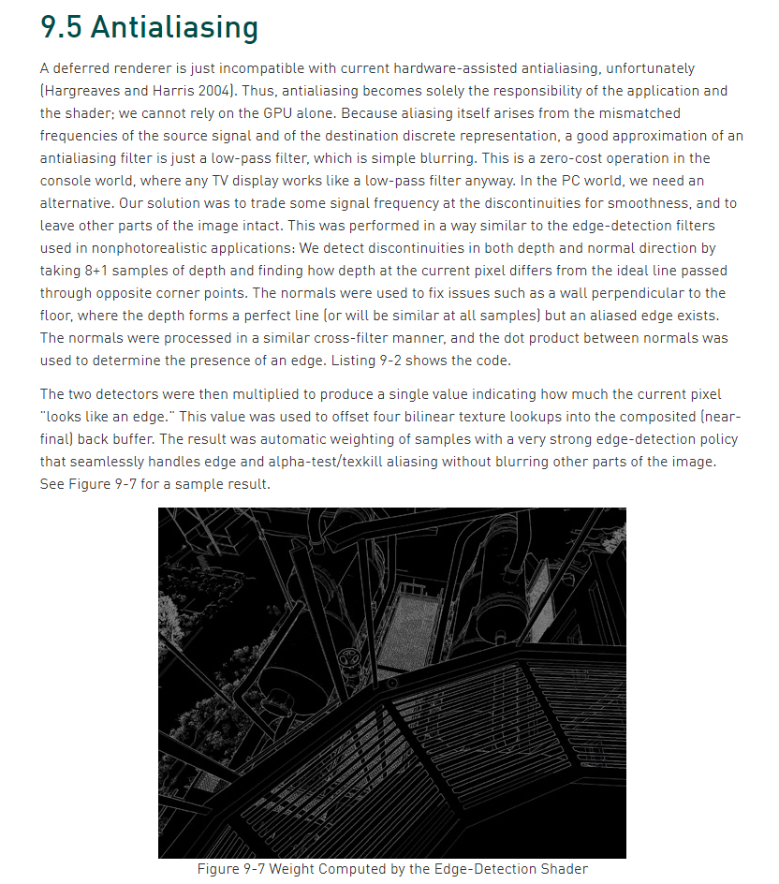
Edge Detection and Blur
Information from [Leadbetter2009a]
[Sousa2007]
[Shishkovtsov2004]
Notes:
The most used alternative to MSAA was edge detection and blur,
such as the one used in S.T.A.L.K.E.R., Crysis 1 and Brutal Legend.
This was simple and cheap, and the best option available for deferred engines at that moment.
But the results were significantly lower quality than MSAA.

Slide 4
Morphological Antialiasing (2009)
[Reshetov2009]
Notes:
But then, in 2009, Morphological antialiasing came into play, and changed the rules.
In my opinion, MLAA biggest achievement was to change the community mindset.
It proved that there might be different high quality approaches to this problem than to use MSAA.
It questioned the standard and generally approved solution to this problem.

Slide 5
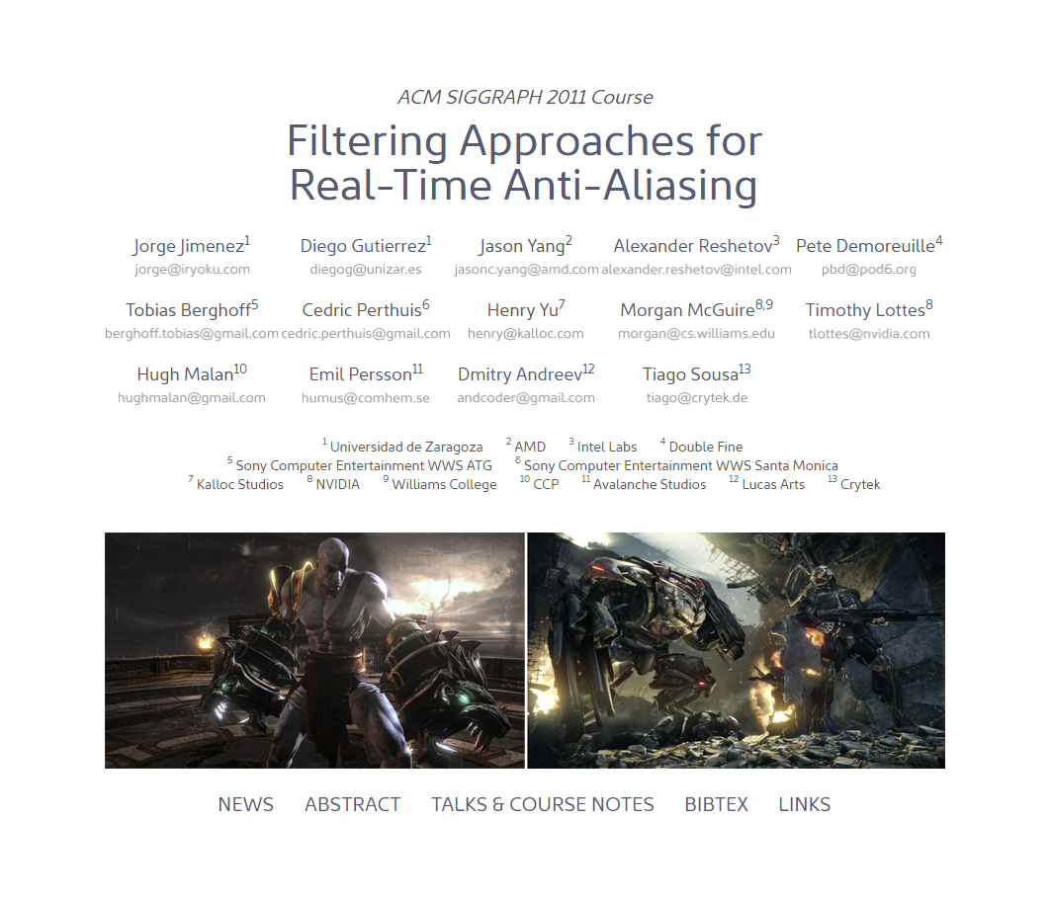
Explosion of Post-AA Techniques
[Jimenez2011a]
Notes:
And this triggered many other people to think about it as well.
On 2011, there were so many post preprocessing aa techniques,
that we actually gather all together into a course.
I’ll cover some of them in the next few slides.

Slide 6
Morphological versus Edge Detect and Blur
Morphological
Edge detect + Search + Blur
Non local information available (patterns)
Edge Detect and Blur
Edge detect + Blur
Only local information available (neighborhood)
Notes:
But before I continue, I’d like to make the distinction between morphological end edge detection and blur.
From my point of view, what makes morphological different is that it performs a search,
which gives the opportunity to do a more correct blend of pixels.

Slide 7
Saboteur (2009)
Information from [Leadbetter2009b]
Notes:
Saboteur shipped on PS3 with an antialiasing quality never seen on consoles,
and possibly the first game to ship
with high quality post processing antialiasing.
Digital Foundry, covered this on detail, and concluded that the technique was MLAA, or a similar flavor of it.
But unfortunately, the actual details are not publicly know, as the presentation was cancelled.

Slide 8
Sony’s Edge MLAA (2009)
[Perthuis2011]
Notes:
Sony also created their own MLAA implementation,
which focused on a fast
PS3 SPU implementation.

Slide 9
Sony’s Edge MLAA (2009)
[Perthuis2011]
Notes:
It put great attention to quality, and in particular detail preservation.
God of War 3, Killzone 3, Little Big Planet 2, among others, shipped with Sony MLAA.
It was even offered
to third parties developing for the PS3.

Slide 10
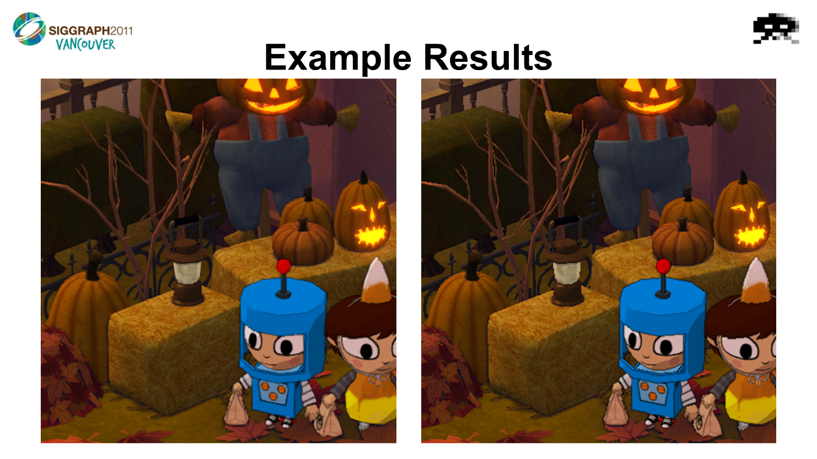
Double Fine’s Costume Quest (2010)
[Demoreuille2011]
Notes:
Double Fine’s Costume Quest shipped with MLAA on the Xbox 360,
perhaps for the first time on this console.

Slide 11
Double Fine’s Costume Quest (2010)
[Demoreuille2011]
Notes:
One of the most interesting features was that it was a hybrid CPU/GPU solution.

Slide 12
Star Wars: The Force Unleashed II - DLAA (2010)
[Andreev2011]
Notes:
Star Wars: The Force Unleashed II shipped with DLAA,
which was similar in spirit to MLAA,
but with a simplified pattern recognition.

Slide 13
Star Wars: The Force Unleashed II - DLAA (2010)
[Andreev2011]
Notes:
The key observation made by this technique
was that AA looks the same as a vertical or horizontal blur
if the right blur radius is used,
which simplifies the calculations.

Slide 14
FXAA Console (2010)
[Lottes2011]
Notes:
Then we have FXAA, perhaps the most widely used post AA technique,
due to the good quality and performance tradeoff,
and the simplicity of its integration.
This technique was used by many games shipping on the previous generation.
It came in two flavors.
The console one, which was a high quality edge detection and blur filter….

Slide 15
FXAA Quality (2010)
[Lottes2011]
Notes:
And FXAA Quality, which could be cataloged as an optimized version of morphological antialiasing,
It avoids performing edge detection for faster runtimes.
This technique focused on performance.

Slide 16
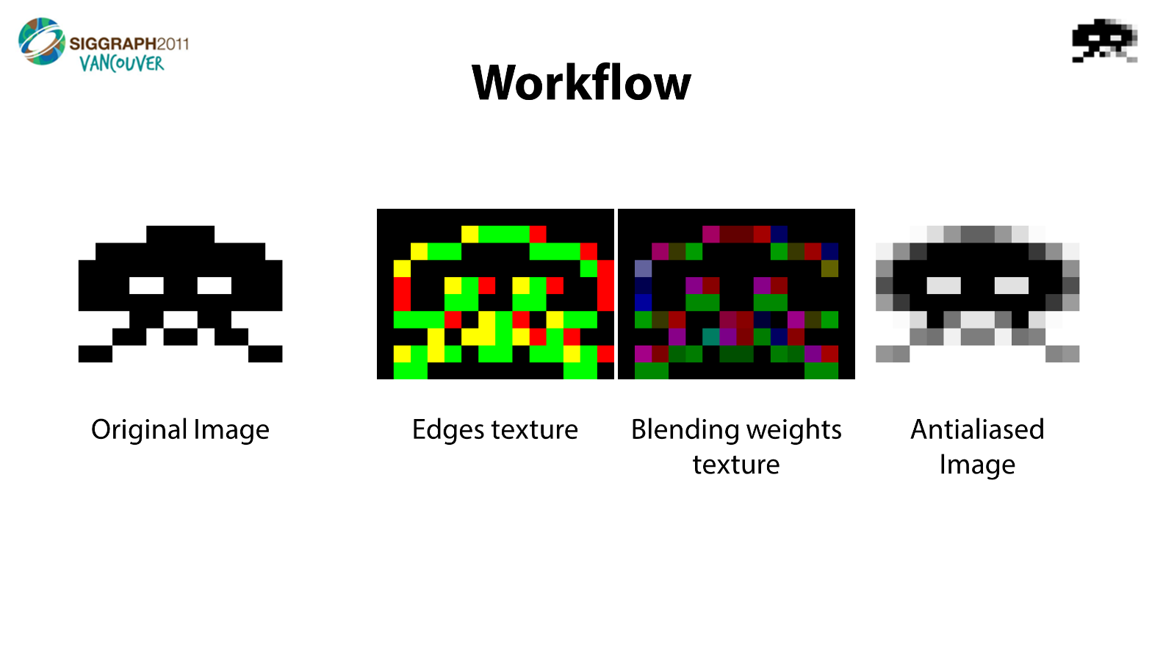
Jimenez’s MLAA (2010)
[Jimenez2011b]
Notes:
On the other end of the spectrum,
we had Jimenez’s MLAA, which was one of the first GPU implementations of MLAA.
Dividing the algorithm in three passes rather than two,
in addition to non-conventional usage of bilinear filtering,
allowed to greatly reduce MLAA computations.

Slide 17
Jimenez’s MLAA (2010)
[Jimenez2011b]
Notes:
The focus of this technique was on achieving the highest quality possible,
by improving the pattern recognition and preserving the sharpness.

Slide 18
SMAA (2011)
[Jimenez2011b]
Notes:
It evolved into SMAA in 2011, and combined multiple approaches to AA into a single technique:
Temporal AA
Morphological AA
And multisampling AA.
To complement the strengths of each one.

Slide 19
SMAA (2011)
[Jimenez2011b]
Notes:
It also included a more advanced morphological component,
that recognized an extended set of pixel patterns.

Slide 20
FXAA / SMAA Features
FXAA Console
FXAA Quality
SMAA T2x
Focus on ultimate performance
Very easy to integrate
Blurrier texture details
Decreased temporal stability
Worse subpixel features
Target medium quality/performance tradeoff
Better gradients than MSAA
Very easy to integrate
Blurrier texture details
Decreased temporal stability
Worse subpixel features
Focus on ultimate quality
Sharpness
Extended pattern recognition
Optional TAA/MSAA combos for subpixel features
Better gradients than MSAA
More complex integration
For Both FXAA/SMAA
Not dealing with MSAA
Compatible with deferred
Notes:
From all the discussed techniques, perhaps the two more popular ones were FXAA and SMAA.
So, what they offered over MSAA?
First of all, they allow developers to not deal with a MSAA path on the codebase, which was highly convenient.
Second, they were often faster.
Third, they allowed deferred engines to have proper antialiasing.
And finally, in terms of quality, they offered great antialiasing on edges of objects,
at the cost of decreased subpixel rendering support for the case of FXAA and SMAA 1x.
As we will see later on, SMAA T2x mitigated this problem by adding a temporal component.

Slide 21
DEAA & GBAA (2011)
[Malan2011]
[Persson2011]
Notes:
Morphological antialiasing lead to techniques that
explored analytically calculating pixel areas
using the distance to the edge,
but keeping a similar post-processing color blending operation.

Slide 22
Low Level Optimizations for GCN [Drobot2014]
[Drobot2014a]
Notes:
Drobot shown in 2014 how distance to edge can be efficiently calculated on the GCN platform,
with this technology eventually shipping on The Tomorrow Children on 2016.

Slide 23
Killzone AA Transition
[Valient2007]
Notes:
To put MLAA implications on previous gen visuals,
I’d like to briefly talk about Killzone.
Second installment of Killzone used partial SSAA.
The adoption of MLAA for the third installment on the franchise,
allowed to shift resources from AA to other rendering features.
Many games chosen to have better lighting,
or just to have different features that could not be included
if they had to pay MSAA cost.

Slide 24
Uncharted 4 (2016)
Notes:
MLAA based techniques excelled on many previous gen titles
because of the simpler geo
and shorter drawing distances.
Losing subpixel features there was not a huge problem.
But many of the games on the current generation of consoles have a more complex nature,
and losing subpixel features became a bigger problem.
This lead to a desire for different or complimentary solutions.
As you might have guessed, I’m talking about…

Slide 25
Temporal AA
Notes:
…Temporal AA.
In my opinion, the invention of MLAA was key for the wide adoption of temporal AA that we observe today.
One of the reasons for temporal AA to exist is possibly the fact that deferred rendering is not compatible with MSAA.
But, from my point of view, other significant reason was that MLAA
made us to question the currently used techniques,
and put post processing antialiasing into the spotlight.

Slide 26
Accelerating Real-Time Shading with Reverse Reprojection Caching [Nehab2007]
[Nehab2007]
Notes:
The first real-time efforts were focused on temporal supersampling of the shading inside of triangles.
Nehab et all introduced in 2007 some of the key concepts of modern temporal antialiasing
including the 2D framebuffer reprojection and the exponential accumulation buffer.

Slide 27
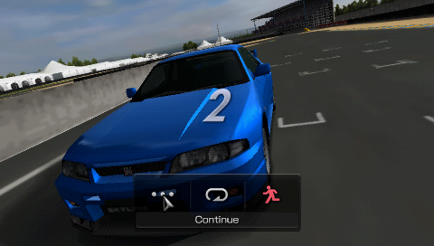
Gran Turismo PSP (2009)
Information from [Greer2009]
Slow Motion
Full Speed, as observed on a PSP
Notes:
Not much time afterwards, Gran Turismo on the PSP shipped with temporal AA without frame blending.
This means to just flicker the subpixel position as you see in the left.
However, if we observe this on a PSP, and due to the slow response of its screen,
we cannot see the flickering anymore.
The screen is effectively blending the frames for us.
This can only be done for 60 fps and for this particular hardware
and maybe only for fast paced games.
But I think it worked very well on this game.

Slide 28
Halo Reach (2010)
Information from [Leadbetter2010]
Notes:
First game to my knowledge to ship with blended temporal antialiasing was Halo Reach.
For AA we can’t use depth rejection as in [Nehab2007],
where previous frame depth is compared with current frame one
for checking for disocclusions.
For the case of jittering the subpixel positions per frame,
each subsample will have a different depth,
which means that we would always reject the previous frame information.
For solving this, a simple approach was used in Halo Reach:
if the pixel is static it blends,
if in motion the frame blending would be turned off.

Slide 29
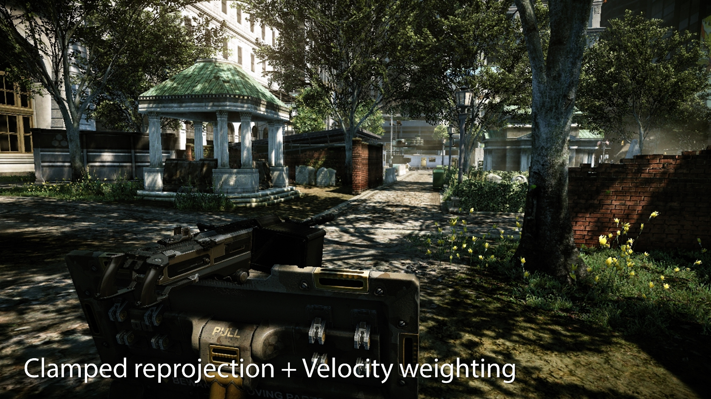
Crysis 2 [2011]
[Sousa2011]
Notes:
Crysis 2 extended [Nehab2007] by introducing velocity weighting,
which consists on comparing the velocities of the own pixel and the reprojected one,
which allowed, for the first time,
to antialias edges in motion while preserving a ghosting free image.

Slide 30
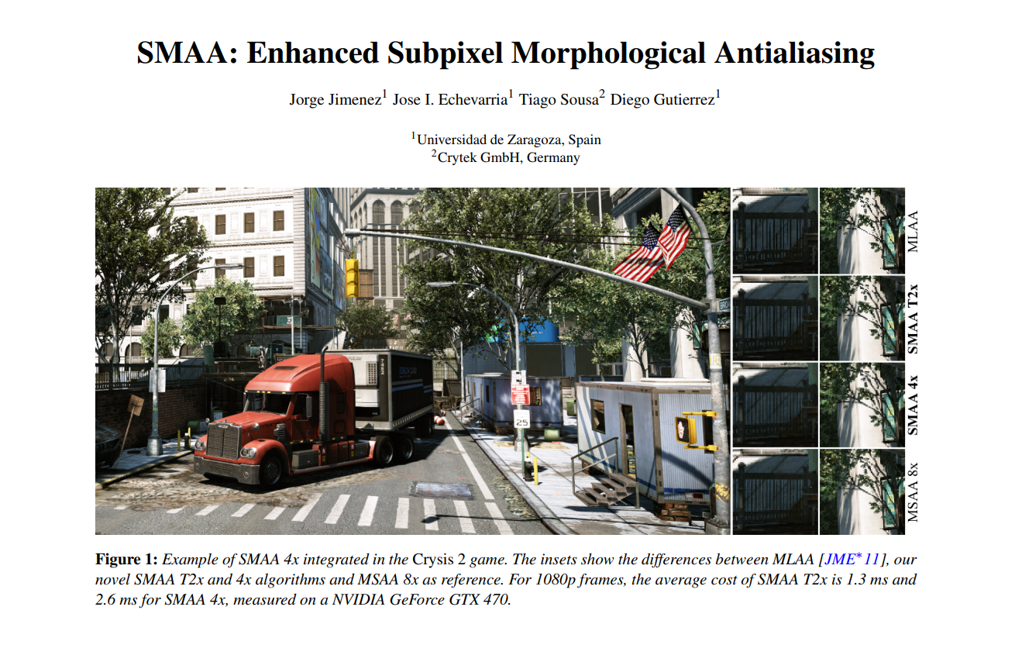
SMAA (2011)
[Jimenez2012]
Notes:
Crysis 2 temporal AA joined with Jimenez’s MLAA into one hybrid technique,
called SMAA, which was mentioned earlier…

Slide 31
Crysis 3 - SMAA (2013)
Notes:
…and shipped on Crysis 3 on PC…

Slide 32
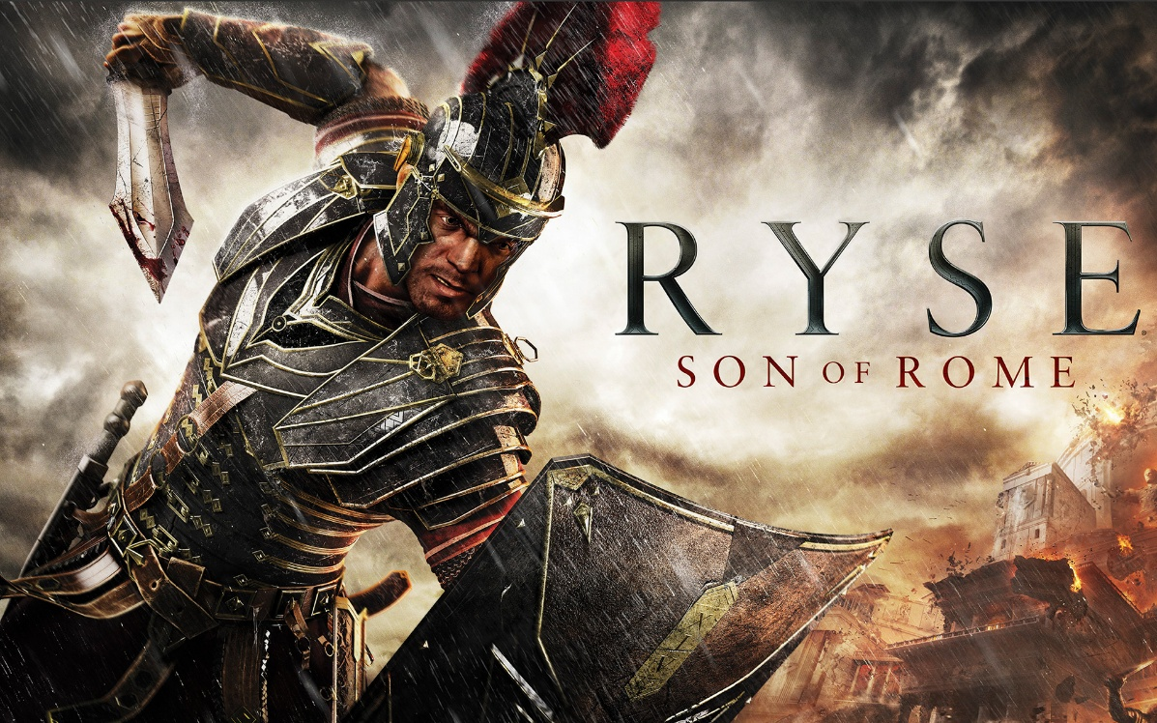
Assassins Creed 4 and Ryse - SMAA (2013)
Notes:
…and also in Assassins Creed 4 and Ryse, for the first time on consoles.

Slide 33
The Last Guardian (2016)
Notes:
Now there are multiple titles shipping with this technique,
with the Last Guardian recently shipping with SMAA as well.
[Based on information appearing on the credits of the game]

Slide 34
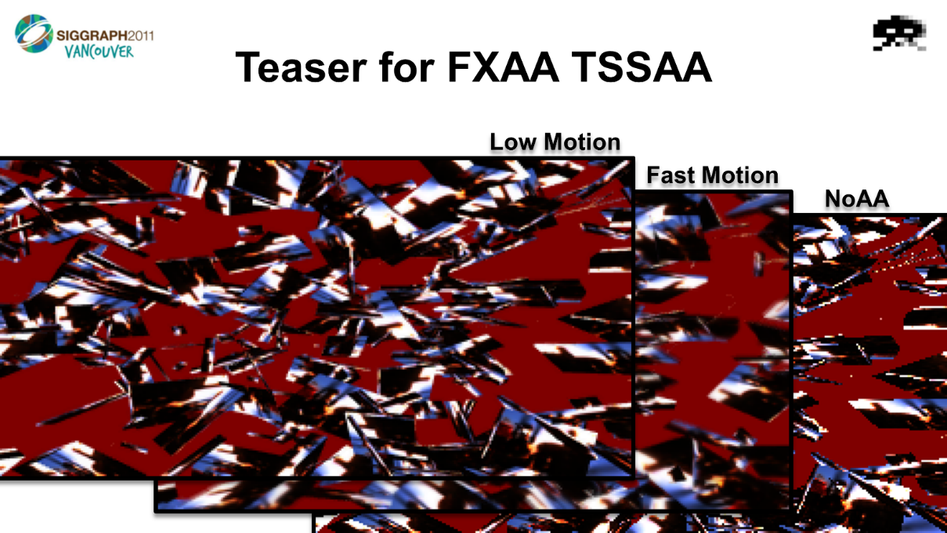
Lottes’ TSSAA & TXAA (2011)
[Lottes2011]
[Cao2016]
Notes:
Concurrently, Timothy Lottes engineered a temporal AA technique that made use of an accumulation buffer as in [Nehab2007],
rather than relying on just using the previous frame.
To make that possible he introduced the neighborhood clamp,
a key contribution that made the accumulation buffer supersampling
to reliably work for antialiasing.
This technique eventually evolved into NVIDIA’s TXAA.

Slide 35
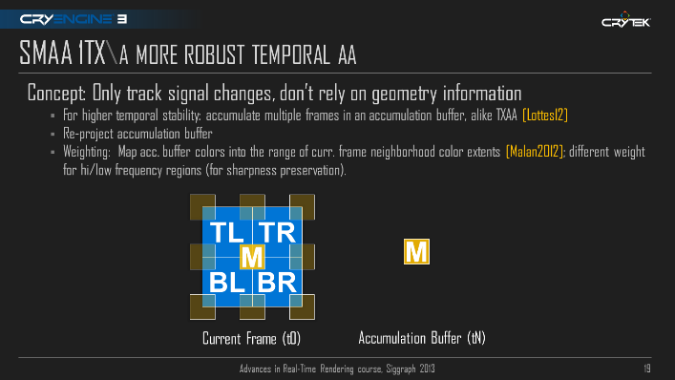
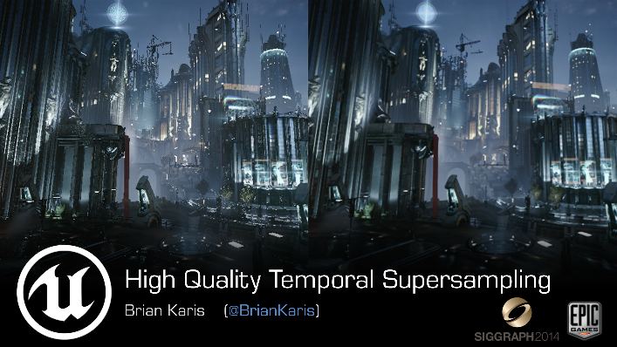
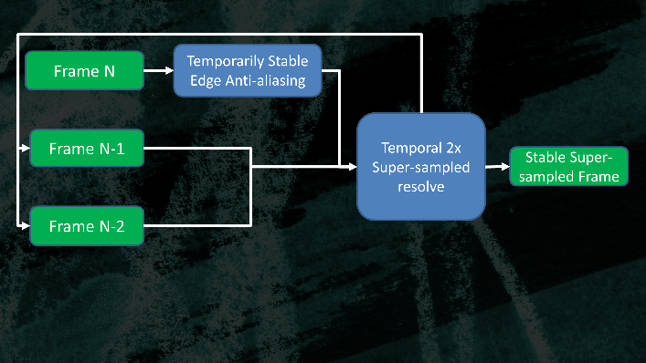
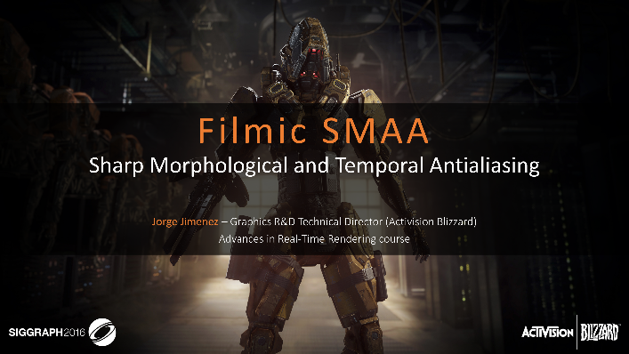
Evolution
[Sousa2013]
[Karis2014]
[Drobot2014b]
[Salvi2016]
[Jimenez2016]
Notes:
Some of the follow up techniques extended these earlier temporal antialiasing efforts,
becoming higher quality, faster and more robust,
Including SMAA 1TX, Unreal 4 Temporal Supersampling, HRAA, Salvi’s variance clipping and Filmic SMAA.
As of today, many games are shipping with temporal AA tech, which is becoming the new standard.
In the case of Call of Duty, we are still making use of morphological antialiasing for increased edge quality in an hybrid solution.

Slide 36
Temporal Upsampling and 4k Reconstruction
Notes:
From temporal AA, a new research direction has recently spawned.
Temporal upsampling,
where previous frame information is used to create a bigger image,
rather than antialiasing
And 4k reconstruction, where only part of the screen is rendered, and the rest is inferred using heuristics.

Slide 37
SRAA (2011)
[McGuire2011]
Notes:
A technique possibly influenced by MLAA,
called SRAA,
shown a search-free approach capable of reconstructing subpixel features.

Slide 38
Infamous Second Son (2014, patched for 4k)
Notes:
Similar ideas, like the differential blend and the object and primitive id buffer reconstruction,
have been deployed recently on the 4k temporal upsamplers of some games shipping on the PS4 Pro,
which in my opinion, shows the extent of MLAA influence on the industry.

Slide 39
Dust Experimental Temporal Upsampling (2012)
[Malan2012]
Notes:
Hugh Malan introduced, possibly for the first time, temporal upsampling.
While it is not known if it shipped or not in the final build,
the visual quality shown was very impressive.

Slide 40
Killzone Shadow Fall (2014)
[Valient2014]
Notes:
The first game known to actually ship with temporal upsampling was Killzone Shadow Fall.
For multiplayer, it ran at 9 60 by 10 80 and performed a temporal horizontal upsample.

Slide 41
Battlefield 1 (2016) and Mass Effect Andromeda (2017)
[Wihlidal2016]
Notes:
The recent introduction of 4k console imaging made temporal upsampling even a more desirable feature.
Some games on the PS4 Pro, including Battlefield 1 and Mass Effect Andromeda,
leverage temporal information to output a higher resolution image,
in this case reconstructing a 4k image from two checkboarded 2k ones.

Slide 42
Dynamic Antialiasing
[Jimenez2017] Dynamic Antialiasing in Call of Duty: Infinite Warfare
Combines dynamic resolution with temporal upsampling
Always outputs 1080p frames, with varying degrees of AA depending on load
Advances in Real-Time Rendering in Games: Part I
Monday 11:40 am
Notes:
The next week, we will be presenting the technology that we created for Infinite Warfare,
which combines dynamic resolution with temporal upsampling to create what we called dynamic antialiasing,
where it isn’t the resolution what changes under load,
but rather the antialiasing quality.

Slide 43
Summary
MLAA questioned the status quo.
MLAA went against the trend.
MLAA possibly slowed down MSAA and hardware antialiasing advances.
Unreal Engine added support for MSAA.
Interesting tradeoffs to be found on hybrid solutions.
Notes:
So, in summary,
MLAA opened the eyes of many researchers and game developers, questioning the status quo.
Many times a piece of technology becomes a trend and everybody in the industry blindly follows.
It is understandable as we, game developers,
need to ship games under very tight schedules,
and following a trend reduces risks.

Slide 44
Summary
MLAA questioned the status quo.
MLAA went against the trend.
MLAA possibly slowed down MSAA and hardware antialiasing advances.
Unreal Engine added support for MSAA.
Interesting tradeoffs to be found on hybrid solutions.
Notes:
But MLAA is one of these cases of successfully going against the trend.
On the other hand, and due to widespread post processing antialiasing adoption,
MSAA and hardware antialiasing was possibly slowed down.
Unreal Engine recently offered support for MSAA in addition to temporal AA,
This shows that maybe a perfect solution doesn’t exist,
and that we sometimes search in circles looking for different tradeoffs.
And from my point of view, I think there are interesting tradeoffs to be found on hybrid solutions,
were you don’t rely on a single system but rather leverage the strengths of multiple approaches.

Slide 45
Q&A - Acknowledgements
Special thanks to Peter-Pike Sloan
Notes:
Ok, so we went from MLAA nine years ago
to an upcoming presentation next week on SIGGRAPH.
So, this concludes my part,
and thank you for the attention.

Slide 46
References
[Andreev2011] Directionally Localized Anti-Aliasing (DLAA)
[Cao2016] Advanced Ambient Occlusion, Shadow and Anti-Aliasing in NVIDIA GameWorks
[Demoreuille2011] Hybrid CPU/GPU MLAA on the Xbox-360
[Drobot2014a] Low Level Optimizations for GCN
[Drobot2014b] Hybrid Reconstruction Antialiasing
[Greer2009] https://www.gtplanet.net/why-gran-turismo-psp-looks-so-good
[Karis2014] High Quality Temporal Antialiasing
[Leadbetter2009a] http://www.eurogamer.net/articles/xbox-360-vs-ps3-face-off-round-22-face-off?page=4
[Leadbetter2009b] http://www.eurogamer.net/articles/digitalfoundry-saboteur-aa-blog-entry
[Leadbetter2010] http://www.eurogamer.net/articles/digitalfoundry-halo-reach-tech-interview?page=2
[Lottes2011] FXAA 3.11 in 15 Slides
[Malan2011] Distance-to-edge Anti-Aliasing (DEAA)

Slide 47
References
[Malan2012] Real-Time Global Illumination and Reflections in Dust 514
[McGuire2011] Subpixel Reconstruction Antialiasing (SRAA)
[Nehab2007] Accelerating Real-Time Shading with Reverse Reprojection Caching
[Jimenez2011a] Filtering Approaches for Real-Time Anti-Aliasing
[Jimenez2011b] Jimenez's MLAA & SMAA (Subpixel Morphological Anti-Aliasing)
[Jimenez2012] SMAA: Enhanced Subpixel Morphological Antialiasing
[Jimenez2016] Filmic SMAA: Sharp Morphological Antialiasing
[Persson2011] Geometry Buffer Anti-Aliasing (GBAA)
[Perthuis2011] MLAA on the PS3
[Reshetov2009] Morphological Antialiasing
[Salvi2016] An Excursion in Temporal Supersampling
[Shishkovtsov2004] Deferred Shading in S.T.A.L.K.E.R.

Slide 48
References
[Sousa2007] Vegetation Procedural Animation and Shading in Crysis
[Sousa2011] Anti-Aliasing Methods in CryENGINE 3
[Sousa2013] CryEngine 3 Graphics Gems
[Valient2007] Deferred Rendering in Killzone 2
[Valient2014] Real-Time Global Illumination and Reflections in Dust 514
[Wihlidal2016] 4k Checkerboard in Battlefield 1 and Mass Effect Andromeda

