Slide 1
Synthetic data for urban object detection & beyond
German Ros, Intel Labs

Slide 2
1. Object Detection for Autonomous Driving
Well-understood problem
Within the CNN regime: Better data → Better results
How do we get “better” data cheaply? → Rendering
How do we define “better”? → Corner cases / special cases?

Slide 3
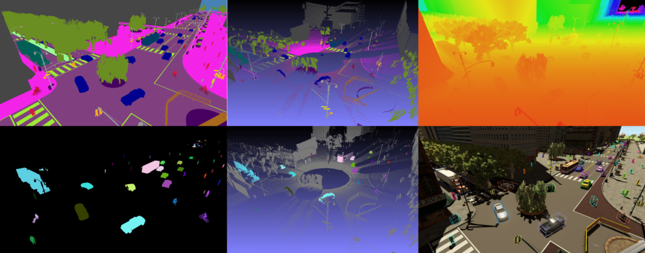
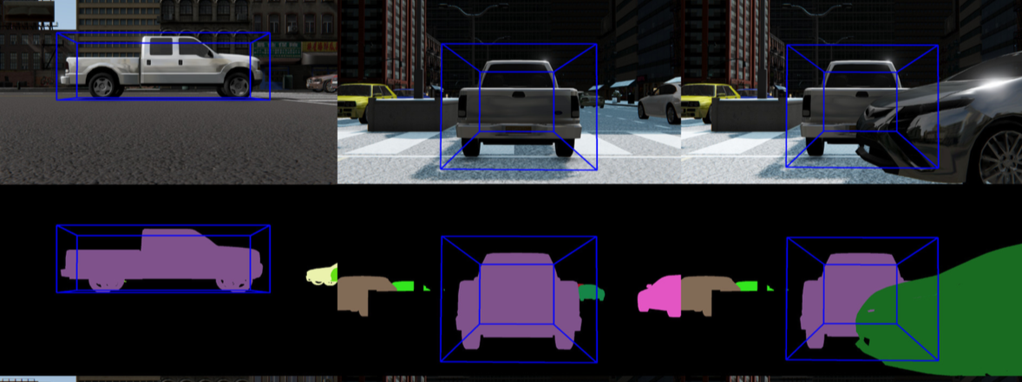
2. Synthetic data for AD perception tasks
* The SYNTHIA dataset: A large collection of synthetic images for semantic segmentation of urban scenes –
Ros, Sellart, Materzynska, Vazquez, Lopez -- 2016
** The SYNTHIA dataset reloaded – Villalonga, Gomez, Ros, Vazquez, Lopez -- 2018

Slide 4
3. Synthetic data & domain adaptation
* From Virtual to Real World Visual Perception using Domain Adaptation – The DPM as Example – Lopez, Xu, Gomez, Vazquez, Ros -- 2017

Slide 5
3. Synthetic data & domain adaptation (II)
Training dataset comparison
SYNTHIA Reloaded
GTAV
Test set KITTI Object detection
Method:
F-RCNN VGG16 + synthetic data + % real data
Higher is better
* The SYNTHIA dataset reloaded – Villalonga, Gomez, Ros, Vazquez, Lopez -- 2018

Slide 6
4. Food for thoughts
Do we need higher graphic quality, or...
… algorithms & Data working together?
Should we make algorithms aware of our data?
Include domain adaptation in our frameworks
Include domain randomization in our frameworks
Others?

Slide 7
5. Beyond perception: Policy learning
Learning policies in simulation CARLA
Transfer policies to real agents
* Driving Policy Transfer via Modularity and Abstraction – Muller, Ghanem, Dosovitskiy, Koltun -- 2018

