Slide 1
Fast Generation of Poisson-Disk Samples on Mesh Surfaces by Progressive Sample Projection
Tong WANG, Reiji SUDA
University of Tokyo

Slide 2
A practical way to generate Poisson-disk samples on mesh surfaces effectively.
  Simple inspiration
  A new parallelization pattern

Slide 3
Poisson-disk Samples
Randomly place samples, checks that any two are not too close.
  Distance be larger than specified radius
Computation time, often very high.
radius
Sample j
distance
Sample i

Slide 4
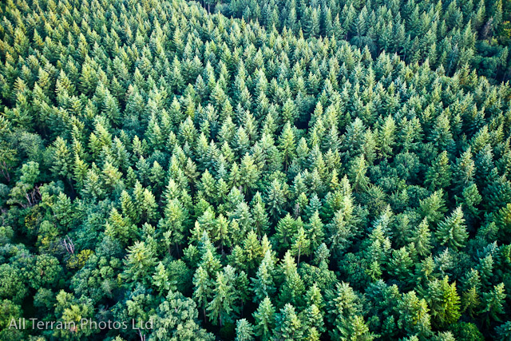
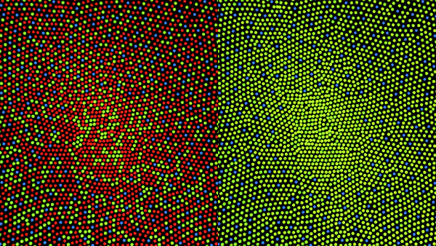
Sampling of nature
Image from Wikipedia
Notes:
World is built upon the concept to keep a distance and maintain your free space

Slide 5
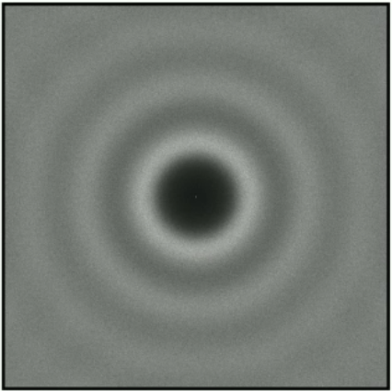
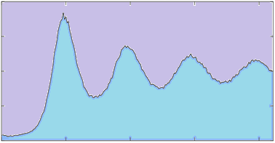
Blue noise feature
One reason that Poisson-disk sampling is good for many applications is because of its blue noise spectral properties.
Frequency
Power
Samples
Power Spectrum
Radial Mean

Slide 6
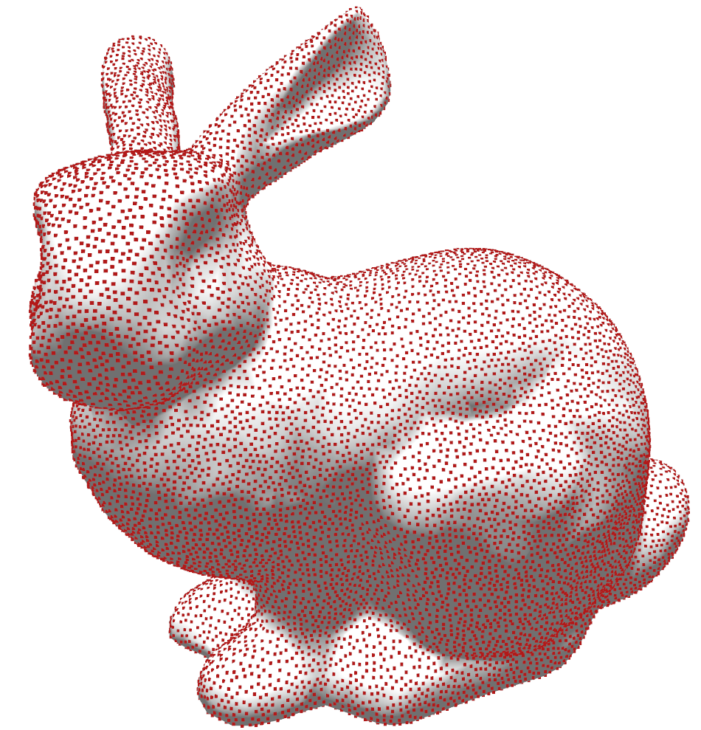
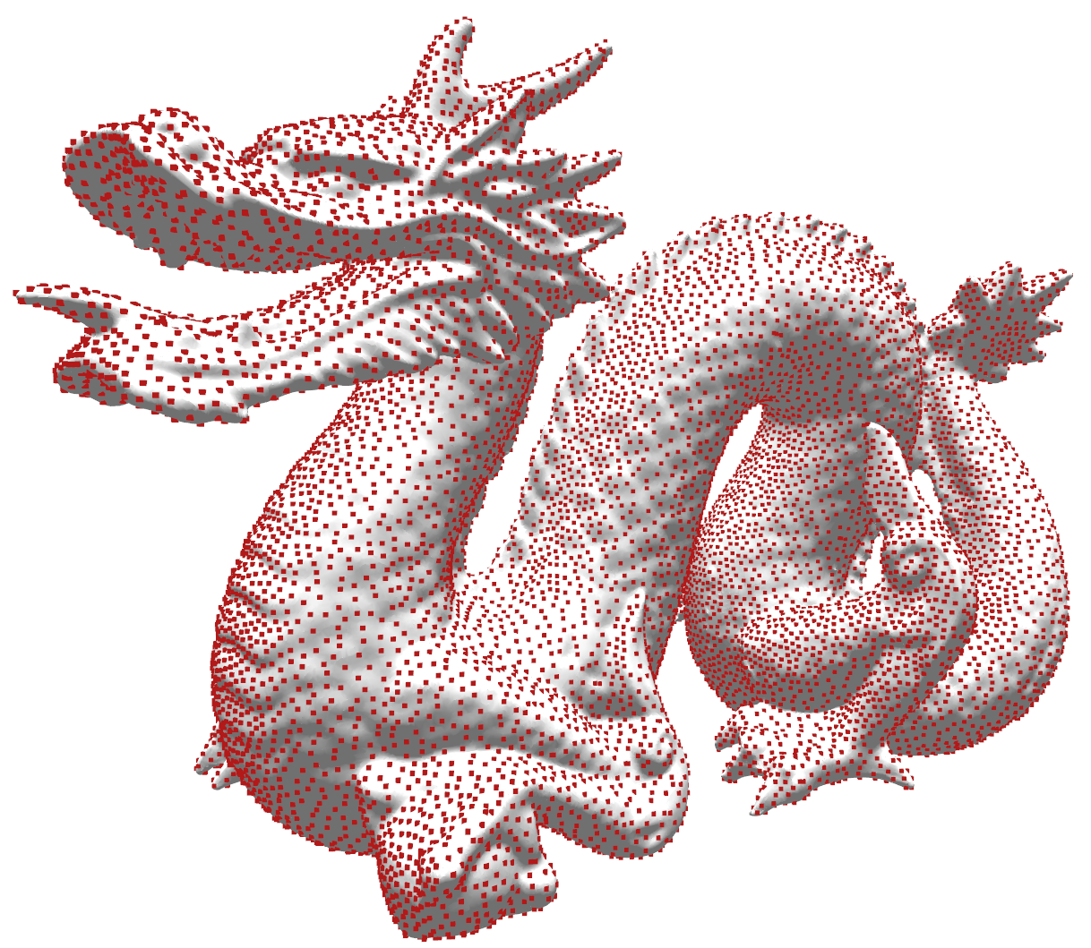
Sampling mesh surfaces
Throwing darts in a clever way
  Often unbiased, well defined.
  Not so easy to parallelize.
  Not very fast.
Relaxation
  Can generate more favorable pattern.
  Need some iterations, often slow.
Mass Elimination
  Small bias.
  Not maximal.
  Fastest so far.
Notes:
Geometric techniques to ensure always sampling in gaps.

Slide 7
Elimination
Process each sample in serial ([Yuksel 2015])
1000 samples
300 samples

Slide 8
Mass Elimination
Eliminate from a massive amount of samples
  Sometimes called Sample pool or pre-sampling samples.
Eliminate samples in parallel.
  [Bowers et al . 2010 ]
  [Ying et al . 2013]
Notes:
They take some serious look at how to parallelize this process.

Slide 9
Problem in Mass Elimination
Which to keep, which to eliminate.
  Without causing chain reaction.
  Without racing.
Thread 2
Thread 1
Thread 3
Thread 4

Slide 10
Parallelize elimination process
Use phase groups.（[Bowers et al . 2010 ]
  Divide space to phase groups.
  Threads processing in the same phase group is isolated and have no interaction with other threads.
  Lower parallelism, some unfavorable bias.
Phase group 2
Phase group 1
Threads Assignment
1
1
2
2
3
3
4
4
5
5
6
6
7
7
8
8
9

Slide 11
Parallelize elimination process
Use priority ([Ying et al . 2013])
Priority: 2
Priority: 2
Priority: 1
P1
Priority: 1
P1
Priority: 1
Priority: 3
P4
P4
P2
P2
Priority: 2
Priority: 4
P3
P3

Slide 12
Sampling mesh surfaces
Throwing darts in a clever way
  Often unbiased, well defined.
  Not so easy to parallelize.
  Not very fast.
Relaxation
  Can generate more favorable pattern.
  Iterations, often slow.
Mass Elimination
  Small bias.
  Fast.
  Low parallelism or irregular parallelization
Sample Projection
Notes:
Geometric techniques to ensure always sampling in gaps.

Slide 13
Another parallel pattern
Draw inspiration form phase group:
  Samples added should have no intra-batch conflicts
Draw inspiration from priority-based method:
  Samples can have different priority.
Also form food baking:
  Rotating food to get better coverage of heat.

Slide 14
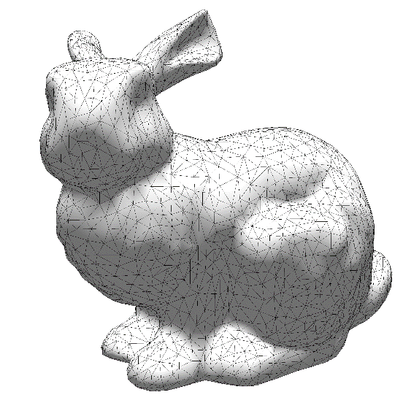
Sample Plane
(projector)

Slide 15
Sample Projection
Prepare some 2D Poisson-disk sample patterns (projectors)
Project samples on the projectors towards mesh surfaces (using ray tracing).
Eliminate conflicts.
Rotate projectors.
Repeat.

Slide 16
What is needed
A pre-generated 2D Poisson-disk sample pattern of a specified radius to start with.
  Quality of the 2D pattern will not affect too much on samples of projection space.
A fast ray tracer to do the projection.
  Embree or
  OptiX on NVIDIA GPUs.
Notes:
It is a well-studied field. Many many algorithms can do the job for you.
Choose a fast method to generate.

Slide 17
Overview of the algorithm
1. Build Orthogonal Ray Batch Group (ORBG).
2. Project samples onto mesh by tracing rays.
3. Eliminate conflicts.
4. If meets demand, break and output.
5. Else, rotate the ORBG, go to 2.

Slide 18
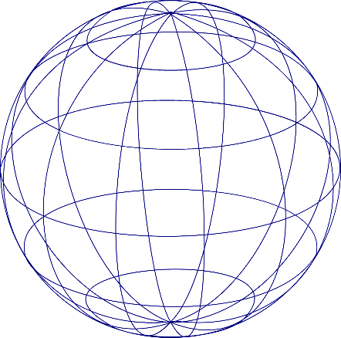
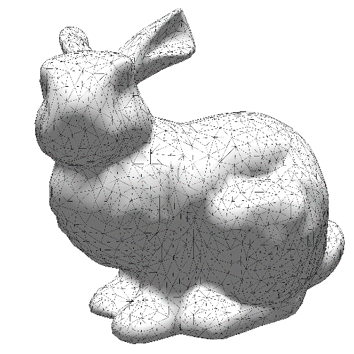


Orthogonal Ray Batch Group (ORBG)
2D Sample plane is called a projector or view plane.
Each plane will generate ray batch for projection.
Three orthogonal planes form a group called ORBG.
View Plane
v
u
View Plane
Coordinate
v
（x_{i},y_{i})
O_{t}
u
View Origin
$$\vec{L}$$
R_{i}
Mesh Center
R_{i}= O_{t} + (x_{i} $\vec{u}$+y_{i} $\vec{v}$) + tNorm($\text{−}\vec{L}$)

Slide 19




Project samples onto mesh surfaces
Record every intersections through each ray.
Deal with restart conflicts.

Slide 20
Conflict elimination

Slide 21
Rotate ORBG
Rotate projectors that generate the ORBG.
Rotation destinations should be low-discrepancy.
Rotation destinations
Projector
Projector
Projector
Projector
Projector
Projector
Notes:
To make this whole progress progressive

Slide 22
Conflict elimination
Samples generated from the same projector have no conflicts.
  Except restart conflicts.
Resolve conflicts from different projectors using priority.
  Very short priority chain.

Slide 23
What’s good about this pattern
No sample-pool needed (Sample-pool free)
  Generating Poisson-disk sample from scratch.
No intra-batch conflicts (intra-batch conflict free)
  No nested priority problem during elimination phase.
  Regular and GPU friendly.

Slide 24
Results and analysis
Performance (CPU: i7-7700K, GPU: NV GTX1080)

Slide 25
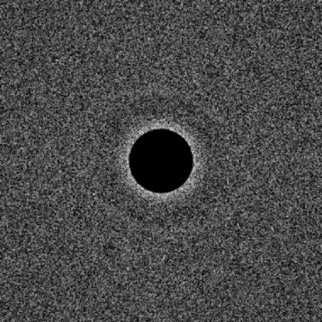
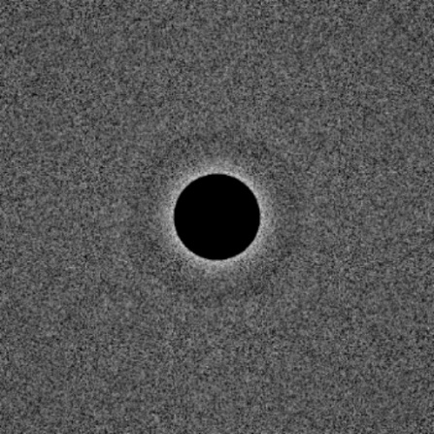
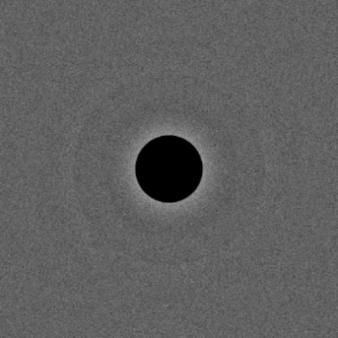
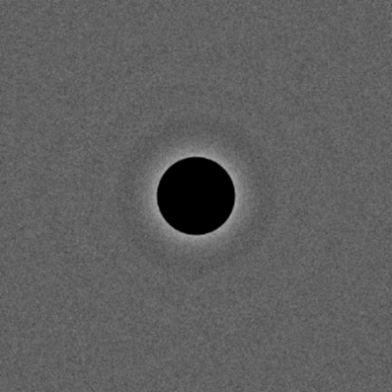
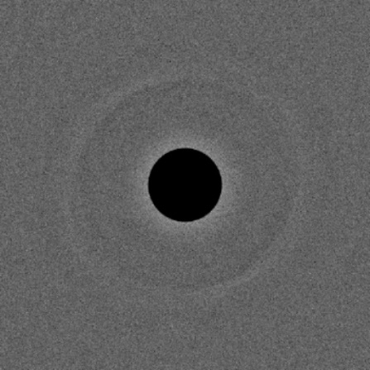
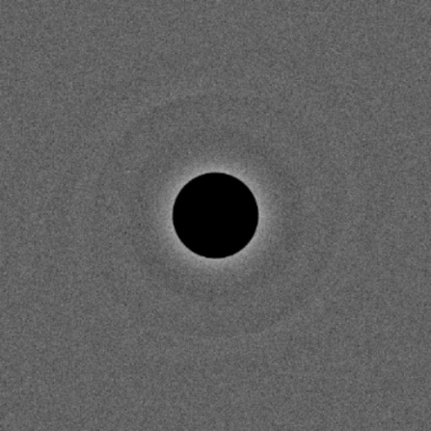
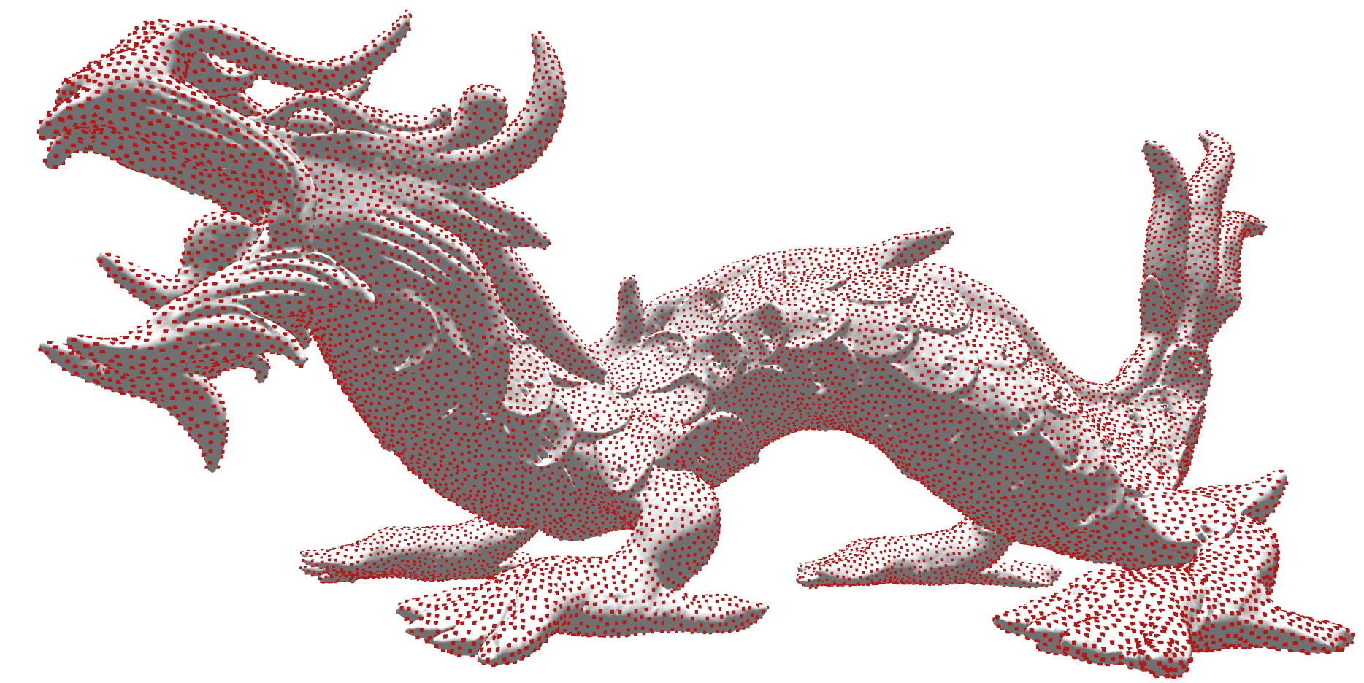
Ours
Reference
Iterations:50
ρ/ρ _{max}=92.5%
Iterations:50
ρ/ρ _{max}=91.0%
Iterations:50
ρ/ρ _{max}=93.5%

Slide 27
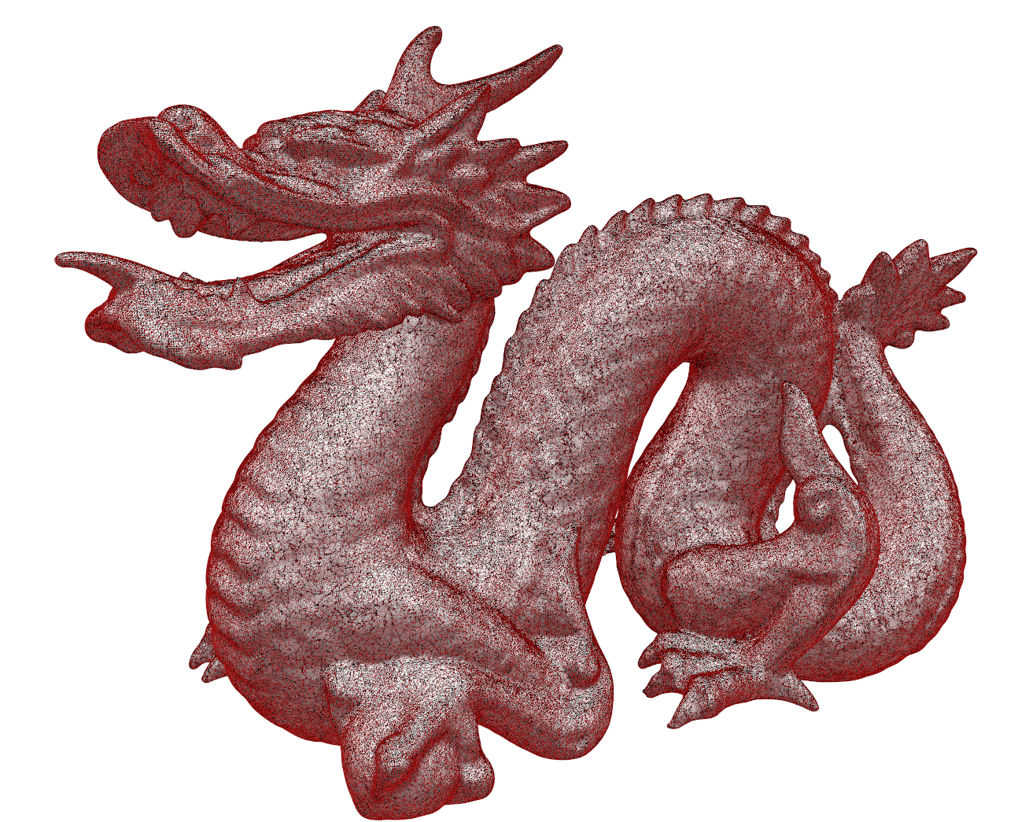
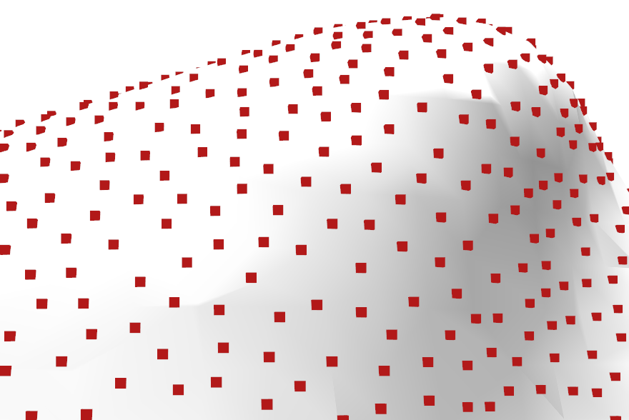
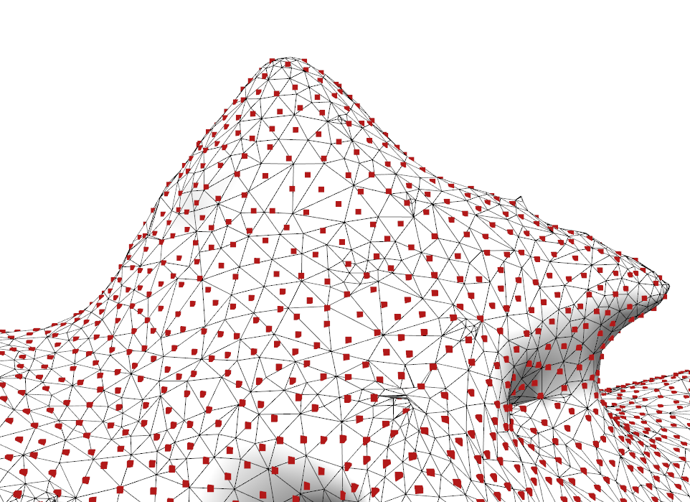
Dragon
Tris: 871K
Samples: 1M
Iteration: 30

Slide 28
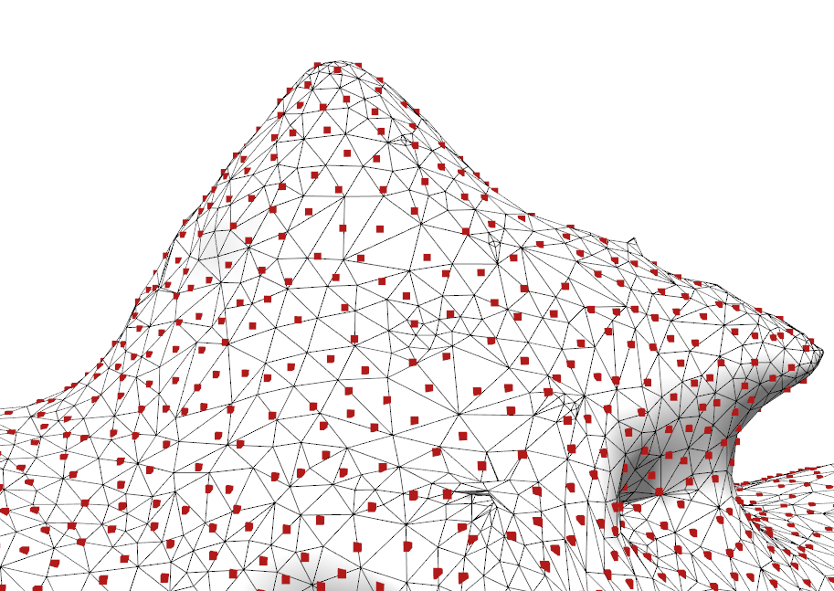
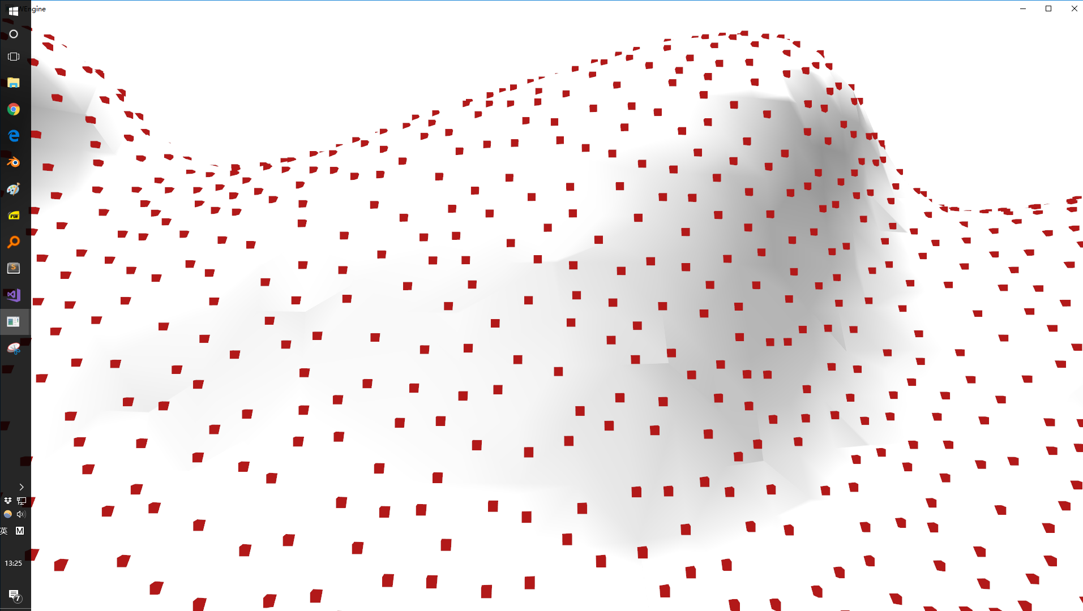
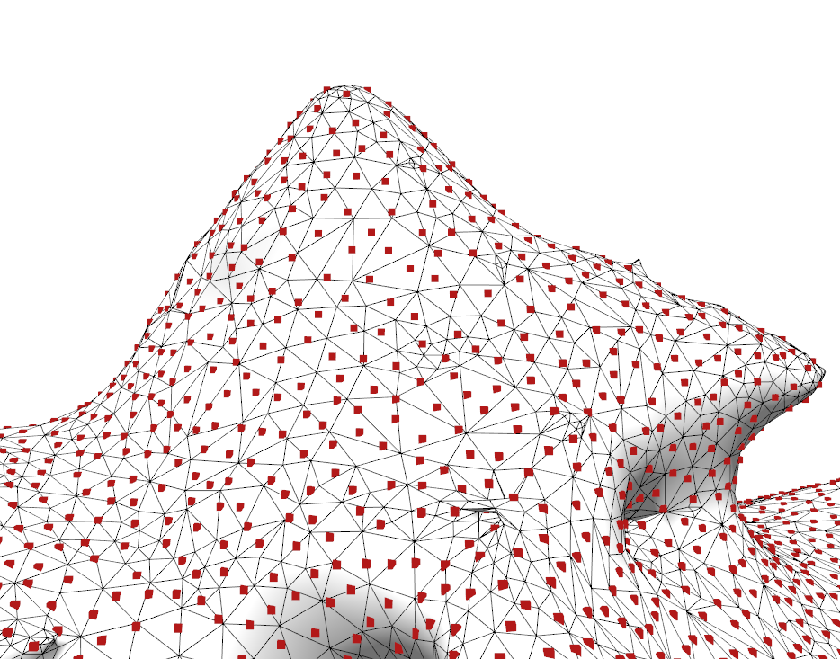
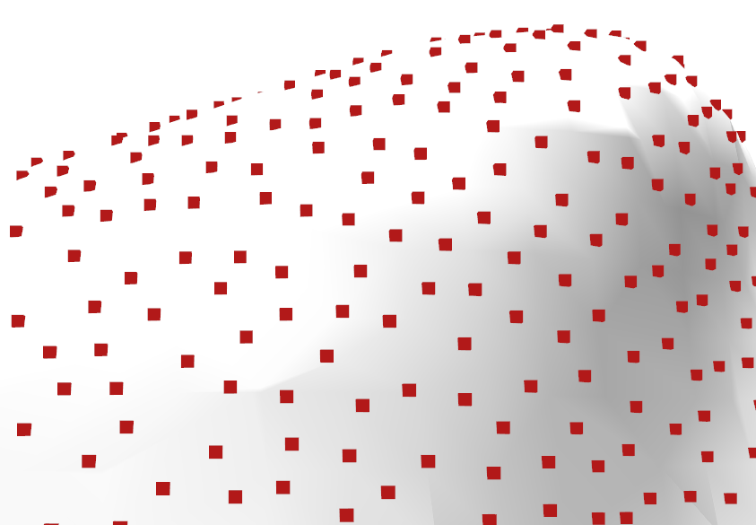
Iteration:1
SR:8.7M/s
Samples: 624618
ρ/ρ _{max}=79.1%
Iteration:1
SR:8.7M/s
Samples: 624618
ρ/ρ _{max}=79.1%
Iteration:3
SR:3.3M/s
Samples: 847880
ρ/ρ _{max}=85.9%
Iteration:3
SR:3.3M/s
Samples: 847880
ρ/ρ _{max}=85.9%
Iteration:1
SR:8.7M/s
Samples: 624618
Ralative ρ=79.1%
Iteration:100
SR:118K/s
Samples: 1114999
ρ/ρ _{max}=96.5%
Iteration:30
SR:413K/s
Samples: 1055810
ρ/ρ _{max}=95.2%

Slide 29
Some choice to explain
Shape of projectors
  Plane can ensure intra-conflict free criteria.
  Non-Euclidean surface
  degenerate the merging step to a mass elimination problem.
Notes:
, why not a pre-generated sphere or other shape to start as pattern.

Slide 30
Some choice to explain
Size of each project set, project from an arbitrary polyhedron rather than hexahedron.
  Complex priority setting.
  The choice of cube is a balance between parallelism and regularity.
  It is also possible to generate usable samples for only one or few iterations.

Slide 31
Project one projector at a time.
  Less parallelism
  More kernel launch.
Project X (X>3) projectors at a once.
  More complex numbers, irregular execution, unbalanced workload.
Notes:
Especially when you have to reconstruct some spatial data structure

Slide 32
Choice on ray tracing or rasterization
Sample projection Sample rasterization
Rasterization is basically a faster primary ray tracing.
A brief flow
  Rasterize mesh to 2D sample plane.
  Fetch points from the target (2D sample plane) only on sample positions.
  Eliminate conflicts the same way.
  Iterate this process by rotating the object (or plane)

Slide 33
Test on equivalent implementation
The implementation of rasterization method can greatly affect the result.

Slide 34
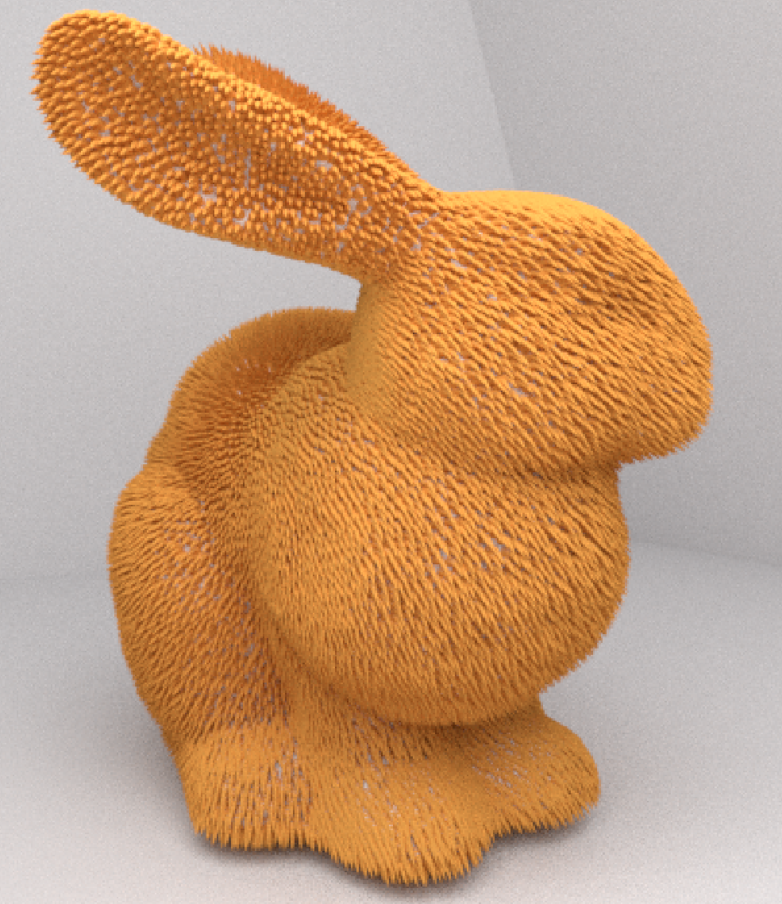
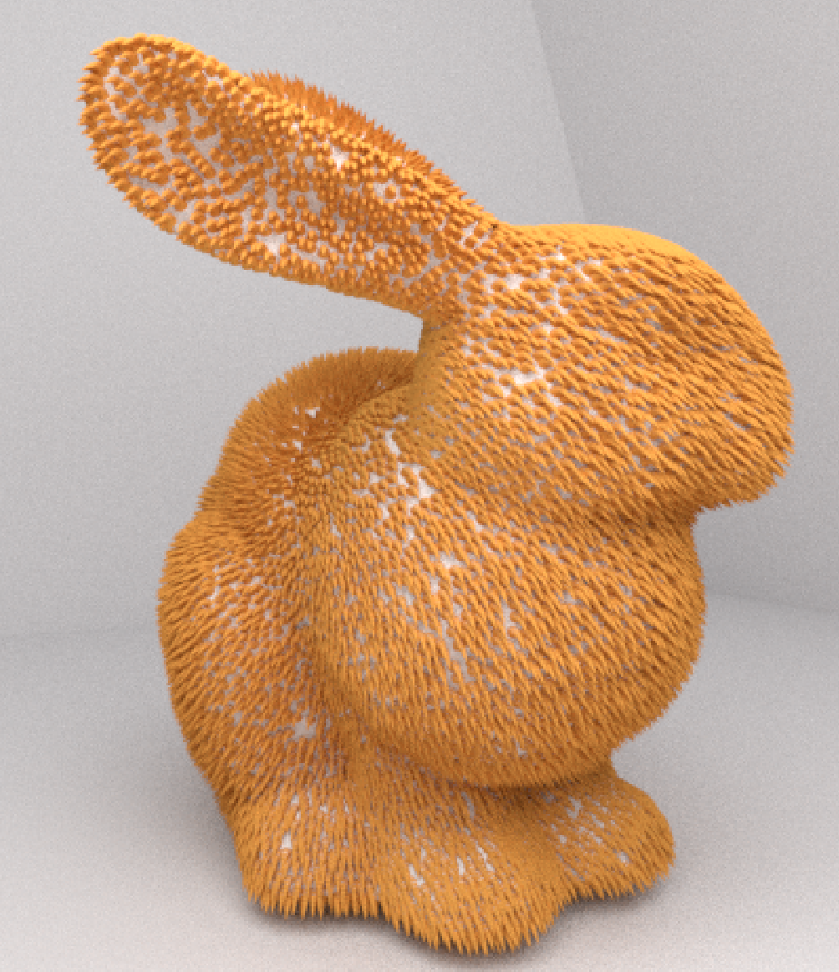
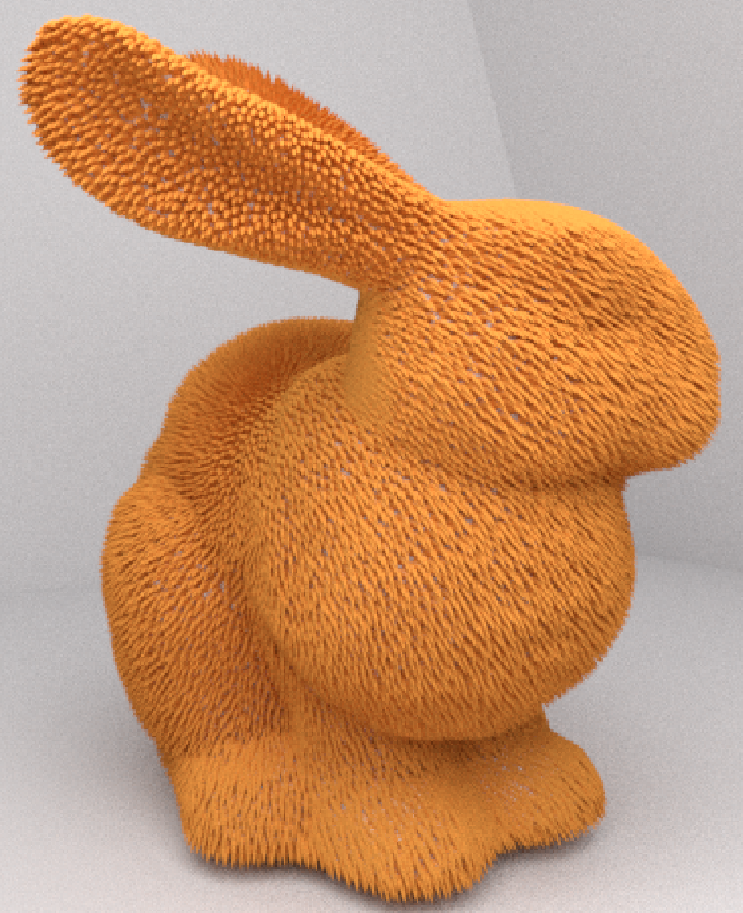
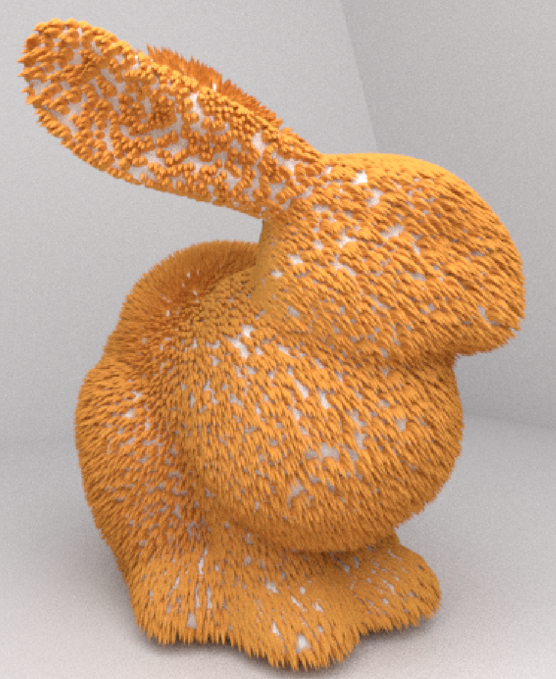
More applications
Few iterations can generate usable results.
Ours
Fur Strands: 20K
Iteration: 3
Time: 11ms
[Ying et al . 2013]
Fur Strands: 20K
|P|/|S|=10
Time: 24ms
Reference
Fur Strands: 20K
Time: 4s
Random
Fur Strands: 20K
Notes:
One advantage of the algorithm is that

Slide 35
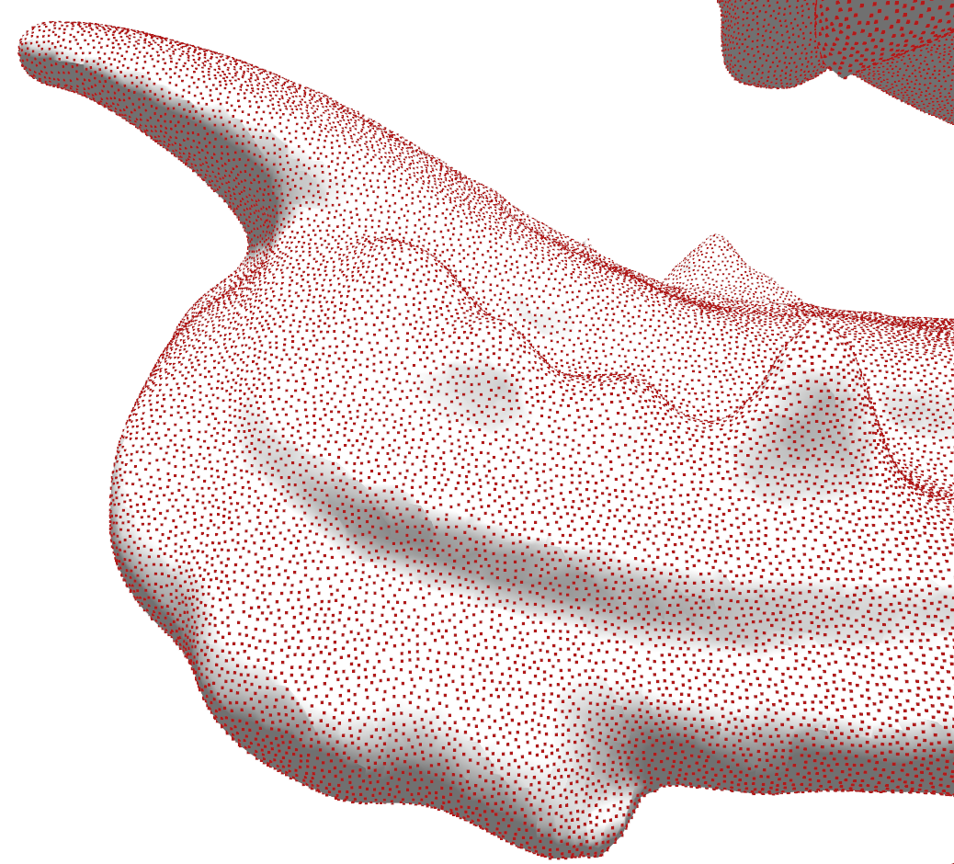
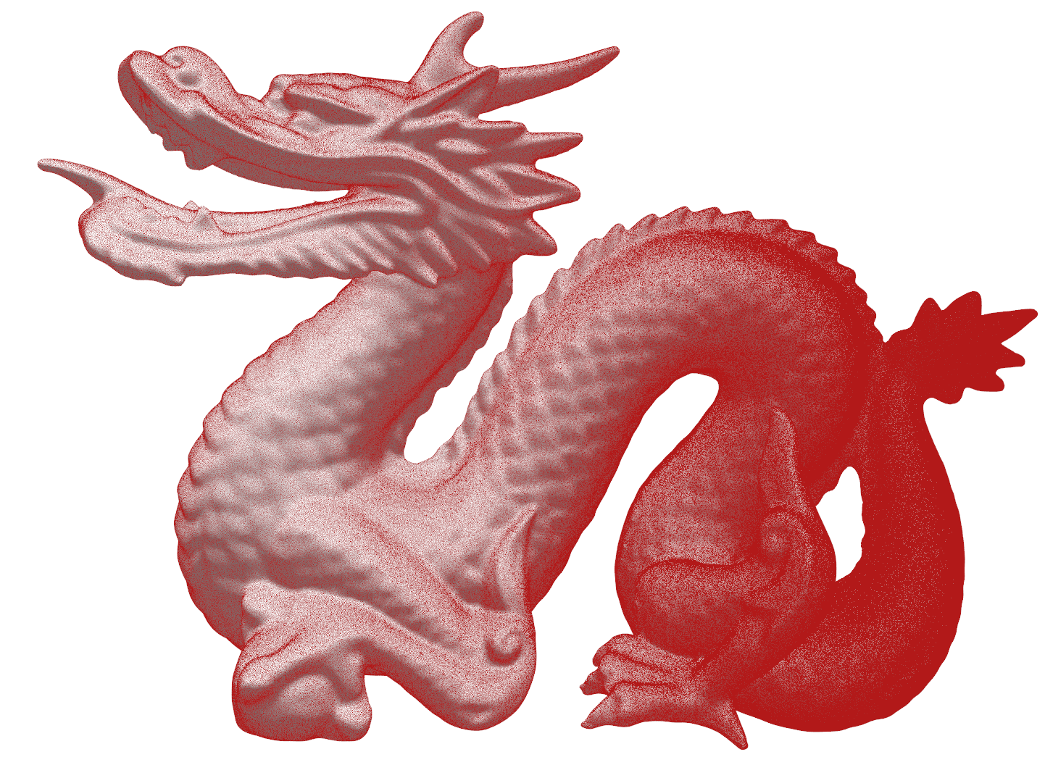
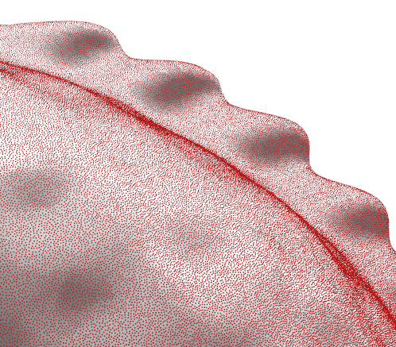
Easy to sample adaptively
Dragon
Tris: 871K
Samples:3.2M
Iterations: 250
SR: 60K/s

Slide 36
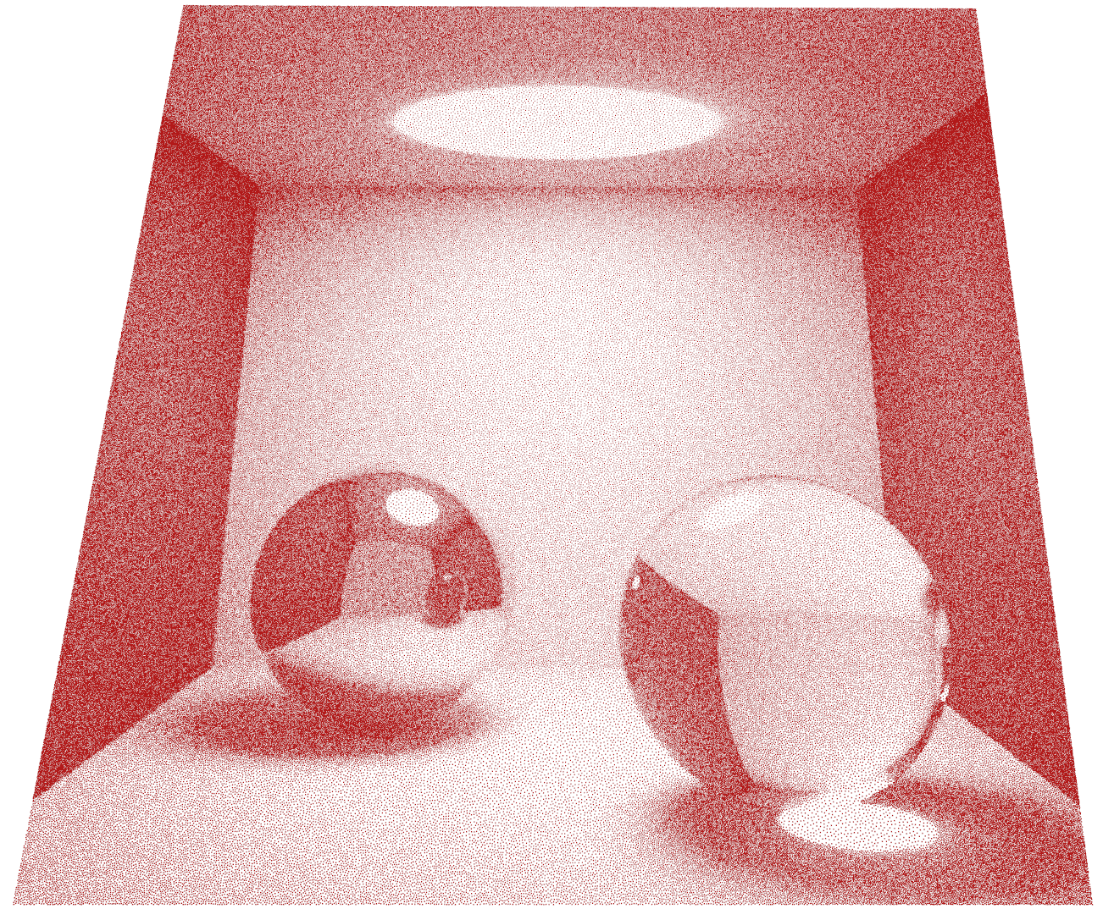
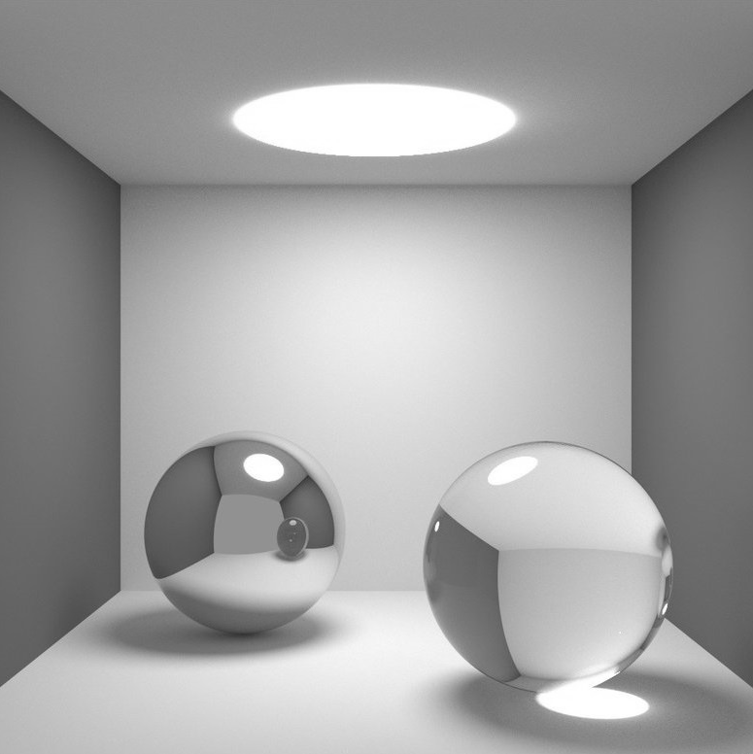
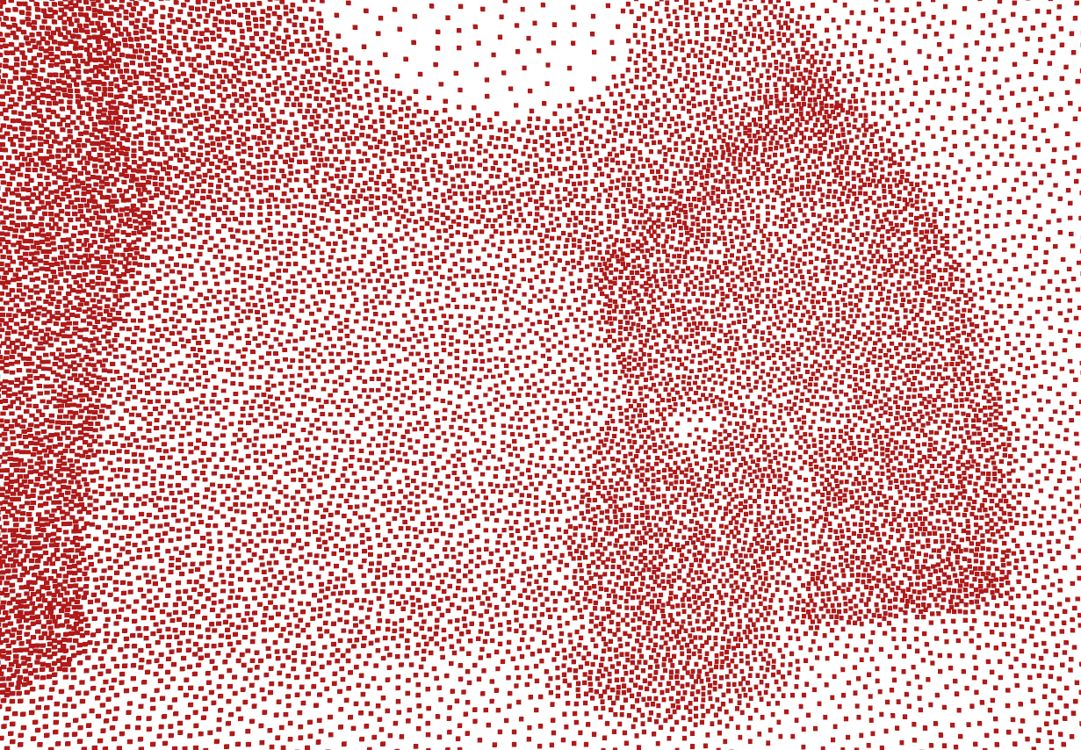
Image Stippling
Samples: 2.4Million
Effective Sampling Rate: 100K/s
Notes:
The end of adaptive sampling

Slide 37
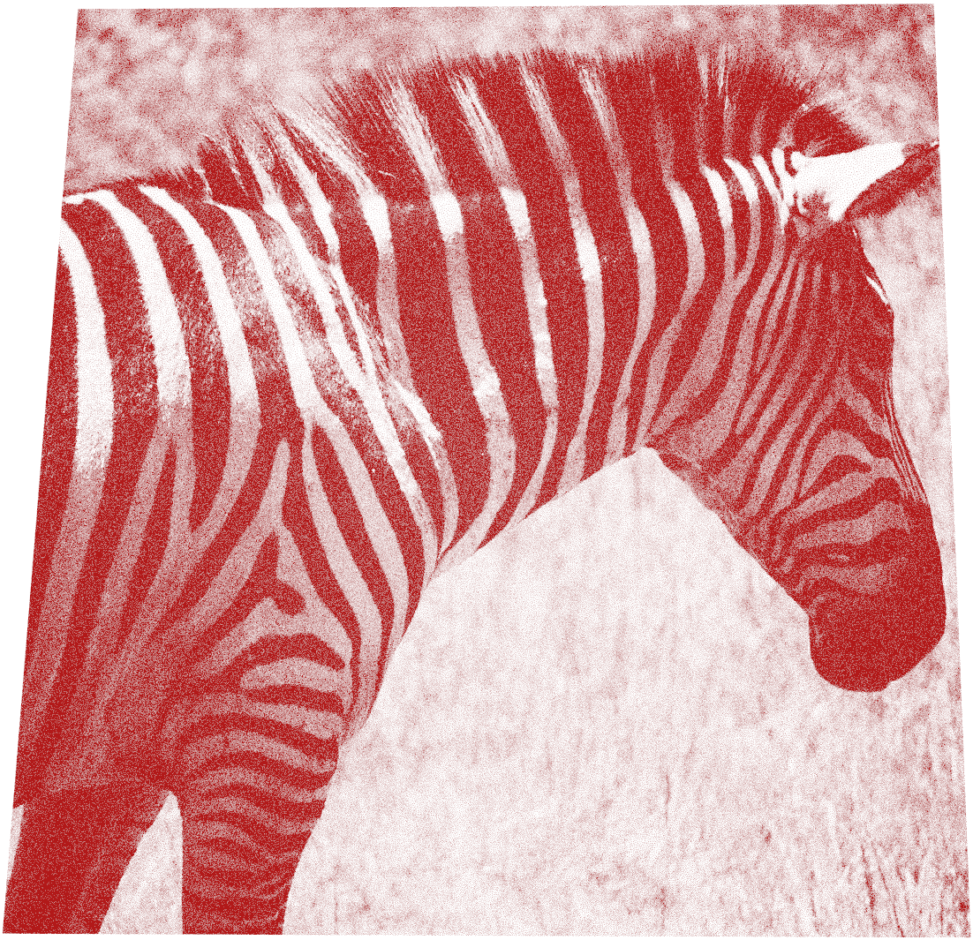
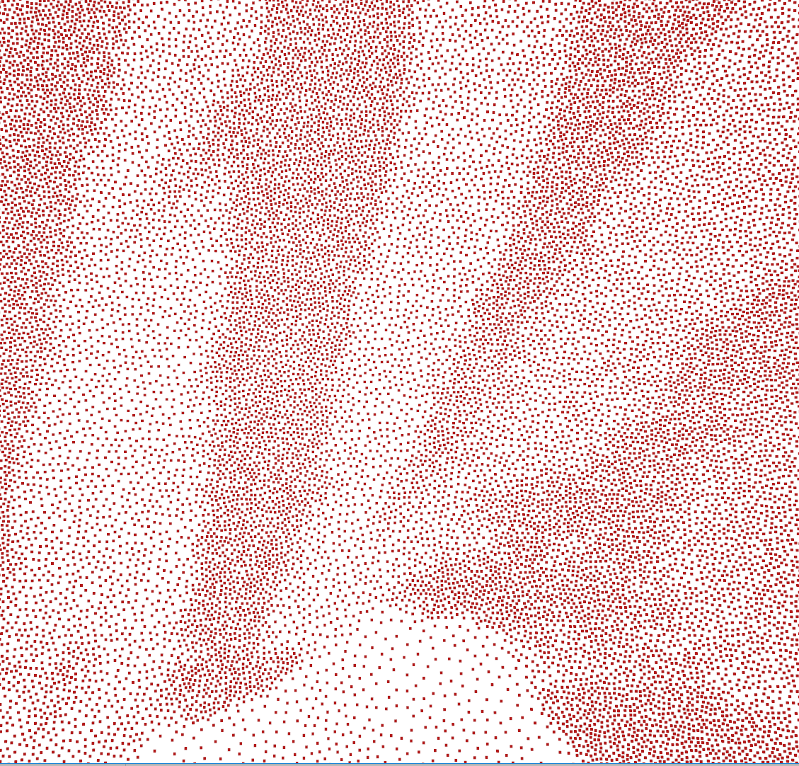
Samples: 2.3Million
Effective Sampling Rate: 105K/s

Slide 38
Limitations
Better for generation of massive amount of samples.
  A little bit heavy on sparse samples.
Convergence is non-linear.
  Gap management will be a good future work.
Radius based, hard to control the exact number of samples.
  Combined with other methods to control the number.
No theoretical explanation on the bias of this method.

Slide 39
Thank you!

