Slide 1
Compressed-LEAF bounding volume hierarchies
Carsten Benthin, Ingo Wald, Sven Woop, Attila Áfra

Slide 2
GOAL
“Brain-dead simple approach to make compressed wide BVHs more efficient”

Slide 3
Bounding Volume hierarchies (BVHs)
BVH node = axis-aligned bounding boxes (AABB) + pointer
32-bit single precision floating point
N-wide BVHs (N = 2,4,8)
inner node, points to other nodes
leaf node, points to leaf data

Slide 4
Bounding Volume hierarchies (BVHs)
Axis-aligned bounding boxes (AABB)
32-bit single precision floating point
N-wide BVHs (N = 2,4,8)
inner node, points to other nodes
multi-node
leaf node, points to leaf data

Slide 5
MULTI-NODE LAYOUT
6 * 8 * sizeof(float) + 8 * sizeof(void*) = 256 bytes
X_{min0}
X_{min1}
X_{min2}
X_{min3}
X_{min4}
X_{min5}
X_{min6}
X_{min7}
X_{max0}
X_{max1}
X_{max2}
X_{max3}
X_{max4}
X_{max5}
X_{max6}
X_{max7}
Y_{min0}
Y_{min1}
Y_{min2}
Y_{min3}
Y_{min4}
Y_{min5}
Y_{min6}
Y_{min7}
Y_{max0}
Y_{max1}
Y_{max2}
Y_{max3}
Y_{max4}
Y_{max5}
Y_{max6}
Y_{max7}
float
Z_{min0}
Z_{min1}
Z_{min2}
Z_{min3}
Z_{min4}
Z_{min5}
Z_{min6}
Z_{min7}
Z_{max0}
Z_{max1}
Z_{max2}
Z_{max3}
Z_{max4}
Z_{max5}
Z_{max6}
Z_{max7}
ptr₀
ptr₁
ptr₂
ptr₃
ptr₄
ptr₅
ptr₆
ptr₇
void*

Slide 6
MULTI-NODE LAYOUT
6 * 8 * sizeof(float) + 8 * sizeof(void*) = 256 bytes
X_{min0}
X_{min1}
X_{min2}
X_{min3}
X_{min4}
X_{min5}
X_{min6}
X_{min7}
X_{max0}
X_{max1}
X_{max2}
X_{max3}
X_{max4}
X_{max5}
X_{max6}
X_{max7}
“BVH Compression”
Mahovski et al.
Segovia et al.
Keely et al.
Wald et al.
Ylitie et al.
…
Y_{min0}
Y_{min1}
Y_{min2}
Y_{min3}
Y_{min4}
Y_{min5}
Y_{min6}
Y_{min7}
Y_{max0}
Y_{max1}
Y_{max2}
Y_{max3}
Y_{max4}
Y_{max5}
Y_{max6}
Y_{max7}
float
Z_{min0}
Z_{min1}
Z_{min2}
Z_{min3}
Z_{min4}
Z_{min5}
Z_{min6}
Z_{min7}
Z_{max0}
Z_{max1}
Z_{max2}
Z_{max3}
Z_{max4}
Z_{max5}
Z_{max6}
Z_{max7}
ptr₀
ptr₁
ptr₂
ptr₃
ptr₄
ptr₅
ptr₆
ptr₇
void*

Slide 7
COMPRESSED MULTI-NODES
Express children AABBs relative to the parent AABB

Slide 8
COMPRESSED MULTI-NODES
Express children AABBs relative to the parent AABB
Use lower precision (4/8/16-bit integer) for encoding

Slide 9
COMPRESSED MULTI-NODES
Express children AABBs relative to the parent AABB
Use lower precision (4/8/16-bit integer) for encoding

Slide 10
COMPRESSED MULTI-NODES
Decompression
start_{X} = parent.min_{X}
scale_{X} = (parent.max_{X} - parent.min_{X}) / 255.f
D_{X} = start_{X} + (float)i_{X} * scale_{X}
Implementation
Maps well to 8-wide SIMD
Decompress all 8 children AABBs in parallel
Compressed multi-node BVH = Quantized BVH (QBVH)

Slide 11
COMPRESSED MULTI-NODE LAYOUT
Uncompressed: 6 * 8 * sizeof(float) + 8 * sizeof(void*) = 256 bytes
Compressed: 6 * sizeof(float) + 6 * 8 * sizeof(char) + 8 * sizeof(void*) = 136 bytes
X_{min0}
X_{min1}
X_{min2}
X_{min3}
X_{min4}
X_{min5}
X_{min6}
X_{min7}
start_{X}
start_{Y}
start_{Z}
scale_{X}
scale_{Y}
scale_{Z}
float
X_{max0}
X_{max1}
X_{max2}
X_{max3}
X_{max4}
X_{max5}
X_{max6}
X_{max7}
X_{min0}
X_{min1}
X_{min2}
X_{min3}
X_{min4}
X_{min5}
X_{min6}
X_{min7}
X_{max0}
X_{max1}
X_{max2}
X_{max3}
X_{max4}
X_{max5}
X_{max6}
X_{max7}
Y_{min0}
Y_{min1}
Y_{min2}
Y_{min3}
Y_{min4}
Y_{min5}
Y_{min6}
Y_{min7}
Y_{min0}
Y_{min1}
Y_{min2}
Y_{min3}
Y_{min4}
Y_{min5}
Y_{min6}
Y_{min7}
Y_{max0}
Y_{max1}
Y_{max2}
Y_{max3}
Y_{max4}
Y_{max5}
Y_{max6}
Y_{max7}
char
Y_{max0}
Y_{max1}
Y_{max2}
Y_{max3}
Y_{max4}
Y_{max5}
Y_{max6}
Y_{max7}
float
Z_{min0}
Z_{min1}
Z_{min2}
Z_{min3}
Z_{min4}
Z_{min5}
Z_{min6}
Z_{min7}
Z_{min0}
Z_{min1}
Z_{min2}
Z_{min3}
Z_{min4}
Z_{min5}
Z_{min6}
Z_{min7}
Z_{max0}
Z_{max1}
Z_{max2}
Z_{max3}
Z_{max4}
Z_{max5}
Z_{max6}
Z_{max7}
ptr₀
ptr₁
ptr₂
ptr₃
ptr₄
ptr₅
ptr₆
ptr₇
Z_{max0}
Z_{max1}
Z_{max2}
Z_{max3}
Z_{max4}
Z_{max5}
Z_{max6}
Z_{max7}
void*
ptr₀
ptr₁
ptr₂
ptr₃
ptr₄
ptr₅
ptr₆
ptr₇
void*

Slide 12
ISSUES WITH QBVHs
Coarser bounds
+2-4% traversal steps
+4-10% intersection steps
Costly decompression
6 times D_{k} = start_{k} + (float)i_{k} * scale_{k} (using SIMD)
~24 SIMD instructions overhead (more than the actual ray-slabs test)
➔ ~10-20% total performance impact (diffuse path tracing) ☹

Slide 13
MEH, I WANT MY PERFORMANCE BACK…
Observations
For a binary BVH half the nodes are leaf nodes, >80% for 8-wide BVH
Ray traverses multiple inner multi-nodes per leaf
Most of the overhead comes from decompressing inner multi-nodes
General Idea
Only compress “leaf” multi-nodes ☺

Slide 14
There’s A LITTLE PROBLEM…
What’s a “leaf” multi-node in a 8-wide BVH?
Only compress “all-leaf” multi-nodes
mixed inner/leaf nodes
“all-leaf” multi-node

Slide 15
COMPRESSED-LEAF BOUNDING VOLUME HIERARCHIES (CLBVH)
CLBVH = regular BVH with compressed “all-leaf” multi-nodes
Tweak top-down BVH builder to primarily generate “all-leaf” multi-nodes
Mark them as “special leaves” (need 1 additional bit)
Keep top-down BVH traversal unchanged ☺
Two types of leaves
Regular leaves
“All-leaf” multi-nodes

Slide 16
FURTHER COMPRESSION…
Store referenced primitive data directly behind “all-leaf” multi-nodes
Get rid of explicit pointers to primitive data
Pointer is given implicitly by children index
start_{X}
start_{Y}
start_{Z}
scale_{X}
scale_{Y}
scale_{Z}
float
X_{min0}
X_{min1}
X_{min2}
X_{min3}
X_{min4}
X_{min5}
X_{min6}
X_{min7}
X_{max0}
X_{max1}
X_{max2}
X_{max3}
X_{max4}
X_{max5}
X_{max6}
X_{max7}
Y_{min0}
Y_{min1}
Y_{min2}
Y_{min3}
Y_{min4}
Y_{min5}
Y_{min6}
Y_{min7}
Y_{max0}
Y_{max1}
Y_{max2}
Y_{max3}
Y_{max4}
Y_{max5}
Y_{max6}
Y_{max7}
char
Z_{min0}
Z_{min1}
Z_{min2}
Z_{min3}
Z_{min4}
Z_{min5}
Z_{min6}
Z_{min7}
Z_{max0}
Z_{max1}
Z_{max2}
Z_{max3}
Z_{max4}
Z_{max5}
Z_{max6}
Z_{max7}
ptr₀
ptr₁
ptr₂
ptr₃
ptr₄
ptr₅
ptr₆
ptr₇
void*

Slide 17
FURTHER COMPRESSION…
Store referenced primitive data directly behind “all-leaf” multi-nodes
Get rid of explicit pointers to primitive data
Pointer is given implicitly by children index
start_{X}
start_{Y}
start_{Z}
scale_{X}
scale_{Y}
scale_{Z}
float
X_{min0}
X_{min1}
X_{min2}
X_{min3}
X_{min4}
X_{min5}
X_{min6}
X_{min7}
X_{max0}
X_{max1}
X_{max2}
X_{max3}
X_{max4}
X_{max5}
X_{max6}
X_{max7}
Y_{min0}
Y_{min1}
Y_{min2}
Y_{min3}
Y_{min4}
Y_{min5}
Y_{min6}
Y_{min7}
Y_{max0}
Y_{max1}
Y_{max2}
Y_{max3}
Y_{max4}
Y_{max5}
Y_{max6}
Y_{max7}
char
Reduces size to 72 bytes only
Z_{min0}
Z_{min1}
Z_{min2}
Z_{min3}
Z_{min4}
Z_{min5}
Z_{min6}
Z_{min7}
Z_{max0}
Z_{max1}
Z_{max2}
Z_{max3}
Z_{max4}
Z_{max5}
Z_{max6}
Z_{max7}
Leaf-Data₀
Leaf-Data₁
Leaf-Data₂
Leaf-Data₃
Leaf-Data₄
Leaf-Data₅
Leaf-Data₆
Leaf-Data₇

Slide 18
EVEN FURTHER COMPRESSION… CLBVH (compact)
Extract shared features in geometry data in “all-leaf” multi-node
Object IDs, vertices, vertex indices, shader IDs, etc.
Re-index data with more compact “indices”
Similar to small treelets
Reduces size of leaf data by 15-25% (lossless compression)
Leaf-Data₀
Leaf-Data₁
Leaf-Data₂
Leaf-Data₃
Leaf-Data₄
Leaf-Data₅
Leaf-Data₆
Leaf-Data₇
New Idx₀
New Idx₁
New Idx₂
New Idx₃
New Idx₄
New Idx₅
New Idx₆
New Idx₇
Shared Data

Slide 19
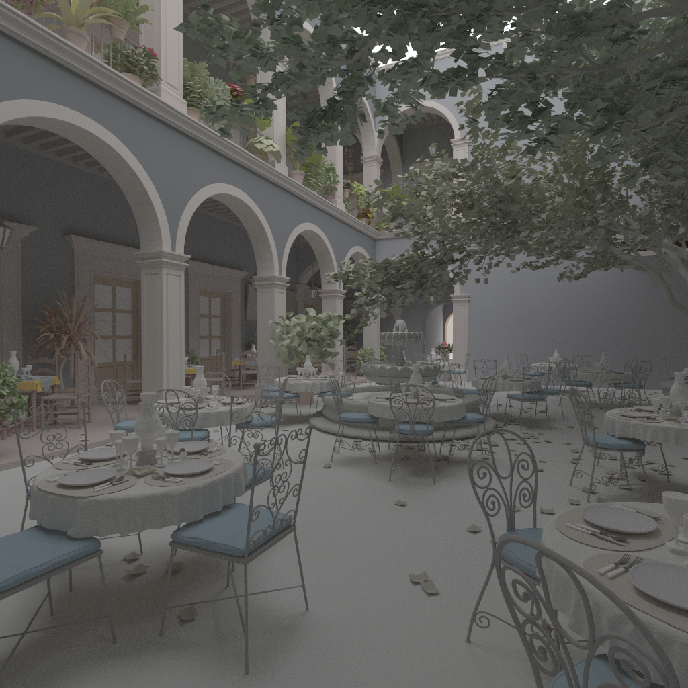
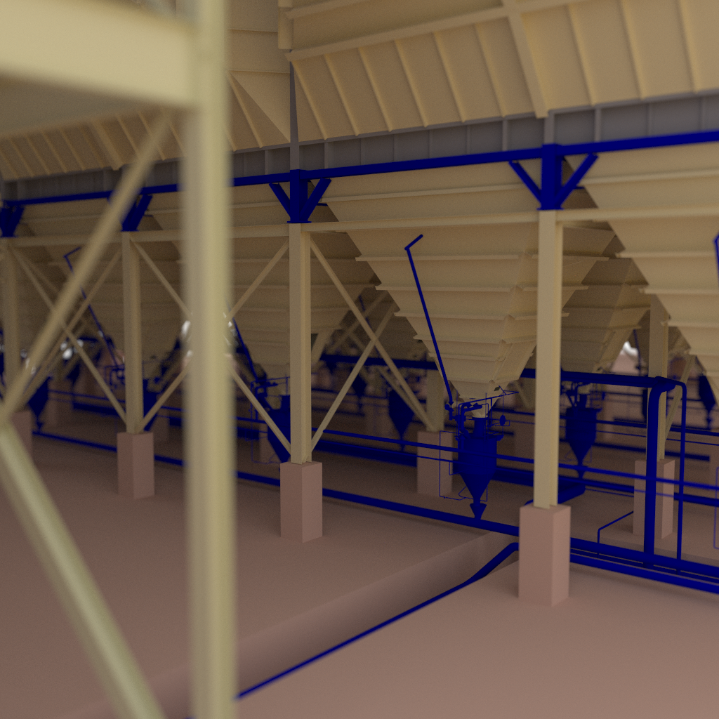
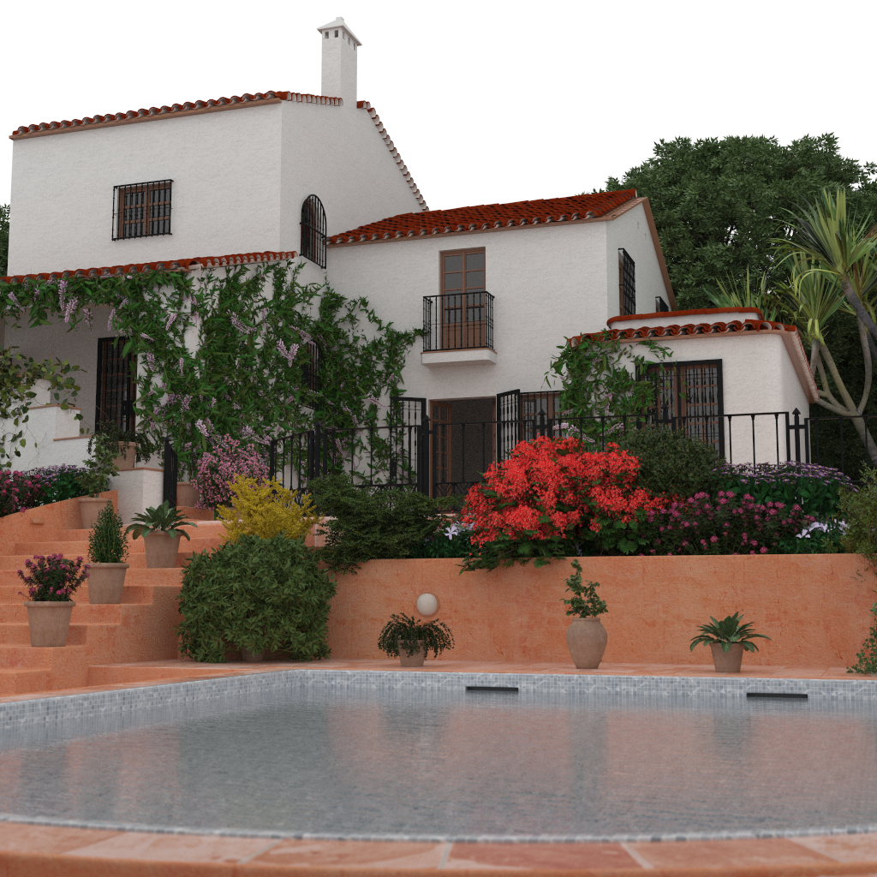
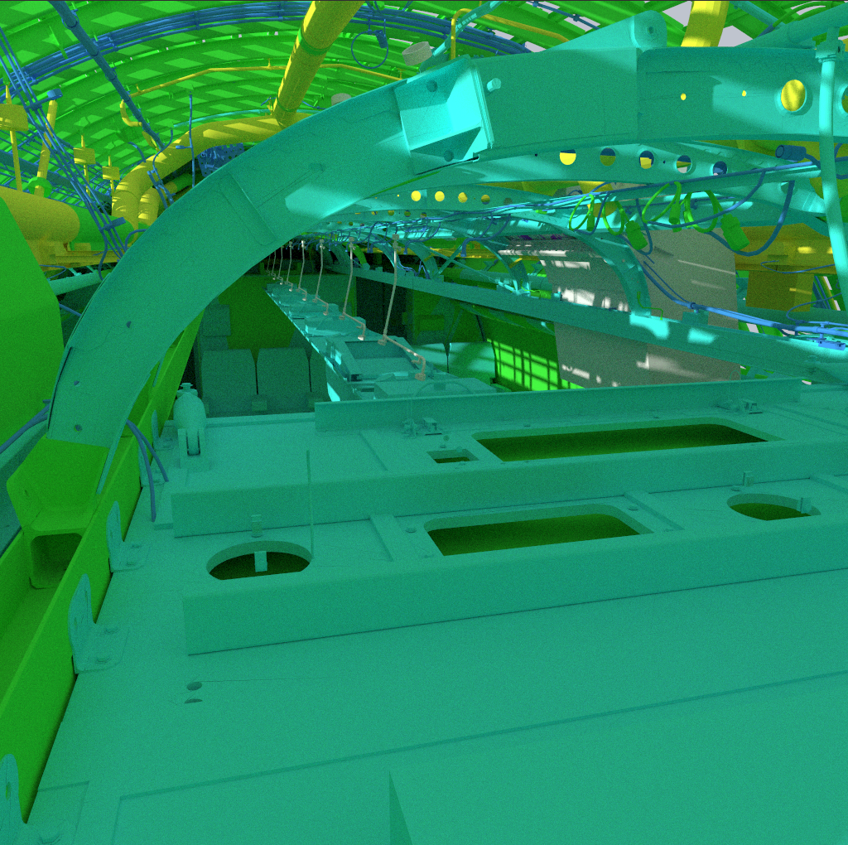
ResultS
Evaluation done in special version of Embree 3.x
Dual-socket Intel® Xeon® Platinum, 2x28 cores, 96 GB memory
Four scenes (10M-350M triangles), diffuse path tracing (up to 8 bounces)
“Best speed” vs. “least memory” mode

Slide 20
ResultS (best SPEED MODE)
From 10-20% performance reduction down to 2-4%

Slide 21
ResultS (BEST SPEED MODE)
BVH memory reduction of 42-46%

Slide 22
ResultS (BEST SPEED MODE)
Only 8-10% total memory reduction

Slide 23
ResultS (LEAST MEMORY MODE)
From 7-15% performance reduction down to 0-3%

Slide 24
ResultS (LEAST MEMORY MODE)
Similar BVH memory reduction of 42-46%

Slide 25
ResultS (LEAST MEMORY MODE)
CLBVH reduces total memory by 16-24%, CLBVH (compact) by 26-37%

Slide 26
Summary & OUTLOOK
Compared to QBVHs, our CLBVHs:
Are able to recover most of the performance slow-down
Provide similar BVH size reductions
Easy to integrate into existing ray tracing engines (impacts only leaf code)
Even allows for (lossless) leaf data compression
Embree already uses a variant of CLBVHs for hair/curve primitives
GPU, custom HW

Slide 27
Questions?

Slide 28
Legal
No license (express or implied, by estoppel or otherwise) to any intellectual property rights is granted by this document.
Intel disclaims all express and implied warranties, including without limitation, the implied warranties of merchantability, fitness for a particular purpose, and non-infringement, as well as any warranty arising from course of performance, course of dealing, or usage in trade.
This document contains information on products, services and/or processes in development. All information provided here is subject to change without notice. Contact your Intel representative to obtain the latest forecast, schedule, specifications and roadmaps.
The products and services described may contain defects or errors known as errata which may cause deviations from published specifications. Current characterized errata are available on request.
Intel technologies' features and benefits depend on system configuration and may require enabled hardware, software or service activation. Performance varies depending on system configuration. No computer system can be absolutely secure. Check with your system manufacturer or retailer or learn more at intel.com.
Software and workloads used in performance tests may have been optimized for performance only on Intel microprocessors. Performance tests, such as SYSmark and MobileMark, are measured using specific computer systems, components, software, operations and functions. Any change to any of those factors may cause the results to vary. You should consult other information and performance tests to assist you in fully evaluating your contemplated purchases, including the performance of that product when combined with other products. For more information go to www.intel.com/benchmarks
Benchmark results were obtained prior to implementation of recent software patches and firmware updates intended to address exploits referred to as "Spectre" and "Meltdown". Implementation of these updates may make these results inapplicable to your device or system.
Intel, Xeon and the Intel logo are trademarks of Intel Corporation or its subsidiaries in the U.S. and/or other countries.
*Other names and brands may be claimed as the property of others
© Intel Corporation.

Slide 29
Acronym List
Application Programming Interface (API)
Bounding Volume Hierarchy (BVH)
Independent Software Vendor (ISV)
Instruction Set Architecture (ISA)
Intel® Advanced Vector Extensions (Intel® AVX)
Intel® Advanced Vector Extensions 2 (Intel® AVX2)
Intel® Advanced Vector Extensions 512 (Intel® AVX-512)
Intel® SPMD Program Compiler (Intel® SPC)
Intel® Streaming SIMD Extensions (Intel® SSE)
Intel® Threading Building Blocks (Intel® TBB)
Non-Uniform Rational Basis Spline (NURBS)
Single Instruction, Multiple Data (SIMD)
Single Program, Multiple Data (SPMD)
Surface Area Heuristic (SAH)

