Slide 1
A Practical and Efficient Approach for Correct Z-Pass Stencil Shadow Volumes
Baran Usta
Leonardo Scandolo
Markus Billeter
Ricardo Marroquim
Elmar Eisemann
Delft University of Technology
Notes:
Hello everyone, I’m Baran and today I will talk about stencil shadow algorithms.

Slide 2
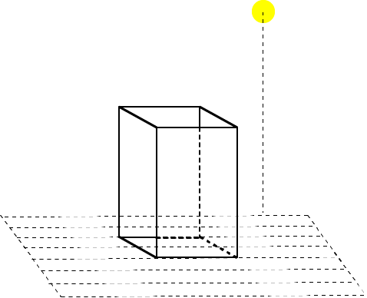
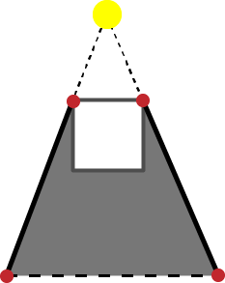
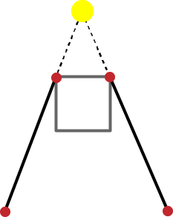
Shadow Volumes
Detect Silhouette Edges
Extend to the infinity
Generating quads
Volume in between the quads
Notes:
So what are Shadow Volumes.. It is a region of space behind of a light facing polygon.
All the points in that space is under the shadow of that polygon.
Lets see how they are constructed.
Let’s say we have such a scene with a light source and a cube.
First silhouette edges are detected. Silhouette edges are the edges that connect one frontfacing and one backfacing triangle from the light source point of view. So, These 2 edges are silhouette edges by that definition.
Then they are extended to the infinity in the direction away from the light source. And when we extend an edge in a direction, we would get a quad.
If we apply this operation to every silhouette edge, the volume enclosed by the object and these generated quads is called shadow volume.
If we want to visualize it in 3d... First, silhouette edges are detected, then extended to the infinity and the volume in between.. is the shadow volume.

Slide 3
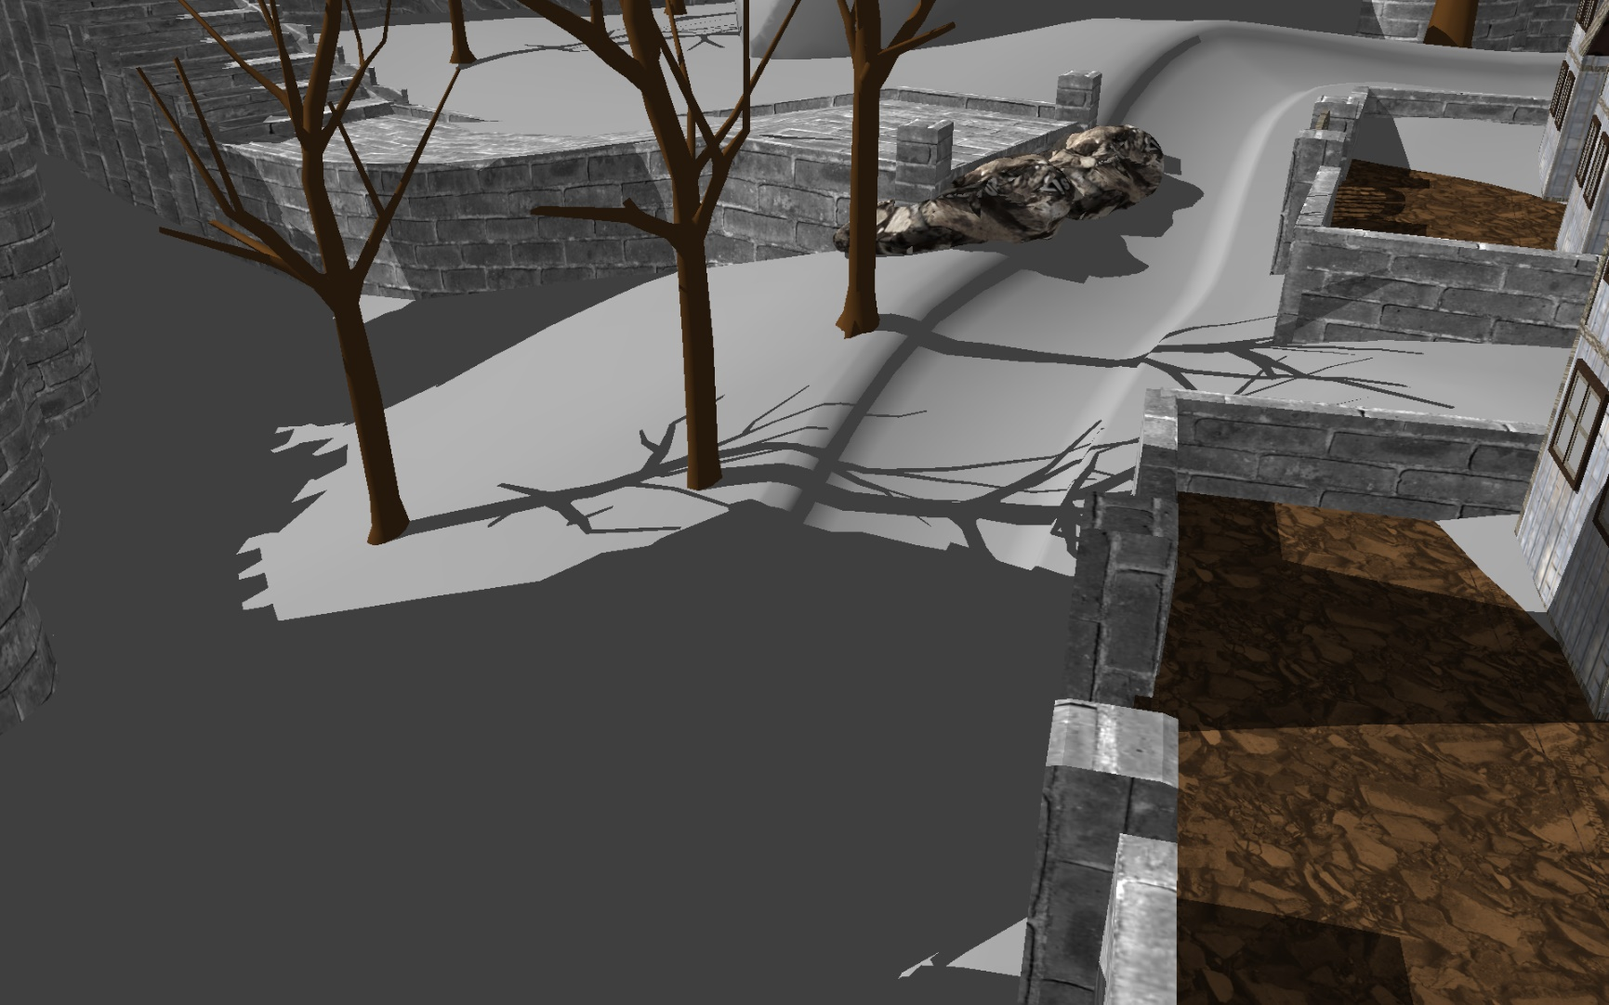
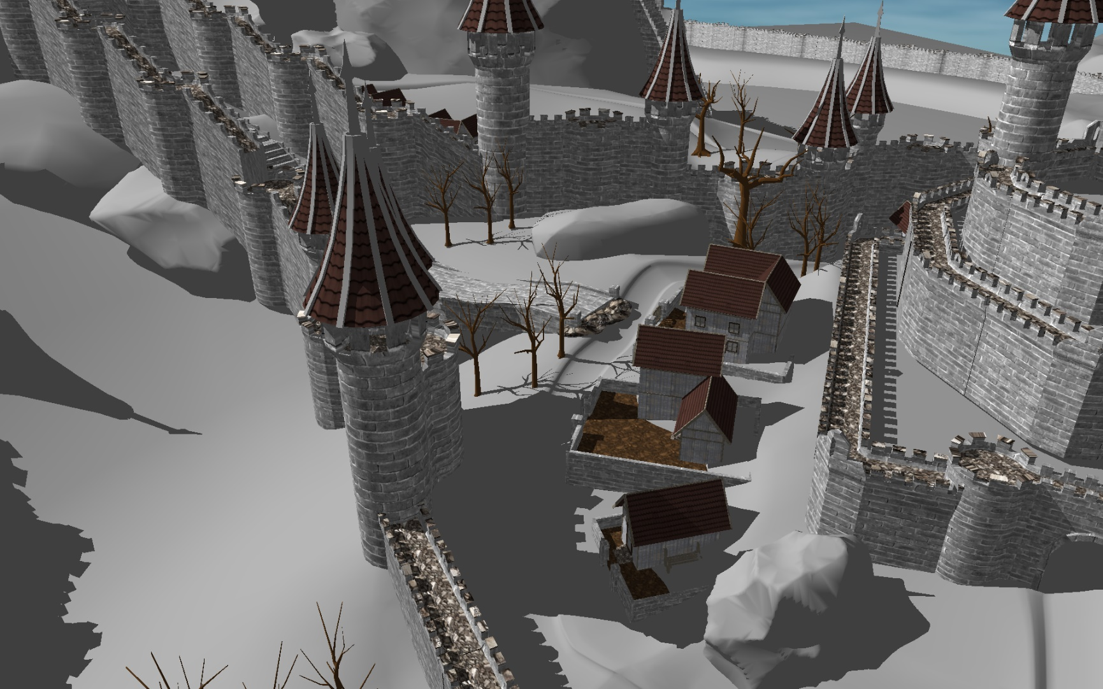
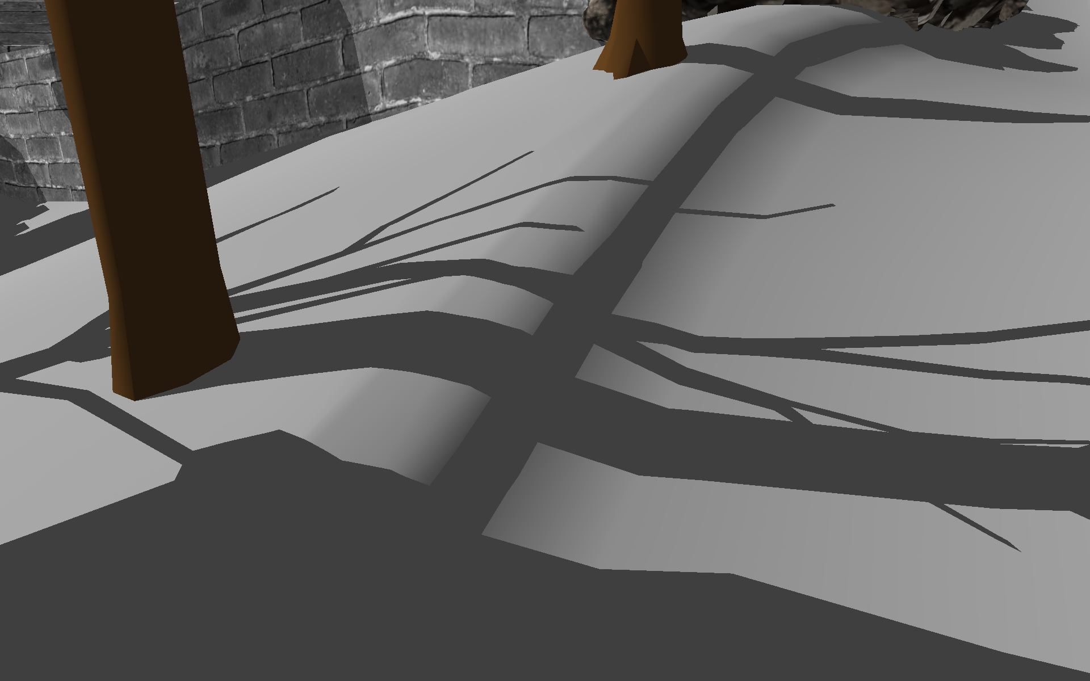
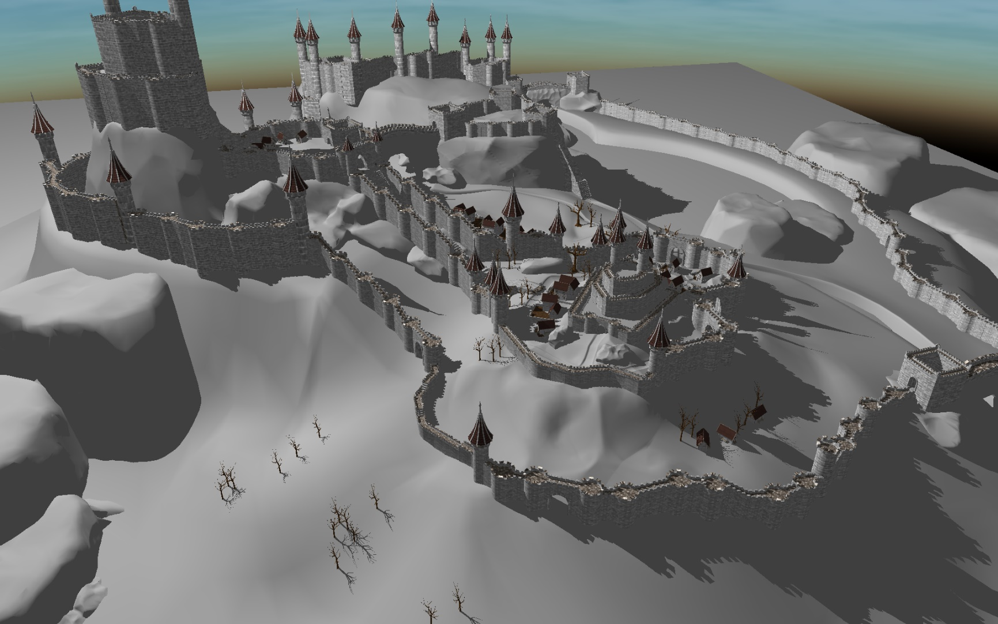
Shadow Volumes
Notes:
Shadow Volumes are very effective calculating pixel perfect hard shadows.
*They can produce artifact free pixel perfect hard shadows regardless the zoom level.

Slide 4
Hard Shadow Rendering
Ray Tracing
[Appel 1968]
Irregular Z-Buffer
[Johnson et al. 2005]
Shadow Volumes
[Crow 1977]
Real time support is not widespread on current commodity hardware
Inconsistent performance
Notes:
Typically there are 3 generic artifact free solutions to this problem.
First one is ray tracing and it becomes popular in real-time rendering too. However, it still is not available for commodity hardwares.
The other approach is Irregular Z-Buffer. However, this one also suffers from some scalability issues.
This brings us to Shadow Volume algorithms. There are many efficient variants...

Slide 5
Shadow Volumes [Crow 1977]
Render Scene to fill depth buffer
Construct the shadow quads
Count the front and back facing quads in each pixel between camera and visible point
Front facing > back facing = in shadow
Otherwise = lit
Counting order does not matter
GPU
Notes:
Crows shadow volumes algorithm first determines the visible points in the scene. Then shadow surfaces are generated.
Since they are invisible, they do not effect visibility but determines the shadowing
In camera point of view, front facing shadow quads are the entry to the shadowed region and back facing ones are the exit. So the back facing ones cancel the effect front facing ones apply.
It means that, there are equal number of back facing and front facing shadow quads in between two lit points. We can determine if a point is in shadow or not by counting the number of front facing and back facing shadow quads.
In order for a visible surface point to be in shadow, the number of front facing shadow quads in between camera and that visible point should be larger than the back facing ones. Otherwise it is lit.
Since we are only counting two types of shadow quads, order does not matter. So it can be easily implemented on gpu in parallel.
Connect point of the camera, point of visible point
From camera to the point, counting the number of these shadow quads.
Put a drawing…..

Slide 6
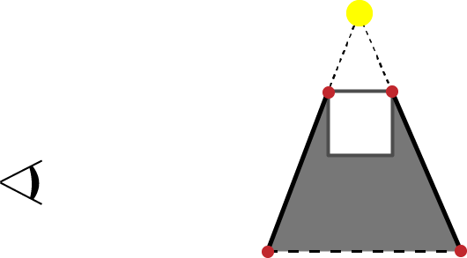
Shadow Volumes [Crow 1977]
FF
BF
1
1
0
0
Notes:
Mention orientation of the shadow quad.
Crows shadow volumes algorithm first determines the visible points in the scene.
Then shadow quads are generated and their normal vector point away from the shadow volume.
Then to determine whether a visible surface point is in shadow, we can count the number of front facing and back facing shadow quads that lies in between camera and the point.
Front facing shadow quad is the entry to shadow region and the back facing one cancels the effect front facing applies.
If the number of front and back facing quads are same, then this point is lit… otherwise it is in shadow
Since we are only counting two types of shadow quads, order does not matter. So it can be easily implemented on gpu in parallel.

Slide 7
Shadow Volumes [Crow 1977]
FF
BF
1
0
0
Notes:
Mention orientation of the shadow quad.
Crows shadow volumes algorithm first determines the visible points in the scene.
Then shadow quads are generated and their normal vector point away from the shadow volume.
Then to determine the whether a visible surface point is in shadow, we can count the number of front facing and back facing shadow quads that lies in between camera and the point.
Front facing shadow quad is the entry to shadow region and the back facing one cancels the effect front facing applies.
If the number of front and back facing quads are same, then this point is lit… otherwise it is in shadow
In order for a visible surface point to be in shadow, the number of front facing shadow quads in between camera and that visible point should be larger than the back facing ones. Otherwise it is lit.
Since we are only counting two types of shadow quads, order does not matter. So it can be easily implemented on gpu in parallel.

Slide 8
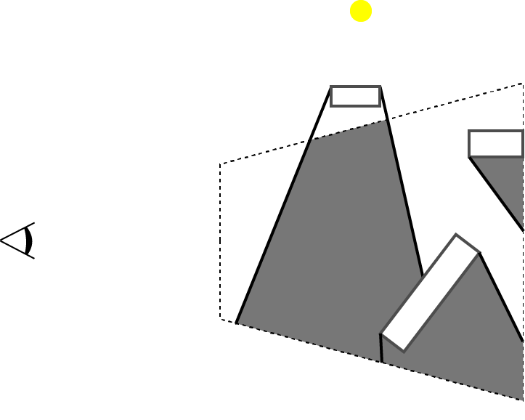
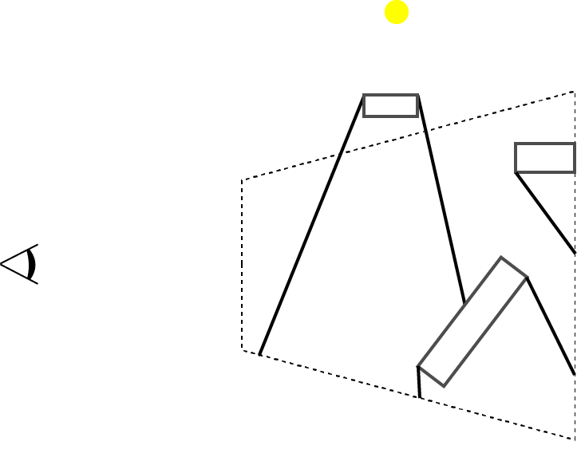
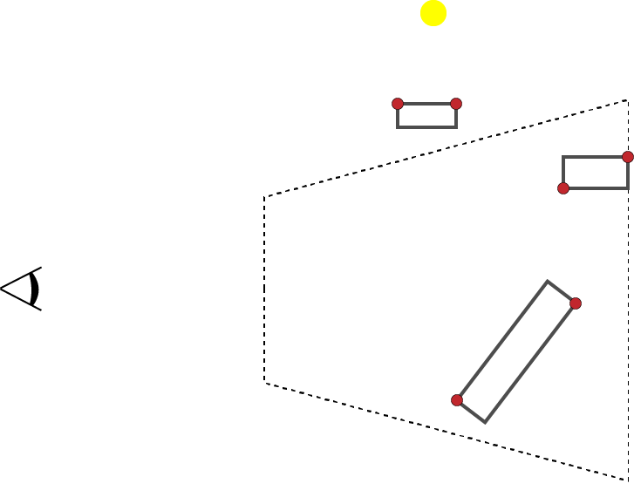
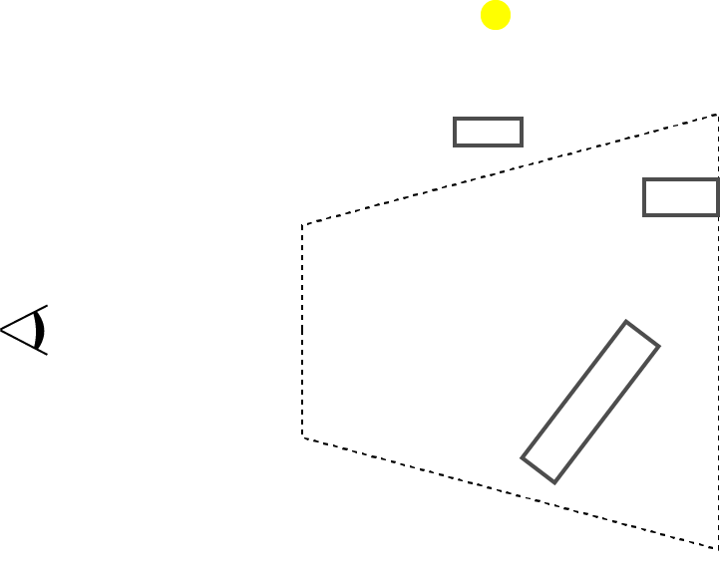
Z-Pass [Heidmann 1991]
Render Pass(Fill Depth Buffer)
Render Pass (Stencil)
Detect silhouette edges
Generate shadow volumes
Update stencil values with enabled depth test
0
0
0
0
0
0
0
0
0
0
Notes:
Z-Pass is the first stencil shadow volume algorithm implementing the Crow’s approach using rendering pipeline.
To determine the visible surfaces, first we need to render the scene to fill the Depth buffer.
Then stencil buffer is reset. Remember to the original algorithm we are gonna count the shadow quads and compare them. Instead of having 2 different counters, we can use only one counter which we increment when there is a front facing shadow quad and decrement for a back facing one.
Then the render pass starts to count the shadow quads in between the near plane and the visible surface point.
In that render pass, first silhouette edges are detected, then extended to infinity constructing the shadow volume.
For every every incoming triangle, test if it has a silhouette edge…

Slide 9
Z-Pass [Heidmann 1991]
Render Pass(Fill Depth Buffer)
Render Pass (Stencil)
Detect silhouette edges
Generate shadow volumes
Update stencil values with enabled depth test
Render Pass (Shading)
Pixels with stencil value 0 are lit
0
+1
0
+1
+1
+1
0
+1
0
0
0
0
+1
0
+1
+1
0
0
0
0
0
-1
+1
Notes:
For example for that pixel, there are 2 front facing and 1 back facing shadow quad which yields +1 in our stencil buffer. In other words, we have more front facing shadow quads then back facing quads. So it is in shadow.
After all the stencil values are calculated, then we can shade the pixels with 0 stencil value. The rest is in shadow.

Slide 10
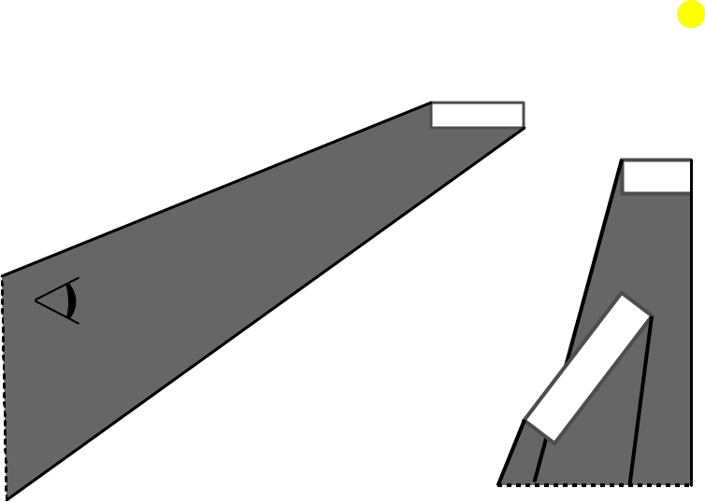
Z-Pass Limitation
FF
BF
Remark
What if the light source is in shadow?
1
1
0
0
Notes:
to the original algoritihm the number of back and front facing quads are equal between two lit points. But as in this scene, these numbers are equal when these 2 points are in shadow too.
So if the camera is in shadow already, our naïve approach does not work anymore.
This translates to Zpass as that if the near plane is in shadow, the algorithm fails. Because Z-pass starts counting from near plane instead of the camera itself.
Stop saying but!!!
The moment cam is in shadow… the counters will be incorrect!

Slide 11
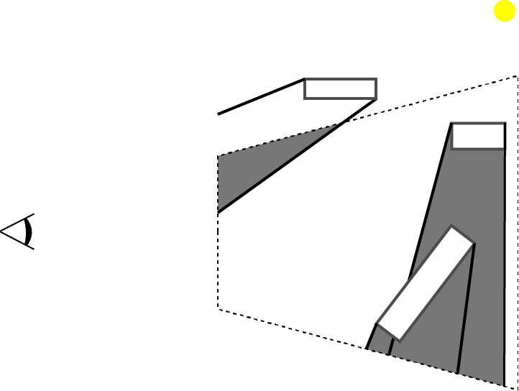
Z-Pass Limitation
Remark
What if the light source is in shadow?
Fail case for Z-Pass
0
0
+1
0
0
+1
0
0
+1
0
0
0
0
0
0
0
-1
+1
Notes:
Every pixel on the near plane that are already in shadow… it fails.

Slide 12
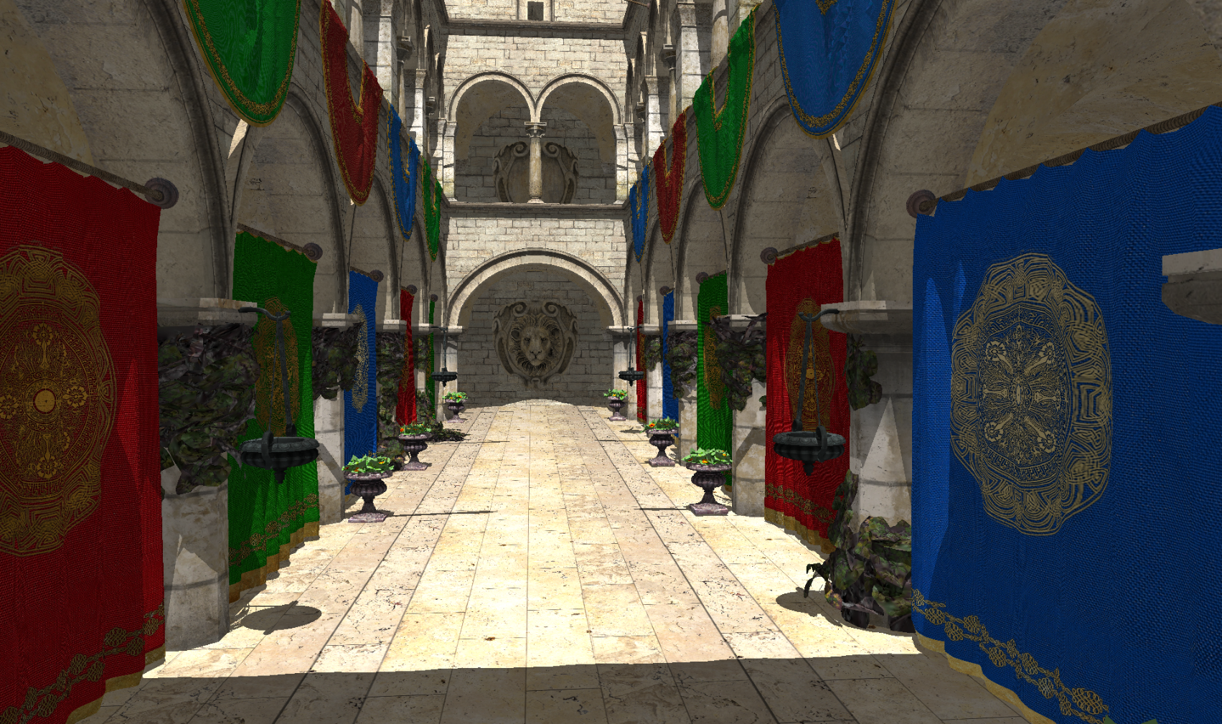
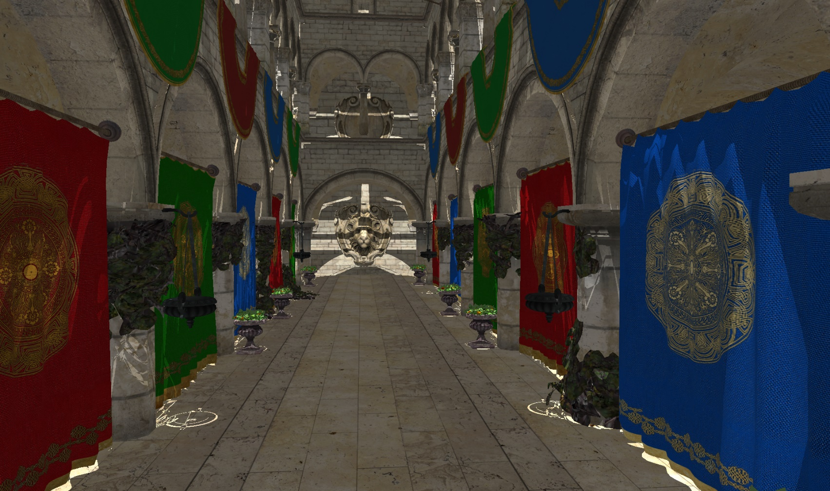
Z-Pass
Notes:
What it should look like, what it does look like.
As you see, although it is fairly easy to implement and effective, it fails to produce correct results for some cases.
Sooo, How can we correct it?

Slide 13
Stencil Shadow Volumes
Render Pass(Fill Depth Buffer)
Render Pass (Stencil)
Detect silhouette edges
Generate shadow volumes
Update stencil values
Render Pass (Shading)
Pixels with stencil value 0 are lit
Notes:
These are the 5 major steps of the Z-Pass algorithm.
And the correct versions of the Z-Pass algorithm either focus on the 3 step or add an additional step there fixing the issue with different approaches.
Wait after they greyed out….
5-10 sec……

Slide 14
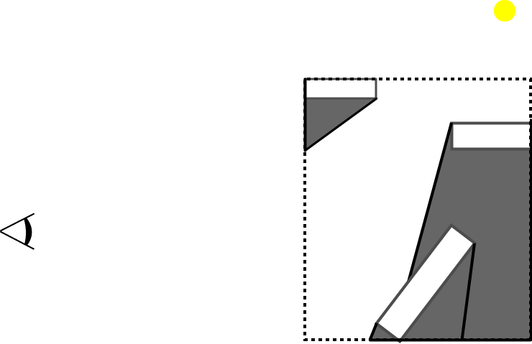
Z-Fail [Carmack 2000, Everitt & Kligard 2002]
Cut shadow volumes against scene Bbox
Create Caps
We can count intersections to any point outside the Bbox
+1
+1
-1
Notes:
Bbox of the scene.
Cut all the shadow volumes
A point out of bbox is not in a shadow volume
Do some dem here. Show it works.

Slide 15
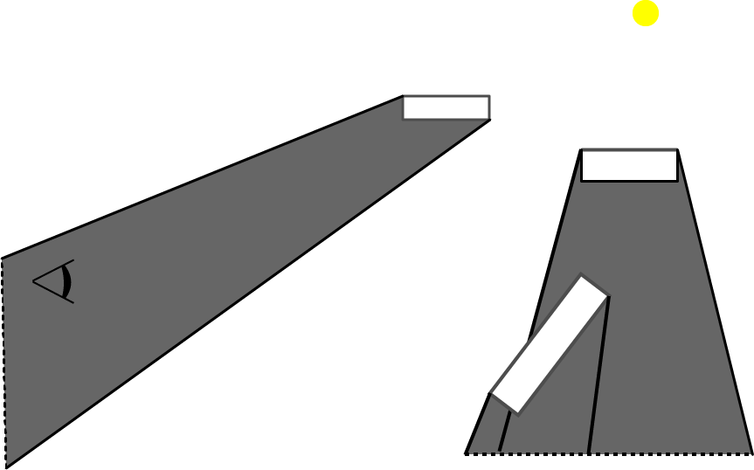
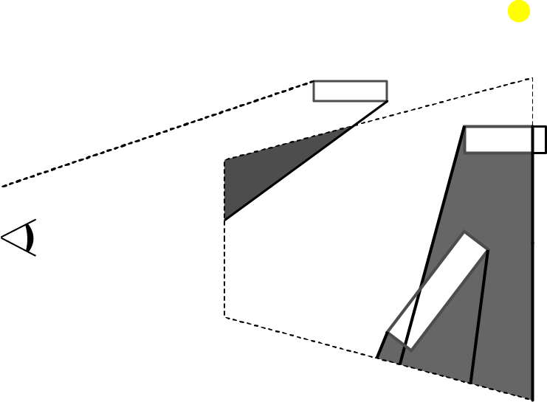
Z-Fail
Depth Clamping
Notes:
For only depth clamp..

Slide 16
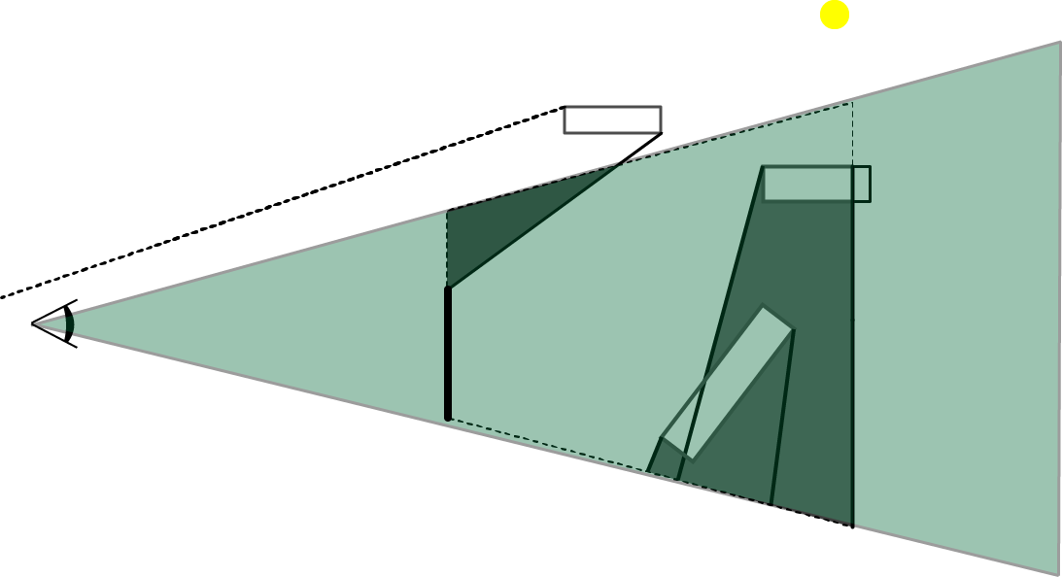
Z-Fail
Can we count from any point?
Notes:
For the point lie out
We can use just outside the frustum.
Inverse depth test!

Slide 17
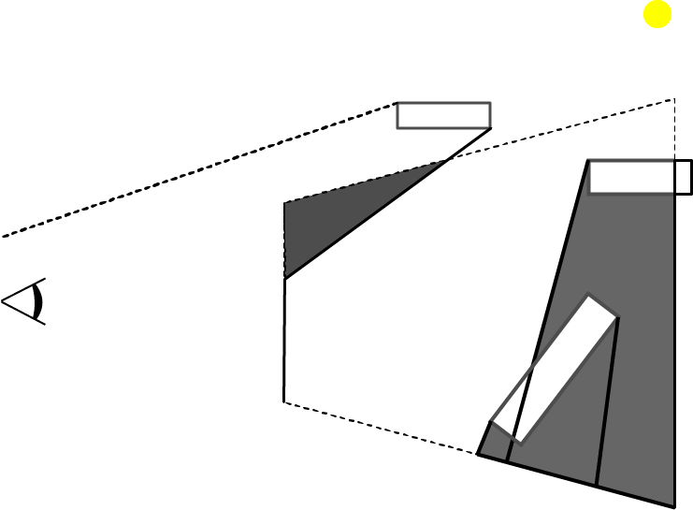
Z-Fail
Pick a point behind the far plane
Count the shadow quads between visible point and the picked point.
In practice: enabling inverse depth test
+1
Notes:
For the point lie out
We can use just outside the frustum.
Inverse depth test!

Slide 18
Z-Fail
Render Pass(Fill Depth Buffer)
Render Pass (Stencil) with depth clamp
Detect silhouette edges
Generate shadow volume
Render Front & Back Cap
Update stencil values
Enabled inverse depth test
Render Pass (Shading)
Pixels with stencil value 0 are lit
+1
0
+1
+1
0
0
0
+1
+1
0
0
0
0
0
0
0
0
+1
0
0
0
Notes:
We have combination of both here.

Slide 19
Z-Fail Limitations
Render Pass(Fill Depth Buffer)
Render Pass (Stencil) with depth clamp
Detect silhouette edges
Generate shadow volume
Render Front & Back Cap
Update stencil values
Enabled inverse depth test
Render Pass (Shading)
Pixels with stencil value 0 are lit
Excessive overdraw
Notes:
Typically, most of the shadow quads are behind the visible point. And Depth test quickly discards them. But here they are drawn to the screen updating the stencils.
So we have to have an algorithm that utilizes the Depth test.

Slide 20
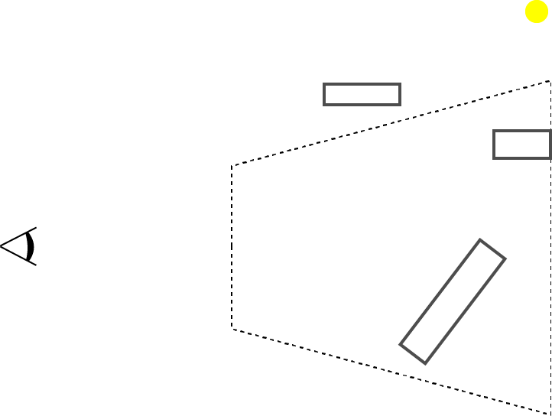
ZP+ [Hornus et al. 2005]
Z-Pass shadow calculation
Render Pass (from light source)
Light source to near plane
Update all the stencil values
Notes:
So, Z-Fail has shown that, the counting has to start out of shadow. And it does the counting behind the visible point.
And how Z-Pass works actually is that it counts all the shadow quads in this segment. And in a scene there is only one point we can be 100% sure that is not in shadow which is the light source itself.
So we need to count the shadow quads in this segment too. And it has to be done for every pixel.

Slide 21
ZP+ [Hornus et al. 2005]
Render Pass(Fill Depth Buffer)
Render Pass (Stencil)
From light source to near plane
Update stencil values
From camera to scene
Detect silhouette edges
Generate shadow volumes
Update stencil values with enabled depth test
Render Pass (Shading)
Shade the pixels with 0 stencil
0
0
0
0
0
+1
+1
+1
0
0
0
0
+1
+1
0
0
+1
+1
0
0
0
0
+1
+1
0
0
-1

Slide 22
ZP+ Limitations
Render Pass(Fill Depth Buffer)
Render Pass (Stencil)
From light source to near plane
Update stencil values
From camera to scene
Detect silhouette edges
Generate shadow volumes
Update stencil values with enabled depth test
Render Pass (Shading)
Shade the pixels with 0 stencil
Full screen size draw
Implementation Complexity

Slide 23
++ZP [Eisemann et al. 2011]
Standard Z-Pass
Render Pass
Light source to camera
1 pixel sized target
Depth Clamp
Notes:
For that we need to analyze why z pass fails in depth.
++ZP categorizes the cases where Z-Pass fails into 2.
First one is, the camera is not occluded but the near plane is. In other words, camera is not in the shadow volume of any object but near plane is.. It solves this case fairly easily using depth clamping which projects the quads goes in between camera and near plane onto the near plane. That enables us to increment the counters at the beginning if these pixels are initially in shadow.
The second case is where the camera is in the shadow volume. Because in that scenario, we still know when we are leaving the volume thanks to the clamping. But clamping does not help to understand when we are entering. What we can do is, we can count the number of occluding objects and initialize all the stencil values with that number. Or equivalently, we can shade the pixels that have stencil value equals to the negative of the number of occluding objects.
If near planeget closer, then it will be on the camera, so only thing we need is connecting the camera to the light source. This is the idea of the ++ZP. Connect light source to camera, Unfortunately we can not move the near plane to the camera. Fortunately, using depth clamp, we can achieve the same result, because everything goes in between near-cam, projected to near plane.

Slide 24
++ZP
Render Pass (Depth)
Render Pass (Stencil)
From light source to camera
1 pixel render target
From camera to scene (Z-Pass w/ depth clamping)
Detect silhouette edges
Generate shadow volumes
Update stencil values with enabled depth test
3. Render Pass (Shading)
Shade the pixels with 0 stencil
+1
+1
+1
+1
+1
+1
+1
+1
+1
0
+1
0
+1
+1
0
0
+1
+1
+1
+1
+1
0
0
0
0
0
0
+1
+1
0
0
-1
1
0
-1
Notes:
Mention the value is used to initialize the stencil buffer.
3 step is same with ZPass

Slide 25
++ZP Limitations
Render Pass (Depth)
Render Pass (Stencil)
From light source to camera
1 pixel render target
From camera to scene (Z-Pass w/ depth clamping)
Render Pass (Shading)
Shade the pixels with 0 stencil
Draw call for the whole scene
Our approach combines these two passes

Slide 26
Our Method
Notes:
We specifically targeted that additional rendering pass.

Slide 27
Atomic ZP
Render Pass (Depth)
Render Pass (Stencil) with depth clamp
Test triangle intersection with ray from light to camera and whether front facing
Increment the atomic counter
Detect silhouette edges
Generate shadow volumes
Update stencil values with enabled depth test
Render Pass (Shading)
If stencil value plus the atomic counter equals 0 the point is lit
0
0
0
0
0
-1
0
0
-1
-1
-1
0
0
-1
-1
1
0
Notes:
If we apply the standard Z-Pass now, remember the clamping is enabled. So there is a backfacing shadow quad next to the near plane.

Slide 28
Atomic ZP
Render Pass
Silhouette detection
Shadow Volume Generation
Ray-triangle intersection for each light facing triangle
Update the atomic counter
Stencil Updates
DEPTH_CLAMP
For the faces in front of the pixel
Render Pass (Shading)
Shade the pixels with stencil value that equals to negative of the occluding object count
-1
+1
0
1
1
0
0
0
0
0
0
0
0
0
0
0
0
0
0
0
0
0
-1
0
0
-1
-1
1
-1
0
0
-1
-1
0
-1
-1
+1
-1
-1
+1
+1
-1
Notes:
Keep the same method. Same trajectory but not have 2 passes. In order to do this, while rendering a shadow quad and updating the stencil… we apply a ray triangle intersection and accumulate with atomic counter.
We wanted to count all the occluding objects in one of the existing render passes. So in the second pass we have all the geometry information to build the shadow volumes. While building these volumes we can also count the number of occluding objects performing ray-triangle intersections between a ray casted from camera to the light source and the light facing triangles. To accumulate them we utilized atomic counters available since OpenGL 4.2. With that small and easy addition to the standard Z-Pass, we achieved artifact free stencil shadow volume algorithm.
So we obtained both simplicity and the speed we aimed for.
And lets see some performance results.

Slide 29
Results
Render Pass (Fill Depth Buffer)
Render Pass (Stencil)
From Light to * (ZP+ & ++ZP)
From camera to scene
Detect silhouette edges
Render shadow quads
Update stencil values
Render Pass (Shading)
Notes:
A stencil shadow volume algorithm consists of these 5 major steps, 1 is optional. And all these algorithms have variations at only 3rd or 4th steps. That’s why, 1st,2nd and 5th step is not included in the timings. For the timing we used 3 common scenes; Buddha, Sponza atrium and closed Citadel. We recorded the timings while the camera moves through a path we determine.

Slide 30
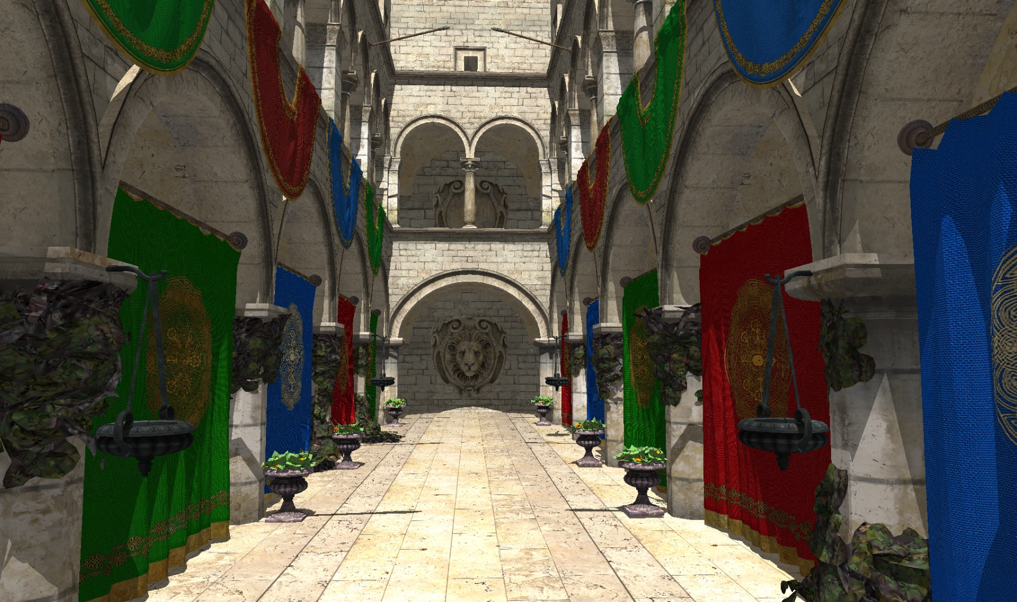
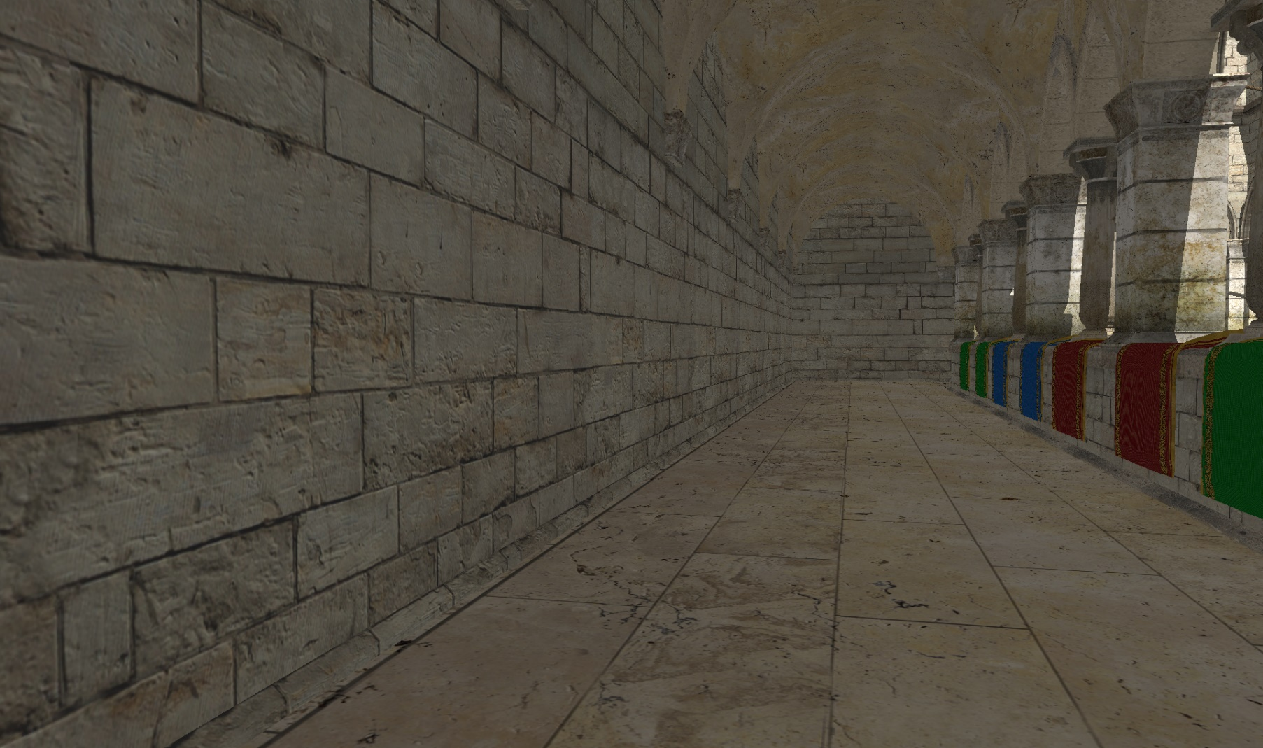
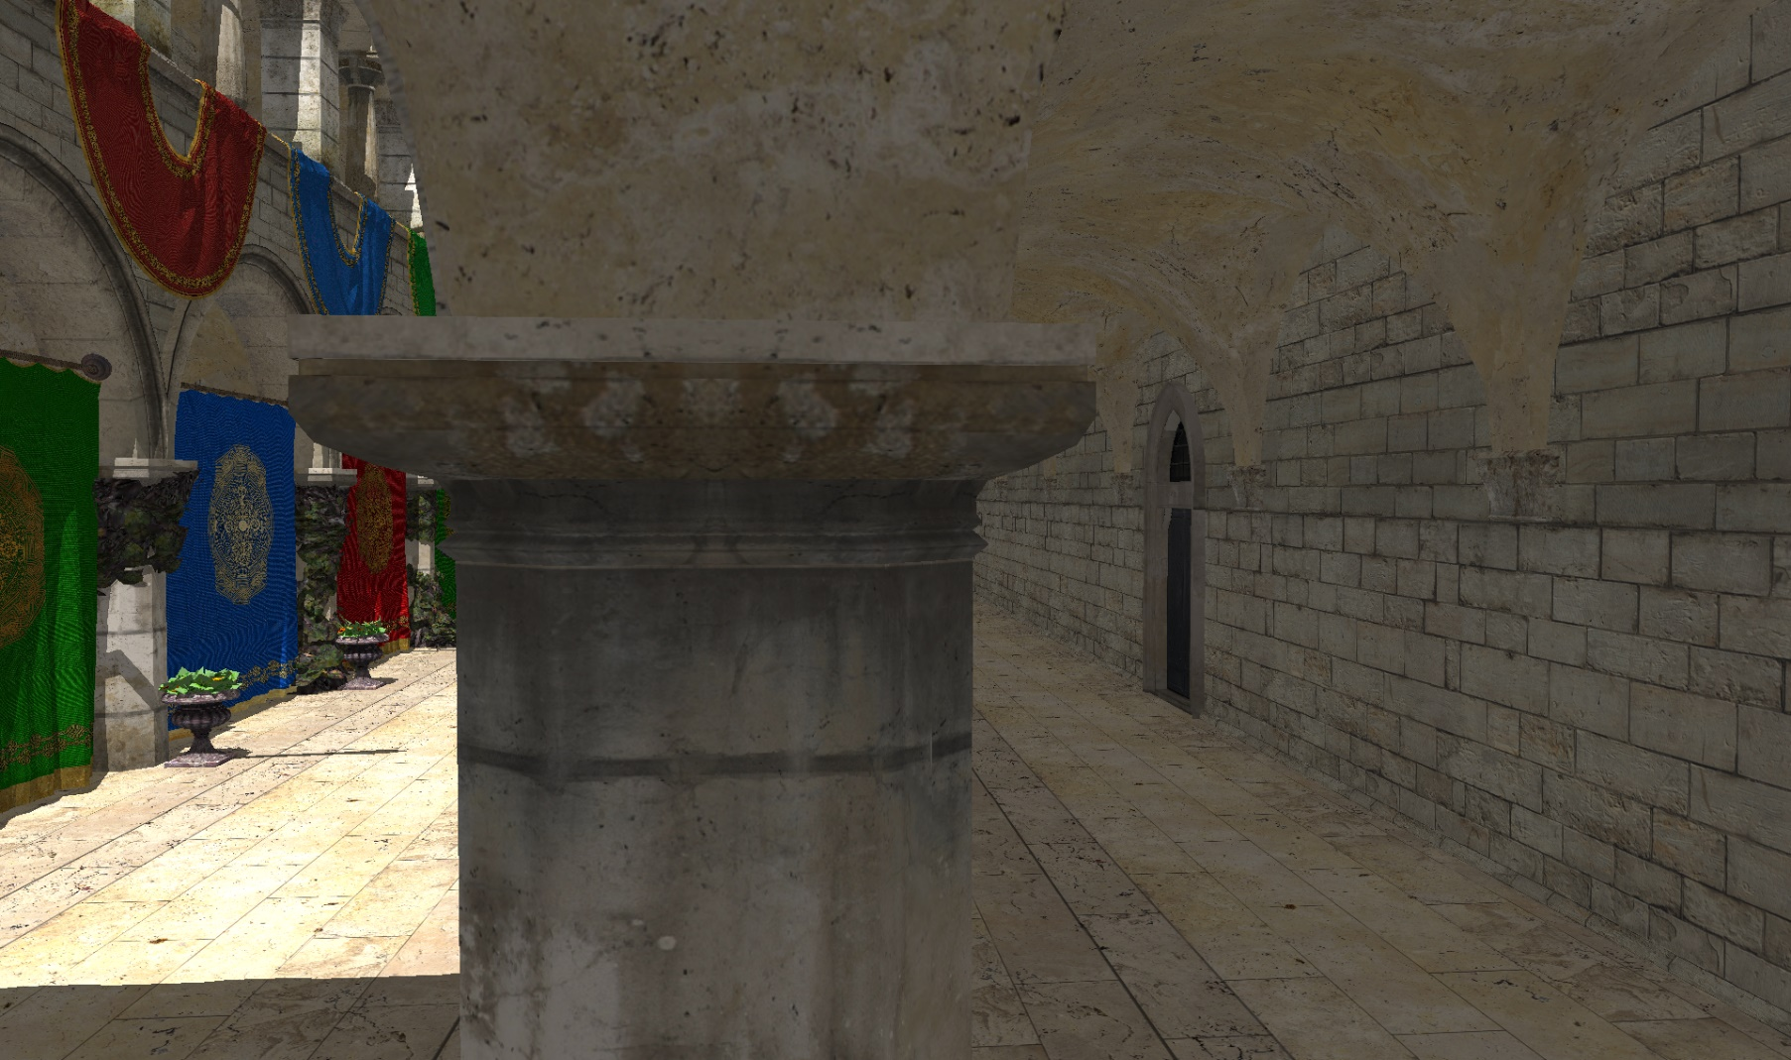
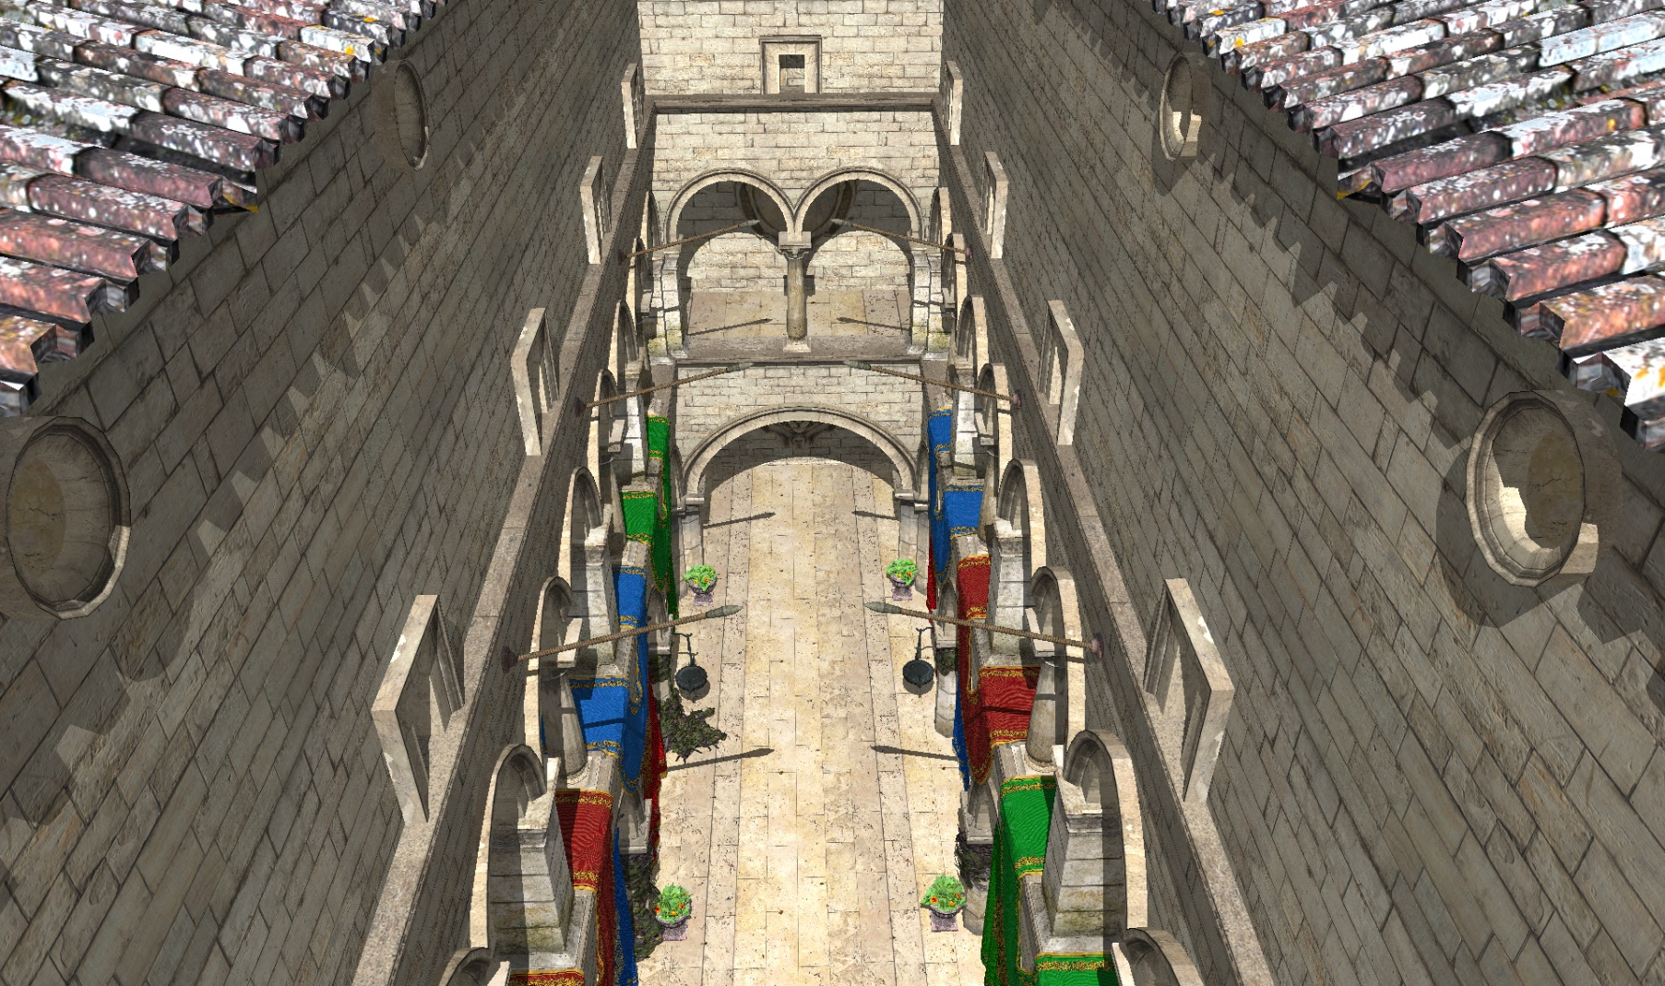
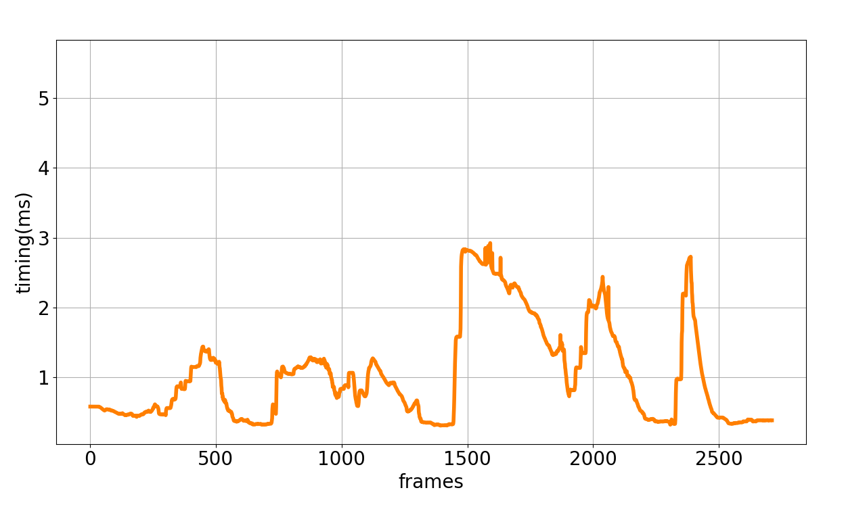
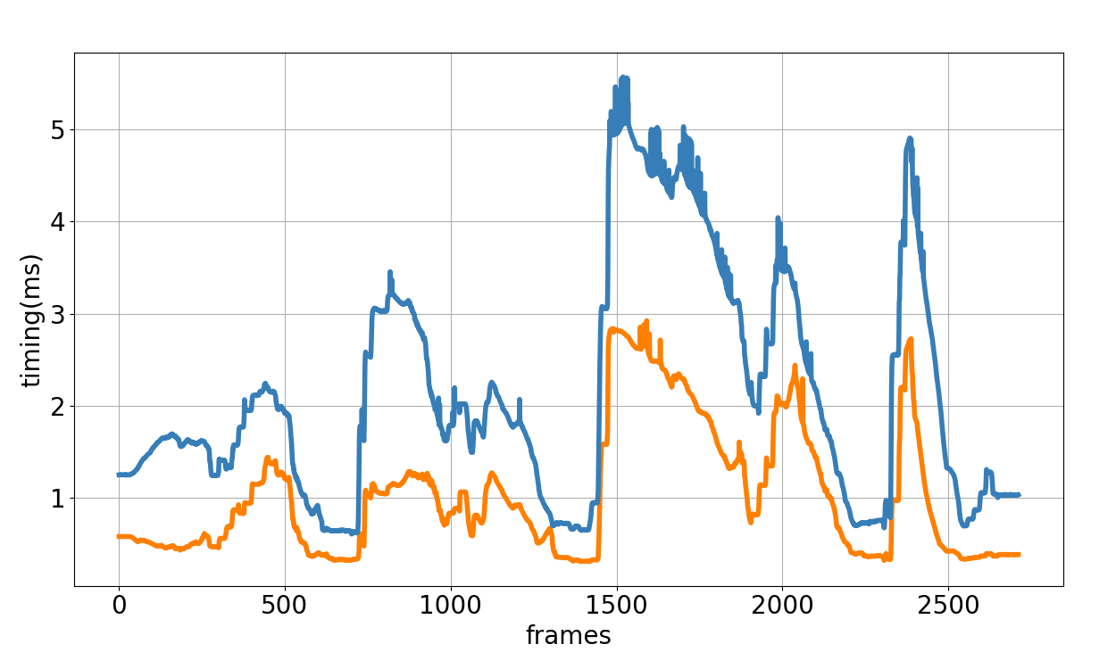
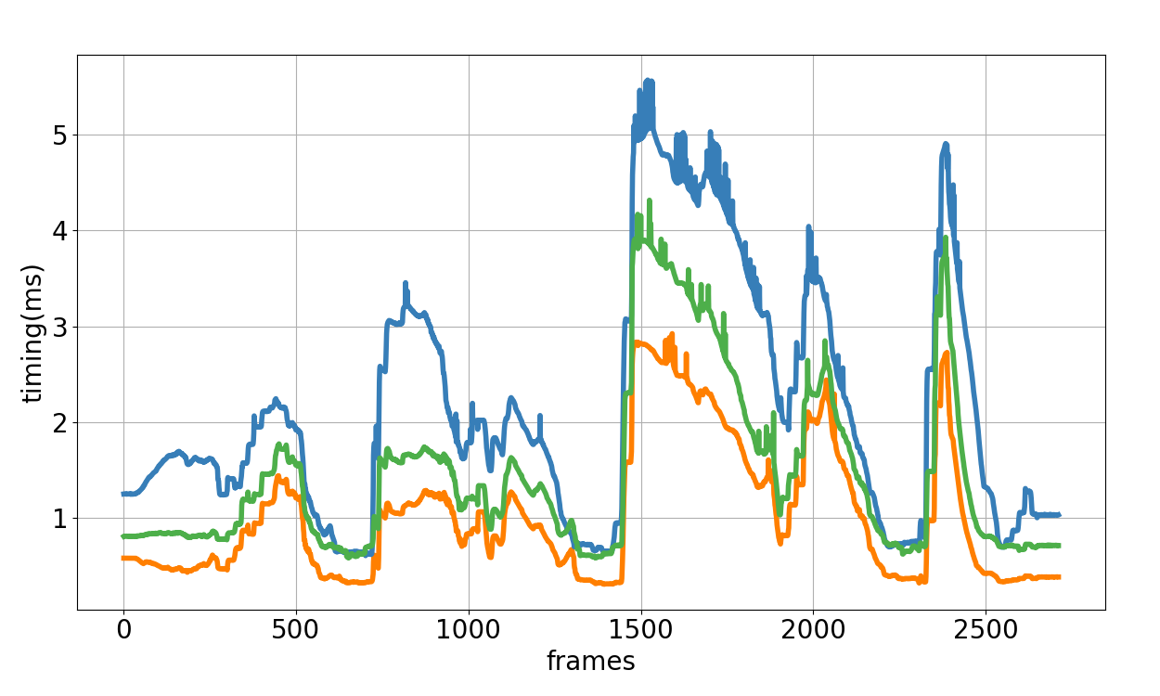
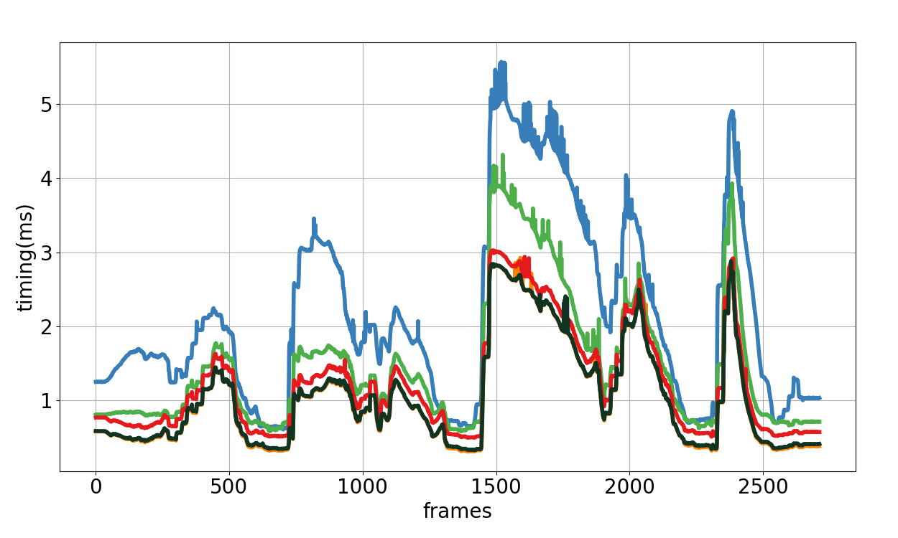
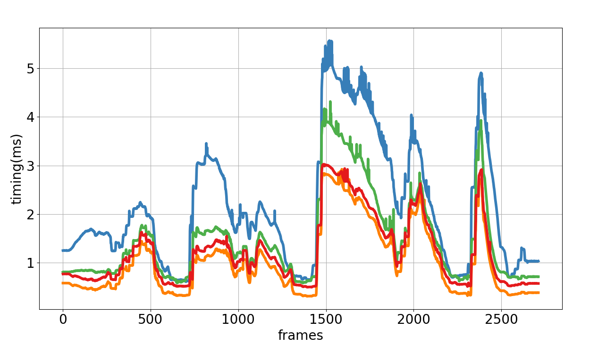
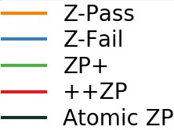
Results
Notes:
We made a fly through in the sponza scene. Before showing a timing.
1- pic and why it is important?
2-
3-
4-
Now lets look at the timings.
Order the legends. And fix the colors.
Discuss on the pictures. Why did we pick them.
2. Pic Little complexity in visible geometry whereas a lot of hidden geometry causes overdraw.
3. Pic both visible and hidden geometry is complex because of the column and the curtains rendered there. Difference between the algorithm should be smaller both again the z-fail would run slowest
4. Visible geometry high but invisible geometry is low.
Make the ZP+ and ++ZP distinctive. Double pass..
Ours is single pass…
Zpass is our baseline.. All of them does additional thing, we can not be better then this. But Zpass fails.
This figure shows the timings for Sponza scene with Z-Pass algorithm.
The starting frame is this where the camera is locatet at top and looks in the similar direction with the shadow quads. Then the camera goes to the first floor and takes a tour. When the camra looks orthogonal to shadow quads the speed drops. Then it takes a tour at the ground floor. Now the camera looks orthogonal to more shadow quads. Now it also considers shadow quads generated by the geometry at the 1st floor. And the last jump in speed is also at the ground floor. Shadow quads causes overdraw and depth test can not eliminate them. Lets see a scene also in action.
Since the camera moves mostly in the scene, we benefit a lot from depth test and z-Fail do not perform good.
In that scene ZP+ is more favorable to Z-fail.
However, ++ZP is still better than ZP+ since it renders to 1 pixel size target.
And our algorithm overlaps with Z-Pass. Yellow line is rarely seen, In other words there are few cases our algorithm does not achive the same performance with Z-Pass.

Slide 34
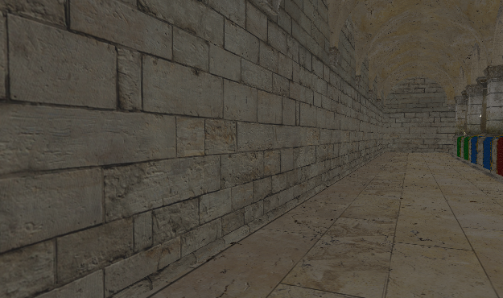
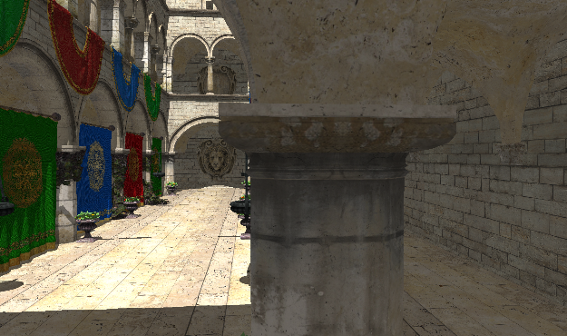
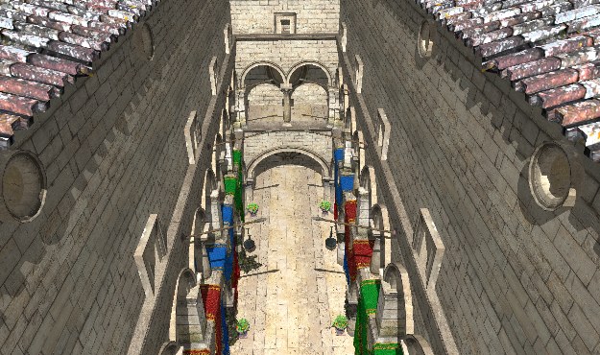
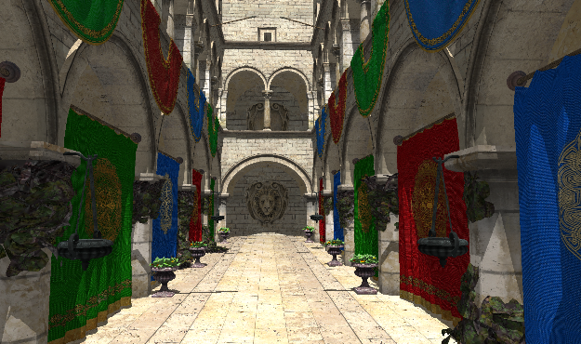
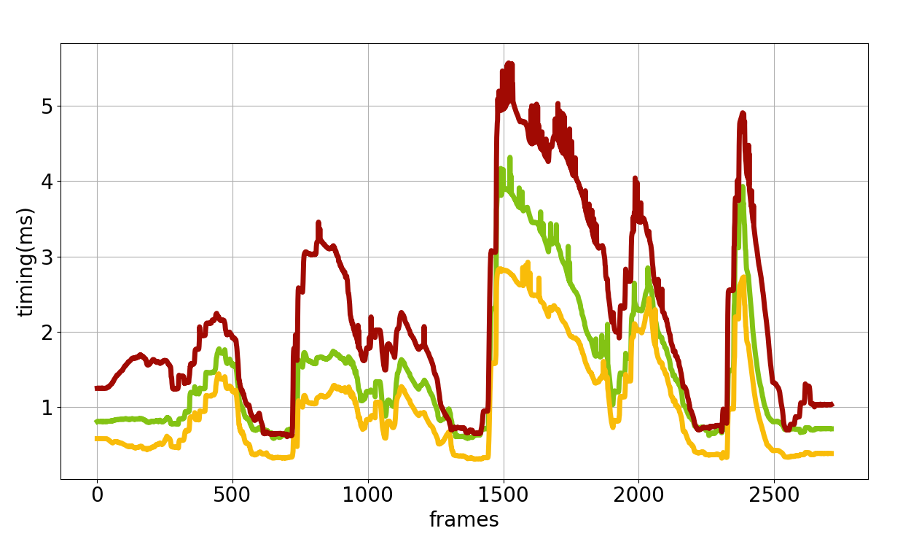
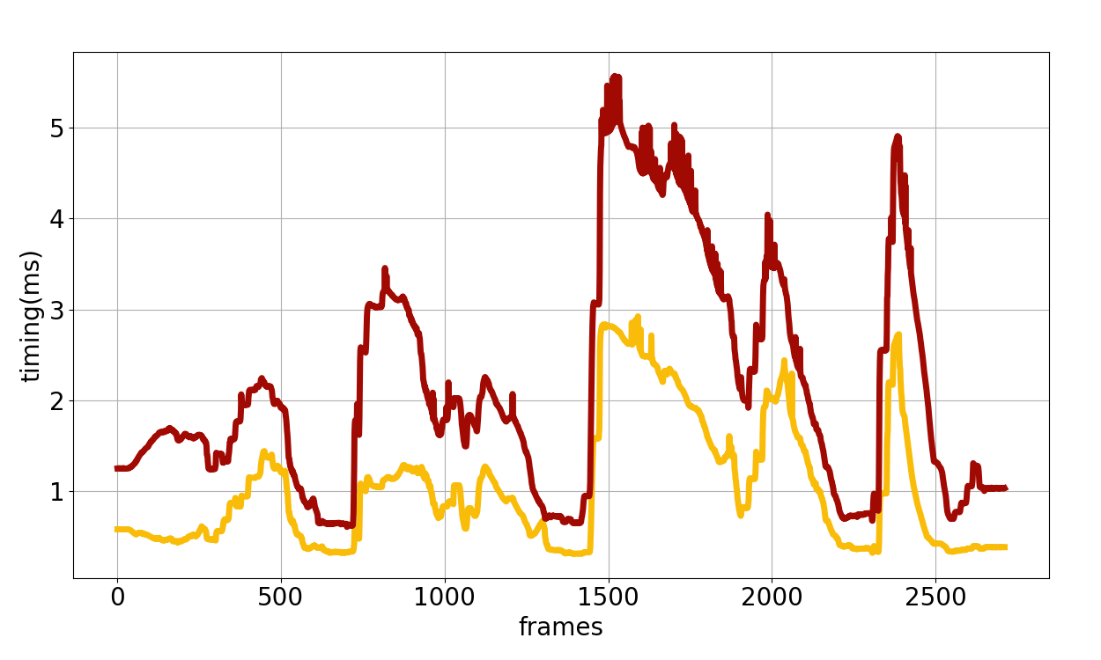
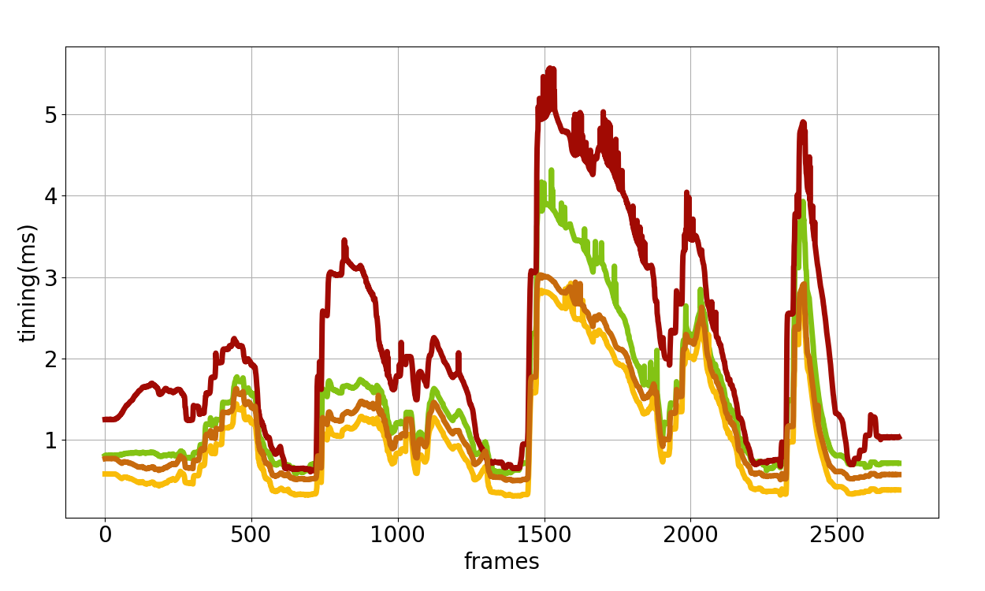
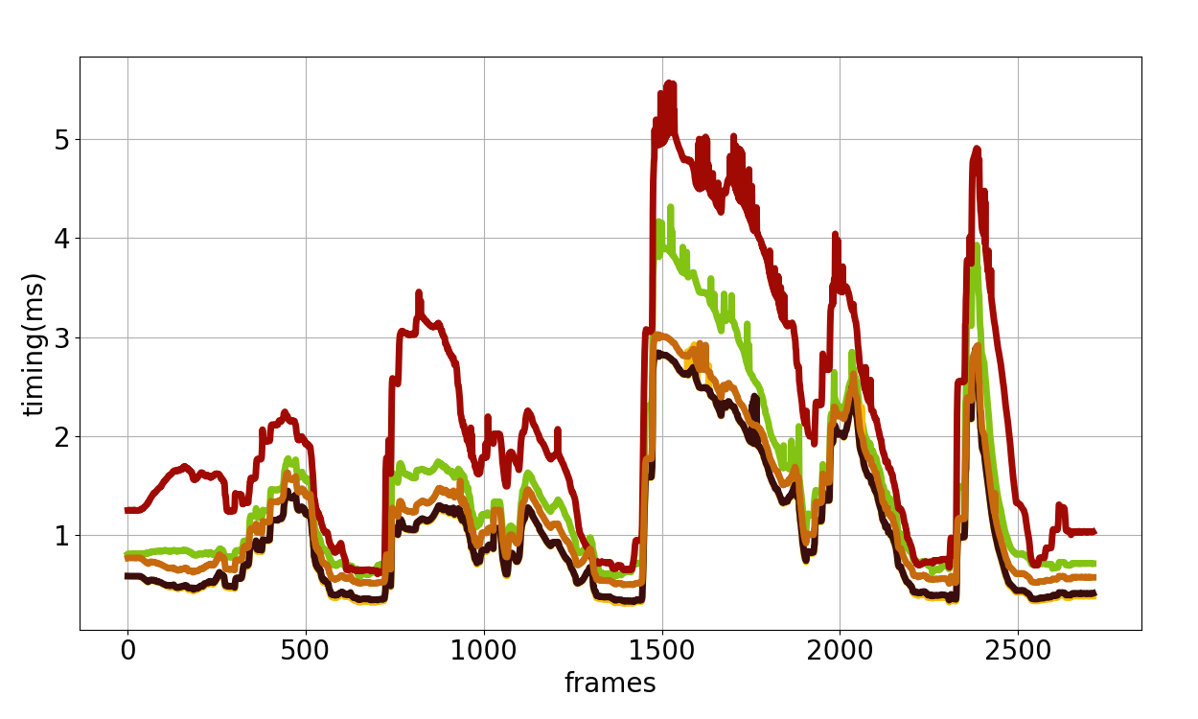
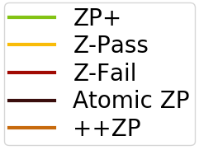
Results
Notes:
We made a fly through in the sponza scene. Before showing a timing.
1- pic and why it is important?
2-
3-
4-
Now lets look at the timings.
Order the legends. And fix the colors.
Discuss on the pictures. Why did we pick them.
2. Pic Little complexity in visible geometry whereas a lot of hidden geometry causes overdraw.
3. Pic both visible and hidden geometry is complex because of the column and the curtains rendered there. Difference between the algorithm should be smaller both again the z-fail would run slowest
4. Visible geometry high but invisible geometry is low.
Make the ZP+ and ++ZP distinctive. Double pass..
Ours is single pass…
Zpass is our baseline.. All of them does additional thing, we can not be better then this. But Zpass fails.
This figure shows the timings for Sponza scene with Z-Pass algorithm.
The starting frame is this where the camera is locatet at top and looks in the similar direction with the shadow quads. Then the camera goes to the first floor and takes a tour. When the camra looks orthogonal to shadow quads the speed drops. Then it takes a tour at the ground floor. Now the camera looks orthogonal to more shadow quads. Now it also considers shadow quads generated by the geometry at the 1st floor. And the last jump in speed is also at the ground floor. Shadow quads causes overdraw and depth test can not eliminate them. Lets see a scene also in action.
Since the camera moves mostly in the scene, we benefit a lot from depth test and z-Fail do not perform good.
In that scene ZP+ is more favorable to Z-fail.
However, ++ZP is still better than ZP+ since it renders to 1 pixel size target.
And our algorithm overlaps with Z-Pass. Yellow line is rarely seen, In other words there are few cases our algorithm does not achive the same performance with Z-Pass.

Slide 35
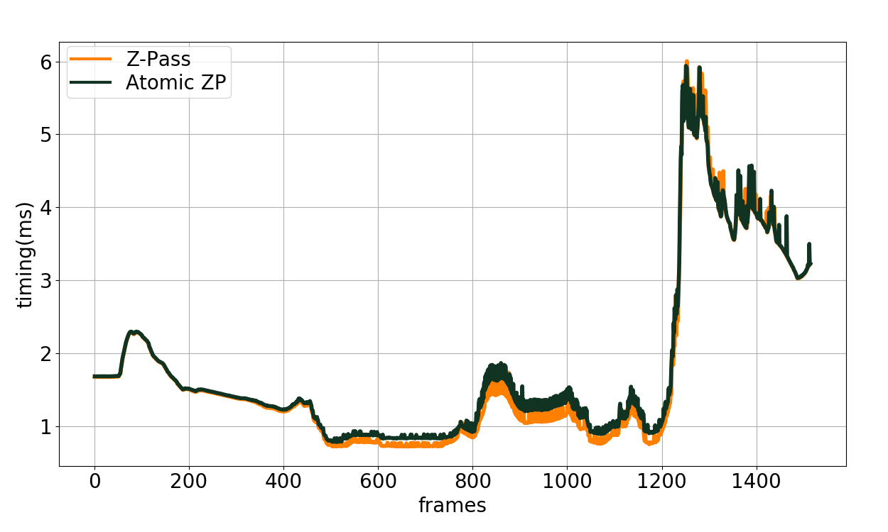
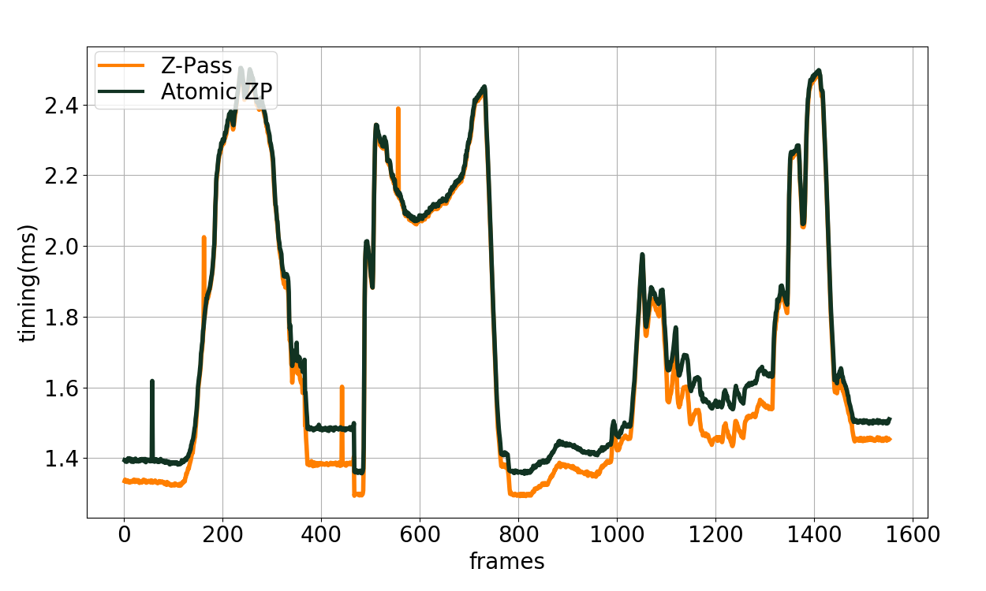
Results
Citadel
Buddha
Notes:
Here you can see that our algorithm and Z-Pass is nearly performs same. The overhead added by that 1 ray-triangle intersection is insignificant.
Achieved almost the baseline

Slide 36
Results
Notes:
In this scene there are a lot of draw calls, that is why the least performant one’s are ZP+ and ++ZP which have additional rendering pass. And our algorithm still performs almost same with Z-Pass.

Slide 37
Conclusion
Easy to implement, artifact free
Avoids additional Render Pass (ZP+ & ++ZP)
Avoids Rendering Hidden Geometry and Caps (Z-Fail)
Performs on par with Z-Pass
1 ray cast per light facing triangle overhead
Notes:
To conclude. We present a stencil algorithm that is very easy to implement and easy to integrate to existing pipelines. It also produces artifact free results.
It completely avoids the additional render pass ZP+ and ++ZP have
It also does not renders any additional geometry as Z-Fail does.
And most importantly, it adds little overhead and has almost the same speed with Z-Pass algorithm.
This gives the ultimate answer to stencil shadow volume. Or at least some answer… ONE MORE ANSWER..

Slide 38
A Practical and Efficient Approach for Correct Z-Pass Stencil Shadow Volume
http://graphics.tudelft.nl
Baran Usta
Leonardo Scandolo
Markus Billeter
Ricardo Marroquim
Elmar Eisemann
b.usta@tudelft.nl
l.scandolo@tudelft.nl
m.billeter@tudelft.n
r.marroquim@tudelft.n
e.eisemann@tudelft.n
Questions?
This work was supported by DyViTo that is funded by the European Union’s Horizon 2020 programme under grant agreement No 765121 and partially funnded by Swiss National Science Foundation Advanced Postdoc Mobility Project 174321.

Slide 39
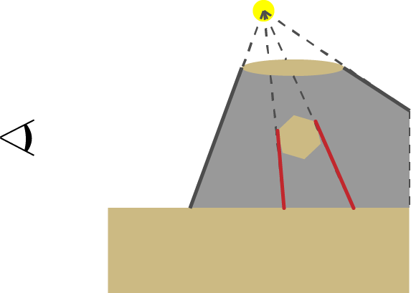
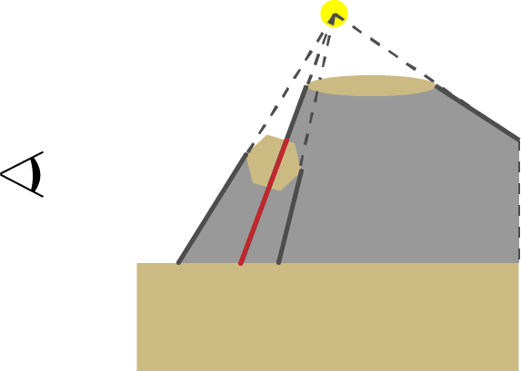
Shadow Volume Generation (Geometry Shader)
Silhouette Edge detection
Modify the index buffer & draw GL_TRIANGLE_ADJACENCY
Edge of 1 FF and 1 BF
Project to Infinity (generates a quad)
Generated face may not be a shadow edge (occluded & clamped)
Occluded
Clamped

Slide 40
ZP+
Edge cases
Near-Plane intersects both projected edge
Near-Plane intersects one projected edge and one infinite edge
Near-Plane intersects both infinite edge

Slide 41
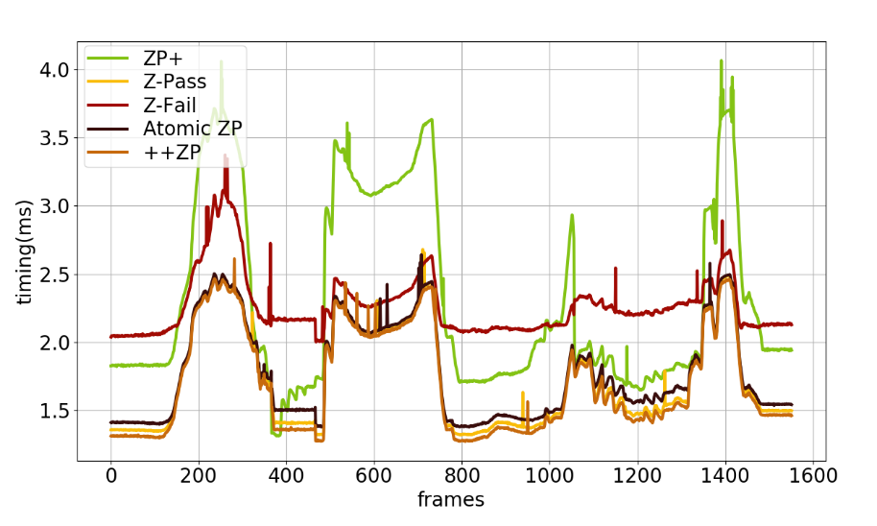
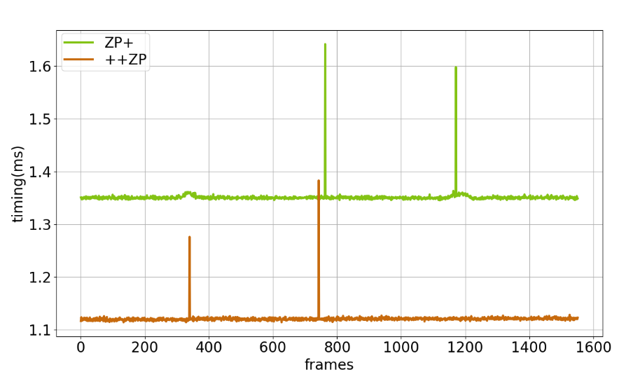
Buddha breakdown
Render Pass
(Stencil Update)
Render Pass
(Stencil Prepass)

