Slide 1
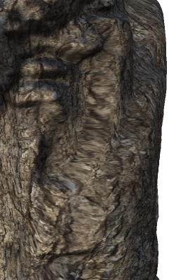
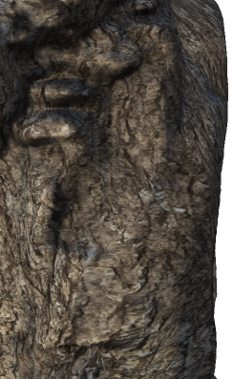
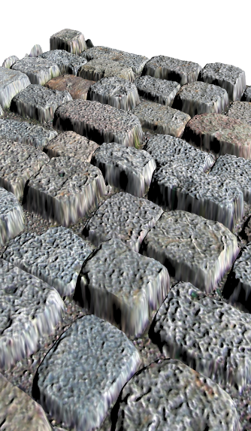
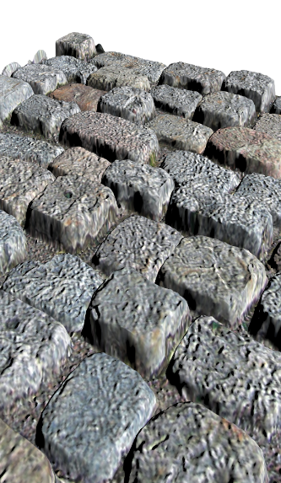
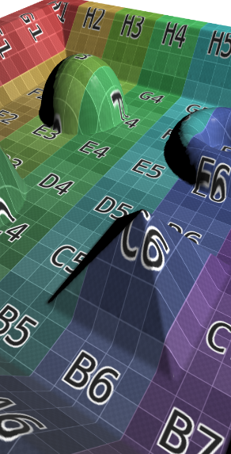
Distortion-Free Displacement Mapping
Tobias Zirr ¹ and Tobias Ritschel ² ¹ Karlsruhe Institute of Technology ² University College London

Slide 2
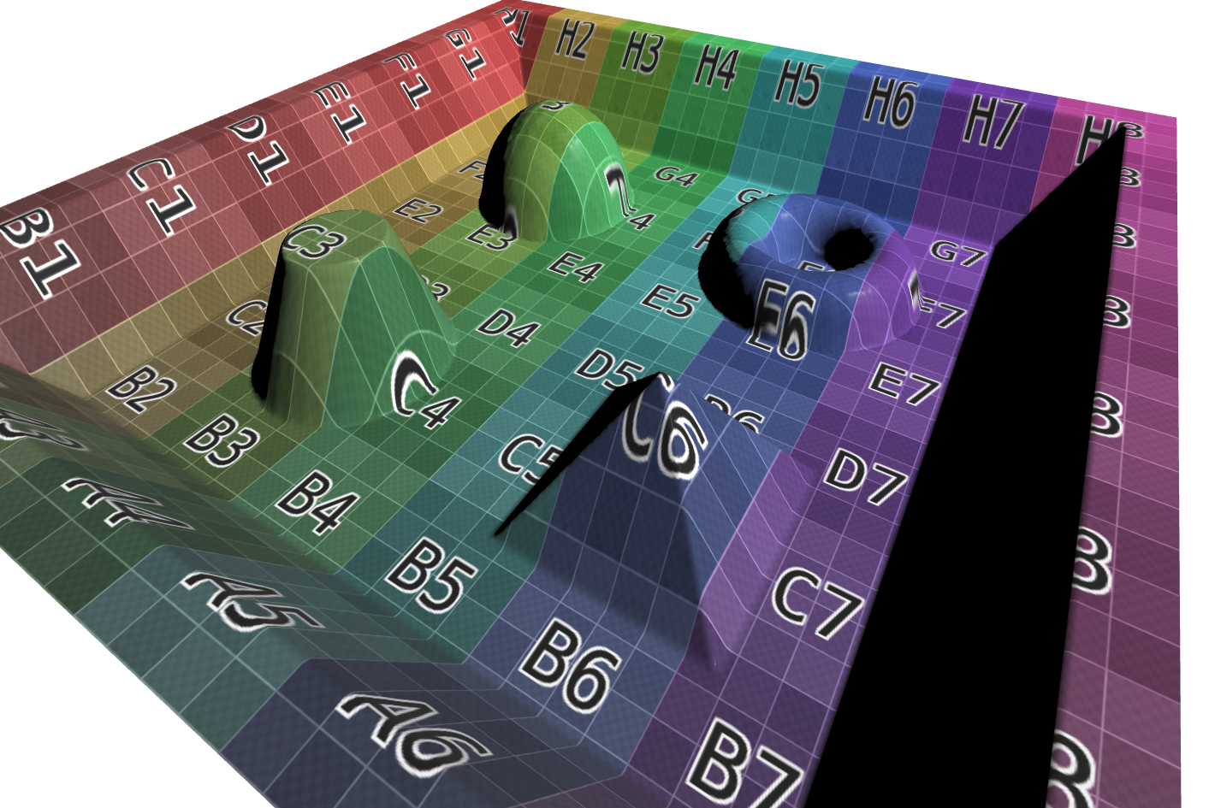
Displacement Mapping causes stretching
Displacement mapping on a plane
Notes:
When we apply displacement mapping to a simple planar quad, we usually use the same texture coordinates for the displacement texture as for the other textures

Slide 3
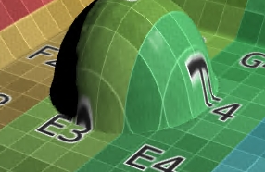
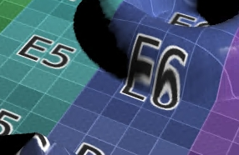
Displacement Mapping causes stretching
Displacement mapping on a plane
Notes:
However, if we look closely, we find that the planar texture coordinates are actually not ideal, once the displacement has made the surface non-planar. Especially in the steeper regions, the color texture is now severely distorted.
Now the question is, why should we not apply standard texture mapping approaches to get better texture coordinates also for the displaced geometry? Can we have sensible results with individual texture coordinates per texel?

Slide 4
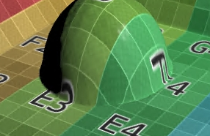
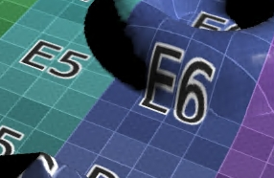
Can we have proper texture unwrapping?
Per-texel texture coordinates?
Notes:
It turns out that of course, we can, and it does in fact improve the results in a lot of cases. Optimizing for minimal distortion on the displaced surface gives us nicer texture mappings with a lot less stretching artifacts. The remainder of the talk will basically discuss how to get there and how to make sure that it still works with texture filtering and other aspects of texturing.

Slide 5
Previous Work
“Indirection Mapping for Quasi-Conformal Relief Texturing” [McGuire and Whitson, 2008]
Spring relaxation on mesh vertices (Iterative, Hierarchical)
Resampling of texture coordinates
Notes:
basic idea was already discussed in a 2008 paper by McGuire and Whitson. In our paper, we detail the commonalities and differences to their paper. Mainly, our project is implemented much faster and more straight-forward in one concise GLSL shader, allowing for interactive preview and editing of the results. Moreover, we apply standard robust optimization techniques to minimize established distortion metrics from parametrization literature, whereas their paper used a rather ad-hoc spring simulation. Basically, they interpret the edges of a displaced mesh as a dynamical system of springs, which they then iteratively relax to achieve more uniform vertex densities. Finally, they resample the warped mesh into a per-texel coordinate indirection texture.

Slide 6
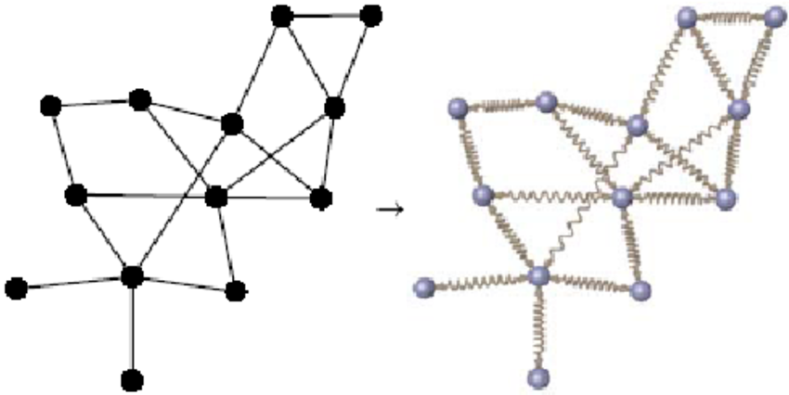
Optimization by Physical Analogies?
Optimization by physical models can give good results
Previous work [McGuire et al., 2008]
Also in graph embedding:
[Brandes, 2003]
Notes:
Now, optimization by dynamical systems analogies like iterative spring simulations are not always doomed to fail. In fact, they have been used quite a bit also in graph embedding for finding good graph layouts.

Slide 7
Optimization by Physical Analogies?
Optimization by physical models can (sometimes) give good results
Previous work [McGuire et al., 2008]
Also in graph embedding:
Problems:
Unknown step sizes
Oscillations?
Annealing?!
Good convergence speed?!
Indirectly defined energy
Guarantees / objectives?!
[Brandes, 2003]
Notes:
However, getting them to work can be a hazzle, and this approach comes with numerous unknowns and problems. Basically, you don’t know how fast you are allowed to simulate the system without causing oscillations that prevent convergence, unless you use annealing over time, in which case you don’t know how to still ensure good convergence rates, a bit like in deep learning. Finally, it is not always clear what you actually optimize for, because your objective is only indirectly encoded in the energies of your dynamical system.

Slide 8
Optimization by Energy Minimzation
Energy minimization is more flexible and controllable
Directly formulate your problem
E.g., metric on per-pixel texture coordinates
No resampling required (vs. previous work)
Notes:
In constrast, if we just look at the problem from non-linear optimization, we can build on lots of previous work from applied math to help with robust convergence. Moreover, we can directly formulate our problem and goals: We can define a metric directly on per-pixel texture coordinates to directly compute the final result. In contrast, the previous work by McGuire et al. has to use a resampling-based inversion to obtain their final texture coordinates.

Slide 9
Optimization by Energy Minimzation
Energy minimization is more flexible and controllable
Directly formulate your problem
E.g., metric on per-pixel texture coordinates
No resampling required (vs. previous work)
Flexible constraints
Boundaries
Artist Intervention
Tradeoffs like angle vs. area
Avoid invalid results like collapsed triangles
Notes:
As a plus, the minimization of energy functions is a really flexible framework that allows adding any additional interesting constraints like boundaries, artist modifications, tweaking of tradeoffs and avoidance of degenerate results. In general, we don’t have to reinvent the wheel, but rather just build on the well-researched field of mesh parameterization and unwrapping. A great overview is given by the 2008 Siggraph Asia Talk of [Hormann et al., 2008]

Slide 10
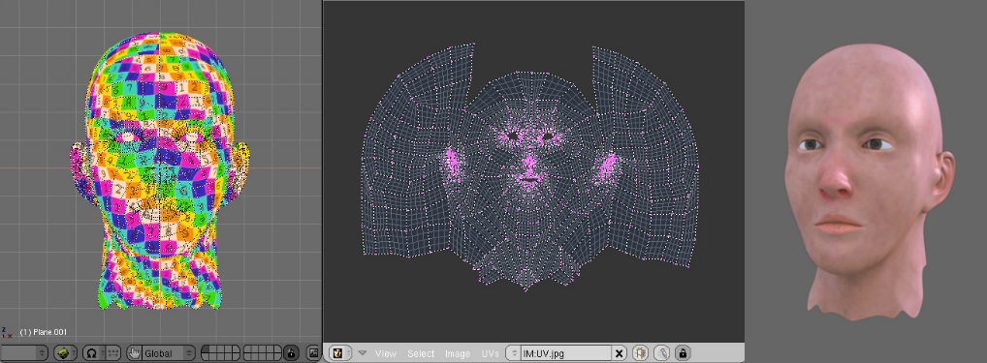
Conformal vs. Isometric Mappings
[Hormann et al., 2008]
Conformal mappings
Preserve angles
Guaranteed existence for “disks”
May require area stretching
Least-Squares Conformal Mapping (LCSM) in Blender
[Hormann et al., 2008]
Notes:
Now that we have chosen our tools, what is the goal that we want to optimize for? There are two typical objectives in parameterization: One is preservation of angles, which is given by conformal mappings. Nicely, there is even a guarantee of their existence for anything isomorphic to a disk.

Slide 11
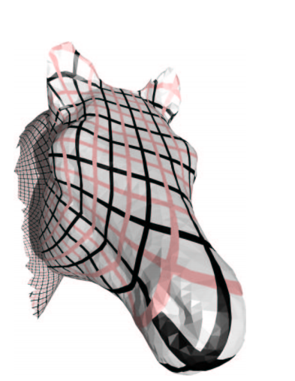
Conformal mappings
Angle preservation
Notes:
The result doesn’t look too bad. However, it quickly becomes apparent that preservation of angles is not all we would ask for from good texture mappings. In fact, we’d rather also have a certain uniform distribution of texture area in order to get stretch-free results.

Slide 12
Conformal vs. Isometric Mappings
[Hormann et al., 2008]
Conformal mappings
Preserve angles
Guaranteed existence for “disks”
May require area stretching
Isometric mappings
Also preserve area
No general existence guarantee
Approach as closely as possible
Least-Squares Conformal Mapping (LCSM) in Blender
[Hormann et al., 2008]
L2 Stretch Minimizing Parameterization [Sander et al., 2001]
Notes:
_Isometric_ mappings _also_ preserve area. However, it is rather obvious that at some point, our problem becomes somewhat over-constrained. Therefore, there is no existence guarantee for these types of mappings, we can only try to get as close as possible.

Slide 13
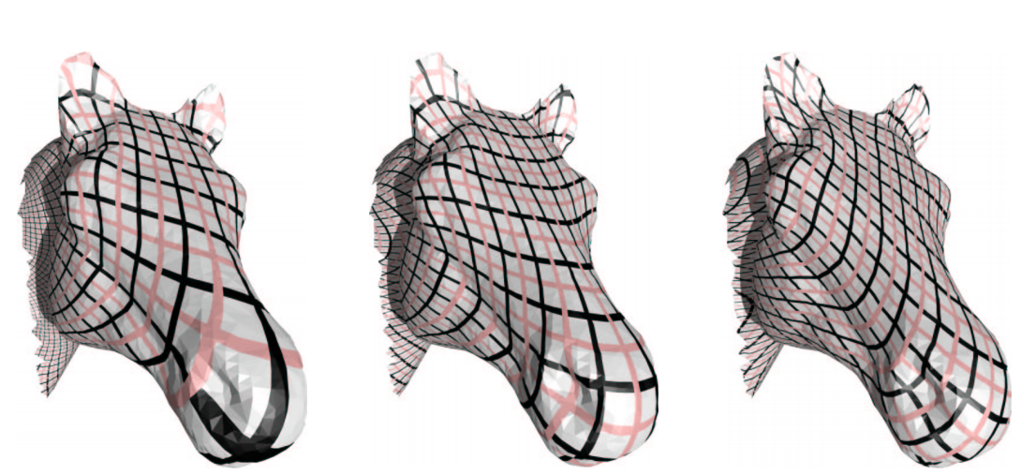
An Adaptable Surface Parameterization [Degener et al., 2003]
Controllable Area Preservation (via energy exponent $θ$)
Notes:
The energy function we use in our paper is taken from the paper ‘An Adaptable Surface Parameterization’ by Degener et al. Their energy provides a free parameter that allows a tradeoff between angle and area preservation, which gets us a lot closer to results that make us happy.

Slide 14
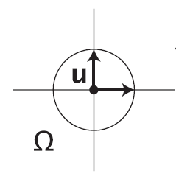
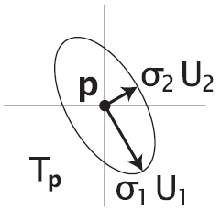
Undistortion Energy [Degener et al., 2003]
Texture Space
3D Space
Texture Mapping
[Hormann et al., 2008]
Notes:
So how do we measure distortion. If we look at a circle in texture space, texture mapping can cause all kinds of stretching of this circle as it is transformed onto the surface of a mesh in 3D space.

Slide 15
Undistortion Energy [Degener et al., 2003]
Texture Space
3D Space
Texture Mapping
[Hormann et al., 2008]
Notes:
Any triangle in the mesh has coordinates both in the texture space and the 3D space, and their angles and areas do not necessarily have to match!

Slide 16
Undistortion Energy [Degener et al., 2003]
Texture Space
3D Space
Texture Mapping
[Hormann et al., 2008]
$σ_{1}$ longest, $σ_{2}$ shortest stretch
Ratio: angle preservation
Product: change in area
Notes:
Now by looking at the singular values sigma of the transformation between texture space and 3D space, we can find the longest stretching sigma_1 and the shortest stretching sigma_2 of the transformation.
The ratio of this stretching gives us the amount of angle perturbation, and the product naturally just gives us the change in differential area.
The values sigma happen to coincide with the square roots of the easily computed eigenvalues of the first fundamental form, which is basically the transformation matrix squared

Slide 17
Undistortion Energy [Degener et al., 2003]
Texture Space
3D Space
Texture Mapping
[Hormann et al., 2008]
Degener et al.:
$$\left(\frac{σ_{1}}{σ_{2}}+\frac{σ_{2}}{σ_{1}}\right)⋅{\left(σ_{1}σ_{2}+\frac{1}{σ_{1}σ_{2}}\right)}^{θ}$$
$σ_{1}$ longest, $σ_{2}$ shortest stretch
Ratio: angle preservation
Product: change in area
Notes:
Therefore, the energy proposed by Degener et al. simply punishes non-unit ratios of the longest and the shortest stretching, while also trying to keep the change in area close to one. The exponent theta allows for a weighting of the area term, trading angle for area preservation.

Slide 18
Local Energy Optimization
Massively parallel gradient descent (GD) per texel
Gradient -> direction of highest local change
Notes:
That’s really all we need on the theory side. If you want to implement this and you are not into parameterization and optimization, some of this might first sound complicated, but really most of it is not much different from a physically-motived iterative spring solver. For each texel, we compute the gradient of our energy function with respect to its current texture coordinates and displacement. From calculus, we know that gradients point into the direction of highest local change, therefore our gradient shows us where to move the texture coordinate to improve energy in the current iteration

Slide 19
Local Energy Optimization
Massively parallel gradient descent (GD) per texel
Find local optimum along gradient line for each texel
Energy
Ideal Step Size
Gradient = direction of highest local change
Notes:
In the reverse gradient direction, energy will go down for some time, as distortion improves, and then, as some of the texture space triangles become smaller and smaller, go up again because their angle and area preservation get worse again. One thing we want to avoid is to choose an arbitrary step size, we’d rather like to take the largest step that gets us closest to the next local optimum.

Slide 20
Local Energy Optimization
Massively parallel gradient descent (GD) per texel
Find local optimum along gradient line for each texel
Energy
Gradient = direction of highest local change
Ternary line search of local optimum
Notes:
Fortunately, there is a fairly easy and fast solution to that, called ternary line search. The search interval defined by the current texture coordinate and the largest step that does not collapse any triangles …. is divided into three equidistant intervals.

Slide 21
Local Energy Optimization
Massively parallel gradient descent (GD) per texel
Find local optimum along gradient line for each texel
Energy
Gradient = direction of highest local change
Ternary line search of local optimum
Notes:
Then the interval boundary with the lowest energy becomes the center of the next search interval, excluding the boundary interval on the opposite side. This narrows our search region recursively

Slide 22
Local Energy Optimization
Massively parallel gradient descent (GD) per texel
Find local optimum along gradient line for each texel
Energy
Gradient = direction of highest local change
Ternary line search of local optimum
Notes:
Until finally, we get close to the local optimum along the gradient line

Slide 23
Ensuring Convergence
Parallel local optimum for constant neighborhood (otherwise oscillations!)
One thread per correction texel quad
Split across four iterations
4 * i + 0
4 * i + 1
4 * i + 2
4 * i + 3
Notes:
A detail that we have to take care of is the fact that our local energy optimization assumes that none of the neighbor texture coordinates are changing while the surrounding texture space is optimized. Therefore, in each parallel iteration, we can only optimize one out of four texels, such that successively, each per-texel texture coordinate can move towards a local optimum without oscillations.

Slide 24
GLSL implementation can run interactively ☺
[MOVIE]
Notes:
We implemented all of this in one concise GLSL shader, which can even interactively run in the browser. We have an online demo for you available on the project page.

Slide 25
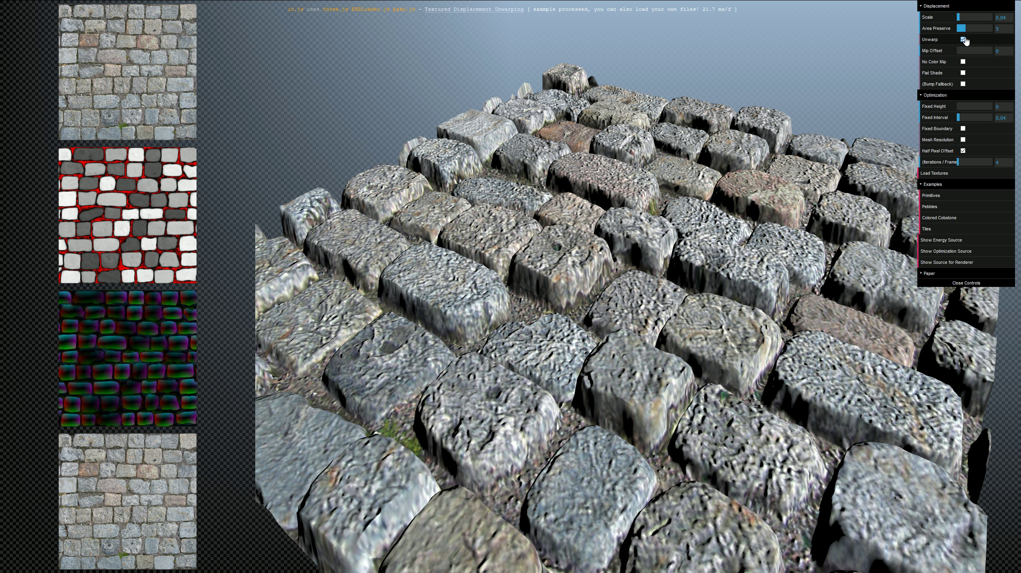
GLSL implementation can run interactively ☺
Notes:
optimized result

Slide 26
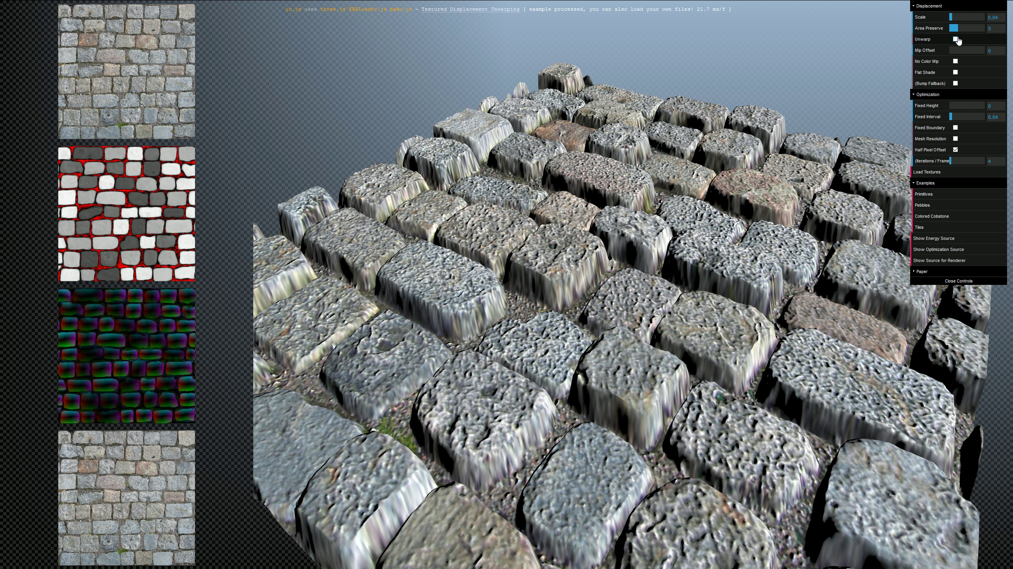
GLSL implementation can run interactively ☺
Notes:
without our correction warping

Slide 27
GLSL implementation can run interactively ☺
Notes:
optimized result

Slide 28
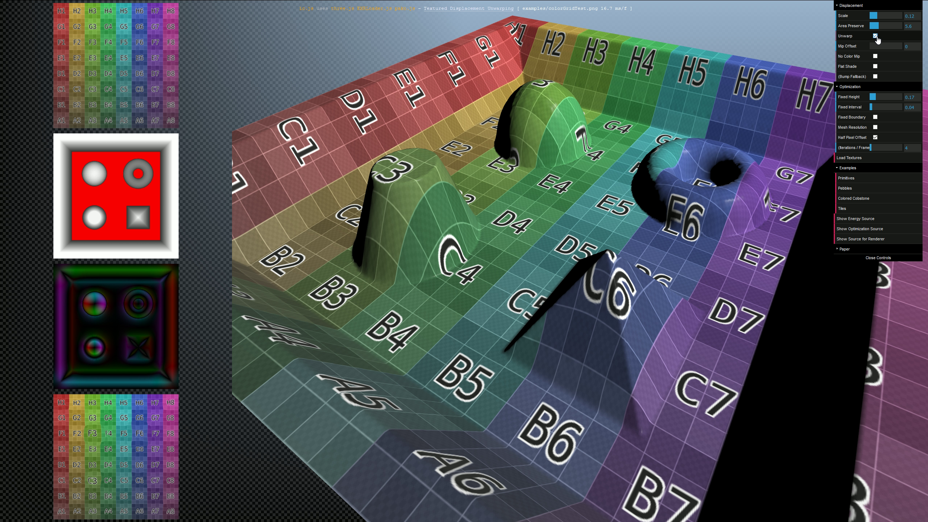
GLSL implementation can run interactively ☺
Notes:
optimized result

Slide 29
GLSL implementation can run interactively ☺
Notes:
without our correction warping

Slide 30
GLSL implementation can run interactively ☺
Notes:
optimized result

Slide 31
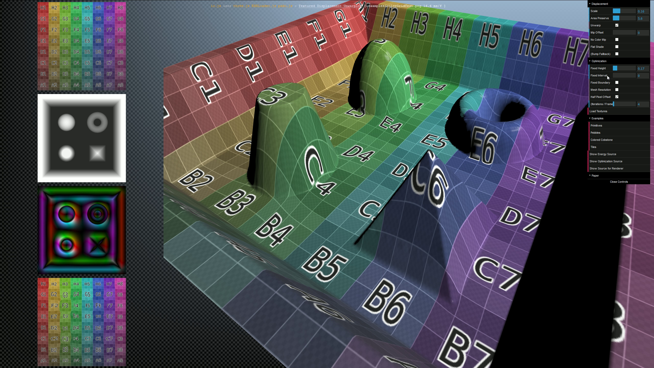
GLSL implementation can run interactively ☺
Notes:
straight lines can curved by the optimizer, which we potentially want to avoid

Slide 32
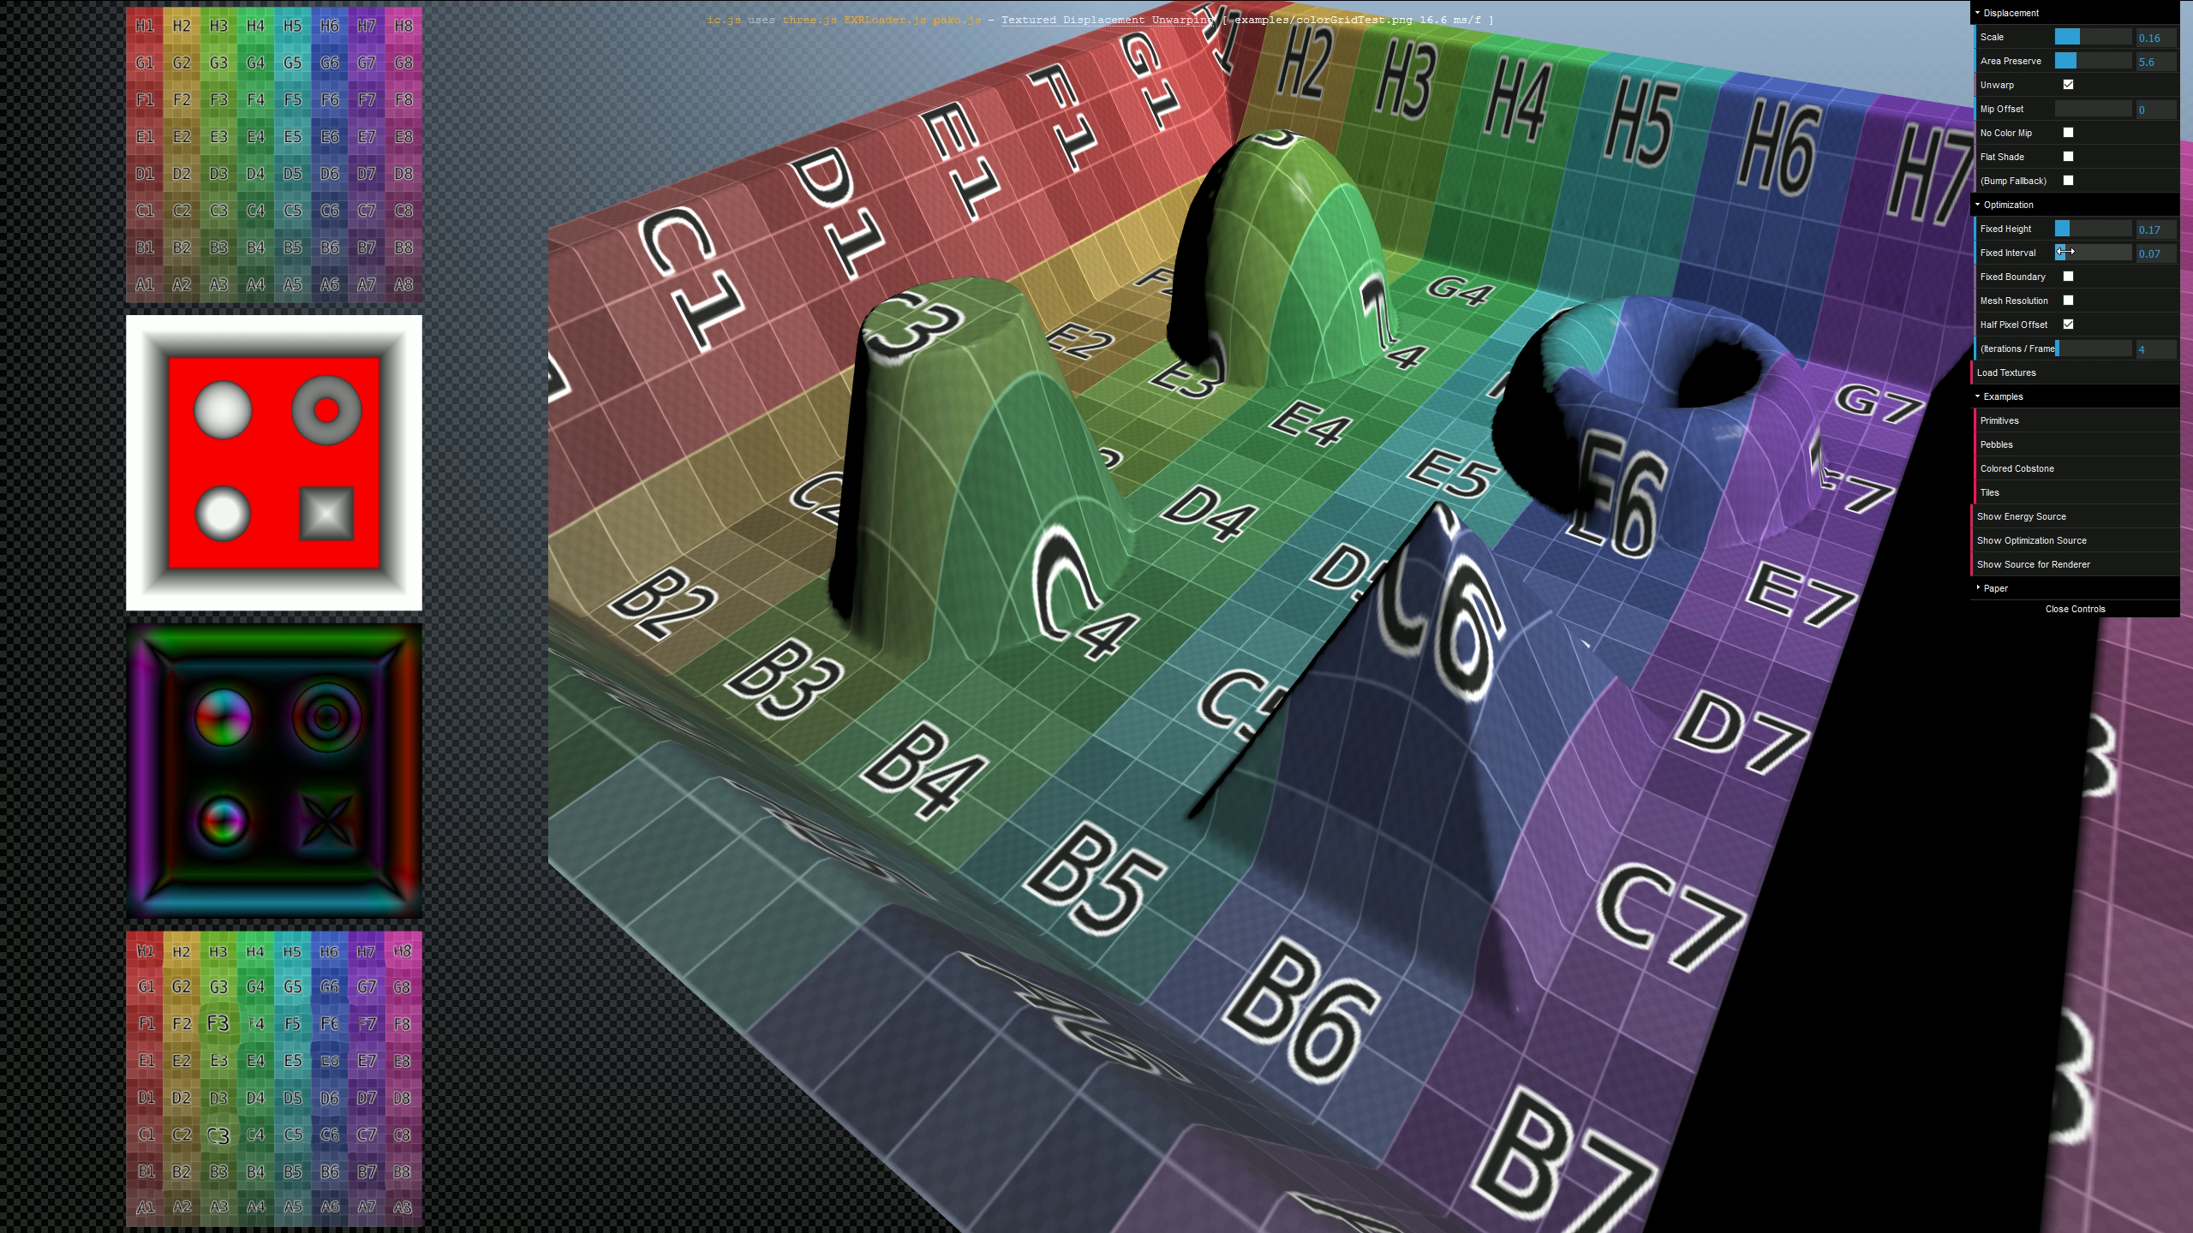
GLSL implementation can run interactively ☺
Notes:
we potentially want to avoid by an additional fixation constraint (red)

Slide 33
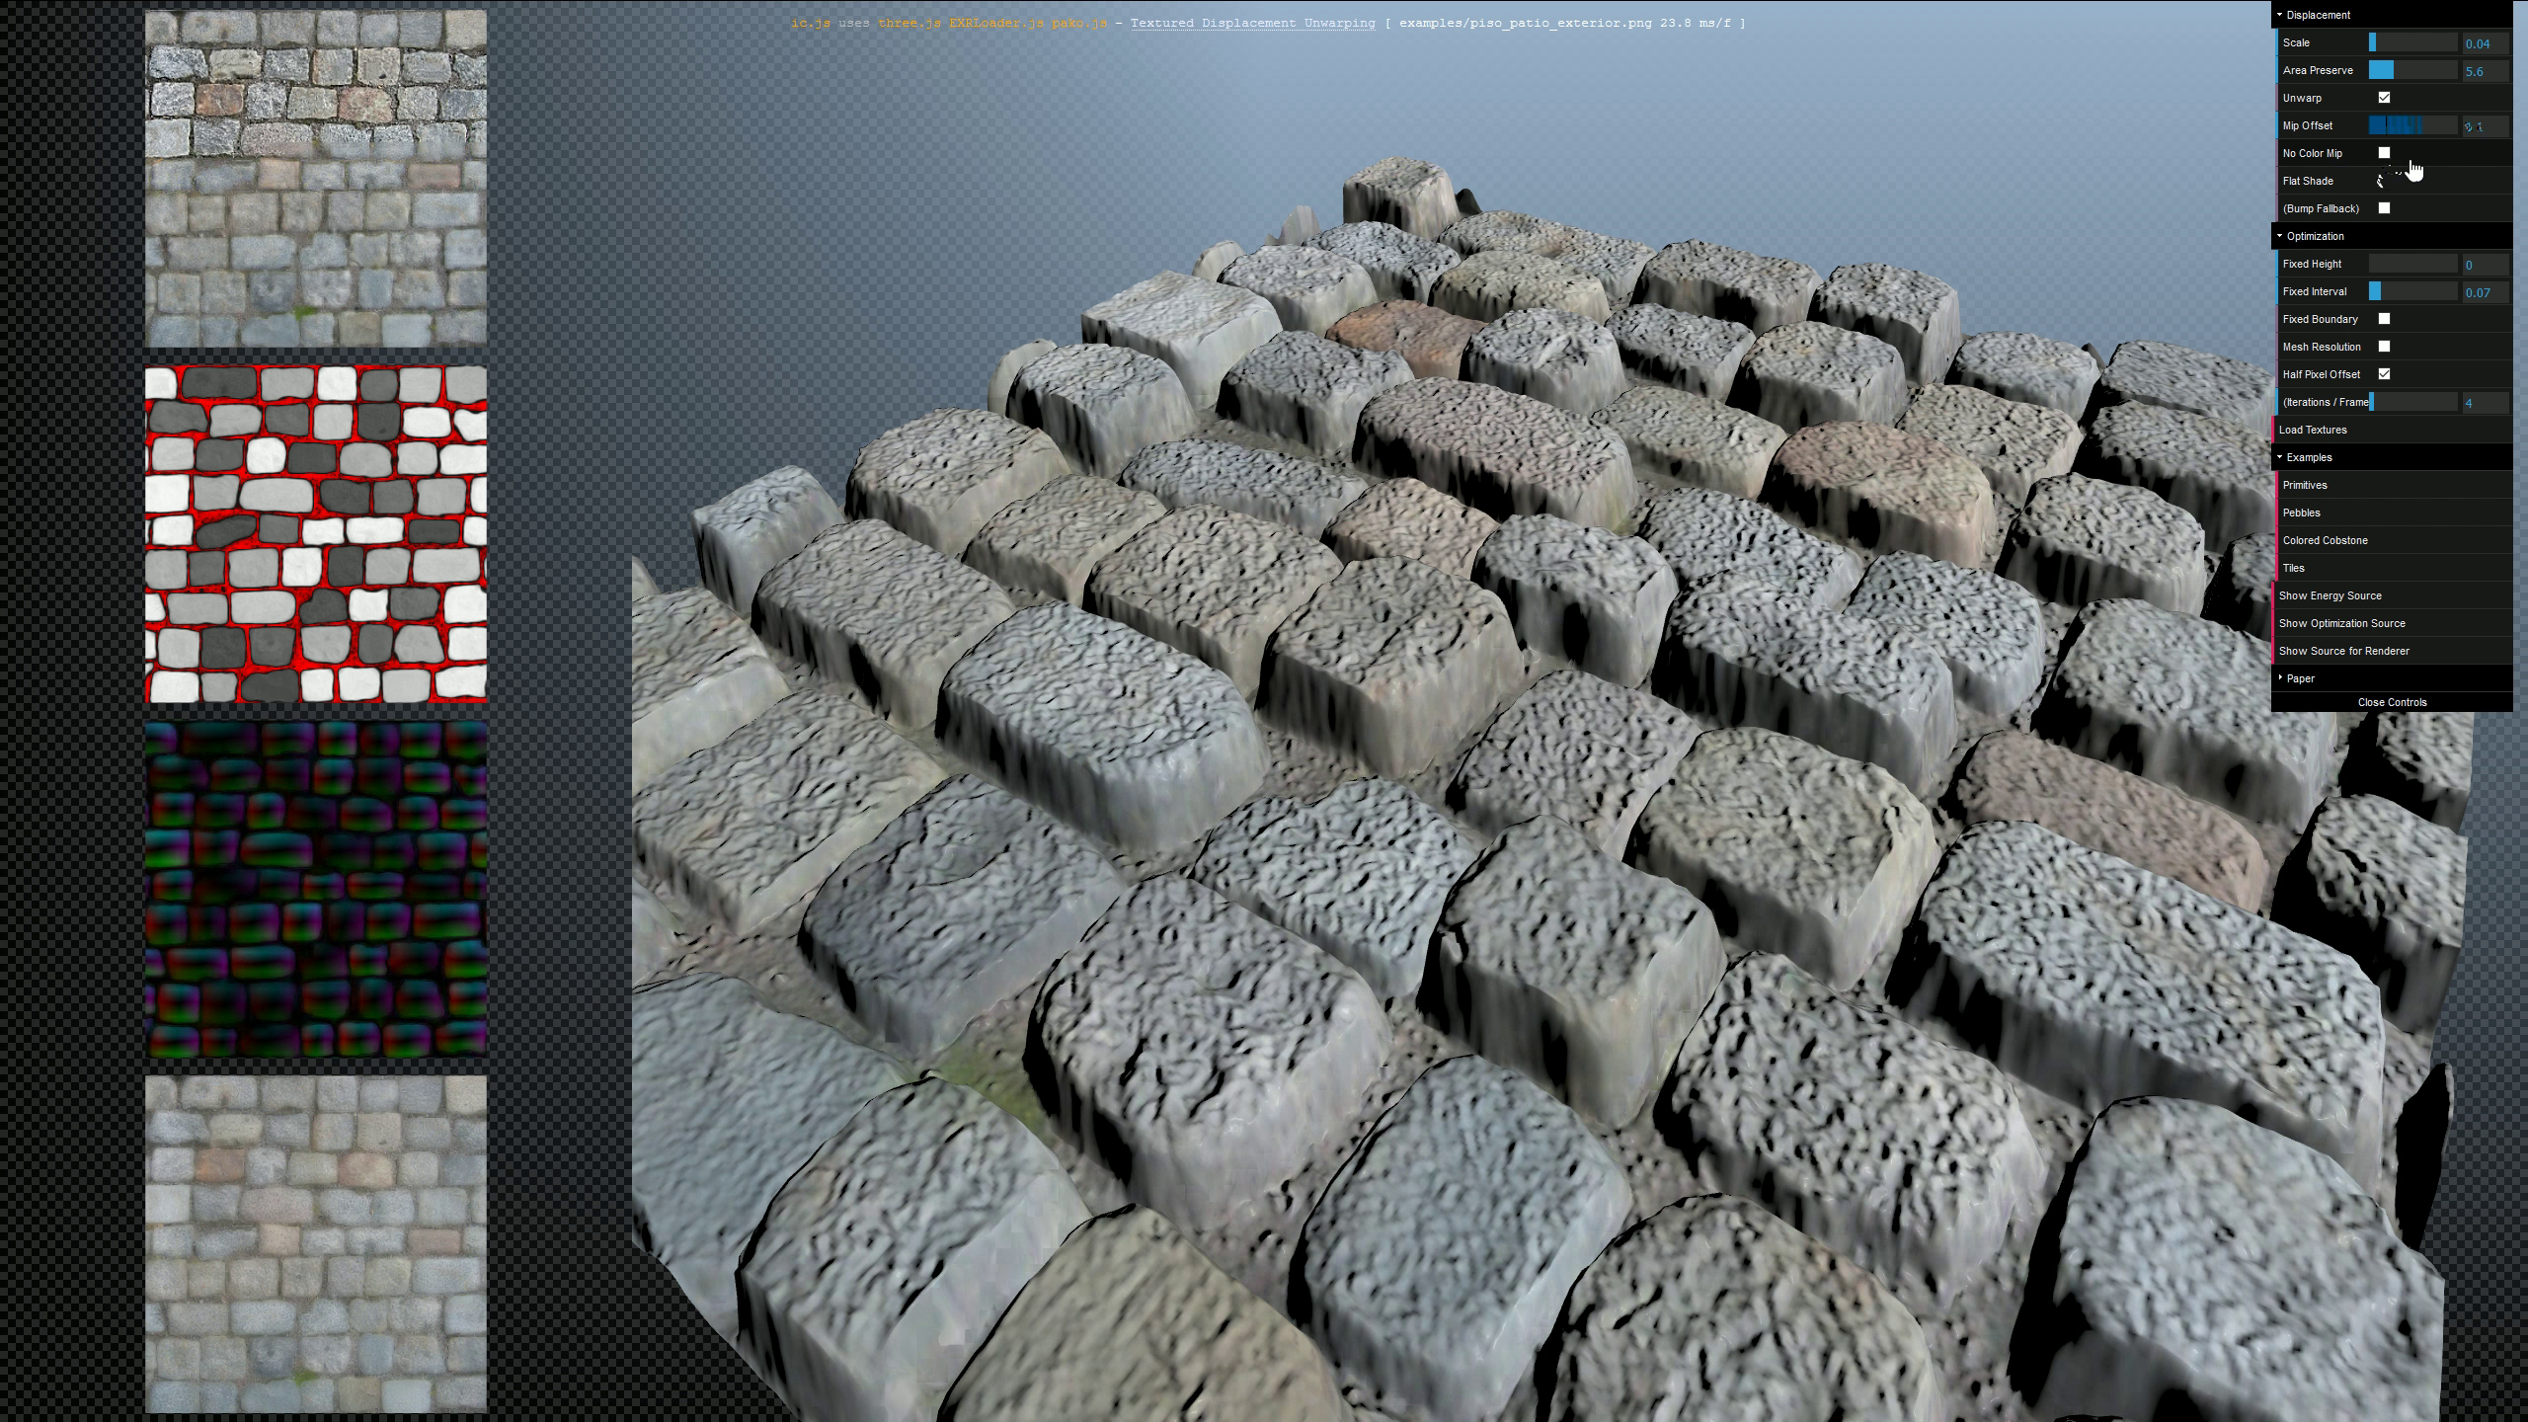
GLSL implementation can run interactively ☺
Notes:
And finally, the effect of mip mapping both the per-texel coordinates and the actual texture map at the same time, with an LOD bias moving up and down again.

Slide 34
GLSL implementation can run interactively ☺
Notes:
And finally, the effect of mip mapping both the per-texel coordinates and the actual texture map at the same time, with an LOD bias moving up and down again.

Slide 35
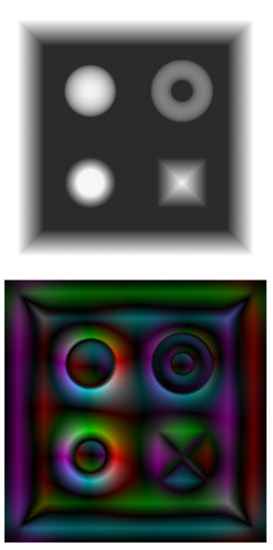
Store relative per-texel coordinates!
We don’t store per-texel coordinates, but per-texel offsets!
Small magnitude (compact quantization)
Works across texture tiling borders (preserving pixel derivatives)
Displacement D
Per-texel texcoord offsets
Notes:
A rather important detail of our approach is that we do not store the actual per-texel coordinates, but rather relative texture coordinate offsets. This has two benefits, for one the magnitude of these offsets is smaller, making them much easier to compress. Secondly, for repeated textures, absolute texture coordinates would introduce discontinuities on texture tiling boundaries. In contrast, relative offsets nicely preserve pixel derivatives.
On a side note, In case of tiling, we also change the boundary conditions of the optimization to allow movement of per-texel coordinates across borders on the fully connected torus.

Slide 36
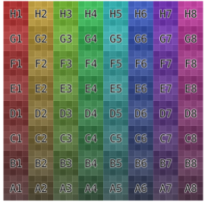
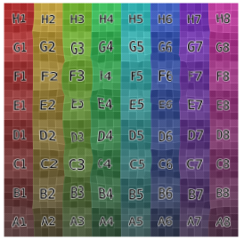
Store relative per-texel coordinates!
Linear texcoord + per-texel offset
Albedo A
Warped A
Displacement D
Per-texel texcoord offsets
Notes:
Our texture correction offsets store the difference from linearly interpolated planar texture coordinates to our per-texel corrected texture coordinates.
In order to apply our undistortion, we simply add the per-texel offsets to the linearly interpolated texture coordinates, and then evaluate the actual surface texture maps using this computed coordinate.

Slide 37
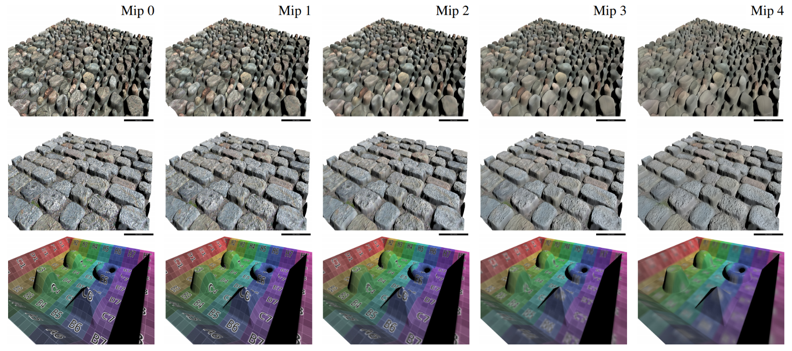
Mip Mapping
Simplest solution works OK:
Mip Maps for both Correction Offsets & Color Textures
Notes:
For mip mapping, the simplest solution actually works quite OK: we mip map both the correction offset texture and the actual surface textures. While mip mapping the per-texel coordinates sometimes shifts these coordinates around a bit, the parallel loss in texture resolution nicely covers that up.

Slide 38
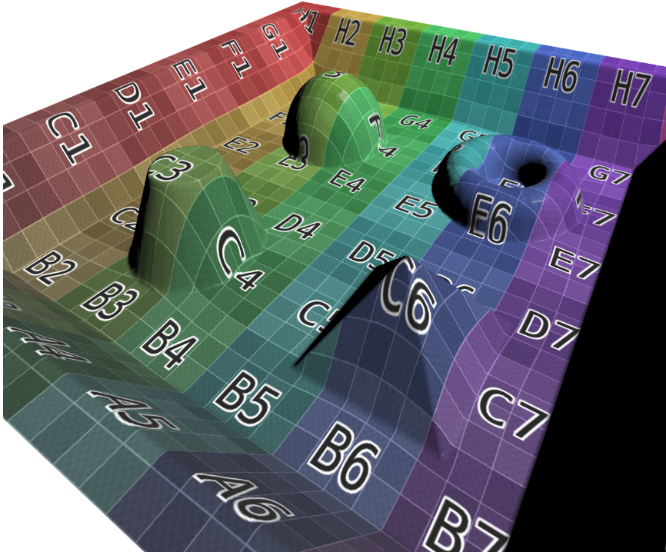
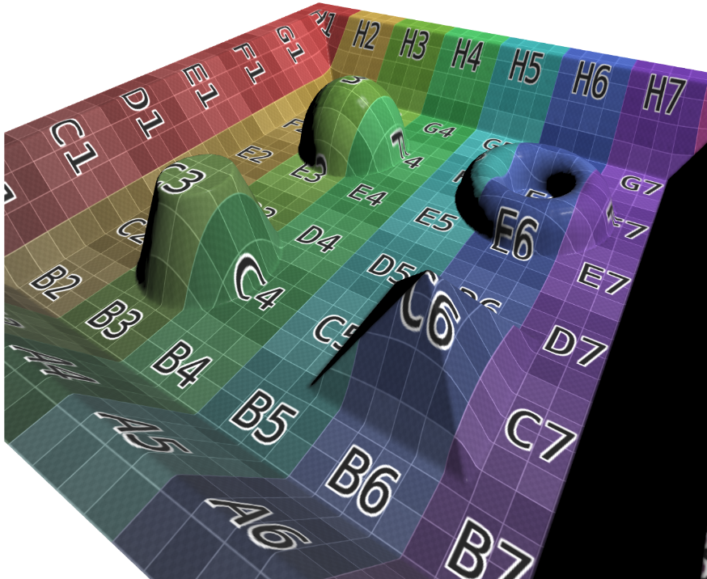
Fixation Energy
Optimization can lead to unwanted distortion
Perturbed straight lines
Notes:
In the video, we already saw that sometimes, we want to fix certain parts of textures to their predetermined location in order to prevent perturbation of important lines.

Slide 39
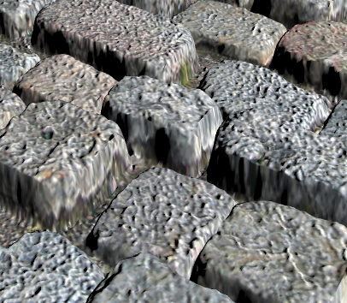
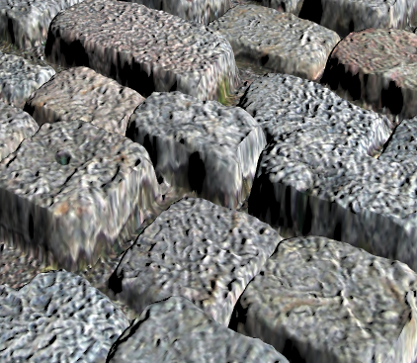
Fixation Energy
Optimization can lead to unwanted distortion
Correlations between texture and geometry
Notes:
This also affects other cases, where the optimization can for example pull up some parts of surface textures that we want to stay down, like dirt inside crevices between cob stones. In the paper, we show a simple and effective fixation energy constraint that allows users to mark arbitrary parts of displacement textures to be excluded from the undistortion optimization.

Slide 40
Fixation Energy
Optimization can lead to unwanted distortion
Correlations between texture and geometry
Perturbed straight lines
We allow to mark parts of textures fixed by an additional fixation energy term
Albedo A
Displacement D, Fixation
Correction Offsets c(u)
Corrected A ( u + c(u) )
Notes:
Note black correction offset texture in fixed parts

Slide 41
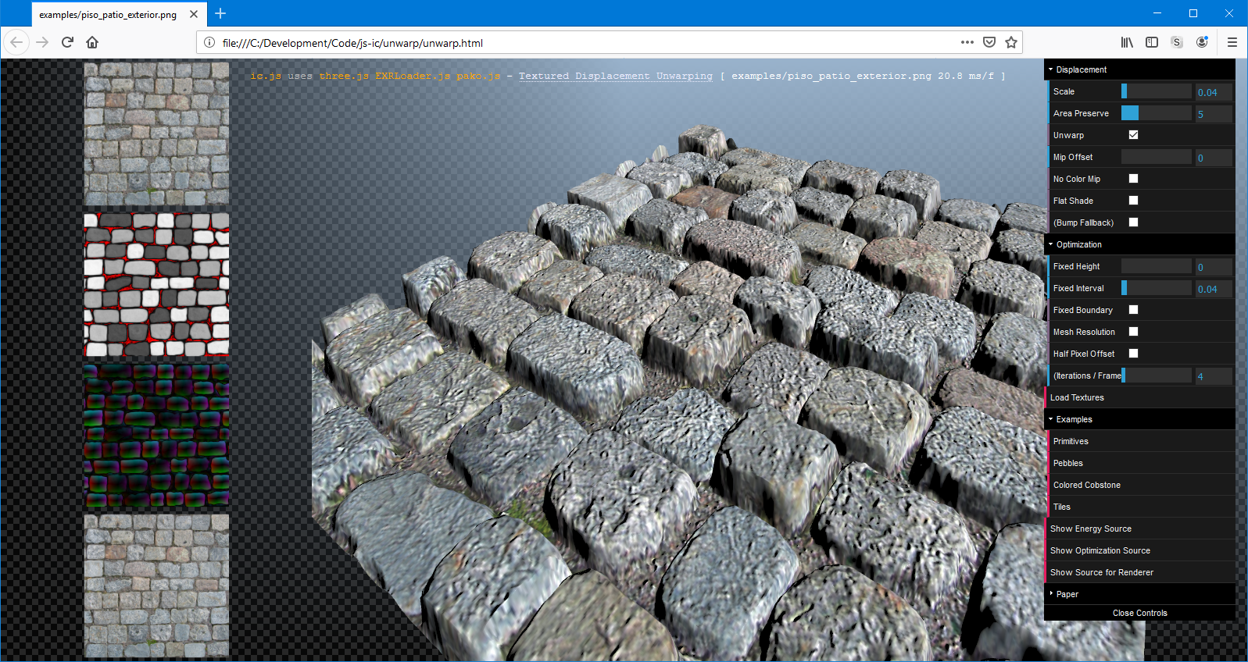
Example Code / Interactive Demo
Example implementation: https://github.com/tszirr/ic.js/tree/master/unwarp
Notes:
online demo tool and source code, you can refer to the following Github repository.

Slide 42
Thank you!
Project sources:
http://www.alphanew.net
Questions?
Contact
Tobias Zirr tobias.zirr@alphanew.net Twitter: @alphanew http://www.alphanew.net
Tobias Ritschel http://www.homepages.ucl.ac.uk/~ucactri
Notes:
With that, I conclude my talk and am open for questions.

Slide 43
Implementation Tips
Default evaluation of displacement: on texel boundaries
Default evaluation of correction offsets: on texel centers

Slide 44
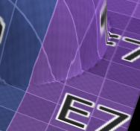
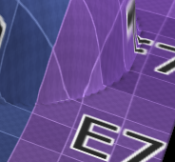
Correct with Half Texel Offset
Match undistortion with displacement grid
Use half texel offset
Apply during correction optimization
Undo during correction evaluation
Fixes resampling artifacts

