Slide 1
Position-Based Simulation of Elastic Models on the GPU with Energy Aware Gauss-Seidel Algorithm
Ozan Cetinaslan
Instituto de Telecomunicações & Faculdade de Ciências, Universidade do Porto, Portugal
Notes:
First of all, I would like to thank you for being in my presentation.
My name is Ozan Cetinaslan, and
The title of my paper is Position-Based Simulation of Elastic Models on the GPU with Energy Aware Gauss-Seidel Algorithm.

Slide 2
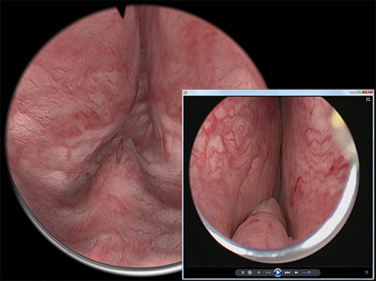
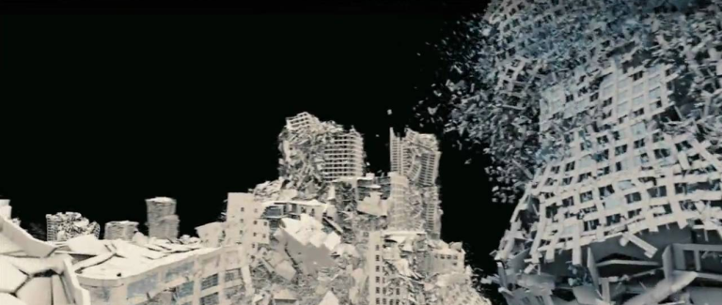
Introduction
Physics-based visual simulations have become ubiquitous in movies, cartoons, medical applications and computer games.
Collapsed Buildings, 2012 © DigitalDomain
Sulley from Monsters Inc, © Disney/Pixar
Medical App. © VirtaMed
Assassin’s Creed, © Ubisoft
Notes:
We can see physics-based simulations in almost any kind applications.
In super cool special effects or in cute animation movies, or in medical applications
And of course in almost all commercial video games

Slide 3
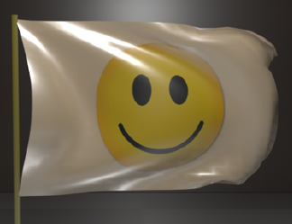
Introduction
Physics-based Simulations
imitate the life-like motions!
Notes:
As all we know,
Physics-based Simulations
imitate the life-like motions

Slide 4
Introduction
To achieve physics-based simulations, numerical methods are employed:
Integration Methods
Implicit / Explicit Euler methods
Verlet method
Second Order Integration method
Runge–Kutta method
…
Iteration Approaches
Newton’s method
Jacobi method
Gauss-Seidel method
Notes:
Although the aim sounds simple, researchers have been working on the subject more than 30 years by focusing on numerical integration methods
such as implicit/explicit euler, verlet integration, second order method, runge-kutta and many others
Besides they focus also on the iteration approaches such as Newton’s method, jacobi method, Gauss-Seidel method and more

Slide 5
Introduction
Muller, M., Heidelberger B., Hennix M., Ratcliff J.,
"Position Based Dynamics "
VRIPhys, 2006
Journal of Visual Communication and Image Representation, 2007
Notes:
Within many methods that come up till now, One technique has become very popular after 2006 and 7. It is called position based dynamics.
Matthias Muller and his colleagues published the work and right now it is an industry standard method.
And personally I like to work with it.

Slide 6
Introduction
Position Based Dynamics (PBD):
Integration Methods
Implicit / Explicit Euler methods
Verlet method
Second Order Integration method [Bender et al. 17]
Runge–Kutta method
…
Iteration Methods
Newton’s method
Jacobi method [Macklin et al. 14]
Gauss-Seidel method
Notes:
It utilizes Verlet method with Gauss-Seidel iteration.
But It is also possible to see the second order method and Jacobi methods associated with position based dynamics

Slide 7
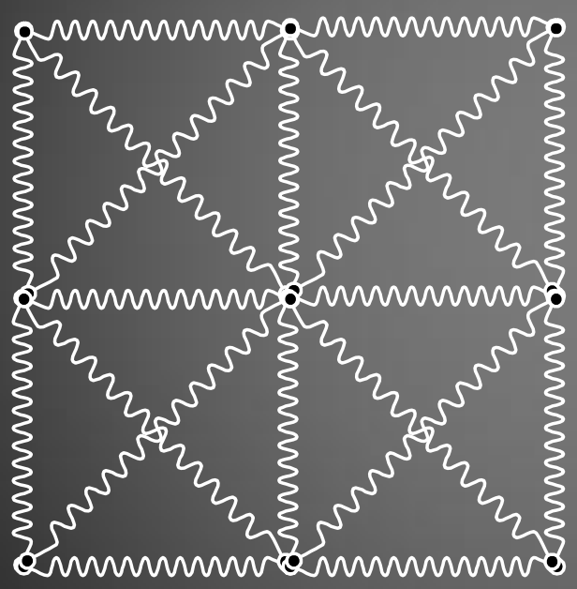
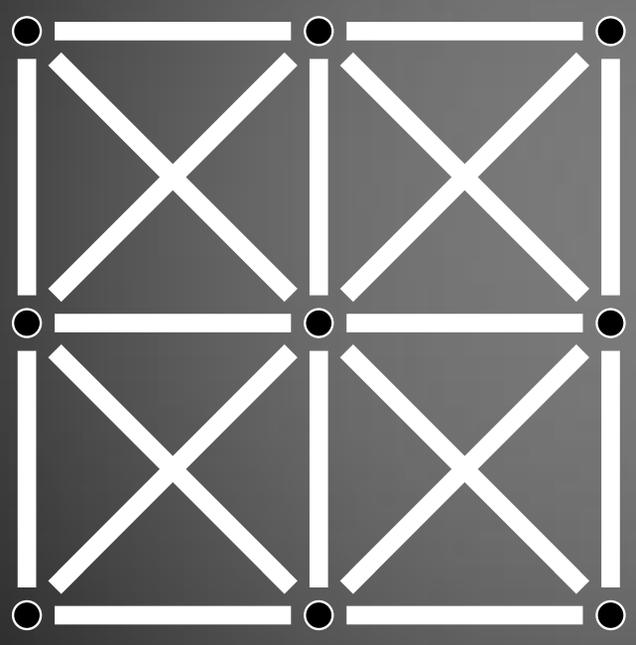
Introduction
The main idea is to consider the mass-spring networks as connected particles
[Stam 2009]
Notes:
The very basic idea of PBD can be explainned as:
It considers the mass-spring networks as connected particles and
Each connection is defined with a projected constraint.

Slide 8
Introduction
In a very general perpective, PBD algorithm:
First, shoots the particles with the integration method.
After, pulls them back with the non-linear Gauss-Seidel iteration.
Notes:
In a very general perpective, PBD algorithm:
First, shoots the particles with the integration method.
After, pulls them back with a non-linear Gauss-Seidel iteration.

Slide 9
Introduction
In a very general perpective, PBD algorithm:
First, shoots the particles with the integration method.
After, pulls them back with the non-linear Gauss-Seidel iteration.
Notes:
So, the method works like fishing. you first throw the bate to the sea and after you roll it back.

Slide 10
Introduction
That implies:
Verlet integration predicts the position of a particle
Gauss-Seidel loop iterates the particle till the final position is obtained
Gauss-Seidel iteration operates based on projected constraints.
1. Position of the particle
Predicted Position
Final Position
Body of the Model
Notes:
So it is exactly the same, Verlet integration throws the particle first
After Gauss-Seidel pulls it back with many iterations.
The iteration rule is based on the constraint function.

Slide 11
Motivation
Due to extreme dependency to Gauss-Seidel:
Is it possible to improve the visual results within Gauss-Seidel on the GPU?
Notes:
So here is the motivation:
If Position based algorithm is heavily dependent on Gauss-Seidel iterations
Is it possible to improve the visual results within Gauss-Seidel on the GPU?
That’s what we searched in this paper.

Slide 12
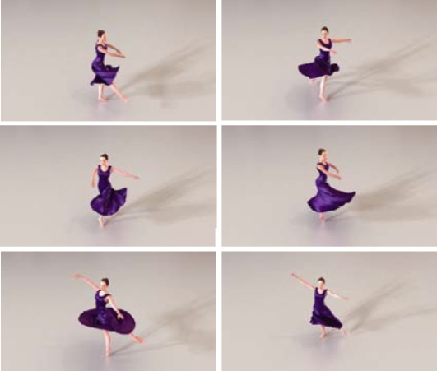
PBD in Literature
Faure, F.,
“Interactive Solid Animation Using Linearized Displacement Constraints”
Computer Animation and Simulation Workshop, 1998
Jakobsen, T.,
“Advanced Character Physics”
Proceedings of the Game Developers Conference, 2001
Stam J.,
"Nucleus: Towards a Unified Dynamics Solver for Computer Graphics"
Proceedings of Computer-Aided Design and Computer Graphics, 2009
Notes:
Before PBD showed up, the similar approaches were proposed by Fransua Faure in a simple solid mechanics simulations
Thomas Jakobson used it in soft and rigid body simulations in famous Hitman game
In the similar time period, Jos Stam offered Nucleus which is a dynamics simulator for Autodesk Maya

Slide 13
PBD in Literature
Notes:
After 2010, It is possible to see many pulications that utilize PBD
It is used to simulate cloth, hair, fur, constitutive materials, elastic rods and even fluid mechanics.

Slide 14
General (X)PBD Algorithm
x^{n+1} = x^{n} + v^{n}h + h²w_{i}f_{ext}
initialize total Lagrange multiplier λ₀ = 0,
while k < Iterations do
for all constraints do
GAUSS-SEIDEL PROCESS
end for
k = k +1
end while
update x^{n+1}
update velocity v^{n+1} = (x^{n+1} - x^{n}) / h
Notes:
The general algorithm of Position Based approach looks like in this pseudo form.
It is quite straight forward. But lets check it a bit more detailed

Slide 15
Verlet Integration
x^{n+1} = x^{n} + v^{n}h + h²w_{i}f_{ext}
initialize total Lagrange multiplier λ₀ = 0,
while k < Iterations do
for all constraints do
GAUSS-SEIDEL PROCESS
end for
k = k +1
end while
update x^{n+1}
update velocity v^{n+1} = (x^{n+1} - x^{n}) / h
Notes:
Verlet integration is the central difference approximation to the second order differential equation and
The Verlet Scheme of Position based dynamics is actually all about positions
So by just looking at this algorithm

Slide 16
Verlet Integration
x^{n+1} = x^{n} + (x^{n} – x^{n-1}) + h²w_{i}f_{ext}
initialize total Lagrange multiplier λ₀ = 0,
while k < Iterations do
for all constraints do
GAUSS-SEIDEL PROCESS
end for
k = k +1
end while
update x^{n+1}
update velocity v^{n+1} = (x^{n+1} - x^{n}) / h
Notes:
I can rewrite the integration in this form and also this notation is used by Jacobson in his Hitman paper
the beutiful feature of Verlet is the velocities are approximated implicitly within the integration
So you do not need to worry about the velocities or step sizes.

Slide 17
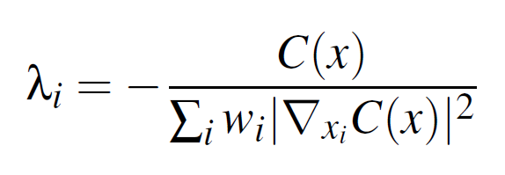
Gauss-Seidel Process
After, the displacements of each point is calculated with a constraint function:
With the help of 1st order Taylor-expansion:
Position updates are obtained as:
where
Notes:
After,
the displacements of each point is calculated with a constraint function
With the help of the first order Taylor – expansion
the position updates are obtained in the bottom left form

Slide 18
Gauss-Seidel Process
In the recent extension to PBD (XPBD):
Position updates are associated with compliance stiffness matrix in order to prevent iteration count and step-size dependency:
where
Notes:
Afterwards in 2016, Nvidia team made an extension to PBD which they call it XPBD.
In this extension they employ the compliance stiffness matrix to address the iteration count dependency.
So the position updates are altered as shown in the bottom left form.
And in this paper, I maintain the same position updates.

Slide 19
Gauss-Seidel Process
x^{n+1} = x^{n} + (x^{n} – x^{n-1}) + h²w_{i}f_{ext}
initialize total Lagrange multiplier λ₀ = 0,
while k < Iterations do
for all constraints do
compute Δλ and Δx
λ_{k+1} = λ_{k} + Δλ
x_{k+1} = x_{k} + Δx
end for
k = k +1
end while
update x^{n+1}
Notes:
So those position updates form the gauss-seidel loop.
And many many times those updates can be iterated during the simulations.

Slide 20
Energy Aware Gauss-Seidel Algorithm
Predicted Position
Initial Position
Final Position
Body of the Model
Notes:
In order to understand our Energy Aware Gauss Seidel Algorithm
Lets again turn back to our fishing metaphor.

Slide 21
Energy Aware Gauss-Seidel Algorithm
Integration
Predicted Position
Initial Position
Gauss-Seidel
Final Position
Body of the Model
Notes:
What was it?
Throw it with the integration and pull it back with Gauss-Seidel

Slide 22
Energy Aware Gauss-Seidel Algorithm
Integration
Predicted Position
Initial Position
Gauss-Seidel
Final Position
Body of the Model
Notes:
And in here, I am more interested with the Gauss-Seidel portion.

Slide 23
Energy Aware Gauss-Seidel Algorithm
Predicted Position
Gauss-Seidel
Final Position
Body of the Model
Δx
Δx
Δx
Δx
4.it.
3.it.
2.it.
1.it.
Notes:
So what we know already is, in each iteration we reposition the particle with the delta x displacement

Slide 24
Energy Aware Gauss-Seidel Algorithm
Predicted Position
Gauss-Seidel
Final Position
Body of the Model
Δx
Δx
Δx
Δx
4.it.
3.it.
2.it.
1.it.
Notes:
Lets take a closer look

Slide 25
Energy Aware Gauss-Seidel Algorithm
(x^{n})^{k}
(x^{n})^{k+1}
(x^{n})^{k+2}
(x^{n})^{k+3}
Notes:
When we apply the updates to the positions

Slide 26
Energy Aware Gauss-Seidel Algorithm
(x^{n})^{k}
Δx
(x^{n})^{k+1}
Δx
(x^{n})^{k+2}
Δx
(x^{n})^{k+3}
Notes:
It seems like, we update only the positions

Slide 27
Energy Aware Gauss-Seidel Algorithm
(x^{n})^{k}
Δx
What about the implicit velocities?
(x^{n})^{k+1}
Δx
(x^{n})^{k+2}
Δx
(x^{n})^{k+3}
Notes:
But what happens to those implicit velocities?

Slide 28
Energy Aware Gauss-Seidel Algorithm
(x^{n})^{k}
V^{k} = (x^{n})^{k+1} - (x^{n})^{k}
(x^{n})^{k+1}
(x^{n})^{k+2}
(x^{n})^{k+3}
Notes:
Well, actually we also update the implicit velocities.
In some references, this velocity update is called as Velocity Time Steping.

Slide 29
Energy Aware Gauss-Seidel Algorithm
(x^{n})^{k}
V^{k} = (x^{n})^{k+1} - (x^{n})^{k}
(x^{n})^{k+1}
V^{k+1} = (x^{n})^{k+2} - (x^{n})^{k}
(x^{n})^{k+2}
(x^{n})^{k+3}
Notes:
In each iteration, velocities get a new value

Slide 30
Energy Aware Gauss-Seidel Algorithm
(x^{n})^{k}
V^{k} = (x^{n})^{k+1} - (x^{n})^{k}
(x^{n})^{k+1}
V^{k+1} = (x^{n})^{k+2} - (x^{n})^{k}
(x^{n})^{k+2}
V^{k+2} = (x^{n})^{k+3} - (x^{n})^{k}
(x^{n})^{k+3}
Notes:
In each iteration, velocities get a new value

Slide 31
Energy Aware Gauss-Seidel Algorithm
Now, what do we know within the Gauss-Seidel Alg.:
Positions
Position changes
Implicit velocities
Constraint values (Potential energy values)
Notes:
So far, we already know:
The Positions and their changes
Implicit velocities and constraint functions (or Potentials)

Slide 32
Energy Aware Gauss-Seidel Algorithm
Now, what do we know within the Gauss-Seidel Alg.:
Positions
Position changes
Implicit velocities
Constraint values (Potential energy values)
Is it posible to create an energy balance within the Gauss-Seidel iteration?
Notes:
With this knowledge
Is it posible to create an energy balance inside the Gauss-Seidel?

Slide 33
Energy Aware Gauss-Seidel Algorithm
Su et al. (2012) applied the conservation principle to a mass-spring network where:
Velocities are based on forces.
Hooke’s law dominates the framework.
There is an integration dependency.
Notes:
In 2012 Jonathan Su applied an energy conservation principle to a complete different framework
In his framework velocities are based on forces.
It is limited with the hookes law and his iterations satisfy the Newmark integration method
So everything is different than PBD

Slide 34
Energy Aware Gauss-Seidel Algorithm
However, inspired by their work, we alter the Gauss-Seidel Algorithm with the energy balance in its each iteration:
That means each iteration satisfies:
ΔKE = - ΔPE
Notes:
However, that is a nice inspiration for our work
At least it gives the idea that we can alter the Gauss-Seidel portion by balancing kinetic and potential energies in every iteration

Slide 35
Energy Aware Gauss-Seidel Algorithm
However, inspired by their work, we alter the Gauss-Seidel Algorithm with the energy balance in its each iteration:
That means each iteration satisfies:
ΔKE = - ΔPE
$$\frac{1}{2}m\left[{\left(V_{}^{k+1}\right)}^{T}V_{}^{k+1} −{\left(V_{}^{k}\right)}^{T}V_{}^{k}\right]=−[C{\left(x^{n}\right)}^{k}−C\left(x^{n−1}\right)]$$
Notes:
So for each iteration, we somehow track this equality.

Slide 36
Energy Aware Gauss-Seidel Algorithm
(x^{n})^{k}
ΔKE = - ΔPE
(x^{n})^{k+1}
ΔKE = - ΔPE
(x^{n})^{k+2}
ΔKE = - ΔPE
(x^{n})^{k+3}
Notes:
And it should seem like this within each iteration

Slide 37
Energy Aware Gauss-Seidel Algorithm
(x^{n})^{k}
ΔKE + ΔPE = ϵ
(x^{n})^{k+1}
ΔKE + ΔPE = ϵ
(x^{n})^{k+2}
ΔKE + ΔPE = ϵ
(x^{n})^{k+3}
Notes:
But Unfortunately, it does not.
It is due to the leak that comes from the verlet velocity approximation.

Slide 38
Energy Aware Gauss-Seidel Algorithm
(x^{n})^{k}
ΔKE + ΔPE = ϵ
(x^{n})^{k+1}
$$C\left(x^{k}\right)=C\left(x^{k}\right)+ ∈$$
ΔKE + ΔPE = ϵ
(x^{n})^{k+2}
$$C\left(x^{k}\right)=C\left(x^{k}\right)+ ∈$$
ΔKE + ΔPE = ϵ
(x^{n})^{k+3}
$$C\left(x^{k}\right)=C\left(x^{k}\right)+ ∈$$
Notes:
For that reason, we plug that leak to the contraint function in every iteration.
So, that leak decides to increase or decrease the contraint value.
That actually means that potential is loaded or relaxed based on this difference.
And this intuitive approach provides an implicit energy balance in each iteration only in the Gauss-Seidel portion.

Slide 39
Energy Aware Gauss-Seidel Algorithm
Integration
Predicted Position
Initial Position
ΔKE = - ΔPE
Final Position
Body of the Model
Gauss-Seidel with Energy Balance
Notes:
And at the end, the big picture turns into this form.

Slide 40
Mesh Coloring Alg.
Connectivity of the particles is a limitation for parallelism:
[Stam 2009]
Notes:
However the story is not over yet. In order to gain some performance, GPU parallelization is an ideal approach
But, If we apply this directly to the computations, connectivity of the particles is a big limitation

Slide 41
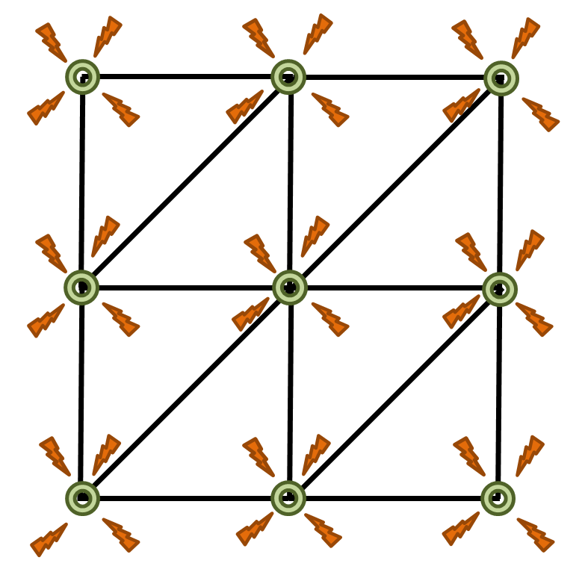
Mesh Coloring Alg.
This limitation is the well-known race condition which is the attack of many threads to one particle simultaneously:
Notes:
This limitation is the well-known race condition which is the attack of many threads to one particle simultaneously
Unfortunately it is not something that we can control and we desire

Slide 42
Mesh Coloring Alg.
In order to avoid race condition, we have to partition the mesh structure:
Notes:
One way to avoid race condition is to partition the mesh to its primitive components

Slide 43
Mesh Coloring Alg.
This partitioning has to be done in such a way that none of the elements share any connectivity:
Notes:
For example if we partition the edges,
This partitioning has to be done in such a way that none of the edges share any single connectivity

Slide 44
Mesh Coloring Alg.
In order to achieve that, an intuitive Mesh Coloring Algorithm is implemented:
Notes:
In order to achieve that, we build a Mesh Coloring Algorithm that groups the elements according to their connectivity

Slide 45
Mesh Coloring Alg.
In order to achieve that, an intuitive Mesh Coloring Algorithm is implemented:
It is a two step algorithm:
Notes:
It is a two step algorithm

Slide 46
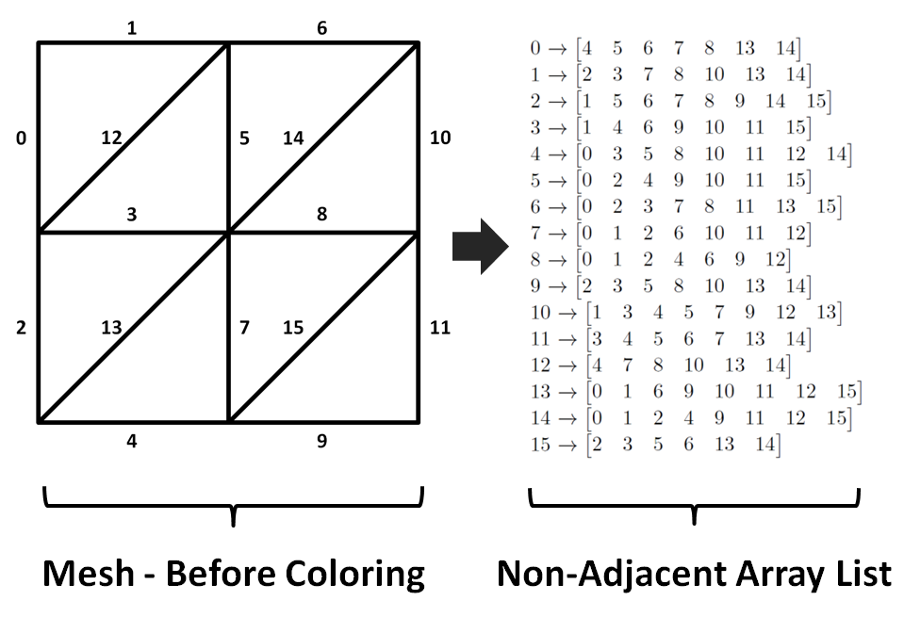
Mesh Coloring Alg.
In order to achieve that, an intuitive Mesh Coloring Algorithm is implemented:
It is a two step algorithm:
First, a non-adjacent array list for each member is created:
Notes:
First, we create a list for each member that consist of all non-neighbor members

Slide 47
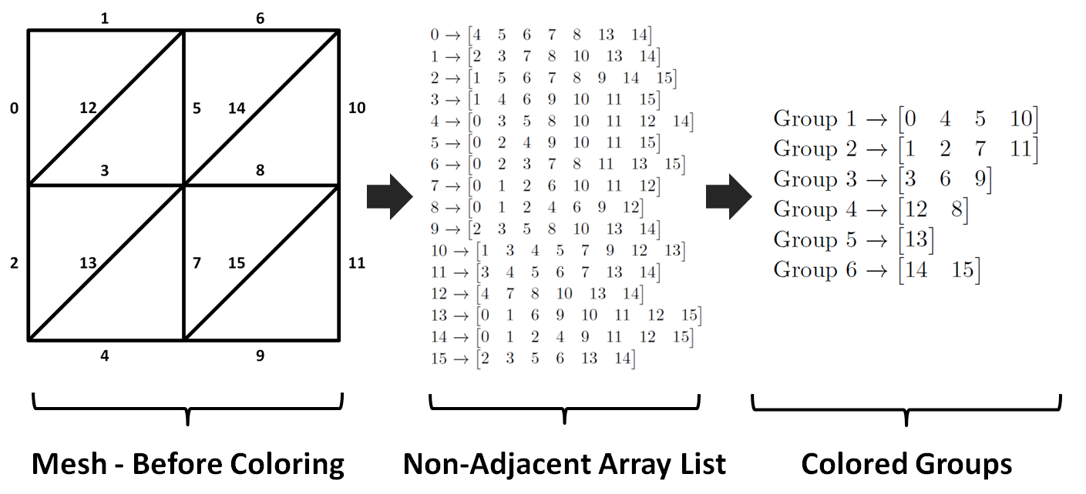
Mesh Coloring Alg.
In order to achieve that, an intuitive Mesh Coloring Algorithm is implemented:
It is a two step algorithm:
Second, colored groups are obtained from the non-adjacent array list:
Notes:
After, from that non-neighbor list, we create the final independent colored groups.
To do that, we walk through all the members, and check their adjacency with the other members
and check if they belong to other groups or not.

Slide 48
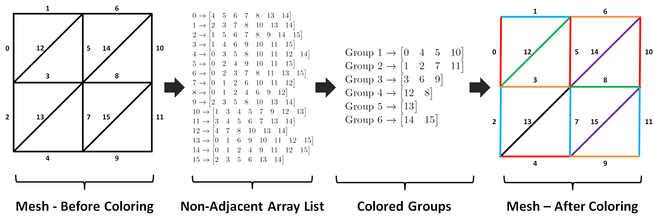
Mesh Coloring Alg.
In order to achieve that, an intuitive Mesh Coloring Algorithm is implemented:
It is a two step algorithm:
Second, independent edges list is obtained from the non-adjacent array list:
Notes:
At the end, Each group is represented by a different color. This colorful mesh nicely illustrates all the colored groups.
For each group I implemented one cuda kernel for the computations.
So that means if there are 6 groups, 6 cuda kernels do the Gauss-Seidel work
If there are 10 groups, 10 cuda kernels run

Slide 49
Constraints
Notes:
Constraints are the biggest part of PBD. And frankly I spent a lot of time to implement all the constraints.
In general, it is common to see these types of geometrically motivated constraints in PBD papers.

Slide 50
Constraints
Notes:
But in this paper, we wanted to be outside of the box and apply some unusual constraints

Slide 51
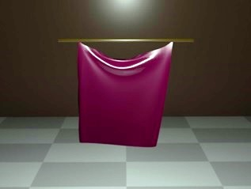
Constraints
2D Meshes:
Hookean Spring:
Liu et al. 13
STVK Spring:
Junior et al. 18
Ani. Cont. Cloth:
Bender et al. 14
Notes:
For example in 2D meshes, We employed old school Hookean spring, newly introduced STVK spring and anisotropic continuous cloth constraints.

Slide 52
Constraints
3D Meshes:
Linear Elastic Material:
Sifakis & Barbic 12
STVK Elastic Material:
Bender et al. 14
Neo-Hookean Elastic Material:
Bender et al. 14
Mooney-Rivlin Elastic Material:
Sin et al. 13
Arruda-Boyce Elastic Material:
Smith et al. 18
Notes:
For the 3D meshes, we employed constitutive materials such as
Linear elasticity, STVK material, Neo-hookean material, Mooney rivlin and Arruda-boyce materials.
Lets see how they work:

Slide 53
Results
Model | # of Edges | # of Faces | # of Iteration | CPU (FPS) | GPU (FPS)
Cloth | 4880 | 3220 | 30 | 17-18 | 50-51
Bunny | 12288 | 8192 | 15 | 2-3 | 37-38
Notes:
Before presenting the results, I would like to mention that
I build the method and my version of XPBD as a Maya plugin. I implemented 2 versions for both of them:
For serial version, I used C++ and for parallel version I used Cuda
In here, we see the classical side by side rival.
In here CPU version runs in 17-18 FPS and GPU runs in 50-51 FPS

Slide 54
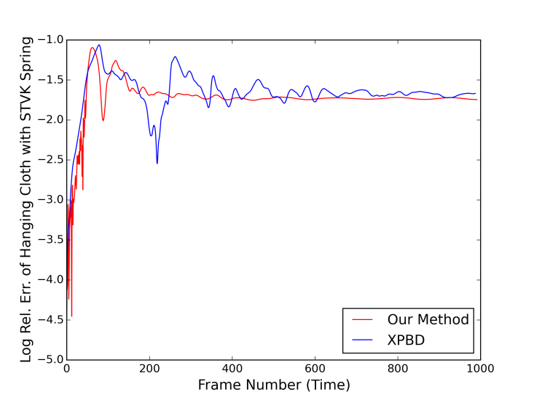
Results
Notes:
When we compare our method with XPBD, we see that XPBD moves wilder than our method.
Although damping is on, its effect is more obvious with our method
and XPBD barely damps the motion

Slide 55
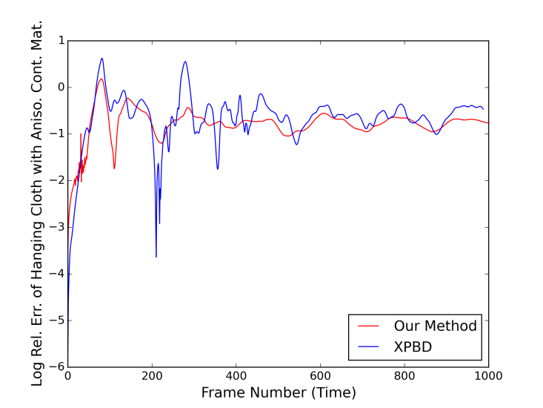
Results
Notes:
Same effect can be seen with the anisotropic continous cloth.
Besides, the relative error shows that our method does not make that wild fluctuations during the motion.

Slide 56
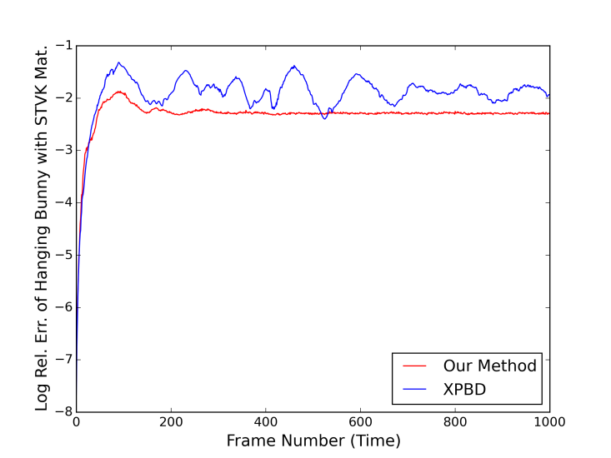
Results
Notes:
For the 3D meshes, when we apply STVK material, XPBD interestingly jiggles the models more than expected
This can be clearly seen in the ears and the head

Slide 57
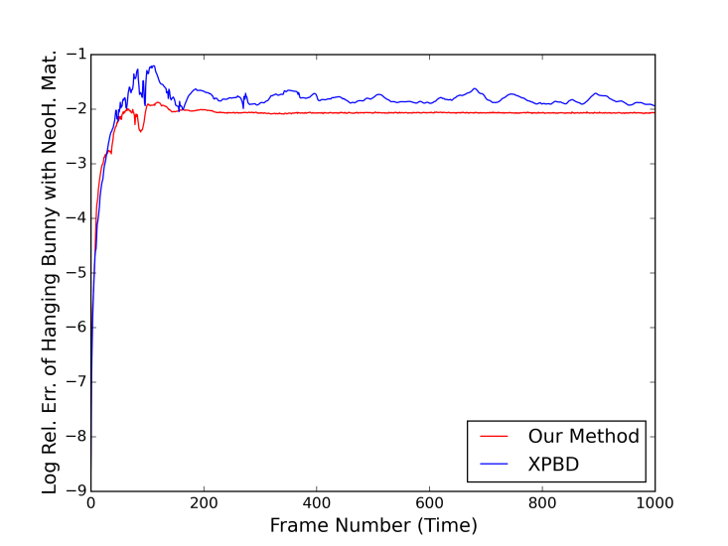
Results
Notes:
With the neohookean material, model behaves very soft with XPBD and stiffer in our method.
Besides, Same damping applied both sides, but this effect can not be observed in XPBD, in our apparoach it damps the motion expectedly
And this can be easily seen in the plots

Slide 58
Results
Notes:
Regarding the interactions. I compress and stretch the torus,
This is the Linear Elasticity,
And again XPBD jiggles more than ours and that makes it difficult to control.

Slide 59
Results
Notes:
In STVK material case, it is beyond jiggling.
mesh behaves almost singular in XPBD and our method preserves the mesh way better

Slide 60
Results
Notes:
Neo hookean material behaves in between linear elasticity and STVK material.
in all cases, the method achivies plausible results.
This clearly show the advantage of the energy balance in Gauss-Seidel iteration

Slide 61
Results
Notes:
I have to admit that
Collisions are not very advance. We support simple sphere and convex object collision for now.
But in the future, I would like to improve the collisions with more advance techniques similar to air meshes and dynamic collisions

Slide 62
Summary
In this paper, we:
extend the Gauss-Seidel iteration of (X)PBD algorithm with the energy balances
Notes:
As a summary,
In this paper, we extend the Gauss-Seidel iteration of position based algorithm with the energy balances

Slide 63
Summary
In this paper, we:
extend the Gauss-Seidel iteration of (X)PBD algorithm with the energy balances
present our intuitive Mesh Coloring Alg. for parallel processing on GPU
Notes:
We present our intuitive Mesh Coloring Alg. that provides parallel computations on GPU

Slide 64
Summary
In this paper, we:
extend the Gauss-Seidel iteration of (X)PBD algorithm with the energy balances
present our intuitive Mesh Coloring Alg. for parallel processing on GPU
present the results by using many spring and constitutive material potentials
Notes:
We have the wide variaty of spring and material constraints

Slide 65
Summary
In this paper, we:
extend the Gauss-Seidel iteration of (X)PBD algorithm with the energy balances
present our intuitive Mesh Coloring Alg. for parallel processing on GPU
present the results by using many spring and constitutive material potentials
show that our method is:
straightforward, stable and easy to adapt to existing frameworks.
Notes:
We also show that the method is
straightforward, stable and easy to adapt to existing frameworks.

Slide 66
THANK YOU!
Notes:
I hope you enjoyed the presentation, and thank you so much for your attention.

